Slide 1
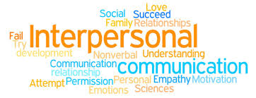
Communication & Health Education
Interpersonal communication

Slide 2
Objectives
By the end of this lecture you will be able to:
Define communication and interpersonal communication.
Define the models of communication
Identify the principles of communication
Define characteristics of interpersonal communication

Slide 3
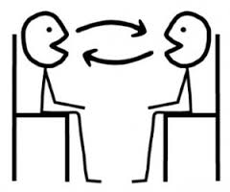
Communication
A dynamic, two ways circular process in which all types of information are shared between two or more people and their environment.

Slide 4
Components of communication
The stimulus : Reason for communication
The sender : The individual who initiate the transmission of information.
The message : The information, feelings, thought and ideas being sent and received.
The medium : The method by which the message is sent).
The receiver : The individual who both receives and interprets the message.
The feed back: The measure by which the effectiveness of the message is gauged (evaluated).

Slide 6
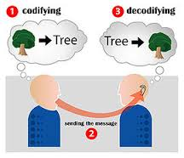
What is interpersonal communication?
It is communication that occurs between persons who have connection.
Communication occurs when you send or receive messages
It is an interdependent process which means: what one person thinks and says impacts on what the other thinks and say.

Slide 7
What is interpersonal communication- cont.
It is always distorted by “noise “occurs within context and involves some opportunity for feed back.
Occurs in each other and of their connection with each other.

Slide 8
Theories of communication
The linear view
Interactional view
Transactional

Slide 9
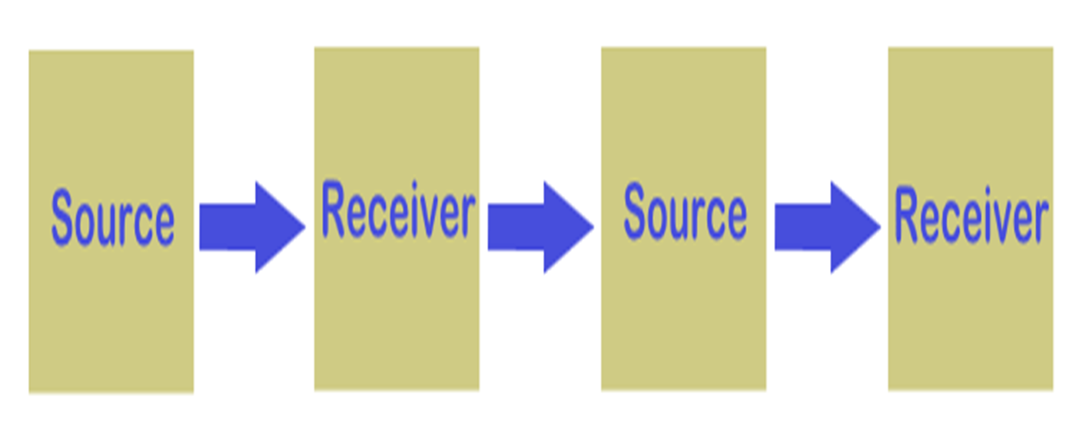
The linear view of human communication
Some early theories viewed communication as linear which means the speaker spoke and the listener listened.
After the speaker finished speaking, the listener would speak.
Indicting one way communication-Active speaker and passive listener.
Speaking and listening were seen as taking place at different times when you spoke you didn’t listen and when you listen you didn’t speak

Slide 10
Interactional view- interactive model
In this view the speaker and the listener were seen as exchanging turns at speaking and listening
Listener give feedback
Communicators create and interpret messages

Slide 11
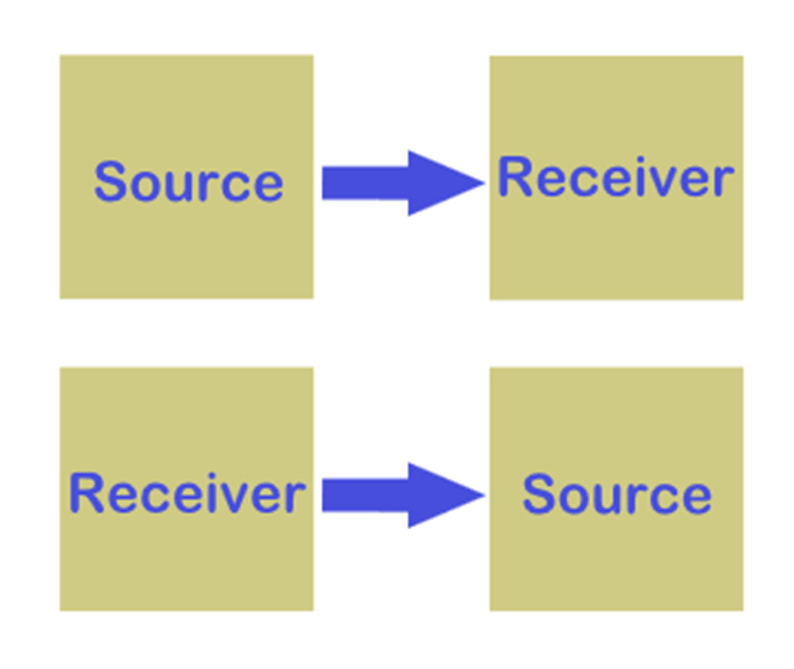
Interactional view

Slide 12
Transactional view
At the same time you send a message you receive a message from your own message and from the reaction of other people .
At the same time that you are listening you are also sending messages.
Elements of communication are seen as interdependent never independent

Slide 13
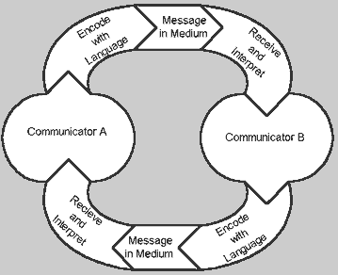
Transactional view

Slide 14
Transactional view- Cont.
Communicators play different roles during the process
Communication vary over time (example change in the audience will change what you say and how you say it)
When interpersonal communication takes place face to face conversation will proceed.

Slide 15
Transactional view- Cont.
Face to face conversation:
This type of interaction that probably comes to mind
when you think of conversation.
However there are other types of conversations such as:
E-mail–usually type your letter in an e-mail program and send it from your computer to your server which relays (transmit) your message to person you are addressing
Chat groups: these groups enable members to conserve in real time in discussion groups called channels.

Slide 16
The process of interpersonal communication
Sources –receiver (at least two person exchange the communication .
Messages (express thoughts, feelings, verbal or non verbal communication.
Every message has an effect and outcome .
Messages overload, feedback and feed forward

Slide 17
The process of interpersonal communication- Continue…..
3. Channel: the medium through which messages signals pass. The channels works like a bridge connecting source and receiver.
4. Noise
5. Context (the environment that influences the form and content of communication).

Slide 18
Noise
It is any thing that interferes with your receiving a message that some one is sending or with their receiving your message.
Noise may be:
1.Physical ( loud talking ,illegible hand writing ,garbage on your computer screen
2.Physiological ( hearing or visual impairment )
3.Articulation disorders . Language speech disorder e.g. Cerebral palsy(CP), down syndrome , and Autism
4. Psychological (preconceived ideas ,wondering thoughts, biases).
5.Semantic (misunderstood meanings ).

Slide 19
Context
It is an environment that influence the form and the content of communication ( natural e.g. street noise, or strict e.g funeral, quite place) .
Context of communication has at least four dimensions.
1.Physical dimension: effect of physical when
communicate, e.g. the room ,workplace readiness.
2.Cultural dimension: consist of rules ,norms, beliefs
and attitudes of the people communicating that are
passed from one generation to other (More details to come later)

Slide 20
Context- Cont.
3. Social-psychological dimension: include the status relationships among the participant e.g. who is the employer and employee, the formality or informality, the cooperativeness or the competitiveness of the interaction
4. Temporal or time dimension: It has to do with where a particular message fits into a sequence of communication events
e.g. if you tell a joke about sickness immediately after your friend tells you she is sick, the joke will be perceived differently from the same joke told as a series of similar jokes to your friends in the locker room of the gym

Slide 21
Interpersonal competence
The ability to communication effectively by mastering the skills of listening, critical thinking ,ethical foundation and power .
The more words you know the more of ways you will have to express your self.
The process goes like this:
1.Knowledge of interpersonal communication leads to greater interpersonal ability.
2.Leads to greater number of choices or option for interaction
3.Leads to greater interpersonal effectiveness

Slide 22
Six themes of competence
1. Interpersonal skills- large and ready collection of
interpersonal skills that can be used as the situation
warrants.
2. Power-skills for increasing and maintaining power
and influence as will as the situation warrant.
3. Listening– effectiveness of listening skills upon the
situation. You cant be a competent communicator if you are a poor listener

Slide 23
Six themes of competence- cont.
4. Critical thinking- skills for thinking logically, intelligently and reasonable about communication & message appropriateness. It is the way of examining information and reaching a judgment and decision
5. Cultural sensitivity- or cultural competency ….skills for communication effectively in intercultural situation
Ethical foundation- skills for communicating effectively with sound ethical principles.
- Communicate with people in a unique valuable way

Slide 24
Principles of interpersonal communication
another way to define communication is to consider its major principles
1. Package of signals involve verbal messages & gestures or together/
2. Involves content and relationships messages (supervisor & trainee).
Note :conflict may arise because of misunderstand relationship message.
3. Process of adjustment: This means sharing the same communication .e.g. learning the other person signals.

Slide 25
Principles of interpersonal communication Cont.
Communication accommodation mean speakers will adjust to the style of their listeners so as to gain social approval and greater communication efficiency
e.g. parents and children have different vocabularies and different meanings
Ambiguous: Having more than one meaning.
Ambiguity results when we use words that can be interpreted differently
Examples person might interpreted time terms differently example: Soon, right away, late.

Slide 26
Principles of interpersonal communication Cont.
5- Purposeful: Interpersonal communication serves various purposes:
General purposes (inner circle)
Motivation (middle circle)
Results (outer circle)

Slide 27
General purposes (inner circle)
Helps you to learn, and better understand the external world.
Helps you relate, maintain close relationships, and find connections
Helps you to influence the attitudes and behaviors of the others.
Helps you to play and help other

Slide 28
Characteristics of interpersonal communication
1. Inevitable ( unavoidable)
2. Irreversible
3. Unrepeatable

Slide 29
Inevitable ( unavoidable)
Sometimes you are communicating even though you may not think you are or you may not even want to.
Example student sitting in the back of the room with expressionless face, the message he or she is sending or sharing involves lack of interest anxiety

Slide 30
Irreversible
Although you may try to qualify deny or somehow reduce the effect of your message you cant withdraw message you have conveyed.
Be carful not to say things you may wish to withdraw later

Slide 31
Unrepeatable
Simply because everyone and everything are constantly changing.
As a result you never can recapture the exact same situation, frame of mind or relationship dynamics that defined a previous interpersonal act.

Slide 32
Culture and interpersonal communication
Culture: consist of the beliefs, ways of behaving that transmitted through communication and learning rather than through genes.

Slide 33
Culture- continue
Gender: is considered a cultural variable at least in a part because culture teach boys and girls different attitude, beliefs, values and way of communication and relating to one another

Slide 34
The importance of culture
People become more sensitive to cultural differences.
They moved from “Cultural assimilation
(People should leave the native culture behind and adapt to their new culture) to a view that values cultural diversity (People should retain their native cultural ways).

Slide 35
The aim of cultural perspective
A cultural emphasis helps to distinguish what is universal (true for all people) from what in relative (true for people in one culture and not true for people in another culture).
communication with different cultures is knowing the cultural principles and ability to communicate, and adjust well based on cultural sensitivity and differences

Slide 36
The aim of cultural perspective- cont.
Cultural perspectives influence:
What you say to yourself and how you talk to others in everyday conversation.
How you interact in a group.
Topics you talk about
Strategies you use in communicating information or in persuasion.

Slide 37
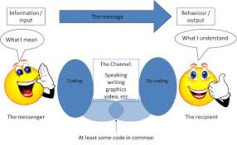
THANK YOU

