Slide 1
Assessment of Growth and development
Spring Semester 2014- 2015

Slide 2
Tools For Assessing Growth & Development
Growth
Anthropometry
Weight
Development
History of milestones of development.
Direct Observation
Developmental Charts
Length or Height
Head circumference
chest circumference

Slide 3
Tools For Assessing Growth & Development
Growth Measurement
Measurement of physical growth in children is a key element in evaluating their health status.
Values of these measures are plotted on percentile charts, and compared with those of the general population.

Slide 4
Tools For Assessing Growth & Development
Growth Charts
Growth charts are available for boys and girls of various ages:
Birth - 36 months: records wt. by age, length by age, wt. for age, & H.C. by age.
2 - 18 years: records wt. by age, stature by age.
Those whose wt. or ht. falls below the 5th percentile are underweight or small in stature.
Those whose measurements are above the 95th percentile are overweight or large in stature.

Slide 5
Tools For Assessing Growth & Development
Percentiles of Growth:
Percentile of growth is statistical representation of 100 children and placement within the 100 members of comparison group.

Slide 6
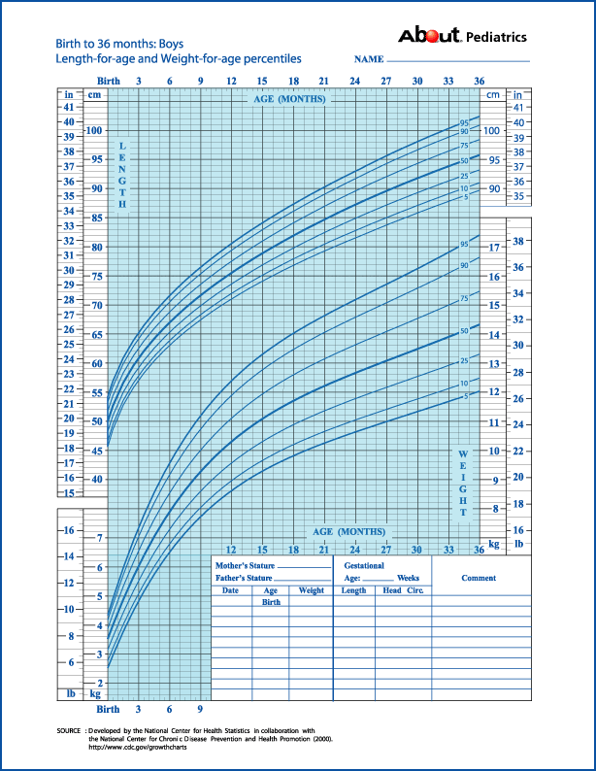

Slide 7
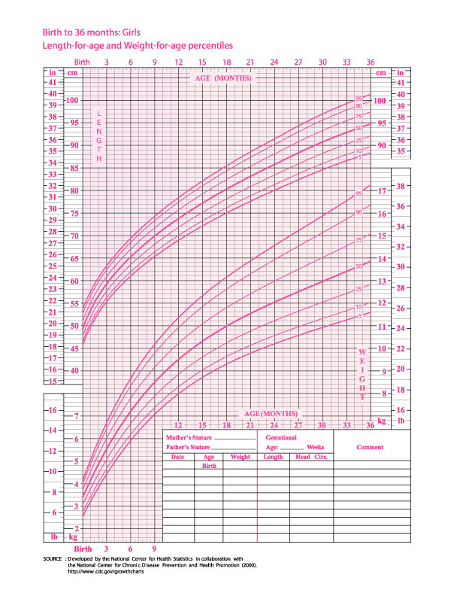

Slide 8
Tools For Assessing Growth & Development
DENEVER DEVELOPMENTAL SCREENING TEST II (DDST-II).
(Frankenburg & Dodds) Quick method for checking a child’s developmental progress.
The test consists of up to 125 items, divided into four parts
Gross motor skills.
Language.
Fine motor adaptive.
Personal - social.
Very commonly used screening tool
Applicable for children from birth until 6 years of age ( 2 months to 71 months) .
10-20 minutes to administer

Slide 9
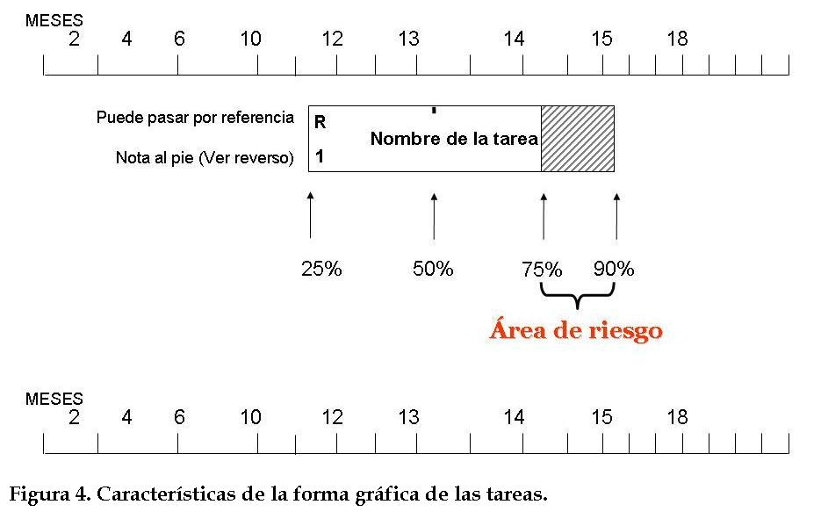
DENEVER DEVELOPMENTAL SCREENING TEST II (DDST-II).
Identifies children at 25, 50, 75, and 90% completion of task
Scored as concern if child completing task in shaded area (75-90%)
Scored as failure if not completed by time 90% complete
Referrals warranted for one failure or two concerns

Slide 10
DENEVER DEVELOPMENTAL SCREENING TEST II (DDST-II).
The test is divided into 4 scales:
Social/personal: aspects of socialization inside and outside the home - eg, smiling. reflects neurologic maturation as well as sociocultural factors; feeding & sleep patterns, play & work relationships are measured

Slide 11
DENEVER DEVELOPMENTAL SCREENING TEST II (DDST-II).
The test is divided into 4 scales:
2. Fine motor function: eye/hand co-ordination, and manipulation of small objects - eg, grasping and drawing. adaptive behavior is an index of inherent capabilities that deals with overall intelligence; it is of broader scope than the limited functions measured in intelligence tests (it is not an IQ test) (e.g problem-solving abilities, eye-hand coordination)

Slide 12
DENEVER DEVELOPMENTAL SCREENING TEST II (DDST-II).
3. Language: production of sounds, and ability to recognize, understand and use language - eg, ability to combine words. includes all evidences of communication; facial & manual cues as well as vocalization are measured

Slide 13
DENEVER DEVELOPMENTAL SCREENING TEST II (DDST-II).
4. Gross motor functions: motor control, sitting, walking, jumping, and other movements. is a measure of maturation; it generally deals with gross posture and various positions; implications are mainly neurologic

Slide 14
DENEVER DEVELOPMENTAL SCREENING TEST II (DDST-II).
15 MONTHS
Walks alone: crawls up stairs | Motor:
Makes tower of 2 cubes; makes a line with crayon: inserts pellet in bottle | Adaptive:
Jargon: follows simple commands: may name a familiar object (ball) | Language
Indicates some desires or needs by pointing: hugs parents | Social:
18 MONTHS
Runs stiffly; sits on small chair: walks up stairs with one hand held; explores drawers and waste baskets | Motor:
Piles 3 cubes: imitates scribbling; imitates vertical stroke: dumps pellet from bottle | Adaptive:
10 words (average); names pictures: identifies one or more parts of body | Language
Feeds self: seeks help when in trouble: may complain when wet or soiled; kisses parent with pucker | Social:

Slide 15
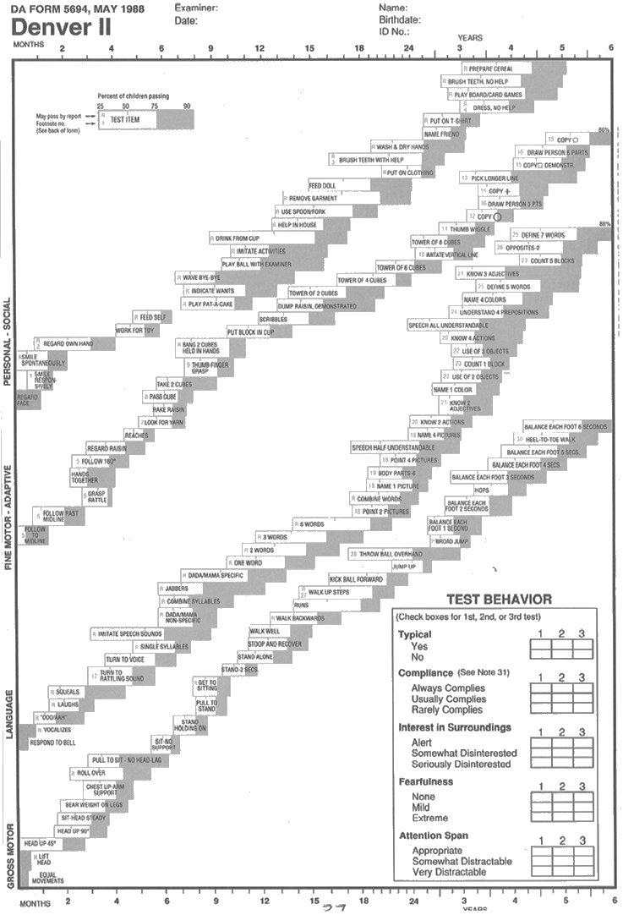

Slide 16
