Slide 1
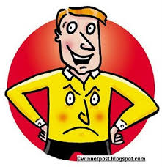
Nonverbal Messages

Slide 2
Definition of nonverbal communication
It define as communication without words by using several signals like posture , smile or frown (عبوس),widen your eyes , touch someone, raise your vocal volume or even say nothing .

Slide 3
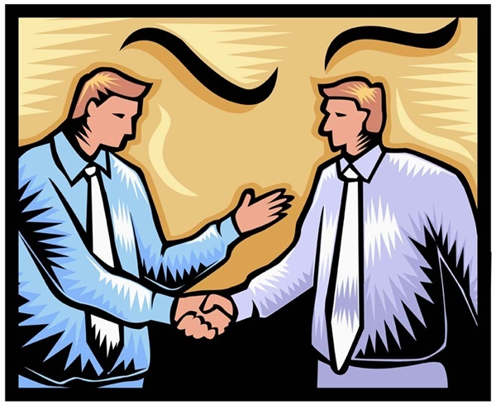
Good Body Language is Essential for Good Communication

Slide 4
The Benefits of competency in non verbal communication
1.The greater your ability to encode and decode non verbal signals ,the higher your popularity and psychological well being are likely to be.
Encoding and decoding are highly correlated: if you are good at expressing yourself nonverbally then you are likely to be good at reading the nonverbal cues of others.

Slide 5
The competency in non verbal communication has two benefits- Cont.
2. The greater your nonverbal skills the more successful you are likely to be at influencing and deceiving others.
In other words skilled nonverbal communicators are highly persuasive. This persuasive power can be used to help or support others or it can be used to deceive and fool.

Slide 6
The function of nonverbal messages
To understand the functions of nonverbal messages you should look at the Integration of nonverbal & verbal messages. It can be explained as:

Slide 7
Integration of nonverbal and verbal messages
1) Serves to accent or emphasize( e.g. raise your voice to underscore a particular word or phrase ,bang your fist on the desk to stress your commitment)
2) Complement or add hints of meaning not communicated by your verbal messages( e.g. smile while telling story to suggest that you find it funny).
3) Regulate: to control or indicate your desire to control (e.g. to make a hand gesture to indicate that you want to speak).

Slide 8
Integration of nonverbal and verbal messages- Cont.
4) repeat: restate the verbal messages nonverbal ( e.g. raised your eye brows , is that right?).
5) substitute: replace the verbal messages with nonverbal( e.g. you can signal “OK” with a hand, shake your head to indicate no ).
6) contradict verbal messages with nonverbal movement( e.g. crossing your fingers” when you are lying).

Slide 9
Researching nonverbal communication Functions
1.Forming and managing impression about person body, skin color, dress eye contact… .also it reflect credibility of person likeability ,attractiveness and dominance or power .
2.Forming and defining relationship ( you communicate nature of relationship) as holding hands or dressing alike .
3.Structuring conversation and social interaction by nodding head toward another person giving the signal that you give this person the turn to speak.

Slide 10
Functions Cont….
4.Influence and deception (gestures that explain what you are saying). Deception the ability to deceive ,to lie or to mislead another person to thinking something is true when its false.
5.Emotional expression( nonverbal expressions about emotion e.g. happiness, sadness.).Use the non-verbal communication with unpleasant messages.

Slide 11
The channels of nonverbal messages.
1)Body messages.
2)Face messages.
3) Eye messages .
4) Spatial messages
5) Artifactual messages
6) Touch messages
7) Silence messages
8) Time messages
9) Smell messages

Slide 12
Body messages- Body movements
Major types of body movements:
1- Emblems are body gestures that directly translate into words or phase ( e.g. “OK” for good job or “V” for victory).
2- Illustrators ( e.g. point your arm to the left means turn to the left).
3- Affect displays ( movements of the face e.g. body tension or relaxation.).

Slide 13
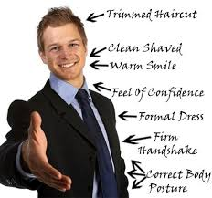

Slide 14
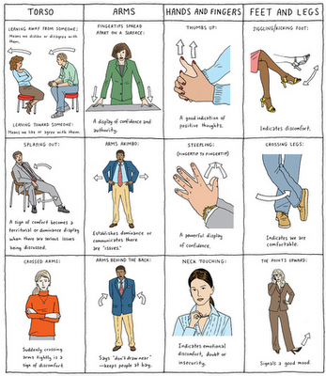

Slide 15
Facial messages
It communicate the eight primary emotions( happiness, surprise, fear, anger, sadness, disgust, contempt (dislike), interest).
Cultural display rules…
e.g. American students displayed facial expression but Japanese are not.
e.g. Japanese women aren't supposed to reveal broad smiles, they hide their smile.

Slide 17
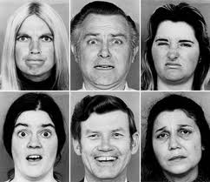
Facial messages

Slide 18
Facial management techniques
Used to communicate feelings to achieve the effect you want. Help people to display emotion In socially acceptable manner and polite interaction
Intensify or exaggerate feeling .
De intensify or minimize feeling…cover up your joy in presence of friend who received bad news
Neutralize or cover or hide a feeling (cover up your sadness to keep from depressing others)
Mask or replace his expression of one emotion for another…express happiness in order to cover up your disappointment
Simulate…express an emotion you don’t feel..

Slide 19
Eye messages
These messages depend on duration, direction & quality .
*purposes of eye contact :-
Request for feed back through and after conversation .
Nature of relationships ,positive or negative relationship.
Eye contact enable you to psychologically lessen the physical distance between your self and other person .

Slide 20
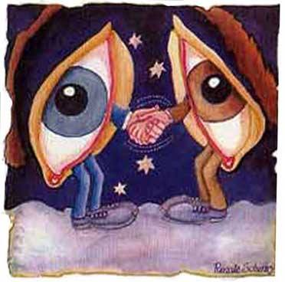
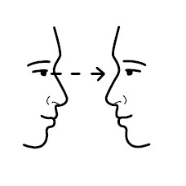
Eye Messages

Slide 21
Eye messages – Cont.
Eye avoidance purposes
-Help others to maintain their privacy you do this when you see couple arguing in public.
It is a signal of lack of interest
Block unpleasant stimuli such as a seen in a movie
To heighten other sense such as close your eyes while listening to Quran to feel the meanings

Slide 22
Space messages ( spatial)
Proxemic distances:
1- intimate distance ( actual touching to 18 inches e.g. you feel other breath).
2- personal ( 18 inch to 4 feet ).
3- social (4to 12 feet e.g. interpersonal business).
4- public 12-25 feet or more protects you. At this distance you can take defensive action if threatened.

Slide 25
Artifactual messages
They are messages that are conveyed through objects:
Color: wearing certain colors send different messages.
Clothing send a message who you are at least in a part ( e.g. Person with a tie vs. person with jeans )
Body adornment ( decoration) Make up, Tattoos
Jewelry: some jewelry is a form of culture display
Space decoration: the way you decorate your private space speaks about you.

Slide 26
Touch Messages
It is primitive (simple, basic)form of communication that develops before other senses
Major meanings of touch:-
1- Positive emotion( communicate positive feelings such as support, appreciation) .
2- Playfulness (our intention to play) .

Slide 27
Touch Messages- Cont.
3- Control( touch may direct the behaviors attitudes or feelings of the other person.
4- Ritual: for greetings or departures ( e.g. shaking hands to say goodbye ).
5- Task- relatedness: occurs while you are performing some functions ( e.g. helping someone out of car).

Slide 28
Touch messages- Cont.
Touch avoidance
e.g. touch and self disclosure are intimate form of comm.
e.g. close self personality are touch avoidance.
e.g. older people have higher touch avoidance for opposite sex persons than do younger people.
e.g. men avoid touch men but women may and do touch other women
Women have higher touch avoidance for opposite sex touching than men.

Slide 29
Silence messages.

Slide 30
Silence messages.
Like words and gesture, silence too communicate important meanings and serves important main functions:-
1- Time to think: allows the speaker to formulate and organize his or her verbal communication. It also seems to prepare the receiver for the importance of these messages
2- to hurt others: After a conflict one or both individuals may remain silent as a kind of punishment. It may also take the form of refusal to acknowledge the presence of another person as in disconfirmation.

Slide 31
Silence messages functions Cont…
3- Response to personal anxiety , shyness or threats. By remaining silent you preclude( prevent) the chance of rejection.
4- to prevent communication of certain messages. In conflict situations silence sometimes used to prevent certain topics from surfacing( developing) and to prevent both parties from saying things they may later regret
5- to communicate emotional response: determination to be uncooperative or defiant( disobedient)

Slide 32
Paralanguage messages
Refers to how you say something.
* Pitch.
* Voice qualities.
* Rate ( speed).
* Volume & rhythm.
Purpose :
Judgments about people e.g. evaluation of emotion status …paralanguage of fear and anxiety can be distinguished.
Judgments about communication effectiveness, fast speed speakers are more persuasive person than slow speed speakers.

Slide 33
Time messages.
The study of temporal communication, known technically as “Chronemics” concerns with the use of time, how you organize it react to it and communicate messages through it.
Example: Psychological time.
The emphasis you place on the past, present or future.
Past: you have special reverence for the past, you relive the old times and regard the old methods as the best, the wisdom of yesterday is applicable also to today and tomorrow. Present: live now not for tomorrow.
Future: look forward to live in the future, example study hard and ignore luxuries because you are preparing for the future.

Slide 34
Smell messages( olfactory communication)
It is extremely important in a wide variety of situations and now big business. e.g. smell of lemon mean health freshness.
Messages that scent seems to communicate:
Attraction messages: people use perfumes to increase their attractiveness.
Taste messages: without smell taste would be severely impaired
Memory messages: smell is powerful memory aid.
Identification messages like tooth paste and kids can identify the smell of brother t-shirt.

Slide 35
Culture and nonverbal messages
Each culture has their own cultural trends and meaning for nonverbal messages, like meaning of signals ,colors, touching ,time , even silence. E.g. yellow in china signify wealth and authority…

Slide 36
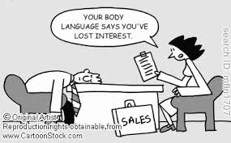
THANK YOU

