Slide 1
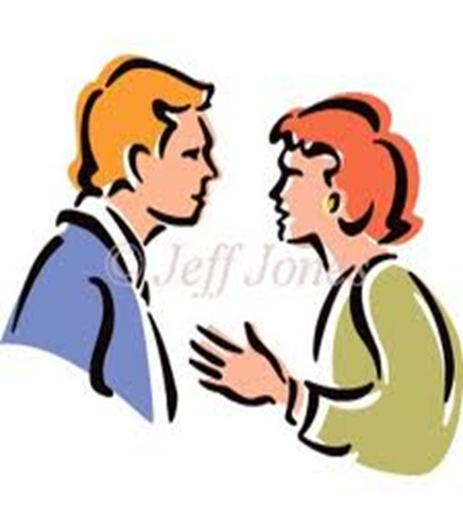
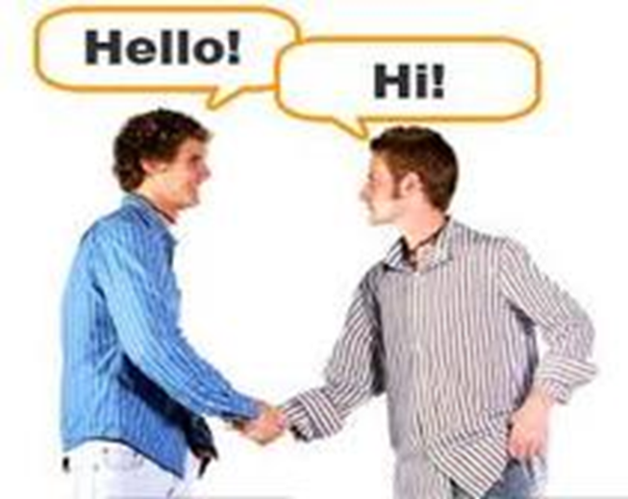
Conversation Messages
Chapter 8

Slide 2
Introduction
Mostly conversation take place face-to-face; this is the type of interaction that properly comes to mind when you think of conversation.

Slide 3
Introduction Cont….
Today much conversation takes place online.
Online communication is becoming a part of people’s experience worldwide.
Such communication are important personally, socially, and professionally

Slide 5
The process of conversation
Five basic steps
Opening
feed forward
Business
Feedback
Closing

Slide 7
Step 1: Opening
Opening is to open conversation, usually with some verbal or non verbal greeting such as “hi”, ”how are you”.
Your greeting tell others that you are accessible, and available to them for conversation.
It helps maintain the relationships.

Slide 8
Step2: Feedforward
Information that is sent before a regular message telling the listener something about what is to follow. Messages that are prefatory (تمهيدا) to more central messages.
You give a person a general idea of what the conversation will focus on.
e.g. did you know that my family is going for a holiday?
Or I have to tell you some thing about what happened yesterday .

Slide 9
Step2: Feedforward- Cont.
With greeting ,you can accomplish a great deal with feedforward, for example you can:
Open the channels of communication
Preview the message
Altercast
Disclaim.

Slide 10
Open the Channels of Communication.
Phatic communication
Consists of the “How are you and “ Nice weather” category of greeting messages that maintain rapport and friendly relationships.
It is primarily social to open channel of communication rather than to communicate
It is information that tells us another person is willing to communicate.
Phatic communication tells us the normal expected, and accepted rules of interaction will be in effect.

Slide 11
Preview Future Messages
Feedforward messages frequently preview other messages such as:
Preview the content: e.g. (I am afraid I have bad news for you)
Preview the importance (listen to this before you make a move….)
Preview the form or style (I will tell you all the gory[unpleasant] details).
Preview the positive or negative quality (you are not going to like this, but here is what l heard)

Slide 12
Altercast
It is often used to place some one in specific role and to request that he\she respond to you in terms of this assumed role.
e.g. ask your friend” as an advertising executive, what would you think of corrective advertising?”
You ask your friend to respond from a particular point of view.

Slide 13
Disclaim
Disclaimer is a statement that aims to ensure that your messages will be understood and will not reflect negatively on you
You fear that your listener will think your comments is inappropriate or that may rush to judge you without hearing your full account.
In such cases you may use some form of disclaimer and say:
e.g. This may not be the place to say this but……
e.g. just hear me before you hang up.

Slide 14
Step 3: Business
It is conducted through exchanges of speakers and listener role (focus of the conversation ).
Business is a good word for this stage because the term emphasizes that:
Most conversations are goal directed. There are purposes that should be fulfilled: learn, relate, play, help..
It includes all kinds of interactions, you talk about all details.
Each culture has its own conversational taboos:conversation, topics or language that should be avoided according to the culture ( politics topic).
Sometimes the business of conversation is Gossip;
Gossip is asocial talk that involve making evaluation about a person who is not present during the conversation

Slide 15
Step 4: Feedback
It is the reverse of the feed forward step.
During this step you reflect back on the conversation and be sure that the business is completed.
Feedback tells the speakers that effect he/she is having on the listener. Based on that you can change, adjust, or modify the content and form of messages.
There are many forms of feedback, verbal and nonverbal
E.g., a frown, or a smile, a yea, a pat on the back, a punch in the mouth …etc

Slide 16
Five dimensions of feedback
Positive (smiles, head nods), your message is well received; Negative ( frown, puzzled look), tells the speaker that something going wrong.
Person focused ( you are sweet) or message focused “can you repeat that phone number”.
Immediate which is the most effective feedback, or Delayed: The longer you wait to praise or punish the less effect it will have

Slide 17
Five dimensions Cont….
4- low monitored: spontaneous and totally honest; high monitored: specific feedback, careful constructed response.
5- Supportive: encourage others or Critical feedback: evaluative, and judge another’s performance.

Slide 18
Step five :Closing
It’s the opposite of first step.
It is the goodbye.
Express your pleasure . “well, it was good talking with you”
Summarize.
Use verbal & nonverbal.

Slide 19
Repairing
At certain times it’s necessary to repair a conversation that has hit a snag. If you said something wrong its irreversible.
So you may try to account for it, and the most common way to do this is with an EXCUSE
e.g. when you do something that others will view negatively, an excuse is said in order to justify your performance
Ideally the excuse lessens the negative impact of the message

Slide 20
Motive for excuse making. Or in other word ;why you need such an excuse !?:
To maintain self-esteem
To project a positive image to yourself and to others
To reduce the stress
To reduce the negative reaction to your performance
To maintain effective interpersonal relationships e.g. “please forgive me; I’m really exhausted

Slide 21
Types of excuses
Deny that you did what you are accused of:(I didn't do it).
You admit to doing it, but you claim that the offense was not really so bad or that there is justification for it “ It wasn't so bad”.
You claim that extenuating circumstances account for the behavior “yes but”. I was too upset to think clearly

Slide 22
Good excuses contain 5 elements
1- Demonstrate that you really see the problem and
partner feeling are legitimate and justify. Avoid
minimizing the issue or neglect the partner feeling.
2- You acknowledge your responsibility for doing what
you do. Avoid qualifying responsibility (I am sorry if I
did any thing wrong).
3- You make it clear that you are unhappy with your self
for doing what you do.
4- Request forgiveness, be specific.
5- Make it clear that this will never happen again.

Slide 23
Effective conversation
Effective conversation is characterized by three Main principles:
Dialogic
Reciprocal
Power

Slide 24
I- Effective conversation is Dialogic
It is more than simple conversation
It’s conversation in which there is genuine two-way interaction
In dialog each person is both speaker and listener, sender and receiver
Dialogue is conversation in which there is deep concern for the other person and for the relationship between the two
In a dialogic interaction you respect the other person enough to allow that person to make his or her choices

Slide 25
Objectives of dialogue are:
Mutual understanding
Supportiveness
empathy

Slide 26
The dialogic communicator avoids
Negative criticism
Negative personal judgments
Dysfunctional communication but keep the channels open by displaying willingness to listen.
Doesn’t manipulate the conversation to try to get you to say something positive about them

Slide 27
Monologue
It is the opposite of dialogic communication
It’s communication in which one person speaks and the other listens
There is no real interaction between participants
The monologic communicator is focused only on his own goals
Has no real concern for the listener’s feeling or attitudes.

Slide 28
The monologic communicator frequently use
Negative criticism
Negative judgment
Dysfunctional communication patterns
Rarely demonstrate that he understand you
They give no cues that they are listening
They wouldn’t request clarification of your ideas
They manipulate the conversation to lead you to say positive things about them
They secure agreement with their beliefs or values

Slide 29
II- Effective Conversation Is Reciprocal
Conversational turns—the changing (or maintaining) of the speaker or listener role during the conversation.
We use a wide variety of verbal and nonverbal cues to signal conversation turns

Slide 30
Speaker cues
As a speaker you regulate the conversation through two major types of cues
Turn-maintaining—enable you maintain the role of speaker
e.g. inhale breathing to show that you have more to say . or vocalizing pauses : “umm”
Turn yielding—cues: tell the listener you are near to finish & want to exchange role.

Slide 31
Listener cues
Turn-requesting. Tell the speaker that you would like to take a turn to speak( opening eyes or mouth).
Turn –denying cues: have nothing to say ( avoid eye contact).
Back channeling cues you communicate various meanings back to the speaker ( can indicate your agreement or disagreement).
Pace( ask speaker to slow down ).
Clarification-- a puzzled facial expression (you need something clarified
Interruption( tells the speaker you are listening and is involved).

Slide 32
Interruption can serve a variety of specific functions:
Used to change topic
To correct the speaker
To seek information or clarification
To introduce essential information
To end the conversation

Slide 33
III- Effective Conversation Involves Power
Most times you’ll want to express yourself with powerful messages
Generally research finds that men use more powerful language forms than women

Slide 34
Characteristics of powerless speech
Hesitation make the speaker sound unprepared and uncertain
Too many intensifiers make you monotonous (repetitive) and don’t allow you to stress what you want to emphasize. E.g. really, this was the greatest
Disqualifiers signal a lack of competence and feeling uncertainty. E.g. I didn’t read the entire article, but….

Slide 35
Characteristics of powerless speech- cont.
Tag questions: Ask for another’s agreement and therefore may signal your need for agreement—and your uncertainty. That was great movie, wasn’t it
Self-critical statement signal a lack of confidence and make public your own inadequacies. E.g. I’m not very good at this
Slang and vulgar language signal low special class and hence little power

Slide 36
Some things you might do to enhance your power:
Avoid self-manipulation
Talk slowly and deliberately
Use facial expression and gestures as appropriate
Select chairs you can get in and out of easily
To communicate dominance with your handshake, exert more pressure than usual and hold the grip a little bit longer than normal.
Use consistent packaging : in other words be careful that your verbal and non- verbal message do not contradict each other

Slide 37
THANK YOU

