Slide 1
Genetics
Spring Semester 2014- 2015

Slide 2
Genetics
Each nucleus contains 46 Chromosomes, arranged in 23 pairs.
One Chromosome of every pair is from each parent
The Chromosomes are filled with tightly coiled strands of DNA
Genes are segments of DNA that contain instructions to make proteins the building blocks of life.

Slide 3
Genetics
Allele – genes that produce alternative characteristic for a specific trait.
Hetrozygote - an organism with two different alleles of a particular gene.
Homozygote - an organism receives the same two allele of a particular gene.
Recessive - an allele that is not expressed in a heterozygous organism.
Dominant - an allele that is expressed in a heterozygous organism.

Slide 4
Genetics
Genotype: Set of genetic traits a person inherits; a person’s inborn capacity or potential "internally coded, inheritable information" (genetic blueprint).
Phenotypes: observable or physical characteristics such as height, body style and psychological characteristics like personality and intelligence "outward, physical manifestation"

Slide 5
Chromosomal abnormalities
There are two major categories of chromosomal abnormalities:
1. irregular number of chromosomes
2. structural modification in a chromosome

Slide 6
Chromosomal Abnormalities: irregular number of chromosomes
Nondisjunction abnormalities:
occurs in the meiosis cell division (where no. of chromo. are reduced to half).
Abnormality may occurs if uneven division (nondisjunction) occur (one sperm or ovum with 22 & the other with 24 chromosome)
If one of these defective cells fuses with normal sperm or ovum, the zygot will have higher or lower chromosome numbers .

Slide 7
Chromosomal Abnormalities: irregular number of chromosomes
Downs Syndrome
(trisomy 21-down syndrome 47 chromosome
An extra chromosome # 21 (3 copies), also referred to as Trisomy 21
Slow development, flat face, slanted eyes, intelligence varies greatly 50% of children die before age 1
Karyotype tests can predict the disorder but not its severity
Monosomy-45 chromosome as in turner’s syndrome
characterized by short stature and the lack of sexual development at puberty.

Slide 8
Chromosomal Abnormalities
Deletion Abnormalities:
part of a chromosome breaks during cell division causing a person with a normal no. of chromo. plus/minus a portion of a chromosome ( cat’s cry syndrome (46XY5q-) portion of chromosome 5 is missing.

Slide 9
Chromosomal Abnormalities
Translocation Abnormalities:
The affected person has parents carrying the abnormality. Parents have normal number of chromosomes but there is a chromosome misplaced and attached abnormally to another chromosome.

Slide 10
Mendel’s 1st Rule
Mendel’s 1st Rule and skill progression.
The Law of Segregation:
For each trait an individual has 2 genes (factors) The 2 genes may be the same or different
When making kids, each parent will contribute only 1 gene
The 2 genes a parent has will separate when making a kid.

Slide 11
Patterns of inheritance
Autosomal dominant inheritance
Autosomal recessive inheritance
Incomplete Dominance
Sex-Linked Inheritance

Slide 12
Patterns of inheritance
Dominant- recessive inheritance
Reflects the interaction of dominant and recessive alleles
Punnett square – diagram used to predict the probability of having a certain type of offspring with a particular genotype and phenotype

Slide 13
Patterns of inheritance
Autosomal Dominant- inheritance
children have usually inherited the disorder from an affected parent
2 persons with a dominantly inherited disorder are unlikely to choose each other, if they did: 75% of their children are affected.
The homozygous trait is probably incompatible with life.
Examples of dominant disorders: achondroplasia (type of dwarfism) and Huntington’s disease (a hereditary disorder with a mental and physical deterioration that leading to death)

Slide 14
Inheritance of a Dominant Gene Disorder
Affected Parent
(Has the Disorder)
D
r
Dr
Affected
(25%)
rr
normal
(25%)
r
Normal
Father
Dr
Affected
(25%)
rr
normal
(25%)
r
(50%)
(50%)

Slide 15
Patterns of inheritance
Autosomal recessive inheritance
Most common form.
Such disorders do not occur unless two genes for the disease are present (e.g: cystic fibrosis, Thalasemia, albinism).
Children with the disorder will always be homozygous for the trait.
Parents will both be carriers.

Slide 16
Inheritance of a Recessive Gene Disorder
Carrier Mother
D
r
DD
Normal
(25%)
Dr
Carrier
(25%)
D
Carrier
Father
Dr
Carrier
(25%)
rr
Affected
(25%)
r

Slide 17
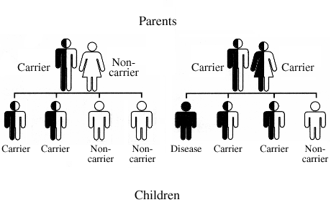
Thalasemia Disease

Slide 18
Patterns of inheritance
Sex-Linked Inheritance
Inherited traits determined by genes on the sex chromosomes
X chromosomes bear over 2500 genes; Y chromosomes carry about 15 genes. X-linked genes are:
Found only on the X chromosome & Typically passed from mothers to sons
Never masked (no carriers) in males since Y gene does not carry the traits
X-linked diseases and mutations such as hemophilia and fragile-X syndrome
Females have a second X chromosome so chances of having mutation or disease are less, BUT they are carriers of it
More males than females have X-linked diseases

Slide 19
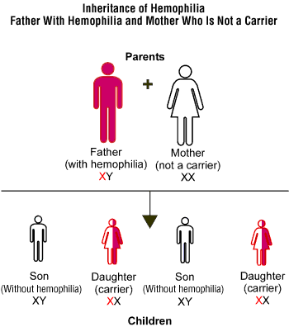

Slide 20
Incomplete Dominance
Heterozygous individuals have a phenotype intermediate between homozygous dominant and homozygous recessive
Sickling gene is a human example when abnormal hemoglobin (Hb) is made from the recessive allele (s)
SS = normal Hb is made
Ss = sickle-cell trait (both normal and abnormal Hb is made)
ss = sickle-cell anemia (only abnormal Hb is made)

