Slide 1
Applying Learning Theories to Health Care
Chapter 3

Slide 2
Applying learning theories to health education
Behaviorist learning theories
Cognitive theory
Social theory
Psychodynamic theory
Humanistic theory

Slide 3
Behaviorist learning theory
Learning is the result of connections made between the stimulus conditions in the environment (S) and the individual’s responses (R)—Sometimes termed S-R model of learning.
Approaches the study of learning by focusing on behaviors that can be observed , measured, and changed.
To encourage people to learn new information or to change their attitudes and responses, behaviorists recommend altering conditions in the environment and reinforcing positive behaviors after they occur.

Slide 4
Behaviorist learning theory
Two ways to change behavior and encourage learning using behaviorist principles
1- respondent conditioning
2- operant conditioning

Slide 5
Behaviorist learning theory
1- Respondent conditioning
Emphasizes the importance of stimulus conditions in the environment and the associations formed in the learning process.
2- Operant conditioning
Focuses on the behavior of the individual and the reinforcement that occurs after the response.

Slide 6
Learning or conditioning is quite simple:
A neutral stimulus (NS) has no particular meaning or value to the learner is paired with Naturally occurring unconditioned or unlearned stimulus (UCS) and Unconditioned response (UCR)
NS+ UCS UCR
After a few such pairings the neutral stimulus alone without the unconditioned stimulus will produce the same response
NS UCR
Without thought or awareness learning occurs when the newly conditioned stimulus (CS) becomes associated with conditioned response(CR)
CS CR

Slide 7
1- Respondent conditioning
Example
someone without experience in hospital---(NS)
Visit sick pt. …..smell odors---(UCS)
that make him feel queasy (nauseous) and light headed---(UCR)
After his first visit, his subsequent visit to hospital—(CS) become associated with feeling anxious and nauseated—(CR)
Especially if the visitor smells odors similar to those encountered during the first experience.

Slide 8
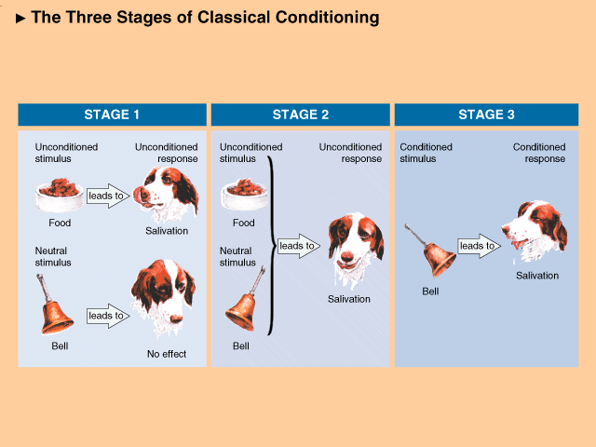

Slide 9
Behavioral Learning Theories (cont):

Slide 10
1- Principle of Respondent conditioning
May provide the basis for long-lasting attitudes toward medicine, healthcare facilities, and health professionals.
Used to get rid of or extinguish (switch off) a previously learned response, which has been found to be especially useful in teaching people to reduce their anxiety or break bad habits.
Teacher encourage the learner to build new associations for learning.
In health care, respondent conditioning has been used to treat addiction, phobias, and tension

Slide 11
2- Operant conditioning
To increase learning, is to apply positive reinforcement or rewards after the behavior occurs.
To decrease a bad habits, is accomplished by using either nonreinforcement or punishment.
If nonreinforcement does not work, then punishment may be employed as way to decrease responses.
There are a risks to use punishment—learner may become so emotionally upset (ashamed, sad, or angry).
To be effective, it is necessary to assess what kinds of reinforcement are likely to increase or decrease the behaviors to each individual.

Slide 12
2- Operant conditioning- cont.
Operant conditioning has been found to work well with nursing home and long-term care residents
and with patients who are not very verbal or do not engage in much thought or reflection
The success of operant conditioning partially depends on when the enforcement is applied. In early stages learning needs to be reinforced every time it occurs

Slide 13
Operant Conditioning- cont.
Learning occurs as the organism Responds to S- stimuli in the environment and is reinforced for making a particular response.
A REINFORCER is applied after a Response strengthens the probability that the response will be performed again under similar conditions.

Slide 14
Example of Positive Reinforcement (PR)
-We may continue to go to work each day because we receive a paycheck on a weekly or monthly basis.
- If we receive awards for writing short stories, we may be more likely to increase the frequency of writing short stories.

Slide 15
Behaviorist learning theory
The basic principles of behaviorist learning are summarized as follows:
1- Focus on the learner’s drives, the external factors in the environment that influence a learner’s associations, and on reinforcements that increase or decrease responses.

Slide 16
Behaviorists cont…………
2- The teacher’s task is first to assess conditions in the environment that lead to specific responses, the learner’s past habits and history of S-R connections, and what is reinforcing for a learner.
Then teachers must effectively manipulate conditions to build new associations, provide appropriate reinforcement, and allow for practice to strengthen connections between stimuli in the environment and a person’s responses or behavior.

Slide 17
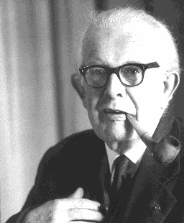
The Cognitive Theory
Jean Piaget
Swiss Psychologist (1896-1980)
Cognition is: The mental activities involved in thinking, knowing, & remembering

Slide 18
Cognitive Learning Theory
In contrast to behaviorist theory, cognitive theory focuses on what goes on “inside” the learner.
Especially learners’:
Perception
Thought
Memory and
Ways of processing and
Structuring information
According to this perspective for individual to learn, they must change their perception and thoughts and form a new understanding and insights.

Slide 19
Cognitive Learning Theories:
Cognitive theorists , unlike behaviorists, maintain that reward is not necessary for learning.
More important are learners’ goals and expectations, which create disequilibrium, imbalance, and tension that motivate them to act.

Slide 20
Cognitive Theory cont…..
Learning involves perceiving the information, interpretation, and reorganizing information into new insights.
The individuals’ goals and expectations are the sources of motivation that create disequilibrium, imbalance, tension and the desire to learn.
In order for the transfer of learning to happen, the leaner must mediate, or act on the learning

Slide 21
The Cognitive Theory
Piaget was interested in how the mind works and organizes information.
He believed that mental development is an orderly, sequential process that begins the day the infant is born. This process is same for all people but the rate of progression is different.
Cognitive development is an interactive process in which a variety of new experiences must exist before intellectual abilities can develop.

Slide 22
Cognitive learning theory- Approaches to learning
Within the cognitive theory several approaches to learning such as:
Gestalt perspective: persons perceives interprets and response to any situation in his or her own way
Cognitive development *****
Information processing *****
Social cognition: focused on the effect of social cultural factors on perception thoughts and motivation

Slide 23
The Cognitive Theory
According to Piaget there are four sequential stages of Cognitive development :
1- The sensorimotor stage
2- the preoperational stage
3- the concrete operations stage
4- the formal operations stage

Slide 24
The sensorimotor stage:
During infancy where infants explore their environment and attempts to coordinate sensory information with motor skills

Slide 25
The preoperational stage
During early childhood where youngsters are able to:
mentally represent the environment
regard the world from their own egocentric (self centered) perspective and
come to grips with symbolization

Slide 26
3- the concrete operations stage
The concrete operation stage during elementary school years where children are able to attend to more than one dimension at a time conceptualize relationships and operate on the environment.

Slide 27
4- The formal operations stage
During adolescence where teenagers begin to think abstractly (theoretically), are able to deal with the future and can see alternatives and criticize

Slide 28
Information-Processing Perspective:
The way individuals perceive, process, store, and retrieve information from experiences determines how learning occurs and what is learned.
Organizing information and making it meaningful aids the attention and storage process; learning occurs through guidance, feedback, and assessing and correcting errors.

Slide 29
Information processing
Stages of information processing:
Attention
Sensory processing: using one or more of the senses
Short term memory storage
Long term memory storage
Action response

Slide 30
Cognitive theory
Principles of cognitive learning theory:
Focus on internal factors within learners, such as their developmental stage of reasoning, perceptions, thoughts, ways of processing and storing information in memory, and the influence of social factors on attitudes, thoughts, and actions
The role of the teacher is to assess learner’s developmental stage, goal & expectations, preferred style, then organize learning experience to be meaningful and keep learning simple and at appropriate level

Slide 31
Social Learning Theory
Learning is often a social process, and other individuals, especially “significant others,” provide compelling examples or role models for how to think, feel, and act.

Slide 32
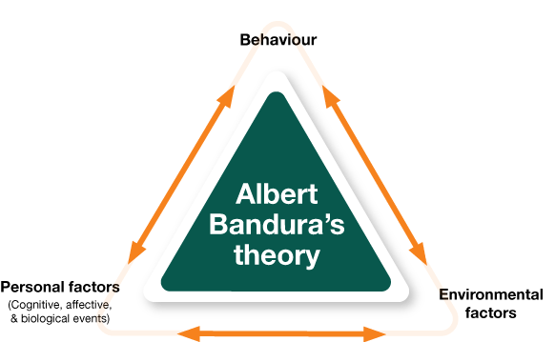
Social Learning Theory

Slide 33
Social learning theory
Role modeling is the central concept of the theory
Social learning theory can be considered a bridge or a transition between behaviorist learning theories and cognitive learning theories.
Behaviorists say that learning has to be represented by a permanent change in behavior

Slide 34
Social learning theory
Principles of social learning theory:
1- Focus on role model, the reinforcement that a model has received, the social environment and the four self regulating processes within the learner
2- The role of the teacher is to act as a typical role model, to use effective role models in teaching that are rewarded for their behavior, to assess the internal self-regulation of the learner, to provide feedback for learner’s performance

Slide 35
Social Learning Theory
Much of the learning occurs by observation, watching others and learning what happens with them.
Social learning theory focuses on the learning that occurs within a social context. It considers that people learn from one another, including such concepts as observational learning, imitation, and modeling.

Slide 36
Social Learning Theory
Albert Bandura is considered the leading proponent of this theory. He outlined a four-step, largely internal process that directs social learning. the behaviorist and cognitive dimensions of the theory

Slide 37
Bandura’s principles (1977)
There are four steps, which are internal processes that direct social learning
1. Attention phase: attention to role models that are high status.
2. Retention phase: the storage and retrieval of what was observed.
3. Reproduction phase: learner copies the observed behavior.
4. Motivation phase: whether the learner is motivated to perform the learned behavior.

Slide 39
Psychodynamic theory
Principles of the Psychodynamic theory
1- Focus on learner’s personality development, significant childhood experiences, conscious and unconscious motivations, id(social values and standards taught)-ego(self) –superego(integrity, morality) conflicts and defensive behaviors
2- The teacher’s role is to listen, ask probing questions about motivations and wishes, assess emotional barriers to learning, and make learning pleasurable while working to promote ego strength in learners

Slide 40
Humanistic theory
The assumptions that each individual is unique and that all individuals have a desire to grow in positive way
According to humanistic, feeling and emotions are the keys to learning, communication, and understanding.

Slide 41
Humanistic Learning Theories
Learning occurs on the basis of a person’s motivation, derived from needs, the desire to grow in positive ways, self-concept, and subjective feelings.
Learning is facilitated by caring facilitators and a nurturing environment that encourage spontaneity, creativity, emotional expression, and positive choices

Slide 42
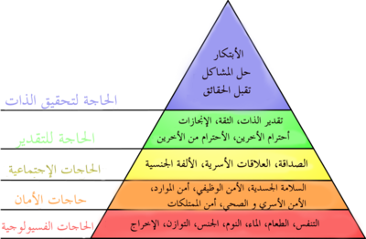
Humanistic theory
One of the best-known humanistic theorist is Abraham Maslow

Slide 43
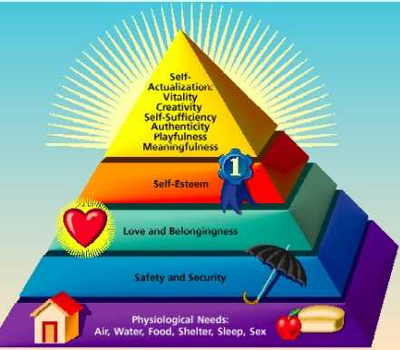

Slide 44
Humanistic theory
Principles of learning:
1- Focus on the learner’s desire for positive growth, subjective feelings, needs, self- concept, choices in life, and interpersonal relation ships
2- The teacher’s role is to assess and encourage changes in learner’s concept, and feelings by providing support, freedom to choose, and opportunities for creativity

Slide 45
Experiences that affect learning
Educator must be knowledgeable
Learner’s past experience
Lack of clarity and meaningfulness on what is to be learned, neglect, poor role models, confusing reinforcement, inappropriate materials for learner’s ability.

Slide 46
To ensure learning is permanent
Organize the learning experience
Make it meaningful
Pace the presentations
Practicing new information
Reinforcement
Assess and evaluate learning

Slide 47
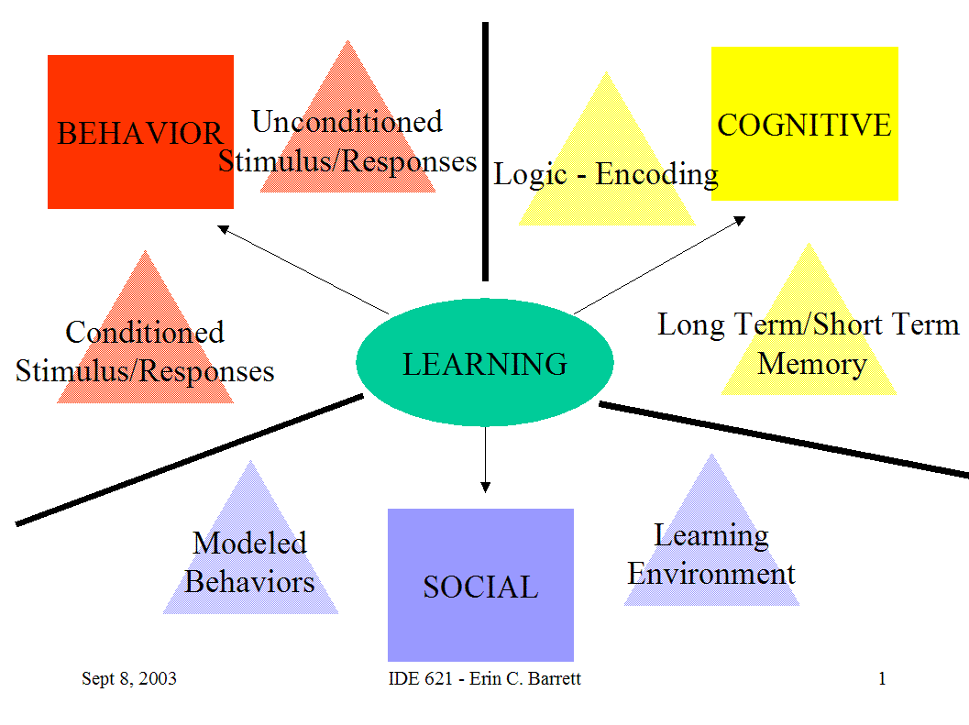
Learning theories Figure

Slide 48
Application of learning theories
Each theory emphasis certain aspects of learning
We can use one or a combination of more than one
Behaviorists focus on stimulus conditions and pay attention to reinforcement, manipulating environment,
Social learning theory stresses role models that would demonstrate the behavior
use the theory according the type of the learner, a passive learner might benefit more from a behaviorist approach.

Slide 49
THANK YOU

