Slide 1
Newborn Baby
Spring Semester 2014- 2015

Slide 2
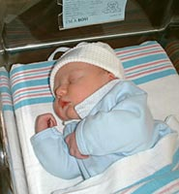
Changes at Birth
The First Breath:
The lungs are filled with air instead of fluid. Higher oxygen levels in the blood and alveoli filled with air instead of fluid allows for vascular resistance to decrease. This results in a greater increase in pulmonary blood flow.

Slide 3
Physiologic adjustment to extrauterine life
First period of reactivity:
lasts for ½ hour, baby is alert & exhibit exploring searching activities, making sucking sounds, rapid H.R & R.R.
Resting period:
lasts 90 minutes, baby generally sleeps, slower H.R & R.R.
Second period of reactivity:
between 2-6 hours of life. Baby is a wake, gagging and choking on mucus. Gain alert & responsive and interest to surrounding.

Slide 4
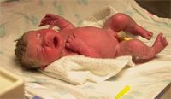
Assessment of well being: Apgar Scoring
Is an assessment scale applied at 1 minute and 5 minutes after birth.
Give a score (0,1, or 2) for each sign.
It serves as a baseline for future evaluation.
A score under 4 is in serious danger and need resuscitation.
A score of 4-6 may need clearing of the airway and O2 supplement.
A score of 7-10 is good

Slide 5
InRev1
The Apgar Scale
Score
Characteristic
0
1
2
Heart rate
Efforts to breathe
Muscle tone
Skin color
Reflex irritability
Absent
Absent
Flaccid,limp
Body pale
or blue
No response
Less than 100 beats per minute
Slow, irregular
Weak, inactive
Body pink, extremities blue
Frown, grimace
More that 100 beats per minute
Good; baby is crying
Strong, active motion
Body and extremities pink
Vigorous crying, coughing, sneezing

Slide 6
The Newborn Baby: Weight
Weight: differs depending on the race, nutritional, intrauterine and genetic factors. Normal rates 2.7-4.0 kg.
Newborn loses 5-10% of birth weight during the 1st few days because of:
No longer under the influence of salt & fluid-retaining maternal hormones.
Diuresis: to remove part of body fluids.
Limited by low caloric content of colostrum.
Time needed to establish sucking.
Stools.
Recaptures birth wt within 10 days

Slide 7
The Newborn Baby
Head-to-heel length: birth length is 48 – 53 cm.
H.C: 33-35 cm.
C.C: 2 cm less than H.C.

Slide 8
Classification of infants based on gestational ages and birth weights
Preterm or premature: infant born before the end of 37 weeks, regardless of weight
Term or full term: born between 38 & 42 weeks, regardless of weight
Postterm: an infant born after 42 weeks regardless of weight
Low birth weight: any infant at birth who weighs less than 2500 gm

Slide 9
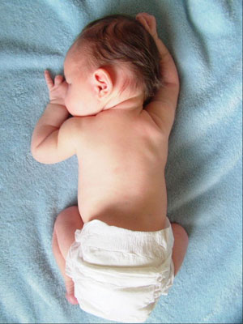
Appearance of newborn
Flexion posture.
Looks , red or cyanotic.
Body covered with varying amount of lanugo and vernix caseosa.

Slide 10
Vital Signs
Temperature | Pulse | Respiratory | Blood Pressure
37.2 C at birth then fall because of heat loss, little fat & immature temperature. Regulating center | 120-160 bpm. ↑ at the moment of birth to 180 bpm. 1 hour after birth ↓ to 120-140 bpm | first few minutes 80 b/m then ↓ to 30-60 b/m when newborn at rest. Usually irregular with short periods of apnea | 80/60 mm/Hg then ↑ at 10th day to 100/50 mm/Hg
Notes:
Development becomes increasingly differentiated.
Differentiated development begins with a generalized
response and progresses to a skilled specific response. For
example, an infant’s initial response to a stimulus involves
the total body; a 5-year-old child can respond more
specifically with laughter or fear.
■ Certain stages of growth and development are more critical
than others. It is known, for example, that the first 10 to
12 weeks after conception are critical. The incidence of
congenital anomalies as a result of exposure to certain
viruses, chemicals, or drugs is greater during this stage
than others.
■ The pace of growth and development is uneven. It is
known that growth is greater during infancy than during
childhood. Asynchronous development is demonstrated by
rapid growth of the head during infancy and the extremities
at puberty.

Slide 11
Head
Large head, overridden sutures.
Head molded to fit cervix.
Caput succedaneum:
Edema of the soft scalp tissue at the presenting part of the head.
Accumulation of serum in the tissues above the bone
Cross suture lines
Disappears in few days
Cephalhematoma:
Localized collection of blood between the skull bone and its periosteum
May involve one or both parietal bones
Weeks to resolve
Dose not cross sutures

Slide 12
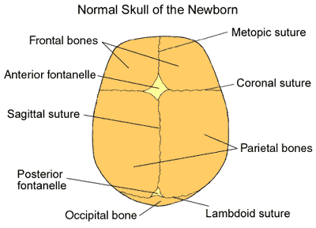

Slide 13
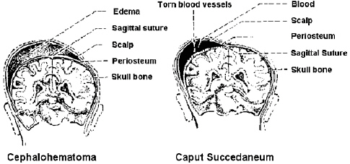
Caput Succedaneum
Cephalohematoma

Slide 14
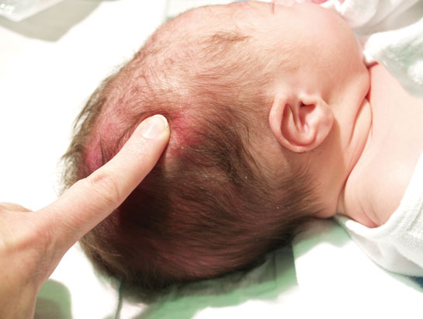
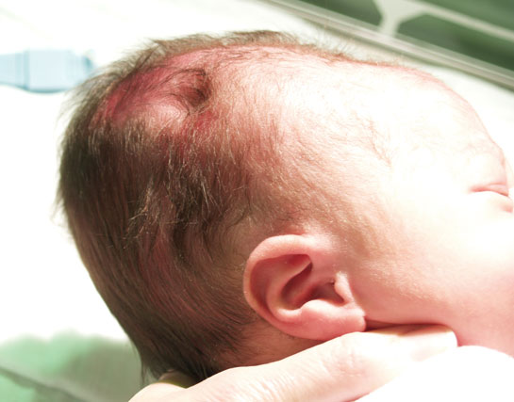
Caput succedaneum

Slide 15
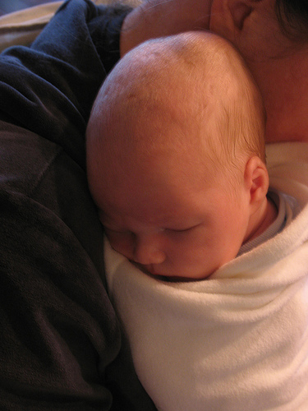
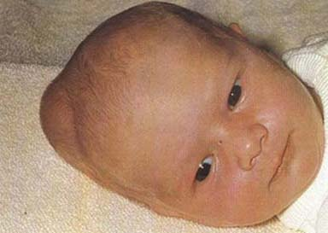
cephalheamatoma

Slide 16
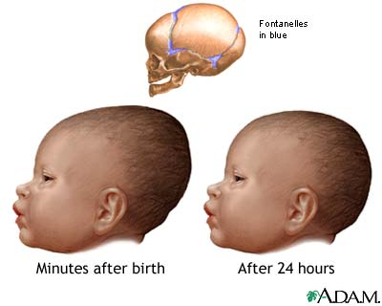

Slide 17
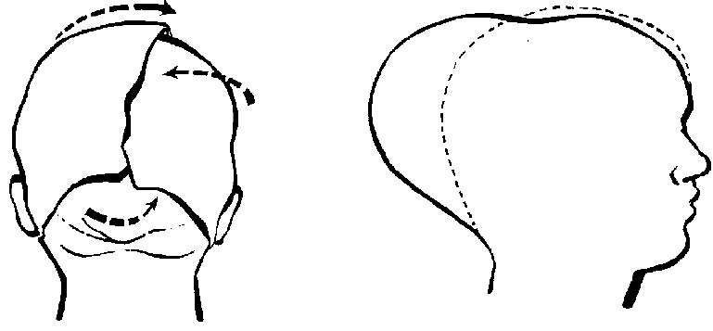
Molding of infant’s head

Slide 18
Fontanelles
6 fontanelles.
Anterior fontanelle, diamond shaped, 2.5-4 cm, will closes at 12-18 mon.
Posterior fontanelle, triangular, 0.5-1.0 cm, closed at 2 mon.
Pair of anteriolateral fontanelle close at 3 mon.
Pair of posteriolateral fontanelle close at 12 mon.

Slide 19
Eyes: tearless cry (lacrimal ducts mature at 3 months) permanent eye color between 3-12 mon.
Ears: pinna tends to bend easily.
Nose: large for face.
Mouth: prominent, large, & short tongue. Natal teeth are unusual. Thrush indicates candida infection.
Neck: short & chubby with many folds. Head lags

Slide 20
Skeletal system Arms are slightly longer than legs. Hands clenched into fists. 3 normal creases. Flat sole of the feet
Chest: looks small (compared to head), engorged breasts (maternal hormone).
Abdomen: protuberant
Bowel sound should be present within an hour. Umbilical cord white gelatinous structure with red & blue streaks for the 1st hour. Begin to dry breaks free by 6th- 10th day.

Slide 21
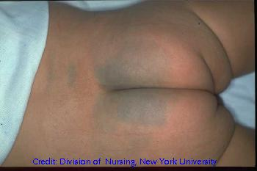
Skin
Vernix casoesa
Acrocyanosis (hand and feet are blue
Lanugo
Bruising, petechiae from birthing
Mongolian spots—generally on back and buttocks
Milia

Slide 22
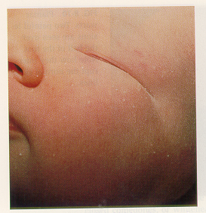
Milia
Small, whitish-yellow papules found close to the skin surface
Particularly common around eyes and midface
Notes:
Milia-tiny white bumps that occur on the face of 40%of newborns. They represent blocked or undeveloped sweat glands and will disappear without treatment.

Slide 23
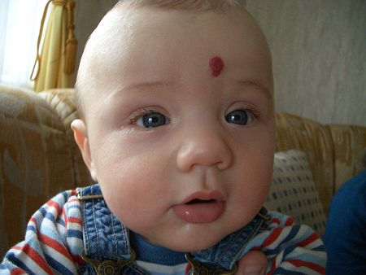
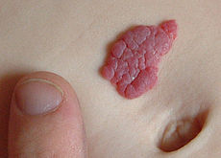
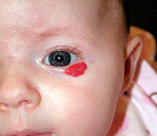
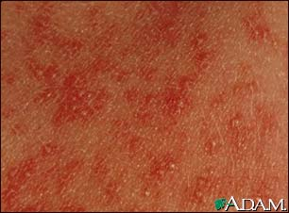
Vasculosus—hemangioma
Strawberry mark—nevous
Vasculosus—hemangioma
Erythema toxicum

Slide 24
Circulatory, hemopoietic & GI
Hgb 14-24 g/dl
Blood coagulation: born with long coagulation time (lower level of vit. K due to lack of Bacteria in the gut).
Baby learns to coordinate breathing, sucking and swallowing
Digestion-simple CHO and protein. (Starches and fats are not easily digested at this time)
Feeding varies—cues hand to mouth movement and sucking fingers intensify when hungry
Prevent regurgitation by not overfeeding, frequent burping and positioning the head slightly elevated
Stool—meconium—greenish black
Stools change and the stooling pattern change indicates good bowel functioning

Slide 25
Immune system & Renal
Passive immunity from mom
Immunoglobulins gradually develop
Should void in first 24 hour
Frequency depends on intake
Not able to concentrate urine

Slide 26
Hepatic system
Iron storage
Conjugation of bilirubin—function not well developed at birth
Physiologic jaundice—after 24
Pathologic jaundice—before 24 hours

Slide 27
Neuromuscular system
Newborn makes twitching movements of extremities without stimuli because of the immaturity of the nervous system. A number of reflexes can be tested in newborn
Neurological Assessment:
observing infant’s movement (latch and suck at the breast, cry , sleep, wake all suggest brain functioning) and response to environment.
Brain functioning is greatly affected by maturity

Slide 28
Neuromuscular system
Normal behavior & response to environment
Wakefulness & sleep: newborn sleeps 16-20 hrs/day with wakeful periods. Individual variation should be considered.
Sucking: normal baby initiates rooting , latching on the nipple and coordinate lip, tongue, palate and pharynx for feeding, otherwise there is a problem in the brain stem
Crying: crying means hunger, thirst, pain or need for protection or comfort.
.

Slide 29
Sucking Reflex
Onset: ~28weeks GA
Well-established: 32-34 weeks GA
Disappears: starting around 12 months
Elicited by the examiner stroking the lips of the infant.

Slide 30
Rooting Reflex
This reflex begins when the corner of the baby's mouth is stroked or touched. The baby will turn his/her head and open his/her mouth to follow and "root" in the direction of the stroking. This helps the baby find the breast or bottle to begin feeding.

Slide 31
Moro Reflex
The Moro reflex is often called a startle reflex because it usually occurs when a baby is startled by a loud sound or movement. In response to the sound, the baby throws back his/her head, extends out the arms & legs, with fingers extended in “c” shape, cries, then pulls the arms and legs back in. lasts about five to six months.

Slide 32
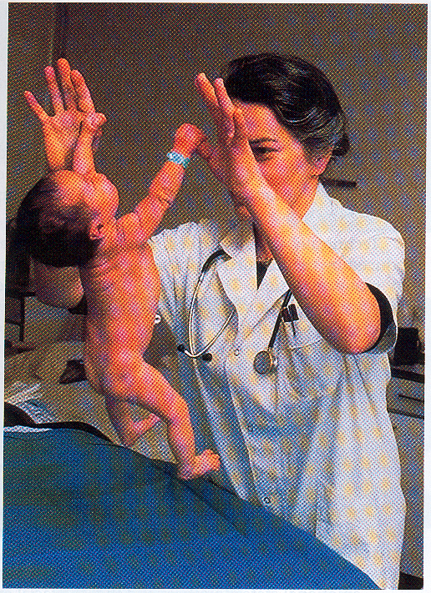
Grasp reflex
Stroking the palm of a baby's hand causes the baby to close his/her fingers in a grasp. The grasp reflex lasts only a couple of months and is stronger in premature babies.

Slide 33
Tonic Neck Reflex
When a baby's head is turned to one side, the arm on that side stretches out and the opposite arm bends up at the elbow. lasts about six to seven months.

Slide 34
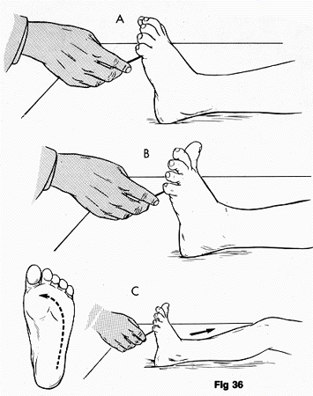
Babinski reflex
When the sole of the foot is firmly stroked, the big toe bends back toward the top of the foot and the other toes fan out. This is a normal reflex up to about 2 years of age.

Slide 35
Step reflex
This reflex is also called the walking or dance reflex because a baby appears to take steps or dance when held upright with his/her feet touching a solid surface.

Slide 36
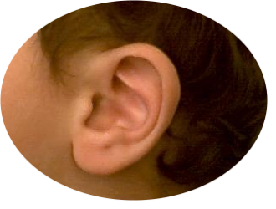
Senses
Hearing: able to hear in utero, within days after birth hearing become acute.
Vision: see as soon as they are born (blinking reflex). Can’t follow objects past the midline. Best focus on black & white. Newborns see best using peripheral vision, out of the corner of their eyes, and when objects are about 22.86-30.48 cm away.

Slide 37
Senses
Touch: The sense of touch in newborns is well developed, particularly around the mouth. They are sensitive to temperature, pressure, and pain.
Smell: well developed, newborns are often able to recognize the smell of their mother within the first few days of life.
Taste: prefer sweet tastes and usually do not like sour, bitter, and salty tastes.
Notes:
Sour حامض
Bitterمر

Slide 38
The Newborn’s States
Sleeping
Newborns sleep an average of 16-18 hours daily.
Newborns usually follow a sleep-wake cycle of around 4 hours of sleep followed by 1 hour of wakefulness.
By 3 or 4 months newborns usually sleep through the night.

