Slide 1
infancy period
Spring Semester 2014- 2015

Slide 2
LEARNING OUTCOMES
After completing this class, you will be able to:
1. Describe usual physical development during infancy
2. Identify tasks characteristic of infancy stage of development
3. Trace psychosocial development according to Erikson during
infancy .
4. Explain cognitive development according to Piaget during infancy

Slide 3
Physical development
The major task for a neonate’s is to adjust to the extrautrine life which needs the neonate to breathing, sleeping, sucking, eating, swallowing, digesting, and eliminating.
Neonatal period from the first day of life to the end of the first month

Slide 4
Physical development
Infants continue to grow and develop rapidly during the first year.
Infants undergo significant physiological changes in
weight, length, head growth, vision, hearing, smell, taste, touch, reflexes, and motor development.
Weight, length , head growth changes can be assessed using standardized growth charts

Slide 5
Physical development: Weight
At birth, most babies weigh from 2.7 to 4 kg
Immediately after birth, most infants lose 5% -10% of their birth weight because of fluid loss which is normal. infants usually regain this loss in about 1 week.
Infants gain weight at the rate of 150 to 210 g weekly for 6 months.
By 5 months of age, infants duplicate their birth weight, and by age 12 months, triplicate their birth weight.

Slide 6
Physical development: Length
The average length (head to heel) of a newborn is about 50 cm
By 6 months infants gain another 13.75 cm of height.
By 12 months they add another 7.5 cm.
The rate of increase in height is largely influenced by the baby’s size at birth and by nutrition.
Supine length is measured for children of less than two years of age.
After two years of age, standing height is taken as a measure of stature.

Slide 7
Physical development: Head and Chest Circumference
Assessment of head circumference (HC) is to determine the growth rate of the skull and the brain.
HC should be measured until the child is 2 years
At birth the average HC is 35 cm and varies only 1 or 2 cm
The chest circumference of the newborn is usually less than the head circumference by about 2 cm

Slide 8
Physical development: Head and Chest Circumference
As the infant grows, the chest circumference becomes larger than the head circumference. At about 9 or 10 months, the head and chest circumferences are about the same.
after 1 year of age the chest circumference is larger than HC

Slide 9
Physical development: Head Molding
at birth many newborn babies have misshapen heads because of the molding of the head that occurs during vaginal deliveries.
Within a week, a newborn’s head usually regains its symmetry,
The larger anterior fontanel (4 to 6 cm in diameter and diamond shaped) its closure occurs between 12 and 18 months.
The posterior fontanel between the parietal bones and the occipital bone closes between 2 and 3 months after birth

Slide 10
Physical development: Vision
the human visual system develops largely after birth, especially during the first few years of life
An infant’s visual acuity 20/100-20/400
The 4- month-old has almost complete color vision and follows objects
Binocularity: fixation of two ocular images into one cerebral picture begins to develop by 6 weeks and established by 4 months.
Between 6 and 10 months the infant can fix on an object and follow it in all directions.

Slide 11
Physical development: Hearing
Newborns with normal hearing will react with a startle to a loud noise .
Between 3 and 6 months the infant will look for sounds, pausing an activity to listen and respond

Slide 12
Physical development: Smell & Taste
The sense of smell does not develop much before birth because baby is surrounded by amniotic fluid until birth.
The senses of smell and taste are functional shortly after birth.
Newborns prefer sweet tastes.
when the first few days of life (around 10 days) babies are able to recognize the smell of their mother’s milk

Slide 13
Physical development: Touch
The sense of touch is well developed at birth.
The infant responds positively to the warmth, love, and security it perceives when touched (skin to skin), held, and cuddled.
The newborn is sensitive to temperature extremes and has poor self-regulation of body temperature.
In response to pain, young babies react diffusely, with a whole body reaction, and cannot isolate the source of discomfort.

Slide 14
Motor Development
A motor skill an action that involves muscles.
Gross motor skills are larger movements the baby makes with his arms, legs, feet, or his entire body.
E.g crawling, running.
Fine motor skills are smaller actions the baby does using his fingers, toes lips and tongue.
E.g picking things between finger and thumb.

Slide 15
Motor Development
Principles of motor development
Gross movements before fine movements
Pattern of development is usually the same, but the rate differs greatly from child to child and from culture to culture.
Initially, infant’s body movement is uncoordinated.
e.g Newborn Turns head from side to side when in a prone position & Grasps by reflex when object is placed in palm of hand
At 1 month of age the infant lifts the head momentarily when prone, and has a head lag when pulled to a sitting position. (lag is when you pull a baby from a supine to a sitting position, and his head lags behind the trunk)

Slide 16
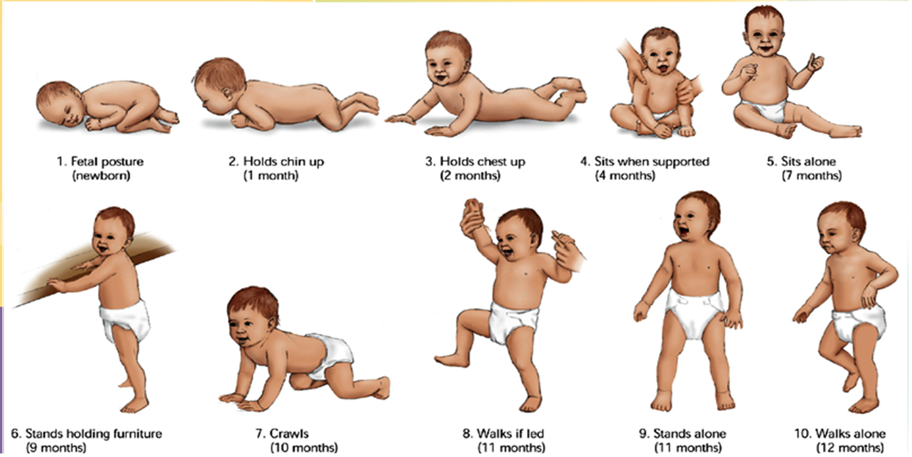
2-3 months

Slide 17
Gross Motor Development
Head lag should be minimal by 3-4 months of age.
4 months Rolls over. Sits with support, holds head steady when sitting.
6 months Lifts chest and shoulders off table when prone,
bearing weight on hands. Manipulates small objects.
After 6 months infants may sit without support.

Slide 18
Gross Motor Development
9 months Creeps and crawls. Uses pincer grasp with thumb and forefinger.
At 9 months they can reach, grasp a rattle, and transfer it from hand to hand.
At 12 months they can turn the pages of a book, put objects into a container, walks alone with help & Uses spoon to feed self.

Slide 19
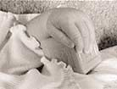
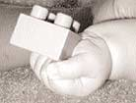
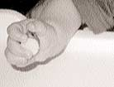
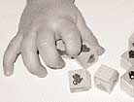
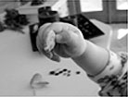
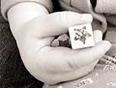
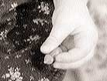
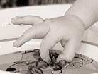
Fine Motor Development
At 4 month: brings hands together and shake rattle.
At 6 month: palmer grasp.
At 7 month: pass object from hand to another.
At 8 month: advanced eye-hand coordination.
At 10 month: pincer grasp.
at 12 month: holds cup or spoon

Slide 20
Psychosocial development
Erikson ( Trust VS Mistrust)
Parents can enhance infant’s sense of trust by
Being sensitive to the infant’s needs and meeting these needs promptly and skillfully
Responding consistently to an infant’s needs
Providing a predictable environment (routines )
handling, stroking, and cuddling, are essentials for healthy psychosocial development.

Slide 21
Psychosocial development
By 7-9 months, most infants show attachment to their parents and may show displeasure when left with strangers (stranger anxiety) & displays fear of being left alone (e.g., going to bed).

Slide 22
Cognitive development
The infant reacts socially to caregivers shows displeasure by crying and satisfaction by soft vocalizations.
Crying is their initial reaction to stress, and the major way they communicate stress
3 months : cooing
4 months Attends to adult face and voice by eye contact and quieting.
6 months :babbles, laughs, and exhibits increased response to verbal play.

Slide 23
Cognitive development
Starts to imitate sounds. Vocalizes one-syllable sounds: “ma ma,” “da da.”
Between 6 and 9 months individual words begin to take on meaning and the infant may look at named objects or people.
The 9- to 12-monthold infant understands many words (e.g., “no,” “hot,” “dog”), uses gestures (e.g., waves “bye-bye”), may articulate one or two words with a specific reference (e.g., “mama,” “dada”)
By 1 year of age, responds to simple commands.
Complies with simple verbal commands.
Waves “bye-bye.”

Slide 24
Cognitive development
Sensorimotor Birth to 2 yrs
Stage 1 Use of reflexes | Birth – 1 month | Most action is reflexive
Stage 2 Primary circular reaction | 1 -4 months | Perception of events is centered on the body The interesting events are occurring within the body (plays with hands, fingers, feet).
Stage 3 Secondary circular reaction | 4 – 8 months | Aware of the external environment , The interesting events in this case are located in the external Beginning of object permanence: shows separation anxiety
Stage 4 Coordination of secondary schemata | 8 – 12 months | Intentionality occurs in interactions with the environment and the infant is moving towards goal directed behavior: works to get toy that is out of reach Fully developed object permanence

Slide 25
Cognitive development
Its recommended to “discourage television viewing for children younger than 2 years, and encourage more interactive activities that will promote proper brain development, such as talking, playing, singing, and reading together”

Slide 26
Teething During the First Year
Development of the baby’s teeth usually begin about the 6th week of pregnancy
The first baby teeth appear at about 6 or 7 months (primary teeth).
Teething often causes pain and swelling and makes for a cranky baby
Has 6-8 deciduous teeth by the first year of age.
The sequence of eruption is:
At 6 months: lower central incisors.
At 7 months: lower lateral incisors.
At 8 months: upper central incisors.
At 9 months: upper lateral incisors.

Slide 27
Language Acquisition
Single-Word Stage: The child says one word at a time
Telegraphic Speech: Two word sentences that communicate a single idea (e.g., Want yogurt)
12 weeks (3 mon) cooing, smiles when talked to
16 weeks (4 mon) turns head in response to human voice
20 weeks makes vowels and consonant sounds
6 months Babbling: Repetition of meaningless language sounds (e.g., babababa)
8 months repeat certain syllables (Da Da ;ma-ma)
12 months understands and says some words

Slide 28
Moral development & Play
They have no concept of the underlying moral order
Play: Solitary Play: When a child plays alone even when with other children

Slide 29
Emotional
At 6 weeks: social smile.
At 4 months: recognize his primary caregiver.
At 7-9 months: stranger anxiety, continue until 12 months.
At 7-9 months: separation anxiety, continue until preschool period.
Separation and stranger anxieties are related to infant’s ability to discriminate between familiar and non-familiar people

Slide 30
Breast Feeding
Is the best source of nutrient for infants
Benefits
Appropriate weight gain
Fewer allergies
Fewer illnesses
Reduced childhood cancer and reduced incidence of breast cancer in mothers and their female offspring
Lower incidence of SIDS
Stronger attachment bond

Slide 31
Infant nutrition
First 4-6 months Breast milk OR Iron-Fortified infant formula
Start with cereals (rice due to fewer allergies) twice daily change by another kind of cereals after a week.
Vegetables: vegetables are the second choice after cereals at 7 month of age, they are rich in iron
Fruits: fruits are offered one month after vegetables (8 mon.).
Meat: usually introduced at 9 months.
Egg yolk at 10 months (↑ iron) should be given before egg white (↑ protein) because protein can cause allergy.
At first birthday whole milk egg white and honey

Slide 32
Introduction of solid food: Tips
Start slowly
Only 1 new food every 4-5 days
Hold baby during feeding
First food: Iron-Fortified infant rice cereal
Use single-ingredient foods
Read food labels
Avoid sweet tastes
Avoid foods that can choke infants

Slide 33
Feeding Problems
Colic (<3months): gas production, and bloating
Cause? Not always known
More in formula fed! (high in carbohydrate)
Overfeeding : swallowing too much air.
Breastfeeding? Foods in the mother’s diet
Cow’s milk, or other items
Spitting up
Normal occurrence: after meals, mouthful of milk.
Unless projectile vomiting in may be organic problem such as pyloric sphincter closure

Slide 34
Common Health Concerns
Teething: gum sore, tender can lead to decreased intake and cry.
Thumb sucking: does not deform the jaw as long as it stops by school-age.
Diaper dermatitis: prolong contact with urine or feces.
Constipation: increased with formula fed.
Sleep problems: as a result of colic or other health problems.

Slide 35
Growth body systems
Blood | Hgb A production largely replaces Hgb F (fetal ) by 4 months (physiologic anemia due to fetal RBCs destruction)
Respiratory | RR slows. Upper respiratory infections tend to be more severe due to small lumen of respiratory tract and inefficient mucus production.
Immune system | Become functioning at 2 months, Produce both IgG & IgM antibodies by the first year.
GI | Can digest protein & carbohydrate at birth. Amylase deficiency until 3rd month of age ( cannot digest complex CHO) Lipase deficiency during entire 1st year. Infant needs frequent feedings. Extrusion reflex exists until 3-4 months. Thus Introduction of solid food 4-6 months.
Energy requirement | < 6 months Wt (kg) x 108/ day 6mo-1 year Wt (kg) x 98/ day

