Slide 1
Chapter 10: The Abdomen

Slide 2
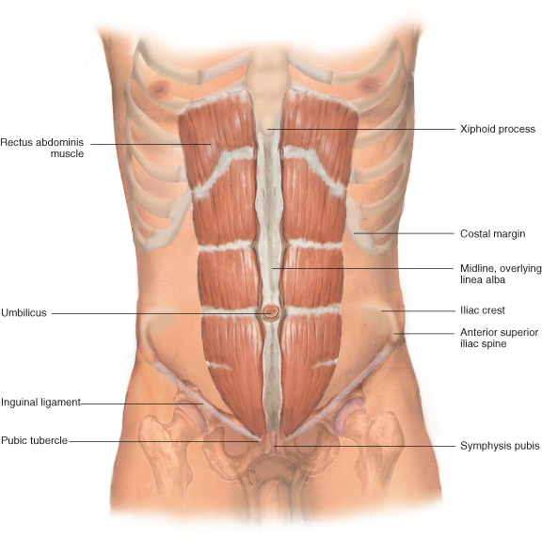
Anatomy of Abdomen
Anatomy and Physiology of the Abdominal Wall and Pelvis

Slide 3
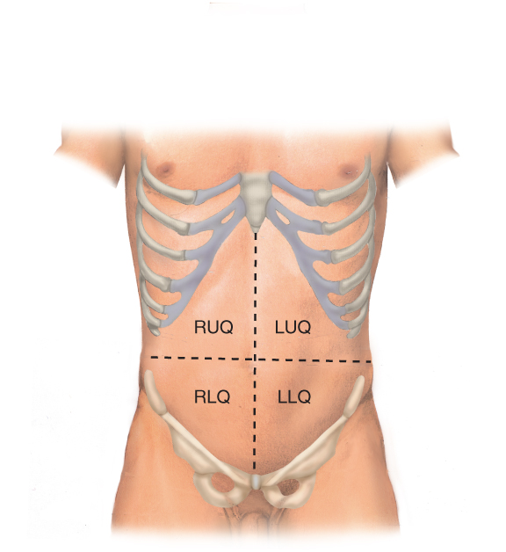
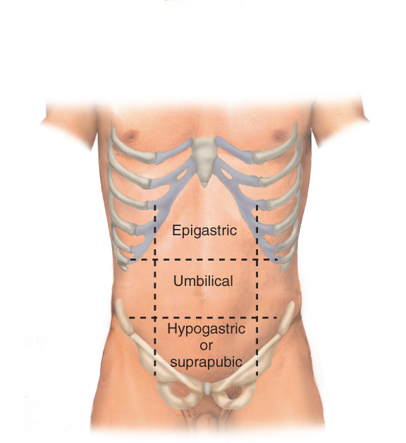
Anatomy of Abdomen
Dividing the Abdomen into Four Quadrants
Dividing the Abdomen into Nine Sections

Slide 4
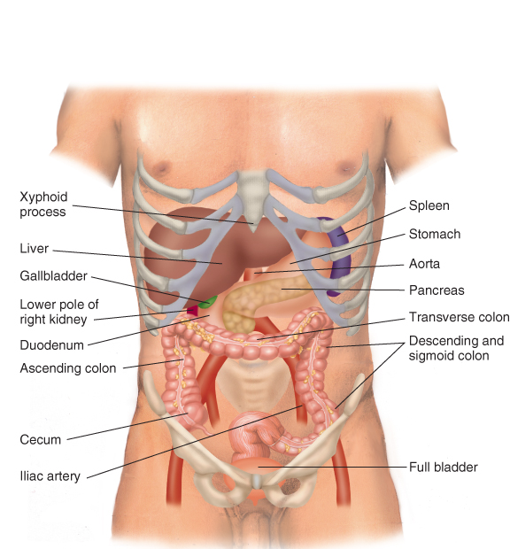
Anatomy of Abdomen
Abdominal Cavity

Slide 5
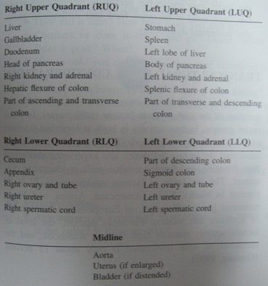

Slide 6
History Taking of Problems in the Abdomen: GI Tract
How is the patient’s appetite?
Any symptoms of the following?
Heartburn: a burning sensation in the epigastric area radiating into the throat; often associated with regurgitation
Excessive gas or flatus; needing to belch or pass gas by the rectum; patients often state they feel bloated
Abdominal fullness or early satiety
Anorexia: lack of an appetite

Slide 7
History Taking of Problems of the Abdomen: GI Tract
Regurgitation: the reflux of food and stomach acid back into the mouth; brine-like taste
Vomiting or retching (spasmodic movement of the chest and diaphragm like vomiting but no stomach contents are passed)
Ask about amount of vomit
Ask about type of vomit: food, green- or yellow-colored bile, mucus, blood, coffee ground emesis (often old blood.) Blood or coffee ground emesis is known as hematemesis

Slide 8
History Taking of Problems of the Abdomen: GI Tract
Qualify the patient’s pain
Visceral Pain: When hollow organs (stomach, colon) forcefully contract or become distended. Solid organs (liver, spleen) can also have this type of pain when they swell against their capsules. This type of pain is usually gnawing, cramping or aching. It is often difficult to localize. (hepatitis)
Parietal Pain: This pain occurs when there is inflammation from the hollow or solid organs that affect the parietal peritoneum. This type of pain is more severe and is usually easily localized (appendicitis)
Referred Pain: Pain that originates at different sites but shares innervation from the same spinal level (gallbladder pain in the shoulder)

Slide 9
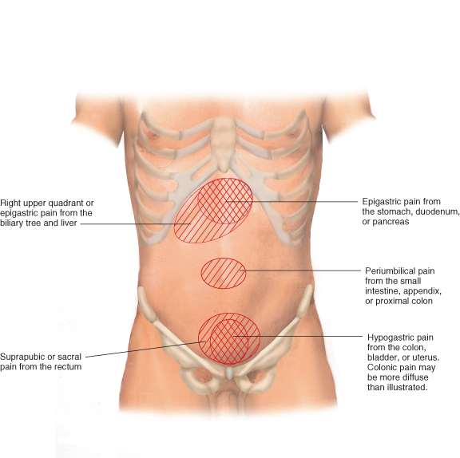
Pain by Abdominal Areas
Types of Visceral Pain

Slide 10
History Taking of Problems of the Abdomen: GI Tract
Ask patients to describe the pain in their own words
Ask patients to point with one finger to the area of pain
Ask about the severity of pain (scale of 1 to 10)
Ask about what brings on the pain (timing)
Ask how often they have the pain (frequency)
Ask how long the pain lasts (duration)
Ask if the pain goes anywhere else (radiation)
Ask if anything aggravates the pain or relieves the pain
Ask about any symptoms associated with the pain

Slide 11
History Taking of Problems of the Abdomen: GI Tract
Ask about bowel movements
Frequency of the bowel movements
Consistency of the bowel movements (diarrhea vs. constipation)
Any pain with bowel movements
Any blood (hematochezia) or black tarry stool (melena) with the bowel movement
Ask about the color of the stools (white or grey stools can indicate liver or gallbladder disease)
Look for any associated signs such as jaundice or icteric sclerae

Slide 12
History Taking of Problems of the Abdomen: GI Tract
Ask about prior medical problems related to the abdomen
Ex., Hepatitis, cirrhosis, gallbladder problems, pancreatitis
Ask about prior surgeries of the abdomen
Ask about any foreign travel, occupational hazards
Ask about tobacco, alcohol, illegal drugs and medication history
Ask about hereditary disorders affecting the abdomen in the history of the patient’s family

Slide 13
History Taking in Problems of the Abdomen: Urinary Tract
Ask about frequency (how often one urinates) and urgency (feeling like one needs to urinate but very little urine is passed)
Ask about any pain with urination (burning at the urethra or aching in the suprapubic area of the bladder)
Ask about the color and smell of the urine; red urine usually means hematuria (blood in the urine)
Ask about difficulty starting to urinate (especially in men) or the leakage of urine (incontinence, which especially occurs in women)
Ask about back pain at the costovertebral angle (kidney) and in the lower back in men (referred pain from the prostate)
In men ask about symptoms in the penis and scrotum

Slide 14
Physical Examination of the Abdomen: Inspection
Inspect the abdomen
Look at the skin: scars, striae (stretch marks), vein pattern, hair distribution, rashes or lesions
Look at the umbilicus: observe contour and location and any signs of an umbilical hernia
Look at the contour of the abdomen: flat, rounded, protuberant, or scaphoid
Is the abdomen symmetric?
Inspect for signs of peristalsis (rhythmic movement of the intestine that can be seen in thin people) and pulsations (within blood vessels such as the aorta)

Slide 15
Physical Examination of the Abdomen: Auscultation
Always auscultate before palpating or percussing the abdomen
Place the diaphragm over the abdomen to hear bowel sounds (borborygmi) which are long gurgles. These sounds are transmitted across the abdomen so it is not necessary to listen at multiple places. The normal frequency of sound is 5 to 34 sounds per minute.
Place the diaphragm over the aorta and iliac arteries to assess for bruits (vascular sounds resembling the whooshing of heart murmurs)
Place the diaphragm over the liver or spleen to listen for friction rub

Slide 16
Physical Examination of the Abdomen: Percussion
Percuss over all four quadrants listening for tympany (hollow sounds) versus dullness (which could be a large stool or a mass)
Percuss over the liver in both the midclavicular line and at the midsternal line
Midclavicular percussion should be 6 – 12 centimeters; longer than this indicates a swollen enlarged liver
Midsternal line percussion should be 4 – 8 centimeters; shorter than this can indicate a small hard cirrhotic liver

Slide 17
Physical Examination of the Abdomen: Percussion
Percuss the spleen by one of two techniques:
Percuss the left lower anterior chest wall between lung resonance above the costal margin (Traube’s space). Dullness can indicate an enlarged spleen while when tympany is prominent splenomegaly is not likely.
Check for a splenic percussion sign. Percuss the lowest interspace in the left anterior axillary line. This area is usually tympanitic. Then have the patient take a deep breath and percuss again. If the spleen is a normal size the percussion remains tympanitic. Shifting from tympany to dullness with inspiration suggests an enlarged spleen. This is a positive splenic percussion sign.

Slide 18
Physical Examination of the Abdomen: Light Palpation
Start palpating the abdomen with gentle probing with the hands. This reassures and relaxes the patient.
Identify any superficial organs or masses
Assess for voluntary guarding (patient consciously flinches when you touch them) versus involuntary guarding (muscles spasm when you touch them but the patient cannot control the reaction.)
Use relaxation techniques to asses voluntary guarding
Have the patient breathe out deeply
Have the patient mouth breathe with the jaw dropped open

Slide 19
Physical Examination of the Abdomen: Deep Palpation
Palpate deeply in the periumbilical area and both lower quadrants. Rebound tenderness occurs if pain increases when the examiner decreases the pressure against the abdomen.
Palpating the liver:
Using the left hand to support the back at the level of the 11th and 12th rib the right hand presses on the abdomen inferior to the border of the liver and continues to palpate superiorly until the liver border is palpated.
Ask the patient to take a deep breath. This can illicit pain in liver or gallbladder disease and also makes it easier to find the inferior border of the liver (the diaphragm lowering during deep inspiration forces the liver downward.)

Slide 20
Physical Examination of the Abdomen: Deep Palpation
The “hooking technique” can be helpful when a patient is obese
Place both hands, side by side, on the right abdomen below the border of liver dullness.
Press in with the fingers and go up toward the costal margin. Ask the patient to take a deep breath. The liver edge should be palpable under the finger pads of both hands.
Palpate the spleen on the left side in much of the same way as the liver with the left hand supporting the back and the right hand palpating the abdomen. Generally the spleen cannot be palpated this way even with deep inspiration. Palpating a splenic tip may indicate splenomegaly

Slide 21
Physical Examination of the Abdomen: Deep Palpation
Palpating the left kidney: Move to the patient’s left side. Place your right hand under the 12th rib. Lift up trying to displace the kidney anteriorly. Place your left hand in the left upper quadrant. Ask the patient to take a deep breath. At the peak of inspiration press your left hand deeply into the left upper quadrant trying to “capture” the kidney between your hands.
Palpating the right kidney: Return to the patient’s right side. Use your left hand to lift the back while your right hand feels deeply into the right upper quadrant. Repeat the same steps as used for the left kidney.
Palpate the costovertebral angle on each side of the back for kidney tenderness.
Palpate over the suprapubic area for bladder tenderness.

Slide 22
Physical Examination of the Abdomen: Special Techniques: Ascites
A protuberant abdomen with bulging flanks is suspicious for ascites (fluid in the abdomen from diseases such as cancer)
Percuss the abdomen for areas of tympany and dullness. Due to gravity, dullness should be located along the lateral sides of the abdomen while the anterior portion should be tympanitic.
Test for shifting dullness. After mapping out the areas of tympany and dullness, have the patient roll to one side. Remap the areas of tympany and dullness. In ascites there should be a shift due to free fluid moving with gravity.
Test for a fluid wave. Have the patient or an assistant press their hands firmly down the midline. This pressure stops the transmission of the wave through fat tissue. Now tap on one flank sharply and feel with your own hand if the wave transmits to the other side of the flank.

Slide 23
Physical Examination of the Abdomen: Special Techniques: Appendicitis
Assessing for appendicitis
Check for involuntary guarding and rebound tenderness in the right lower quadrant
Perform a rectal examination in both sexes and a pelvic examination in women
Check for Rovsing’s sign (rebound tenderness in the left lower quadrant)
Check for Psoas sign (the patient flexes their thigh against the examiner’s hand; pain indicates a positive sign)
Check for the Obturator sign (flex the patient’s thigh and rotate the leg internally at the hip; pain indicates a positive sign)

Slide 24
Diagnostic procedures of Abdomen

Slide 25
Diagnostic procedures
Colonoscopy
Proctoscopy (anoscopy)
Sigmoidoscopy
Cholangiography
Esophagogastroduodenoscopy (EGD)
Barium Enema
Barium Meal
Cystoscopy

Slide 26
Colonoscopy
Flexible fiberoptic endoscope passed through the rectum and advanced to visualize the large intestine;
any abnormalities can be photographed and biopsied;
Polyps can be removed and bleeding areas may be cauterized
Invasive

Slide 27
Colonoscopy :Indications
Helps to diagnose
bleeding,
diverticulosis, pauches or plugs in colon
polyps,
stricture, narrowing
tumor,
Inflammatory bowel disease
ulcerative colitis

Slide 28
Colonoscopy
Preparations; liquid diet 24 hrs before procedure, oral liquid preparation for cleaning bowel given the evening before examination. Then NPO.
Procedure; patient is placed in left side with knees drawn up while endoscope is passed through the bowel
Follow up care; V/S, assess signs for perforation

Slide 29
Proctoscopy (anoscopy)
Rigid scope passed through the rectum to visualize the mucosal surface of the anus and rectum
Helps to diagnose polyps, bleeding, tumors, and other defects
Invasive
Preparations: None
Follow up care; observe for signs of perforation, sitz baths may be ordered to relieve discomfort

Slide 30
Sigmoidoscopy
Flexible fiberoptic endoscope passed through the rectum and advanced to visualize the rectum, sigmoid colon, and proximal colon; any lesions can be biopsied
Helps to diagnose tumors, polyps, diverticula, or bleeding
invasive
Preparation; liquid diet 24hrs before examination, cleaning enema the morning of the procedure
Follow up care; observe for signs of perforation, sitz baths may be ordered to relieve discomfort

Slide 31
Percutaneous transhepatic cholangiography (PTC)
A procedure of x-ray to visualize the hepatic , common bile ducts, cystic duct and gall bladder.
This procedure is done under local anesthesia by a radiologist.
During the exam, a thin needle is inserted through the skin (percutaneous) and through the liver (transhepatic) into biliary system.
Then contrast media is injected, and the biliary system is outlined - imaging is performed fluoroscopy with selected images hard copied.

Slide 32
Percutaneous transhepatic cholangiography (PTC)
Helps to distinguish obstructive jaundice caused by liver disease from jaundice caused by biliary obstruction (e.g., from a tumor, common bile duct injury, stones within the bile ducts)
Invasive
Preparation: NPO, Hx of allergy to iodine or sea food, coagulation studies, PT, PTT
Follow up care; bed rest 8 hrs, assess the patient for abdominal distention. insertion site for bleeding & swelling , V/S, infection

Slide 33
Esophagogastroduodenoscopy (EGD)
Endoscope passed through the mouth and advanced to visualize the esophagus, stomach, and duodenum;
any abnormalities can be photographed and biopsied; bleeding areas may be cauterized
Helps to diagnose acute or chronic upper GI bleeding, esophageal or gastric varices, polyps, tumors, ulcers, esophagitis, gastritis, esophageal stenosis, and gastroesophageal reflux
Invasive
Preparation :NPO
Follow up care; V/S, NPO 2-4 until gag reflex returns, assess signs of perforation

Slide 34
Barium Enema
Radiology test used to visualize the colon; barium enhances image, Aids in diagnosis of polyps, tumors, fistulas, obstruction, diverticula, and stenosis
Noninvasive
Preparations; pt placed in low residue diet 2 days before procedure, must have clear fluid the evening before examination & NPO also pt should take laxatives to clean bowel the evening before examination
Follow up care; mild laxative or cleaning enema, assess stool, drink plenty of water.

Slide 35
Upper gastrointestinal (GI) series (barium swallow)
Radiology test used to visualize the esophagus, stomach, and duodenum.
Aids in diagnosis of hiatal hernia, ulcers, tumors, foreign bodies, bowel obstruction
Noninvasive
The test done with pt in upright position, pt swallow barium sulfate mixture & fluoroscopy is used to follow the passage of the barium down the esophagus
Follow up care; assess abdomen distention & bowel sounds, give laxative, assess stool to ensure all barium is expelled.

Slide 36
Cystoscopy
Is used to directly visualize the urethra and bladder.
The cystoscope, has a self contained optic lens system that provides a magnified, illuminated view of the bladder.
The cystoscope is manipulated to allow complete visualization of urethra, bladder, the ureteral orifice and prostatic urethra, in addition pelvis of kidney.
It also permits to obtain urine specimen from each kidney to evaluate its function.
Cup forceps can be inserted through cystoscope for biopsy.

Slide 37
Cystoscopy
Calculi can be removed from urethra, bladder, and ureter using cystoscopy.
Preparation; pre procedure
Explain procedure and allay their fear
If upper cystoscopy to performed; patient NPO for hours before procedure.
Post procedure; relief discomfort ( burning on voiding, blood in urine, urinary frequency from trauma to mucous membrane)

Slide 38
Cystoscopy
Moist heat to lower abdomen and sitz baths recommended.
A patient with obstructed pathology may experience urinary retention if the instrument used caused edema.
Warm sitz baths and antispasmoic medications used. In addition, intermittent catheterizations for few hours is used
Also patient is monitored for S&S of obstruction.

