Slide 1
Assessment and management of patients with Hepatic and Biliary Disorders Chapter 39

Slide 2
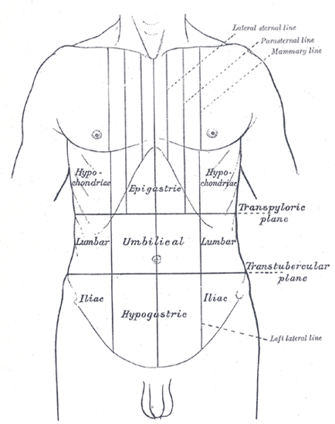
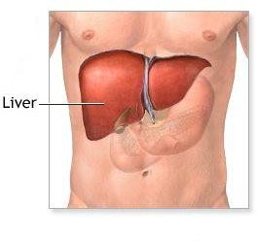

Slide 3
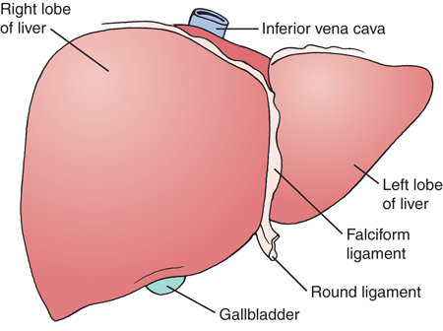
Jordan University of Science and Technology
Faculty of Nursing

Slide 4
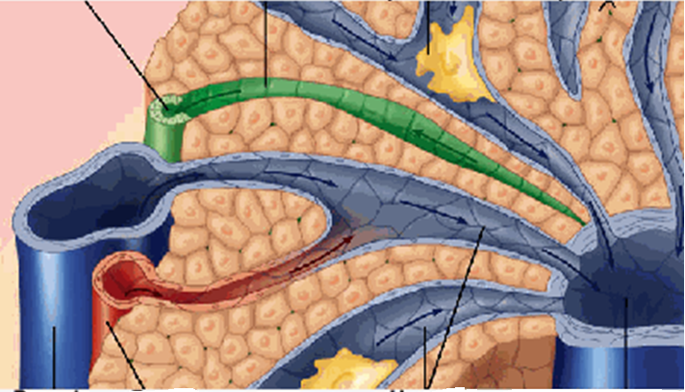

Slide 5
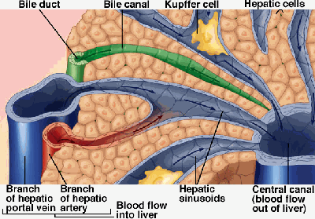

Slide 6
Functions of the Liver:
Glucose Metabolism and regulation of blood glucose concentration.
Ammonia conversion to urea that can be excreted in the urea.
Protein Metabolism: Synthesis almost all plasma proteins+ clotting factors.
Fat Metabolism: Breakdown of fatty acids for the production of energy and Ketone bodies
Vitamin and Iron Storage: A, B12 and D And several of the B-Complex.
Drug Metabolism
Bile formation: Composed mainly from water, lecithin, and electrolytes and contain some fatty acids, chol., bilirubin and bile salts.
Bilirubin Excretion

Slide 7
Gerontologic consideration
Decreases in size and weight
Reduced drug metabolism
Increase risk of GB stone
Higher risk of biliary tract diseases

Slide 8
Assessment

Slide 9
Health History:
Present or previous exposure or ingestion of hepatotoxic
agents, drugs
Family history or history of cirrhosis, hepatitis, cancer
History of blood transfusions, injection, dental treatment, hemodialysis
Hepatic vein thrombosis
Dietary intake
Duration and onset of present symptoms

Slide 10
Physical Examination
Skin Inspection
Pallor, Jaundice: Skin, Mucosa, and Sclera
Muscle atrophy, Edema, Skin excoriation from scratching (pruritis)
Petechia, Echomosis, Spider angiomas, and palmar erythema.
Abdominal Assessment:
Dilated abdominal wall veins, Ascites, Abdominal dullness.
Palpation for liver tenderness, Size (Firm, sharp ridge with a smooth surface).
Cirrhosis of the liver: smooth, hard, shrunken, fibrotic
Acute Hepatitis: Soft edges and easily moves
Percussion of upper and lower borders.

Slide 11
Cognitive / neuro assessment
Recall, memory, abstract thinking

Slide 12
Diagnostic Evaluation:
Liver Function Tests
Liver Biopsy
Other Diagnostic Tests
- Ultrasonography: guide the biopsy
- Computed Tomography (CT): identify normal structure
- Magnatic Resonance Imaging: identify normal structure
- Laproscopy
- A radio-Isotop Liver scan (Liver size and hepatic flow)

Slide 13
Common Liver Function Tests (table 39-1 p1121)
70% damage to notice change
Serum Bilirubin Test (Direct, Total)
http://www.youtube.com/watch?v=bFdTgty0T0I
Serum Albumin Test
Prothrombin Time (PT) Test
Serum Alkaline Phosphatase Test: Elevation indicate an obstruction of bile flow, liver injury, or certain liver cancer
Serum Ammonia

Slide 14
Serum Aminotransferases (transaminases): Released from damaged liver cells
Alanin Transaminase (ALT) Test,: Released from damaged Liver cells. It is good indicator for the progress or worsening of the Liver
Aspartate Transaminase (AST): Released from damaged liver, heart, muscle, or brain cell
Gamma Glutamyl transpiptidase (GGT) and LDH:
Increase in biliary cholistasis

Slide 15
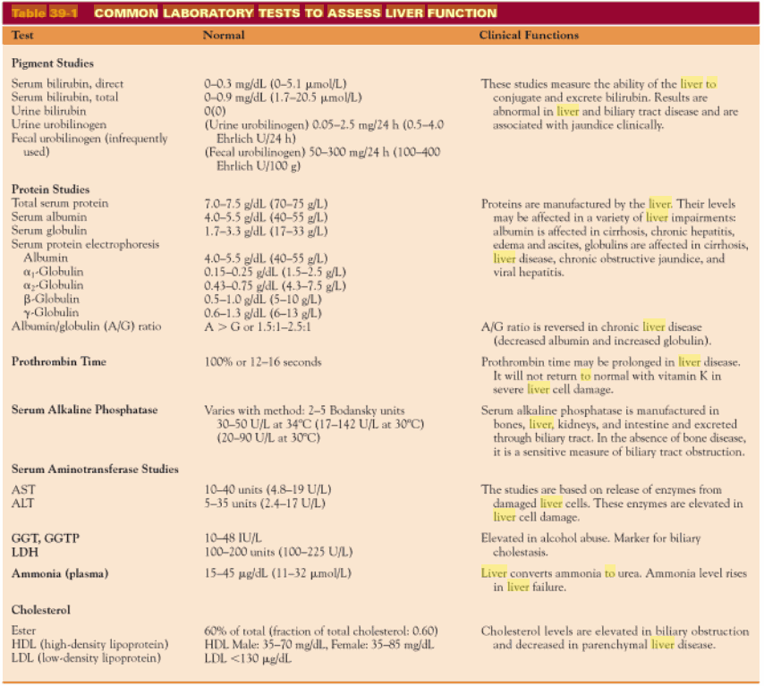

Slide 16
Liver Biopsy chart 39-2 p 1122
Needle Aspiration of liver tissue to examine liver cells ( An Invasive Procedure)
Out-patient procedure.
- Location 6th intercostal space, Mid Axillary Line
Preparation:
- Check PT, PTT, And platelet count, and check for compatible donor blood.
- Check for consent form.
- Vital signs
- Patient education is essential for preparation
- anesthesia: local

Slide 17
During Procedure Nursing Care:
- Position: Supine with RT arm above head.
- Expose the Rt side of the patient’s upper ` abdomen (Rt hypochondriac region)
- Instruct the patient to inhale and exhale several time then exhale and hold.
- physician may create incision before introducing the needle

Slide 18
Post-Procedure Nursing Care:
Turn the patient onto the Rt side, place the pillow under the costal margin for several hours ( Recumbent and immobile) for 1h, then on the back for 3h.
- Assess vital signs q 10-15 min for 1 hr
- observe puncture site for hemorrhage after test
- if the patient discharge ask him to avoid heavy lifting and strenuous activity for 1 week
- Major complications are liver injury, bleeding, and peritonitis, and Pneumothorax.
Page 39-2
Video:http://www.youtube.com/watch?v=ug3n7bvq2Wg&feature=related

Slide 19
Hepatic Dysfunction
Clinical Manifestations of Liver Dysfunction:
Jaundice: Increase concentration of Bilirubin
Portal Hypertension
Ascites
Nutritional deficiencies: Result from the inability of the liver cells to metabolize certain vitamins.
Hepatic Encephalopathy or coma: Due to accumulation of ammonia in the serum due to impaired protein metabolism.

Slide 20
Hepatic Disorders:
Jaundice:
Bilirubin is (more than 2.5 mg/dl).
Yellow- or green-tinged body tissues, sclera, and skin due to increased serum bilirubin levels

Slide 21
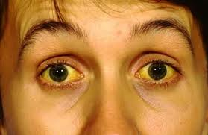

Slide 22
Types and causes:
Pre-hepatic (Hemolytic) Jaundice: Result of excess breakdown of RBC’s and liver is presented with more bilirubin than it’s capable of excretion
- Hemolytic transfusion reaction
- Hemolytic Disorders ( hereditary or acquired)
- Hemolytic disease of the newborn
- Autoimmune hemolytic anemia
- increase urine and stool urobilinogen (formed in intestines, by bacterial reabsorbed)
2. Intra-hepatic (Hepatocellular): Decreased bilirubin uptake by damaged liver cells
- Hepatitis
- Cirrhosis
- Cancer of the liver
Change in LFT

Slide 23
Cont……..
Post-hepatic ( Obstructive) Jaundice: due to occlusion of the bile ducts
- Gallstone ( cholelithiasis).
- Inflammatory process
- Tumor
- pressure from enlarged organ
4. Hereditary Hyperbilirubinemia: due to several inherited disorders.
- Gilbert’s syndrome
- Dubin-Johnson syndrome
Causes
Impaired Hepatic intake
Conjugation of bilirubin
Excretion of bilirubin into biliary system

Slide 24
Continue:
Hepatocellular and obstructive jaundice types are most associated with liver disease.
Signs and Symptoms Associated with Hepatocellular and Obstructive Jaundice
Hepatocellular
Patient may appear mildly or severely ill.
Lack of appetite, nausea, weight loss
Malaise, fatigue, weakness
Headache, chills, and fever if infectious in origin
Obstructive
Dark orange-brown urine and light clay-colored stools
Dyspepsia and intolerance of fats, impaired digestion
Pruritus

Slide 25
Clinical Manifestations
Yellow Sclera
Yellowish-orange Skin
Clay-colored feces
Tea-colored urine
Pruritis
Fatigue
Anorexia
Laboratory diagnostic tests: Increased serum bilirubin, alkaline phosphatase, cholesterol, serum bile salts, prolonged PT.

