Slide 1
Chapter 66 Assessment of Musculoskeletal Function

Slide 2
Functions of the Musculoskeletal System
Protection of vital organs
Mobility and movement
Facilitate return of blood to the heart
Production of blood cells (hematopoiesis)
Reservoir for immature blood cells
Reservoir for vital minerals

Slide 3
Structure
206 Bones in the body
Long bones
Short bones
Flat bones
Irregular bones
Joints
Muscles

Slide 4
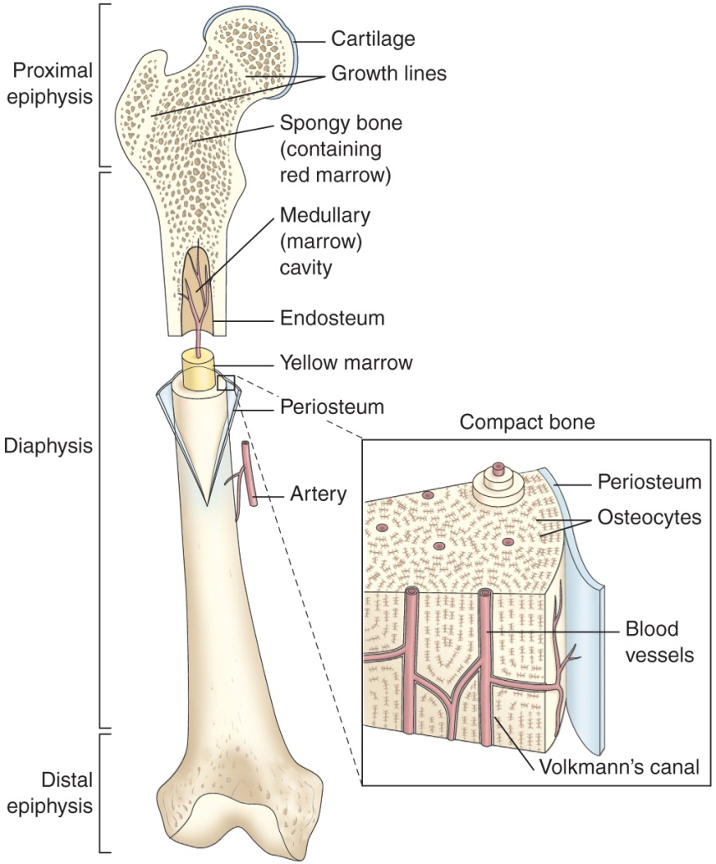
Structure of a Long Bone; Composition of Compact Bone

Slide 5
Joints (Articulation): Junction of Two or More Bones
Synartrosis: immovable joints
Amphiartrosis: allow limited movement
Diarthrosis: freely movable
Ball and socket
Hinge
Saddle
Pivot
Gliding

Slide 6
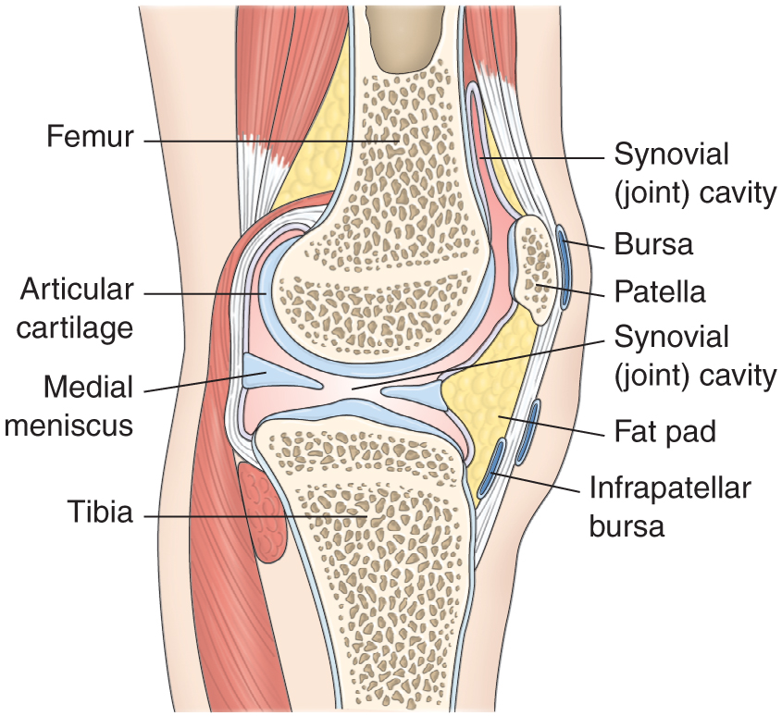
Hinge Joint of the Knee

Slide 7
Muscles
Attached to bones and other structures by tendons
Encased in a fibrous tissue—fascia
Contraction of muscle causes movement
Sarcomere—the contractile unit of skeletal muscle which contains actin and myosin
Muscle cell fibers react to electrical stimulation
Contraction utilizes energy in the form of ATP
Anaerobic pathways using glucose metabolized from stored glycogen provide energy for more strenuous muscle activity

Slide 8
Terms
Cancellous bone tissue
Cortical bone tissue
Diaphysis
Epiphysis
Cartilage
Periosteum
Endosteum
Joint capsule
Ligaments
Synovium
Bursa

Slide 9
Bone Cells
Osteoblasts
Function in bone formation
Osteocytes
Mature bone cells that function in bone maintenance
Located in the lacunae
Osteoclasts
Multinuclear cells function in destroying, resorbing, and remodeling bone
Located in Howship’s lacunae

Slide 10
Bone Formation and Maintenance
Osteogenesis: process of bone formation
Ossification: the process of formation of the bone matrix and deposition of minerals
Bone is in constant state of turnover
Regulating factors
Stress and weight-bearing
Vitamin D
Parathyroid hormone and calcitonin
Blood supply
Role of calcium

Slide 11
Bone Healing
Hematoma and inflammation
Angiogenesis and cartilage formation
Cartilage calcification
Cartilage removal
Bone formation
Remodeling

Slide 12
Assessment of the Musculoskeletal System
Include data related to function ability; ADLs, IADLS, and ability to perform various activities. Note any problems related to mobility.
Health history: family history, general health maintenance, nutrition, occupation, learning needs, socioeconomic factors, and medications—include OTC
Assessment of pain and altered sensations
Physical assessment: posture, gait, bone integrity, joint function, muscle strength and size, skin, neurovascular status

Slide 13
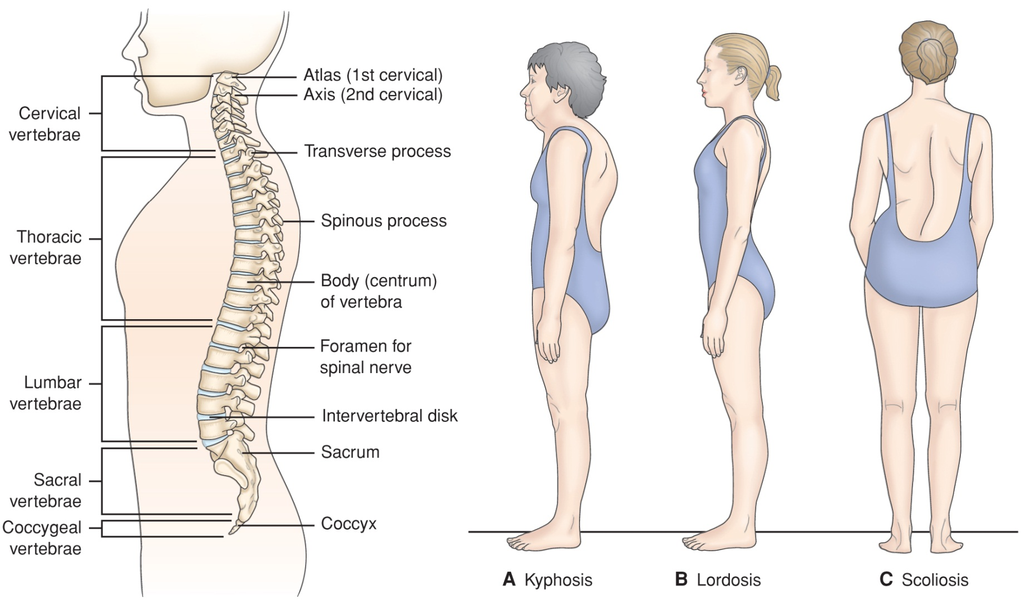
Normal Spine and 3 Abnormalities

Slide 14
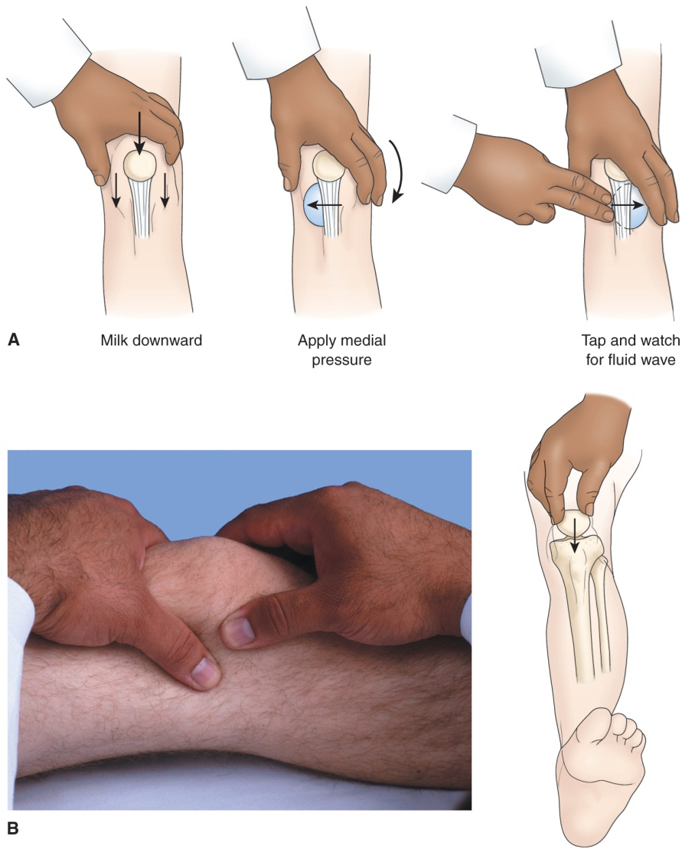
Detecting Fluid in the Knee

Slide 15
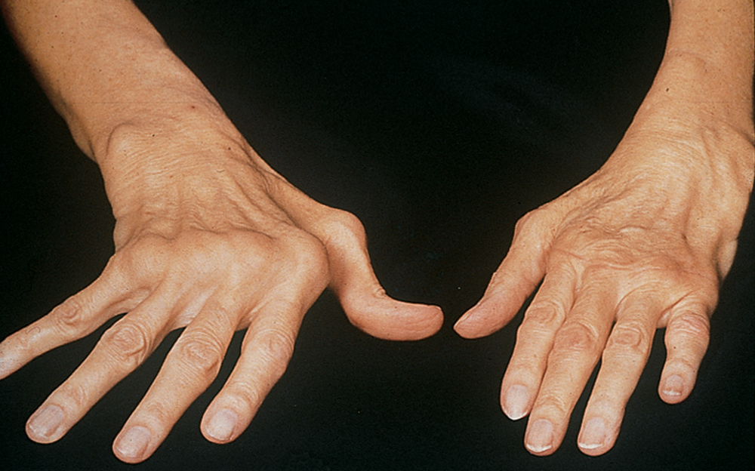
Rheumatoid Arthritis—Ulnar Deviation and “Swan-Neck” Deformity

Slide 16
Diagnostic Evaluation
X-rays
Computed tomography
MRI
Arthrography
Bone densitometry
Bone scan
Arthroscopy
Arthrocentesis
Electromyography
Biopsy
Laboratory studies

