Slide 1
Chapter 40 Assessment and Management of Patients With Biliary Disorders

Slide 2
Question
Is the following statement True or False?
Bile is stored in the gallbladder.

Slide 3
Review of Anatomy and Physiology
Gallbladder
Pancreas
Insulin
Glucagon
Somatostatin

Slide 4
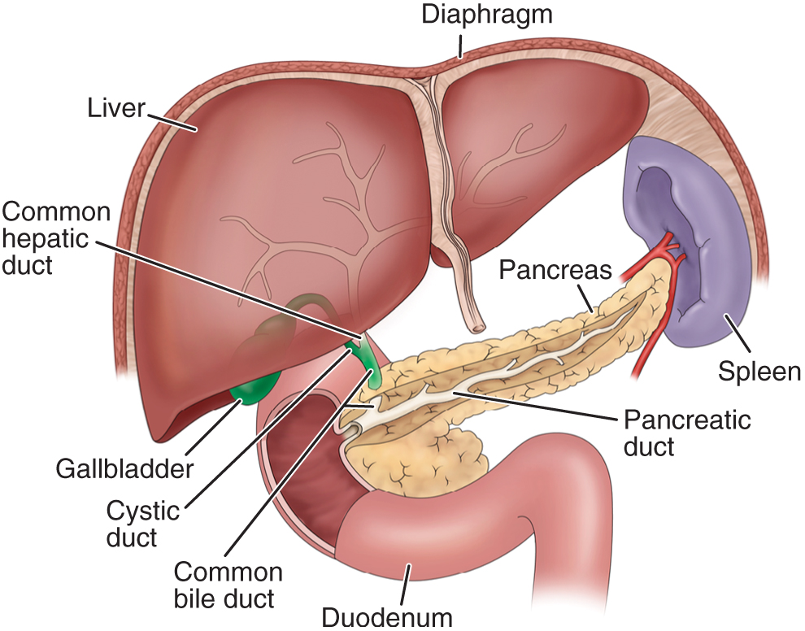
Liver, Biliary System, and Pancreas

Slide 5
Cholelithiasis
Pathophysiology
Pigment stones precipitating of unconjugated pigment in the bile to form stones represent one third of cases. Causes cirrhosis, hemolysis and infection of the biliary tree
Cholesterol stones: Cholesterol is insoluble in water, solubility depend on bile acid and lecithin (phospholipid) in bile. Decreased bile acid and increase cholesterol synthesis in liver cause bile supersaturating with cholesterol which precipitate and form stone
Risk factors multi para, Frequent changes in Wt, Rapid Wt loss, oral contraceptive, estrogens, cystic fibrosis, DM, and increases with age due to more cholesterol synthesis and decreased bile acid synthesis

Slide 6
Cholelithiasis—Manifestations
May have no or minimal symptoms and may be acute or chronic.
Epigastric distress: fullness, abdominal distention, vague upper right quadrant pain. Distress may occur after eating a fatty meal.
Acute symptoms occur with obstruction and inflammation or infection: fever, palpable abdominal mass, severe right abdominal that radiates to the back or right shoulder, nausea and vomiting.
Biliary colic is episodes of severe pain usually associated with nausea and vomiting, which usually occur several hours after a heavy meal.
Jaundice may develop due to blockage of the common bile duct.

Slide 7
Question
Is the following statement True or False?
Cholecystitis is when a patient has calculi in the gallbladder.

Slide 8
Diagnostic Tests:
Abdominal X-ray
U/S
Radionuclide imaging: IV radioactive agent
Cholecystography: oral iodine contrast agent used 10-12 hrs before X-ray, NPO
Endoscopic retrograde cholengiopancretography (ERCP): Direct observation through fiberoptic scope inserted through esophagus into DU ( Discuss nursing implication).
Percutaneous transhepatic Cholengiography: inject the dye directly into the biliary tree.

Slide 9
Medical Management of Cholelithiasis
Cholecystectomy
Laparoscopic cholecystectomy
Dietary management
Medications: ursodeoxycholic acid and chenodeoxycholic acid
Nonsurgical removal
By instrumentation
Intracorporeal or extracorporeal lithotripsy

Slide 10
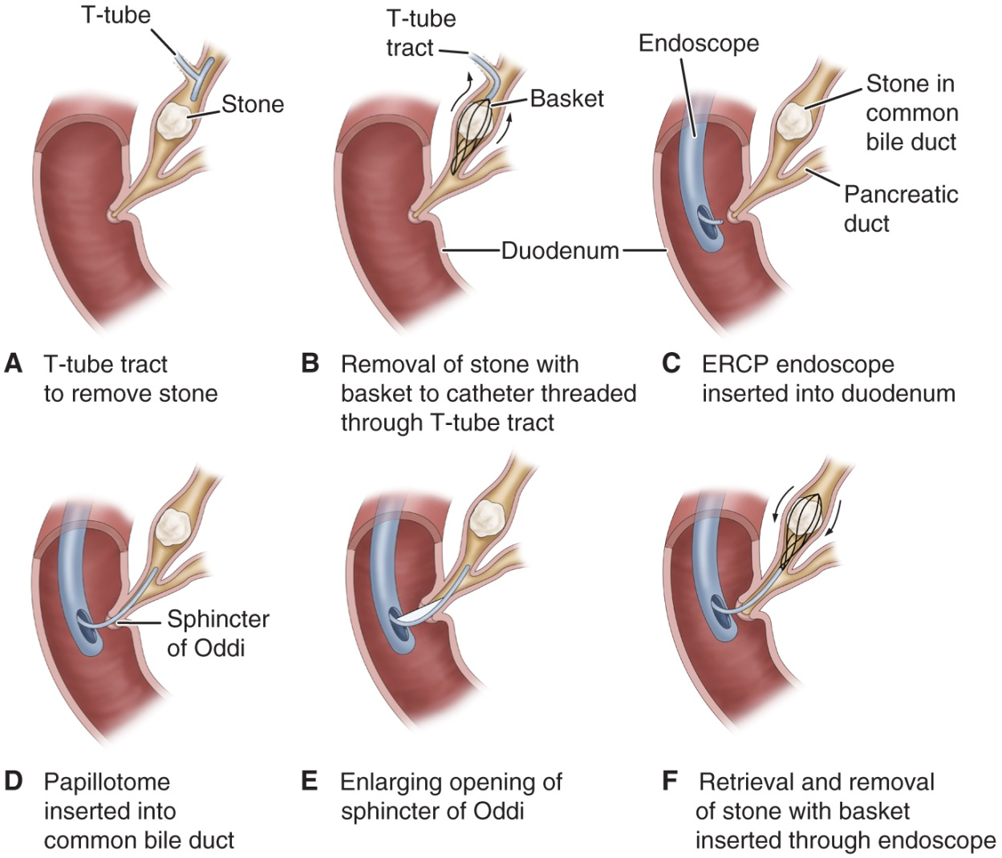
Nonsurgical Techniques for Removing Gallstones

Slide 11
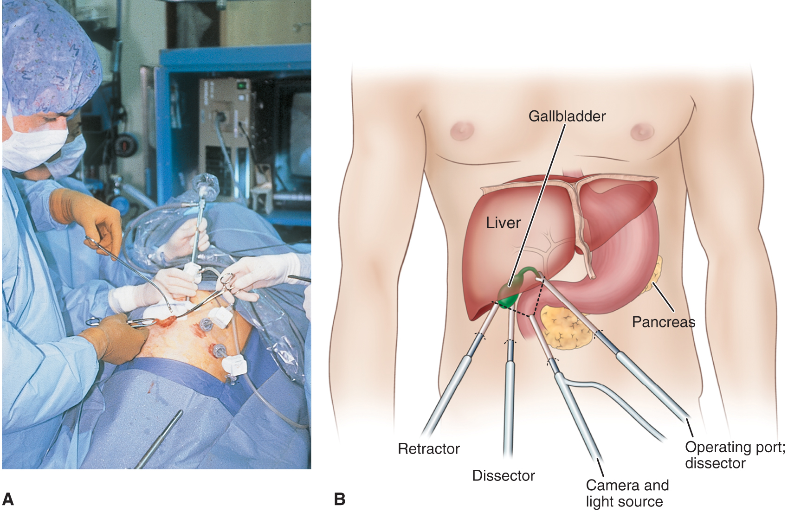
Laparoscopic Cholecystectomy

Slide 12
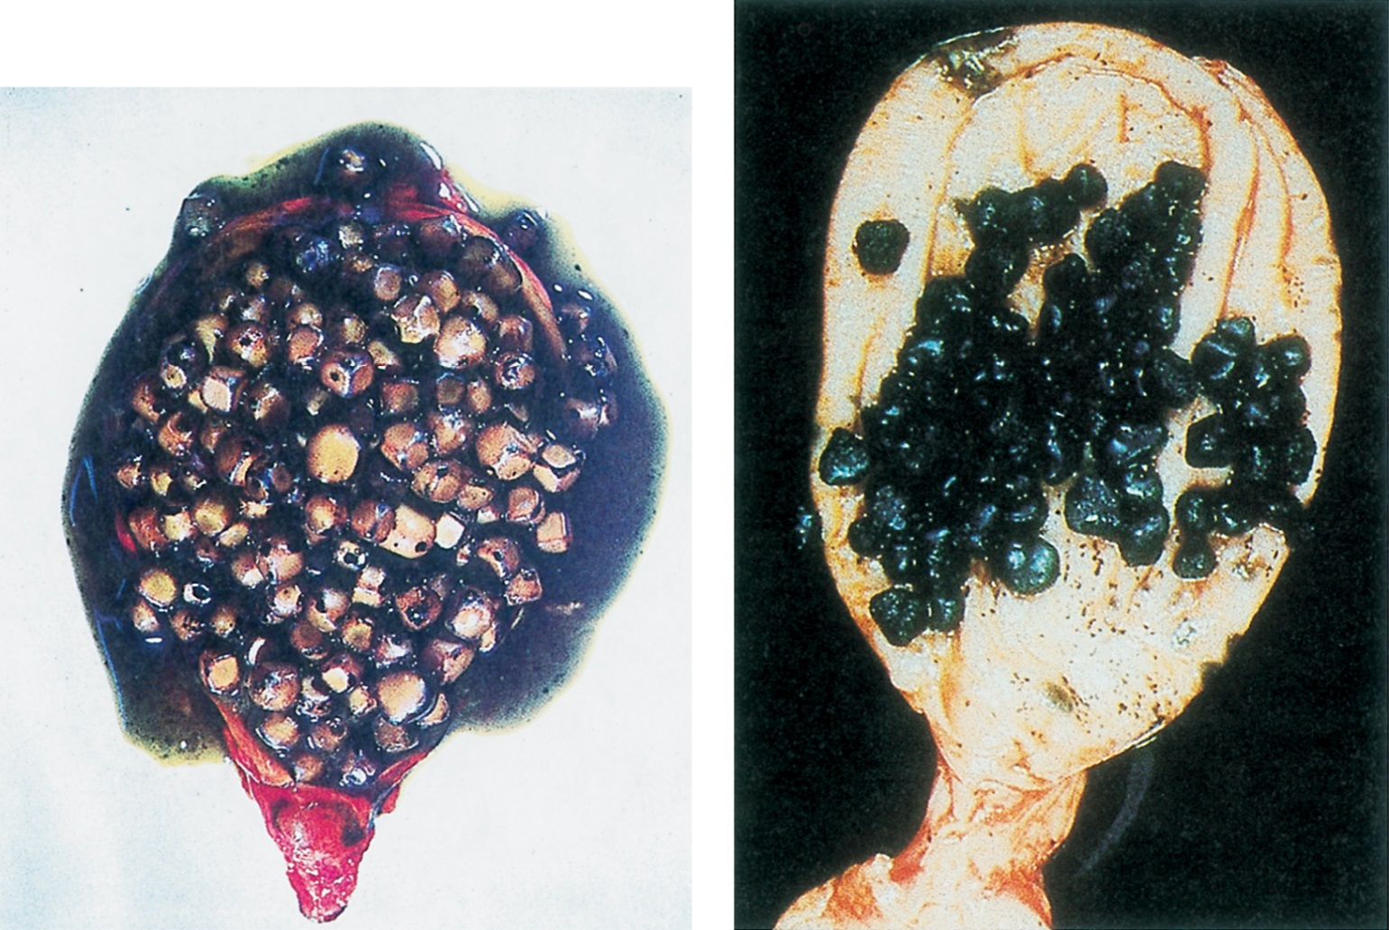
Cholesterol Gallstones and Pigment Gallstones

Slide 13
Nursing Process: The Care of the Patient Undergoing Surgery for Gallbladder Disease—Assessment
Patient history
Knowledge and teaching needs
Respiratory status and risk factors for respiratory complications postoperative
Nutritional status
Monitor for potential bleeding
Gastrointestinal symptoms: after laparoscopic surgery asses for loss of appetite, vomiting, pain, distention, fever—potential infection or disruption of GI tract

Slide 14
Nursing Process: The Care of the Patient Undergoing Surgery for Gallbladder Disease—Diagnoses
Acute pain
Impaired gas exchange
Impaired skin integrity
Imbalanced nutrition
Deficient knowledge

Slide 15
Collaborative Problems/Potential Complications
Bleeding
Gastrointestinal symptoms
Complications as related to surgery in general: atelectasis, thrombophlebitis

Slide 16
Nursing Process: The Care of the Patient Undergoing Surgery for Gallbladder Disease—Planning
Goals may include relief of pain, adequate ventilation, intact skin, improved biliary drainage, optimal nutritional intake, absence of complications, and understanding of self-care routines.

Slide 17
Postoperative Care Interventions
Low Fowler’s position
May have NG
NPO until bowel sounds return, then a soft, low-fat, high-carbohydrate diet postoperatively
Care of biliary drainage system
Administer analgesics as ordered and medicate to promote/permit ambulation and activities, including deep breathing
Turn, and encourage coughing and deep breathing, splinting to reduce pain
Ambulation

Slide 18
Patient Teaching—See Chart 40-3
Medications
Diet: at discharge, maintain a nutritious diet and avoid excess fat. Fat restriction is usually lifted in 4–6 weeks.
Instruct in wound care, dressing changes, care of T-tube
Activity
Instruct patient and family to report signs of gastrointestinal complications, changes in color of stool or urine, fever, unrelieved or increased pain, nausea, vomiting, and redness/edema/signs of infection at incision site

Slide 19
Pancreatitis
A severe disorder that can lead to death. Acute pancreatitis does not usually lead to chronic pancreatitis.
Acute pancreatitis: the pancreatic duct becomes obstructed and enzymes back up into the pancreatic duct, causing auto digestion and inflammation of the pancreas.
Chronic pancreatitis: a progressive inflammatory disorder with destruction of the pancreas. Cells are replaced by fibrous tissue, and pressure within the pancreas increases. Mechanical obstruction of the pancreatic and common bile ducts and destruction of the secreting cells of the pancreas occur.

Slide 20
Manifestations Acute Chronic
Severe abdominal pain
Patient appears acutely ill
Abdominal guarding
Nausea and vomiting
Fever, jaundice, confusion, and agitation may occur
Ecchymosis in the flank or umbilical area may occur
May develop respiratory distress, hypoxia, renal failure, hypovolemia, and shock
Recurrent attacks of severe upper abdominal and back pain accompanied by vomiting
Weight loss
Steatorrhea

Slide 21
Question
What is a major symptom of chronic pancreatitis?
Recurrent attacks of severe upper abdominal and back pain accompanied by vomiting
Fever, jaundice, confusion, and agitation
Ecchymosis in the flank or umbilical area
Abdominal guarding

Slide 22
Causes:
Biliary tract disease: Stones
Long term use of alcohol
Bacterial or viral infection
Blunt abd trauma, peptic ulcer, ischemic vascular disease
Hyperlipidemia, hypercalcemia
Use of corticosteriods, thiazide diuretics, and oralcontraceptivr
ERCP or surgeries near to pancreas.

Slide 23
Assessment and diagnostic findings
History of Abd pain
Serum amylase and Lipase
Increase WBC’s
X-Ray studies
Ultrasound
Abd CT-Scan
ERCP rarely used because patient is acutely ill.

Slide 24
Nursing Process: The Care of the Patient With Acute Pancreatitis—Assessment
Focus on abdominal pain and discomfort
Fluid and electrolyte status
Medications
Alcohol use
GI assessment and nutritional status
Respiratory status
Emotional and psychological status of patient and family; anxiety and coping

Slide 25
Nursing Process: The Care of the Patient With Acute Pancreatitis—Diagnoses
Acute pain
Ineffective breathing pattern
Imbalanced nutrition
Impaired skin integrity

Slide 26
Collaborative Problems/Potential Complications
Fluid and electrolyte disturbances
Necrosis of the pancreas
Shock
Multiple organ dysfunction syndrome
DIC

Slide 27
Nursing Process: The Care of the Patient With Acute Pancreatitis—Planning
Major goals include relief of pain and discomfort, improved respiratory function, improved nutritional status, maintenance of skin integrity, and absence of complications.

Slide 28
Relieving Pain and Discomfort
Use of analgesics
Nasogastric suction to relieve nausea and distention
Frequent oral care
Bed rest
Measures to promote comfort and relieve anxiety

Slide 29
Tumors of the Pancreas
Pancreatic cysts
Cancer of the pancreas
Risk factors
Sites of lesions
Medical treatment
Chemotherapy
Radiation (limited)
Surgery
Treatment may be palliative

Slide 30
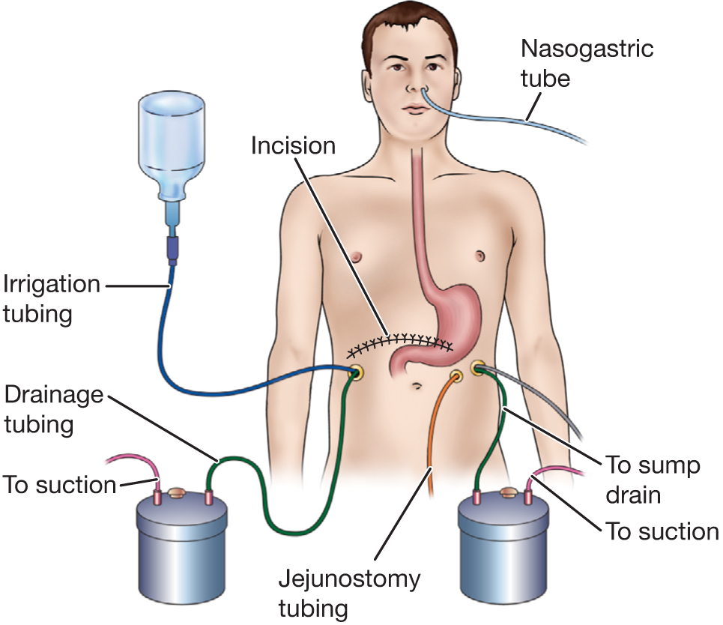
Multiple Sumps after Pancreatic Surgery

Slide 31
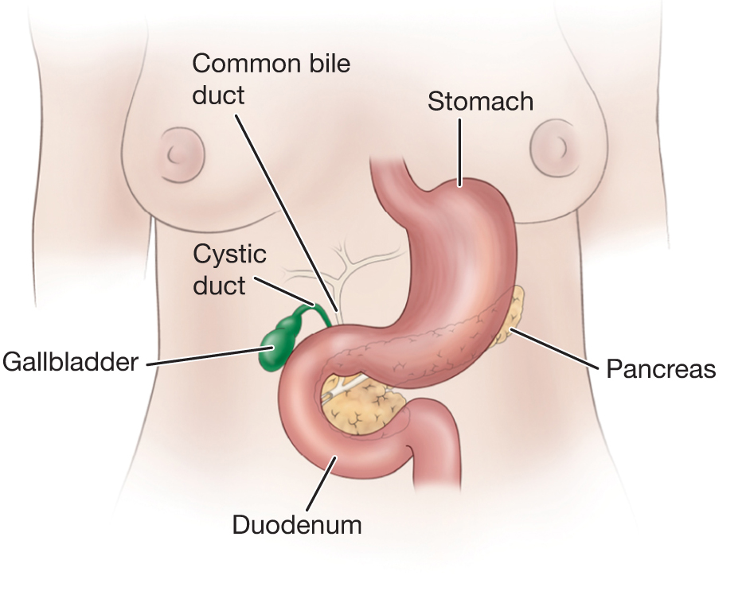
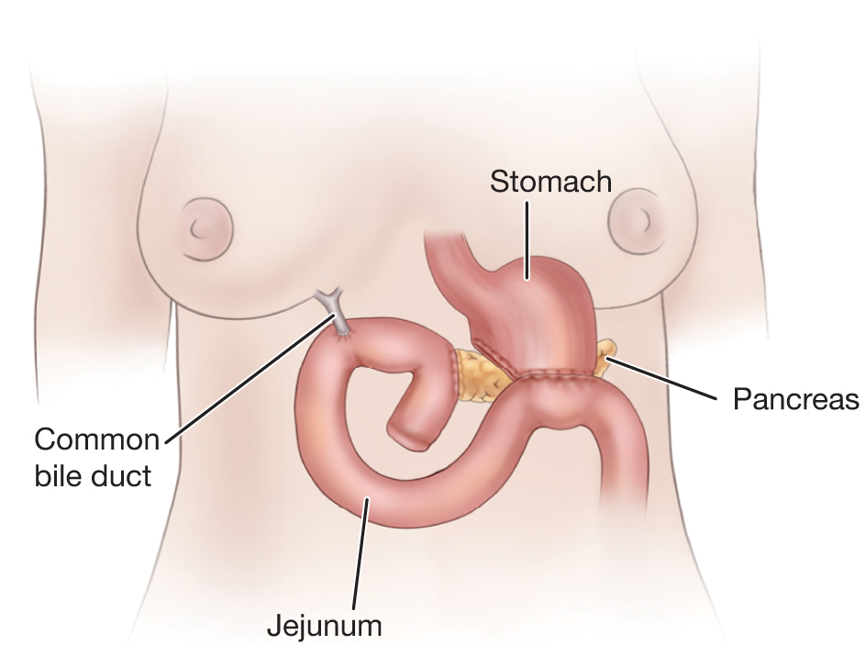
Pancreatoduodenectomy (Whipple’s Procedure)

