Slide 1
Chapter 9 The Breasts and Axillae

Slide 2
Structure and Function
Surface anatomy
Location of breasts on chest wall
Axillary tail of Spence
Nipple and areola
Internal anatomy
Glandular tissue
Lobes, lobules, and alveoli
Lactiferous ducts and sinuses
Fibrous tissue
Suspensory ligaments or Cooper’s ligaments
Adipose tissue
Four quadrants of the

Slide 3
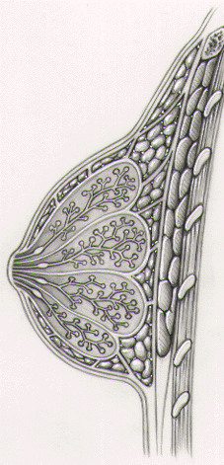
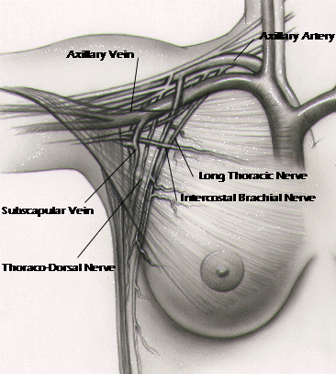
pectoralis major
serratus anterior

Slide 4
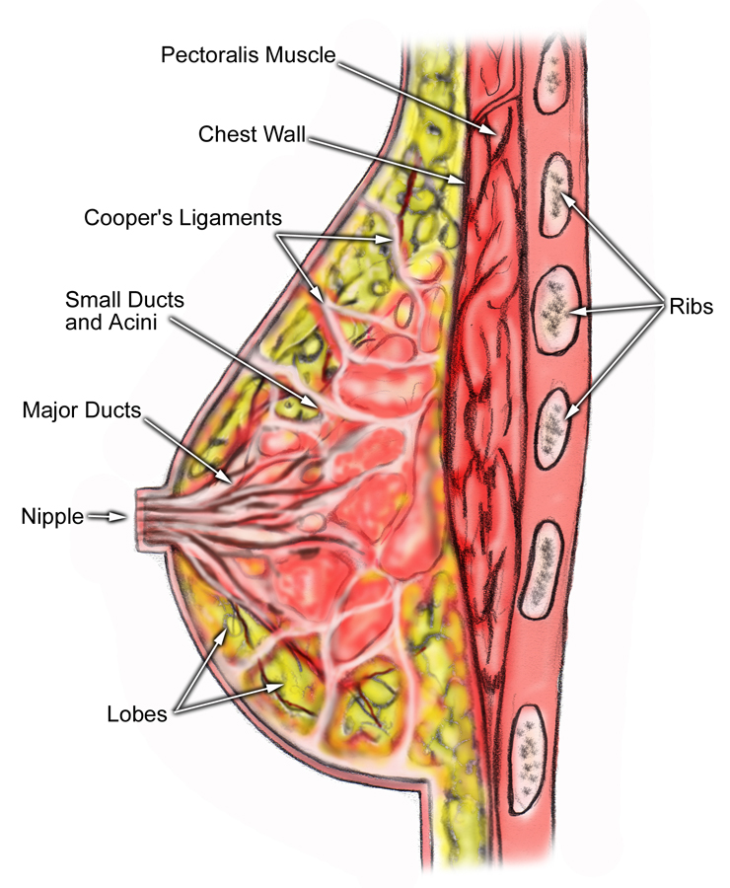

Slide 5
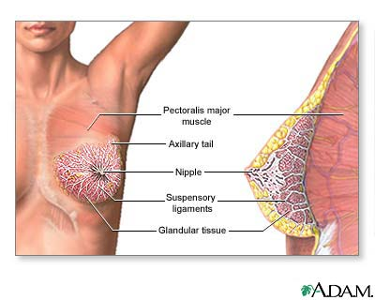

Slide 6
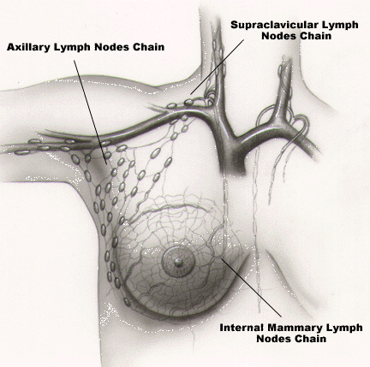
Structure and Function, cont.
Lymphatics
Axillary nodes
Central axillary nodes
Pectoral (anterior)
Subscapular (posterior)
Lateral
Drainage patterns

Slide 7
Anatomy and Physiology
To describe your findings divide the breast into four quadrants
Horizontal and vertical lines crossing the nipple
Remember that the axillary tail of breast tissue extends into the anterior axillary fold
As an alternative method, you can localize findings as the time on face of a clock and distance in centimeters from nipple

Slide 8
The Health History
Questions about a woman’s breasts may be included in the history or deferred to physical exam
Questions to ask:
Do you examine your breasts? How often?
Ask about discomfort, pain or lumps
Ask about discharge from the nipple and when it occurs
If she still has menstrual cycles, ask when during the cycle she examines her breast
5-7 days after onset of menses is ideal time

Slide 9
Health Promotion and Counseling
Discuss with your patient
Risk factors for breast cancer
Screening measures: Self breast exam, Clinical breast exam and mammography
Educate on how to do self breast exam
What to do if a lump/mass is detected

Slide 10
Health Promotion and Counseling
Palpable masses of the breast
Assessing risk of breast cancer
Female with age 65
2 or more 1st degree relatives with breast cancer
Late age of 1st pregnancy>30 yrs
Early menarche<12yr
Late menopause>55yr
No full terms pregnancies
Never breast fed a child
Recent oral contraceptive use
Obesity
Alcohol consumptions
Others; see page 396
Breast cancer screening
Perform breast self-examination
5 -7 days after the onset of menses
Perform clinical self-examination
Women 20 – 40 years Q3 yrs
Women >40 yearly
Last mammogram and result
Women 40 – 50 Q 1-2 yrs
Women>50 yearly

Slide 11
Techniques of Examination
Female Breast
Inspection
Palpation
Breast
Nipple
Male Breast
Axillae
Special Techniques

Slide 12
Objective Data— The Physical Exam
Preparation
Position
Draping
Equipment needed
Small pillow
Ruler marked in centimeters
Pamphlet or teaching aid for BSE

Slide 13
The Female Breast
Clinical breast examination enhances detection of breast cancers that mammography may miss and provides opportunity for the patient to demonstrate techniques for self-examination
Clinicians should try to adopt a standardized approach
Use a systematic and thorough search pattern
Use finger-pads
Vary palpation pressures
Use a circular motion

Slide 14
The Female Breast
Be aware that women and girls may feel apprehensive
Be reassuring
Use a courteous and gentle approach
Keep patient properly draped
Ask patient if she has noticed any lumps/other problems and if she performs monthly breast self-exam

Slide 15
Inspection
Inspect with patient in sitting position
Disrobed to the waist
Look for skin changes, symmetry, contours, retraction
Four views
Arms at sides
Arms over head
Arms pressed against hips
Leaning forward

Slide 16
Palpation
Patient should be supine
Palpate a rectangular area from clavicle to inframammary fold and midsternal line to posterior axillary line and into axilla for the tail of breast
Thorough examination takes 3 minutes/breast
Use finger-pads of 2nd, 3rd, 4th fingers
Use vertical strip pattern (best validated technique)
Palpate in small, concentric circles
Apply light, medium and deep pressure
Examine the entire breast, including periphery, tail and axilla

Slide 17
Palpation
Lateral portion of breast
Ask patient to roll onto opposite hip, hand on forehead with shoulder pressed against exam table
Flattens lateral breast tissue
Medial portion of breast
Ask patient to lie with shoulders flat against exam table, place hand at her neck and lift up elbow until even with shoulder

Slide 18
Palpation
Examine breast tissue for:
Consistency of tissues
Tenderness
Nodules
Location
Size
Shape
Consistency
Delimitation
Tenderness
Mobility

Slide 19
Nipple
Palpate each nipple
Note elasticity

Slide 20
Male Breast
Inspect nipple and areola for nodules, swelling, ulceration
Palpate areola and breast tissue for nodules
If breast is enlarged
Distinguish between soft, fatty enlargement of obesity and firm disc of glandular enlargement (gynecomastia)

Slide 21
Axillae
Have patient in a sitting position
Inspection
Rash
Infection
Unusual pigmentation

Slide 22
Axillae
Palpation
Left axilla: ask patient to relax with left arm down
Cup together fingers of your right hand
Reach as high as possible toward apex of axilla
Fingers should lie directly behind pectoral muscles, toward midclavicle
Press fingers toward chest wall and slide them downward
Try to feel central nodes against chest wall
One or more soft, small (<1cm), nontender nodes is normal

Slide 23
Axillae
If central nodes feel large, hard or tender or if there is suspicious lesion, feel for other groups of axillary nodes
Pectoral nodes
Lateral nodes
Subscapular nodes

Slide 24
Special Techniques
Assessment of spontaneous nipple discharge
Try to determine origin
Compress areola with index finger
Watch for discharge appearing through one of duct openings on nipple’s surface
Note color, consistency, quantity and exact location

Slide 25
Recording Your Findings
Initially you may want to use sentences
As you become more familiar with terms you can us phrases
“Breasts symmetric and without masses. Nipples without discharge.”
“Breasts pendulous with diffuse fibrocystic changes. Single firm 1 x 1 cm mass, mobile and nontender, with overlying peau d’orange appearance in right breast, upper outer quadrant at 11 o’clock”
Axillary adenopathy usually included after Neck section

Slide 26
Teach Breast Self-Examination
Schedule of self-exam
Describe correct technique
Return demonstration

Slide 27
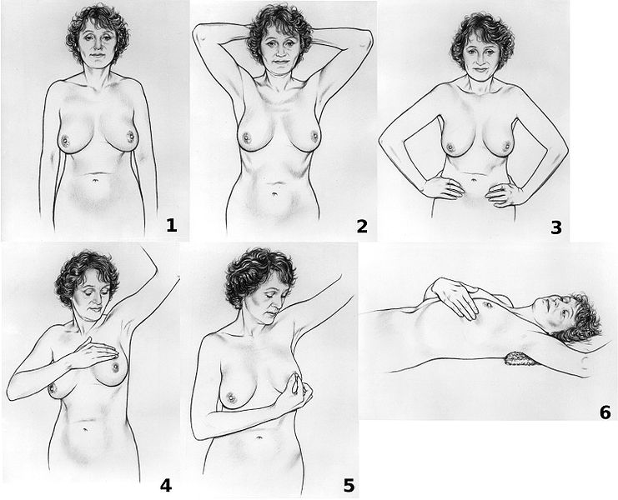

Slide 28
Abnormal Findings
Signs of retraction and inflammation
Dimpling
Edema (peau d’orange)
Nipple retraction
Fixation
Deviation in nipple pointing
Breast lump
Benign breast disease (formerly fibrocystic breast disease)
Cancer
Fibroadenoma

Slide 29
Common breast masses
 | Fibroadenoma | fibrocystic breast disease | cancer
Usual age | 15 - 25 | 30 - 50 | 30 -90, most common after 50
number | Usually single | Single or multiple | Usually single
shape | round | round | irregular
consistency | ? Soft, usually firm | Soft to firm, usually elastic | Firm or hard
delimination | Well delineated | Well delineated | Not clearly delineated from surrounding
mobility | Very mobile | mobile | ?fixed to skin or underlying tissue
tenderness | Usually nontender | Often tender | Usually nontender
Retraction signs | absent | absent | ? present

Slide 30
Abnormal Findings Abnormal Nipple Discharge
Mammary duct ectasia; sticky, purulent discharge, white, grey, brown, green or bloody, usually bilateral and from multiple ducts.
Carcinoma; spontaneous unilateral bloody discharge from 1 or 2 ducts
Intraductal papilloma; spontaneous serous discharge, unilateral, from single duct
Paget’s disease (intraductal carcinoma);early lesion has clear yellow discharge and dry, scaling crusts, friable at nipple apex, spread to areola with erythematous halo on areola and crusted eczematous, retracted nipple.

Slide 31
Abnormal Findings
Disorders during lactation
Plugged duct; one milk duct is clogged. Breast tender, may be reddened
Breast abscess; a pocket of pus accumulate in one local area ( generalized infection)
Mastitis; an inflammatory mass, usually in single quarter, area is tender, red, swollen, hot and hard.
Abnormalities in the male breast
Gynecomastia; rises from imbalance of estrogens and androgens, could be as a result of medication
Carcinoma; hard, irregular, ulcerating nodule.

Slide 32
Diagnostic Procedure Mammogram
Is a radiograph of the breast to detect the presence of tumors too small to be discovered at palpation.
It may include injection of a dye into the mammary ducts especially in identifying intraductal papillomas.
During procedure, pt stands or sits with breasts pushed against film holder.
It is a popular tool to detect early breast cancer & it should be performed as a regular medical examinations as follow:
a baseline mammogram should be done between the age of 35 -40
between the age 40 to 49 mammogram should be done every 1 to 2 years
after age of 50 a yearly mammogram is recommended.

Slide 33
