Slide 1
Nursing management of patients with burn

Slide 2
Classifications of burns depth of burn

Slide 3
Depth of burn

Slide 4
Assessment estimation of total body surface area

Slide 5
Electrical burns

Slide 6
Burn pathophysiology

Slide 7
Pathophysiology of burn

Slide 8
Pathophysiology changes in Initial burn-shock period

Slide 9
Pathophysiology cardiovascular alterations

Slide 10
Cardiovascular changes

Slide 11
Pathophysiology fluid and electrolyte alterations

Slide 13
Pulmonary alterations

Slide 14
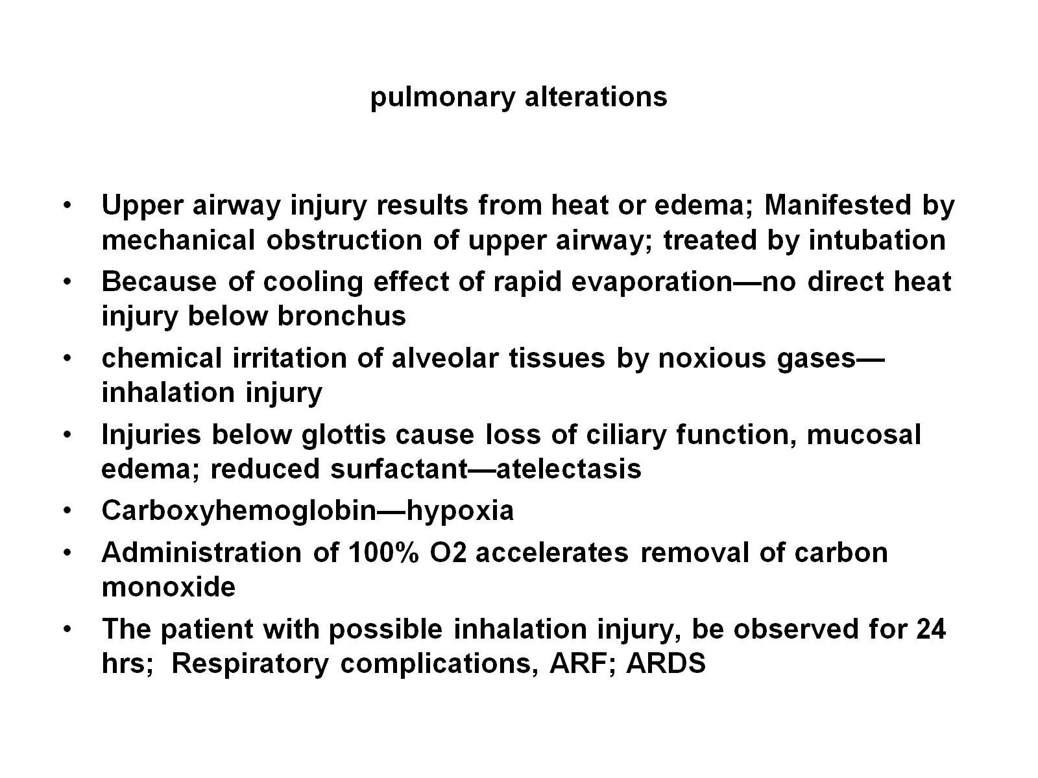
pulmonary alterations

Slide 15
Other alterations

Slide 16
Other alterations

Slide 17
Management of burn injury

Slide 18
Emergency Resuscitative Phase E/R, on the-scene care

Slide 19
Medical management in the ER

Slide 20
Medical mangment

Slide 21
Medical management in ER continues

Slide 22
Transfer to a burn center

Slide 23
Management of fluid loss and shock

Slide 24
Fluid resuscitation fluid requirements

Slide 25
Fluid resuscitation fluid requirements

Slide 26
Nursing management

Slide 27
acute/intermediate phase

Slide 28
Infection prevention

Slide 29
Infection prevention

Slide 30
Wound cleaning Hydrotherapy

Slide 31
Topical antibacterial therapy

Slide 32
Wound dressing

Slide 33
Wound dressing

Slide 34
Wound debridement

Slide 35
Wound grafting

Slide 36
Biologic dressing (homografts, heterografts)

Slide 37
Wound graft Biosynthetic and synthetic dressings

Slide 38
Autografts

Slide 39
Care of the graft site

Slide 40
Care of the donor site

