Slide 2
Cancer

Slide 3
Comparison of Benign and Malignant Neoplasms (see .16-1

Slide 4
Comparison of Benign and Malignant Neoplasms

Slide 5
Theories of Carcinogenesis

Slide 6
Theories of Carcinogenesis

Slide 7
Theories of Carcinogenesis

Slide 8
Theories of Carcinogenesis

Slide 9
Known Carcinogens and Risk Factors for Cancer

Slide 10
Known Carcinogens and Risk Factors for Cancer

Slide 11
Known Carcinogens and Risk Factors for Cancer

Slide 12
Characteristics of Malignant Cells

Slide 13
Physical and Psychological Effects of Cancer

Slide 14
Physical and Psychological Effects of Cancer

Slide 15
Laboratory and Diagnostic Tests for Cancer

Slide 16
Chemotherapy Roles and Chemotherapeutic Agents

Slide 17
Chemotherapy Roles and Chemotherapeutic Agents

Slide 18
Chemotherapy Roles and Chemotherapeutic Agents

Slide 19
Chemotherapy Roles and Chemotherapeutic Agents

Slide 20
Chemotherapy Roles and Chemotherapeutic Agents

Slide 21
Surgery, Radiation Therapy, & Biotherapy in Cancer Treatment

Slide 22
Surgery, Radiation Therapy, & Biotherapy in Cancer Treatment

Slide 23
Nursing Interventions for Common Oncologic Emergencies

Slide 24
Nursing Interventions for Common Oncologic Emergencies

Slide 25
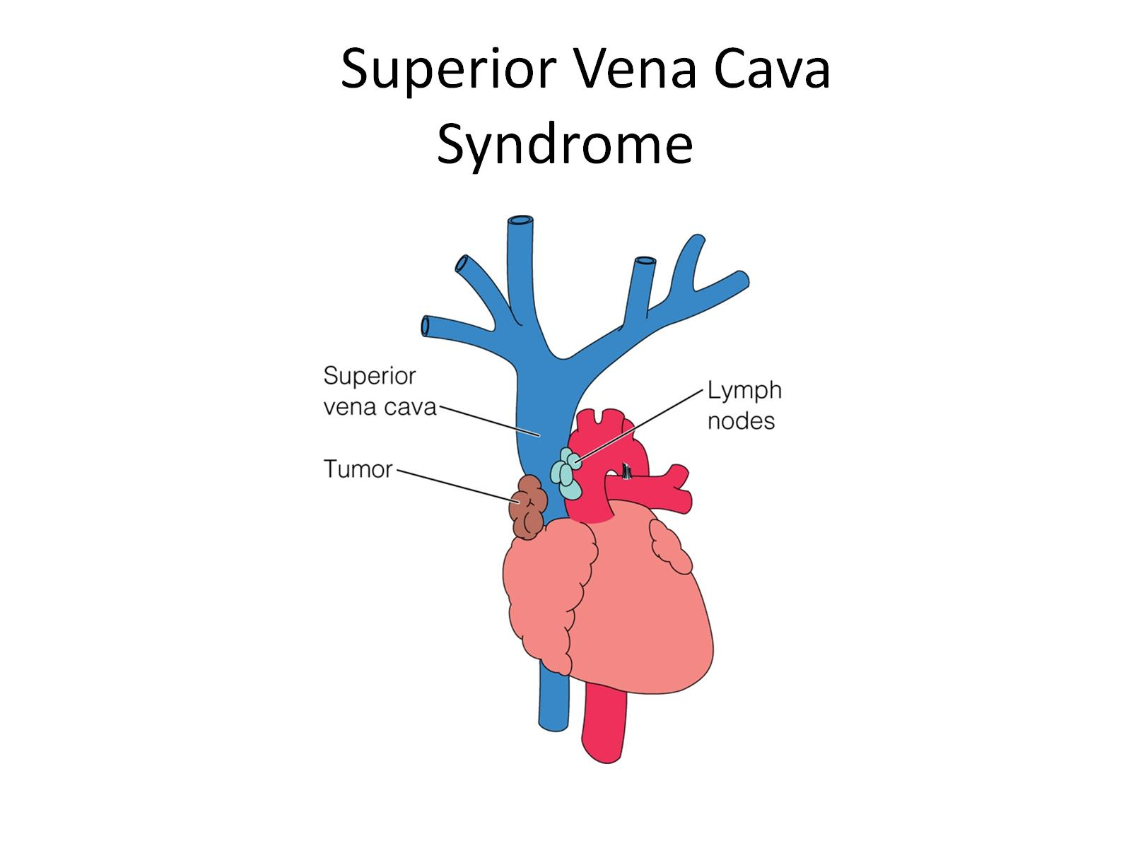
Superior Vena Cava Syndrome

Slide 26
Nursing Diagnoses and Interventions

Slide 27
Nursing Diagnoses and Interventions

Slide 28
Nursing Diagnoses and Interventions

Slide 29
Nursing Diagnoses and Interventions

Slide 30
Nursing Diagnoses and Interventions

Slide 31
Nursing Diagnoses and Interventions

Slide 32
Resources

Slide 33
Resources

Slide 34
Resources

