Slide 1


Cardiac Dysrrhythmias
NSG 409
Fall 2016-2017
Jordan University of Science & Technology
Faculty of Nursing

Slide 2
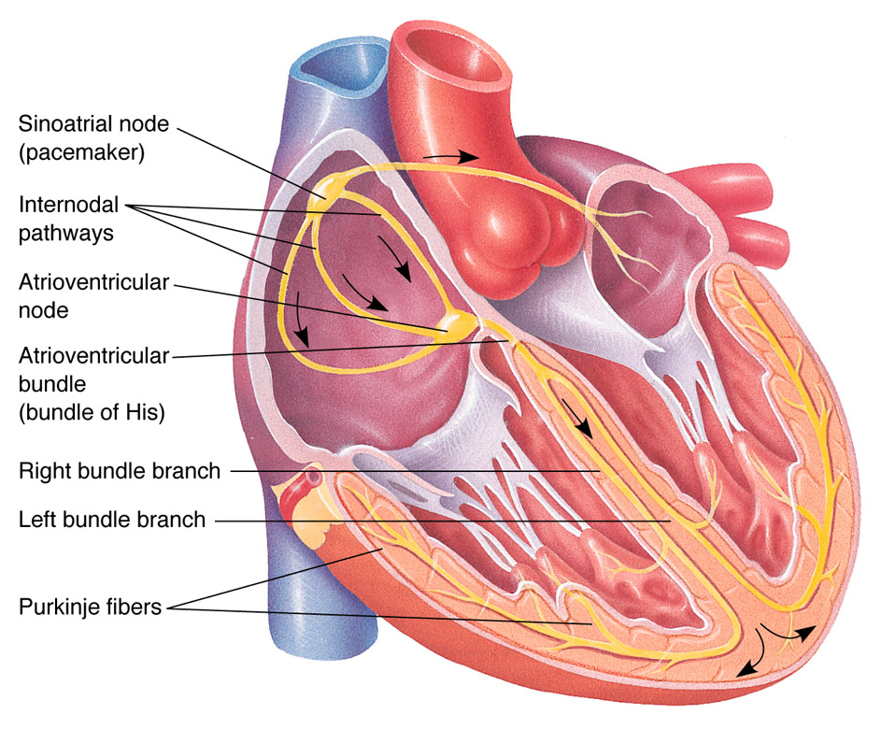
Conduction System in the Heart
SA Node
AV Node

Slide 3
Conduction Pathways
Sinus Node (60-100)
Bachmann’s Bundle
Intra-ventricular Pathway
A/V Junction (40-60)
Bundle of His
Purkinge Fibers (20-40)
Bundle Branches
Posterior
Anterior
Notes:
AV junction slows impulses – important if atria become irritable – AV junction screens impulses (fail-safe mechanism)
Fastest inherent rate will be pacemaker & override all other stimuli – determines what paces the heart
Normally – SA node
Other sites can become irritable & begin to discharge impulses & override SA node
Escape – if SA node drops below its inherent rate, the site with next highest inherent rate takes over (AV node).

Slide 4
Conduction Pathways
Notes:
AV junction slows impulses – important if atria become irritable – AV junction screens impulses (fail-safe mechanism)
Fastest inherent rate will be pacemaker & override all other stimuli – determines what paces the heart
Normally – SA node
Other sites can become irritable & begin to discharge impulses & override SA node
Escape – if SA node drops below its inherent rate, the site with next highest inherent rate takes over (AV node).

Slide 5
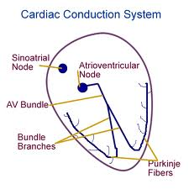

Slide 6
Conduction Pathways
SA 60 – 100
AV junction 40 – 60
Ventricles 20 – 40
Tachycardia > 100
Bradycardia < 60
Notes:
AV junction slows impulses – important if atria become irritable – AV junction screens impulses (fail-safe mechanism)
Fastest inherent rate will be pacemaker & override all other stimuli – determines what paces the heart
Normally – SA node
Other sites can become irritable & begin to discharge impulses & override SA node
Escape – if SA node drops below its inherent rate, the site with next highest inherent rate takes over (AV node).

Slide 7

Electrocardiogram (ECG)
ECG is a graphic recording of the heart’s electrical activity that precedes mechanical activity (contraction)
Electrical activity is detected and recorded through electrodes

Slide 8
ECG Leads
You can obtain many /(12) views of the heart activity by monitoring the voltage change through electrodes placed at various places on the body surfaces.
Three leads are bipolar:I, II, III
Three augmented: aVR, aVL, Avf
6 unipolar: V1, V2, V3, V4, V5, V6

Slide 9
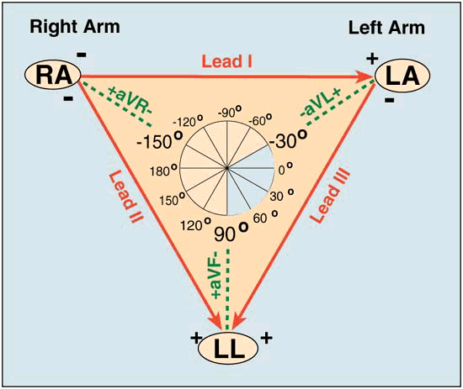
ECG
The 12-lead ECG provides spatial information about the heart's electrical activity in 3 approximately orthogonal directions:
  Bipolar – Unipolar lead
  Frontal – Horizontal plan
    Right ⇔ Left
    Superior ⇔ Inferior
    Anterior ⇔ Posterior

Slide 10
Standard 12-Lead ECG
Consist of
  6-Limb (Augmented) Leads (Frontal Plane) Include:
    3-Bipolar leads (I, II, III)
    3-Unipolar leads (aV_{R,} aV_{L}, aV_{F})
  6-Precordial (Chest or V) Leads (Horizontal Plane) Include:
    6-Unipolar Chest (V) Leads (V₁, V₂, V₃, V₄, V₅, V₆)

Slide 11
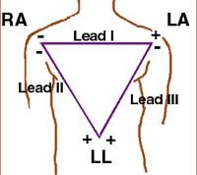
Einthoven's triangle: Three bipolar leads (I , II , III)

Slide 12
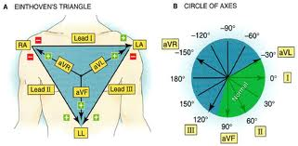

Slide 13
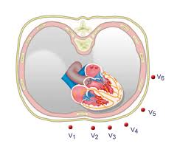
6 unibolar Leads: V1, V2, V3, V4, V5, V6

Slide 14
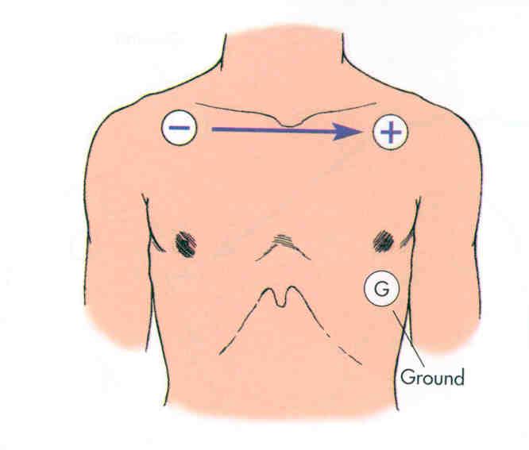
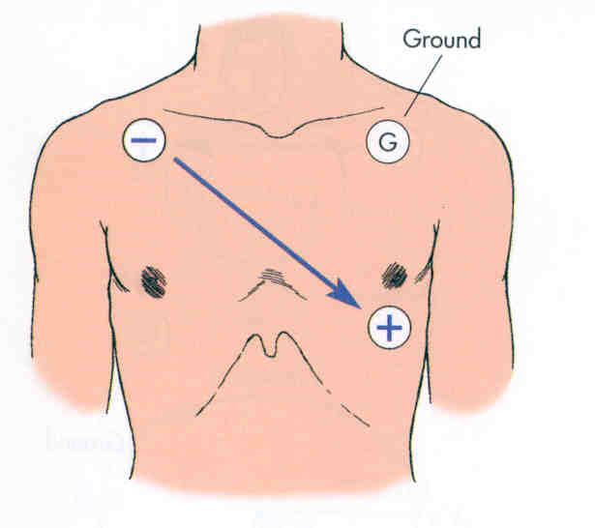
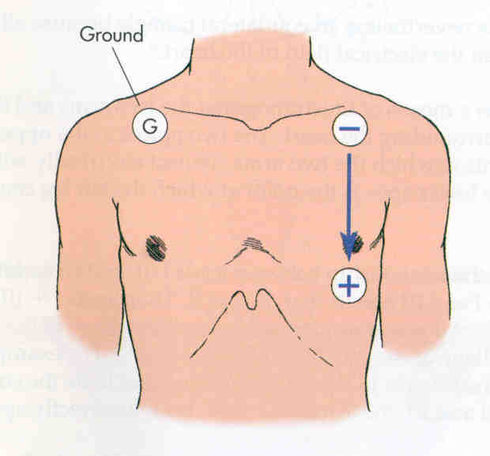
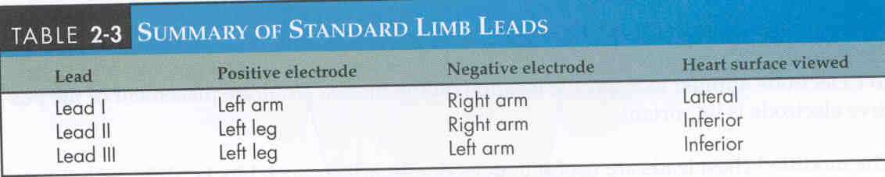
Bipolar Limb Leads -Frontal Plane
I
III
II

Slide 15
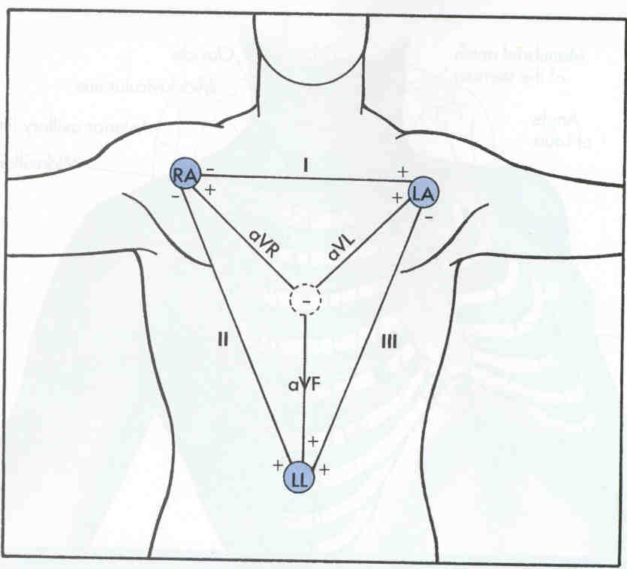
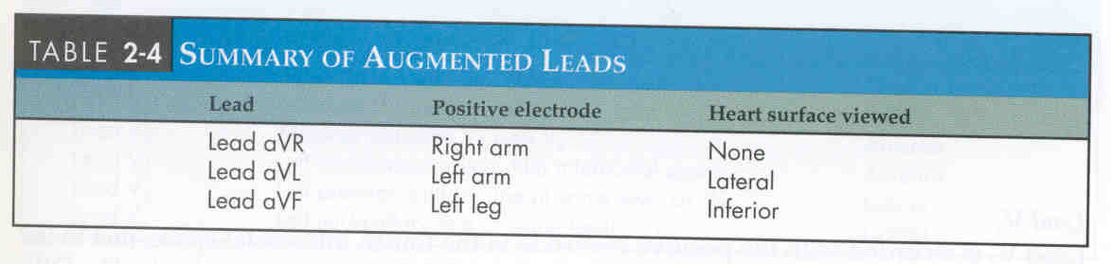
Unipolar Limb Leads – Frontal Plane

Slide 16
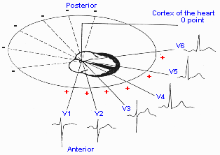
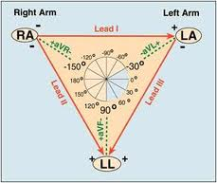

Slide 17
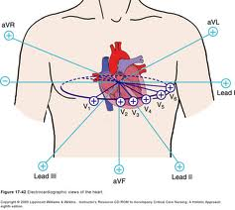

Slide 18
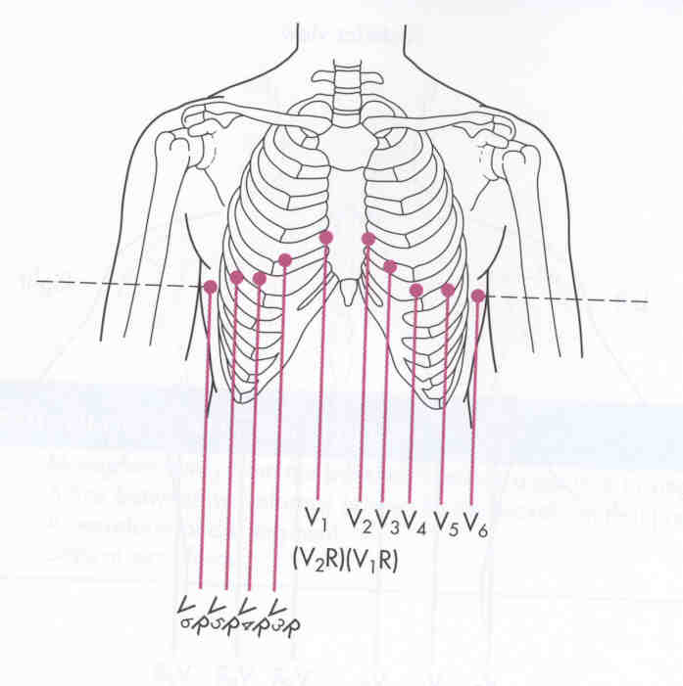
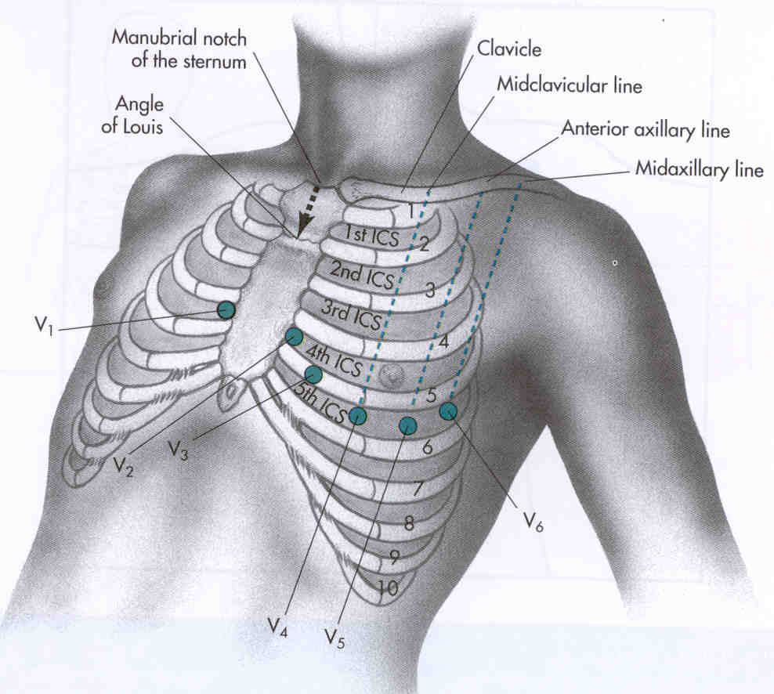
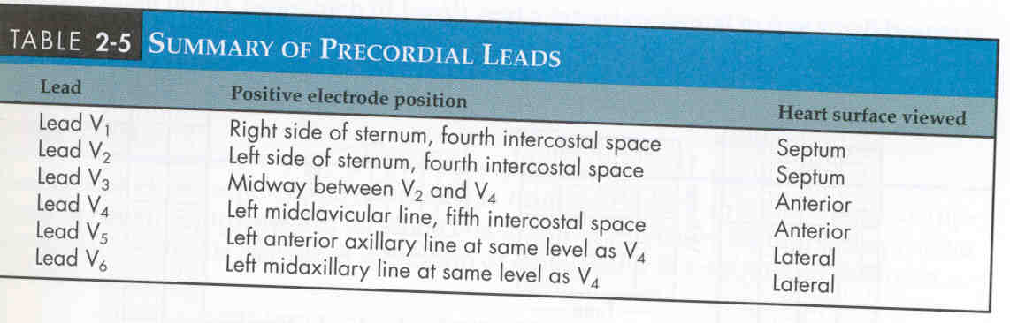
Unipolar Chest Leads – Horizontal Plane

Slide 19
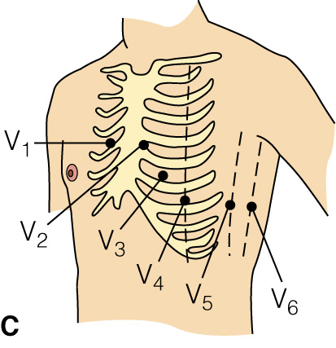
Chest Leads

Slide 20
Watch the following videos
http://www.medicine.mcgill.ca/physio/vlab/cardio/ECGbasics.htm
http://www.youtube.com/watch?v=zp198Wk54oM

Slide 21
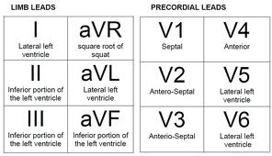

Slide 22
II, III, aVF: inferior
I, aVL,V5-V6: left Lateal
V1-V4: Anterioseptal
RIGHT SIDED V4-V6: Right Ventricle
PPOSTERIOR VIEW V7-V9: Posterior

Slide 23
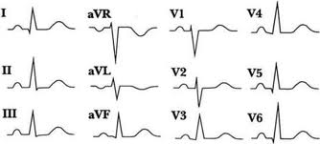

Slide 24
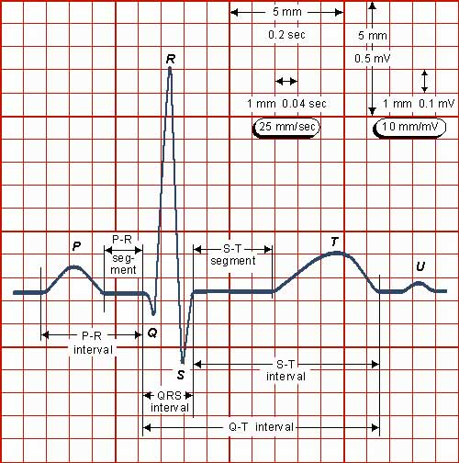
The ECG

Slide 25
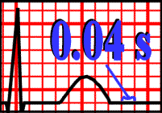
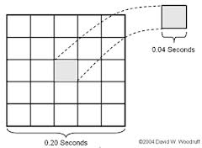
1 small box = 0.04 second
1 large box = 0.2 second

Slide 26
Electrocardiogram Tracing
ST segment > 1 mm significant
Isoelectric line
PR Interval Normal .12 - .20 secs
QRS Normal < .12 secs,
ECG pattern
  P-wave represents depolarization of the atria
  P-R interval represents the time it takes for the impulse to spread from the atria to the ventricles
  QRS complex represents depolarization of the ventricles
  T-wave represents repolarization of the ventricles
  ST segment indicates the completion of the ventricular depolarization and that repolarization is about to begin
  Q-T interval represents electrical systole
  U-wave: not normally present, sometimes follows the T wave, same direction as T wave. It may indicate hypokalemia
Notes:
QT interval varies with age, sex and heart rate
U-wave is small wave that sometimes follows the T wave. It may indicate hypovolemia

Slide 27
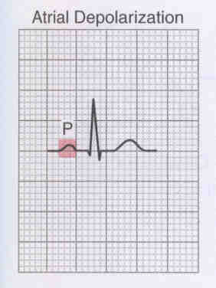
ECG Wave Forms
P wave
Represents the atrial depolarization.
0.1 sec in duration and less than 2.5 mM in height
< 0.12
Notes:
P = SA node, NSR – normal sinus rhythm; <.12 sec
Slight pause between the P wave and the QRS complex occurs at the atrioventricular node and gives the ventricles time to fill with blood before they contract
Problems with SA node or atria

Slide 28
P wave
P = SA node, NSR – normal sinus rhythm; <.12 sec
Slight pause between the P wave and the QRS complex occurs at the atrioventricular node and gives the ventricles time to fill with blood before they contract
It reflects Problems with SA node or atria

Slide 29
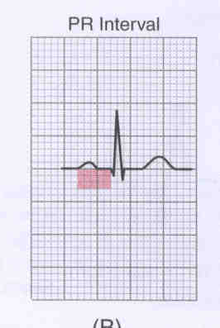
ECG Wave Forms
PR interval
0.12 – 0.20
Notes:
Represents atrial contraction & ventricular filling; .12-.20
An activity that causes both atria to contract and send blood to the ventricles
PR interval - .12 - .2 (3 – 5 small blocks)
PR interval – begins 1st sign of P wave & ends with 1st deflection of next wave (QRS)
Tissues of AV junction do not conduct impulses as fast as other cardiac electrical tissues. Therefore depolarization takes longer here. Allows time for atrial contraction & complete filling of ventricles.

Slide 30
PR
Represents atrial contraction & ventricular filling; .12-.20
An activity that causes both atria to contract and send blood to the ventricles
PR interval - .12 - .2 (3 – 5 small blocks)
PR interval – begins 1st sign of P wave & ends with 1st deflection of next wave (QRS)
Tissues of AV junction do not conduct impulses as fast as other cardiac electrical tissues. Therefore depolarization takes longer here. Allows time for atrial contraction & complete filling of ventricles.

Slide 31
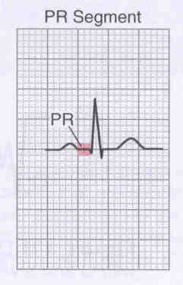
ECG Wave Forms
PR segment

Slide 32
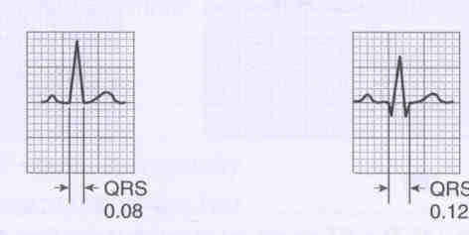
ECG Wave Forms
QRS Complex
0.04 - 0.12
12
1
Notes:
QRS – .04-.10; Represents ventricular depolarization) An electrical activity that causes both ventricles to contract and send blood out into the body
< .12 (3 small blocks)
Q = 1st deflection
R = 1st (+) after P
S = 2nd (-) after P or 1st (-) after R
QRS – could be inverted
Problems with ventricles

Slide 33
QRS
QRS – .04-.10; Represents ventricular depolarization) An electrical activity that causes both ventricles to contract and send blood out into the body
< .12 (3 small blocks)
Q = 1st deflection
R = 1st (+) after P
S = 2nd (-) after P or 1st (-) after R
QRS – could be inverted
Problems with ventricles

Slide 34
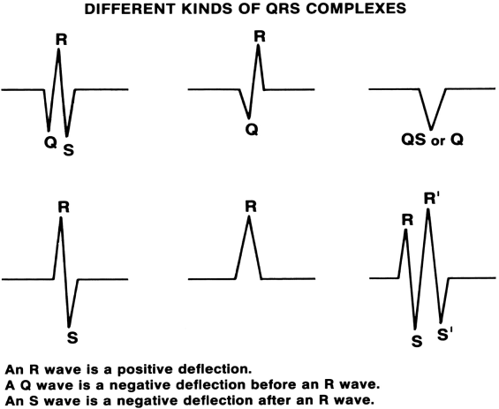

Slide 36
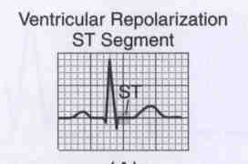
ECG Wave Forms
ST segment
Notes:
Represents the beginning of repolarization of the ventricles
St segment = isoelectric line between QRS & T (overhead)
ST segment changed
Elevated = MI (injury or evolving MI)
Inverted = digitalis effect, ischemia
Dig = dip
Hypokalemia

Slide 37
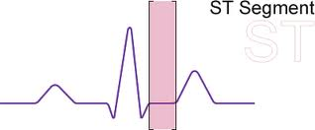
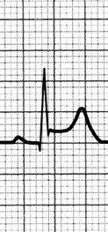
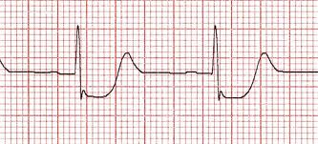
ST segment
Represents the beginning of repolarization of the ventricles
St segment = isoelectric line between QRS & T (overhead)
ST segment changed
  Elevated = MI (injury or evolving MI)
  Inverted = digitalis effect, ischemia
  Dig = dip
  Hypokalemia

Slide 38
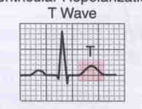
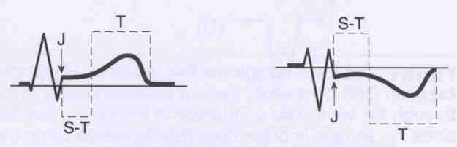
ECG Wave Forms
T wave
Represents (repolarization) the return of the excited muscle cells of the ventricles to their normal state
ST Segment
Notes:
T - represents (repolarization) the return of the excited muscle cells of the ventricles to their normal state

Slide 39
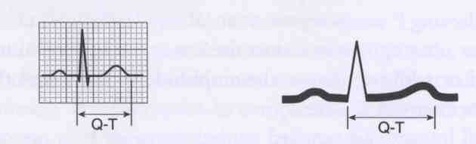
ECG Wave Forms
QT interval
0.32 - 0.42 sec
Notes:
QT = <.4 sec
Beginning of Q to the end of T

Slide 40
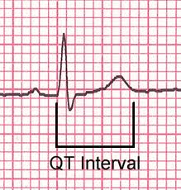
QT interval :
  0.33-(0.42 seconds for men and 0.43 seconds for women)
  From the beginning of V. depolarization to the end of ventricular repolarization. Measured from the beginning of the QRS complex to the end of T wave

Slide 41
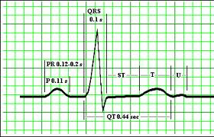
ECG Wave Forms
T wave: ventricular repolarization
U wave
origin for this wave is not clear - but probably represents "afterdepolarizations" in the ventricles. Its significant is uncertain, but its typically seen in hypokalemia.

Slide 42
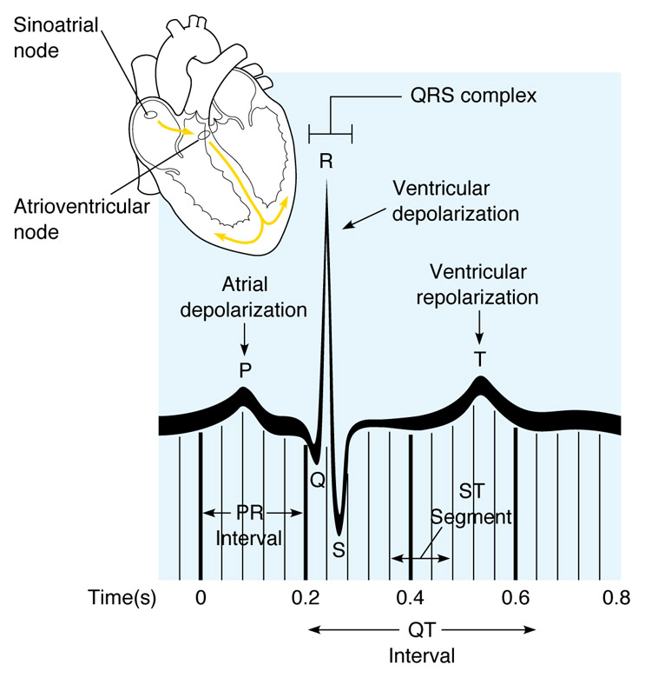
Normal Cardiac Cycle

Slide 43
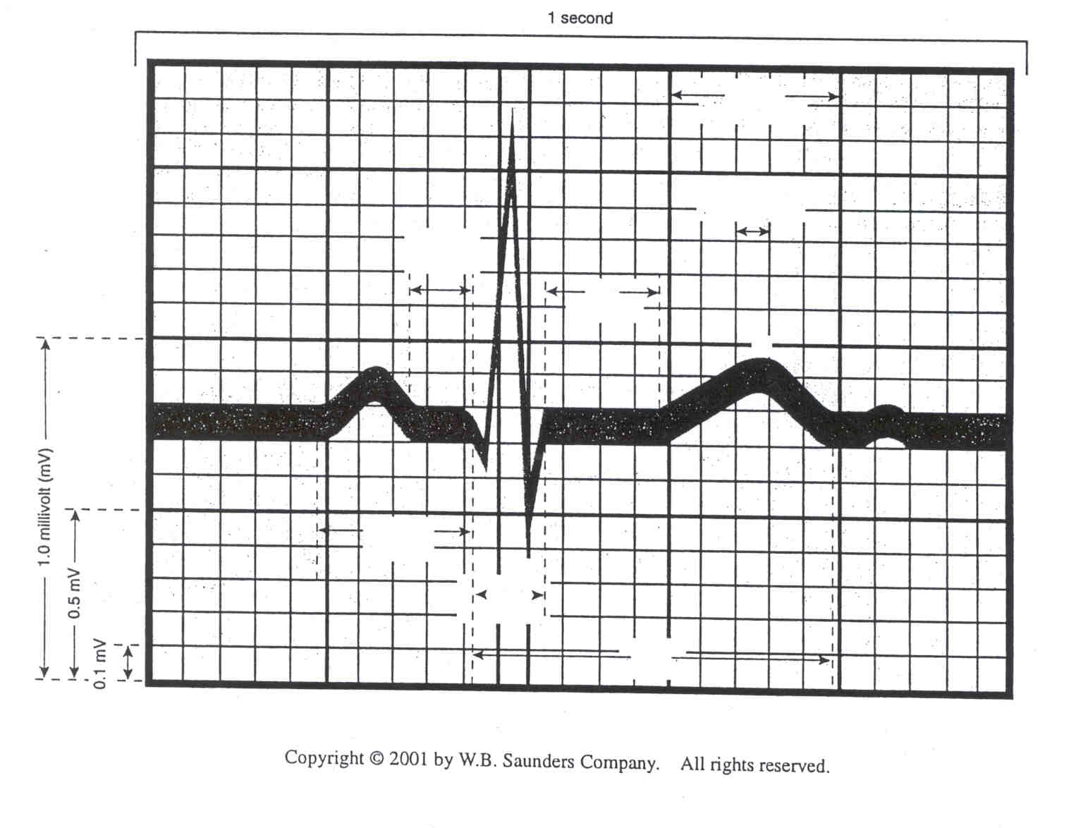
Normal Cardiac Cycle

Slide 44
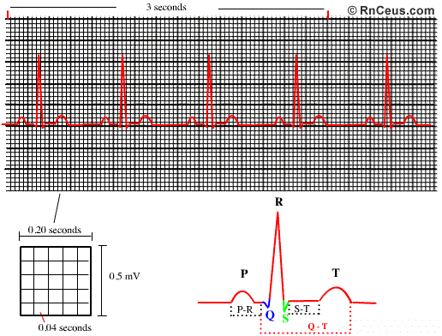
ECG Strip
Reflects the electrical activity in the heart
Small (0.05sec) & large (0.2sec) boxes
Slash marks

Slide 45
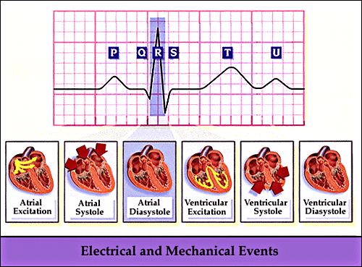
Electrical and Mechanical Events

Slide 46
ECG - Analysis
Use a consistent method to analyze an ECG strip:
  Rate
  Rhythm
  Assess P wave
  Assess P to QRS ratio
  Interval duration
  Identify abnormalities

Slide 47
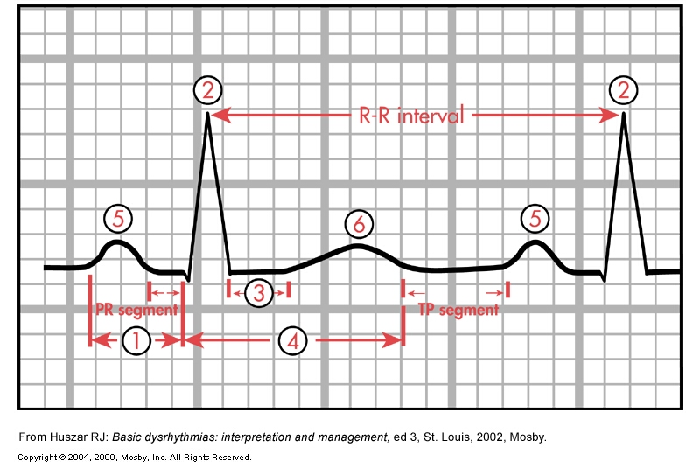
ECG – Rhythm Analysis
Fig. 35-9

Slide 48
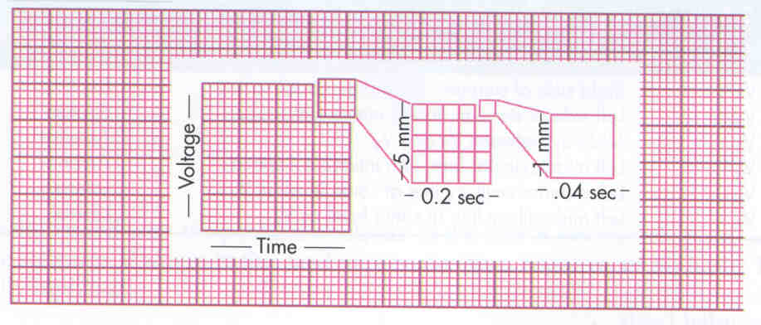
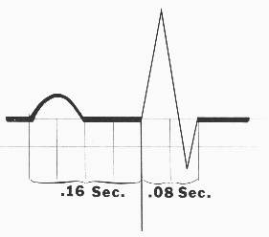
ECG Rate Measurement

Slide 49
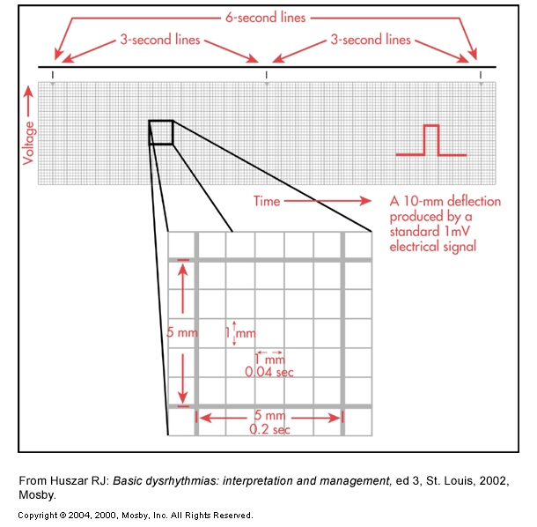
ECG Rate Measurement
Fig. 35-5

Slide 50
ECG Rate Measurement
Number of QRS complexes in 6 seconds (30 large boxes) multiplied by 10
Hr = # QRSs (in 6 seconds) x 10
Or 1500 divided by Number of small boxes between 2 consecutive complexes
Or 300 divided by Number of large boxes between 2 consecutive complexes

Slide 51
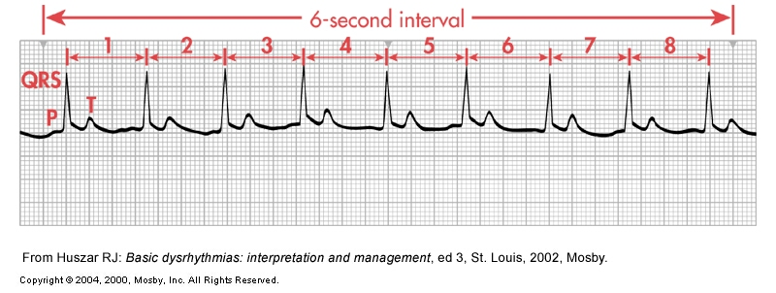
Assessment of Cardiac Rate

Slide 52
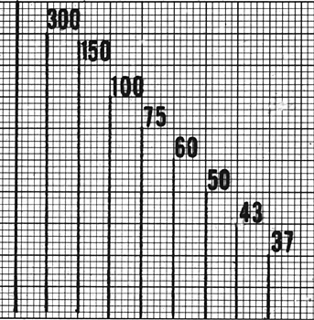
ECG Rate Measurement

Slide 53
Practice Calculate Rate

Slide 54
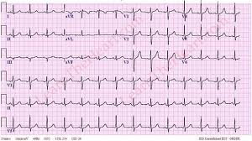

Slide 55
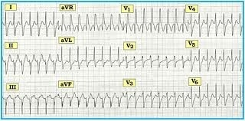
Its Time to practice

Slide 56

Its Time to practice

Slide 57

Cardiac Dysrrhythmias
HOW MUCH Do YOU KNOW!

Slide 58


Normal Sinus Rhythm
Rhythm- regular, P-P interval and R-R intervals may vary
Rate 60-100 bpm
P-waves -one P wave preceding each QRS complex
P-R interval-0.12-0.20
QRS-0.04-0.12 secs.
Q-T interval .32-.42 secs

Slide 59

Dysrrhythmias
Abnormal cardiac rhythms
Prompt assessment of abnormal cardiac rhythm and patient’s response is critical

Slide 60
Dysrrhythmias
Any deviation from the heart’s normal electrical rhythm is dysrhythmias.
The absence of cardiac electrical activity is Arrhythmias
Refers to any disturbance in the :
  rate,
  regularity
  site of origin
  conduction of cardiac electrical imbalance

Slide 61
Dysrrhythmias
Altered impulse formation (AUTOMACITY):
Tachydysrhythmia/Tachycardia. (Rapid HR).
Bradydysrhytmia/ Bradycaria (Slow HR).
Ectopic rhytms (Impulses originate outside normal conduction pathways).

Slide 62

Dysrrhythmias
Decreased Automaticity
Sinus Bradycardia

Slide 63



Increased/Abnormal Automaticity
Sinus tachycardia
Ectopic atrial tachycardia
Junctional tachycardia

Slide 64
Dysrrhythmias
Altered Conductivity:
Block in normal conduction pathway.
Varying degrees of heart block.
Bundle Branch Block.
Re-entry phenomenon (Impulse activates tissue, then returns to reactivate via different circuit):

Slide 65

Dysrrhythmias
Mechanism of Reentry:
Impulse activates tissue, then returns to reactivate via different circuit

Slide 66
Reentry Dysrrhythmias
AV nodal reentrant tachycardia (AVNRT)
AV reentrant tachycardia (AVRT)
Atrial flutter
Atrial fibrillation
Ventricular tachycardia

Slide 67

Dysrrhythmias

Slide 68
Dysrhythmias
Causes of Dysrhythmias :
  Myocardial ischemia
  Distension of the heart chambers
  Blood gas abnormalities
  Electrolyte imbalance
  Trauma to myocardium
  Drug effect and drug toxicity
  Hypothermia
  CNS damage
  Normal occurrence

Slide 69
Electrolyte abnormalities on the ECG
Hypokalemia: figure (17-47)
Flat or inverted T wave.
Prominent U wave.
Prolonged QT interval.
Depressed ST segment.
Ventricular dysrhythmias

Slide 70


Slide 71
Electrolyte Imbalance & ECG
Hyperkalemia:
Tall T wave “tented”.
Flattened P wave.
Decrease R wave amplitude.
PR interval is prologed
Widened QRS.
PVCs, VF to Asystole.

Slide 72


Slide 73
Electrolyte Imbalance & ECG
Hypocalcemia:
Prolonged ST segment.
Prolonged QT interval.
VT.
Hypercalcemia:
Shortening ST segment.
Shortening QT interval.
Ventricular dysrhythmias
Decrease impulse conduction. (Brady cardia, Heart-block).

Slide 74


Slide 75

Sinus Tachycardia
Rapid, regular rhythm
Rate of 100 to 180 bpm
Normal P-wave and QRS complex
Rx: Reduce myocardial demands

Slide 76


Slide 77

Sinus Tachycardia

Slide 78
Sinus Tachycardia
Clinical Associations
Associated with physiologic stressors
  Exercise
  Hypotension
  Hypovolemia
  Myocardial ischemia
  CHF

Slide 79
Sinus Tachycardia
Significance
Patients may have symptoms of dizziness and hypotension may occur
Increased myocardial oxygen consumption is associated with increased HR
Angina or increase in infarct size may accompany persistent tachycardia in patient with acute MI

Slide 80
Sinus Tachycardia
Treatment
Determined by underlying causes
  Sedation, O₂
  Digitalis & Diuretics if HF
  Propranolol if tachy caused by thyrotoxicosis
  β-adrenergic blockers to reduce HR and myocardial oxygen consumption

Slide 81

Sinus Bradycardia
SA node fires at a rate of <60 times per minute
Normal rhythm in aerobically trained athletes and during sleep.
Normal P-wave and QRS complex
Management:
  to correct underlying cause if symptomatic
  May need pacemaker
  atropine. Can cause ⬇ BP.

Slide 82

Sinus Bradycardia

Slide 83
Sinus Bradycardia
Fig. 35-11, A

Slide 84
Sinus Bradycardia
Clinical Association
Occurs in response to
  Carotid sinus massage
  Hypothermia
  Increased vagal tone
  Sever pain
  Sleep
  Drugs (Beta blockers, verapamil, diltiazem, digitalis)

Slide 85
Sinus Bradycardia
Clinical Association
Occurs in disease states
  Hypothyroidism
  Increased intracranial pressure
  Obstructive jaundice
  Inferior wall MI
  Spinal cord injury

Slide 86
Sinus Bradycardia
Significance
Hypotension with decreased CO may occur
An acute MI may predispose the heart to escape arrhythmias and premature beats
Treatment
Consists of atropine
Pacemaker may be required

Slide 87

What is this

Slide 88

Sinus Arrhythmia
Abnormal or in peds, normal
Rhythm: irregular, may vary with breathing
Dominant pacemaker: sinus
R to R, irregular, may vary with breathing
Rate: 60-100; increased with inspiration and decreased with expiration
PR .12-.20
QRS < .12
Tx: None - prehospital

Slide 89


Slide 90


Slide 91


Slide 92
Atrial Dysrhythmias
Premature Atrial contraction
Paroxysmal Supraventricular tachycardia
Atrial flutter
Atrial Fibrillation

Slide 93

Premature Atrial Contraction (PAC)
A premature atrial contraction (PAC) occurs when an ectopic atrial impulse discharges prematurely
While the sinoatrial node typically regulates the heartbeat during normal sinus rhythm, PACs occur when another region of the atria depolarizes before the sinoatrial node and thus triggers a premature heartbeat.

Slide 94

Premature Atrial Contraction (PAC)
Can occur at any rate
The rhythm is irregular because of the early beat but is regular at other times
All intervals can be within normal limits
There is a P for every QRS and a QRS for every P
The P waves all look the same except the P in front of the PAC will be different

Slide 95
Premature Atrial Contraction (PAC)
PACs may occur in healthy individuals as a result of various stimuli, such as emotions, tobacco, alcohol, and caffeine.
PACs also may be associated with rheumatic heart disease, ischemic heart disease, mitral stenosis, heart failure, hypokalemia, hypomagnesemia, medications, and hyperthyroidism.

Slide 96
PACs
Alternatively, PACs may be a precursor to an atrial tachycardia, atrial fibrillation, or atrial flutter, indicating an increasing atrial irritability.
No treatment is necessary in many cases. The patient should be monitored and frequency of premature beats documented. Assess and treat underlying condition

Slide 97
Paroxysmal Supraventricular Tachycardia (PSVT)
May be triggered by a premature heartbeat that repeatedly activates the heart at a fast rate.
Rapid atrial rhythm occurring at a rate of 150 to 250 beats/minute
Emotions , tobbacoo, alcohol intake, caffeine, rheumatic heart disease
Pts with no underlying heart disease often may experience only palpitation, lightheadedness, depending on the rate and duration !!
The rhythm is regular
QRS intervals can be within normal limits

Slide 98

Paroxysmal Supraventricular Tachycardia (PSVT)
There can be a P wave, but more likely it will be hidden in the T wave or the preceding QRS wave at a faster rate. P wave may be negative in lead II, III, aVF
Starts and stops abruptly.

Slide 99


Slide 100
Paroxysmal Supraventricular Tachycardia (PSVT)
It is almost always experienced as an uncomfortable palpitation.
This rhythm is often transient. It may last form few second to several hours or even days.
Treat with Vagal stimulation (carotid message or Valsalva maneuver or adenosine IV).
Cardioversion or overdrive pacing may be required.

Slide 101


Slide 102

Atrial Flutter
Usually significant
Rhythm: depends on ration
Dominant pacemaker: atrial pacemakers
R to R: variable
Rate: 250-350 b/m
PR: can’t determine
QRS < .12
250-350 bpm

Slide 103

Atrial Flutter
Atrial tachyarrhythmia identified by recurring, regular, sawtooth- shaped flutter waves
Associated with slower ventricular response
AV may allow every 2nd, 3rd, or 4th atrial stimuli to reach the ventricles resulting in 2:1, or 3:1, or 4:1 ratio flutter

Slide 104


Atrial Flutter

Slide 105
Atrial Flutter
Clinical Associations
Usually occurs with:
  CAD
  Mitral valve disorders
  Pulmonary embolus
  Chronic lung disease
  Cardiomyopathy

Slide 106
Atrial Flutter
Significance
High ventricular rates with atrial flutter can decrease CO and cause serious consequences such as heart failure
Risk for stroke because of risk of thrombus formation in the atria
  Coumadin used for atrial flutter > 72h

Slide 107
Atrial Flutter
Treatment
Primary goal is to slow ventricular response by increasing AV block
Electrical cardioversion may be used to convert atrial flutter to sinus rhythm in emergency situation
Diltiazem, digoxin, and β-adrenergic blockers used to control ventricular rate
Antiarrhythmic drugs used to convert atrial flutter to sinus rhythm or maintain sinus rhythm (Ca++ Blockers, Ibutilide, Amudarone).

Slide 108

Atrial Fibrillation
Usually significant – 25%  Cardiovascular output
Rhythm: Irregularly irregular
Dominant pacemaker: atrial escape
R to R: Irregularly irregular
Rate: variable 350-500 bpm
PR – fib waves can’t determine
QRS: < .12
350-500 bpm

Slide 109


Slide 110
Atrial Fibrillation
Total disorganization of atrial activity without effective atrial contraction
Chronic or intermittent

Slide 111
Atrial Fibrillation
Clinical Associations
Usually occurs with
  Underlying heart disease, such as rheumatic heart disease
  Pulmonary disease
  CHF
  Congenital heart disease
  Open heart surgery

Slide 112
Atrial Fibrillation
Clinical Associations
Often acutely caused by
  Thyrotoxicosis
  Alcohol intoxication
  Caffeine use
  Electrolyte disturbance
  Cardiac surgery

Slide 113
Atrial Fibrillation
Significance
Can often result in decrease in CO because of ineffective atrial contractions and rapid ventricular response
Thrombi may form in atria and may pass to brain, causing stroke
  Risk for stroke increases five-fold in atrial fibrillation
  Risk even higher in structural heart disease, HTN, and an age over 65
Anticoagulation with Coumadin used to prevent stroke

Slide 114
Atrial Fibrillation
Treatment: same as in Atrial Flutter.
Primary goal is to slow ventricular response by increasing AV block
Electrical cardioversion may be used to convert atrial flutter to sinus rhythm in emergency situation
Diltiazem, digoxin, and β-adrenergic blockers used to control ventricular rate
Antiarrhythmic drugs used to convert atrial flutter to sinus rhythm or maintain sinus rhythm (Ca++ Blockers, Ibutilide, Amudarone).
Ablation, Pacing, implanted cardioversion device (ICD) are other Rx options.

Slide 115


Slide 116


Slide 117
Junctional Rhythm
AKA nodal rhythm
The SA node fails to fire and the AV node becomes the pacemaker
  Slower rate
P wave:
  Inverted: retrograde conduction before the conduction thru ventricles
  Buried: retrograde conduction at the same time of ventricular conduction
  Inverted after the QRS: retrograde conduction after ventricular conduction
117

Slide 118


Slide 119


Slide 120
Ventricular Dysrhythmias

Slide 121



Premature Ventricular Contractions
PVC or escape beat?
Wide QRS, > .12
Single, coupled, trigeminy, quad?
Compensatory pause?
Contraction originating in ectopic focus of the ventricles
Premature occurrence of QRS complex
Multifocal, unifocal, ventricular bigeminy, ventricular trigeminy, couples, and triplets
Comp. pause

Slide 122
Number of PVCs per minute:
Single.
Coupled (2 PVCs in a row).
Triplet or salvo (3 PVCs in a row).
Bigeminy (PVC every other beat) (after each sinus beat.
Trigeminy (PVC every third), beat after 2 sinus beats.
Unifocal: arise from one site and appears in one form.
Multifocal: arise from different ectopic sites and appears in several forms.

Slide 123
PVCs - more
Tx depends on quantity, location, pt. Clinical presentation, underlying cause, and if post arrest.
T
“Wide and bizarre”
PVCs are warning signs, that something is wrong …..

Slide 124

Premature Ventricular Contractions

Slide 125
Sustained PVCs: PVCs last more than 30 second, lethal and lead to VT.
Non Sustained PVCs: PVCs last less than 30 second

Slide 126
PVCs Triggers:
FACTORS PROMOTING PVCs:
Hypoxia
Acidosis
Tobacco, Alcohol. Caffeine.
Electrolyte imbalance (Hypokalemia).
Coronary heart disease, heart failure &CAD.
Mechanical stimulation of heart (catheter insertion).
Excercise
Perfusion after thrombolytic therapy.
Post MI.
After surgery.
Anxiety.

Slide 127
Premature Ventricular Contractions
Clinical Associations
Stimulants
Hypokalemia
Exercise
MI, ischemia

Slide 128
Premature Ventricular Contractions
Significance
Usually a benign finding in patient with a normal heart
In heart disease, PVCs may reduce CO and precipitate angina and heart failure
  In ischemic heart disease or acute MI, represents ventricular irritability

Slide 129
Premature Ventricular Contractions
Treatment
Assessment of hemodynamic status is important to determine if drug therapy is indicated
  lidocaine or amiodarone (Drugs of choice)
  β-adrenergic blockers, procainamide,

Slide 130
Indication of myocardial irritability and increase risk for lethal dysrhythmiaa>
PVCs occurring within 4 hors of MI.
Frequent (> 6 / min).
Multifocal.
R on T phenomenon (together).

Slide 131
Premature Ventricular Contractions
Always Remember that PVCs are warning signs, that something is wrong …..

Slide 132


Ventricular Tachycardia
Always significant
Rhythm: regular
Dominant pacemaker: ventricular pacers
R to R: regular
Rate: >100
P wave not seen or not related to QRS
PR: none
QRS: > .12

Slide 133
Ventricular Tachycardia
Run of three or more PVCs occurs
Monomorphic, polymorphic, sustained, and nonsustained
Considered life-threatening because of decreased CO and the possibility of deterioration of ventricular tachycardia to ventricular fibrillation

Slide 134

Monomorphic ventricular tachycardia means that the appearance of all the beats match each other in each lead of a surface electrocardiogram (ECG).

Slide 135

Polymorphic ventricular tachycardia: has beat-to-beat variations in its morphology.

Slide 136
Ventricular tachycardia can be classified based on its
Sustained: If the rhythm lasts more than 30 seconds.
Non sustained: If the fast rhythm self-terminates within 30 seconds

Slide 137

Ventricular Tachycardia
Clinical Associations
Associated with
  Acute MI
  Significant electrolyte imbalances
  Coronary reperfusion after thrombolytic therapy
  CNS disorders

Slide 138
Ventricular Tachycardia
Significance
Have been observed in patients with no evidence of heart disease
May cause severe decrease in CO
Precursor to V-Fib
Result may be pulmonary edema, shock, and decreased blood flow to the brain

Slide 139
Ventricular Tachycardia
Treatment
If VT is monomorphic and patient is hemodynamically stable and has preserved left ventricular function IV lidocaine, procainamide, or amiodarone is used.
Synchronized cardioversion is used when drug therapy is ineffective if the patient is unstable

Slide 140
Synchronized cardioversion
Preparation for cardioversion (if stable hemodynamically):
Keep pt NPO.
If pt on antiarrythmic drug, stop it 24 hrs before the procedure.
Start IVF.
Prepare for CPR.
GIVE ANTICOAGULANT.
GIVE SEDATION.
Do TEE.

Slide 141
Ventricular Tachycardia
Treatment
Drugs prolonging QT should be discontinued.
Unsynchronized cardioversion may be needed
Ventricular tachycardia without a pulse is treated as ventricular fibrillation, rapid defibrillation is attempted.
Long-term: Implanted Cardioverter Device (ICD)

Slide 142


Ventricular Fibrillation
Always significant – “dead patient”
Rhythm: none
Dominant pacemaker: ventricular escape
Rate: none
PR: none (fib. waves)
QRS: none distinctive

Slide 143

Ventricular Fibrillation
Severe derangement of the heart rhythm characterized on ECG by irregular undulations of varying contour and amplitude
No effective contraction or CO occurs

Slide 144
Ventricular Fibrillation
Clinical Associations
Occurs in
  Acute MI
  Myocardial ischemia
  Chronic diseases such as CAD
  Electrical shock
  Hyperkalemia
  Drug toxicity
  Hypothermia
  May occur during catheterization procedures or with coronary reperfusion after thrombolytic therapy

Slide 145
Ventricular Fibrillation
Significance
Results in unconsciousness, absence of pulse, apnea, and seizures
If untreated, patient will die
Treatment
Immediate initiation of CPR and ACLS with use of drug therapy and defibrillation

Slide 146

Ventricular Standstill
Cardiac arrest pt.
Rhythm: regular
Dominant pacemaker: sinus or atria
Rate: atrial – 60-100
PR: none
QRS: none
Tx: Epi, atropine, dopamine, pacing?, etc.

Slide 147

Asystole
Dead/cardiac arrest pt.
Rate: none
Dominant pacemaker: none
Rhythm: none
QRS & PR: none
Tx: epi, atropine, pacing?, dopamine, etc.

Slide 148

First Degree AV Block
Can be significant, esp. with previous MI
Rhythm: regular
Dominant pacemaker: sinus
Rate: usually 60-140
R to R: regular
PR: > .20
QRS: < .12
Tx: depends on underlying conditions and clinical presentation

Slide 149

First-Degree AV Block
Every impulse is conducted to the ventricles, but duration of AV conduction is prolonged

Slide 150
First-Degree AV Block
Clinical Associations
Usually occurs with:
  Chronic ischemic heart disease
  MI
  Rheumatic fever
  Vagal stimulation
  Drugs such as digitalis, β-adrenergic blockers, flecainide, and IV verapamil (Ca++ blockers)

Slide 151
First-Degree AV Block
Significance
May be a precursor to higher degrees of AV block
No treatment

Slide 152

Second Degree Block:
Mobitz I (Wenckebach)
Usually significant: esp. if bradycardic
Rhythm: variable, progressive PR ratio, dropped QRS
R to R: gradual increase, dropped QRS
Rate: variable
PR: gradual lengthening
QRS: usually < .12

Slide 153
Second-Degree AV Block, Type 1
Includes gradual lengthening of the PR interval, which occurs because of prolonged AV conduction time
Most commonly occurs at AV node, but can occur in His-Purkinje system

Slide 154
Second-Degree AV Block, Type 1
Clinical Associations
May result from drugs such as digoxin or β-adrenergic blockers
Associated with ischemic cardiac disease and other diseases slowing AV conduction

Slide 155
Second-Degree AV Block, Type 1
Significance
Usually a result of myocardial ischemia on an inferior MI
May be warning signal of impending significant AV conduction disturbance

Slide 156
Second-Degree AV Block, Type 1
Treatment
If symptomatic, atopine is used to increase HR or pacemaker may be needed
If asymptomatic, rhythm closely observed with transcutaneous pacemaker on standby

Slide 157

Second Degree Block:
Mobitz Type II
Usually significant: high degree AV block, may progress to 3rd degree block
Rhythm: regular, depends on ratio
R to R: usually regular, depends on ratio
Rate: variable 60-100
PR: consistent .12-.20, except when there is a dropped QRS
QRS: usually > .12

Slide 158
Second-Degree AV Block, Type 2
P wave not conducted without progressive antecedent PR lengthening
  Almost always occurs when bundle branch block is present
Certain number of impulses from the sinus node are not conducted to the ventricles

Slide 159
Second-Degree AV Block, Type 2
Clinical Associations
Associated with rheumatic heart disease, CAD, acute anterior MI, and digitalis toxicity
Significance
Often progresses to third-degree and is associated with poor prognosis
May result in decreased CO with subsequent hypotension and myocardial ischemia

Slide 160
Second-Degree AV Block, Type 2
Treatment
Before the insertion of a permanent pacemaker may involve use of temporary transvenous or transcutaneous pacemaker
Temporary drug measures (Atropine or isoproterenol) to increase HR until pacemaker is available

Slide 161

Third Degree Heart Block complete heart block
Significant/serious
Rhythm: regular
  R to R & P to P: regular
Rate: slow
P-wave: more than one P per QRS; no relation to QRS
PR: varies in length
QRS: > .12 usually (vent)

Slide 162
Third-Degree AV Heart Block
Complete heart block
no impulses from atria are conducted to ventricles
Ventricular rhythm is escape rhythm, and ectopic pacemaker may be above or below bifurcation of His bundle
Clinical Associations
Calcification or fibrosis of conduction system
CAD
MI
Cardiomyopathy

Slide 163
Third-Degree AV Heart Block

Slide 164
Third-Degree AV Heart Block
Significance
Almost always results in reduced CO with subsequent ischemia and heart failure
Syncope may result from severe bradycardia or periods of asystole

Slide 165
Third-Degree AV Heart Block
Treatment
Temporary transvenous or transcutaneous pacemaker may be used on an emergency basis in a patient with acute MI
Drugs used to temporarily increase HR and support blood pressure before pacemaker insertion
Atropine

Slide 166


Slide 167


Slide 168


Slide 169


Slide 170


Slide 171
Medical Management
Pharmacological management
Work of it depend on Action potential of the heart
Notes:
-Class I: NA channel blockers
IA: decrease the NA flow into the cell and prolong action potential resulting in depressing ventricular depolarization
RX: (PVCs, supra ven tachy, and prevent vent. Tachy)
Class I B: decrease refractory period but have little effect on automaticity. RX of Vent dysrhythmias, PVCs, Vent Tachy, prevent Vent Fibri
Class I C: decrease automaticity and conduction through the AV node. RX of life threatening V-tach and fib.
-Class II: Beta Blockers: decrease automaticity and conduction through AV node. RX of supr vent tachy, and prevent Vent Fibrillation.
-Contraindicated in : COPD, Asthma or other restrictive or constructive diseases
-Class III: Potassium Channel Blockers: Prolong depolarization and refractory period and decrease intraventricular conduction. RX: V-tach and Fib
-Class IV: Ca Channel blockers: decrease automaticity and conduction, reduce myocardial contractility. RX: supra vent tach
-Class V: decrease conduction through AV node. RX supra vent. Tach.
Drug toxicity:
1. Procainimide: signs of HF, decreased CO, prolonged PR interval and wide QRS
2. Disopyramide: urinary retention, CHF, ocular pain
3. Lidocaine: Changes in neurological status, (agitation, confusion, dizziness)
4. Amiodarone: pulmonary fibrosis )increased dyspnea, cough), hepatic dysfunction (LFT, Jaundice)
5. Digoxin: anorexia, nausea, vomiting, blurred or double vision, yellow-green halos, new onset dysrhythmias

Slide 172

Action Potential

Slide 173
Antidysrhythmic drugs
Antidysrhythmic drugs are used to restore a normal cardiac rhythm and to prevent the life-threatening squeal of dysrhythmias
Unfortunately, these drugs are not always effective and sometimes even worsen mortality.
Antidysrhythmics are classified by their effect on the cardiac action potential; however, many have more than one action

Slide 174
Class I: NA channel blockers
  Stablize the cell membrane by blocking the influx of sodium through fast channels.
Class IA: (Quinidine, Procainamide) decrease the NA flow into the cell and prolong action potential resulting in depressing ventricular depolarization
RX: (PVCs, supra ven tachy, and prevent vent. Tachy)
Class I B: (Lidocaine ) decrease refractory period but have little effect on automaticity. RX of Vent dysrhythmias, PVCs, Vent Tachy, prevent Vent Fibri
Class I C: (Flecainide, Propafenone) decrease automaticity and conduction through the AV node. RX of life threatening V-tach and fib.

Slide 175
Class I Antiarrhythmic Drugs
Quinidine, procainamide, and disopyramide are class IA antidysrhythmics.
These drugs do not improve mortality,
may cause life-threatening dysrhythmias, and interact with other drugs commonly used for patients with cardiovascular disease.
The class IB antidysrhythmics include lidocaine, mexiletine, and tocainide. Although lidocaine continues to be widely used, it is less efficacious than procainamide.

Slide 176
Class I Antiarrhythmic Drugs
research data do not support the effectiveness of class I antidysrhythmics.
The current trend is to use classII, III antidysrhythmics, cardioversion, and implantable cardioverter–defibrillators rather than class I drugs

Slide 177
Class II
-Beta Blockers: decrease automaticity and conduction through AV node. RX of supr vent tachy, and prevent Vent Fibrillation.
-Contraindicated in : COPD, Asthma or other restrictive or constructive diseases

Slide 178
Class II Antiarrhythmic Drugs
Beta blockers are class II drugs that are also used for patients with tachydysrhythmias, ST segment elevation AMI, non–ST segment elevation AMI, continuing or recurrent ischemic pain, hypertension, and CHF.
This class of drugs has a broad spectrum of activity, an established safety record, and is currently the best class of antidysrhythmics for general use.
Beta blockers interfere with sympathetic nervous system stimulation, contributing to decreased heart rate, depressed atrioventricular (AV) node conduction, decreased contractility, and decreased myocardial oxygen demand.
Esmolol, propranolol, sotalol, and acebutolol are the only approved beta blockers used to treat dysrhythmias.
All beta blockers, except esmolol and sotalol, are indicated for hypertension.

Slide 179
Class II Antiarrhythmic Drugs
Unless contraindicated, beta blockers should be a part of early treatment for patients with AMI or unstable angina.
Metoprolol, propranolol, atenolol, and nadolol are approved for angina, whereas metoprolol and atenolol are indicated as first-line drugs for AMI.
The first dose is given IV; successive doses are usually given orally. The goal is to reduce the patient’s resting heart rate to 55 to 60 beats/minute.27
Beta blockers are contraindicated in patients with severe asthma or bronchospasm, severe chronic obstruction pulmonary disease, cardiogenic shock, overt left ventricular failure, severe bradycardia, or greater than first-degree heart block.
Adverse effects for beta blockers include bradycardia, heart block, hypotension, heart failure, bronchospasm, cold extremities, insomnia, fatigue, and depression.

Slide 180
Class III
Potassium Channel Blockers: Prolong depolarization and refractory period and decrease intraventricular conduction.
RX: V-tach and Fib

Slide 181
Class III Antiarrhythmic Drugs
Class III antidysrhythmic drugs include amiodarone, sotalol, ibutilide, and dofetilide.
It is important to know each drug’s unique properties because individual agents contain unique properties not shared by other class III drugs.
Amiodarone is the treatment of choice for patients with marked ventricular dysfunction and AF.
Amiodarone has been shown to decrease ventricular fibrillation and death due to dysrhythmias for patients after AMI.
In a recent study, patients who received amiodarone experienced less recurrent AF than patients who received sotalol or propafenone.

Slide 182
Class III Antiarrhythmic Drugs
The Advanced Cardiac Life Support algorithms now include amiodarone as a first-line option for treating ventricular fibrillation/pulseless ventricular tachycardia, wide complex tachycardia, and AF.
Limitations of amiodarone include its variable onset of action, intolerable adverse effects, dangerous drug interactions, and life-threatening complications associated with chronic therapy.

Slide 183
Class III Antiarrhythmic Drugs
Ibutilide and dofetilide are newer class III drugs that are indicated for AF and atrial flutter.
Dofetilide blocks the rapid potassium current channel, which prolongs the action potential duration and refractory period.
The exact mechanism of action for ibutilide is unclear.
Although these drugs may cause a prolonged QT interval , they have fewer systemic adverse effects than amiodarone and sotalol.

Slide 184
Class IV
Ca Channel blockers: decrease automaticity and conduction, reduce myocardial contractility. RX: supra vent tach

Slide 185
Class IV Antiarrhythmic Drugs
verapamil and diltiazem, decrease automaticity of the sinoatrial (SA) and AV nodes, slow conduction, and prolong the AV nodal refractory period.
These agents have negative inotropic and peripheral vasodilation effects. In addition, calcium channel blockers have antiplatelet and antiischemic effects.
Verapamil and diltiazem are contraindicated for usual forms of ventricular tachycardia, severe sinus bradycardia, sick sinus syndrome, digoxin toxicity, hypotension, heart failure, AV conduction defects, and severe aortic stenosis, and are not standard therapies for AMI.
Adverse effects include hypotension, AV block, bradycardia, headache, dizziness, peripheral edema, nausea, constipation, and flushing

Slide 186
Class V
Decrease conduction through AV node.
RX supra vent. Tach.

Slide 187
Unclassified Antiarrhythmic Drugs
Adenosine is a first-line antidysrhythmic that effectively converts narrow-complex paroxysmal supraventricular tachycardia to normal sinus rhythm by slowing conduction through the AV node.
Adenosine is effective in terminating dysrhythmias due to reentry involving the SA and AV nodes; however, it does not convert AF or atrial flutter to sinus rhythm.
It is also used to differentiate between VT and supraventricular tachycardia (SVT), and treat rare forms of idiopathic VT,
Adenosine’s half life is less than 10 seconds; therefore, adverse effects are short-lived.

Slide 188
Unclassified Antiarrhythmic Drugs
Magnesium sulfate is the drug of choice for treating (prolonged VT).
Magnesium is also used for refractory VT and ventricular fibrillation, and life-threatening dysrhythmias due to digitalis toxicity.
Its mechanism of action is unclear; however, it has calcium channel blocking properties and inhibits sodium and potassium channels.
The dose for patients in cardiac arrest is 1 to 2 g diluted in 10 mL of D5W given by IV push.
Adverse effects include hypotension, nausea, depressed reflexes, and flushing.

Slide 189
Unclassified Antiarrhythmic Drugs
Atropine, a parasympatholytic agent, is a first-line drug used to treat symptomatic bradycardia and slowed conduction at the AV node.
It is also indicated for asystole or bradycardic pulseless electrical activity.
Atropine reduces the effects of vagal stimulation, thus increasing heart rate and improving cardiac function.
It is important not to increase the heart rate excessively in patients with ischemic heart disease because this may increase myocardial oxygen consumption and worsen ischemia.

Slide 190
Unclassified Antiarrhythmic Drugs
Digoxin is a mild positive inotrope with antidysrhythmic and bradycardic actions.
Digoxin inhibits the sodium–potassium pump, causing a rise in intracellular sodium.
This rise promotes calcium influx and ultimately enhanced myocardial contractility.
Digoxin also activates the parasympathetic system, causing a decreased heart rate and increased atrioventricular nodal inhibition.
Although commonly prescribed for dysrhythmias, digoxin is most beneficial for patients with acute AF with a rapid ventricular rate or chronic CHF with chronic AF.
Digoxin is no longer indicated for paroxysmal AF, SVT, mitral stenosis with normal sinus rhythm, or acute left ventricular failure, and is not effective in converting AF to sinus rhythm

Slide 191
Unclassified Antiarrhythmic Drugs
Loading doses of digoxin must be given slowly and take up to 2 hours to be effective.
The current trend is to administer lower doses that lessen the risk of toxicity.
Routine doses are individualized based on the patient’s diagnosis, symptoms, underlying disease processes, age, response to therapy, and blood levels

Slide 192
Unclassified Antiarrhythmic drugs
A recently proposed therapeutic digoxin level is 0.5 to 1.0 ng/mL for HF patient, and 0.8 to 2 ng/ml for those with disrhythmias.
Signs and symptoms of digitalis toxicity include palpitations, syncope, dysrhythmias, elevated digoxin level, anorexia, vomiting, diarrhea, nausea, fatigue, confusion, insomnia, headache, depression, vertigo, facial pain, and colored or blurred vision.
Digitalis levels may be increased by the concurrent use of quinidine, verapamil, amiodarone, captopril, diltiazem, esmolol, indomethacin, quinine, or ibuprofen.
Finally, hypokalemia, hypomagnesemia, and hypothyroidism may predispose the patient to digitalis toxicity.

Slide 193
Drug toxicity
1. Procainimide: signs of HF, decreased CO, prolonged PR interval and wide QRS
2. Disopyramide: urinary retention, CHF, ocular pain
3. Lidocaine: Changes in neurological status, (agitation, confusion, dizziness).
4. Amiodarone: pulmonary fibrosis (increased dyspnea, cough), hepatic dysfunction (LFT, Jaundice)
5. Digoxin: anorexia, nausea, vomiting, blurred or double vision, yellow-green halos, new onset dysrhythmias

Slide 194
Nursing Role
Nursing responsibilities in regards to Medications:
  Baseline data (VS, ECG wave, rate and rhythm)
  Assess medication regimen to identify drugs that interfere with antidysrhythmic medis.
  Observe for drug toxicity
  Monitor ECG
  Client and family teaching

Slide 195
Cardioversion

Slide 196
Medical Management Continued
Countershock
direct current charge cause all cells of the heart to depolarize at the same time and interrupt cardiac rhythm which allows the SN to recover and control impulse.
a. Cardioversion:
direct electrical current synchronized with the patient’s rhythm (with the patient’s QRS complex).
Notes:
Countershock: direct current charge cause all cells of the heart to depolarize at the same time and interrupt cardiac rhythm which allows the SN to recover and control impulse
Synchronize cardioversion: direct electrical current synchronized with the patient’s rhythm (with the patient’s QRS complex)
-performed to treat Supra vent tach, A-Fib, A-flutter, and may be in tachycardia.
-before cardioversion, obtain any necessary labs values, prepare resuscitation equipments, and emergency drugs.
-during cardioversion: turn on cardioverser defibrillator and monitor,
set defibrillator to synchronize.
Place pads on client’s chest below right clavicle right to the sternum and in the midaxillary line on the left..
Turn ECG strip for continuous printout during procedure.
charge paddles to the prescribed energy
apply pads firmly to the chest
Turn off Oxygen
Ensure no one is touching the patient or bed
Depress the buttons on the pads simultaneously
Assess client and ECG rhythm
Repeat procedure if necessary
RISKS: thromboembolism, RX with anticoagulants for 3 weeks before cardiversion is attempted
Defibrillation: emergency treatment that delivers direct current charge without regard to the cardiac cycle. First identify the presence of lethal dysrhythmia (Pulsless, VT, VF, or asystol)
Can be External on the chest or internal defibrillation by applying the paddles directly on the heart

Slide 197
Cardioversion
Choice therapy for hemodynamically unstable ventricular or supraventricular tachyarrhythmias
Delivers countershock during QRS complex. The device detects the patient’s R wave and deliver the shock during ventricular depolarization.
Done on non-emergency basis
Electronic device used in place of SA node
Paces both the atrium as well as the ventricle
  Increases HR when appropriate
Used in management of heart failure, symptomatic bradyarrhythmias, and neurocardiogenic syncope

Slide 198
Cardioversion
Complications
Skin irritation, redness or burns
Arching of current (remove NTG patches)
Direct myocardial damage may occur (rare unless repeated high energy shocks)
VF (incidence is less than 5%, may be greater if digoxin toxicity, low K or AMI)
Systemic emboli (1.2- 1.5% in chronic atrial fib)

Slide 199
Cardioversion
Continue Complications
Pumonary edema (uncommon, but can occur in patients with mitral or aortic valve disease or LVF)
Hypotension (rare, may last for hrs, unknown cause)
Bradycardia or asystole

Slide 200
Cardioversion Procedure
Explain the procedure
NPO before 6-8 hours
Digoxin levels - Normal
Record 12 leads ECG , monitor O2, manage airway and ventilate as indicated. Obtain VS and ready resuscitation equipment .
Initiate continuous cardiac monitoring and pulse Oximetry
Initiate IV access and initiate fluid therapy as indicated
Turn on the defibrillator and monitor and attach the monitoring electrode to the patient chest.
Select a monitoring lead with a tall R wave
Turn on the synchronized mode button
Notes:
Synchronize cardioversion: direct electrical current synchronized with the patient’s rhythm (with the patient’s QRS complex)
-performed to treat Supra vent tach, A-Fib, A-flutter, and may be in tachycardia.
-before cardioversion, obtain any necessary labs values, prepare resuscitation equipments, and emergency drugs.
-during cardioversion: turn on cardioverser defibrillator and monitor,
set defibrillator to synchronize.
Place pads on client’s chest below right clavicle right to the sternum and in the midaxillary line on the left..
Turn ECG strip for continuous printout during procedure.
charge paddles to the prescribed energy
apply pads firmly to the chest
Turn off Oxygen
Ensure no one is touching the patient or bed
Depress the buttons on the pads simultaneously
Assess client and ECG rhythm
Repeat procedure if necessary
RISKS: thromboembolism, RX with anticoagulants for 3 weeks before cardiversion is attempted

Slide 201
Cardioversion Procedure
10. Sedate the patient and maintain an adequate airway
11. Remove paddles (Place pads on client’s chest below right clavicle right to the sternum and in the midaxillary line on the left..)
12. charge paddles to the prescribed energy
13. apply pads firmly to the chest (25 pounds of firm pressure on the paddles)
14. Call out “clear”
15. Assess the patient’s rhythm, airway, and VS
16. Subsequent shocks may need to be delivered
17. If patient’s rhythm deteriorate to VF, turn off the synchronizer and immediately defibrillate the patient, starting
with 200J and increasing to 360 J as needed
Notes:
Sedate the patient and maintain an adequate airway
Remove paddles (Place pads on client’s chest below right clavicle right to the sternum and in the midaxillary line on the left..)
charge paddles to the prescribed energy
apply pads firmly to the chest (25 pounds of firm pressure on the paddles)
Call out “clear”
Assess the patient’s rhythm, airway, and VS
Subsequent shocks may need to be delivered
If patient’s rhythm deteriorate to VF, turn off the synchronizer and immediately defibrillate the patient, starting with 200J and increasing to 360 J as needed

Slide 202
Cardioversion Procedure
Antidysrhythmic agent may need to be initiated to maintain sinus rhythm
    RISKS: thromboembolism, RX with anticoagulants for 3 weeks before cardiversion is attempted
Notes:
Antidysrhythmic agent may need to be initiated to maintain sinus rhythm
RISKS: thromboembolism, RX with anticoagulants for 3 weeks before cardiversion is attempted

Slide 203
Cardioversion
How many Jolus
Atrial flutter usually 50J
Atrial fibrillation 200J
Monomorphic Ventricular Tachycardia with a pulse 200 J (100? to 200 to –
300-360)

Slide 204
Cardioversion
Can I Sedate the patient
Cardioversion is very painful
Difficult situation
?Midazolam 1 mg IV and/or Fentanyl 50-100 micrograms

Slide 205
Defibrillation
emergency treatment that delivers direct current charge without regard to the cardiac cycle. First identify the presence of lethal dysrhythmia (Pulsless, VT, VF, or asystol).
Ideally performed within 15 to 20 seconds of onset of arrhythmia
  Can be External on the chest or internal defibrillation by applying the paddles directly on the heart

Slide 206
Defibrillation
b. Defibrillation
  Electrical current (shock) of pre-set voltage to the heart
  Causes the myocardium to completely repolarize (that will produce transient asystole!!!)
  Allows the heart’s intrinsic pacemaker gain control
  ONLY used for Ventricular Fibrillation and for PULSELESS AND UNCONSCIOUS PATIENT’S
  Follow ACLS protocol and only specially trained personnel may perform the procedure

Slide 207
Defibrillation
Most effective method of terminating ventricular fibrillation
Ideally performed within 15 to 20 seconds of onset of arrhythmia
Passage of direct current electrical shock through heart to depolarize cells
Intent is to allow SA node to resume role

Slide 208

Defibrillation

Slide 209
Implantable Cardioverter-Defibrillator (ICD)
Treatment for life-threatening ventricular arrhythmias
Lead system placed via subclavian vein to endocardium
Pulse generator is implanted over pectoral muscle
After sensing system defects in lethal arrhythmia, delivers shock to the patient’s heart muscle
Initiate overdrive pacing of supraventricular and ventricular tachycardias
Provide backup pacing for bradyarrhythmias after defibrillation

Slide 210

Implantable Cardioverter-Defibrillator (ICD)

Slide 211
Medical Management Continued
Pacemaker Therapy
  Indication
  Temporary pacemaker
  Permanent pacemaker
    Epicardial
    Endocardial
  Sensing
  Pacing
    Atrial pacing
    Ventricular pacing
    Atroventricular pacing
Notes:
Pacemaker: a pulse generator used to provide electrical impulse to the heart when the heart fails to generate or conduct its own impulse.
-pacemaker is connected to an electrode/s pases intraveniously to the heart or sutured to the epicardium
-the electrode/s sense the electrical activity of the heart and provide a stimuli when necessary (PACING)
Indication: treatment of bradydysrhythmias and tachydysrhythmias, temporary conduction problems after surgery, or long term treatment for AV-Block
Temporary pacemakers accomplished by attaching an external pacemaker box to an electrode threaded intravenously into right ventricle or placing pads on chest wall for emergency pacing.
Permanent Pacemaker: electrods may be attached directly onto heart (epicardial) or passed transvenously into the heart (endocardial)
Epicardial pacing require exposing the heart and placing the pulse generator in a subcutanous pocket in the subclavian space or abdominal wall
Transvenous (endocardial) pacemaker requires only local anesthesia and the leads placed in the right heart via cephalic, subclavian, or jugular vein. And the generator placed in a subclavicle space
Sensing: ability of Pacemaker to detect heart own beats. If the paceemaker sense the heart beats within the programmed limits, NO electrical stimuli provided
Pacing: Ability to initiate electrical impulse to stimulate the heart to contract. It occurs when the hearts rate falls below the pacemaker’s programmed rate.

Slide 212
Pacemaker
Pacemaker: a pulse generator used to provide electrical impulse to the heart when the heart fails to generate or conduct its own impulse.
-pacemaker is connected to an electrode/s pases intraveniously to the heart or sutured to the epicardium
-the electrode/s sense the electrical activity of the heart and provide a stimuli when necessary (PACING)

Slide 213


Pace Maker

Slide 214
Indications
Treatment of bradydysrhythmias.
Tachydysrhythmias.
Temporary conduction problems after surgery,
Long term treatment for AV-Block

Slide 215
Types
Temporary pacemakers :accomplished by attaching an external pacemaker box to an electrode threaded intravenously into right ventricle or placing pads on chest wall for emergency pacing.
Permanent Pacemaker: electrods may be attached directly onto heart (epicardial) or passed transvenously into the heart (endocardial)

Slide 216
Pacemaker Electrodes placement:
Epicardial pacing require exposing the heart and placing the pulse generator in a subcutanous pocket in the subclavian space or abdominal wall
Transvenous (endocardial) pacemaker requires only local anesthesia and the leads placed in the right heart via cephalic, subclavian, or jugular vein. And the generator placed in a subclavicle space

Slide 217
Pacemaker Terms
Sensing: ability of Pacemaker to detect heart own beats. If the paceemaker sense the heart beats within the programmed limits, NO electrical stimuli provided
Pacing: Ability to initiate electrical impulse to stimulate the heart to contract. It occurs when the hearts rate falls below the pacemaker’s programmed rate.

Slide 218
Pace Maker Terminology
Demand pacing: The pacemaker paces only when the heart’s intrinsic rate is below the pacemaker’s programmed rate (only when necessary, or on demand). This mode means that the pacemaker senses intrinsic cardiac activity and inhibits its output when intrinsic activity is present.
Asynchronous pacing: The pacemaker releases a pacing stimulus at the programmed rate regardless of the heart’s intrinsic activity. No sensing occurs, so the pacemaker fires in competition with the heart’s natural rhythm

Slide 219
Pace Maker Terminology
Capture: Ability of the pacing stimulus to depolarize the chamber being paced. Capture is recognized on the electrocardiogram whenever the pacing spike is followed immediately by the appropriate waveform: an atrial spike followed by a P wave or a ventricular spike followed by a wide QRS complex.

Slide 220

Pacemaker

Slide 221
Medical Management Continued
Pacemaker Programming
  Rate control: controls the pacemaker to fire at a set rate
  Sensitivity control: allows the pacemaker to be set either on
    demand, so it fires only when it sense failure of the heart’s intrinsic rate,
    or asynchronous mode so it fires at a fixed rate regardless of the heart’s intrinsic rate
  Output control: regulates the amount of energy used to stimulate the heart muscle to provide capture.
  Pacing is detected on the ECG by presence of pacing artifact (sharp spike before the P-wave with atrial pacing, and before the QRS with ventricular pacing, and before P and QRS in AV pacing)

Slide 222

Pace maker
Setting on a pacer
Rate
Sensitivity
mA - milliamperage

Slide 223

Pacemaker - Spikes

Slide 224

Atrial Pacemaker

Slide 225

Ventricular Pacemaker

Slide 226

AV Sequential Pacemaker

Slide 227

Pacemaker – failure to Sense

Slide 228

Pacemaker – failure to Sense

Slide 229

Pacemaker – Failure to capture

Slide 230

Pacemaker – Failure to capture

Slide 231
Other therapies to manage Dysrhythmias
Vagal Maneuvers
Cardiac mapping:
  Cardiac mapping and Ablative therapy used to locate and destroy the effect of an ectopic impulse
Ablative therapy:
  by cooled nitrous oxide, low power, high frequency radiation, localized electric shock, and pulsed laser energy
Surgery
Automatic Implantable Cardioverter-Defibrillator (AICD):
  to prevent sudden cardiac death especialy in patients with uncontrolled tachycardia
    The electrodes are placed within the myocardium
Notes:
Ablation
AICD:

Slide 232
Catheter Ablation Therapy
Radiofrequency energy used to “burn” (ablate) areas of conduction system as treatment for tacharrhythmias
Used for AV nodal reentrant tachycardia to control ventricular response to certain tachyarrhythmias, and in atrial flutter

Slide 233
Questions to answer in order to identify an unknown arrhythmia:
1. Is the rate slow (<60 bpm) or fast (>100 bpm)?
Slow → Suggests sinus bradycardia, sinus arrest, or conduction block
Fast → Suggets increased/abnormal automaticity or reentry
2. Is the rhythm irregular?
Irregular → Suggests atrial fibrillation, 2nd degree AV block, multifocal atrial tachycardia, or atrial flutter with variable AV block
3. Is the QRS complex narrow or wide?
Narrow → Rhythm must originate from the AV node or above
Wide → Rhythm may originate from anywhere

Slide 234
Questions to answer in order to identify an unknown arrhythmia:
4. Are there P waves?
Absent P waves → Suggests atrial fibrillation, ventricular tachycardia, or rhythms originating from the AV node
5. What is the relationship between the P waves and QRS complexes?
More P waves than QRS complexes → Suggests 2nd or 3rd degree AV block
More QRS complexes than P waves → Suggests a ventricular rhythm

