Slide 1
PCI & Cardiac Surgery
Nur 409
Fall 2016-2017

Slide 2
Cardiac Management
Invasive Interventions include: PTCA, Laser Angioplasty, Directional Atherectomy, Stent Placement, & CABG

Slide 3
Interventional Angioplasty
An interventional procedure is a non-surgical treatment used to open narrowed coronary arteries to improve blood flow to the heart.
An interventional procedure can be performed during a diagnostic cardiac catheterization when a blockage is identified, or it may be scheduled after a catheterization has confirmed the presence of coronary artery disease.

Slide 4
Percutaneous Coronary Intervention: PCI
Coronary arteriography and percutaneous balloon angioplasty (PTCA)
Goal: reperfuse myocardium
Balloon widens artery
Metal stent placed to maintain vessel patency
Require antiplatelet therapy post stent minimum of 6 months

Slide 5
GOALS OF PTCA
Improve blood flow to myocardium-”cracking” the atheroma
PTCA done in cardiac catherization lab.
Several inflations & balloon sizes may be required to achieve desired goal, usually defined as less <20% residual stenosis
Advantages of PTCA
Performed under local anesthesia
Provides alternative to surgery
Eliminates recovery from thoracotomy surgery
Pt is ambulatory within 24hrs
Length of Stay (LOS): 1-3 Days vs 5-7 post CABG

Slide 6
Percutaneous Transluminal Coronary Angioplasty [PTCA]
Indications for PTCA:
Alleviate angina pectoris
unrelieved by medical treatment
Acute MI
Persistent chest pain (angina)
Pts with lesions >70% stenosis
placing large areas of heart at risk for ischemia

Slide 7
Indications for PTCA:
Patients with surgical risk factors (elderly, poor LV Funx., sever underlying diseases).
Blockage of one or more coronary arteries (Multivessel occlusion)
Residual obstruction in a coronary artery during or after a heart attack
Recurrent stenosis and graft
closure or coronary disease for patients underwent CABG

Slide 8
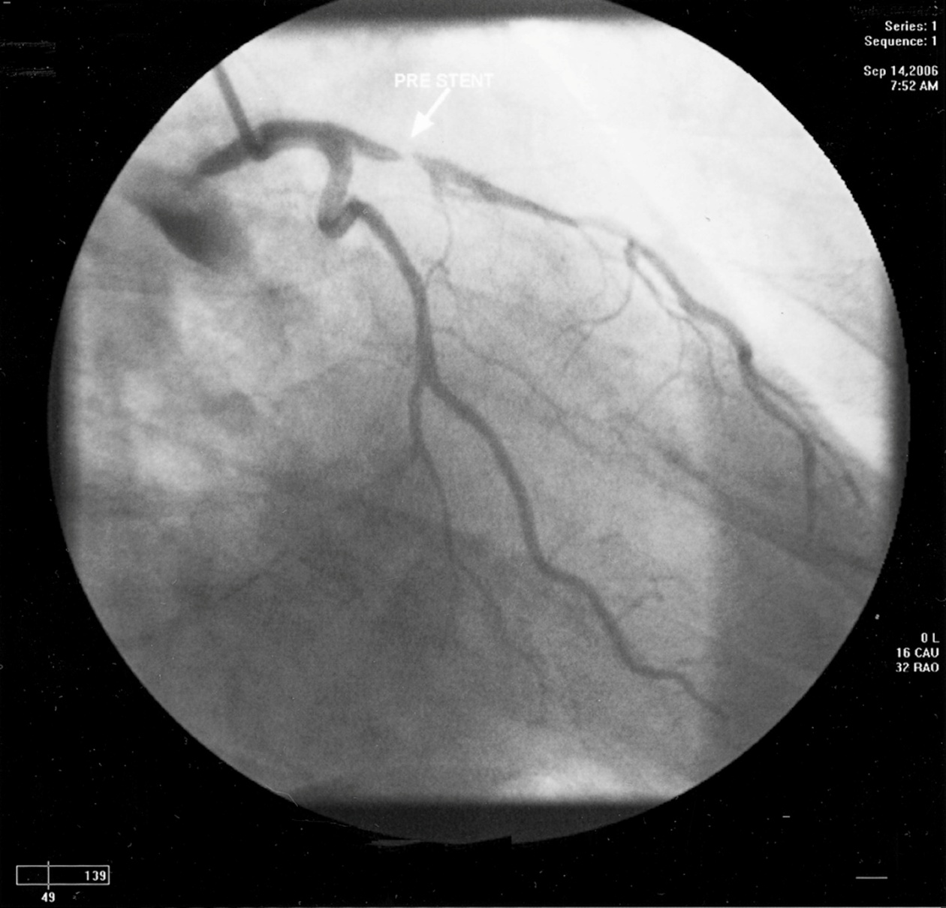

Slide 9
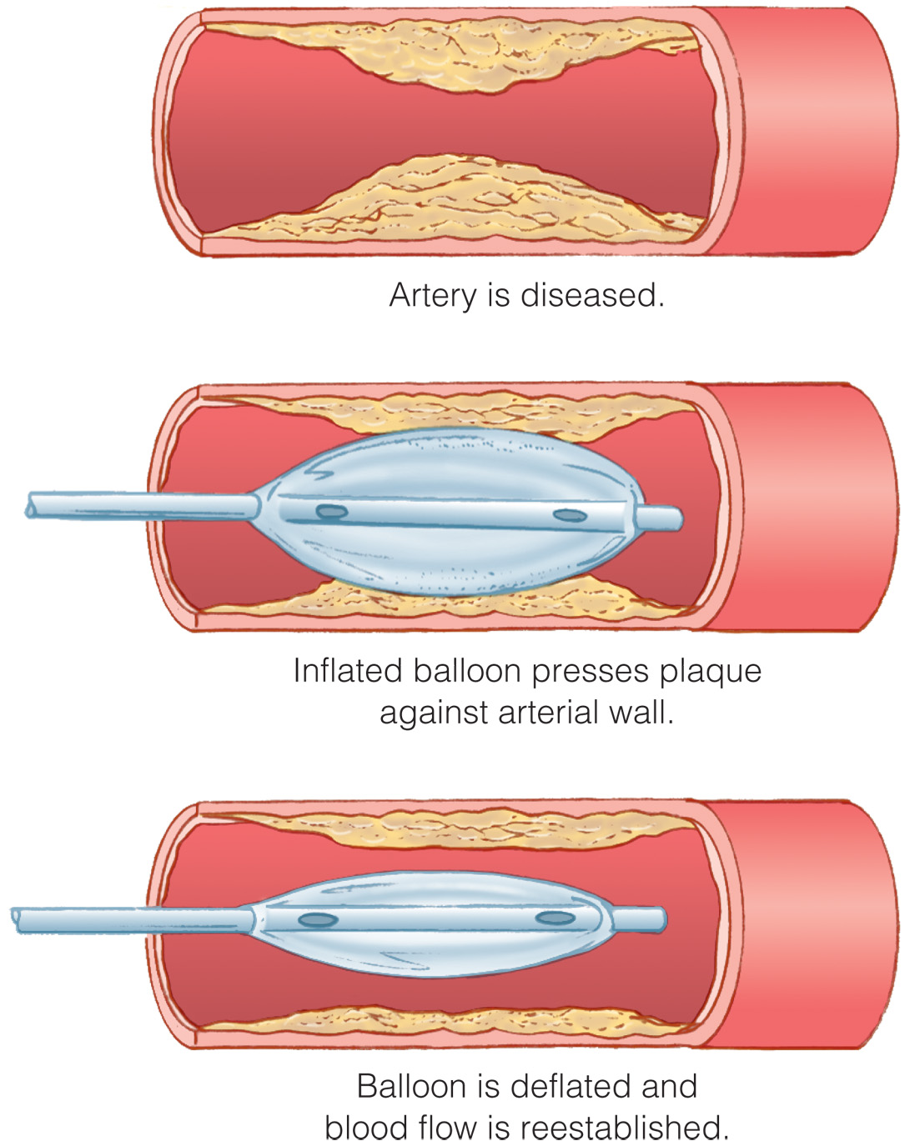
Coronary Angioplasty Procedure.

Slide 10
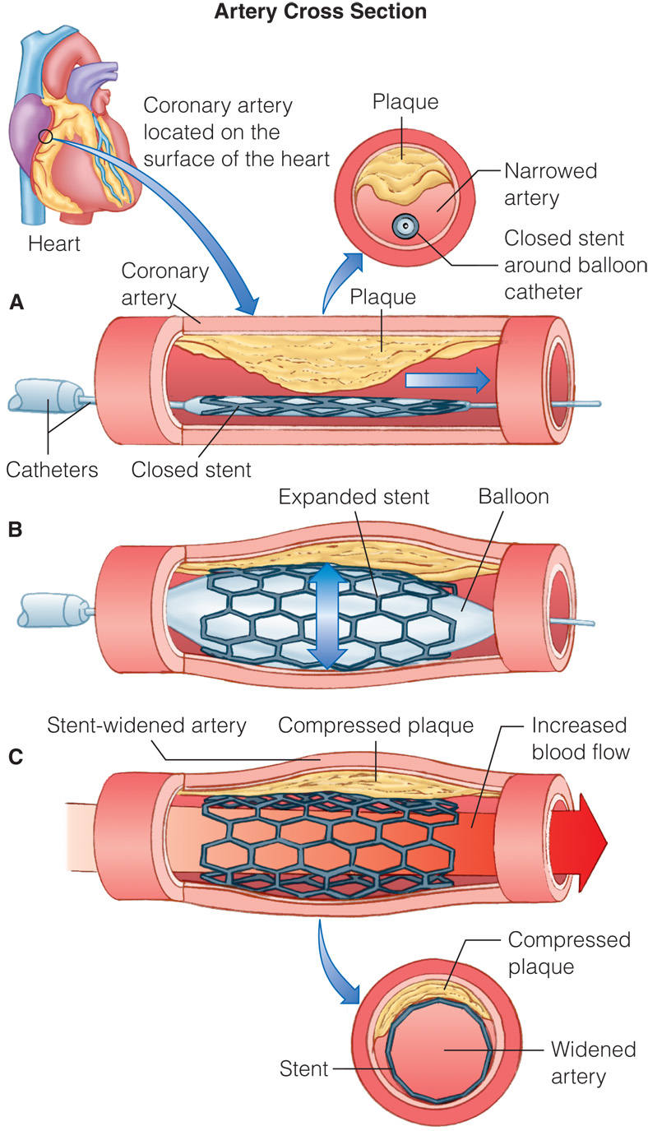
Stent Placement Following Angioplasty.

Slide 11
PTCA – Pre-procedure Care
Lab tests
Cardiac enzymes.
PT, PTT.
Electrolytes (K+)
K+ level must be within normal because low levels increase sensitivity and excitability of myocardium; risk for ventricular dysrhythmia increase.

Slide 12
-Creatinine & BUN
Increased creatinine and/or BUN indicate problems in kidneys. Good kidneys is important during angioplasty in which the contrast media is introduced and needed to be filtered and execreted.
Well hydrated patient before procedure

Slide 13
PTCA - Preparations
24 hours before the Stent procedure:
patient is placed on Aspirin 325 mg x 1/day
Nitroglycerine and Ca++ blockers x 3/day is prescribed to prevent vasospasm
Discontinue Metformin drug for DM patients (interfere with contrast media)
Hold anticoagulant drugs if taken (like warfarin).
Food and fluid are restricted 6 to 8 hours before the test.
health care provider should explain the procedure and its risks.
A witnessed, signed consent for the procedure is required.
Allergies history: to seafood, if the pt had a bad reaction to contrast material in the past

Slide 14
PTCA – During Procedure
The patient is anticoagulated with 5000-10000 U of heparin bolus to prevent clot formation on the catheter system.
Bolus dose of heparin (2000-5000 U) may be needed to maintain ACT (Activated Clotting Time) level of 250-300 seconds.
Monitor patient anticoagulant status
ACT is monitored at baseline, 5 minutes after heparin bolus, and every 30 minutes after for the duration of the procedure.

Slide 15
PTCA – Post Procedure
Bed rest 4-6 hours after sheaths removed (sheaths removed 3-4 hours after procedure).
Maintain leg in strait position
Avoid flexing or bending leg at hip level
Avoid vigorous use of abdominal muscles (coughing, sneezing).
Monitor ECG, VS, LOC
Neurovascular check below catheter insertion site (color, sensation, pulses).

Slide 16
PTCA – Post Procedure
Monitor sheath insertion site for bleeding (apply 5 lb sand bag, suture, collagen plugs).
Monitor for signs of angina (chest pain) recurs.
If vasospasm occur, administer vasodilators (nitro., isosorbide, nifidipine sublingual)
Patient sent home with Aspirin, Ca++ blockers, & lipolytic drugs
Perform treadmill stress test 6 weeks after procedure and compare to the one before the PTCA. Repeat the test at 6 months and 1 year.

Slide 17
ursing Care

Slide 18
PTCA – Complications
Angina, MI, and Vasospasm
Abrupt closure of dilated segment.
Coronary artery dissection
Restenosis
Dysrhythmias
Hemorrhage
Allergy
Travel of stent.

Slide 19
Preventing Bleeding
Hematoma at insertion site = sign of bleeding
Retroperitoneal bleed most common
Device placed at insertion site to prevent bleeding
S/S of bleeding may include:
Fever, swelling, oozing, or extension of bruising at catheter site

Slide 20
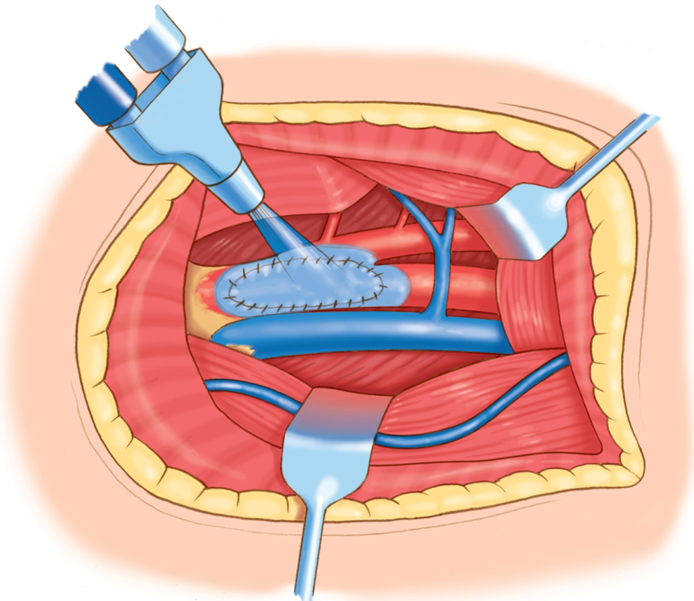
Figure 6-14 Collagen patch for arterial insertion site.

Slide 21
OTHER INTERVENTIONAL CARDIAC PROCEDURES
Laser Angioplasty-uses pulsed laser energy to vaporize plaque & reopen blocked arteries
Coronary Atherectomy-involves widening of artery lumen by removing atherosclerotic plaque. Directional catheter is a device that shaves the plaque off vessel walls by means of a rotary cutting head, retaining the fragments in the device’s housing & removing them from vessel.

Slide 22
Learning Outcome
Discuss care of the patient following coronary artery bypass surgery.

Slide 23
CABG Surgeries
Native vessels or conduits are “harvested” and used to bypass blood flow past diseased areas of coronary artery.
Prolongs life in patients with left main CAD and three-vessel disease with poor left ventricular function

Slide 24
What is Open Heart Surgery? It isn’t just CABG
Valve replacement
VSD
Ascending Thoracic Aneurysm Repair
Left Ventricular aneurysm repair
Surgery to relieve hypertrophy in CMPs
All need to be on the Cardio-pulmonary pump in the OR

Slide 25
History
1967 the first CABAG surgery in the USA.
First open-heart surgery procedure in Jordan in 1970.
First heart-valve replacement in the country in 1972.
First coronary artery bypass in Jordan in 1973.

Slide 26
Indication
The 2004 ACC/ AHA CABG guidelines state CABG is the preferred treatment for:
Disease of the Left Main Coronary Artery
Disease of all three coronary vessels (LAD, LCX, & RCA).
Diffuse disease not amendable to treatment with a PTCA.

Slide 27
CABG Versus Balloon Angioplasty
A systematic review of the 22 RCTs comparing CABG with balloon angioplasty concluded the following :
Survival was similar for CABG and PCI (with balloon angioplasty) at 1 year and 5 years.
Survival was similar for CABG and PCI in subjects with 1-vessel CAD (including those with disease of the proximal portion of the LAD artery) or multivessel CAD.
Incidence of MI was similar at 5 years after randomization.

Slide 28
CABG Versus Balloon Angioplasty
Procedural stroke occurred more commonly with CABG than with PCI (1.2% versus 0.6%).
Relief of angina was accomplished more effectively with CABG than with PCI 1 year after randomization and 5 years after randomization.
During the first year after randomization, repeat coronary revascularization was performed less often after CABG than after PCI (3.8% versus 26.5%).

Slide 29
Characteristics of Graft
Diameter similar to coronary arteries
No disease or vessel wall abnormalities
Adequate length
Commonly used grafts:
Saphenous vein graft
Internal mammary artery grafts

Slide 30
Saphenous Vein Graft
Anastomoses one end of vein to aorta (proximal) and other end to coronary artery past obstruction (distal)
May be simple or sequential (also called skip)
May be taken from above or below the knee
About 50% occluded after 10 years
Vein failure:
Thrombosis
Fibrointimal hyperplasia
Atherosclerosis

Slide 31
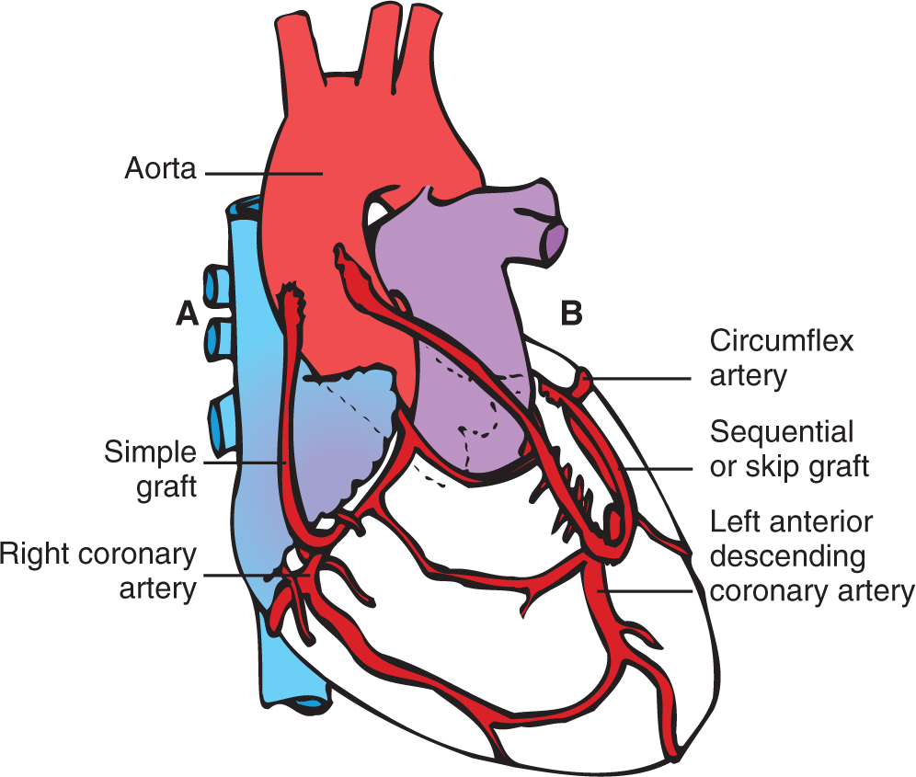
Saphenous Vein Grafts

Slide 32
Vessel Patency
1. internal mammary artery graft 90% patency at 10 years
2. saphenous vein graft 50% patency at 10 years
3. PTCA of stenotic vessel 60% patency at 6 months
4. PTCA + stent of stenotic vessel 80% patency at 6 months

Slide 33
Internal Mammary Artery Grafts
Preferred alternative to saphenous
Used as a pedicle graft to bypass diseased artery
Both left and right can be used.
Left internal mammary artery longer and larger
Used to bypass LAD
Right internal mammary artery is used for right coronary artery or LCX.
90% patency at 10 years

Slide 34
Other Grafts
Radial artery
More prone to spasm
Postoperative add nitroglycerin followed by oral nitrates
Right gastroepiploic artery
Homologous (nonnative) grafts
Saphenous, umbilical, or bovine internal mammary artery

Slide 35
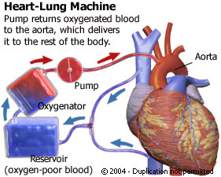
Cardiopulmonary bypass machine

Slide 36
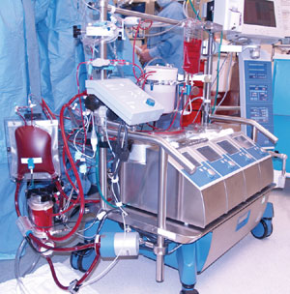
Cardiopulmonary bypass machine

Slide 37
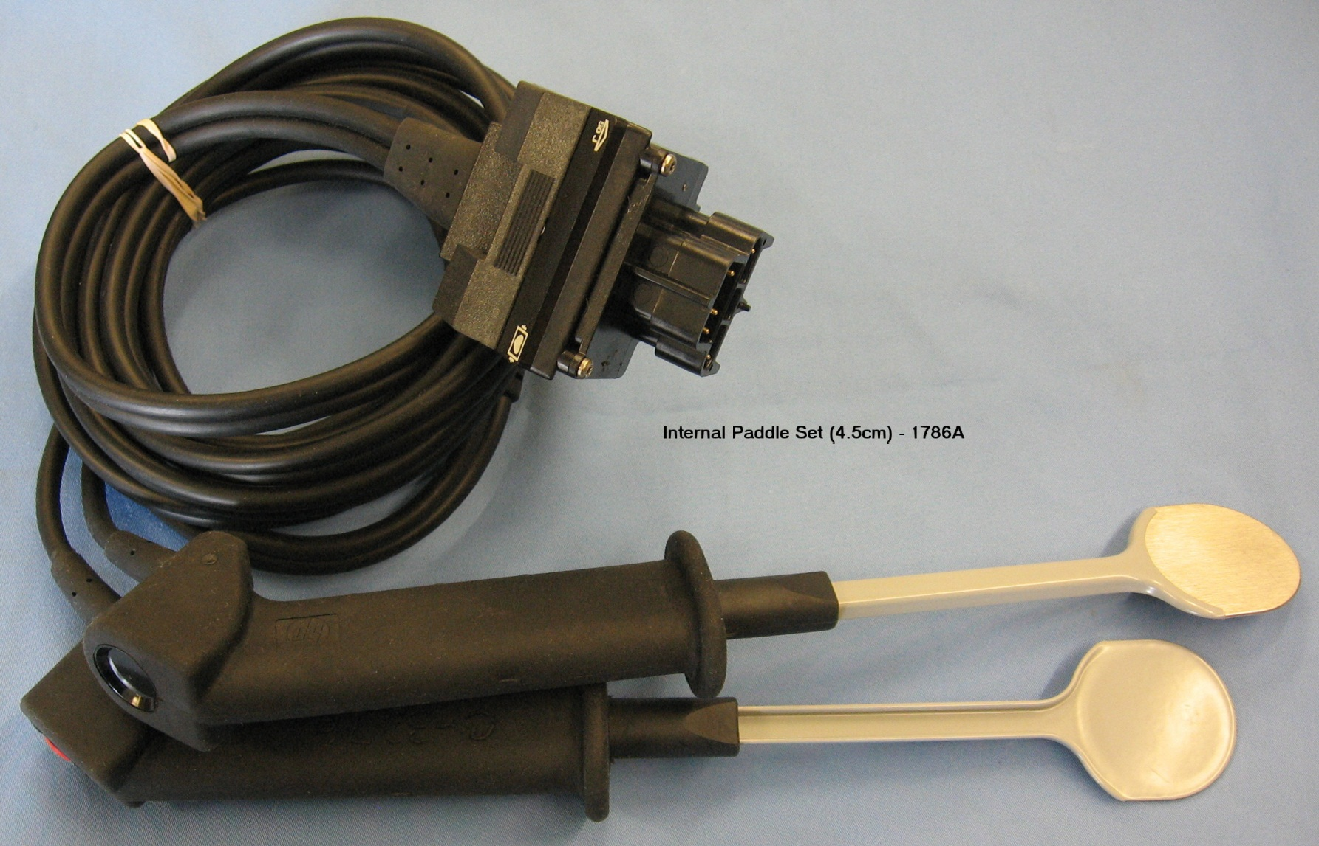

Slide 38
Cardiopulmonary Bypass
Complications
Arrhythmias
Fluid resuscitation
Decreased cardiac contractility
Control of blood pressure
Respiratory problems
Postoperative bleeding
Pump head

Slide 39
Overview of CABG Procedure
https://www.youtube.com/watch?v=GvGAgQOhQqY
https://www.youtube.com/watch?v=t8D9BZ4BcCQ&list=PLgn7xySUm4KRdTaOncyl4J0dC3HjRT-w8

Slide 40
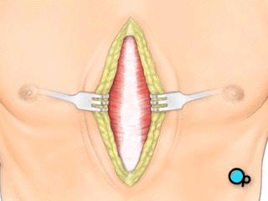
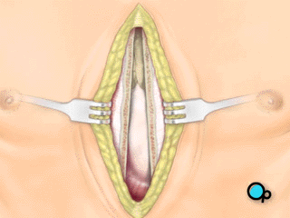
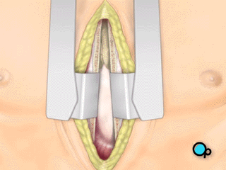
Overview of CABG Procedure
Expose breast bone
Skin
incision
Divide breast bone
Retractor placed

Slide 41
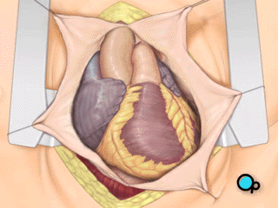
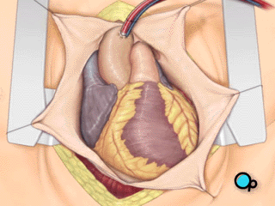
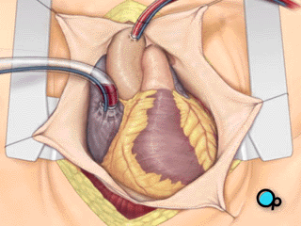
Overview of CABG Procedure
pericardiotomy
Heart visualized
Aortic cannula brings blood
from CPB to aorta
Venous cannula drains blood
From heart to CPB

Slide 42
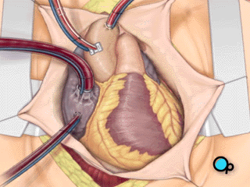
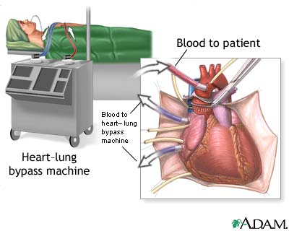
Overview of CABG procedure
Cardioplegia tube
In coronary sinus
Cardioplegia tube inserted
In aorta

Slide 43
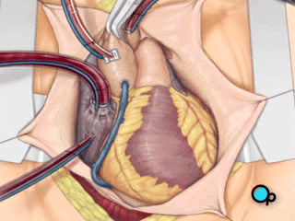
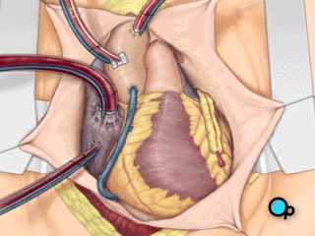
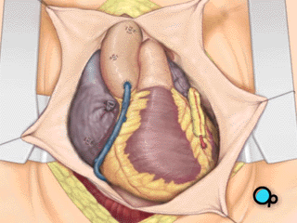
Overview of CABG procedure
Heart stopped, aortic clamp
Placed, no flow in heart
Bypass vessel grafted
Clamp removed,
Cardioplegia reversed
Heart beating normally,
CPB stopped

Slide 44
Newer Techniques
Off-pump CABG surgery (OPCABG)
Decreased length of stay
Incidence of stroke 48 to 72 hours (vs. immediately after surgery if on cardiopulmonary bypass)
Minimally invasive direct coronary artery bypass grafting (MIDCABG)
Number of grafts restricted

Slide 45
Transmyocardial Laser Revascularization (TMLR)
Option for unstable angina refractory to interventions
Eligibility:
Prior CABG surgery, multiple cardiac interventions with maximal medication
Physiology of laser
Angiogenesis
Direct channel patency

Slide 46
Post-TMR Care
Inotropic support
Monitoring fluid status
Antiarrhythmic therapy
Manage angina.
Monitor ST segment.
Anticoagulation therapy

Slide 47
Cardiac Surgery
Preoperative care
Typical preparation
PATIENT education (see box 22-2 p451)
Intraoperative phase
Surgical approach
Cardiopulmonary bypass
Cold or warm cardioplegia
Topical hypothermia

Slide 48
Postoperative CABG
Temporary epicardial pacing
Mediastinal chest tubes
Mediastinal and pericardial
Pleural chest tubes
Cardiac and hemodynamic monitoring

Slide 49
Immediate postoperative care
Cardiac monitoring, maintenance of oxygenation& hemodynamic stability
See box 22-3 (page 453)

Slide 50
Collaborative Management in the Postoperative Phase
Monitor frequently
Anticipate possible complications
Treatment: pulmonary management, hemodynamics, assessing for bleeding, neurologic status, renal status, GI status, pain control, infection prevention

Slide 51
Postoperative Management
Manage hypothermia
Core temperature monitoring
Rewarming
Prevent shivering
Shivering often occurs between 90 and 180 minutes.
Increases metabolic rate, oxygen consumption, CO₂ production, and myocardial workload

Slide 52
Prevent Infection
Assess for S/S of infection: Increased temperature, drainage from incision, increased color in sputum, redness at the incision site.

Slide 53
Monitoring for Signs of SIRS

Slide 54
Manage Post-Op Pain
Analgesia: Common drug morphine, fentanyl, and hydromorphine as well as NSAID as supplementary
Positioning
Distraction and relaxation techniques
Differentiate angina from incisional pain

Slide 55
Volume Resuscitation
Adequate intravascular volume to provide preload is primary concern.
SIRS causes fluid to shift into the interstitial spaces.
No fluid is definitively recommended

Slide 56
Hemodynamics: Dysrhythmia Control
Common post CABG
Ventricular first 24 hours post-op
Supraventricular 24 hours to 5 days post-op
A-fib common: treat with Amiodarone, Beta-blockers, pacing

Slide 58
Improving cardiac contractility
Optimal volume resuscitation
Sympathomimetic drugs
Stunned myocardium.
Hibernating myocardium

Slide 59
Hemodynamics: BP Control
Assess & address low or high BP
Controlling BP
Maintain between 120 systolic and MAP 70 mm Hg
HighBP: give nitroprusside, nitroglycerin,hydralazine, ACE Inhibitors
Low BP: give fluid, inotropes, or vasopressor

Slide 60
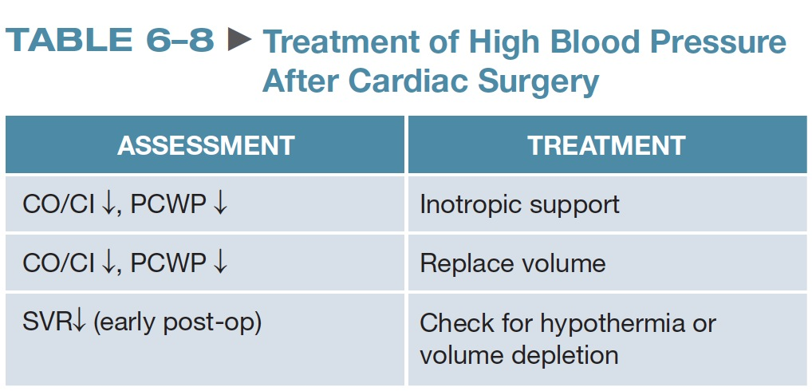

Slide 61
Pulmonary Management Post CABG
Common complication
Patients managed on mechanical ventilator after surgery
Desired outcomes: early extubation, adequate ventilation, oxygenation
Nurse must assess for readiness for extubation

Slide 62
Bleeding
Assess for bleeding.
Alarm!! clopidogrel (plavix) should be stopped 5 days before surgery
Chest tube drainage Q 15 minutes then hourly
S/S hypovolemia, Hgb/Hct
Reverse anticoagulant (protamine).
Rewarm the patient.
Administer blood products (platelates).
Administer antifibrinolytics

Slide 63
Bleeding
Assess for tamponade
Lack of chest tube drainage,
Decreased BP, narrowed pulse pressure, increased HR,
JVD, elevated CVP, and muffled heart tones

Slide 64
Bleeding Complication: Cardiac Tamponade
Excessive accumulation of blood in pericardial space
Warning signs:
Decreased chest tube output
Decreased cardiac output and BP
A-line demonstrates pulsus paradoxus.
Increase and equalization of pressures
Definitive diagnosis: echocardiogram

Slide 65
Question
Which of the following is a technique used to prevent postoperative complication of cardiac tamponade?
A. Monitoring coagulation studies
B. Milking or stripping the chest tube
C. Rewarming the patient
D. Administering aminocaproic acid (Amicar)

Slide 66
Answer
B. Milking or stripping the chest tube
Rationale: Milking or stripping the chest tubes is indicated when the chest tube output decreases because the blood is beginning to clot in the pericardial space. This technique does increase negative pressure. Infusion of fluid can also be used to keep the cardiac structures from collapsing.

Slide 67
Post-Op Organ System Management
Neuro Status
Risk for CVA 2.5%
Complete thorough neurologic assessment
Renal Status
U/O should be 0.5 mL/kg/hr
Monitor hourly for 24-48 hours
Draw BUN/Creatinine

Slide 68
Post-Op Organ System Management
GI Manangement
Complications include: peptic ulcer disease, pancreatitis, bowel ischemia
Risk factors for complications: age over 70, alcohol abuse, emergent operation
Administer meds to prevent complications: antiemetics, H2-blockers, PPI’s

Slide 69
Postoperative Management
Preventing renal complications
Autodiurese with depletion electrolytes
Slight metabolic acidosis
Decreasing urine output
Fluid or loop diuretics
Renal failure

Slide 70
Postoperative Management (cont.)
Preventing endocrine complications
Strict glycemic control
Adrenal insufficiency
Preventing gastrointestinal complications
Monitoring for infection
SIRS or overshoot rewarming
Mediastinitis
Risk factors

Slide 71
Patient Teaching and Discharge
Hospitalization after CABG usually 4 to 7 days
Discharge planning begins on admission.
Discharge medications typically include
Aspirin
Beta-blocker
ACE inhibitor
Statin
Smoking cessation interventions

Slide 72
Postoperative Care
Wound care
Assessment of operative site
Preventing neurological complications
Neurological assessment
Hyperperfusion syndrome
CN injury

Slide 73
Patient Education
Risk factor reduction
Incision care
Neurological changes
Medication education
Follow-up physician appointments

