Slide 1
Central Limit Theorem
And distribution of sample means

Slide 2
Start with any distribution with a well defined μ and variance σ, can be continuous or discrete.
Take samples and average them. Plot them. As you take more and more samples it starts to approximate a normal distribution.

Slide 3
Central Limit Theorem = Distribution of sample means will approach a normal distribution as n approaches infinity . Very important!
True even when raw scores NOT normal!
What about sample size?
(1) If raw scores ARE normal, any n will do
(2) If raw scores are not normal but are symmetrically distributed, a small. n will usually suffice
(3) If the raw scores are severely skewed, n must be “sufficiently large”
For most distributions → n ≥ 30

Slide 4
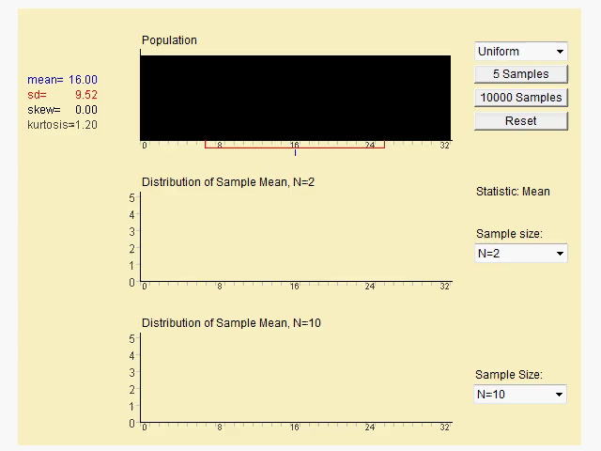
Central Limit theorem in action

Slide 5
As sample size becomes larger, the distribution becomes more and more normal.
If the population data is not normally distributed, the CLT applies with sample sizes N >30.
So you can start with a random distribution, take a sample (of at least 30), plot the average of those samples and you will end up with a normal distribution
This is why a normal distribution is SO helpful and comes up so often.

Slide 6
Sampling distribution of the Sample Mean
Derived from samples of original distribution
Will have same mean as original distribution
But as the sample size gets larger, will get a tighter fit around the mean.
When n is small eg. N=1 will usually not be normal no matter how many trials you do. As n ➔∞ get normal distribution
The more samples, the closer to the mean the distribution of your sample means will be

Slide 7
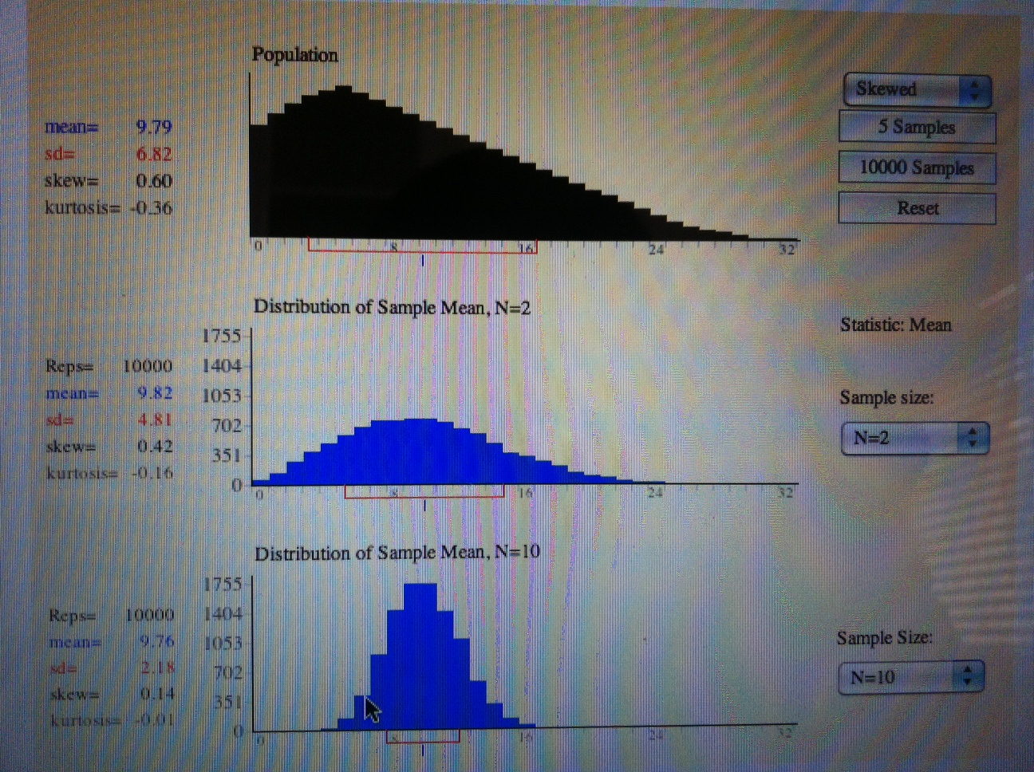

Slide 8
Why is CLT so useful?
Because we often do not have the numbers for the entire population.
This is almost impossible/costly. Eg. BP on everyone, vitamin D levels on everyone.
We need to take a sample of the population, and from that sample determine how accurately it represents the true population
So if we know that;
  Multiple samples of the mean can approximate a normal distribution
  And that a larger sample size decreases the SD then we can do MANY THINGS!

Slide 9
Inferential statistics
When we looked at Z scores and normal distributions, we looked at individual scores within a normal distribution
- eg heights of all students
- BP of all patients
- income of all graduates
In practice it is not possible to get the value for all people in the population. A SAMPLE needs to be taken, but we need to know how well the sample represents the population.

Slide 10
This where are normal distribution becomes USEFUL.
Because IF we can determine the standard distribution of the distribution of the sample means, then we can use the Normal Standard Distribution to determine probabilities for different Z scores

Slide 11
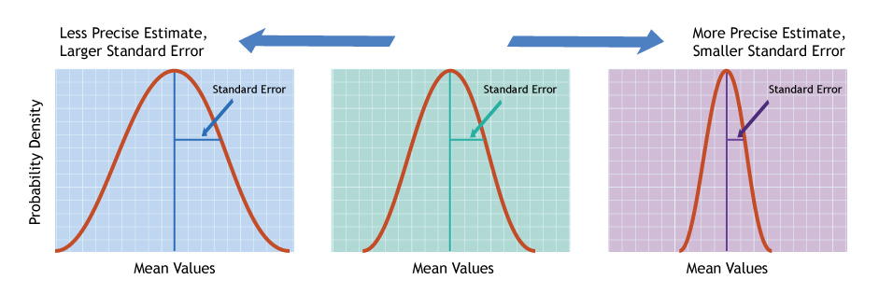

Slide 12
Standard Error
standard error of mean = SD of “sampling distribution of mean” = SD of sample mean
Variability of around μ
Special type of standard deviation, type of “error”
Average amount by which deviates from μ
Less error = better, more reliable estimate of population parameter
The term “sampling error” does not mean a sampling mistake – rather it indicates that means drawn from multiple samples taken from a population will vary from each other due to random chance and therefore may deviate from the population mean
“How close is my sample mean to the TRUE MEAN?”

Slide 13
What will make the sample mean more accurate?
We know, the larger the sample (n) the closer the values to the true mean. Also the smaller true σ, the less the spread of sample means.

Slide 14
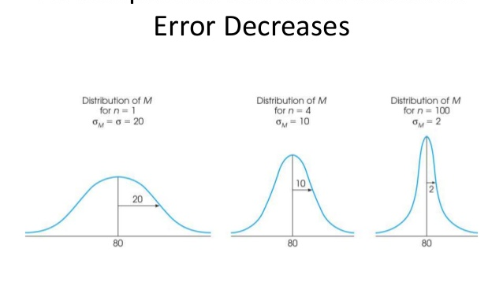

Slide 15
Standard error of mean
Where
This does not give the variability of the population, it gives a precision of the estimate of the mean ie. “How close is my sample mean to the TRUE MEAN?”

Slide 16
Example
The Census Bureau reports the average age at death for female Americans is 79.7 years, with standard deviation 14.5 years.
μ = 79.7 years SD = 14.5 years

Slide 17
Example
I looked at 48 more recent obituaries
79 70 48 99 85 71 45
more ⇓⇓ data
87 75 90 95 51 99 69
71 49 93 80 89 77 72
101 69 92 92 86 78 92
89 91 81 74 68 89 92
64 71 50 81 88 42 91
44 51 85 81 92 93

Slide 18
What is the distribution of the sample mean of samples of size n = 48?

Slide 19
What is the distribution of the sample mean of samples of size n = 48?
Even though age at death is left skewed, with
n = 48 (large enough) the Central Limit Theorem applies, and the sample mean has approximate Normal distribution.

Slide 20
Normal Distribution
Find the probability that a random sample of 48 U.S. women’s deaths gives a sample mean 77.52 or less.
Z = (77.52 – 79.7) / 2.09 = -2.18 / 2.09 = -1.04
Probability = 0.1492
About 15% of all samples of 48 deaths give a sample mean 77.52 or less.

Slide 21
Example (a)
The foreman of a bottling plant has observed that the amount of soda in each “32-ounce” bottle is actually a normally distributed random variable, with a mean of 32.2 ounces and a standard deviation of 0.3 ounce.
If a customer buys one bottle, what is the probability that the bottle will contain more than 32 ounces?
look up a normal probability.

Slide 22



Example (a)
We want to find P(X > 32), where X is normally distributed and =32.2 and =.3
“there is about a 75% probability that a single bottle of soda contains more than 32oz.”

Slide 23
Example (b)
The foreman of a bottling plant has observed that the amount of soda in each “32-ounce” bottle is actually a normally distributed random variable, with a mean of 32.2 ounces and a standard deviation of .3 ounce.
If a customer buys a carton of four bottles, what is the probability that the mean amount of the four bottles will be greater than 32 ounces?

Slide 24


We want to find P(X > 32), where X is normally distributed
with =32.2 and =.3
Things we know:
X is normally distributed, therefore so will X.
= 32.2 oz.

Slide 25

Example (b)…
If a customer buys a carton of four bottles, what is the probability that the mean amount of the four bottles will be greater than 32 ounces?
“There is about a 91% chance the mean of the four bottles will exceed 32oz.”

Slide 26
There is about a 91% chance the mean of the four bottles will exceed 32oz.
Probability
91%
z- scores for the sample means

Slide 27
Example 3
Weight of adult women in a population is normally distributed, with a mean of 75 kg. Approximately 95 % of all women weigh between 55kg and 95kg.
What would the standard error of the mean for a sample of the weight of 49 women be?
For 64 women?
For 625 women?

Slide 28
1.42 SE of mean for N=49
1.25 SE of mean for N = 64
0.4 SE of mean for N= 625
What does this mean? It means that for larger samples the precision of the sample mean is better. That is it is closer to the true mean.
Calculate 95% confidence intervals for each sample mean.

Slide 29
Example 4
The average male drinks 2 L of water when active outdoors (with standard deviation of 0.7l). You are planning a full day nature trip for 50 men, and plan to bring 110 L. what is the probability you will run out?

Slide 30
Why are Sampling Distributions Important?
Tell us the probability of getting a particular sample mean , given μ & σ
Critical for inferential statistics!
Allow us to estimate population parameters
Allow us to determine if a sample mean differs from a known population mean just because of chance
Allow us to compare differences between sample means – due to chance or to experimental treatment?
Sampling distribution is the most fundamental concept underlying all statistical tests

Slide 31
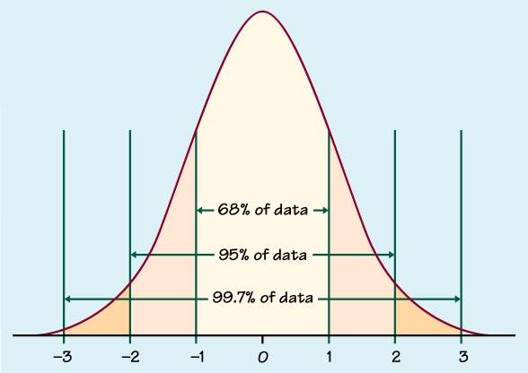
Confidence Interval of the Mean

Slide 32
Finding an interval
IQ is distributed normally with mean 100 and std. dev. 15
Find the interval in which 95% of the data lie.
68-95-99.7 rule: 2 std. dev.
15 * 2 = 30
95% of scores lie between 70 and 130

Slide 33
Confidence Interval (CI) of the Mean
Draw a sample from a population and calculate the sample mean ( ).
This is your estimate of the true mean but it is probably not equal to the true mean
How confident can you be that the estimate you obtained is a good estimate of the true mean?
Confidence Intervals provide a measure of the precision of the estimate of the mean from one sample.
Notes:
-

Slide 34
95 % Confidence Interval Procedure
If the population data are normally distributed and the standard deviation (σ) is known, we know that the sample means have a normal distribution.
So 95 % of all possible means are within ± 1.96 standard errors of the true mean
The formula for a 95% confidence interval is
± 1.96 *

Slide 35
What is the z score that is associated with 95% area under the curve? z=1.96
Probability
95%
z- scores for the sample means

Slide 36
Confidence Interval for a Mean
There’s a 95% probability that the population mean μ is within E of the sample mean .

Slide 37
Distribution of sample means
Z_{0.025} = 1.96
0.025
0.025

Slide 38
Confidence Interval for a Mean
E = Error Margin
There’s a 95% probability that , the sample mean, is within E of the population mean μ.

Slide 39
95% Confidence Interval Example
Weight data for 32 patients with known standard deviation
= 161.8, σ = 44.2
SEM = 44.2 / = 7.8
95% confidence interval for the estimate of the mean =
161.8 ± 1.96 * 7.8 = (146.5, 177.1)
We are 95% confident that the true mean weight for people in the population that this sample of 32 was drawn from is between 146.5 and 177.1 pounds

Slide 40
Interpretation of 95% CI
Correct
  We have 95% confidence that the true population mean lies within this interval
  95% of the time, in repeated sampling, the interval calculated from the same sample size will include the true mean μ
Incorrect
  The probability that the mean lies between the lower and upper limits is 0.95

Slide 41
90% Confidence Interval:Lower Bound < μ < Upper Bound
What “90% confidence” does not mean
We are 90% confident that the sample mean for the observed sample (the data used to obtain the bounds) lies between the bounds. ABSOLUTELY FALSE.
You can be 100% confident that the sample mean for the given data is equal to itself with virtually no error margin.

Slide 42
What “90% confidence” means
(When the conditions are satisfied.)
  90% of all samples produce an interval that covers the true mean μ.
  We have an interval from one sample, chosen randomly.
  Our interval either does or does not cover μ: in practice we just don’t know. We do know that the procedure works 90% of the time.

Slide 43
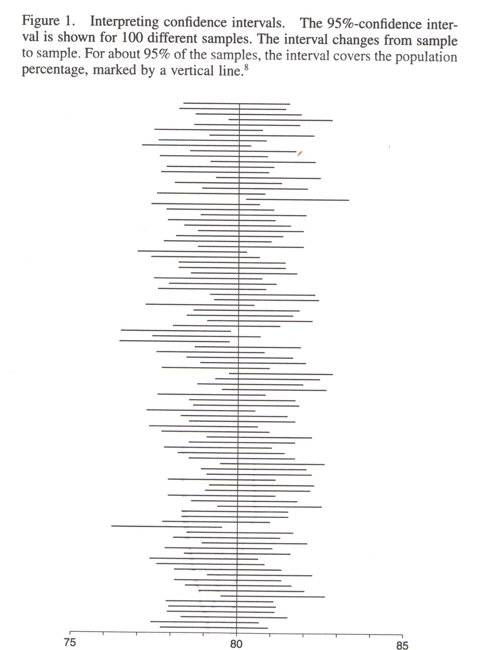

Slide 44
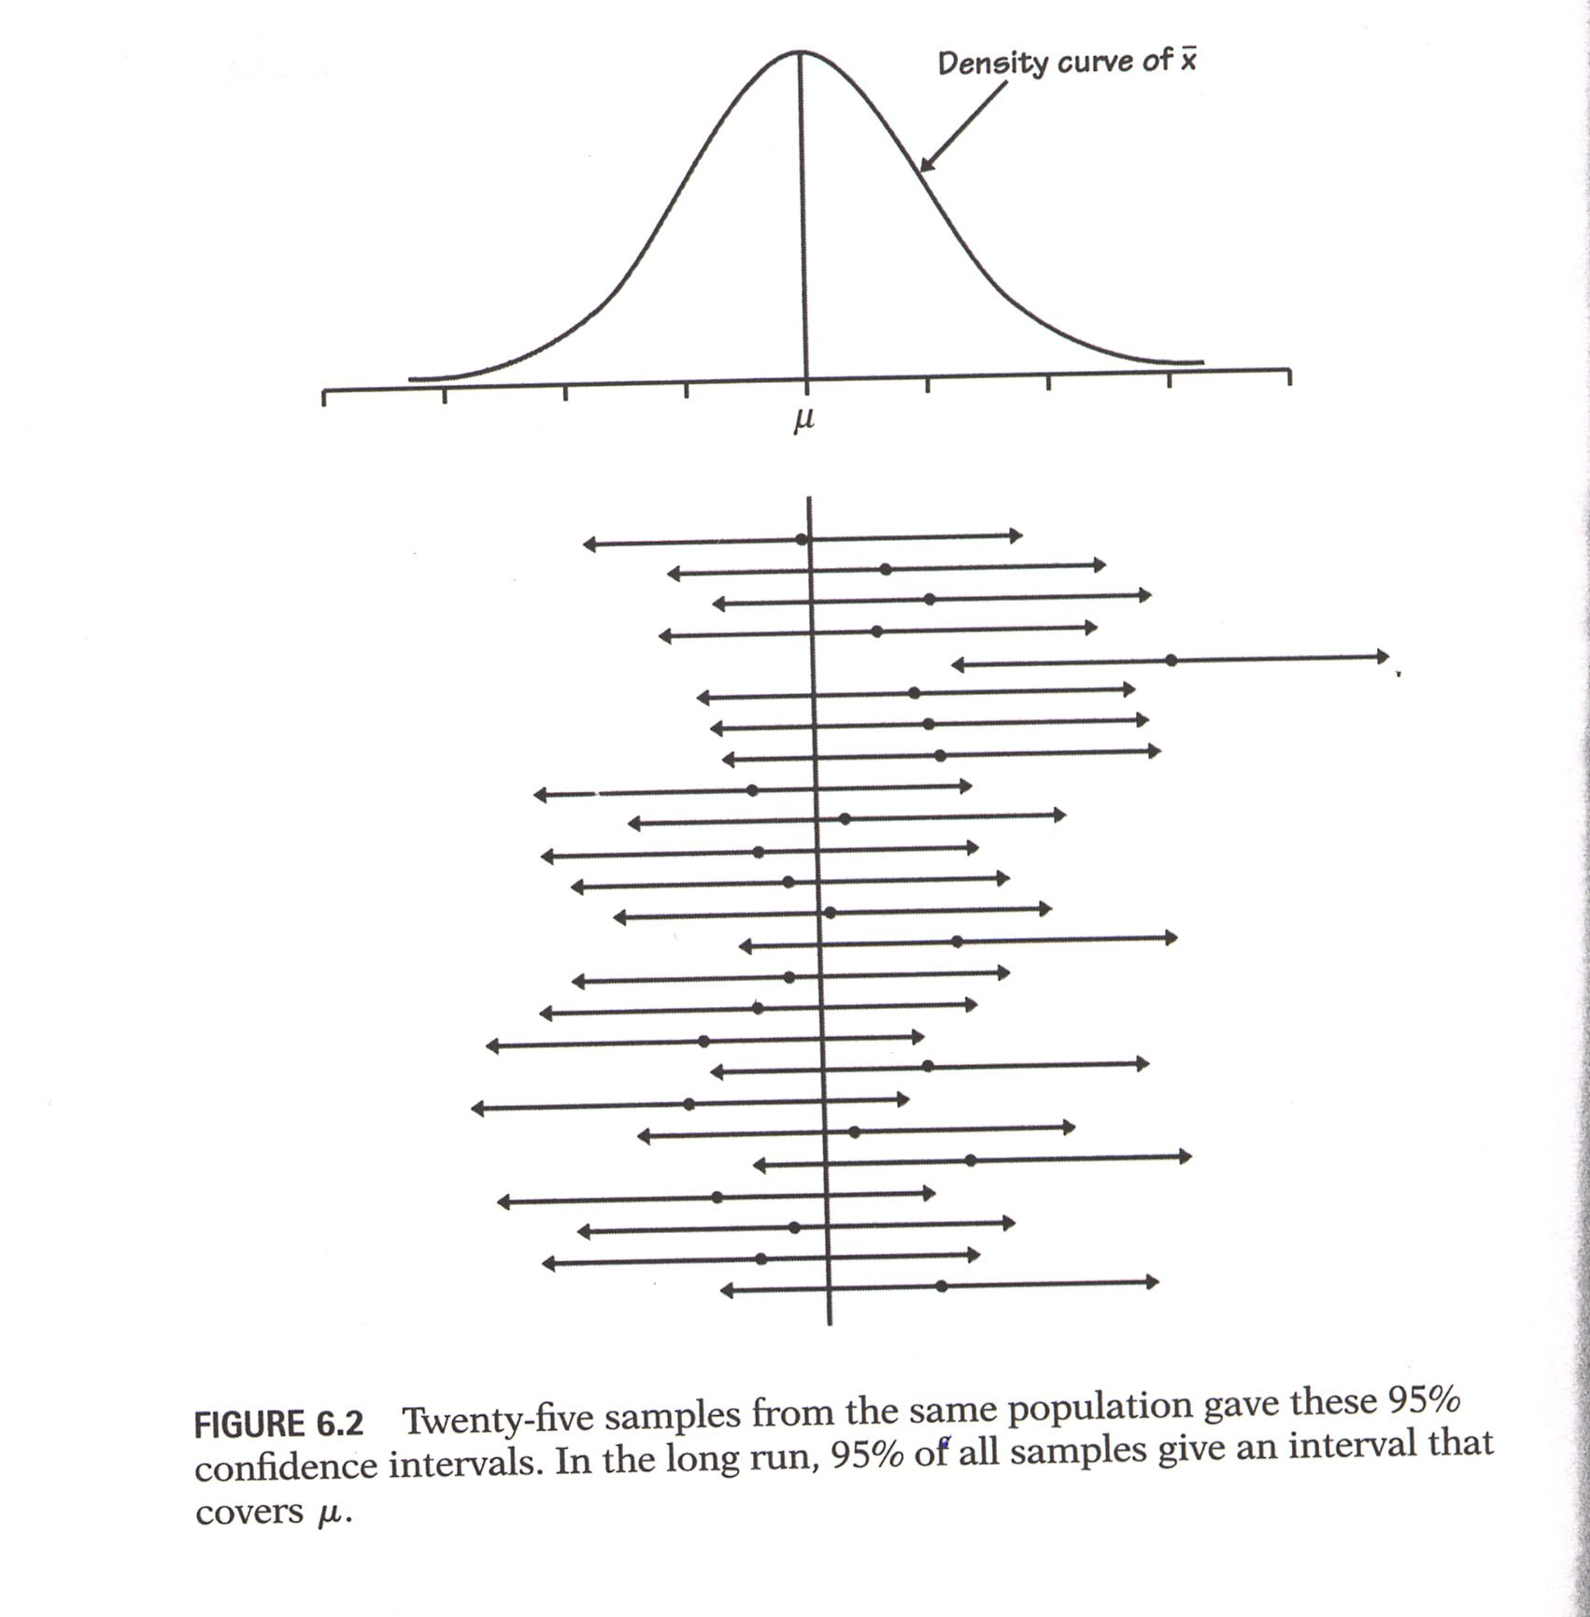

Slide 45
99 percent C.I for the mean age of Jordanians was computed to be (29.8; 38.5 years). What is the interpretation attached to this interval?
(a) We are 99 percent confident that the mean age of Jordanians is between 29.8 and 38.5.
(b) Ninety-nine percent of the residents in our sample had ages between 29.8 and 38.5.
(c) We are 99 percent confident that the mean age of Jordanians in our sample is between 29.8 and 38.5.
(d) All of the above are valid interpretations.

