Slide 1
The Nervous System (NS)
mashehabat@just.edu.jo

Slide 2
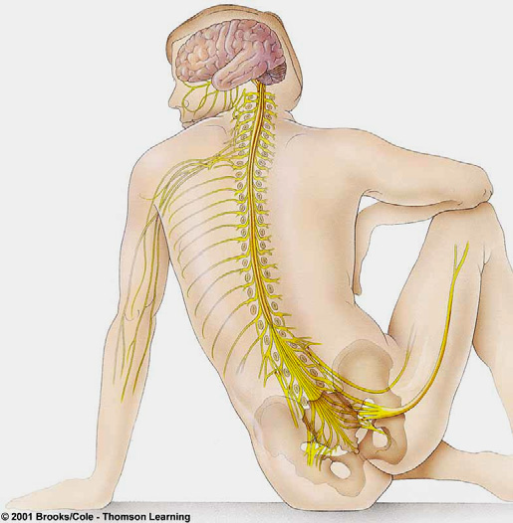
Organization of the nervous system
Based on differences in the structure, location, and functions, nervous system is subdivided into:
Central nervous system (CNS)
Brain and spinal cord
Contained within bone
Peripheral nervous system (PNS)
All nerve tissue outside CNS
Sensory & motor divisions

Slide 3
Nervous System generalized model of function
INPUT
(PNS: sensory neurons; afferent neurons)
INTEGRATION
(CNS: inter-neurons)
OUTPUT
(PNS: motor neurons; efferent neurons)

Slide 4
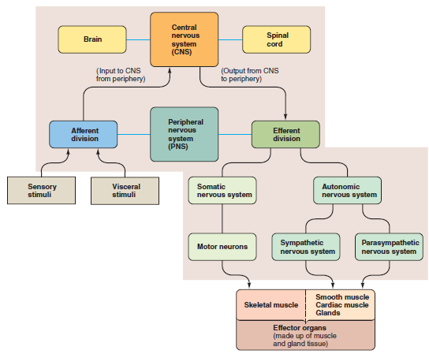
Organization of the nervous system
Notes:
Somatic → external environment
Autonomic → internal environment
The somatic nervous system (SoNS) is the part of the peripheral nervous system ^{[1]} associated with the voluntary control of body movements via skeletal muscles
The autonomic nervous system (ANS or visceral nervous system) is the part of the peripheral nervous system that acts as a control system functioning largely below the level of consciousness, and controls visceral functions

Slide 5
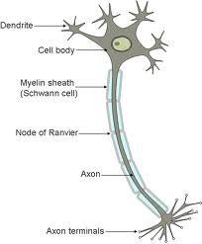
Structure of a typical neuron
Direction
of impulse
(Lipid)
Notes:
Nerves and Neurons
• a nerve is an organ
• a neuron is a cell of nerve tissue
Nerves can be entirely sensory, entirely motor, or mixed
A neuron can only be sensory (afferent) or motor efferent)

Slide 6
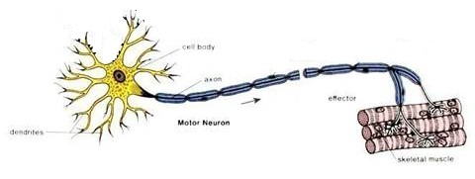
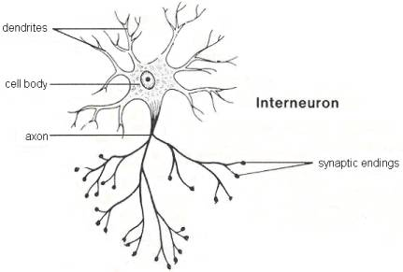
Functional classes of neurons
Afferent neurons:
Sensory receptor at peripheral ending (generates AP)
Convey input to the CNS
Cell body outside CNS
Efferent neurons:
Cell bodies in the CNS
Convey output for the effector organs
(muscles, glands)
Interneurons:
99% of all neurons
Integrating peripheral responses to peripheral information
Notes:
Dendrites (from Greek δένδρον déndron, “tree”) are the branched projections of a neuron that act to conduct the electrochemical stimulation received from other neural cells to the cell body, or soma, of the neuron from which the dendrites project

Slide 7
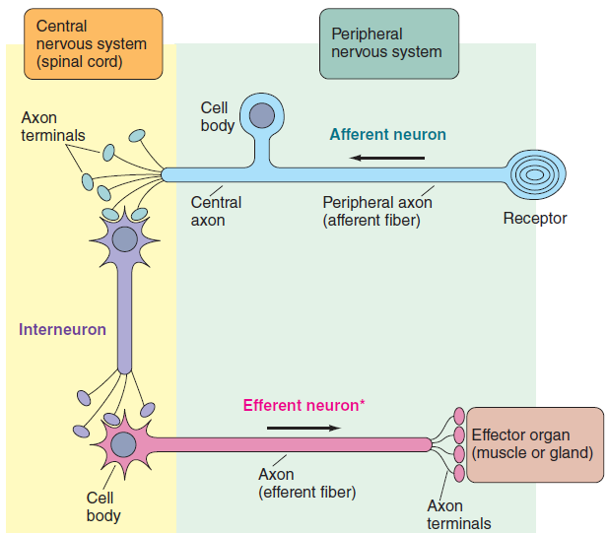
Structure and location of the three functional classes of neurons

Slide 8
The Central Nervous System (CNS)

Slide 9
CNS
Consists of:
The brain
Spinal cord
Notes:
perceive (be consciously aware of )

Slide 10
The Brain
Major brain functions:
Regulates internal environment
Experiences emotions
Voluntarily controls movements
Perceives own body and surroundings
Engages in other higher cognitive processes (e.g. Thought and memory)
Brain functions as a whole (neurons linked via synapsis).
Notes:
Perception (from the Latin perceptio, percipio) is the process of attaining awareness or understanding of the environment by organizing and interpreting sensory information
cognition refers to mental processes. These processes include attention, remembering, producing and understanding language, solving problems, and making decisions

Slide 11
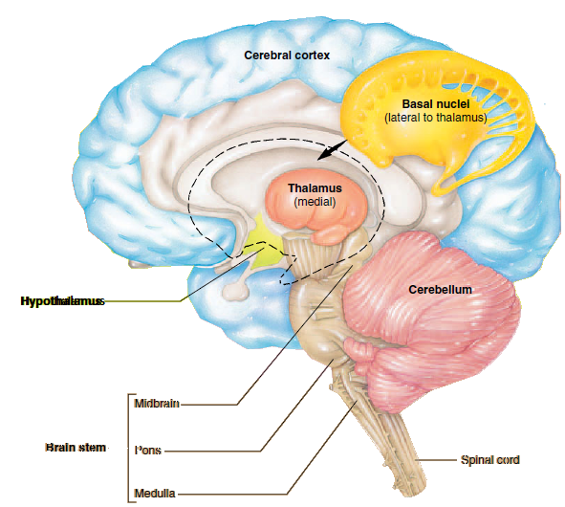
Structures of the Major Components of the Brain
Based on anatomical distinction, functional specialization, and development, brain has the following regions:
Brain stem (Medulla, pons, midbrain)
Cerebellum
Forebrain
Diencephalon
Hypothalamus
Thalamus
Cerebrum
Basal nuclei
Cerebral cortex

Slide 12
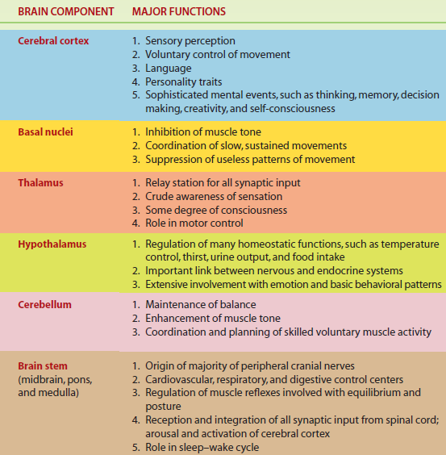
Functions of the Major Components of the Brain

Slide 13
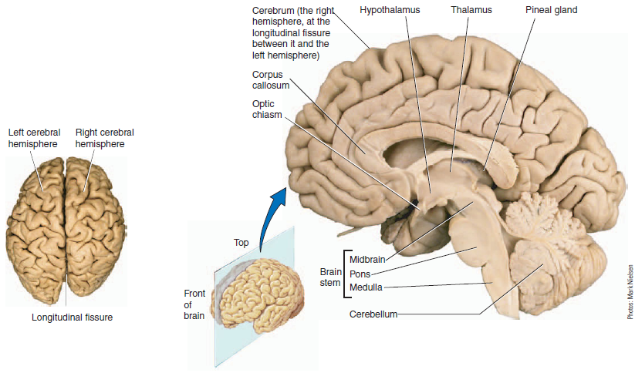
Cerebral Cortex
Corpus callosum:
neuronal axons connecting the two hemispheres
Notes:
The cerebral cortex is a sheet of neural tissue that is outermost to the cerebrum of the mammalian brain
The human cerebral cortex is 2–4 mm (0.08–0.16 inches) thick
corpus callosum, a thick band consisting of an estimated
300 million neuronal axons traveling between the two
Hemispheres
The corpus callosum is the body’s
“information superhighway.”

Slide 14
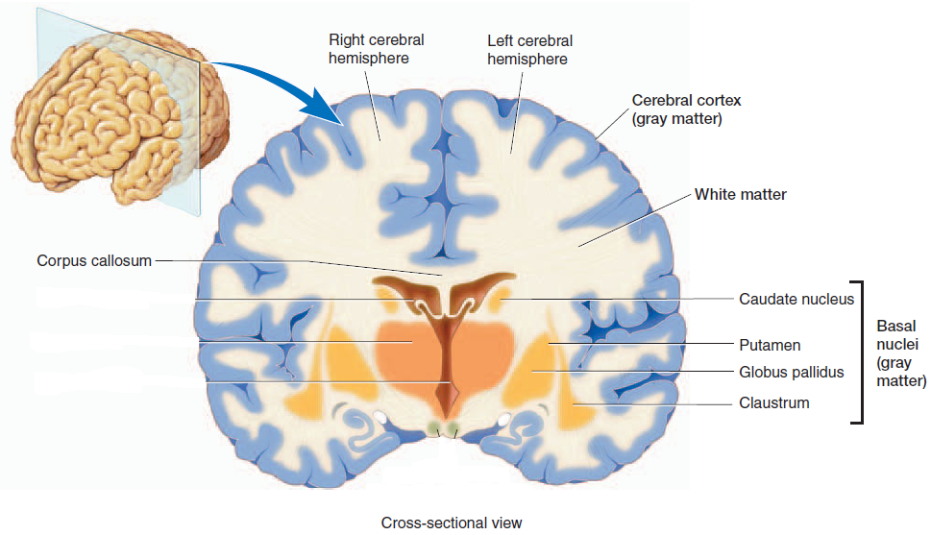
Cerebral Cortex
neuronal cell bodies and
their dendrites and
most glial cells
myelinated nerve fibers (axons)
Notes:
In preserved brains, it has a gray color, hence the name "gray matter". In contrast to gray matter that is formed from neurons and their unmyelinated fibers, the white matter below them is formed predominantly by myelinated axons interconnecting neurons in different regions of the cerebral cortex with each other and neurons in other parts of the central nervous system.
Throughout the entire CNS, gray matter consists predominantly
of densely packaged neuronal cell bodies and
their dendrites as well as most glial cells. Bundles or tracts of
myelinated nerve fibers (axons) constitute the white matter;
its white appearance is due to the lipid composition of the
myelin.
The fiber tracts in the white matter transmit signals
from one part of the cerebral cortex to another or between
the cortex and other regions of the CNS

Slide 15
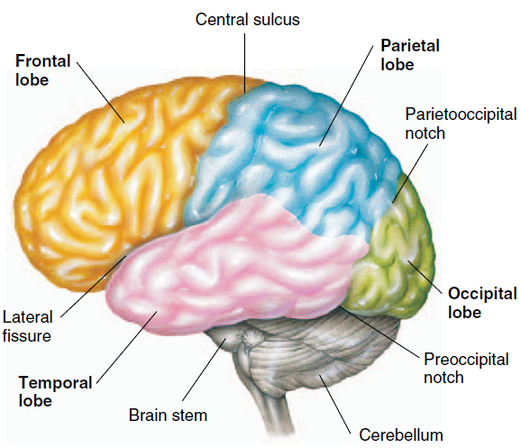
Cortical lobes
Voluntary motor activity
Speaking ability
Elaboration of thought
Receiving
and processing sensory input
Initial processing of visual input
Reception of sound sensation
Notes:
The anatomic landmarks used in cortical mapping are
certain deep folds that divide each half of the cortex into four
major lobes: the occipital, temporal, parietal, and frontal lobes
The occipital lobes, which are located posteriorly (at the
back of the head), do the initial processing of visual input.
Sound sensation is initially received by the temporal lobes,
located laterally (on the sides of the head) (● Figure 5-7a and
b). You will learn more about the functions of these regions
in Chapter 6 when we discuss vision and hearing.
The parietal lobes and frontal lobes, located on the top of
the head, are separated by a deep infolding, the central sulcus, which runs roughly down the middle of the lateral surface
of each hemisphere. The parietal lobes lie to the rear of
the central sulcus on each side, and the frontal lobes lie in
front of it.
The parietal lobes are primarily responsible for receiving
and processing sensory input. The frontal lobes are
responsible for three main functions: (1) voluntary motor
activity, (2) speaking ability, and (3) elaboration of thought.
We are next going to examine the role of the parietal lobes in
sensory perception, then turn our attention to the functions
of the frontal lobes in more detail.

Slide 16
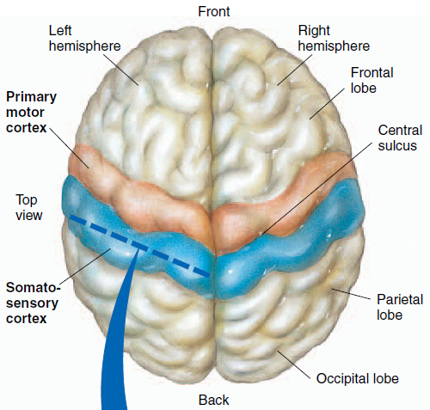
The parietal lobes
The somatosensory cortex:
located in the front portion of each parietal lobe
Immediately behind the central sulcus
It is the site for initial cortical processing
and perception of:
Somesthetic input (sensations from the surface of the body, such as touch, pressure,
heat, cold, and pain )
Proprioceptive input (awareness of body position)
Notes:
Sensations from the surface of the body, such as touch, pressure,
heat, cold, and pain are collectively known as somesthetic
sensations (somesthetic means “body feelings”).
Proprioception is the awareness of body
position.

Slide 17
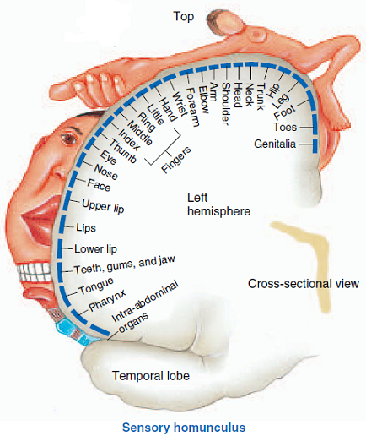
The somatosensory cortex
Each region within the somatosensory cortex receives input from a specific area of the body.
Different parts of the body are not equally represented
The size of each body part in this homunculus indicates the relative proportion of the somatosensory cortex devoted to that area.
Reception of opposite side inputs
The connection between different body parts and areas in brain hemispheres
Notes:
Sensory homunculus (homunculus means “little man”)
The size of each body part in this homunculus
indicates the relative proportion of the somatosensory cortex
devoted to that area.
The size of each body part in this homunculus
indicates the relative proportion of the somatosensory cortex
devoted to that area. The exaggerated size of the face, tongue,
hands, and genitalia indicates the high degree of sensory perception
associated with these body parts.
The thalamus makes you
aware that something hot versus something cold is touching
your body, but it does not tell you where or of what intensity.
The somatosensory cortex localizes the source of sensory input
and perceives the level of intensity of the stimulus
capable of spatial discrimination, so it can discern shapes of
objects being held and can distinguish subtle differences in
similar objects that come into contact with the skin.
The somatosensory cortex, in turn, projects this sensory
input via white matter fibers to adjacent higher sensory areas
for even further elaboration, analysis, and integration of sensory
information. These higher areas are important in perceiving
complex patterns of somatosensory stimulation—for
example, simultaneous appreciation of the texture, firmness,
temperature, shape, position, and location of an object you are
holding.

Slide 18
The somatosensory cortex
Thalamus vs. somatosensory cortex:
Thalamus → simple awareness of sensation
Somatosensory cortex → full sensory perception (location, intensity ….)
Capable of spatial discrimination; shapes and small differences between objects
Connections with higher brain centers:
via white matter fibers to adjacent higher sensory areas for further elaboration, analysis, and integration of sensory information.
Notes:
Sensory homunculus (homunculus means “little man”)
The size of each body part in this homunculus
indicates the relative proportion of the somatosensory cortex
devoted to that area.
The thalamus makes you
aware that something hot versus something cold is touching
your body, but it does not tell you where or of what intensity.
The somatosensory cortex localizes the source of sensory input
and perceives the level of intensity of the stimulus
capable of spatial discrimination, so it can discern shapes of
objects being held and can distinguish subtle differences in
similar objects that come into contact with the skin.
The somatosensory cortex, in turn, projects this sensory
input via white matter fibers to adjacent higher sensory areas
for even further elaboration, analysis, and integration of sensory
information. These higher areas are important in perceiving
complex patterns of somatosensory stimulation—for
example, simultaneous appreciation of the texture, firmness,
temperature, shape, position, and location of an object you are
holding.

Slide 19
The frontal lobes
Primary motor cortex:
Immediately in front of the central sulcus
Next to the somatosensory cortex
Confers voluntary control over movement produced by skeletal muscles.
Controls opposite side muscles of the body
Involved in the planning, control, and execution of voluntary motor functions
The motor cortex itself does not initiate voluntary movement
Notes:
Neuronal tracts originating in the
motor cortex of the left hemisphere cross over before passing
down the spinal cord to terminate on efferent motor neurons
that trigger skeletal muscle contraction on the right side of
the body. Accordingly, damage to the motor cortex on the left
side of the brain produces paralysis on the right side of the
body, and the converse is also true.
The fingers, thumbs, and muscles important in
speech, especially those of the lips and tongue, are grossly
exaggerated, indicating the fine degree of motor control these
body parts have. Compare this to how little brain tissue is
devoted to the trunk, arms, and lower extremities, which are
not capable of such complex movements
Thus the extent of
representation in the motor cortex is proportional to the precision
and complexity of motor skills required of the respective
part.

Slide 20
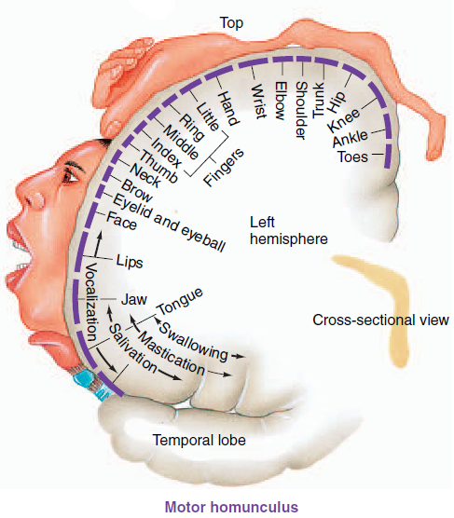
The primary motor cortex
The extent of representation in the motor cortex is proportional to the precision and complexity of motor skills required of the respective part
Location and relative amount of motor cortex devoted to output to the muscles of each body part

Slide 21
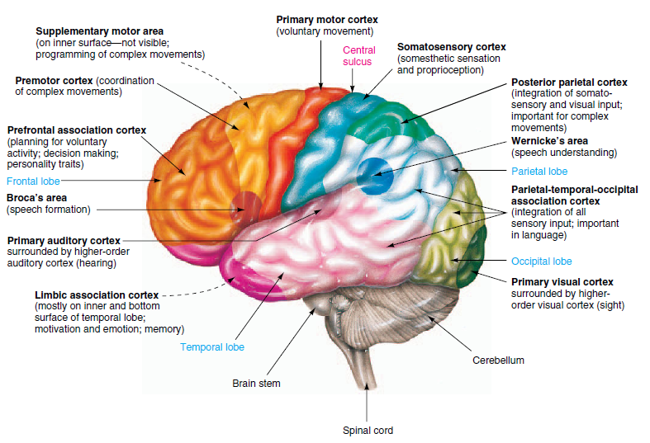
Other brain regions important in motor control
Notes:
lower brain regions
and the spinal cord control involuntary skeletal muscle
activity, such as in maintaining posture
The higher
motor areas of the brain that researchers believe are involved
in this voluntary decision-making period include the supplementary
motor area, the premotor cortex, and the posterior
parietal cortex (● Figure 5-7a). These higher areas all command
the primary motor cortex. Furthermore, a subcortical
region of the brain, the cerebellum, plays an important role,
by sending input to the motor areas of the cortex, in planning,
initiating, and timing certain kinds of movement.

Slide 22
Brain plasticity
When an area of the brain associated with a particular activity is destroyed, other areas of the brain may gradually assume some or all of the functions of the damaged region
Mechanism:
??? formation of new neural pathways (not new neurons, but new connections between existing neurons)
Notes:
In response to changes in experience are mediated in part by alterations in dendritic shape

Slide 23
Cortical control of language
Areas of the brain responsible for language ability are found in only one hemisphere - the left hemisphere.
Cortical language areas:
Broca’s area; speaking ability (expression)
Wernicke’s area; language comprehension
Formulating coherent patterns of speech that are transferred via a bundle of fibers to broca’s area
Understanding both spoken and written messages
Inputs from
Visual cortex
Auditory cortex

Slide 24
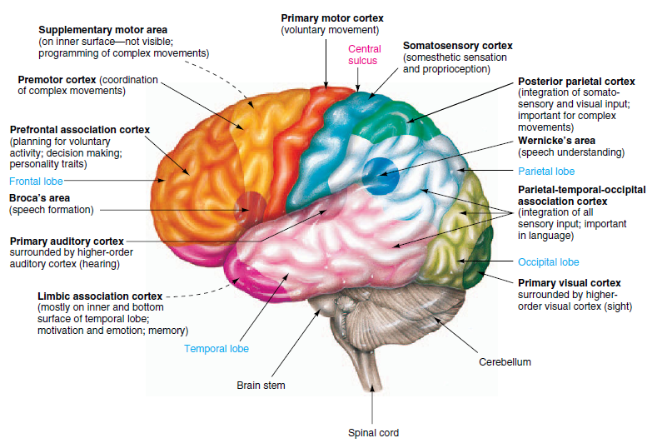
Cortical language areas
Notes:
Broca’s area, which governs speaking ability, is
located in the left frontal lobe in close association with the
motor areas of the cortex that control the muscles necessary
for articulation
Damage to Broca’s area results
in a failure of word formation, although the patient can
still understand the spoken and written word. Such people
know what they want to say but cannot express themselves.
Even though they can move their lips and tongue, they cannot
establish the proper motor command to articulate the desired
words.
In contrast, patients with a lesion in Wernicke’s
area cannot understand words they see or hear. They can speak
fluently, even though their perfectly articulated words make
no sense. They cannot attach meaning to words or choose appropriate
words to convey their thoughts

Slide 25
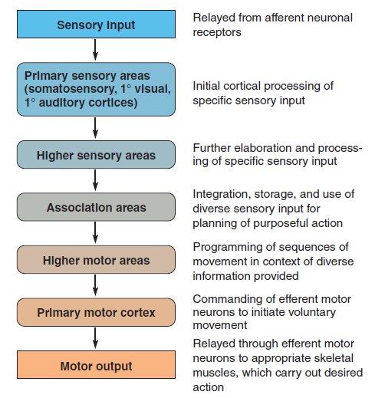
Schematic linking of various regions of the cortex

Slide 26
Electroencephalogram (EEG)
The recording of electrical activity (potentials) along the scalp
A tracing (measurement) of voltage fluctuations resulting from ionic current flows within the neurons of the brain versus time recorded from electrodes placed over scalp in a specific array
Deep parts of the brain are not well sampled
Notes:
Alpha rhythm: fairly regular but waxing and waning, with dominant frequency 8 - 13 Hz. It typically occurs over the occipital region when the person is awake but relaxed and content. Beta rhythm: to call this a "rhythm" is really too polite. It is low-amplitude, high-frequency and irregular. It is the typical EEG of the awake adult. It also occurs in REM sleep. Theta rhytm. Typical frequency 3-7 Hz, higher amplitude than alpha. Delta rhythm. Typical frequency 0.5 - 2 Hz, even higher amplitude.

Slide 27
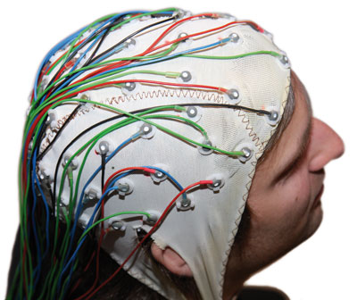
EEG Elements
Electrodes:
Active electrodes: Attached to the scalp
Reference electrode: Mastoid, nose, ear lobe...
Amplifier
The EEG records differences in voltage – difference in electrical potential from one electrode to another
Notes:
Electrodes: Ag/AgCl, tin…
A reference electrode is an electrode which has a stable and well-known electrode potential.
amplifier or simply amp, is a device for increasing the power of a signal.

Slide 28
EEG Rhythms
Alpha (α) waves
Most common in adults.
Posteriorly (occipital) more than anteriorly
Especially prominent with closed eyes and with relaxation.
Disappears normally with attention (e.g., mental arithmetic, stress, opening eyes).
In most instances, it is regarded as a normal waveform.

Slide 29
EEG Rhythms
Beta (β) waves
Small in amplitude
More evident anteriorly
Drugs, such as barbiturates and benzodiazepines, augment beta waves
Notes:
Barbiturates/benzodiazepines → central nervous system depressants

Slide 30
EEG Rhythms
Theta (θ) waves
Normally seen in sleep
In awake adults, these waves are abnormal if they occur in excess.

Slide 31
EEG Rhythms
Delta (δ) waves
Normally seen in deep sleep.
Delta waves are abnormal in the awake adult.
Often, they have the largest amplitude of all waves.
Theta and delta waves are known collectively as slow waves.

Slide 32
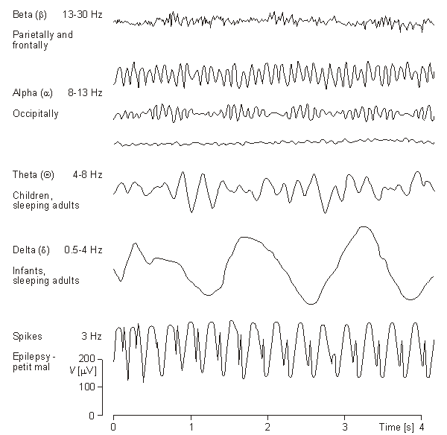
EEG Rhythms

Slide 33
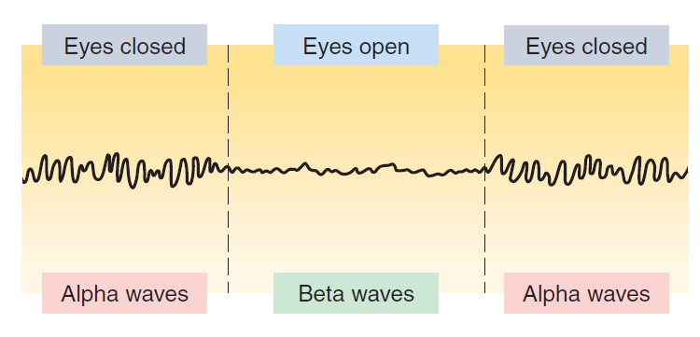
EEG uses
To distinguish various stages of sleep
A clinical tool in the diagnosis of cerebral dysfunction (e.g. Epilepsy)
Legal determination of brain death
Notes:
Epileptic
seizures occur when a large collection of neurons abnormally
undergo synchronous action potentials that produce stereotypical,
involuntary spasms and alterations in behavior.

