Slide 1
Congestive Heart Failure
mashehabat@just.edu.jo

Slide 2
Definition
Heart Failure: The inability of the heart to maintain an output adequate to maintain the metabolic demands of the body.

Slide 3
What is HF
Complex syndrome that can result from any structural or functional cardiac disorder that impairs the ability of the heart to function as a pump to support a physiological circulation.

Slide 4
Pathophysiology
Main Causes of Heart Failure:
Ischemic Heart Disease
Hypertension
Other Causes:
Valvular Heart Disease.
Congenital Heart Disease.
Alcohol and Drugs.
Arrhythmias………………

Slide 5
Pathophysiological Changes in HF
Ventricular Dilatation.
Myocyte Hypertrophy.
Salt and Water Retention.
Sympathetic Stimulation.
Peripheral Vasoconstriction.

Slide 6
Signs & Symptoms
Symptoms:
Exertional Dyspnoea
Orthopnia
Paraxysmal Nocturnal Dyspnoea
Signs:
Cardiomegaly
Elevated Jugular Venous Pressure
Tachycardia
Hypotension
Bi-basal crackles
Pleural effusion
Ankle Edema
Ascites
Tender hepatomegaly.

Slide 7
Classification of heart failure
No limitation. Normal physical exercise doesn’t cause fatigue, dyspnea or palpitations.
Mild limitation. Comfortable at rest but normal physical activity produces fatigue, dyspnea or palpitations.
Marked limitation. Comfortable at rest but gentle physical activity produces marked symptoms of HF.
Symptoms of HF occur at rest and are exacerbated by any physical activity.

Slide 8
Kussmaul’s sign
This is a rise in the JVP seen with inspiration. It is the opposite of what is seen in normal people and this reflects the inability of the heart to compensate for a modest increase in venous return. This sign is classically seen in constrictive pericarditis in association with a raised JVP. This condition was originally described in tuberculous pericarditis and is rarely seen. Kussmauls sign is also seen in right ventricular infarction, right heart failure, tricuspid stenosis, and restrictive cardiomyopathy. It is not seen in acute cardiac tamponade- although it may be seen if tamponade occurs with a degree of constricive pericardiditis

Slide 9
PMI
The apex beat, also called the point of maximum impulse (PMI), is the furthermost point outwards (laterally) and downwards (inferiorly) from the sternum at which the cardiac impulse can be felt. The cardiac impulse is the result of the heart rotating, moving forward and striking against the chest wall during systole.
The normal apex beat can be palpated in the precordium left 5th intercostal space, at the point of intersection with the left midclavicular line. In children the apex beat occurs in the fourth rib interspace medial to the nipple. The apex beat may also be found at abnormal locations; in many cases of dextrocardia, the apex beat may be felt on the right side. Lateral and/or inferior displacement of the apex beat usually indicates enlargement of the heart.

Slide 10
Heart Sounds
S1
The first heart sound - S1 - is in time with the pulse in your carotid artery in your neck. The sound of the tricuspid valve closing may be louder in patients with pulmonary hypertension due to increased pressure beyond the valve. Non-heart-related factors such as obesity, muscularity, emphysema, and fluid around the heart can reduce both S1 and S2. The position of the valves when the ventricles contract can have a big effect on the first heart sound. If the valves are wide open when the ventricule contracts, a loud S1 is heard. This can occur with anemia, fever or hyperthyroid. When the valves are partly closed when the ventricule contracts, S1 is faint. Beta-blockers produce a fainter S1. Structural changes in the heart valves can also affect S1. Fibrosis and calcification of the mitral valve may reduce S1, while stenosis of the mitral valve may cause a louder S1.
S2
The second heart sound marks the beginning of diastole - the heart's relaxation phase - when the ventricles fill with blood. In children and teenagers, S2 may be more pronounced. Right ventricular ejection time is slightly longer than left ventricular ejection time. As a result, the pulmonic valve closes a little later than the aortic valve. Higher closing pressures occur in patients with chronic high blood pressure, pulmonary hypertension, or during exercise or excitement. This results in a louder A2 (the closing sound of the aortic valve). On the other hand, low blood pressure reduces the sound. The second heart sound may be "split" in patients with right bundle branch block, which results in delayed pulmonic valve closing. Left bundle branch block may cause aortic valve closing (A2) to be slower than pulmonic valve closing (P2).
S3
During diastole there are 2 sounds of ventricular filling: The first is from the atrial walls and the second is from the contraction of the atriums. The third heart sound is caused by vibration of the ventricular walls, resulting from the first rapid filling so it is heard just after S2. The third heart sound is low in frequency and intensity. An S3 is commonly heard in children and young adults. In older adults and the elderly with heart disease, an S3 often means heart failure.
S4
The fourth heart sound occurs during the second phase of ventricular filling: when the atriums contract just before S1. As with S3, the fourth heart sound is thought to be caused by the vibration of valves, supporting structures, and the ventricular walls. An abnormal S4 is heard in people with conditions that increase resistance to ventricular filling, such as a weak left ventricle.

Slide 11
Edema
Bilateral lower extremity edema

Slide 12
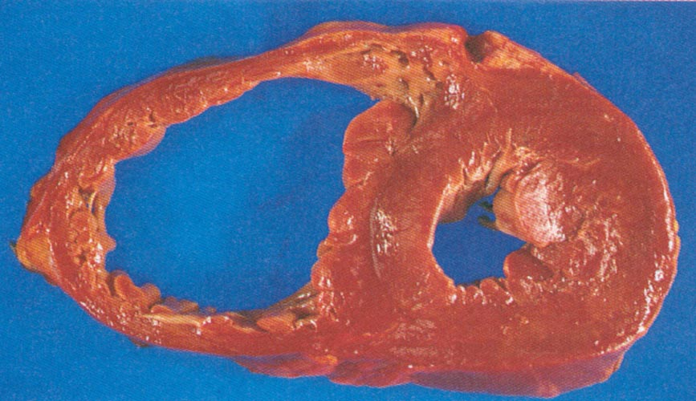
Hypertension
Hypertrophic Cardiomyopathy

Slide 13
Compensatory Mechanisms
Increased Heart Rate
Sympathetic = Norepinephrine
Dilation
Frank Starling = Contractility
Neurohormonal
Redistribution of Blood to the Brain

Slide 14
CHF Vicious Cycle
Low Output
Increased Preload Increased Afterload Norepinephrine
Increased Salt Vasoconstriction Renal Blood Flow
Renin
Angiotension I
Angiotension II
Aldosterone

Slide 15
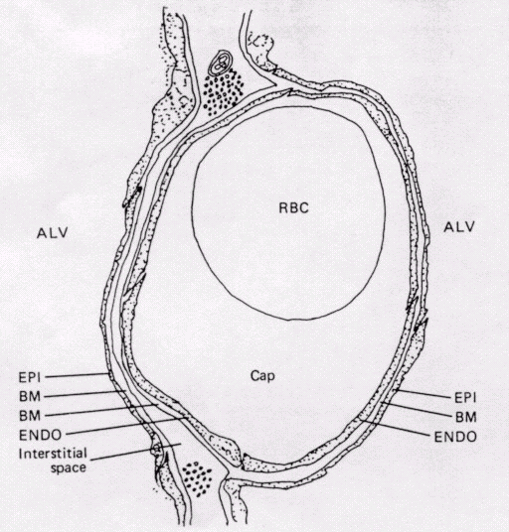
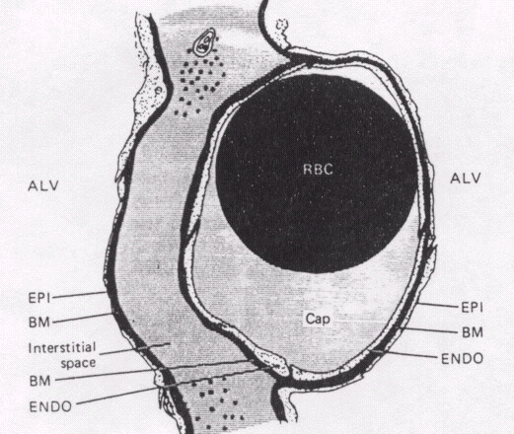
Infiltration of Interstitial Space
Normal
Micro-anatomy
Micro-anatomy with fluid movement.

Slide 16
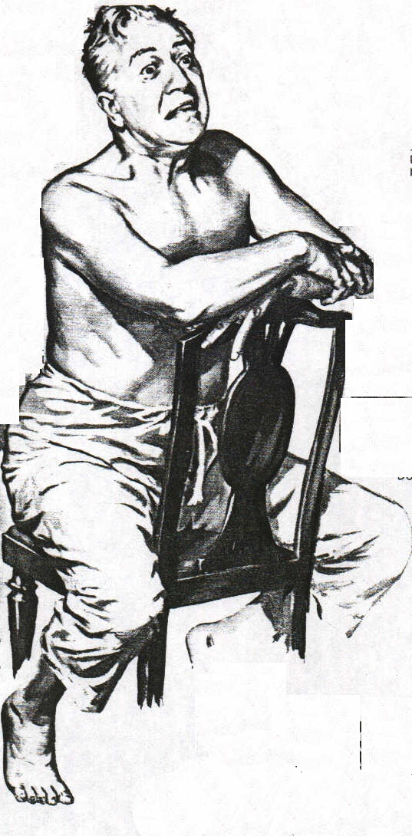
Acute Pulmonary Edema
a true life- threatening emergency

Slide 17
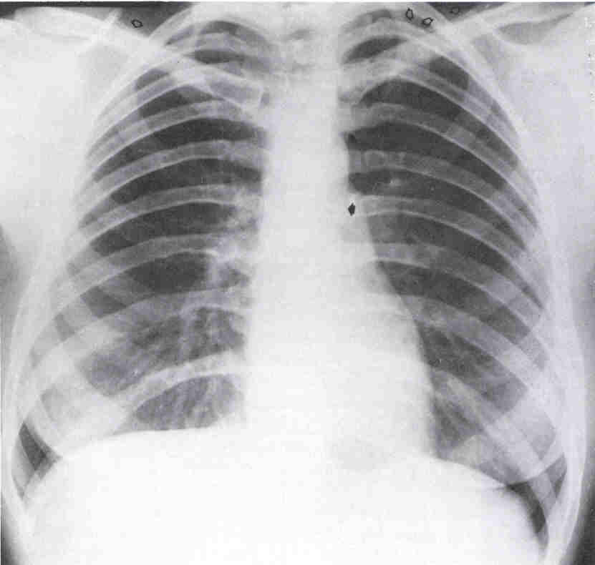
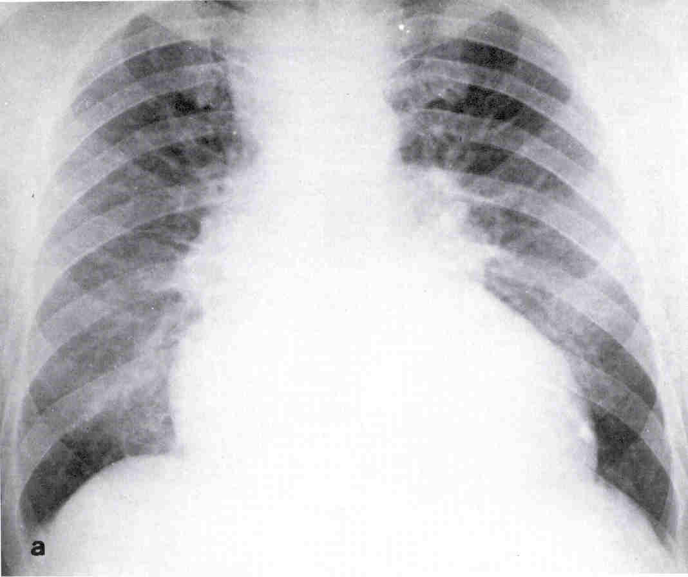

Slide 18
Treatment
Prevention. Control of risk factors
Life style
Treat etiologic cause / aggravating factors
Drug therapy
Personal care. Team work
Revascularization if ischemia causes HF
ICD (Implantable Cardiac Defibrillator)
Ventricular resyncronization
Ventricular assist devices
Heart transplant
Artificial heart
Neoangiogenesis, Gene therapy
All
Selected patients

Slide 19
Treatment Objectives
Survival
Morbidity
Exercise capacity
Quality of life
Neurohormonal changes
Progression of CHF
Symptoms
(Cost)
Notes:
Treatment of Heart Failure.
Objectives
The objectives of treatment of the patient with heart failure are many, but they may be summarized in two principles: decrease symptoms and prolong life. In daily practice, the first priority is symptom control and the best plan is to adjust to the individual patient’s particular circumstances over the course of therapy. Nevertheless, the rest of the listed objectives should not be forgotten, as medical therapy now has the potential for decreasing morbidity (hospital admissions, embolism, etc.), increasing exercise capacity (all of the usually prescribed drugs), improve the quality of life, control neurohormonal changes (ACE-I, beta blockers), retard progression (ACEI) and prolong life.

Slide 20
Treatment
Pharmacologic Therapy
Diuretics
ACE inhibitors
Beta Blockers
Digitalis
Spironolactone
Other
Notes:
Treatment of Heart Failure.
Drugs
This is a simple and pragmatic classification of the vast numbers and types of medications in the pharmacopoeia for the treatment of heart failure.

