Slide 1
Chapter 41 Assessment and Management of Patients With Diabetes Mellitus

Slide 2
Nursing Care for DM
Clients face lifelong changes in lifestyle and health status
Major role of the nurse is that of educator in both hospital and community settings
Plan of care and content differ according to the type of diabetes
Nursing care focuses on teaching to manage the illness

Slide 3
Diabetes Mellitus
A group of diseases characterized by hyperglycemia due to defects in insulin secretion, insulin action, or both
Affects nearly 21 million people in the United States
Almost 1/3 of cases are undiagnosed
Prevalence is increasing
Minority populations and the elderly are disproportionately affected

Slide 4
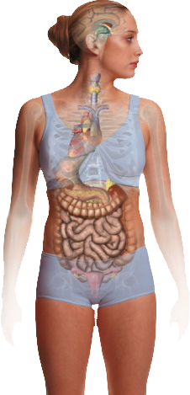
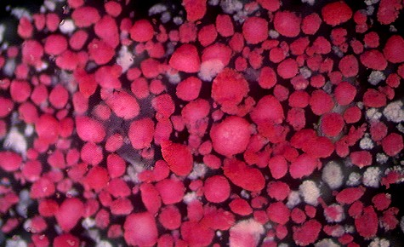
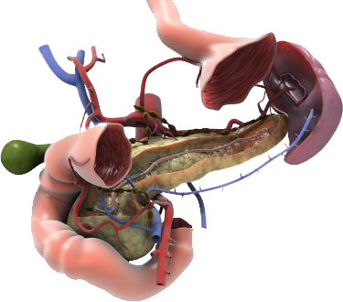
Endocrine Pancreas
Islets of Langerhans
Beta cells
Insulin
Pancreas
Islets (β-cells)

Slide 5
Functions of Insulin
Transports and metabolizes glucose for energy
Stimulates storage of glucose in the liver and muscle as glycogen
Signals the liver to stop the release of glucose
Enhances the storage of dietary fat in adipose tissue
Accelerates transport of amino acids into cells
Inhibits the breakdown of stored glucose, protein, and fat

Slide 6
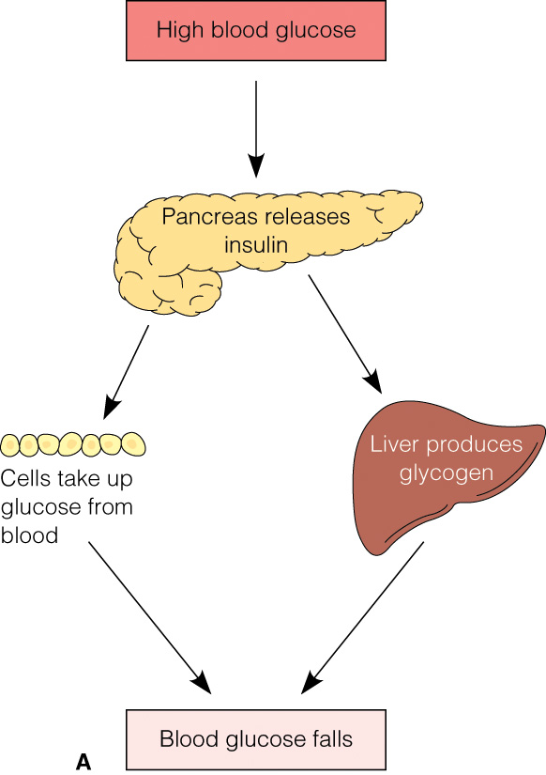
Type 1 and Type 2 Diabetes
Notes:
Figure 20–1 Regulation (homeostasis) of blood glucose levels by insulin and glucagon. A, High blood glucose is lowered by insulin release. B, Low blood glucose is raised by glucagon release.

Slide 7
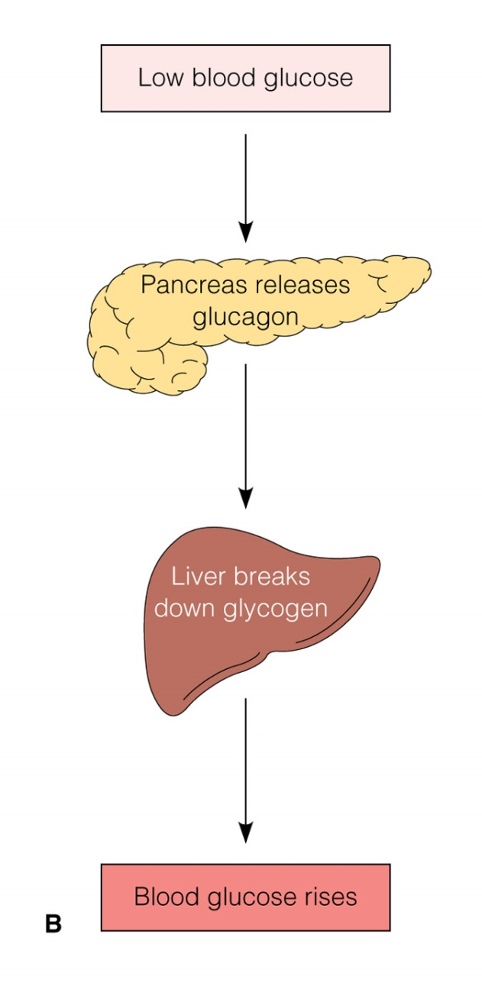
Type 1 and Type 2 Diabetes
Notes:
Figure 20–1 (continued) Regulation (homeostasis) of blood glucose levels by insulin and glucagon. A, High blood glucose is lowered by insulin release. B, Low blood glucose is raised by glucagon release.

Slide 8
Secretion of Insulin
Is stimulated by:
What change in homeostasis causes the beta cells to secrete insulin?
Hyperglycemia
Glucose levels in the bloodstream regulate the rate of insulin secretion

Slide 9
Normal physiologic insulin secretion
Conceptual depiction of physiologic insulin secretion
Normal prandial insulin
Insulin levels
Adapted from Mayfield.
Breakfast
Lunch
Supper
Bedtime
Normal Basal Insulin
24-hour profile
Insulin peaks immediately after meals (“prandial” insulin)
There is always a base amount of insulin available (“basal” insulin)
A constant supply of basal insulin is essential to maintain overall glycemic control

Slide 10
Endogenous basal and prandial insulin secretion (insulin secreted by the body)
Basal insulin secretion
Occurs continuously Suppresses hepatic glucose production between meals and overnight Maintains a nearly constant level throughout the day; therefore, it is not appropriate for handling post meal glucose increases Provides about 50% of daily insulin requirements
Prandial insulin secretion
Occurs in response to food intake or a meal Helps to control hyperglycemia after meals Provides the other 50% of daily insulin requirement

Slide 11
How does insulin work?
Insulin attaches to receptors on the surface of the body’s cells
Insulin acts as a “gatekeeper” for glucose, allowing it to enter cells
Insulin receptor
Cell
Glucose channel
Glucose

Slide 12
Classifications of Diabetes
Type 1 diabetes
Type 2 diabetes
Gestational diabetes
Diabetes mellitus associated with other conditions or syndromes
See Table 41-1

Slide 13
Type 1 Diabetes
Insulin producing beta cells in the pancreas are destroyed by an autoimmune process
Requires insulin, as little or no insulin is produced
Onset is acute and usually before 30 years of age
5–10% of persons with diabetes

Slide 14
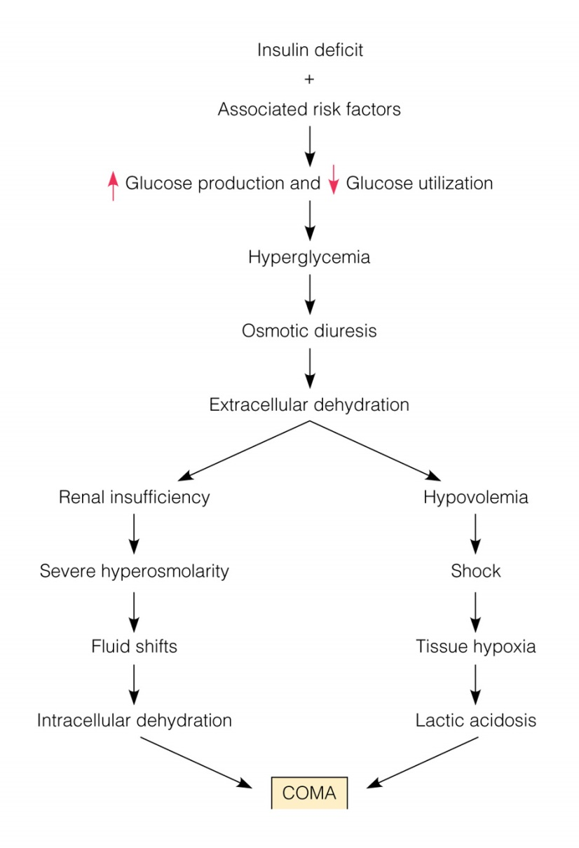
Type 1 and
Notes:
Figure 20–2 Pathophysiologic results of type 1 DM.

Slide 15
Type 2 Diabetes
Decreased sensitivity to insulin (insulin resistance) and impaired beta cell function results in decreased insulin production
90–95% of person with diabetes
More common in persons over age 30 and in the obese
Slow, progressive glucose intolerance
Treated initially with diet and exercise
Oral hypoglycemic agents and insulin may be used

Slide 16
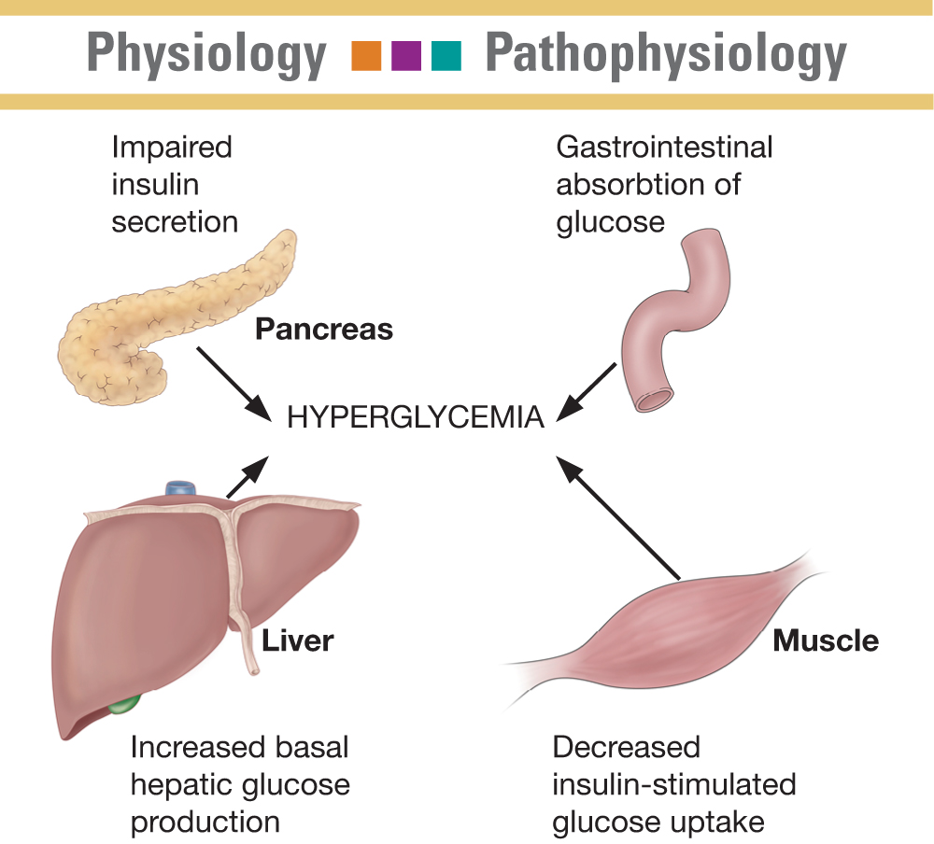
Pathogenesis of Type 2 Diabetes

Slide 17
Type 1 vs. Type 2
Age of onset
Usually < 30
Age of onset
Usually > 40

Slide 18
Type 1 vs. Type 2
Body wt at onset
Normal to thin
Insulin production
None
Insulin injections
Always
Body wt at onset
80% overweight
Insulin production
Not enough
Insulin injections
Sometimes

Slide 19
Type 1 vs. Type 2
Management
Insulin
Diet
Exercise
Management
Diet (wt. Loss)
Exercise
Possibly oral hypoglycemic meds
Possibly insulin

Slide 20
Other specific types of Diabetes Mellitus
Gestational
Pancreatitis
Drug or chemical induces diabetes (steroids)

Slide 21
Risk Factors
Type 1: not inherited but a genetic predisposition combined with immunologic and possibly environmental (viral) factors
Type 2: family history of diabetes, obesity, race/ethnicity, age greater than 45 years, previous identified impaired fasting glucose or impaired glucose tolerance, hypertension ≥ 140/90, HDL ≤ 35 and/or triglycerides ≥ 250, history of gestational diabetes or babies over 9 pounds
See Chart 41-1

Slide 22
Clinical Manifestations
“Three Ps”
Polyuria
Polydypsia
Polyphagia
Fatigue, weakness, vision changes, tingling or numbness in hands or feet, dry skin, skin lesions or wounds that are slow to heal, recurrent infections
Type 1 may have sudden weight loss, nausea, vomiting, and abdominal pain if DKA has developed

Slide 23
S&S of Hyperglycemia
Neurological
C/O headache
Dull senses
Stupor
Drowsy
Blurred Vision

Slide 24
S&S of Hyperglycemia
Cardiovascular
Tachycardia
Decreased BP
(Dehydration)
Respiratory
Kussmaul's respirations
Sweet and fruity breath
Acetone breath

Slide 25
S&S of Hyperglycemia
Gastro-intestinal
Polyphagia
N/V
Polydipsia

Slide 26
S&S of Hyperglycemia
Genital-urinary
Polyuria
Glycosuria
Skeletal-muscular
Weak

Slide 27
S&S of Hyperglycemia
Integumentary
Dry skin
Flushed face

Slide 28
Diagnostic tests
Blood glucose / Fasting blood glucose
Glycosylated Hemoglobin Assay

Slide 29
Blood Glucose Fasting blood Glucose
Measures blood glucose levels after fasting
Results
Normal – 70-115 mg/dL
Diabetic level > 126 mg/dL
Critical > 400 mg/dL
Critical < 50 mg/dL

Slide 30
Fasting Blood Glucose Nursing Responsibility
Fast 6-8 hours
Water OK
No insulin or anti-diabetic meds
Exercise will effect results

Slide 31
Glycosylated Hemoglobin Assays (Hgb A1C)
% of glycosylated hemoglobin
RBC lifecycle
@ 120 days (4 months)
Glucose slowly binds with Hgb → glycosylated
h serum glucose level → h glycosylated Hgb levels

Slide 32
Hgb A₁C
Provides an average blood glucose levels
Past 2-3 months
Can be taken any time

Slide 33
Normal levels (non-diabetic)
4-6%
Diabetic level (goal)
<8%

Slide 35
Small Group Questions
Mr. McMillan is a 50 year old client brough into the ER with extreme fatigue and dehydration. After the MD sees him the nurses asks Mr. McMillan some additional questions. Based on the clients answers the nurse requests that the MD add a glucose level to the lab work. The results are 800mg/dL.

Slide 36
Small group questions
What question did the nurse most likely ask?
Why was Mr. McMillan fatigued?
Why was he dehydrated?

Slide 37
Type 1 & 2 Diabetes: Key Concepts
Minimizing the complications of diabetes requires:
Early diagnosis and treatment of diabetes
Maintaining HbA_{1C} level < 7%
Achieving HbA_{1C} < 7% requires control of post-prandial and fasting hyperglycemia
Notes:
They key concepts in type 2 diabetes are (1) minimize diabetes complications with early diagnosis and treatment with maintenance of HbA_{1C} below 7% and (2) achieving this control by reducing both post-prandial and fasting hyperglycemia.
New treatment guidelines are expected in December 2003 which stress the need for tighter glycemic control. The recommendations will be for fewer steps and more aggressive treatment earlier on in order to reach glucose target levels.

Slide 38
CDA Guidelines (for glycemic control)
Normal
Optimal
A_{1C} level
(0.04-0.06)
(< 0.07)
Preprandial
glycemia
3.5-6.1
4-7
(mmol/L)
Postprandial
glycemia
4.4-7.8
7-11
(
mmol/L)
Haars s et al., CMAJ 2003; 159 (Suppl.): S1-29. Gerstein, H.C. et al. CDA views on the UKPDS and revision of the guidelines affected by the results of this study.

Slide 39
Steps to Glycemic Control
Establish glycemic objectives
Target fasting and post-prandial glycemia
Diet counseling with exercise component
Diabetes education for every patient
Pharmacological treatment; oral and insulin

Slide 40
Medical Management of DM
No cure
Goal is Control! And prevent complications
Individualized treatment plans
Diet
Exercise
Meds

Slide 41
Treatment goal is to normalize blood glucose levels
Intensive control dramatically decreases vascular and neuropathic complications

Slide 42
Dietary Management—Goals
Provide optimal nutrition; all essential food constituents
Meet energy needs
Achieve and maintain a reasonable weight
Prevent wide fluctuations of blood glucose levels
Decrease serum lipids, if elevated

Slide 43
Role of the Nurse
Be knowledgeable about dietary management
Communicate important information to the dietician or other management specialists
Reinforce patient understanding
Support dietary and lifestyle changes

Slide 44
The exchange system
Six categories
Starch
Meat
Milk
Vegetable
Fruit
Fat

Slide 45
General guidelines of Dietary Management
Protein
20%
Fat
20%
Carbohydrates
60%
ADA: American Diabetic Association

Slide 46
Diabetic Meal Plan
Small frequent meals
CONSISTENCY!
Amount of calories
Amount of carbohydrates
Time
Snacks
Notes:
Pacing food intake throughout the day places more manageable demands on the pancreas

Slide 47
Diabetic Meal Plan
If the client is obese, the key to treatment is…
Weight loss!

Slide 48
Meal Plan considerations
Food preferences
Lifestyle
Schedule
Ethnic / Cultural background

Slide 49
Glycemic Index
Describes how much a food increases blood glucose
Combine starchy food with protein and fat containing food slows absorption, and glycemic response
Raw or whole foods tend to have lower response than cooked, chopped, or pureed foods
Eat whole fruits rather than juices; decreases glycemic response due to fiber-slowing absorption
Adding food with sugars may produce lower response if eaten with foods that are more slowly absorbed

Slide 50
Other Dietary Concerns
Alcohol
Nutritive and nonnutritive sweeteners
Reading labels

Slide 51
Exercise and Diabetes
i blood glucose levels

Slide 52
Exercise
Lowers blood sugar
Aids in weight loss
Lowers cardiovascular risk

Slide 53
More Benefits of exercise
Increases circulation
Improve serum lipid levels
Improves cardiovascular status
Assist with wt control
Decreases stress

Slide 54
Exercise Precautions
Exercise with elevated blood sugar levels (above 250 mg/dL) and ketones in urine should be avoided
Insulin normally decreases with exercise; patients on exogenous insulin should eat a 15g carbohydrate snack before moderate exercise to prevent hypoglycemia
If exercising to control or reduce weight, insulin must be adjusted
Best time = 60-90 minutes after a meal
Potential post-exercise hypoglycemia
Need to monitor blood glucose levels

Slide 55
Exercise Recommendations
Encourage regular daily exercise
Gradual, slow increase in exercise period is encouraged
Modify exercise regimen to patient needs and presence of diabetic complications or potential cardiovascular problems
Exercise stress test for patients older than age 30 who have 2 or more risk factors is recommended
Gerontologic considerations
See Chart 41-5

Slide 56
Monitoring:
Self-Monitoring of blood glucose( SMBG): Enables people with DM to adjust the treatment regimen to obtain optimal blood glucose control. Allow early detection of hypo and hyperglycemia and normalizing blood glucose levels.
Disadvantages of SMBG are in the need for good visual acuity, fine motor coordination, cognitive ability, comfort with technology, willingness and cost
Candidates for SMBG:
- Unstable DM
- A tendency for sever ketosis and hypoglycemia
- Hypoglycemia without warning symptoms
- Abnormal renal glucose threshold

Slide 57
Cont….
Glucosylated Hemoglobin: HgbA1c (2-3 month)
Urine testing for glucose
Urine testing for Ketones (Ketonuria): should be performed whenever patients with type 1 have glucosuria or persistently elevated blood glucose levels ( more than 240mg/dl for two testing periods), and during illness and pregnancy.

Slide 58
Ideal Testing Frequency
Stable type 2
1-2 readings/day
Type 1 or Unstable type 2
3-8 readings/day
Important to stress the need to vary testing times
AC, PC, h.s. and prn during the night

Slide 59
DM Screening and Monitoring Tests
DM Screening Tests
Casual plasma glucose (PG): (>200 mg/dL) any time of day without regard to time since the last meal
Fasting plasma glucose (FPG): (> 126 mg/dL) no caloric intake in 8 hours
Two-hour PG: (>200mg/dL) during an oral glucose tolerance test

Slide 60
DM Screening and Monitoring Tests
Urine test: indicates presence of protein as albumin
Serum cholesterol and triglyceride levels: indicators of arthrosclerosis and increased cardiovascular impairment
Serum electrolytes: measure in clients who have DKA or HHS to determine imbalances

Slide 61
Insulin Therapy
Blood glucose monitoring
Categories of insulin (see Table 41-3)
Rapid-acting
Short-acting
Intermediate-acting
Very long-acting
Inhaled insulin

Slide 62
Onset – Peak - Duration
Onset
The time period from injection to when it begins to take effect
Peak
When insulin is working its hardest and therefore blood glucose levels are at their lowest

Slide 63
Onset – Peak - Duration
Duration
Length of time the insulin works or lasts

Slide 64
Insulin Preparations
Rapid-acting
Vial and cartridge
Aspart (NovoRapid®) Lispro (Humalog®)
Start < 15 min.
Short-acting (regular) Vial and cartridge
Novolin®ge Toronto Humulin® R
Start 30-60 min.
Peak 4 hr
Intermediate Vial and cartridge
Novolin®ge NPH
Humulin® N
Start 1.5 hrs
Peak 7 hr
Prolonged action
Humulin® U vial only
Lantus (Glargine) vial only
Levemir (Detemir) cartridge
Start 3-4 hrs. Peakless
Notes:
Novolin® (Insulin, Human Biosynthetic) is a trademark owned by Novo Nordisk A/S and used by Novo Nordisk Canada Inc., under licence.
Humulin® is a registered trademark of Eli Lilly Canada Inc.

Slide 65
Insulin PreMixes
Regular + intermediate
Novolin® 10/90, 20/80, 30/70, 40/60, 50/50
Humulin® 30/70, 20/80
Analogue Pre-Mix
Humalog® 25/75 (insulin lispro protamine suspension)
NovoMix 30* (protaminated insulin aspart)

Slide 66
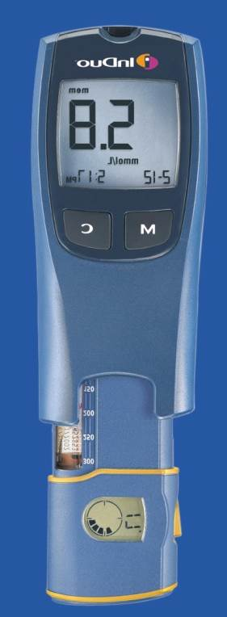
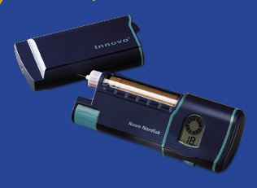
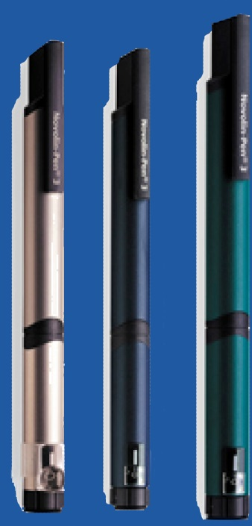
Advancing Insulin Therapy Through Device Innovation
Notes:
Pens, for example Novolin-Pen® 3, is the most commonly used insulin delivery device.
Innovo® is the first ‘ doser ’ on the market. It has a memory feature that tells patients if and when they took their last dose and the number of units of their last dose. It has a number of other helpful features.
InDuo® is the newest insulin delivery system that has integrated both the insulin delivery device and the glucose meter.
Note to speaker:
Speak to your Novo Nordisk representative about the opportunity for the attending physicians to inject themselves, using Novo-Pen® 1.5 and NovoFine® needles. This may be useful in having them overcome their own fears.

Slide 67
Types of Insulin – Very short acting/ rapid acting
Lispro (Humalog)
Aspart (Novolog)
Insulin pumps
Rapid reduction of glucose level
Appearance | Onset | Peak | Duration
Clear | ¼ hour | 1 hour | 3 hours

Slide 68
Types of Insulin – Short-acting / regular
Humalog R; Novolin R; Iletin II Regular
Administered 20-30 minutes before meals
IV
Usually given 4 x a day
Appearance | Onset | Peak | Duration
Clear | ½ - 1 hr (1 hour) | 2-3 hrs (3 hour) | 4-6 hrs (5 hours)

Slide 69
Types of Insulin – Intermediate-acting
NPH; Humulin N; Lente: Novolin L; Novolin N
Administer after meals
Usually given 2x a day
Eat at onset!
Appearance | Onset | Peak | Duration
Cloudy | 2-4 hrs (2 hrs) | 6-12 hrs (12 hrs) | 16-20 hrs (24 hrs)

Slide 70
Learning Tip: Even and Odd
Short-acting think odd
(1-3-5)
Intermediate-acting think even
(2-12-24)

Slide 71
When should insulin be administered
Short-acting / regular
30 min before meals (ac)
Do not allow more than 30 min to pass by without eating
→ hypoglycemia
Intermediate acting
After meals (pc)
If mixed (regular & intermediate)
30 min before meals

Slide 72
What route is insulin administered
IV
Regular
Sub-cutaneous

Slide 73
Syringe Types
Insulin syringe
27-29 gauge

Slide 74
Route (Self Administration)
Subcutaneous tissue
If you can “pinch an inch”
90 degree angle
If you can’t “pinch an inch”
45 degree angle

Slide 75
Area’s of injection
Abdomen
Arm
Thigh
Hips

Slide 76
Factors affecting absorption rates
Quickest
Abdomen

Slide 77
Insulin Pumps
Portable infusion pump
Subcutaneous needle
Continuous/basal rate
Additional bolus if needed
Change site q24-48 hours

Slide 78
Insulin Pumps
S/E - risks
Hypoglycemia
Infection
Hyperglycemia

Slide 79
Small Group Question
Mrs. Evans is 60 year old women with type 2 DM. She is on Intermediate Acting Insulin [Novolin L (Lente)] every morning. She normally eats her meals at 8:00 AM, 12:00 PM, and 6:00 PM.
What time should she take her morning insulin?
When will this dose onset?
When will this does peak?
What does this insulin look like?

Slide 80
Sliding Scale
Used during
Surgery
Illness
Stress
Determines insulin dose based on FSBG
FSBS check usually every 4-6 hrs
Usually regular insulin is used

Slide 81
Sample Sliding Scale
Check FSBS before meals and at HS (2200)
4u Humulin R insulin for glucose 151-200 mg/dL
6u Humulin R insulin for glucose 201-250 mg/dL
8u Humulin R insulin for glucose 251-300 mg/dL
10u Humulin R insulin for glucose 301-350 mg/dL
Call MD for glucose >350 mg/dL

Slide 82
Insulin Storage
Vial NOT being used →refrigerate
Vial in use → room temperature
Storage life un-refrigerated = 1 month

Slide 83
Insulin regimens:
1. Conventional regimen: is to simplify the insulin regimen ( 1-2 injections/day). May be appropriate for the terminally ill, unwilling or unable to engage in the self-management activities that are part of amore complex insulin regimen
2. Intensive regimen: 3-4 injection/day to achieve as much control over blood glucose levels as is safe and practical and to decrease complications

Slide 84
Teaching Patients Insulin Self-Management
Use and action of insulin
Symptoms of hypoglycemia and hyperglycemia
Required actions
Blood glucose monitoring
Self-injection of insulin
Insulin pump use

