Slide 1
Complications of insulin therapy:
The most common complication of insulin therapy is hypoglycemia.
Local allergic reaction: swelling, redness, tenderness and induration… 2-4 cm wheal may appear in the sight of injection 1-2 hours after injection administered. (occur at the beginning stage of therapy).
Systemic allergic reactions: Are rare. Can treated with giving small doses of insulin which gradually increased.
Insulin lipodystrophy: local reaction cause either lipoatrophy or lipohypertrophy (fibrofatty masses) at the site of injection.

Slide 2
Cont…
Insulin resistance: due to obesity or immune antibodies.
Morning Hyperglycemia: insufficient level of insulin due to dawn phenomena (normal glucose level up to 3 am when Bld glucose start to rise) and Somogyi effect (nocturnal hypoglycemia followed by rebound hyperglycemia)
- Insulin waning: the progressive increase in blood glucose from bed time to morning and is prevented by moving the evening dose of NPH insulin to bed time

Slide 3
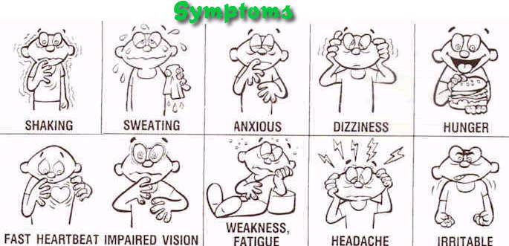
Insulin Therapy Complications
Hypoglycemia
Causes
  Too much insulin
  Too little food
  Extreme exercise

Slide 4
Hypoglycemia
Definition: When blood glucose levels fall below 70mg/dL
< 50mg/dL = severe

Slide 5
Hypoglycemia: Etiology
Any time
  Usually: Before meals or a night
Too much insulin or oral hypoglycemic meds
Too little food
Excessive exercise
Notes:
Skipped meals, Under-eating, Eating late
Unplanned exercise
Excess insulin or oral hypoglycemic meds

Slide 6
S&S of Hypoglycemia
Neuro
  Dizzy / faint
  Nervous / Irritability
  Blurred vision
  Numb tongue or lips

Slide 7
S&S of Hypoglycemia
Cardiovascular
  Full bounding pulse
Respiratory
  Shallow breathing
Gastro-intestinal
  Polyphagia

Slide 8
S&S of Hypoglycemia
Genital-urinary
  No polydipsia
  No polyuria
Skeletal/muscular
  Weak
  Trembling / tremor
Integumentary
  Perspiring/ Moist
  Pale

Slide 9
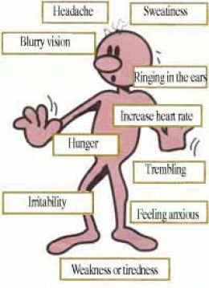
Hypoglycemia:
Dx & Assessment
Signs & Symptoms
Can occur suddenly!
If pt is a long time diabetic →
No early S&S

Slide 10

Hypoglycemia:
Dx & Assessment
#1 Dx tool
  Lab Values
FSBS

Slide 11
Hypoglycemia can result:
When a patients baseline blood glucose level is 100mg/dL →
  Drops to 60 mg/dL
When a patients baseline blood glucose level is 200mg/dL →
  Drops to 120 mg/dL

Slide 12
Hypoglycemia:
Medical Management
Assess for S&S
P blood sugar level
Admin. fast sugar

Slide 13
Hypoglycemic Protocol: Sample
For BG <60 mg/dL
  If patient can take PO, give 15g of fast acting carbohydrate.
  Check FSBG q 15 minutes and repeat above if BG<80.

Slide 14
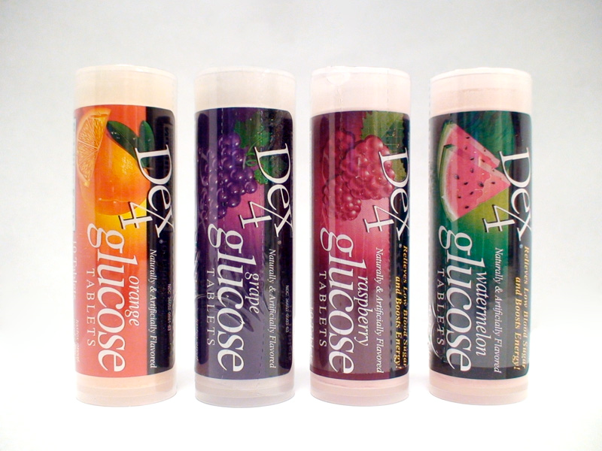
Glucose Fast!
15 g fast acting carbohydrate
  4-6 oz. Juice/soda

Slide 15
Rules to remember
Do not add sugar to OJ
Recheck FSBS q 15 min until WNL
Avoid high fat → slows absorption of glucose
Instruct: carry fast sugar
NPO if “unconscious” or confused
If meal is >1 hr away, follow with a protein and complex carbohydrate

Slide 16
Hypoglycemia treatment
Unconscious
Position: side lying

Slide 17
Hypoglycemia
Gerontological Consideration
Cognitive deficits →
  not recognize S&S
Decreased renal function →
  oral hypoglycemic meds stay in body longer
More likely to _________a meal
  Skip
Vision problems →
  inaccurate insulin draws

Slide 18
Hypoglycemia
Nursing measures
Follow protocol
Teach
  Carry simple sugar at all times
  S&S or hypoglycemia
  How to prevent Hypoglycemia
  Check FSBS if you suspect → NOW!

Slide 19
Somogyi Effect
Hyperglycemia secondary to asymptomatic hypoglycemia (especially at night)
If the insulin is increased in evening, the problem worsens
Check capillary glycemia around 3 a.m. to eliminate hypoglycemia
In this case, reduce the h.s. NPH
Notes:
The Somogyi effect is often best illustrated by a log book or case example.

Slide 20

I
N
S
U
L
I
N
I
N
J
E
C
T
I
O
N
Somogyi Phenomenon
Cause:
Counter regulatory hormones response to hypoglycemia at med-night.
Increase in hepatic glucose production.
Insulin resistance because of the Counter regulatory hormones.
Treatment:
Decrease pre-supper intermediate insulin.
Defer the dose to 9 PM.
Change or start pre-bed snack.
Multiple Insulin Injection Therapy

Slide 21
I
N
S
U
L
I
N
I
N
J
E
C
T
I
O
N
Dawn Phenomenon
Cause:
Less insulin at bed time.
More food at bed time.
Not using NPH at night.
Treatment:
Use enough dose.
Reduce bed time snack.
Add NPH pre-supper.
Multiple Insulin Injection Therapy

Slide 22
Oral Antidiabetic Agents
Used for patients with type 2 diabetes who cannot be treated with diet and exercise alone.
Combinations of oral drugs may be used
Major side effect: hypoglycemia
Nursing interventions: monitor blood glucose, and for hypoglycemia and other potential side effects
Patient teaching

Slide 23
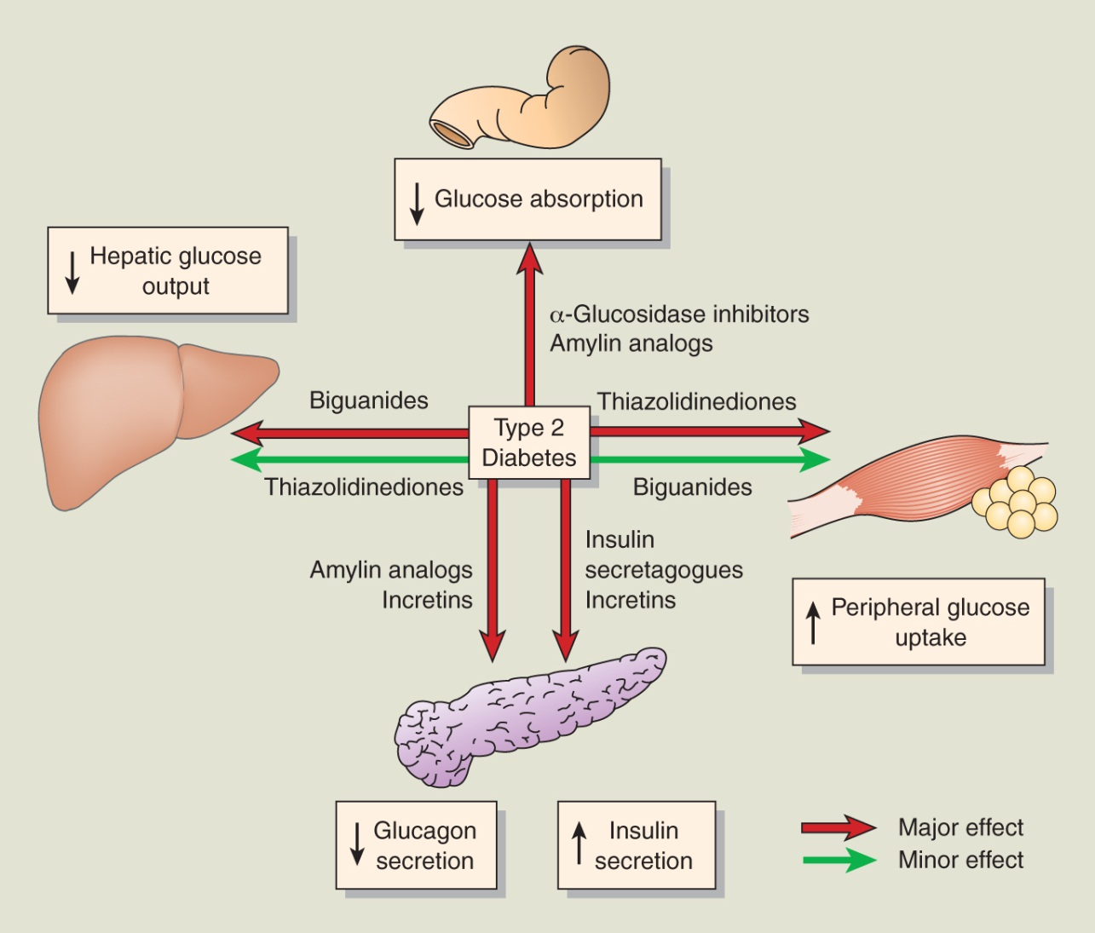
Sites of Action of Oral Antidiabetic Agents

Slide 24
Oral Antidiabetic Drugs
● Classification
Sulfonylureas
Thiazolidinediones
Biguanides
α-glucosidase inhibitors
Meglitinides

Slide 25
Oral Hypoglycemic Agents
Sulfonylurea
Cholpropamide (Diabanese)
Glipizide (Glucotrol)
Glimepride (Amaryl)
Glyburide (Diabeta, Micronase)

Slide 26
Oral Hypoglycemic Agents
Biguanides
  Metformin (Glucophage)
  Glucovance
  Sulfonyurea+Biguanide

Slide 27
Oral Hypoglycemic Agents
Oral hypoglycemic meds are not Insulin
Oral hypoglycemic meds require some production of insulin
Oral hypoglycemic agents are used in the treatment of type ___DM
  Type 2
Oral hypoglycemic meds are meant to supplement diet and exercise, not replace them

Slide 28
Oral Hypoglycemic Agents
Oral hypoglycemic meds cannot be used during pregnancy
Oral hypoglycemic meds may need to be held temporarily and insulin prescribed if BS levels rise due to stress or illness etc.
Action varies so effect may be enhanced by use of multiple meds

Slide 29
Sulfonylureas
Sulfonylurea’s work primarily by h the secretion of insulin by directly stimulating the pancreas
Side-effects of Sulfonylurea
  Hypoglycemia
  GI upset

Slide 30
Biguanides
Biguanides work primarily by aiding insulin’s action on peripheral receptor sites (target cells)
Biguanides are NOT associated with episodes of hypoglycemia
Biguanides + sulfonylurea may h the glucose lowering effect

Slide 31
Biguanides
Major side effects of Metformin are:
  Anorexia/ wt. Loss
Metformin is contraindicated in patients with Renal impairment

Slide 32
Ⅱ. Thiazolidinediones (Tzds)
Representative Drugs rosiglitazone troglitazone
pioglitazone ciglitazone
Pharmacological effects
●Improving function of pancreas β cells
●Ameliorating insulin resistance
●Ameliorating fat metabolic disorder
●Preventing and treating type 2 diabetes mellitus and their cardiovascular complications
Adverse reactions
Troglitazone occasionally induces hepatic injury

Slide 33
Ⅳ. α-glucosidase inhibitors
Representative Drugs
acarbose voglibose miglitol
Key points
● To inhibit digestion of starch & disaccharides via competitively inhibiting intestinal α-glucosidase (sucrase, maltase, glycoamylase, dextranase)
● Used alone or together with sulfonylureas to treat type 2 diabetes
● Main adverse reaction: flatulence, diarrhea, bellyache.
● Patients with inflammatory bowel disease & kidney impaired forbidden.

Slide 34
Ⅴ. Meglitinides
Representative Drugs
Repaglinide
Key point
● To increase insulin release by inhibiting ATP-sensitive K⁺-channel
● Unlike sulfonylureas, they have no direct effect on insulin release
● Used alone or together with biguanides to treat type 2 diabetes
● Carefully used for patients with kidney or liver impaired.

Slide 35
Insulin and Oral
Hypoglycemic Agents
Insulin
  Monitor storage and expiration of insulin
  Monitor and maintain a record of blood glucose readings as prescribed
  Monitor food intake
Oral Hypoglycemics
  Administer with food
  Assess diet and exercise
  Monitor for hypoglycemia and hyperglycemia
  Assess for side effects

Slide 36
Acute Complications of Diabetes
Hypoglycemia
Diabetic ketoacidosis (DKA)
Hyperglycemic hyperosmolar nonketotic syndrome (HHNS), aka hyperosmolar nonketotic coma or hyperglycemia hyperosmolar syndrome (HHS)

Slide 37
Hypoglycemia
Abnormally low blood glucose level (below 50–60 mg/dL)
Causes include too much insulin or oral hypoglycemic agents, too little food, and excessive physical activity
Manifestations
  Adrenergic symptoms: sweating, tremors, tachycardia, palpitations, nervousness, hunger
  Central nervous system symptoms: inability to concentrate, headache, confusion, memory lapses, slurred speech, numbness of lips and tongue, irrational or combative behavior, double vision, drowsiness
  Severe hypoglycemia may cause disorientation, seizures, and loss of consciousness

Slide 38
Assessment
Onset is abrupt and may be unexpected
Symptoms vary from person to person
Symptoms also vary related to the rapidly of decrease in blood glucose and usual blood glucose range
Decreased adrenergic response may affect symptoms in persons who have had diabetes for many years probably related to autonomic neuropathy

Slide 39
Complications
  Manifestations of hypoglycemia caused by responses of the autonomic nervous system
    Hunger
    Shakiness
    Nausea
    Irritability
    Anxiety
    Rapid pulse
    Pale, cool skin
    Hypotension
    Sweating

Slide 40
Complications
  Manifestations caused by impaired cerebral function
    Strange or unusual feelings
    Slurred speech
    Blurred vision
    Headache
    Decreasing levels of consciousness
    Difficulty in thinking
    Inability to concentrate
    Seizures
    Change in emotional behavior
    Coma

Slide 41
Management of Hypoglycemia
Treatment must be immediate
Give 15 g of fast-acting, concentrated carbohydrate
  3 or 4 glucose tablets
  4–6 ounces of juice or regular soda (not diet soda)
  6–10 hard candies
  2–3 teaspoons of honey
Retest blood glucose in 15 minutes, retreat if >70 mg/dL or if symptoms persist more than 10–15 minutes and testing is not possible.
Provide a snack with protein and carbohydrate unless the patient plans to eat a meal within 30–60 minutes.

Slide 42
Emergency Measures
If the patient cannot swallow or is unconscious:
  Subcutaneous or intramuscular glucagon 1 mg
  25–50 mL 50% dextrose solution IV

Slide 43
Diabetic Ketoacidosis (DKA)
Caused by an absence of or inadequate amount of insulin resulting in abnormal metabolism of carbohydrate, protein, and fat
Clinical features
  Hyperglycemia
  Dehydration
  Acidosis
Manifestations include polyuria, polydipsia, blurred vision, weakness, headache, anorexia, abdominal pain, nausea vomiting, acetone breath, hyperventilation with Kussmaul respirations, and mental status changes

Slide 44
Pathophysiology of DKA
Causes:
1. Decreased or missed dose of insulin.
2. illness (stress………> which stimulate the secretion of certain hormones such as glucagon, epinephrine and norepinephrine, cortisol, and growth hormone….. Promote production of glucose from liver and interfere glucose utilization
3. Undiagnosed and untreated diabetes

Slide 45
Assessment of DKA
Blood glucose levels vary from 300–800 mg/dL
Severity of DKA is not related to blood glucose level
Ketoacidosis is reflected in low serum bicarbonate and low pH; low PCO₂ reflects respiratory compensation
Ketone bodies in blood and urine
Electrolytes vary according to water loss and level of hydration

Slide 46
Complications
Manifestations of Diabetic Ketoacidosis
  Dehydration (from hyperglycemia)
    Thirst
    Weakness
    Warm, dry skin with poor turgor
    Malaise
    Soft eyeballs
    Rapid, weak pulse
    Dry mucous membranes
    Hypotension

Slide 47
Complications
  Metabolic acidosis (from ketosis)
    Nausea and vomiting
    Lethargy
    Ketone (fruity, alcohol-like) breath odor
    Coma
  Other manifestations
    Abdominal pain (cause unknown)
    Kussmaul’s respirations (increased rate and depth of respirations, with a longer expiration; a compensatory response to prevent a further decrease in pH)

Slide 48
Prevention
“Sick day rules”
Assess for underlying causes
Diagnosis and proper management of diabetes

Slide 49
Treatment of DKA
Rehydration with IV fluid
IV continuous infusion of regular insulin
Reverse acidosis and restore electrolyte balance
Note: rehydration leads to increased plasma volume and decreased K⁺, insulin enhances the movement of K⁺ from extracellular fluid into the cells
Monitor
  Blood glucose and renal function/UO
  EKG and electrolyte levels—Potassium
  VS, lung assessments, signs of fluid overload

Slide 50
Hyperglycemic Hyperosmolar Nonketotic Syndrome
Hyperosmolality and hyperglycemia occur due to lack of effective insulin. Ketosis is minimal or absent.
Hyperglycemia causes osmotic diuresis with loss of water and electrolytes; hypernatremia, and increased osmolality occur.
Manifestations include hypotension, profound dehydration, tachycardia, and variable neurologic signs due to cerebral dehydration.
High mortality.

Slide 51
Complications
  Manifestations of hyperosmolar hyperglycemic state (HHS)
    Occurs in clients who have type 2 diabetes and is characterized by a plasma osmolarity of 340 mOsm/L or greater, and blood glucose levels of over 600 mg/dl, which causes altered levels of consciousness

Slide 52
Treatment of HHNS
Rehydration
Insulin administration
Monitor fluid volume and electrolyte status
Prevention
  BGSM
  Diagnosis and management of diabetes
  Assess and promote self-care management skills

Slide 53
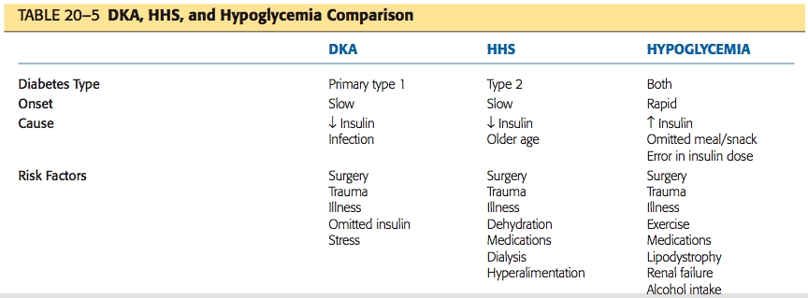
DKA, HHS, and
Hypoglycemia Compared

Slide 54
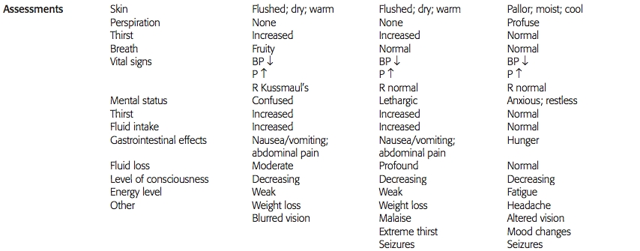
DKA, HHS, and
Hypoglycemia Compared

Slide 55
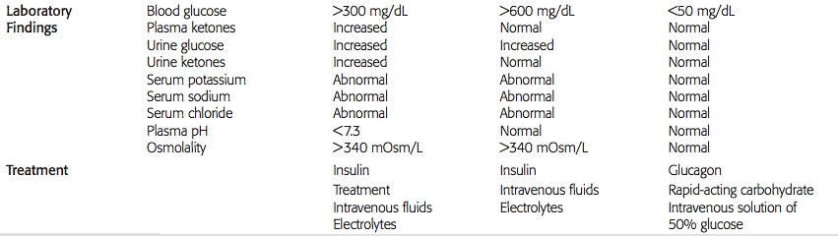
DKA, HHS, and
Hypoglycemia Compared

Slide 56
Long-Term Complications of Diabetes
Macrovascular complications
  Accelerated atherosclerotic changes
  Coronary artery disease, cerebrovascular disease, and peripheral vascular disease
Microvascular complications
  Diabetic retinopathy, nephropathy
Neuropathic changes
  Peripheral neuropathy, autonomic neuropathies, hypoglycemic unawareness, neuropathy, sexual dysfunction

Slide 57
sensorimotor polyneuropathy
: parasthesias, burning sensations, feet become numb, decrease awareness of position and WT of objects, decrease sensation of light touch lead to an unsteady gait, decrease sensation of pain and temperature

Slide 58
Clinical manifestation:
Cardiovascular: Slight tachycardia, orthostatic hypotension, silent or painless myocardial ischemia and infarction
Gastrointestinal: Delayed gastric emptying, bloating ,nausea, and vomiting, Diabetic constipation or diarrhea may occur.
Urinary: Urinary retention, decreased sensation of bladder fullness, increase risk of UTI.
Adrenal gland (Hypoglycemic Unawareness): Diminished or absent of adrenegic symptoms of hypoglycemia
Sudomotor neuropathy: decrease or absence of sweating of the extremities, with a compensatory increase in upper body sweating. Dryness of feet increase the risk of foot ulcer
Sexual dysfunction: impotence in men ( This complication makes the patients to seek health and mainly DM discovered after that).

Slide 59
Diabetic Retinopathy
Refer to fig. 41-8

Slide 60
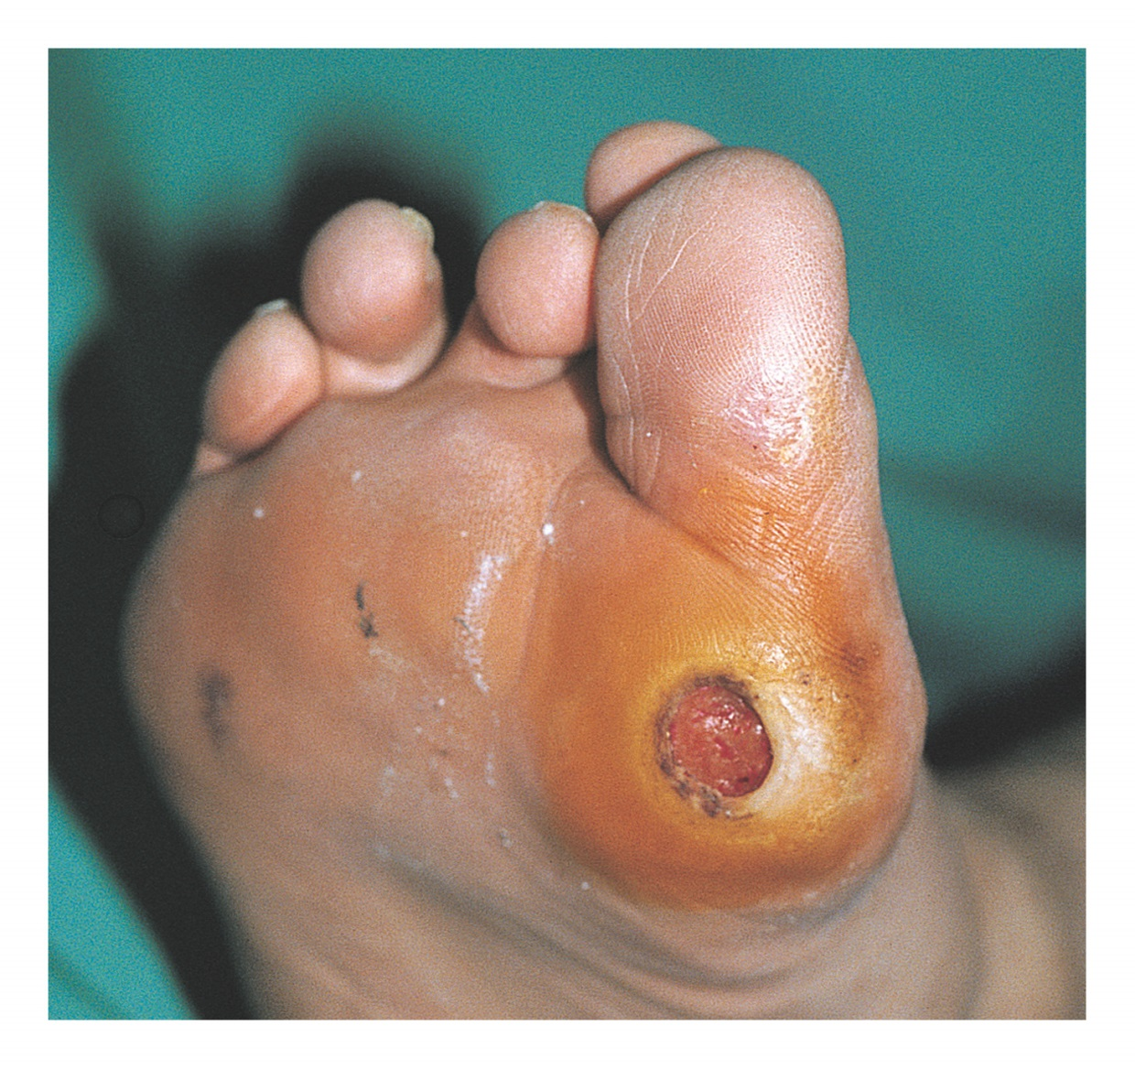
Type 1 and
Type 2 Diabetes
Notes:
Figure 20–6 Ulceration following trauma in the foot of the person with diabetes.

Slide 61
Diabetic foot:
Three diabetic complications increase risk of foot infection:
Neuropathy: sensory neuropathy leads to loss of pain and pressure sensation, autonomic neuropathy lead to increase dryness and fissuring of the skin
Peripheral vascular disease: poor circulation…. Poor wound healing
Immunocompramise DM impairs the ability of specialized WBC’s to destroy bacteria.
Medical management: Control of Glucose level, bed rest, antibiotic, debridement.
Nursing management:

Slide 62
Nursing Process: The Care of the Patient with Diabetes—Assessment
Assess the primary presenting problem
In addition, assess needs related to diabetes
Patient knowledge of diabetes and diabetes care skills
Blood glucose levels
Skin assessment
Preventative health measures
See Chart 41-4

Slide 63
Teaching Patients Self-Care
Assess knowledge and adherence to plan of care.
Provide basic information about diabetes, its cause and symptoms, and acute and chronic complications and their treatment.
Teach self-care activities to prevent long-term complications including foot care, eye care, and risk-factor management.
Include family in plan of care.
Provide information, encourage health promotion activities, and recommended health screenings.

Slide 64
NURSING INTERVENTIONS:
Advice patient about the importance of an individualized meal plan in meeting weekly weight loss goals and assist with compliance.
Assess patients for cognitive or sensory impairments, which may interfere with the ability to accurately administer insulin.
Demonstrate and explain thoroughly the procedure for insulin self-injection. Help patient to achieve mastery of technique by taking step by step approach.
Review dosage and time of injections in relation to meals, activity, and bedtime based on patients individualized insulin regimen.
Instruct patient in the importance of accuracy of insulin preparation and meal timing to avoid hypoglycemia.

Slide 65
Explain the importance of exercise in maintaining or reducing weight.
Advise patient to assess blood glucose level before strenuous activity and to eat carbohydrate snack before exercising to avoid hypoglycemia.
Assess feet and legs for skin temperature, sensation, soft tissues injuries, corns, calluses, dryness, hair distribution, pulses and deep tendon reflexes.
Maintain skin integrity by protecting feet from breakdown.
Advice patient who smokes to stop smoking or reduce if possible, to reduce vasoconstriction and enhance peripheral flow.

