Slide 1
Dysrhythmias Dr. Jehad Rababah

Slide 2
Cardiac Conduction System

Slide 3
Properties of Cardiac Cells
Automaticity
Excitability
Conductivity
Contractility
3
Notes:
See Table 36-1.

Slide 4
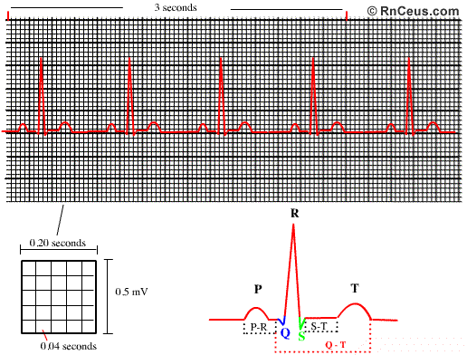
ECG Strip
Reflects the electrical activity in the heart
Small (0.05sec) & large (0.2sec) boxes
Slash marks

Slide 5
ECG Waveform
P wave: depolarization of the atria
PR interval
AV delay
0.12-0.2 sec
QRS complex
0.06-0.11 sec
ST segment: isoelectric
T wave: repolarization of ventricles
U wave: hypokalemia?
QT interval

Slide 6
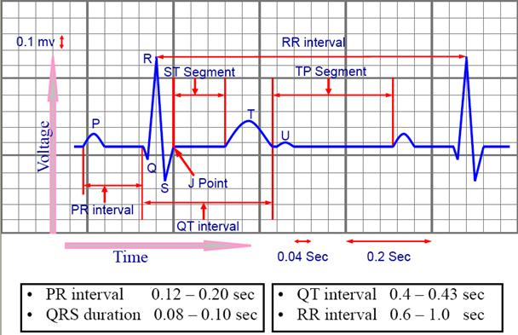
ECG Waveform

Slide 8
Calculating Heart Rate
Ventricular rate
Atrial rate
Regular/irregular HR:
# of QRS’s in 6 seconds X 10
Regular rhythm:
300/# of large boxes between 2 R’s
1500/# of small boxes between 2 R’s

Slide 9
Calculating Heart Rate
Counting QRS’s vs counting R-R intervals

Slide 10
Calculating Heart Rate

Slide 11
Analysis of ECG Rhythm
Determine ventricular & atrial rates
Examine rhythm
P waves & their ratio with QRS’s
PR interval
QRS complex shape & duration
ST segment
Conduct a thorough assessment along with rhythm analysis

Slide 12
Normal Sinus Rhythm
Sinus node fires 60 to 100 bpm
1 P – 1 QRS
Follows normal conduction pattern
12

Slide 13
Dysrhythmias Classification
Sinus | Atrial | Junctional | Ventricular | AV Blocks
Tachy Brady S. dysrhythmia S. Arrest Sick sinus | Premature AC Paroxysmal supraventricular tachy A flutter A Fib Multifocal atrial Tachy | Junctional rhythm Premature junctional contraction | Premature ventricular contraction (PVC) V Tach Torsades de points V Fib Accelerated idioventricular rhythm | First Degree Second degree Mobitz type I Second degree Mobitz Type II Third degree
13
Notes:
The 12-lead ECG may show changes suggesting structural changes or damage such as ischemia, infarction, enlarged cardiac chambers, electrolyte imbalance, or drug toxicity. Obtaining 12 ECG views of the heart is also helpful in the assessment of dysrhythmias.

Slide 14
Sinus Tachycardia
SA node >100 bpm
Normal sinus characteristics the same
Cause: sympathetic stimulation
Tx: only if symptomatic
B-blockers
14
Notes:
The conduction pathway is the same in sinus tachycardia as that in normal sinus rhythm.
The P wave is normal, precedes each QRS complex, and has a normal shape and duration. The PR interval is normal, and the QRS complex has a normal shape and duration.

Slide 15
Sinus Bradycardia
Sinus node fires <60 bpm
Normal in athletes & during sleep
Severe pain, inferior wall MI,
Tx: atropine, pacemaker?
15
Notes:
Rhythm is regular. The P wave precedes each QRS complex and has a normal shape and duration. The PR interval is normal, and the QRS complex has a normal shape and duration.

Slide 16
Sinus Dysrhythmia
AKA sinus arrhythmia
Variation in the rhythm
Rate increases with insp. And decreases with exp.
Requires no treatment
16
Notes:
Rhythm is regular. The P wave precedes each QRS complex and has a normal shape and duration. The PR interval is normal, and the QRS complex has a normal shape and duration.

Slide 17
Sinus Arrest & SA Block
Sinus arrest
SA fails to fire
SA block (SA exit block)
SA fires but the impulse is delayed or blocked
Causes:
Disruption of SA
MI
Med (Dig & B-Blockers)
Tx: similar to S. brady (if symptomatic)
17
Notes:
Rhythm is regular. The P wave precedes each QRS complex and has a normal shape and duration. The PR interval is normal, and the QRS complex has a normal shape and duration.

Slide 18
Sinus Arrest & SA Block
ECG is the same
18
Notes:
Rhythm is regular. The P wave precedes each QRS complex and has a normal shape and duration. The PR interval is normal, and the QRS complex has a normal shape and duration.

Slide 19
Sick Sinus Syndrome
SA depression
Brady, arrest, or block
Usually associated with rapid atrial dysrhythmias
19
Notes:
Rhythm is regular. The P wave precedes each QRS complex and has a normal shape and duration. The PR interval is normal, and the QRS complex has a normal shape and duration.

Slide 20
Premature Atrial Contraction (PAC)
Ectopic impulse produced by the SA node
Conducted to the AV node
Different shape of P wave
20
Notes:
Rhythm is regular. The P wave precedes each QRS complex and has a normal shape and duration. The PR interval is normal, and the QRS complex has a normal shape and duration.

Slide 21
Premature Atrial Contraction (PAC)
Causes
Normal variation
Stress, etc.
CAD
Rheumatic heart disease
Precursor to A fib/flutter
Complaint: skip of beats
No treatment, just monitoring
21
Notes:
Rhythm is regular. The P wave precedes each QRS complex and has a normal shape and duration. The PR interval is normal, and the QRS complex has a normal shape and duration.

Slide 22
Paroxysmal supraventricular tachycardia (PSVT)
Rate: 150-250bpm
PSVT with block: occurs with dig toxicity
PSVT:
Starts and ends abruptly
PAC often initiate the rhythm
Rate: faster than S. Tachy
Vagal stimulation: no response or returns to normal
S. Tachy slows down slightly
Causes:
Same as PAC
22
Notes:
Rhythm is regular. The P wave precedes each QRS complex and has a normal shape and duration. The PR interval is normal, and the QRS complex has a normal shape and duration.

Slide 23
Paroxysmal supraventricular tachycardia (PSVT)
23
Notes:
Rhythm is regular. The P wave precedes each QRS complex and has a normal shape and duration. The PR interval is normal, and the QRS complex has a normal shape and duration.

Slide 24
Paroxysmal supraventricular tachycardia (PSVT)
S/Sx:
Palpitations
Light headedness
Dyspnea
Tx:
Carotid massage
Valsalva maneuver
Adenosine
Cardioversion
24
Notes:
Rhythm is regular. The P wave precedes each QRS complex and has a normal shape and duration. The PR interval is normal, and the QRS complex has a normal shape and duration.

Slide 25
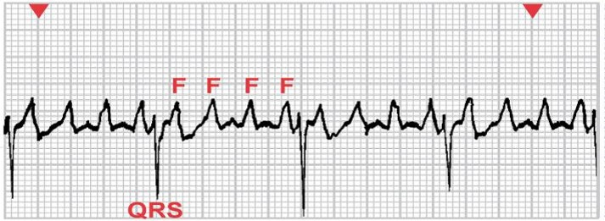
Atrial Flutter
Atrial tachydysrhythmia identified by recurring, regular, sawtooth-shaped flutter waves
Atrial rate: 250-350
Originates from a single ectopic focus
AV node is the gatekeeper
25
Notes:
Rhythm is regular. The P wave precedes each QRS complex and has a normal shape and duration. The PR interval is normal, and the QRS complex has a normal shape and duration.

Slide 26
Atrial Flutter
Causes:
Heart disease
Decrease in CO
Loss of atrial kick
Risk for thrombus formation
Tx:
Same as A Fib
26
Notes:
Rhythm is regular. The P wave precedes each QRS complex and has a normal shape and duration. The PR interval is normal, and the QRS complex has a normal shape and duration.

Slide 27
Atrial Fibrillation
Atrial rate: 350-500bpm
Most common dysrhythmia
Total disorganization of atrial electrical activity due to multiple ectopic foci
No definable P waves
Results in loss of effective atrial contraction
Loss of atrial kick
Prevalence increases with age
27

Slide 28
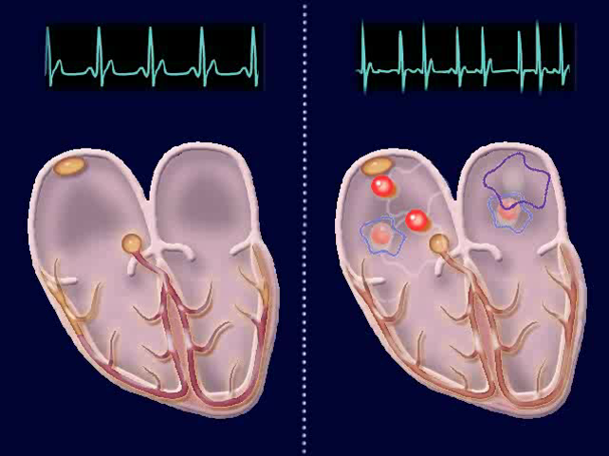
28

Slide 29
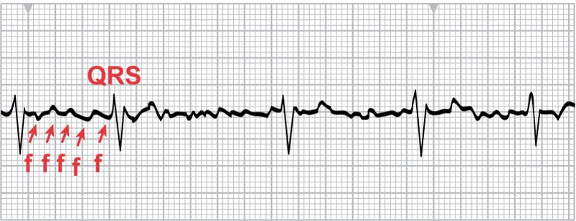
Atrial Fibrillation
29
Notes:
During atrial fibrillation, the atrial rate may be as high as 350 to 600 beats/minute. P waves are replaced by chaotic, fibrillatory waves. Ventricular rate varies, and the rhythm is usually irregular. When the ventricular rate is between 60 and 100, it is atrial fibrillation with a controlled ventricular response. Atrial fibrillation with ventricular rate >100 is atrial fibrillation with a rapid ventricular response. Atrial fibrillation with ventricular rate <60 is atrial fibrillation with a slow ventricular response. The PR interval is not measurable, and the QRS complex usually has a normal shape and duration. At times, atrial flutter and atrial fibrillation may coexist.

Slide 30
Atrial Fibrillation
Ventricular rate:
Controlled ventricular response = 60-100
Slow ventricular response < 60
Rapid ventricular response > 100
Causes:
Ischemic heart disease
Heart failure
Congenital
Caffeine, Thyrotexosis, Heart surgeries
30

Slide 31
Atrial Fibrillation
Thrombi may form in the atria
High risk for stroke
Tx:
Drugs for rate control: Digoxin, β-adrenergic blockers, calcium channel blockers
Long-term anticoagulation: Coumadin
Cardioversion
Ablation
Pacing
31
Notes:
Ventricular rate control is a priority for patients with atrial fibrillation.

Slide 32
Multifocal Atrial Tachycardia
Rapid atrial rate: >100 bpm
Various shapes of P waves
Three or more shapes
Usually asymptomatic
Tx:
Slow down the atrial rate
32
Notes:
Ventricular rate control is a priority for patients with atrial fibrillation.

Slide 33
Junctional Rhythm
AKA nodal rhythm
The SA node fails to fire and the AV node becomes the pacemaker
Slower rate
P wave:
Inverted: retrograde conduction before the conduction thru ventricles
Buried: retrograde conduction at the same time of ventricular conduction
Inverted after the QRS: retrograde conduction after ventricular conduction
33

Slide 34
Junctional Rhythm
34

Slide 35
Junctional Rhythm
Causes:
SA node dysfunction
E.g. Hypoxia, hyperkalemia, & MI
S/Sx:
Hypotension
Decreased CO
Decreased perfusion
Tx:
Treat the cause
Atropine or pacemaker
35

Slide 36
Premature Junctional Contraction (PJC)
Ectopic impulse from the AV junction
QRS complex:
Narrow
Atrial depolarization occurs before, during, or after ventricular conduction
Frequent PJC → junctional rhythm
S/Sx: skipping a beat
Tx: not necessary
36

Slide 37
Premature Junctional Contraction (PJC)
37

Slide 38
Premature Ventricular Contractions
Contraction originating in ectopic focus of the ventricles
Premature occurrence of a wide and distorted QRS complex
No P wave
Considered a precursor of V Tach/V Fib
QRS description:
Shape/pattern
Frequency
38

Slide 39
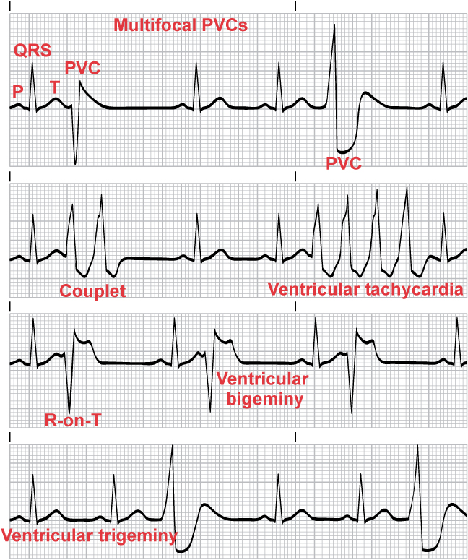
Premature Ventricular Contractions
39

Slide 40
Premature Ventricular Contractions
40

Slide 41
Premature Ventricular Contractions
Causes:
Ischemic heart disease
Irritation of the heart
Hypokalemia
Significance:
Usually requires no treatment
Report any R-on-T
41

Slide 42
Premature Ventricular Contractions
42

Slide 43
Ventricular Tachycardia
Run of three or more PVCs
Ventricular rate > 100 bpm
Usually 150 to 250
Rhythm may be regular or irregular
Life-threatening because of decreased CO and the possibility of deterioration to ventricular fibrillation
No P wave
Precursor of V Fib
43

Slide 44
Ventricular Tachycardia
44

Slide 45
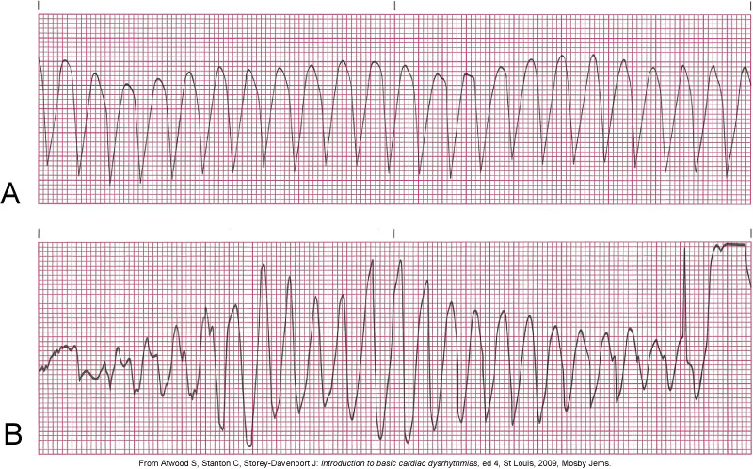
Ventricular Tachycardia
45

Slide 46
Ventricular Tachycardia
Causes:
Same as PVC’s
Un/stable…. Pulse/less
Tx:
Hemodynamically stable: lidocaine
Unstable: cardioversion
Start CPR and defib if pulseless
Implantable cardioverter-defibrillator (ICD)
46

Slide 47
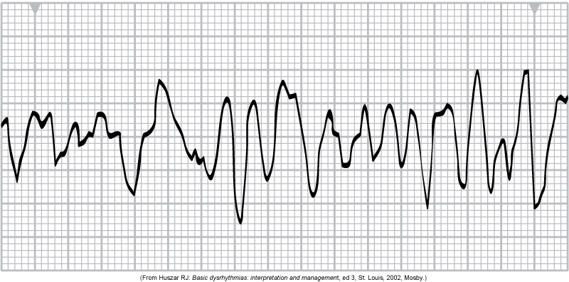
Ventricular Fibrillation
Unresponsive, pulseless, and apneic state
If not treated rapidly, death will result
Heart unable to pump blood effectively
HR is not measurable
Rhythm is irregular and chaotic
47
Notes:
VF is a lethal dysrhythmia.

Slide 48
Ventricular Fibrillation
Causes:
Same as PVC’s
Prolonged QT interval
Tx:
CPR
Defib
ICD
48
Notes:
VF is a lethal dysrhythmia.

Slide 49
Accelerated Idioventricular Rhythm
Speeding up of ventricular pacemaker cells
They become the lead pacemaker
Causes:
CAD
Reperfusion after thrombolytics
Tx:
Usually pt remains stable
Rarely develops into a V Tach
49
Notes:
VF is a lethal dysrhythmia.

Slide 50
Atrioventricular (AV) Blocks
Sinus impulses are delayed or blocked by the AV
Block at:
AV node
Bundle of His
Branches
50
Notes:
VF is a lethal dysrhythmia.

Slide 51
AV Blocks- First Degree
Not a complete block
Rather, a delay in conduction
“Lazy” AV node
P Wave:
Normal pattern
1 P for 1 QRS
PR interval prolonged > 0.2 sec (more than one large box)
51
Notes:
VF is a lethal dysrhythmia.

Slide 52
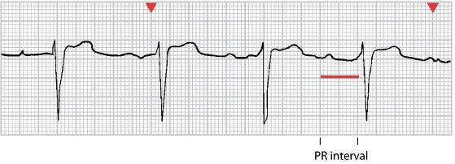
AV Blocks- First Degree
52
Notes:
VF is a lethal dysrhythmia.

Slide 53
AV Blocks- First Degree
Causes
Meds: dig, B & Ca blockers
CAD
May develop into 2nd or 3rd degree block
No treatment
monitoring
53
Notes:
VF is a lethal dysrhythmia.

Slide 54
AV Blocks- Second Degree Mobitz Type I (Wenckebach)
Progressive delay until conduction is blocked
Repeatable cycle
P wave:
Normal pattern
1 P to 0 QRS preceded by a series of 1 P to 1 QRS
PR interval progressively longer till block
Atrial rate is different from ventricular
54
Notes:
VF is a lethal dysrhythmia.

Slide 55
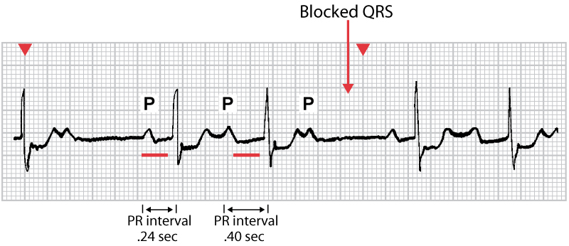
AV Blocks- Second Degree Mobitz Type I (Wenckebach)
55
Notes:
VF is a lethal dysrhythmia.

Slide 56
AV Blocks- Second Degree Mobitz Type I (Wenckebach)
Causes
Meds: dig
Inferior wall MI
Rarely symptomatic
Tx
Monitoring
Treat the cause
56

Slide 57
AV Blocks- Second Degree Mobitz Type II
Intermittent block in the AV node
P wave:
Normal pattern
Variant P to QRS ratio
PR interval fixed when the AV conduction takes place
Often a permanent problem
57
Notes:
VF is a lethal dysrhythmia.

Slide 58
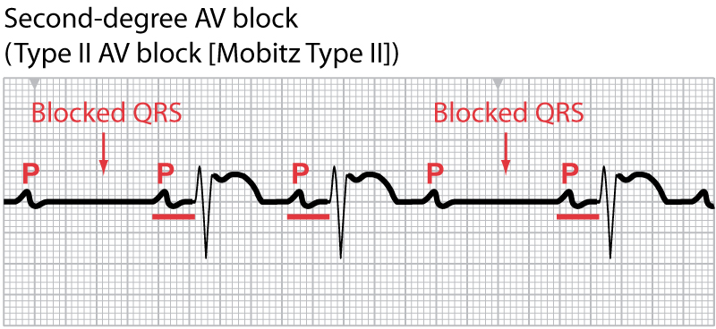
AV Blocks- Second Degree Mobitz Type II
58
Notes:
VF is a lethal dysrhythmia.

Slide 59
AV Blocks- Second Degree Mobitz Type II
Causes
Fibrotic disease
Anterior wall MI
3rd degree block is likely
Tx
Monitoring
Atropine
Pacing
59

Slide 60
AV Blocks- Third Degree
AKA complete AV Block
No SA node impulses transmitted to the ventricles
Ventricular pacemaker at the junction or ventricles
No relationship between the P waves and QRS complexes
Both PP and RR intervals are regular
QRS:
Narrow: junctional pace
Wide: ventricular pace
60
Notes:
VF is a lethal dysrhythmia.

Slide 61
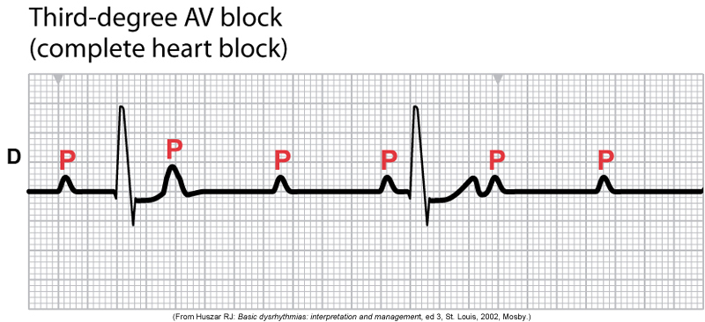
AV Blocks- Third Degree
61
Notes:
VF is a lethal dysrhythmia.

Slide 62
AV Blocks- Third Degree
Causes
Same as other AV blocks
Pt shows S/Sx of low CO and/or bradycardia
Asymptomatic if normal CO
Tx
Monitoring
Permanent pacing
62

Slide 63
Electrolytes Effects
63
Notes:
VF is a lethal dysrhythmia.

Slide 64
Hyperkalemia
64
Notes:
VF is a lethal dysrhythmia.

Slide 65
Hypokalemia
65
Notes:
VF is a lethal dysrhythmia.

Slide 66
Hypo- & Hypercalcemia
66
Notes:
VF is a lethal dysrhythmia.

Slide 67
Changes Associated With Ischemia
67

Slide 68
Changes Associated With Infarction
68

Slide 69
Questions?
69

