Slide 1
Chapter 59 Assessment and Management of Patients With Hearing and Balance Disorders

Slide 2
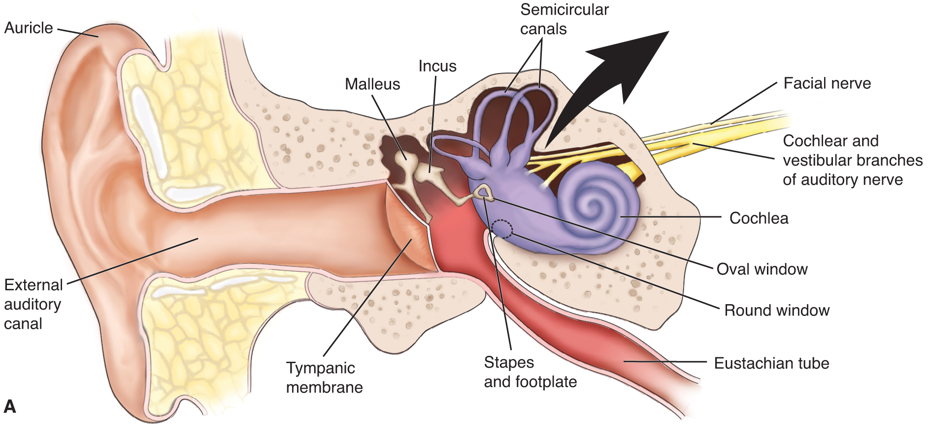
Anatomy of the Ear

Slide 3
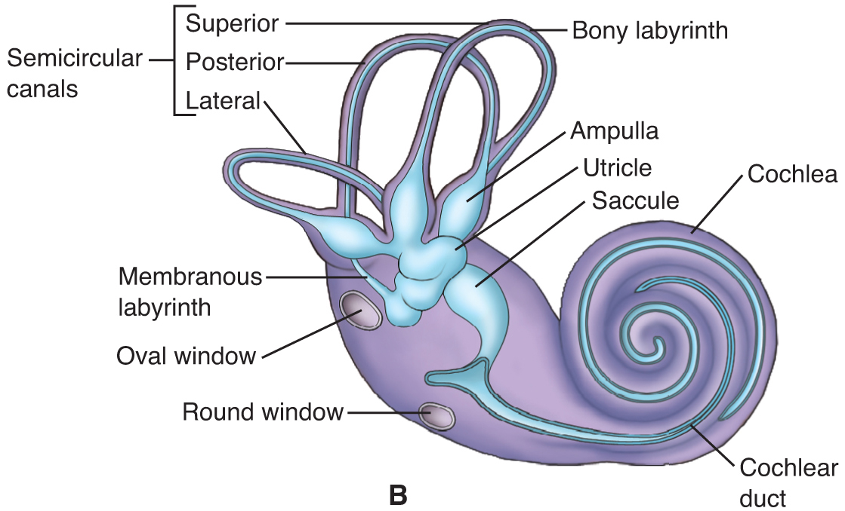
Anatomy of the Inner Ear

Slide 4
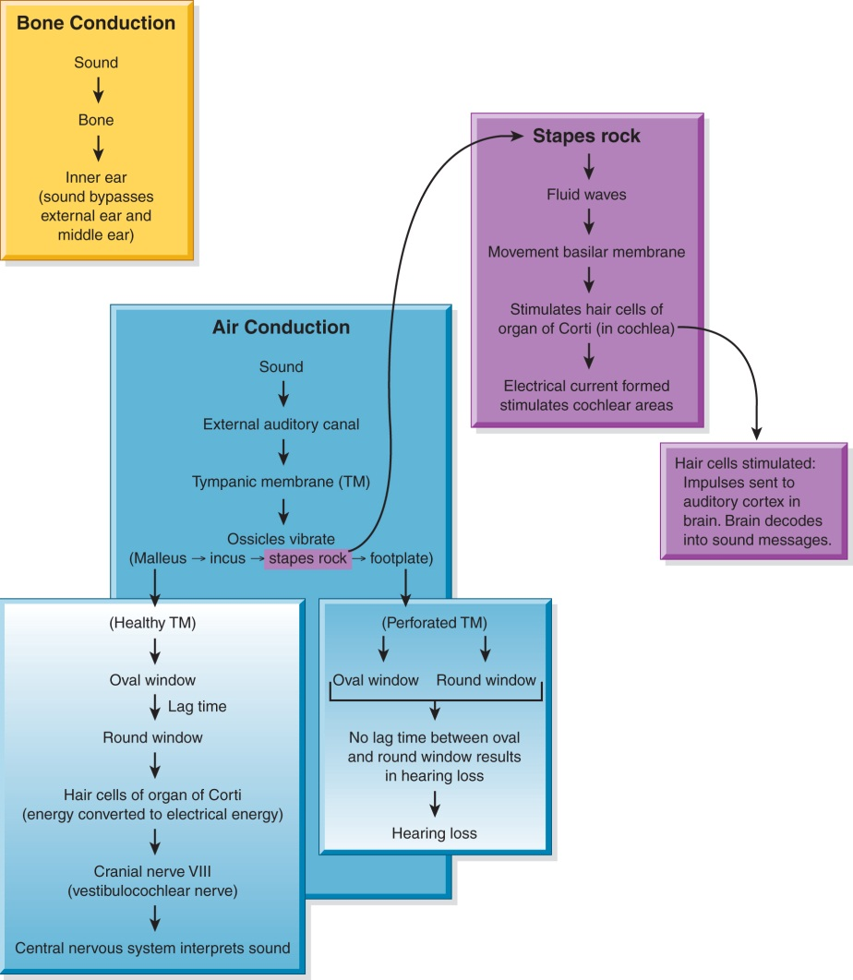
Bone Conduction Compared to Air Conduction

Slide 5
Assessment
Inspection of the external ear
Otoscopic examination
Gross auditory acuity
Whisper test
Weber test
Rinne test

Slide 6
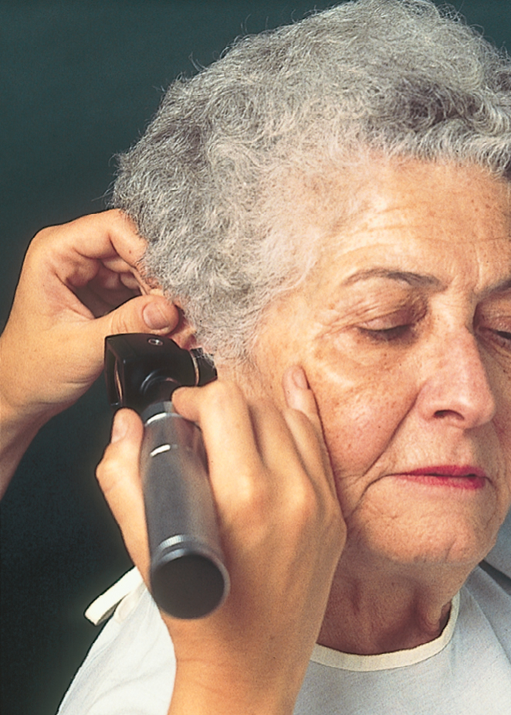
Technique for Using Otoscope

Slide 7
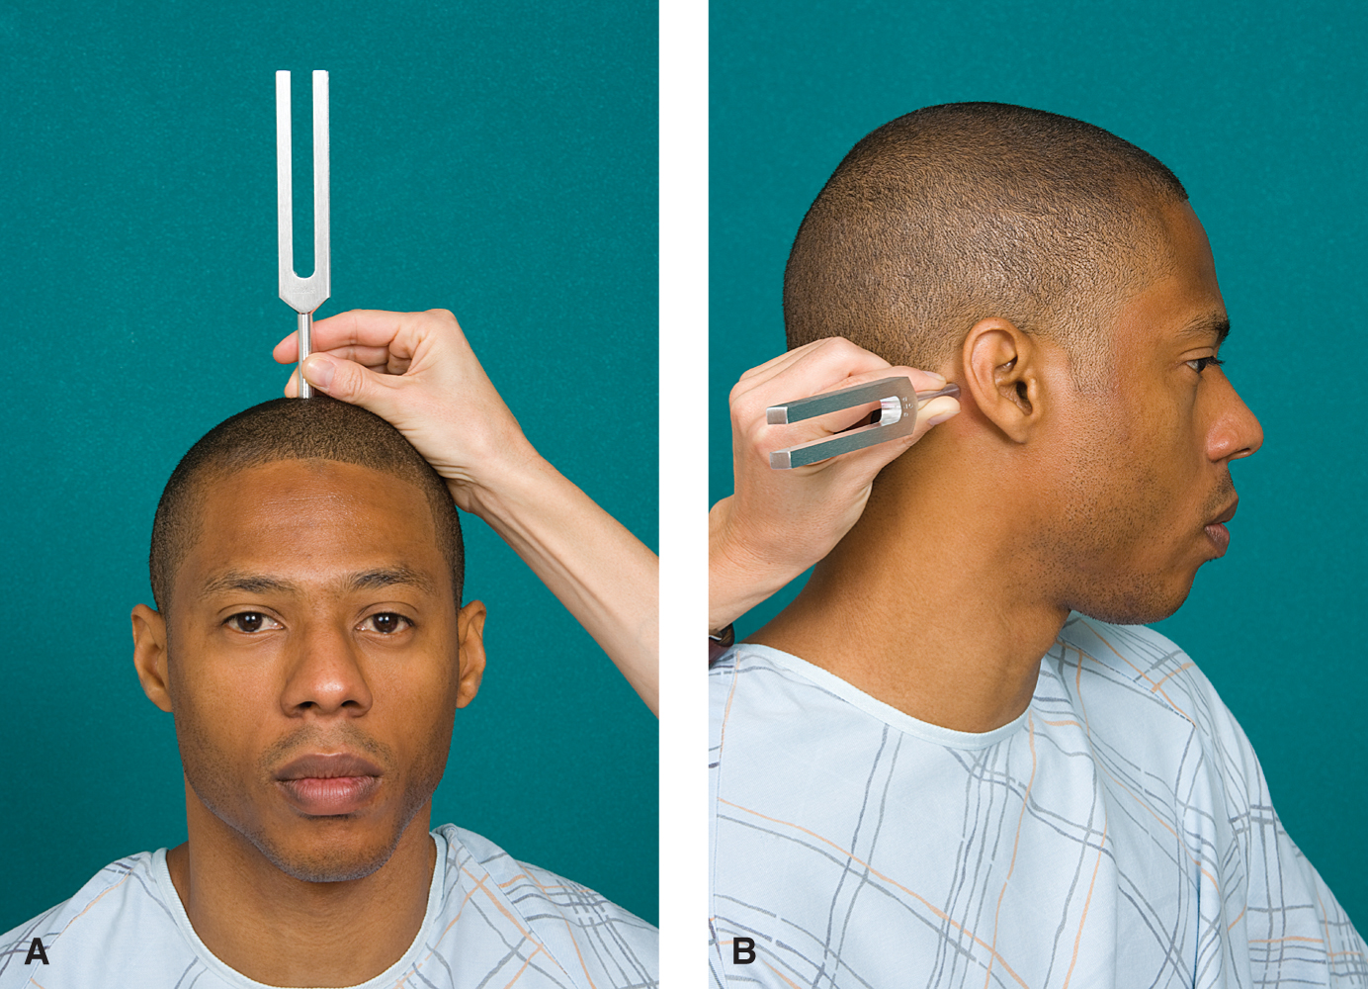
Weber Test

Slide 8
Diagnostic Evaluation
Audiometry
Tympanogram
Auditory Brainstem response
Electronystagmography
Platform posturography
Sinusoidal harmonic acceleration
Middle ear endoscopy

Slide 9
Hearing Loss
Affects more than 28 million people in U.S.
Increased incidence with age—presbycussis
Risk factors include exposure to excessive noise levels
Types
Conductive; due to external of middle ear problem
Sensorineural; due to damage to the cochlea or vestibulocochlear nerve
Mixed; both conductive and sensorineural
Functional (psychogenic); due to emotional problem

Slide 10
Manifestations
Early symptoms include
Tinnitus: perception of sound; often “ringing in the ears”
Increased inability to hear in a group
Turning up the volume on the TV
Impairment may be gradual and not recognized by the person experiencing the loss
As hearing loss increases, person may experience deterioration of speech, fatigue, indifference, social isolation or withdrawal, and other symptoms

Slide 11
Guidelines for Communicating with the Hearing-Impaired
Use a low-tone, normal voice
Speak slowly and distinctly
Reduce background noise and distractions
Face the person and get his or her attention
Speak into the less-impaired ear
Use gestures and facial expressions
If necessary, write out information or obtain a sign language translator

Slide 12
Conditions of the External Ear
Cerumen impaction
Removal may be by irrigation, suction, or instrumentation
Gentle irrigation should be used with lowest pressure, directing stream behind the obstruction. Glycerin, mineral oil, ½ strength H₂O₂, or peroxide in glyceryl may help soften cerumen
Foreign bodies
Removal may be by irrigation, suction, or instrumentation
Objects that may swell (such as vegetables or insects) should not be irrigated
Foreign body removal can be dangerous and may require extraction in the operating room

Slide 13
Conditions of the External Ear
External otitis
Inflammation most commonly due to bacteria Staphylococcus or Pseudomonas, or fungal infection due to Aspergillus.
Manifestations include pain and tenderness, discharge, edema, erythema, pruritis, hearing loss, feelings of fullness in the ear.
Therapy is aimed at reducing discomfort, reducing edema, and treating the infection.
A wick may be inserted in the canal to keep it open and facilitate medication administration.
Malignant external otitis: rare, progressive infection that effects the external auditory canal, surrounding tissue, and the skull.

Slide 14
Conditions of the Middle Ear
Tympanic membrane perforation
Acute otitis media
Most frequently seen in children
Pathogens are most commonly Streptococcus pneumonia, Haemophilus influenzae
Manifestations include otalgia (ear pain), fever, and hearing loss
Treatment
Antibiotic therapy
Myringotomy or tympanotomy

Slide 15
Conditions of the Middle Ear
Serous otitis media: fluid in the middle ear without evidence of infection
Chronic otitis media
Result of recurrent acute otitis media
Chronic infection damages the tympanic membrane, ossicle, and involves the mastoid
Treatment
Prevent by treatment of acute otitis
Tympanoplasty, ossiculoplasty, or mastoidectomy

Slide 16
Middle Ear Surgical Procedures
Tympanoplasty
Reconstruction of the tympanic membrane
Ossiculoplasty
Reconstruction of the bones of the middle ear
Prostheses are used to reconnect the ossicles to reestablish sound conduction
Mastoidectomy
Removal of diseased bone, mastoid air cells, and cholesteatoma to create a noninfected, healthy ear
Cholesteatoma: benign tumor, an ingrowth of skin that causes persistently high pressure in the middle ear, which cause hearing loss, neurologic disorders, and destroys structures

Slide 17
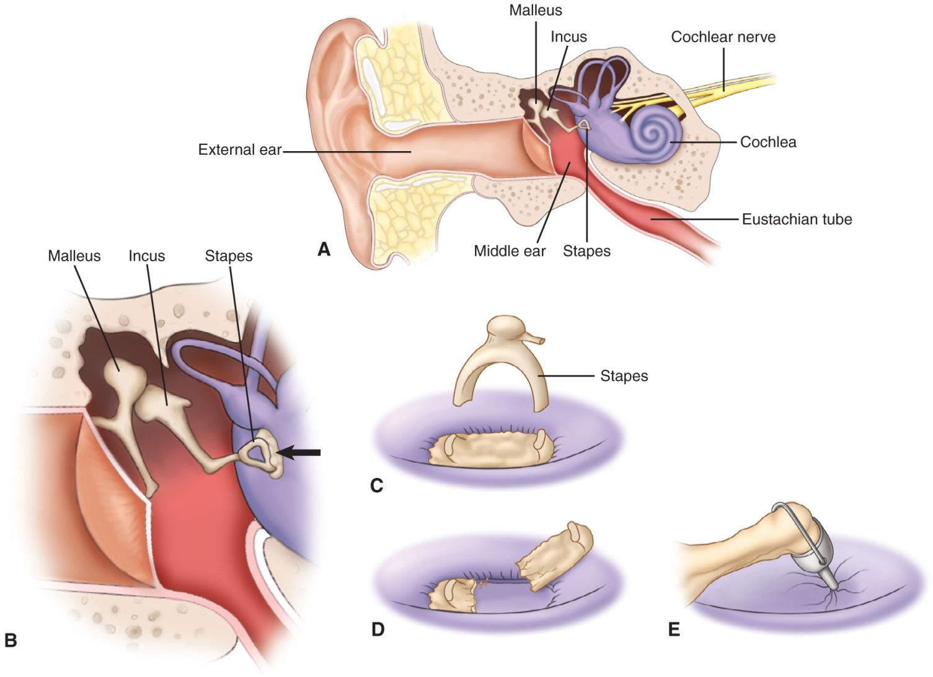
Stapedectomy for Otosclerosis

Slide 18
Nursing Process: Patient Undergoing Mastoid Surgery—Assessment
Health History
Include data related to the ear disorder, hearing loss, otalgia, otorhea, and vertigo
Medications

Slide 19
Nursing Process: Patient Undergoing Mastoid Surgery—Diagnoses
Anxiety
Acute pain
Risk for infection
Disturbed auditory sensory perception
Risk for trauma related to imbalance or vertigo
Disturbed sensory perception related to damage to facial nerve
Impaired skin integrity
Deficient knowledge

Slide 20
Nursing Process: Patient Undergoing Mastoid Surgery—Planning
Major goals include:
Reduction of anxiety
Freedom from pain and discomfort
Prevention of infection
Stable or improved hearing and communication
Absence of vertigo and injury
Absence of or adjustment to altered sensory perception, return of skin integrity
Increased knowledge of disease
Surgical procedure and postoperative care

Slide 21
Interventions
Reduction of anxiety
Reinforce information and patient teaching
Provide support and allow to discuss anxieties
Relieving pain
Medicate with analgesics for ear discomfort
Note: Occasional sharp shooting pans may occur as the eustachian tube opens and allows air into the middle ear. Constant throbbing pain and fever may indicate infection
Preventing injury
Safety measures such as assisting with ambulation
Provide antiemetics or antivertigo medications

Slide 22
Interventions
Improving communication and hearing
Note: hearing may reduced for several weeks following surgery due to edema, accumulation of blood and fluid in the middle ear, and due to dressings and packings.
Use measures to improve hearing and communication and discussed in “Communicating with the Hearing Impaired.”
Preventing infection
Monitor for signs and symptoms of infection.
Administer antibiotics as ordered.
Prevent contamination of ear with water from showers, washing hair, etc.

Slide 23
Patient Teaching
Medications teaching; analgesics, antivertigo medications
Activity restrictions
Gently blow nose only one side at a time, and sneeze and cough with mouth open
Note: patient may need instruction to avoid heavy lifting, exertion, and nose blowing to prevent dislodgement of grafts or prostheses
Safety issues related to potential vertigo
Instruction regarding potential complications and reporting of problems
Avoid getting water in ear
Follow-up care

Slide 24
Conditions of the Inner Ear
Disorders of the vestibular system affect more than 30 million in the U.S. and falls resulting from these disorders result in 100,000 hip fractures a year.
Dizziness: any altered sense of orientation in space
Vertigo: the illusion of motion or a spinning sensation
Nystagmus: involuntary rhythmic movement of the eyes. This is associated with vestibular dysfunction.

Slide 25
Conditions of the Inner Ear
Tinnitus
Labyrinthitis
Benign positional vertigo (BBPV)
Ototoxicity
Acoustic neuroma: tumor of the VIII cranial nerve

Slide 26
Ménière’s Disease
Abnormal inner ear fluid balance cause by malabsorption of the endolymphatic sac or blockage of the endolymphatic duct
Manifestations include fluctuating, progressive hearing loss; tinnitus; feeling of pressure or fullness; and episodic, incapacitating vertigo that may be accompanied by nausea and vomiting
Treatment
Low-sodium diet, 2000 mg a day
Meclizine (Antivert); also tranquilizers, antiemetics, and diuretics may be used
Surgical management to eliminate attacks of vertigo; endolymphatic sac decompression, middle and inner ear perfusion, and vestibular nerve sectioning

