Slide 1
Chapter 42 Assessment and Management of Patients With Endocrine Disorders

Slide 2
Endocrine System
Effects almost every cell, organ, and function of the body
The endocrine system is closely linked with the nervous system and the immune system
Negative feedback mechanism
Hormones
Steroid: act inside the cell
Peptide (protein): act on cell surface
Amine
Fatty acid derivative

Slide 3
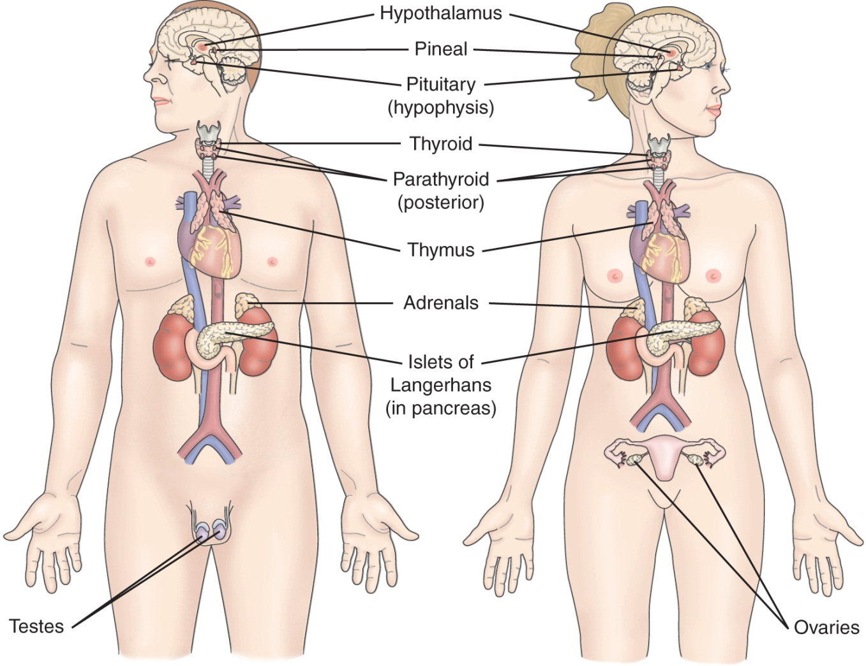
Major Hormone Secreting Glands of the Endocrine System

Slide 4
Hypothalamus
Hormones
CRH
TRH
GHRH
GnRH
Somatostatin
Control the release pituitary hormones

Slide 5
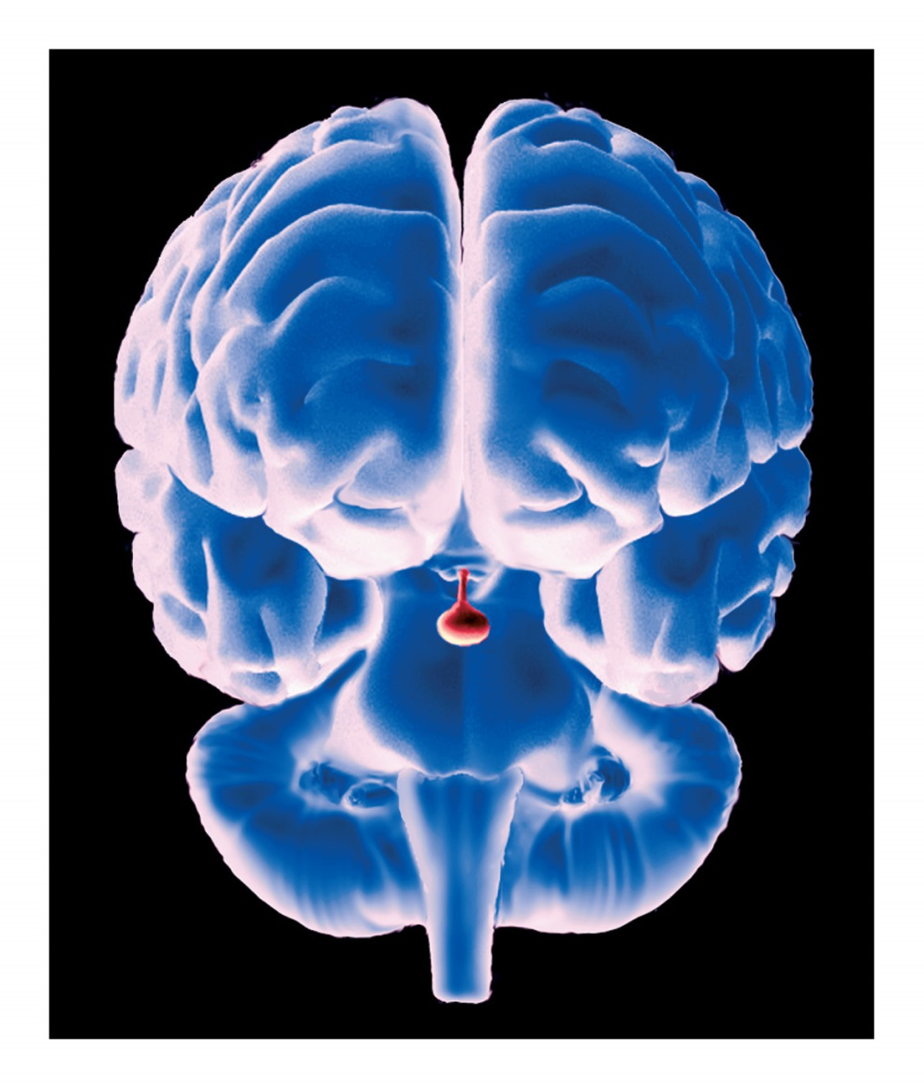
Endocrine Glands
Notes:
Figure 18–2 Location of the pituitary gland.

Slide 6
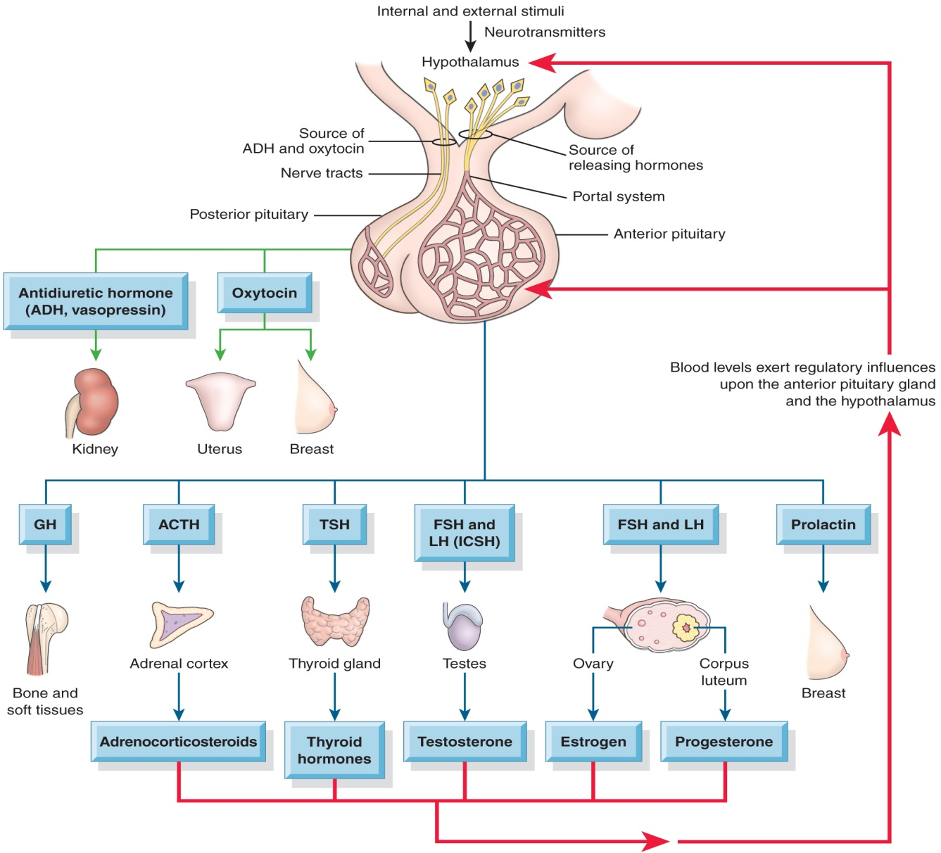
Pituitary Gland and Its Hormones

Slide 7
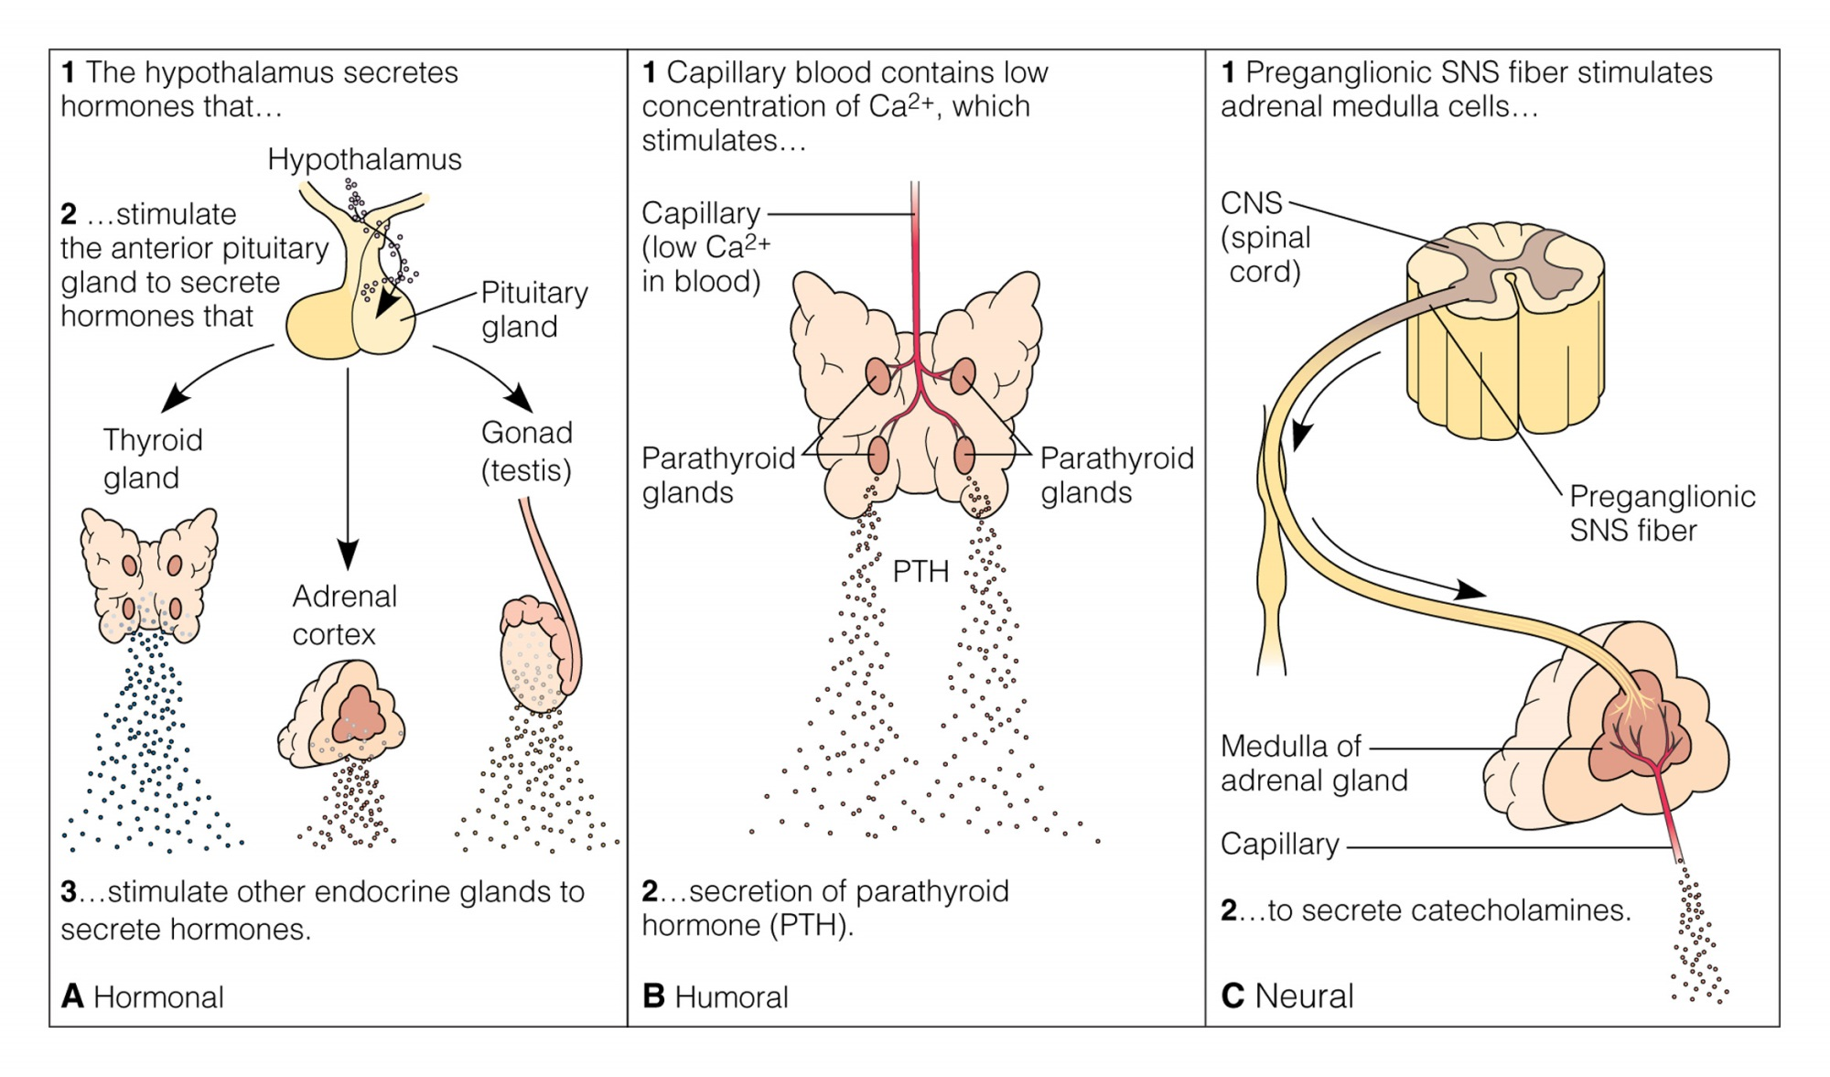
Endocrine Glands
Notes:
Figure 18–7 Examples of three mechanisms of hormone release: A, hormonal; B, humoral; or C, neural.

Slide 8
Assessment:
Health history:
Fatigue and changes in the energy level and its effect on the daily activity
Changes in the heat and cold tolerance
Recent changes in Weight ( increase or decrease)
Fluid loss or retention
Changes in sexual functions
Changes in mood, memory, ability to concentrate and alteration in sleep
Physical assessment:
Skin changes (texture)
Eye changes (exophthalmos)
Changes in phyical appearance ( such as facial hear in women, moon face, buffalo hump, increase size of the hand and the feet)
Vital signs ( hypertension in hyperfunction of adrenal gland)
Diagnostic Evaluation:
Hormonal levels
Urine test for the presence of hormones such as epinephrine and norepinephrine in the tumor of adrenal gland
Stimulation and suppression test

Slide 9
Thyroid
Thyroid hormones: T₃, T₄ also produces calcitonin
Iodine is contained in thyroid hormone
TSH from the anterior pituitary controls the release of thyroid hormone
TRH from the hypothalamus controls the release of TSH
Thyroid hormone controls cellular metabolic activity
T₃ is more potent and more rapid-acting than T₄
Calcitonin is secreted in response to high plasma calcium level and increases calcium deposition in bone

Slide 10
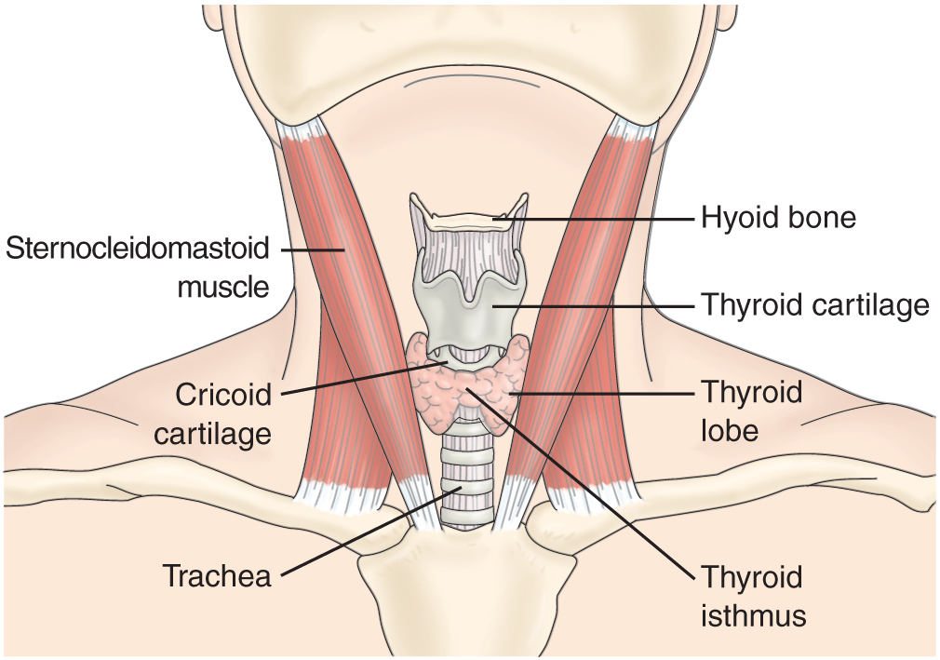
Thyroid Gland

Slide 11
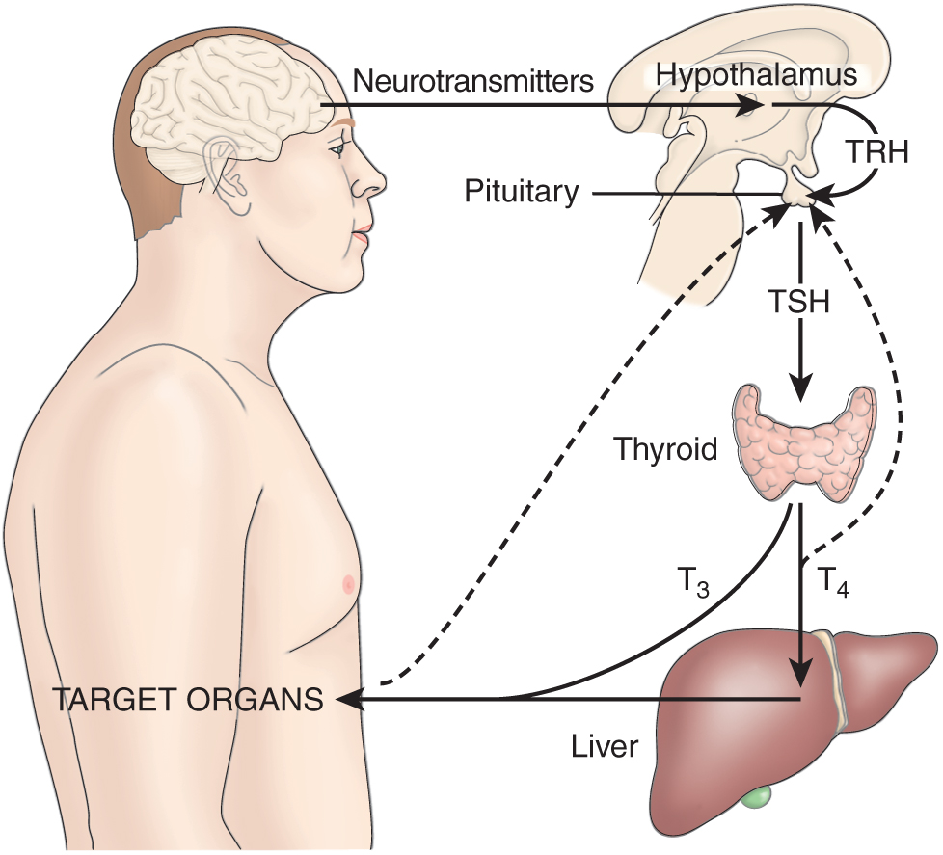
Hypothalamic-Pituitary-Thyroid Axis

Slide 12
Assessment and diagnostic findings:
Physical Exam of the thyroid gland:
1. Inspection for swelling and symmetry
2. Palpation for size, shape, consistency, symmetry, and tenderness
3. Auscultation for bruits which indicate high blood flow to the thyroid gland ( should be reported)
See table 42-2 for findings on physical examination of TG

Slide 13
Thyroid Diagnostic Tests
TSH
Serum free T4 to confirm abnormal TSH
T3 and T4
T4 resin uptake: to determine the amount of thyroid hormone bound to thyroxine-binding globulin (TBG) and the number of available binding sites
Thyroid antibodies
Radioactive iodine uptake
Fine-needle biopsy
Thyroid scan, radioscan, or scintiscan
Serum thyroglobulin to detect persistence or recurrence of thyroid carcinom

Slide 14
Cont……
Fine-Needle Aspiration
Thyroid scan, Radioscan, or Scintiscan
Ultrasonography, CT and MRI
Other secondary Lab. Test such as ALT, SGPT, and LDH, ECG
Nursing implication to thyroid tests:
- Nursing role is to assess the patient if taken medication or agents that may contain Iodine and thus affect test results. ( Chart 42-1 shows list of medications that may alter thyroid test results)

Slide 15
Hypothyroidism
Causes: Autoimmune thyroiditis; Hashimoto’s disease (most common cause) (See Chart 42-2)
Affects women 5X more frequently than men
Types of hypothyroidism:
Primary or thyroidal hypothyroidism: dysfunction of thyroid it self (decreased T3,T4, Increased TSH, Goiter)
Central Hypothyroidism : or hypothalamic hypothyroidism (tertiary) or pituitary hypothyroidism (Secondary) or both ( Decreased T3, T4 Results from decreased TRH and /or Decreased TSH, No goiter)

Slide 16
Manifestations:
Early symptoms may be nonspecific
Fatigue; hair, skin and nail changes; numbness and tingling of fingers; menstrual disturbances, subnormal temperature and pulse; weight gain; subdued emotional and mental responses; slow speech; tongue, hands, and feet may enlarge; personality and cognitive changes; cardiac and respiratory complications
Myxedema may progress to stupor, coma, and death

Slide 17
Cont. manifestations
Edema caused by infiltration of the skin with complex retaining carbohydrate molecules as a result of altered metabolism ( Myxedema….. Sever degree of hypothyroidism) cause thickening of the skin enlarged tongue, hands, and feet , hairs fall from the eye brows, facemask, usually patient complaining of cold even in warm environment, frequently complain of constipation, Deafness may occur
Sever hypothyroidism is associated with elevated cholesterol, atherosclerosis, coronary artery disease, and poor left ventricular function
Myxedema Coma: most extreme hypothyroidism ( Hypothermic and unconscious), coma following lethargy which progress to stupor and then coma

Slide 18
Medical Management of Hypothyroidism
Synthetic levothyroxine-replacement therapy
Dosage is based on the level TSH
- monitor of TSH level is essential
- Life long therapy
-Teach the patient S/S of low and over dose of medication
Medication interactions
Effects of hypnotic and sedative agents; reduce dosage
Support of cardiac function and respiratory function
Prevention of complications

Slide 19
4. Medication Interactions:
Thyroid hormones increases blood glucose level: require adjustment of insulin and oral hypoglycemic agents.
Thyroid hormone action may increased by phenytoin and tricyclic antidepressants
Thyroid hormone may increase the effect of digitalis glycosides, anti coagulants, and indomethacin.
Bone loss may also occur
Hypothyroidism increases the effect of hypnotics and sedative agents (monitoring of the patient taking this meds is important for respiratory distress).

Slide 20
Nursing Management:
Modifying activity: Assisting with care and hygiene because the patient energy levels are low and the pt is having a problem cardiac and respiratory function
Monitoring of vital signs and cognitive level: detect deterioration in mental status, s/s indicating that medication has increased metabolic rate beyond the body’s capacity to response( cardiac and respiratory) and limitation and decrease the complication of myxedema
Promoting physical comfort: such as cold intolerance by providing patient with extra clothing and blankets
Provide emotional support: changes in body image and appearance, feeling of guilt and depression
Promoting home and community-Based care: By teaching patient self-care

Slide 21
Hyperthyroidism
The second most prevalent endocrine disorder
Excessive output of thyroid hormone
Graves disease (most common cause)
Affects women 8X more frequently than men
Manifestations—thyrotoxicosis—nervousness; palpitations; rapid pulse; tolerate heat poorly; tremors; skin is flushed, warm, soft, and moist; however, elders’ skin may be dry and pruritic; exophthalmos, increased appetite and dietary intake; weight loss; elevated systolic BP; may progress to cardiac dysrhythmias and failure

Slide 22
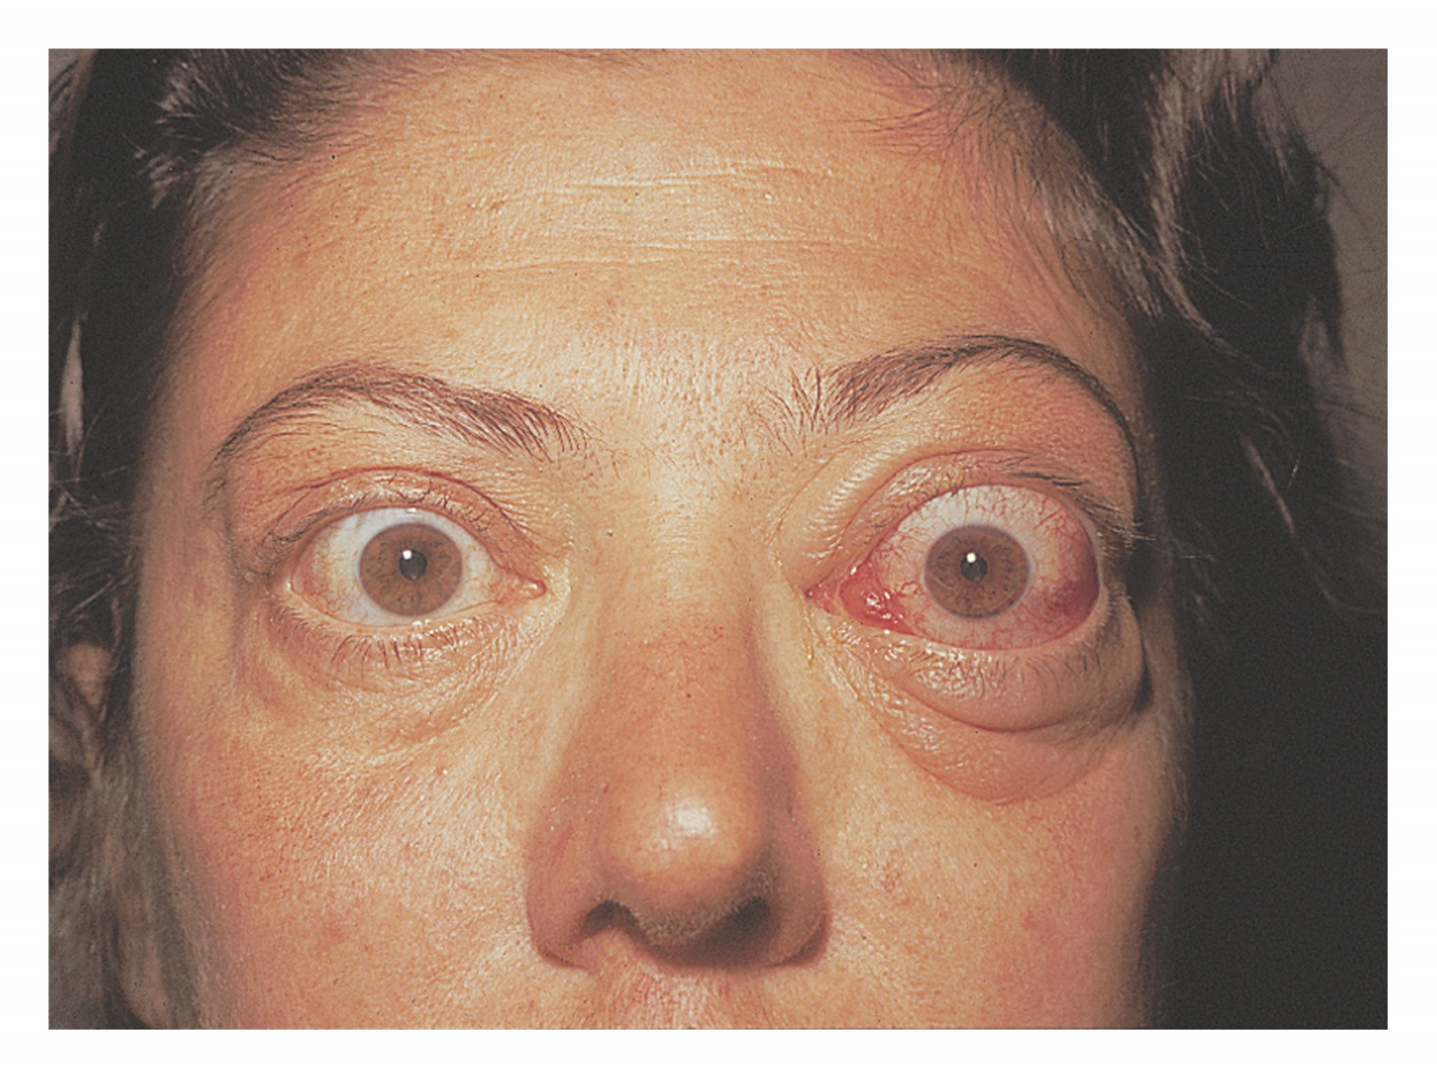
Hyperfunction and Hypofunction Disorders
Notes:
Figure 19–1 Exophthalmos in a client with Graves’ disease. The disease causes edema of fat deposits behind the eyes and inflammation of the extraocular muscles. The accumulating pressure forces the eyes outward from their orbits.

Slide 23
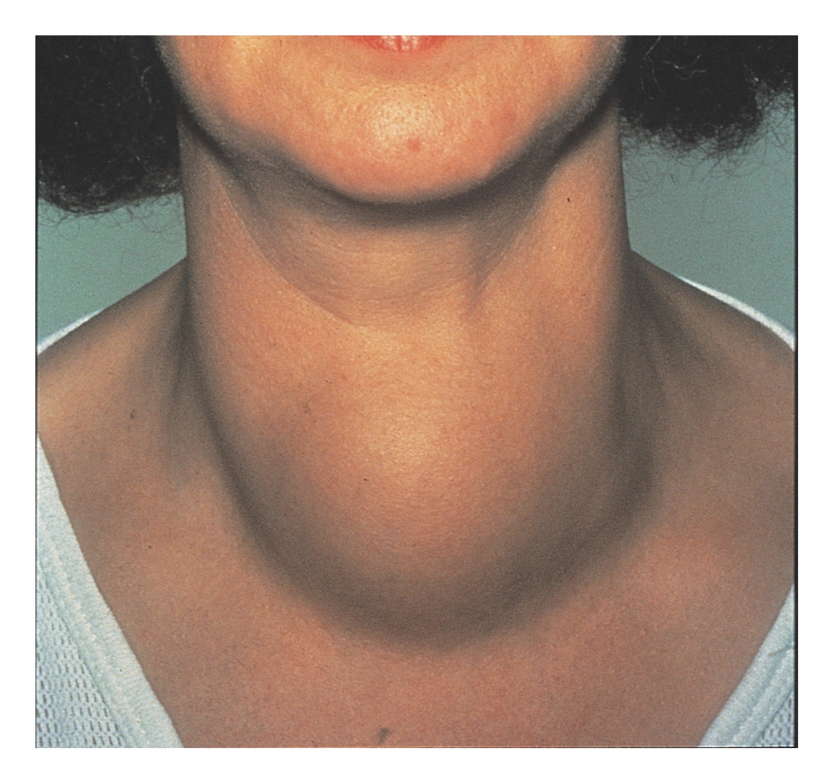
Hyperfunction and Hypofunction Disorders
Notes:
Figure 19–2 Toxic multinodular goiter. The formation and growth of numerous nodules in the thyroid gland cause the characteristic massive enlargement of the neck.

Slide 24
Assessment and diagnostic findings:
Enlarged, soft, pulsate thrill, bruit heard over thyroid arteries
S/S
Increased T4, and increased Iodine uptake by the thyroid gland in excess of 50%

Slide 25
Medical Management of Hyperthyroidism
Radioactive ¹³¹I therapy
Medications (See Table 42-3)
Propylthiouracil and methimazole
Sodium or potassium iodine solutions
Dexamethasone
Beta-blockers
Surgery; subtotal thyroidectomy
Relapse of disorder is common
Disease or treatment may result in hypothyroidism

Slide 26
Nursing Implications for Selected Endocrine Medications
Hyperthyroidism Medications: assess for hypersensitivity to iodine or shellfish prior to giving medication
Antithyroid Drugs: monitor for side effects such as pruritis rash, elevated temperature, anorexia, loss of taste, menstrual changes, fatigue, and weight gain

Slide 27
Nursing Implications for Selected Endocrine Medications
Hypothyroidism Treatments
Administer 1 hour prior to eating or at least 2 hours after eating
Monitor for minor bruising, bleeding gums, and blood in the urine
Monitor for coronary insufficiency, chest pain, dyspnea, and tachycardia
Hyperparathyroidism Therapy
Education to avoid OTC medications with calcium, drink fluids, and remain active

Slide 28
Surgical management:
Before surgery: Propylthiouracil is given to relieve signs of hyperthyroidism
Beta-blockers (propranolol used to reduce heart rate)
Deep breathing and coughing with splinting of neck ( support neck and avoid strain on suture line)
Observe signs of respiratory distress and laryngeal stridor causes by tracheal edema ( keep tracheostomy set available)
Semi-fowler without pillows
Observe dressing at operative site and back of neck and shoulders for signs of hemorrhage.
Potential complications: Hypoparathyroidism, Vocal cord paralysis result from tracheal intubation or laryngeal nerve damage.

Slide 29
Thyroidectomy
Treatment of choice for thyroid cancer
Cancer surgery may include modified or radical neck dissection, and may include treatment with radioactive iodine to minimize metastasis
Preoperative goals include the reduction of stress and anxiety to avoid precipitation of thyroid storm
Preoperative teaching includes dietary guidance to meet patient metabolic needs and avoidance of caffeinated beverages and other stimulants, explanation of tests and procedures, and demonstration of support of head to be used postoperatively

Slide 30
Postoperative Care
Monitor dressing for potential bleeding and hematoma formation; check posterior dressing
Monitor respirations; potential airway impairment
Assess pain and provide pain relief measures
Semi-Fowler’s position, support head
Assess voice but discourage talking
Potential hypocalcaemia related to injury or removal of parathyroid glands; monitor for hypocalcaemia

Slide 31
Thyroid Storm:
Thyrotoxicosis: Sever hyperthyroidism of abrupt onset. And it is fatal if not treated
Causes: due to stress result from injury, infection, thyroid and non-thyroid surgery, tooth extraction, insulin reaction, diabetes acidosis, pregnancy, abrupt antithyroid medication, extreme emotional stress, vigorous palpation of the thyroid.
Manifestations:
- High fever above 38.5
- Extreme tachycardia > 130 bpm
- Exaggerated symptoms of hyperthyroidism: irritability with disturbances of a major system ( GI: Wt loss, diarrhea, abd pain; cardiac: edema, chest pain, dyspnea, palpitation )
- Altered neurological or mental state, as delirium, psychosis, and coma

Slide 32
Medical management:
Reduce body temperature
Reduce heart rate and prevent vascular collapse
O2 administration to improve tissue oxygenation
Monitoring O2 saturation and blood gases to assess respiratory status.
IVF containing glucose to replace liver glycogen
Antithyroid medications
Hydrocortisone to treat shock or adrenal insufficiency.

Slide 33
Parathyroid
Four glands on the posterior thyroid gland
Parathormone regulates calcium and phosphorus balance
Increased parathormone elevates blood calcium by increasing calcium absorption from the kidney, intestine, and bone.
Parathormone lowers phosphorus level.

Slide 34
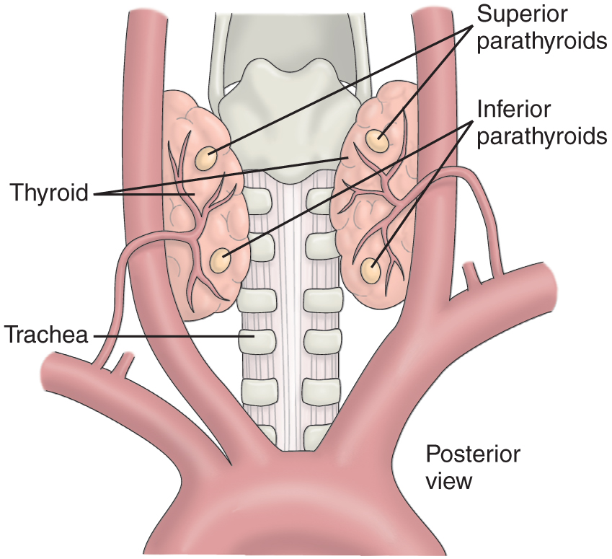
Parathyroid Glands

Slide 35
Hyperparathyroidism
Primary hyperparathyroidism is 2–4X more frequent in women.
Manifestations include elevated serum calcium, bone decalcification, renal calculi, apathy, fatigue, muscle weakness, nausea, vomiting, constipation, hypertension, cardiac dysrhythmias, psychological manifestations
Treatment
Parathyroidectomy
Hydration therapy
Encourage mobility reduce calcium excretion
Diet: encourage fluid, avoid excess or restricted calcium
Hypercalcemic crisis

Slide 36
Hypoparathryoidism
Deficiency of parathormone usually due to surgery— thyroidectomy, parathyroidectomy, or radical neck dissection
Results in hypocalcaemia and hyperphosphatemia
Manifestations include tetany, numbness and tingling in extremities, stiffness of hands and feet, bronchospasm, laryngeal spasm, carpopedal spasm, anxiety, irritability, depression, delirium, ECG changes
Chvostek’s sign
Trousseau’s sign

Slide 37
Management of Hypoparathyroidism
Increase serum calcium level to 9—10 mg/dL
Calcium gluconate IV
May also use sedatives such as pentobarbital to decrease neuromuscular irritability
Parathormone may be administered; potential allergic reactions
Environment free of noise, drafts, bright lights, sudden movement
Diet high in calcium and low in phosphorus
Vitamin D

Slide 38
Adrenal Glands
Adrenal medulla
Functions as part of the autonomic nervous system
Catecholamines; epinephrine and norepinephrine
Adrenal cortex
Glucocorticoids
Mineralocorticoids
Androgens

Slide 39
The Adrenal Glands:
glucocorticoids (cortisole):
- play important role in glucose, protein, and fat metabolism and have role in stress adaptation
- Elevate blood glucose level - inhibit the inflammatory response to tissue injury
- Suppress allergic reaction -
- Side effects: Develop DM, Osteoporosis, Peptic ulcer, Muscle wasting, poor wound healing, Redistribution of body fat and increase body Wt.
- Large amount of exogenous cortisole inhibit release of ACTH and endogenous cortisole, lead to adrenal atrophy and sudden withdrawal of cortisole leads to adrenal insufficiency

Slide 40
Cont….
2. Mineralocoticoids (Aldosterone):
- Influence electrolyte balance and blood pressure hmeostasis.
- Retain sodium and excrete potassium and hydrogen ions
3. Adrenal Sex hormones: (Androgens) (Male sex hormones)
- May secret small amount of female sex hormones (Estrogen)
- Excess secretion can lead to Masculinization (adrenogenetal syndrome)

Slide 41
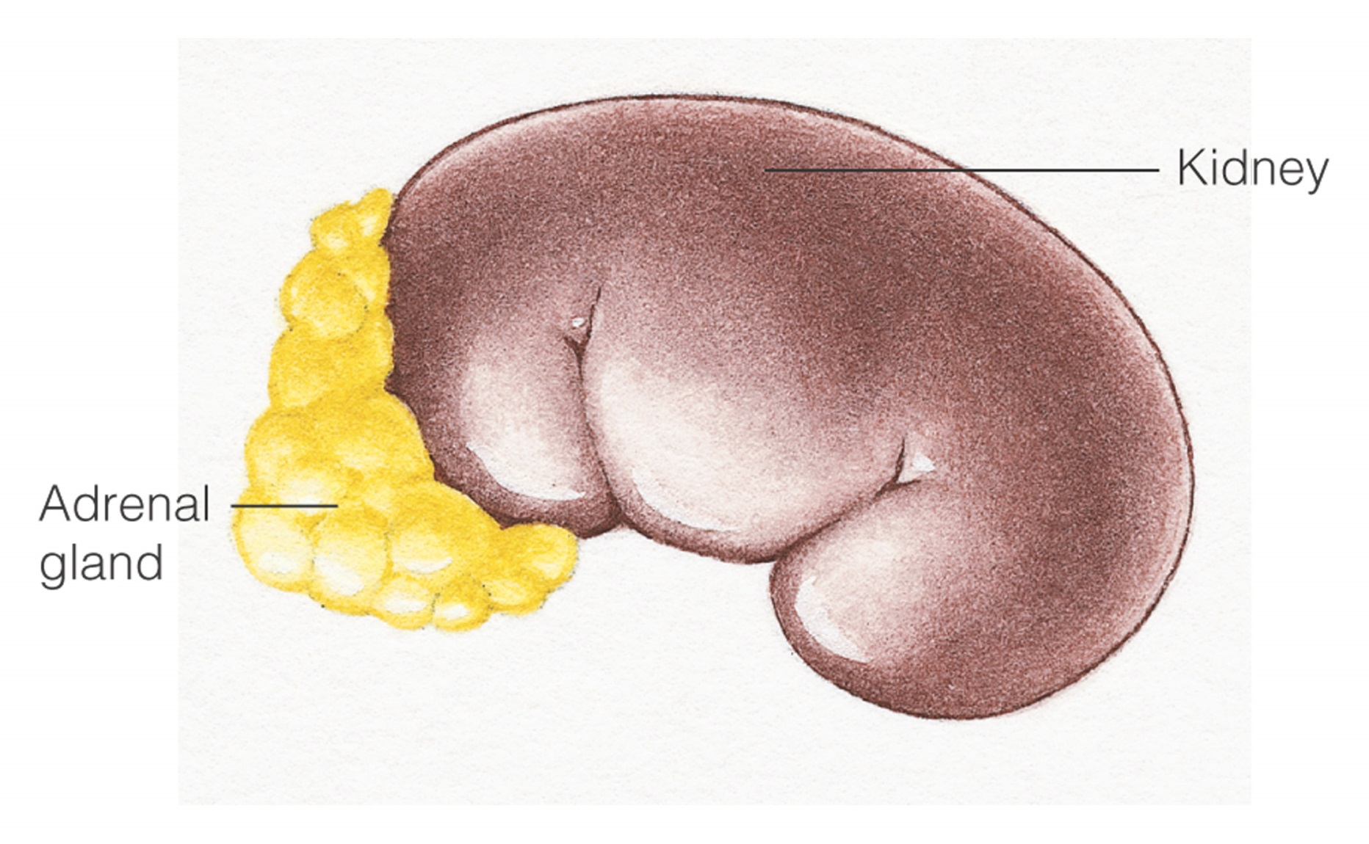
Endocrine Glands
Notes:
Figure 18–5 Location of the adrenal glands.

Slide 42
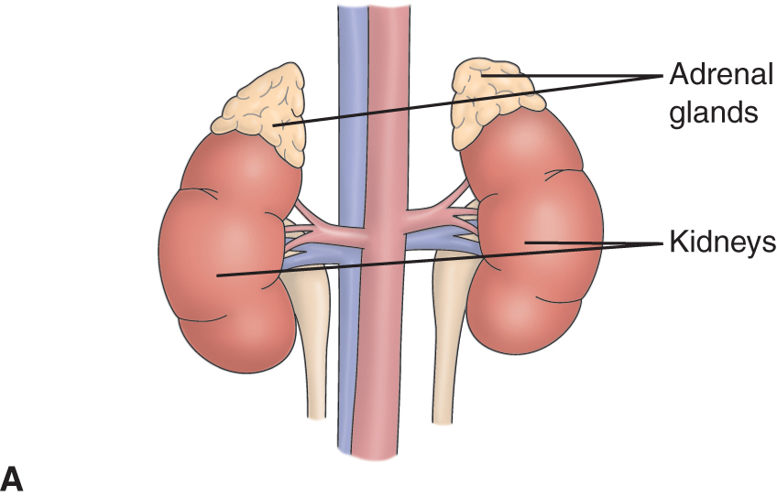
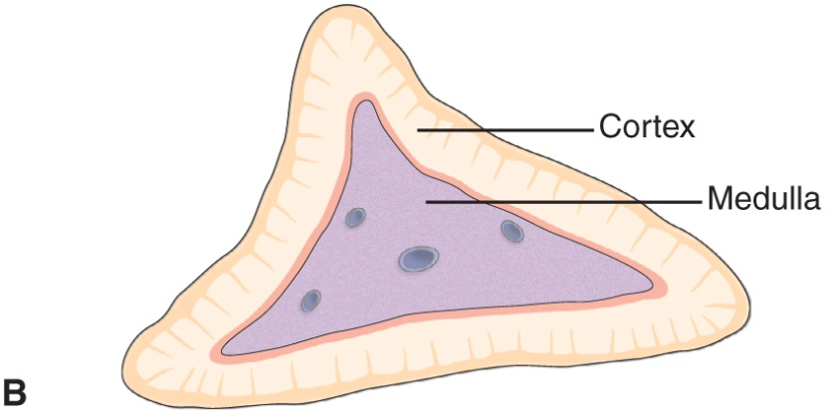
Adrenal Glands

Slide 43
Adrenocortical Insufficiency
Addison’s disease
May be the result of adrenal suppression by exogenous steroid use- Autoimmune or idiopathic atrophy of the adrenal gland (Cortex) (80%)
- Surgical remove of both glands
- Infection including TB and histoplasmosis
- Sudden cessation of exogenous adrenocortical hormone therapy
Manifestations include muscle weakness, anorexia, GI symptoms, fatigue, dark pigmentation of skin and mucosa, hypotension, low blood glucose, low serum sodium, high serum potassium, mental changes, apathy, emotional lability, confusion
Addisonian crisis
Diagnostic tests; adrenocortical hormone levels, ACTH levels, ACTH stimulation test

Slide 44
Addisonian Crisis: (hypotensive crisis)
Cyanosis and classic signs of circulatory shock: pallor, hypotension, rapid, weak pulse, rapid respiration
Headache, nausea, abdominal pain and diarrhea
slight overexertion, exposure to cold, acute infection or decreased salt intake can lead to circulatory collapse
Sign of confusion and restlessness.
Stress or surgery or dehydration and preparation for diagnostic tests can precipitate crisis.

Slide 45
Assessment and diagnostic Findings:
Hypoglycemia and hyponatremia and hyperkalemia
Increased WBC’s ( leukocytosis)
Diagnosis confirmed with low levels of:
- Adrenocortical hormones in the blood or urine
- Decreased serum cortisol levels
Medical management:
Combat shock ( addisonian crisis) by:
- Restoring blood circulation
- Administering fluids and corticosteroids
- monitoring vital signs
= placing the patient in recumbent position with leg elevated

Slide 46
Cont…
Administering Hydrocortisone ( solu-cortef) followed by D5NS.
Vasopressor amines for hypotention
Antibiotic if infection presented
Oral intake as tolerated
Replacement of cortical hormones if gland doesn’t regain function
Salts and fluid supplement during GI losses

Slide 47
Nursing Management:
Monitor vital signs and signs of infection, dehydration
Monitor signs of electrolyte imbalance
I/O daily, assess skin turgor
Administer steroids with milk or antacids to prevent ulcer
Prevent contact with other patient who have infection, limit visitors
Monitor for Addison's crisis: ( shock , hypotension, rapid weak pulse, rapid respiration, pallor, extreme weakness:

Slide 48
Cont…
Avoid physical and psychological stressors to prevent circulatory collapse
Improving activity tolerance ( avoid unnecessary activity and stress, maintain quit, non stressful environment, assist in daily activity)
Restoring fluid balance:
- instruct pt. to report increased thirst, monitor signs of dehydration
- Lying, sitting, and standing BP: decreased systolic pressure of 20mmHg may indicate fluid depletion
- Encourage foods and fruits that restore F and E balance
- Administer hormonal replacement as ordered

Slide 49
Nursing Process: The Care of the Patient with Adrenocortical Insufficiency— Assessment
Level of stress; note any illness or stressors that may precipitate problems
Fluid and electrolyte status
VS and postural blood pressures
Note signs and symptoms related to adrenocortical insufficiency such as weight changes, muscle weakness, and fatigue
Medications
Monitor for signs and symptoms of Addisonian crisis

Slide 50
Nursing Process: The Care of the Patient with Adrenocortical Insufficiency— Diagnoses
Risk for fluid volume deficit
Activity intolerance and fatigue
Knowledge deficit

Slide 51
Interventions
Risk for fluid deficit; monitor for signs and symptoms of fluid volume deficit, encourage fluids and foods, select foods high in sodium, administer hormone replacement as prescribed
Activity intolerance; avoid stress and activity until stable, perform all activities for patient when in crisis, maintain a quiet nonstressful environment, measures to reduce anxiety
Teaching (See Chart 42-10)

Slide 52
Cushing’s Syndrome
Due to excessive adrenocortical activity or corticosteroid medications
Manifestations include hyperglycemia which may develop into diabetes, weight gain, central type obesity with “buffalo hump,” heavy trunk and thin extremities, fragile thin skin, ecchymosis, striae, weakness, lassitude, sleep disturbances, osteoporosis, muscle wasting, hypertension, “moon-face”, acne, increased susceptibility to infection, slow healing, virilization in women, loss of libido, mood changes, increased serum sodium, decreased serum potassium (See Chart 42-11)
Dexamethasone suppression test

Slide 53
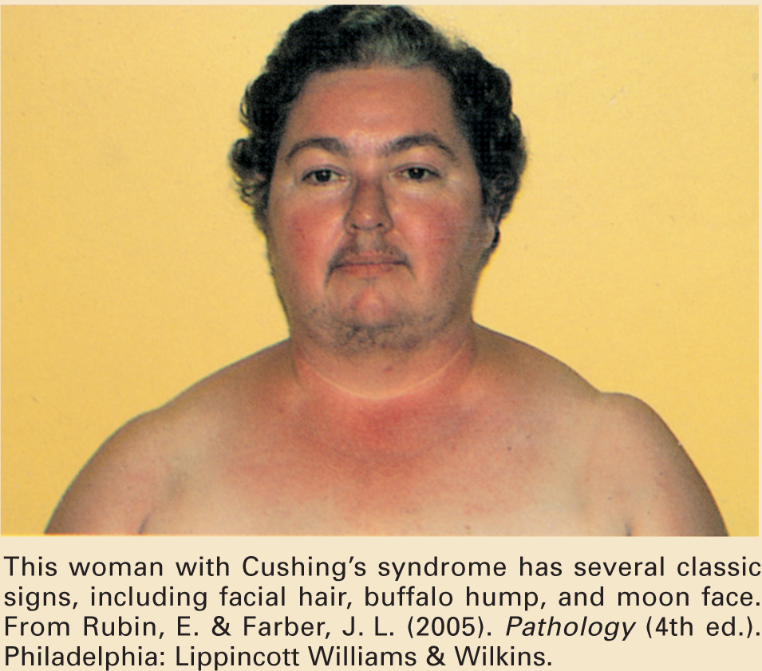
Cushing’s Syndrome

Slide 54
Nursing Process: The Care of the Patient with Cushing’s Syndrome—Assessment
Activity level and ability to carry out self-care
Skin assessment
Changes in physical appearance and patient responses to these changes
Mental function
Emotional status
Medications

Slide 55
Nursing Process: The Care of the Patient with Cushing’s Syndrome—Diagnoses
Risk for injury
Risk for infection
Self-care deficit
Impaired skin integrity
Disturbed body image
Disturbed thought processes

Slide 56
Collaborative Problems/Potential Complications
Addisonian crisis
Adverse effects of adrenocortical activity

Slide 57
Nursing Process: The Care of the Patient with Cushing’s Syndrome—Planning
Goals may include decreased risk of injury, decreased risk of infection, increased ability to carry out self-care activities, improved skin integrity, improved body image, improved mental function, and absence of complications

Slide 58
Interventions
Decrease risk of injury; establish a protective environment; assist as needed; encourage diet high in protein, calcium, and vitamin D.
Decrease risk of infection; avoid exposure to infections, assess patient carefully as corticosteroids mask signs of infection.
Plan and space rest and activity.
Meticulous skin care and frequent, careful skin assessment.
Explanation to the patient and family about causes of emotional instability.
Patient teaching. (See Chart 42-12)

Slide 59
Corticosteroid Therapy
Widely used drugs to treat adrenal insufficiency, suppress inflammation and autoimmune response, control allergic reactions, and reduce transplant rejection
Common corticosteroids (See Table 42-5)
Patient teaching
Timing of doses
Need to take as prescribed, tapering required to discontinue or reduce therapy
Potential side-effects and measures to reduction of side-effects (See Table 42-6)

