Slide 1
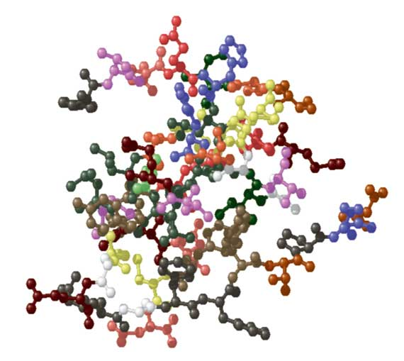
Endocrine disorders Dr. Reem ali
Spring Semester 2014

Slide 2
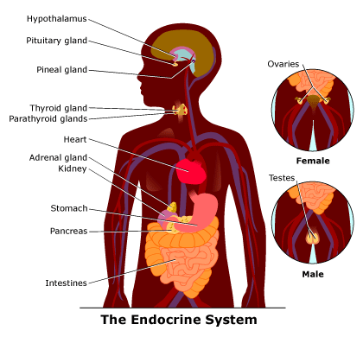
Endocrine System

Slide 3
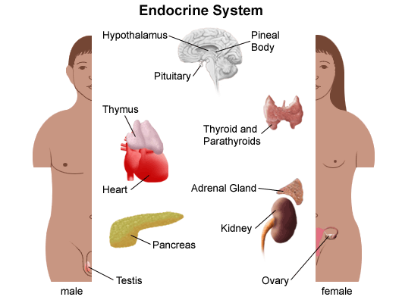
Endocrine System

Slide 4
Endocrine System: functions
Controls basic body functions
Metabolism
Growth
Sexual development

Slide 5
Endocrine disorder
Pancreatic Disorders
Type 2 Diabetes
Thyroid disorders
Juvenile Diabetes Milletus
Juvenile Hypo-thyroidism
Hypoglycemia
Goiter
Hyper-thyroidism
Congenital Hypo-thyroidism

Slide 6
Endocrine System: Diabetes Mellitus
DM is a metabolic disorder
DM is a condition in which sufficient amounts of insulin are either not produced or the body is unable to use the insulin that is produced
If uncontrolled DM can be life threatening and cause serious complications affect all body system

Slide 7
Types of Diabetes Mellitus*
Type 1 diabetes*
Idiopathic type 1 DM
Immune-mediated diabetes
represents 10% of all DM cases
Body’s immune system destroys cells in the pancreas that produce insulin
sudden onset
Type 2 diabetes

Slide 8
Type 1 DM*
Body fails to produce insulin due to autoimmune process
Glucose cannot enter the cells causing body’s cells to starve
Insulin injections dependent

Slide 9
Type 1 DM: Symptoms
Abrupt onset
In children DM S&S resemble to flu, GI or appendicitis
Hyperglycemia and acidosis
Polyphagia, polydipsia & polyuria
Elevated glucose in the urine
Unusual thirst
Blurred vision
Nausea & vomiting
Abdominal pain
Irritability & Mood changes

Slide 10
Type 1 DM: Diagnosis
Diagnosis
FBS ≥ 126 mg/dl
RBS ≥ 200 mg/dl
Oral glucose tolerance test (OGTT) ≥ 200 mg/dl in the 2-hour sample
DKA:
BS ≥ 330 mg/dl
Ketonemia & ketonuria positive (ketone more than 5 mEq/L)
Acidosis (pH less than 7.3
serum bicarbonate level of 18 mEq/L or less (< 5 mEq/L is indicative of severe DKA)

Slide 11
Type 1 DM: Treatment
The goals of treatment
Keep BS within normal ranges
Resume normal life routine
Prevent complications
Treatment is based on:
Daily insulin injections (mix of rapid-acting-regular- and intermediate acting- lente- insulin)
It may be two or three injections/day which is 30 minutes before meal
Balanced diet that contains, fat, protein, CHO and vitamins
Concentrated sweets are discouraged
Exercise, regular blood & urine testing

Slide 12
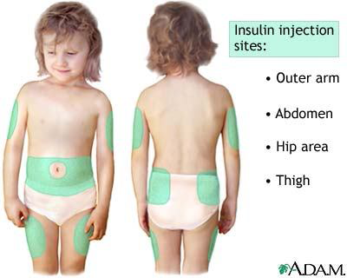
Type 1 DM: sites of insulin injection

Slide 13
Type 2 DM
Is inability to produce enough or to properly use of insulin
Exact cause is unknown, though there is an inherited susceptibility
Most common in adults
Represents 90-95% of all diabetes cases
DM 2 can be prevented by maintain ideal body weight and regular exercise

Slide 14
Type 2 DM: symptoms
Frequent and difficult infection
Extreme hunger and loss of Wt
Excessive urination
Thirst
Blurred vision
Mood changes
Nausea & vomiting
High level of sugar in blood and urine
Weakness & fatigue

Slide 15
Type 2 DM: Risk factors
age (incidence increases with age)
family history of diabetes
being overweight
not exercising regularly
a low level HDL (high density lipoprotein)

Slide 16
Type 2 DM: Treatment
Wt loss
Improve nutrition
Insulin replacement
Exercise

Slide 17
Hypoglycemia
Is a condition of having low glucose level that is not enough to fuel body’s cells
Could be a complication of diabetes (insulin reaction). Causes of hypoglycemia in DM children
Too much insulin
A missed meal
Delayed meal
Too little food compared to amount of insulin taken
More exercise than usual
Hyperinsulinism ((inborn metabolic error)

Slide 18
Hypoglycemia
Prolonged hypoglycemia may cause seizures and brain injury
S &S
Shaking, dizziness, irritability
Sweating, pallor
Headache, hunger
Sudden mood changes
Confusion and poor attention
Tingling sensation around the mouth

Slide 19
Hypoglycemia: Treatment
For a child with DM immediately give the child sugar as in orange juice, hard candy
For children without DM
Small and frequent meals
Snacks
Variety of healthy foods
Regular exercise

Slide 20
Diabetes Mellitus: Nursing Care
Nursing diagnosis: risk for injury R/T insulin deficiency
Administer the most suitable dose of insulin
Safe and accurate insulin injection
Educate parents about types of insulin
Regular check of BS (blood sugar)

Slide 21
Diabetes Mellitus: Nursing Care
Nursing diagnosis: risk for injury R/T hypoglycemia
Recognize of S& S of hypoglycemia
Have readily absorbed CHO followed by complex CHO (protein, bread, cheese)
Administer glucagon to unconscious child
Regular check of BS (blood sugar)

Slide 22
Diabetes Mellitus: Nursing Care
Nursing diagnosis: knowledge deficit R/T care of a child with newly diagnosed DM
Encourage normalacy
Very little food restrictions, though balanced diet
Teach proper ways of storing mixing and administering insulin
Dental care and regular ophthalmic examination
Teach parents about S&S and management of hypo/hyperglycemia
Regular check of BS (blood sugar)
Keeping records of blood/urine tests, insulin, food

Slide 23
Diabetes Mellitus: Nursing Care
Balanced diet
50-60% CHO
30% protein
10-15% fat
Lipodystrophy
Restricted food (Pepsi, jam, sacrin,
DKA (dehydration, acidosis, hyperglycemia)

Slide 24
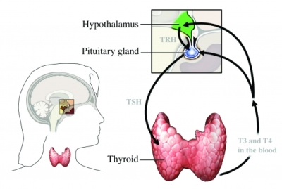
Hypothyroidism
Thyroid gland regulates metabolism and calcium.
A thyroid disorder may be congenital or acquired during childhood
Most common thyroid disorder is hypothyroidism

Slide 25
Congenital Hypothyroidism*
Congenital hypothyroidism (CH)
Deficiency of thyroid hormone present at birth
It could be permanent or transient
Permanent CH caused by defective gland development, enzymatic defect or pituitary dysfunction
Transient CH caused by intrauterine transfer of antithyroid drugs. Or immature hypothalamus & pituitary gland in premature infants
If untreated can lead to mental retardation

Slide 26
Congenital Hypothyroidism: Clinical Manifestation
Signs of CH are varied and often are not seen at all in newborn
Newborn with CH may be post-term and have birth wt over 4Kg
CM for newborn:
Poor feeding
Lethargy
Prolonged jaundice
Respiratory difficulty and cyanosis
Bradycardia
Large fontanel

Slide 27
Congenital Hypothyroidism: Clinical Manifestation
CM for infants which mostly appear after 6 wks of life:
Depressed nasal bridge, puffy eyelids and large tongue
Abdominal distention
Umbilical hernia
Hyporeflexia, bradycardia, hypothermia
anemia
Short limbs (retarded bone growth)
Developmental delayed of nervous system and possible mental retardation (if not treated)

Slide 28
Congenital Hypothyroidism: Clinical Manifestation
Dx: neonatal screening for T4 (low) and TSH (high)
Treatment
Replacement of thyroid hormone
It could be life-time treatment or discontinue after 3 years
Nursing care
Early diagnosis of CH (neonatal screening; unusual good & quiet baby)
Parents education
If one dose is missing it should be given with the next dose
S&S of overdose: rapid pulse, irritability, fever, weight loss, sweating and insomnia

Slide 29
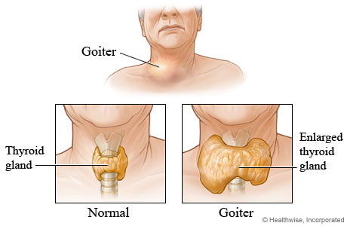
Goiter
Is an enlargement of the thyroid gland
Enlargement could be associated with hypo/hyper or normal thyroid hormone secretion
Could be congenital or acquired
Caused by: maternal antithyroid drugs (congenital); increased secretion of TSH, neoplastic or inflammatory process

Slide 30
Hyperthyroidism (Graves Disease)*
Overactivity of the thyroid gland results in high level of thyroid hormone(TH)
Very rare in children and adolescents
High level of TH increases the body’s metabolism
causes are
Newborn: maternal hyperthyroidism
Adult : autoimmune disorder

Slide 31
Hyperthyroidism (Graves Disease)
CM
Poor weight gain
Tachycardia and increased BP
Tremors & insomnia
Nervousness & emotional lability
Hyperactivity
Protruding eyes (Exophthalmos)
Short attention span
Heat intolerance and diaphoresis

Slide 32
Hyperthyroidism (Graves Disease)
Possible complication for infants
Premature closing of fontanels
Slowed growth
Mental retardation
Diagnosis is based on high levels of T4 & T3 and depressed TSH
Treatment
Antithyroid drugs
Thyroidectomy
Ablation (removal) with radio iodine

Slide 33
Hyperthyroidism (Graves Disease)
Nursing care
Provide quiet environment and rest periods
Appropriate dietary requirement
Side effect of the medication (skin rash, edema of lower extremities, leukopenia, decreased sense of taste)

Slide 34
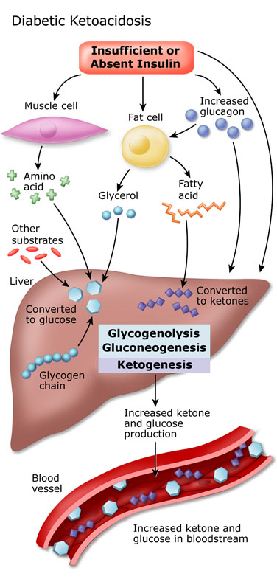

Slide 35
Hyperthyroidism (Graves Disease)
Nursing care
http://youtu.be/0mn2mu0NyFA
http://youtu.be/X0ezy1t6N08

