Slide 1
health promotion
Dr. Reem Ali
Spring Semester 2015-2016

Slide 2
Pediatric Nursing
Concerns with care of infants and children
Preventing disease or injury
Assisting children, including those with permanent disability or health problems to achieve and maintain an optimum level of health and development
Treating or rehabilitating children with health deviations
Requires the knowledge of:
normal psychomotor, psychosocial, and cognitive growth and development
Pediatric health problems and needs
Preventive care and anticipatory guidance

Slide 3
Characteristics of a Pediatric Nurse
Communicate well with children
Be honest
Establish a trust relationship with children & their parents
Altruistic (acting of the good/concern for the welfare of others) able to support children through difficult/ painful procedures
Knowledgeable about diseases and medication (teacher)

Slide 4
Characteristics of a Pediatric Nurse
Familiar with community resources and organization (networker)
Role model and child & family advocate
Recognize uniqueness
Develop partnership with parents (mutual respect and sharing the decision making role)
Coordinating the health care team

Slide 5
Role of a Pediatric Nurse
Establishing a therapeutic relationship (caring) with clients
Family advocacy (influence public-policy and resource allocation decisions within political, economic, and social systems)
Disease prevention &health promotion
Support in treating disease and disabilities & health teaching
Counselling, coordination/collaboration
Health care planning & ethical decision making,
Researcher

Slide 6
Family-Centered Care
A philosophy of care to meet the emotional needs of children
Key elements of family centered care are:
Respects and recognises importance of family role in the lives of healthy and ill children
supports families in their natural care giving roles and promotes healthy patterns of living at home in communities
Both families and professionals viewed as equal in the relationship
Facilitate family/professional collaboration & family decision making
Honouring of cultural diversity
Encourage family-to-family support

Slide 7
Hospitalization & a Child & Family Reaction
Hospitalization is a stressful experience for parents and a crisis for children
It is a change from the usual state of health and environment
Children have a limited number of coping mechanisms, thus hospitalization experience is stressful
Family/Children’s reaction to hospitalization depends on
A child’s developmental age
Previous experience with illness and separation
Support system
The nature of the illness

Slide 8
Infant & Toddler Response Hospitalization
Anxiety
Loss of control
Fears

Slide 9
Infant & Toddler Response Hospitalization
Anxiety :Separation anxiety
Major stress from middle of infancy throughout the pre-school years..
When a child separated from primary care giver, he goes through these stages:
Protest (crying for parent & refuse attention of anyone else)
despair (crying stops, the child less active, withdraws from others & disinterested in food & playing, & extremely quiet)
Detached ( the child ignores people, becomes more interested in the surroundings)

Slide 10
Infant & Toddler Response Hospitalization
Loss of control
Toddlers are striving for autonomy
When their needs for autonomy meet with obstacles toddlers react with negativism (temper tantrums)
Stress imposed by hospitalization as manifested by physical restriction, limited movement altered routine increases child’s perception of threat and affect his coping skills.
Fears: Fears of bodily injury and pain

Slide 11
Preschoolers’ Response Hospitalization
Fears of hospitalization includes
Separation anxiety
Loss of control
Bodily injury and pain from intrusive procedures
Preschooler’s ability to understand the reason for hospitalization is limited by egocentricity and magical thinking..
Common behaviors in response to hospitalization
Aggression
Regression ( withdraw, dependency)

Slide 12
School-age children’s Response to Hospitalization
Common fears includes;
Disability
Death,
Unknown
Loss of control and independence
Separation from peers
Interruption of daily routine

Slide 13
Adolescent’s Response to Hospitalization
Common fears includes
loss of control
pain
sexual changes
separation from peer group
Common behaviors in hospital
Rejection and uncooperative
self-assertion; self control
cooperation then he may change to anxiety
depression, loneliness or overconfidence and manipulation.

Slide 14
Family’s response to the child’s illness and hospitalization
Parents’ reaction s includes:
Disbelief
Guilt
Anger
Fears
anxiety and frustration
Siblings' reaction includes:
Fear
jealous
guilt

Slide 15
Nursing Diagnosis
Anxiety/ fear R/T distressing procedures and events
Anxiety /fear related to separation from accustomed routine and support
Activity intolerance R/T generalized weakness and fatigue
Potential for injury R/T trauma of unfamiliar environment, therapy and hazardous equipment
Self- care deficit R/T mechanical restrictions or bed rest
Altered parenting R/T lack of knowledge ; change in family unite (new child)

Slide 16
Promoting Healthy Parenting
Provide parenting and child care education
Empathize with parent’s sense of responsibilities and offer reassurance and support that the parent can learn to know the child’s needs.
Provide positive reinforcement for appropriate behaviour..
Teach parents the importance of balance between the infants needs and needs of other members
Help family identify and utilize personal and community resources

Slide 17
Child Health
Traditionally, health is assessed by observing mortality (death) and morbidity (illness) rates over time.
Health is defined as " a state of complete physical, mental, and social well-being and not merely the absence of disease” (WHO).
According to ANA health is “ a dynamic state of being in which the developmental and behavioral potential of an individual is realized to the fullest extent possible……. [Health is] an experience that may occur in the presence or absence of disease or injury”

Slide 18
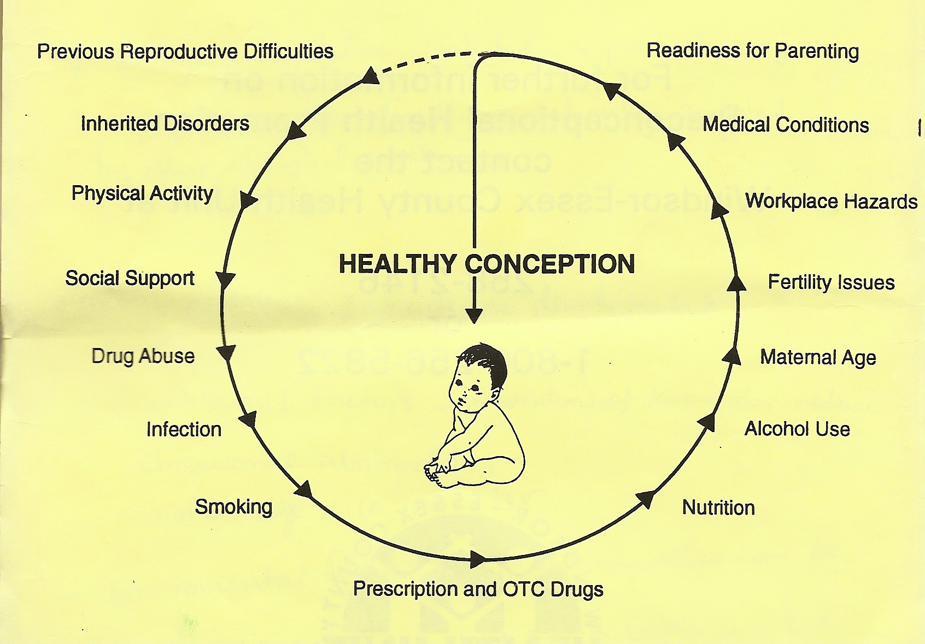
Child Health: pre-conception health
OTC: Over The Counter

Slide 19
Communication
Communication is a complex process that includes the perceptions and judgments of all individual involved
Communication may be verbal, nonverbal, or abstract
Successful communication must be appropriate to the situation, properly timed, and clearly delivered. Verbal and nonverbal messages must be congruous

Slide 20
Guideline for Effective Communication (interview)
During interview pay attention to infants and younger children through play. Older children may be active participants.
Pay attention to children non-verbal communication.
Allow children time to feel comfortable.
Avoid sudden or rapid advances, broad smiles, and extended eye contact.
Talk to parents if child is initially shy
Communicate through transition objects such as dolls, before questioning a young child directly

Slide 21
Guideline for Effective Communication (interview)
Assume a position that is at eye level with child.
Speak in a quiet, confident voice
Use simple words and short sentences.
Be honest with children.
Allow children to express their concerns and fears.
Younger school-age children want explanation and reasons for everything
Children younger than 5 years are egocentric, therefore focus communication on them.
Experiences of other children do not interest them.

Slide 22
Guideline for Effective Communication (interview)
Nonverbal messages should be consistent with words and actions ( do not smile while doing something painful)
Older children have an adequate and satisfactory use of language thus they require simple explanation. Allow them to touch and examine articles that will come in contact with them.
Give older children the opportunity to talk without the parents’ present.

Slide 23
Guideline for Effective Communication with Adolescents
They are willing to discuss their concerns with an adult outside the family
They are quick to reject persons who attempt to impose their values on them or who appear to have little respect for who they are and what they think or say
Listen to them, don’t interrupt, and avoid comments or expressions that convey disapproval or surprise.
Maintain privacy

Slide 24
Health Promotion in infancy

Slide 25
Definitions
Newborn: first few hours of life
Neonatal period is defined as the first month of life
Infancy is the whole first year of life
Perinatal period: period around birth it may extend from 28 wks of gestation to first week after birth

Slide 26
Definitions
Live birth: all babies born with any signs of life
Preterm baby: is one born before 37 weeks of gestation
Term baby: is one born between 37-41 wks
Low birth weight: newborn less or equal 2500 g at birth despite his maturity

Slide 27
Child Health: mortality
The infant mortality rate is the number of deaths during the first year of life per 1000 live births. It may be further divided into neonatal mortality (<28 days of life) and post-neonatal mortality (28 days to 11 months).
Birth weight is considered the major determinant of neonatal death in technologically developed countries and is closely related to gestational age.
The relationship between birth weight and mortality shows that the lower the birth weight, the higher the mortality.

Slide 28
Jordanian Statistics
Neonatal mortality: deaths (per 1000 live birth) occur during the first months of life. Jordan neonatal mortality rate is 14.9 (HPC; 2012)
Infant mortality: deaths in the whole of the first year. 2/3 of infant deaths occurs between the end of first month to 12 months. Jordan infant mortality rate is 20.93 (List by the United Nations Population Division; 2005-2010)

Slide 29
Health Promotion: Infancy
Areas of focus in well-baby health visits (6 times during infancy) are:
Growth milestones: Ht., Wt., H.C.
Developmental milestones.
Dental health.
Nutritional adequacy.
Parent-child relationship.
Vision & hearing assessments.
Immunization

Slide 30
Health Promotion: Infancy
Growth & Development..
physical parameters are monitored by plotting measurements on a standardized growth charts :
Weight
Height
Head circumference
Assess developmental milestone
Immunization

Slide 31
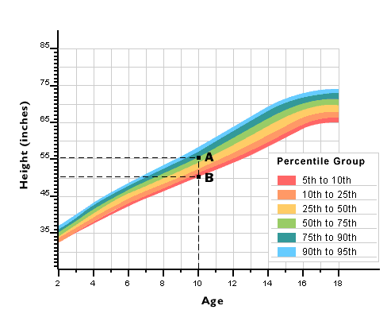

Slide 32
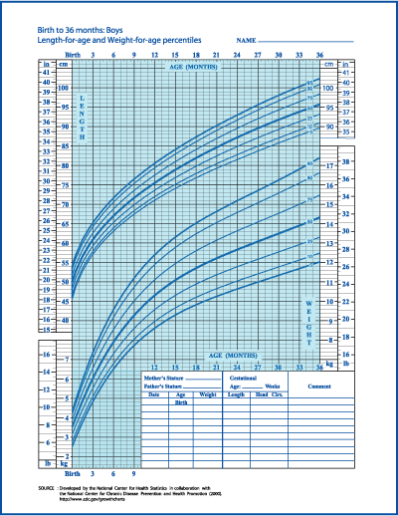

Slide 33
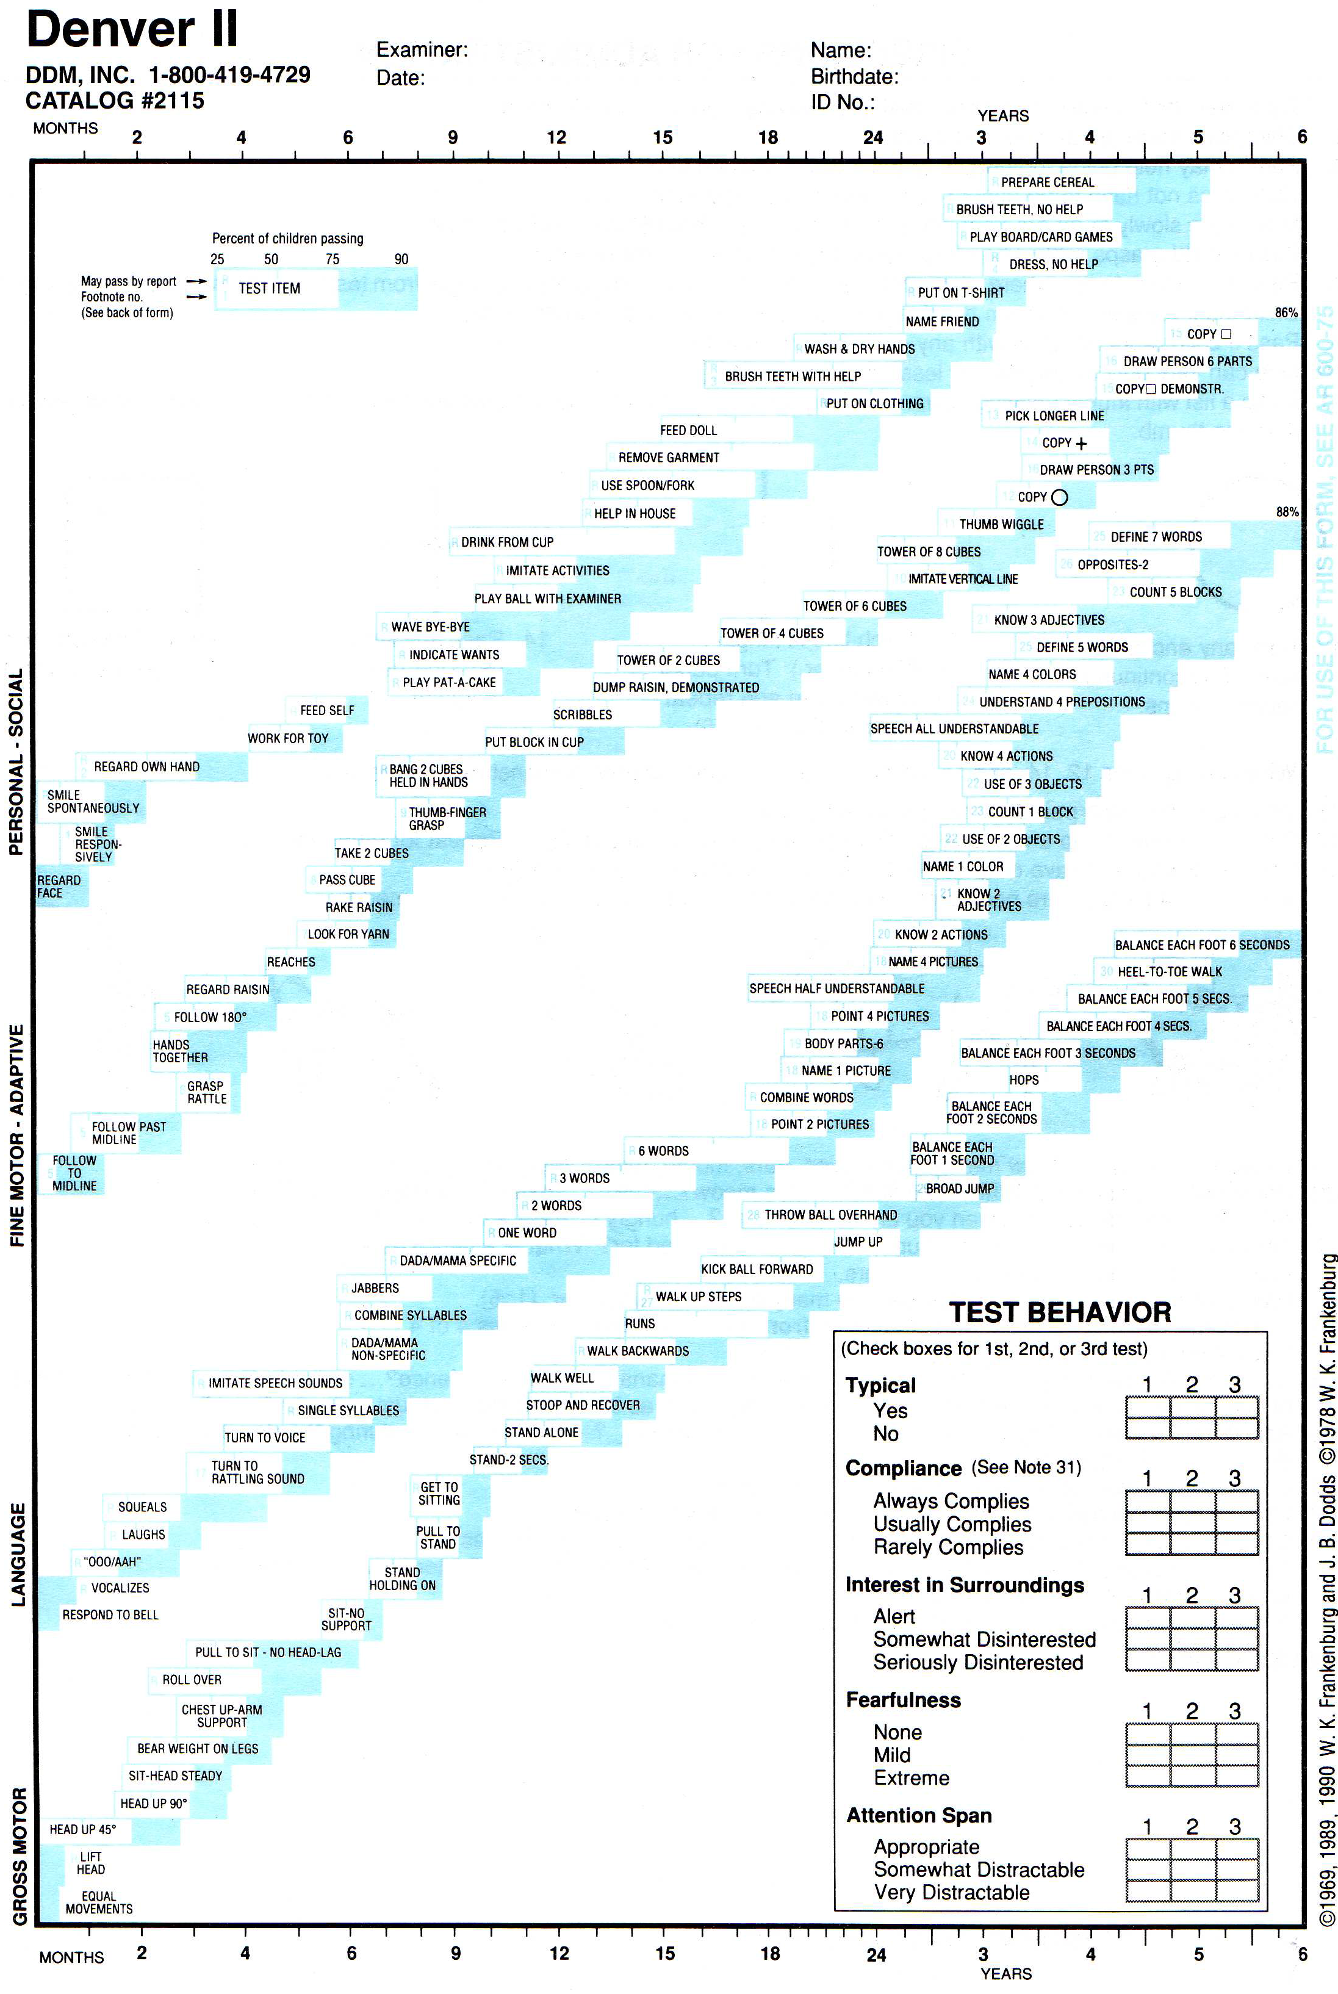
Health Promotion: Adolescence
Management of scoliosis
Involves straightening and realignment of the vertebrae by
either external (bracing)
internal (surgical) fixation techniques.

Slide 34
National Jordanian Vaccination Program
Age | 1 mon | 61 days | 91 days | 121 days | 10 m | 12 m | 18-24 m | 6 yrs
Vaccine
BCG | ☻
DTP |  | ☻ | ☻ | ☻ |  |  | ☻ | dT
PCV |  | ☻ | ☻ | ☻ |  | ☻ | ☻
Polio. V |  | IPV | IPV/OPV | OPV | OPV |  | OPV | OPV
HIB |  | ☻ | ☻ | ☻
HBV |  | ☻ | ☻ | ☻
Measles |  |  |  |  | ☻
MMR |  |  |  |  |  | ☻ | ☻
Notes:
at Is the Chickenpox Vaccine?
The chickenpox vaccine is a shot that can protect nearly everyone who gets it from catching chickenpox. It's also called the varicella vaccine because chickenpox is caused by the varicella-zoster virus. The vaccine is made from a live but weakened, or attenuated, virus.
Viruses that have been attenuated are less virulent than viruses that are not. Although the virus in the chickenpox vaccine is generally incapable of causing a disease, it still stimulates a response from the body's immune system. That response is what gives someone who's had a shot for chickenpox immunity from the illness.
Why Do People Need a Chickenpox Vaccine?
Most cases of chickenpox are relatively mild and run their course in five to 10 days. But it can be very serious, even life threatening, in a small percentage of people. Before the varicella vaccine was licensed in the U.S. in 1995, there were approximately 100 deaths and more than 11,000 hospitalizations a year from chickenpox. Most of the people who died were healthy before they got chickenpox.
The risk of serious, life-threatening complications is greatest among infants, adults, and people with weakened immune systems. But anyone can develop serious complications and there is no way to predict who will.
There's another reason for getting a shot for chickenpox. The illness is highly contagious and can be spread by direct contact or through the air by sneezing or coughing. Also, someone can get it by coming in contact with fluid from chickenpox blisters. For that reason, children with chickenpox need to be kept out of school or day care for about a week or more. Also, the illness causes an itchy rash that usually forms between 200 and 500 blisters over the entire body, headaches, coughing, and fussiness. So even if the illness is mild, it still means five to 10 days of being uncomfortable.
Continue reading below...
Are Children Required to Get a Chickenpox Vaccination?
Most states require that children entering child care and school show evidence of immunity to chickenpox or evidence of having been given the chickenpox vaccine.
Who Should Get Vaccinated With the Chickenpox Vaccine?
The chickenpox vaccine is recommended for all children under the age of 13 who have not had chickenpox. It is also recommended for all adolescents and adults who have not been vaccinated and have not had chickenpox.
If you have had chickenpox there is no need for you to get the vaccine.
Since 2005, the vaccine has also been available as part of a combination vaccine called MMRV, which offers protection against measles, mumps, rubella, and varicella

Slide 35
Health Promotion: Infancy
Factors that influence growth and development..
Heredity.
Neuroendocrine factors.
Gender.
Disease.
Season, climate, and oxygen concentration.
Prenatal influences.
Environmental hazards.
Socioeconomic level.
Nutrition.
Interpersonal relationships

Slide 36
Health Promotion: Infancy
Growth Milestone
Weight (Wt.):
Average birth weight is 3400g, double their Wt. at 4-6 months and triple it by 1 year.
Gain 907 gm/ mon. until age of 5 mon. then decreased by half this amount during the 2nd 6 mon. of age..
Average 1-year-old male weighs 10 kg.
Average 1-year-old female weighs 9.5 kg
Height (Ht):
Average Ht. at birth 50 cm, increases by 2.5 cm/mon. during the 1st 6 mon. & half this amount during the 2nd 6 mon
by the end of first year birth has increases by almost 50% mainly in trunk rather than legs)
Average Ht. at 6 mon. is 65cm & at 1 year is 74 cm

Slide 37
Health Promotion: Infancy
Head Circumference (H.C):
Average birth head circumference is 33-35 cm.
Average H.C. is 43 cm at 6 months and 46 cm at 1 year.
Chest Circumference (C.C):
Average birth chest circumference is 2 cm less than HC.
Vital signs:
Pulse at birth 120-160 bpm. Respiratory rate 30-40 breath/min. blood pressure 80/50 mmHg.

Slide 38
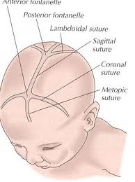
Health Promotion: Infancy
Head & fontanels
HC Increases rapidly reflecting rapid brain growth.
By the end of 1st year, brain reach 2/3 of its adult size (increases in Wt. 2.5 times of its birth Wt.).
Posterior fontanel (triangular, 0.5-1 cm. Closes between 2-3 month of age), & anterior fontanel (diamond shape 4-5 cm, closes at 12-18 months).

Slide 39
Health Promotion: Infancy
Developmental milestones
Shape
Abdomen is protuberant.
Legs may appear short and bowed
Large head proportion to the rest of the body.
Gross motor development (large body movements)
Newborn baby turns head when prone.
Rolls over from back to side and Lifts chest off the bed at 3 mon.
Sitting at 6-8 mon.
Creeping at 9 mon.
Cruising at 10-11 mon,
Walking at 12 mon. avg(8-15).

Slide 40
Health Promotion: Infancy
Fine motor development
Accept an object, grasp it with whole hand and bring hands together at 5 mon.
Pass an object from one hand to the other at 7 mon.
Pincer grasp at 10 mon.

Slide 41
Health Promotion: Infancy
Language Developmental
Begin to make small cooing (dove-like) sounds by the end of the first month.
Use crying as a way of communication (hungry, wet, lonely or in pain) at 2 months.
Squeal with pleasure to smiling faces or friendly tone at 3 months.
Laugh out loud and talkative (i.e.:, babbling, gurgling when spoken to) at 4 months.
Speaks a first word (da-da, ma-ma, da-da) at 9 months
At 10 months says bye-bye, No
Play
solitary play

Slide 42
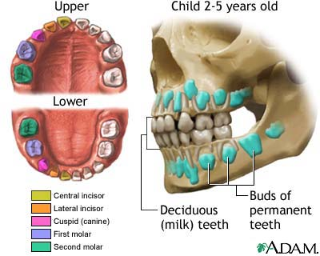
Health Promotion during Infancy: Dental health
First tooth usually erupts at age 6 months, followed by a new one monthly.
Water with fluoride is essential.
Begin brushing even before teeth erupt (using a soft washcloth).

Slide 43
Health Promotion during Infancy: Sleep
Pattern vary among infants, first month sleep when not eating. After that require 10-12 hours sleep at night and several naps during the day.
Always put infant on his back or side to sleep to prevent SIDS with no pillow.

Slide 44
Health Promotion during Infancy: Nutrition
First 6 months of life:
Human milk is the most desirable complete diet for infant.
Commercial iron-fortified formula is the second choice. Whole milk (cow’s) should not be introduced to infants until after 1 year of age..
The introduction of solid foods before 4-6 months is not recommended (immature systems & food allergies).
Second 6 months of life:
Chewing movements do not begin until 7-9 months, thus foods require chewing should not be introduced before that.
Extrusion reflex fades at 4 months until this time it is difficult to introduce solid foods.
Quantity of food: newborn stomach can hold up to 30 ml, at 1 year of age increased to 1 cup (240ml).

Slide 45
Health Promotion during Infancy: Introduction of solid foods
Start with cereals (rice due to fewer allergies) twice daily change by another kind of cereals after a week.
Vegetables: vegetables are the second choice after cereals at 7 month of age, they are rich in iron
Fruits: fruits are offered one month after vegetables (8 mon.).
Meat: usually introduced at 9 months.
Egg yolk at 10 months (↑ iron) should be given before egg white (↑ protein) because protein can cause allergy.
Weaning is gradual, could be started at 9 months (diminished sucking reflex)

Slide 46
Health Promotion during Infancy: Injury Prevention
Aspiration: round, cylindrical objects, hotdog, carrot. Toys should be checked for loose pieces or parts (button eyes).
Falls: 2nd major cause of death in infants. Infants should not be lift unattended on a raised surface.
Motor vehicle accidents: use car seats for newborn.
Drowning: do not leave infant alone in a bathtub.
Poisoning and burns.
Notes:
Children younger than 5 years should not be offered popcorn or peanuts.

Slide 47
Health Promotion during Infancy: Concerns R/T Normal Growth & Development
Teething:
Gums are sore and tender causing pain with less eating or feeding, which make infant hungry and irritable.
High fever, convulsions, vomiting & diarrhea, earache are never normal signs of teething.
Acetaminophine Q 4 hours is enough to decrease pain.
Thumb sucking:
Peaks at 18 mon. it is a normal habit and does not deform the jaw line or cause baby talk as well as it stops by school age.

Slide 48
Health Promotion during Infancy: Concerns R/T Normal Growth & Development
Pacifier
Problem of cleanliness.
Problem of aspiration if it wasn’t one piece.
Strangulation if wear it on a string around the neck.
Weaning should be at 9 months maximum (time of decreased sucking reflex) after that it became difficult.

Slide 49
Health Promotion during Infancy: Concerns R/T Normal Growth & Development
Colic: paroxysmal abdominal pain
Usually occur in infants younger than 3 mon. of age.
Unclear cause but may occur from overfeeding, swallowing too much air while feeding, or from a formula that is too high in carbohydrate.
Thorough assessment should be done R/O any intestinal obstructions or diseases.

Slide 50
Health Promotion during Infancy: Concerns R/T Normal Growth & Development
Failure to Thrive (FTT)
FTT describes infant who fails to gain weight, height or both.
There is a wide variation in normal growth and development in general, the rate of change may be a better indicator of a problem rather than the actual measurement.
There are multiple causes that will disturb the body’s metabolism enough to result in delayed growth.
Two types of FTT are organic and non-organic

Slide 51
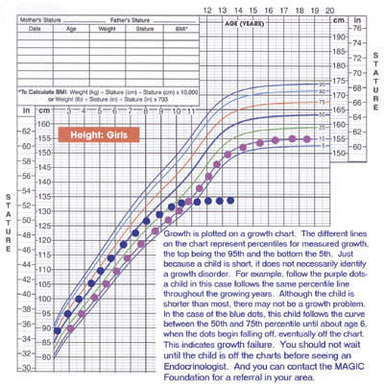
Health Promotion: Infancy
Failure to Thrive (FTT)
FTT describes infant who fails to gain weight, height or both.
There is a wide variation in normal growth and development in general, the rate of change may be a better indicator of a problem rather than the actual measurement.
There are multiple causes that will disturb the body’s metabolism enough to result in delayed growth.
Two types of FTT are organic and non-organic

Slide 52
Health Promotion during Infancy: Concerns R/T Normal Growth & Development
Types of FTT
1- Organic (Intrinsic): medical problems such as:
Chromosomal abnormalities (e.g. Down syndrome).
Defects in major organs & systems (cardiac, respiratory, GI problems).
Abnormalities of the endocrine system (thyroid hormone deficiency, growth hormone deficiency).
Damage to the brain or CNS that may lead to feeding difficulties.
Anemia or other blood disorders.

Slide 53
Health Promotion during Infancy: Concerns R/T Normal Growth & Development
Types of FTT
2- Non-organic (Extrinsic):
Environmental, psychosocial problems.
Emotional deprivation, parental withdrawal or rejection.
Economic factors: low living conditions.
Exposure to infections/ toxins

Slide 54
Health Promotion during Infancy: Concerns R/T Normal Growth & Development
Clinical manifestation of FTT:
Ht., Wt. & H.C. deficiencies.
Delayed physical skills (rolling over, sitting, standing, …etc.).
Mental & social skills are delayed.
Delay of development of secondary sexual characteristics.
Poor hygiene
Less smiling with poor eye contact.

Slide 55
Health Promotion during Infancy: Concerns R/T Health
Diaper Rashes
Most common skin problem during infancy.
Characterized by scaling and/or ulceration of the skin in the diaper area.
It could involve the buttock, lower abdomen, genitalia and upper portion of the thighs.
Etiology: combination of factors: prolonged contact of urine and feces, which breaks into ammonia, leading to maceration and irritation, that cause redness and tenderness. It could be infected with candida.
Nursing Care: Education and prevention:
Change diaper frequently.
Clean skin with water and mild soap.
Dry well and expose to air.
Use petroleum products that act as a barrier to moisture.
In mild cases use Zinc Oxide.

Slide 56
Health Promotion during Infancy: Concerns R/T Health
Bottle mouth Syndrome
Is early severe dental caries of deciduous teeth caused by sucrose in milk
This occurs when infant falls a sleep with a bottle of milk for a long period of time, that allows the milk to stain the oral cavity

Slide 57
Health Promotion during Infancy: Sudden Infant Death Syndrome
2/1000 infants die in their sleep for no apparent reason each year.
Risk of SIDS is highest at 4-6 weeks of age.
Parental blame.
SIDS theories:
Sleep apnea and heart problems
Transition from reflexive breathing to voluntary control.
Inability to swallow effectively in the prone sleeping position (Back to sleep & no soft bedding)

Slide 58
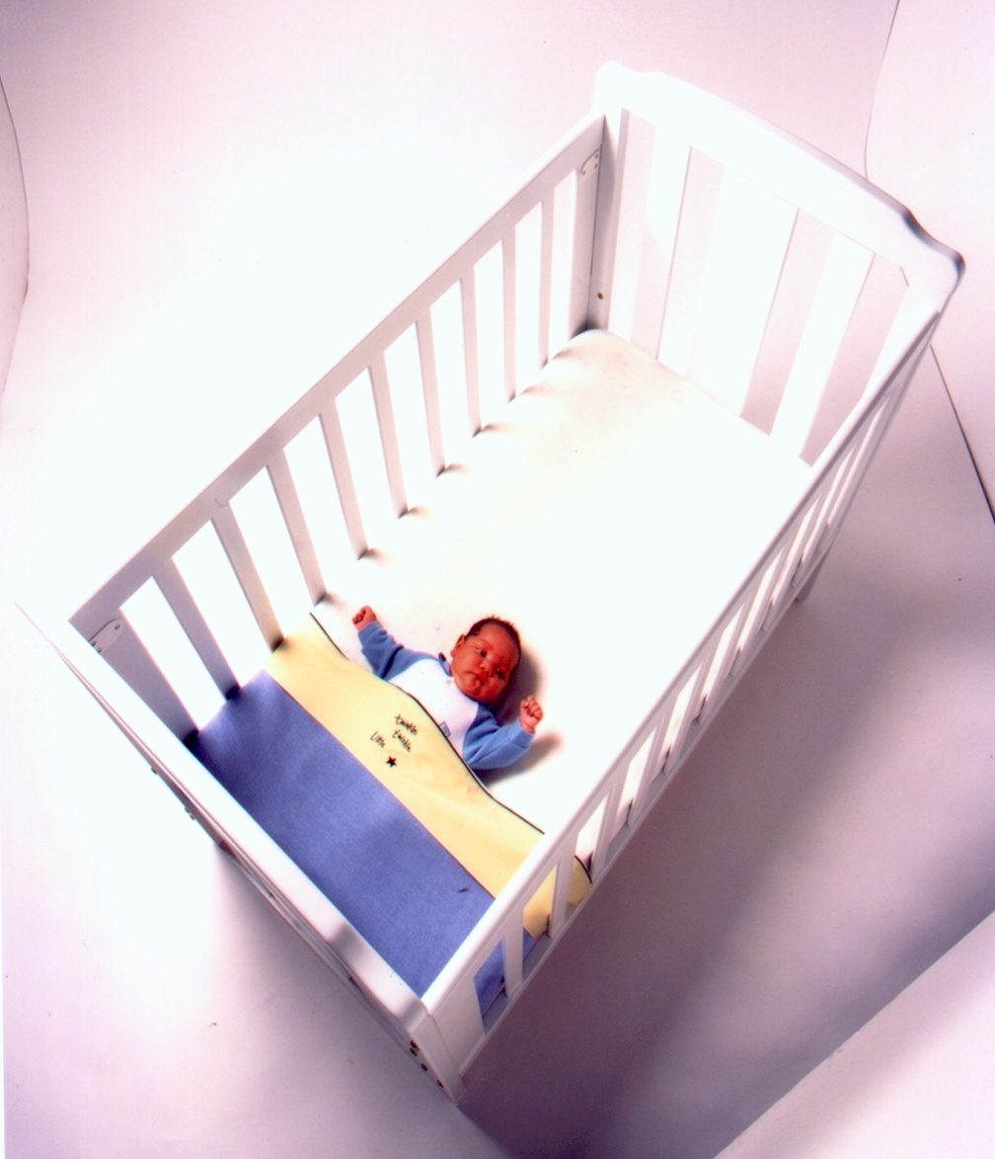
Health Promotion during Infancy: Sudden Infant Death Syndrome
Risk Factors for SIDS:
Low-birth weight infants 5 times – 10 times more likely to die of SIDS.
Twins and triplets have 2 times SIDS rate.
Young mothers & fathers.
Mothers who smoked.
Mothers who had difficult pregnancy.
Mothers with poor nutrition during pregnancy.

Slide 59
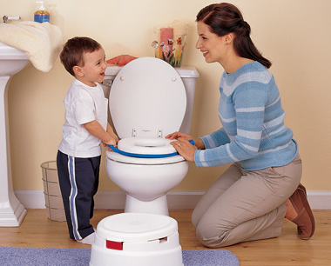
Health Promotion during Toddlerhood

Slide 60
Health Promotion during Toddlerhood: Physical Growth
Gain about 2.5 kg and 12 cm /year during the toddler period.
H.C = C.C at 6 months of age, at 2 years of age C.C <H.C.
H.C increased 2 cm during the second year compared to 12 cm during the first year.

Slide 61
Health Promotion during Toddlerhood: Appearance
Subcutaneous tissues or baby fat begins to disappear toward the end of the second year (baby looks more leaner).
Protuberant (prominent) abdomen from underdeveloped abdominal muscles.
Forward curve of the spine at the sacral area (Lordosis).
Bowleggedness persists through the period (leg muscles bear the weight of large trunk), walk with a wide stance.

Slide 62
Health Promotion during Toddlerhood: Body Systems
Respiration: slows slightly, abdominal breathing.
Heart rate: slows from 110 to 90 bpm.
Blood pressure: increased to 99/64 mmHg.
Brain develops to about 75% of its adult size.
Stomach capacity increases. Can eat 3 meals/day.
Stomach secretions become more acidic which decrease gastrointestinal infections.
Possible control of the urinary and anal sphincters.

Slide 63
Health Promotion during Toddlerhood: Dental Health
8 new teeth (the canines and the first molars) erupt during the 2nd year.
All 20 deciduous teeth are generally present by 2.5-3 years of age.
First dental visit at around 2.5 years.
Soft toothbrush with water (no toothpaste), with supervision.

Slide 64
Health Promotion during Toddlerhood: Play & Safety
Parallel play (alongside each other, not with others).
Imitation is very common.
Short attention span.
Accidents are the major cause of death.
Poisoning from ingestion of cleaning products, drugs, and poisonous plants.
Aspiration or ingestion of small objects.
Motor vehicle accidents (MVA)
Burns, falls, and playground injuries.

Slide 65
Health Promotion during Toddlerhood: Nutrition
Growth rate dramatically decreases, thus lower calories, proteins, and fluids are needed.
Decrease appetite (physiologic anorexia) they sit and play with food..
One tablespoon of each food served is a good start.
Insist on feeding themselves (may refuse to eat at all), they are picky eaters.
Avoid diet high in sugar / high in fats (no more than 30% of daily calorie from fat). Daily calories requirement = 1300 kcal.
Adequate Calcium and Phosphorous is important for bone mineralization (whole milk).
Assess intake of 5 food groups.

Slide 66
Health Promotion during Toddlerhood: Sleep & Fears
Sleep pattern
Total hours 12 hours / night with 2 naps as a start. At the end of toddler stage decreased to 8 hours/night and one nap.
Some sleep problems are common like fear of separation. Nightmares started about age of 3..
Bedtime rituals are needed to represent security.
Fears
Separation anxiety: Begins about 6-7 months and persists throughout the preschool period.
Going to sleep.
Large animals.

Slide 67
Health Promotion during Toddlerhood: Toilet Training
Readiness for toilet training is unusual before 18 months.
Signs of readiness:..
Dry for 2 hours.
Site and squats.
Begin to be uncomfortable in wet diaper.
Verbalize desire to void or defecate.

Slide 68
Health Promotion during Toddlerhood: Toilet Training
Some helpful strategies for Toilet training
Use potty-chair and limit time to 5-10 min.
Praised for cooperative behavior or successful evacuation.
Dressing children in easily removed clothing (using training pants).
Use same words always for urination or defecation (not to confuse them).
If resist, try again in few weeks.

Slide 69
Parental Concerns Associated with Toddlers
Negativism.
Persistent negative “no” response to every request.
Negativism is not an expression of being stubborn or disrespectful, but a necessary assertion of control.
One method of dealing with the negativism is by reducing the opportunities for a “no” answer.
Temper tantrums..
It’s a way to release their tension. They may lie down on the floor, kick their feet, and scream.
Head banging and breath holding are other behaviours some children use.
Ignore the behavior and provide safe environment..

Slide 70
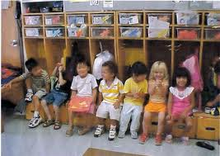
Health Promotion During Pre-School-Age

Slide 71
Health Promotion during Pre-School-Age: Physical Growth
Body contour changes to slimmer, taller, and much more childlike proportions.
Language; using correct grammer
The anteroposterior and transverse diameter of the chest reach adult proportions.
Pulse rate decreases to 85 bpm.
Blood pressure 100/60 mmHg.
Stronger muscles thus can perform gymnastics activity.
Weight: slight gain, average gain 2 kg a year.
Height: only 6-8 cm a year.
Head circumference not routinely measured over 2 year-old.

Slide 72
Health Promotion during Pre-School-Age: Play & Safety
Play:
Do not need many toys because they use their imaginations (imaginary friends).
They enjoy games that use imitation (playing house).
Around 5 years, they become interested in group games.
Safety
Their interest in learning and imitating adult roles may lead them into exploring blades, electric saw, taking medicine…etc. (supervision is so important)
Automobile safety.
Educate children about the potential threat of harm from others.

Slide 73
Health Promotion during Pre-School-Age: Nutrition & Sleep
Nutritional health (similar to toddlers)
Offering small servings of food.
Nutritious snacks (fruit, cheese, juice, and milk).
All 5-food groups should be included.
Sleep:
They refuse naps even if they’re tired.
Refuse to go to sleep because of the night waking from nightmares or night terrors.
Use night-light, and continue bedtime routines

Slide 74
Health Promotion during Pre-School-Age: Teeth & Fears
Teeth care:
Should start independent tooth brushing as daily practice (if not started at toddler age).
Encourage not eating candies or sweets.
Fears:
Occurs because their imagination is so active.
Fear of dark.
Fear of mutilation (simple injury, painful procedures).
Fear of separation.

Slide 75
Health Promotion during Pre-School-Age: common health problems
Infectious diseases:
Communicable diseases: Chicken Pox, Diphtheria, Measles, Pertussis, …etc.
Conjunctivitis.
Stomatitis.
Ingestion of injurious agents:
Cosmetics and personal care products, cleaning products, plants, foreign bodies, gasoline.
Heavy metal poisoning (mercury, iron, lead)

Slide 76
Health Promotion during Pre-School-Age: Tonsilitis
The causative agent may be viral or bacterial.
Often viral in children younger than 3-year-old.
Bacterial is more common in the school age children.
Manifestations of viral infection:
gradual onset
low-grade fever,
slight erythema of the pharynx.
Manifestations of the bacterial infection:
abrupt onset,
temperature equal to or more than 40 º C,
white exudates and severe sore throat.

Slide 77
Health Promotion during Pre-School-Age: Enuresis
Involuntary passage of urine past the age when a child should be expected to have attained bladder control (4 years)
Occur approximately 5- 7 years of age.
Enuresis is primarily an alteration of neuromuscular bladder functioning.
The symptoms may be influenced by emotional factors (birth of a sibling).
No clear etiology. Predictive factors are:
Longer duration of sleep in infancy.
Positive family history.
Slower rate of physical development in children up to 3 years.

Slide 78
Health Promotion during Pre-School-Age: Enuresis
Types:
Primary: if bladder training was never achieved.
Secondary or acquired: if control was established but has now been lost.
Nocturnal: occur at night (most common type)
Diurnal: occur during the day.
Both.

Slide 79
Health Promotion during Pre-School-Age: Enuresis
Management:
Attempts to correct stress factors if any.
Limit fluids after dinner.
Drug therapy (Tofranil): anticholinergic drug that inhibits urination, given an hour before bed.
Bladder stretching exercises.
Motivational therapy/ positive reinforcement (recording the dry nights).
Punishment is contraindicated.

Slide 80
Health Promotion during School-Age

Slide 81
Health Promotion: School-Age
Physical growth and maturation of systems:
Healthiest years of childhood.
Gastrointestinal is reflected in fewer stomach upsets, better maintenance of blood sugar levels and an increases stomach capacity.
Bladder capacity generally greater in girls than in boys
The immune system become more competent in its ability to localize infections and to produce an antibody-antigen response.
Innocent heart murmurs may be heard due to the changing size of the heart in reference to the thorax

Slide 82
Health Promotion: School-Age
Physical growth and maturation of systems:
Physiologic splitting of heart sounds may be present for the first time
At 6 year-old frontal sinuses are developed increases the possibility of sinus headache.
Brain growth is complete by age of 10 years

Slide 83
Health Promotion: School-Age
Physical growth and maturation of systems:
Preadolescence is the period that begins toward the end of middle childhood and ends with the thirteenth birthday.
The first physiologic signs begin to appear of about 9 years (particularly in girls) and are usually clearly evident in 11-12 years-old children.
Either early or late appearance of these characteristics is a source of embarrassment to both sexes.

Slide 84
Health Promotion: School-Age
Weight increased by 1.3-2.2 kg/year.
Height: 2.5-5 cm/year.
Average 6 year-old Wt. is 21 kg.
Average 6 year-old Ht. is 115 cm.
Average 12 year-old Wt. is 40 kg.
Average 12 year-old Ht. is 150 cm.
Pulse rate decrease to 70-80bpm.
Blood pressure increased to 112/60 mm Hg.
Respiration is 20-25 breath/ min.

Slide 85
Health Promotion during School-Age: Teeth
Age of loose tooth: deciduous teeth are gradually lost and permanent teeth erupt around age of 6 years.
Average child gains 28 teeth between 6 and 12 years.
Regular dental visits.
Regular brushing.
Malocclusion and dental caries are common.

Slide 86
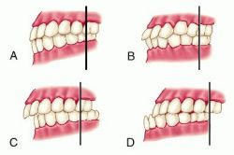
Health Promotion During School-Age: Common health problems
Malocclusion
In the case of good teeth occlusion, the upper teeth overlap the lower teeth by a small amount and teeth are evenly spaced. Malocclusion is the deviation from normal
Malocclusion may be
Congenital or related to conditions such as cleft palate, a small lower jaw
May result from constant mouth breathing or abnormal tongue position.
Teeth braces may be needed for treatment.

Slide 87
Health Promotion During School-Age: Play
Around 7 years of age, imagination is declined.
play involves increased physical skill, & intellectual ability
Children form groups, they begin to evolve a sense of belonging to a team or club.
The games they play have fixed and unvarying rules that may be bizarre and extraordinarily rigid.
They also enjoy many quiet and solitary activities such as collections.
The newly acquired skill of reading becomes increasingly satisfying.
Enjoy challenging play – video/computer games, helping in kitchen with jobs (making salad) drawing..

Slide 88
Health Promotion During School-Age: Safety
More accidents as a result of being independence.
Children can follow instructions thus education is so important.
Bicycle safety (use helmet), drugs, tobacco use.

Slide 89
Health Promotion During School-Age: Nutrition
Good appetites.
They need a breakfast to provide them with enough energy to get them through active morning.
Educate them about some elementary facts of nutrition (nutritious snacks).
Fostering industry by helping to plan meals.
Require more iron during pre-puberty and adequate calcium and fluoride for teething.
Balanced diet
Obesity may occur (junk food)

Slide 90
Health Promotion During School-Age: Sleep & Fears
Sleep:
Younger school age sleeps 10-12 hour/day.
Older school age sleeps 8-10 hour/day.
Nighttime terrors may continue during the beginning of school.
Fears:
Most of the new fears that trouble them are related to school and family (e.g., bullies).
Excessive worry about past behaviour.
Fear of kidnapping, death.

Slide 91
Health Promotion During School-Age: Common health problems
Attention Deficit Disorder (ADD)/Attention Deficit Hyperactivity Disorder (ADHD).
Problem with
inattentiveness
over-activity
Impulsivity الاندفاع
or a combination of the above problems

Slide 92
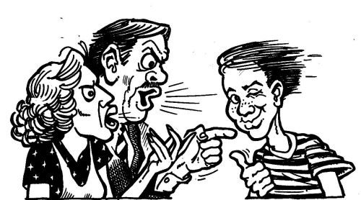
Health Promotion during Adolescence

Slide 93
Health Promotion: Adolescence
Early adolescence period (12-14).
Middle adolescence period (15-16).
Late adolescence period (17-20).
physical changes
increased physical growth
development of secondary sex characteristics & changes in appearance.
These periods include puberty, primary and secondary sex characteristics.
The physical changes of puberty are primarily the result of hormonal activity influenced by the central nervous system.

Slide 94
Health Promotion: Adolescence
Primary sex characteristics are the external and internal organs that carry on reproductive functions.
Secondary sex characteristics are the characteristics that distinguish the sexes from each other but play no direct part in reproduction.
Menarche, the onset of menstruation, occurs about 2.5 years after the onset of puberty
These changes may cause embarrassment thus protect adolescent’s privacy is highly important..

Slide 95
Health Promotion: Adolescence
Teeth:
Adolescents gain their 2nd molars at about 13 years old.
3rd molar between 18-21 years.
Safety:
Motor vehicle accidents are the leading cause of death among adolescents.
Motorcycles, bikes, scooters need safety helmet.
Drowning.
Smoking, drugs, and alcohol should be discouraged.

Slide 96
Health Promotion: Adolescence
Nutrition:
greater nutritional requirement due to extensive growth.
They have an increased appetite, enjoy food (quick snacks).
They are poorly nourished despite the large intake (empty-calorie snacks, sweets, and soft drinks).
Adolescents who are slightly obese because of pre-pubertal changes may begin low- calorie or starvation diets to lose weight.
a substantial increase in the need for iron, calcium, and zinc for growth of the skeletal system ,expansion of muscle mass, sexual maturation and blood volume
Girls need more iron supplementation

Slide 97
Health Promotion: Adolescence
Sleep
Adolescents need more sleep than school-age children to support the growth spurt (protein synthesis occurs most readily during sleep).
Daily sleep hours = 12 hour.

Slide 98
Health Promotion: Adolescence
Acne
Self-limiting inflammatory disease that involves the sebaceous glands mainly in the face, neck, back, upper arms, chest, and shoulders.
Occurs more frequently in male adolescents
Genetic factors may play apart in the development of acne
Premenstrual flares of acne occur in nearly 70% of females

Slide 99
Health Promotion: Adolescence
Management of Acne
Adequate rests, moderate exercise, well-balanced diet, and decrease emotional stress
Cleansing: Gentle cleansing with mild cleanser once or twice/day
Medication (topical) and sunblock agents are effective measures.

Slide 100
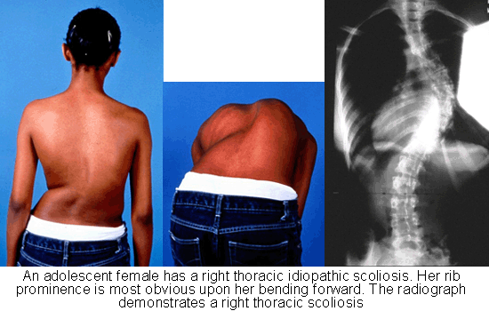
Health Promotion: Adolescence
Scoliosis
Is a lateral curvature of the spine usually associated with a rotary deformity that eventually causes cosmetic and physiologic alterations in the spine, chest, and pelvis.
It can appear at any age but is more frequent in adolescent girls.
May occur spontaneously or in association with other diseases or deformities.

