Slide 1
Chapter 4: Beginning the Physical Examination: General Survey and Vital Signs

Slide 2
Components of General Survey
General appearance
Vital Signs
Height
Weight
Blood Pressure
Pulse
Respiratory rate
Temperature

Slide 3
Health History
Changes in weight
Weight gain: nutrition vs. medical causes
Weight loss: medical vs. psycho-social causes
Fatigue and weakness
Medical, psychiatric, psycho-social causes
Fever, chills, night sweats
Infectious, inflammatory, neoplastic processes

Slide 4
Setting the Stage
Four basic techniques used in nearly all regions of the body in physical examination:
Inspection
Palpation
Auscultation
Percussion
Comprehensive vs. Focused examination
Depends on the history obtained prior to the examination

Slide 5
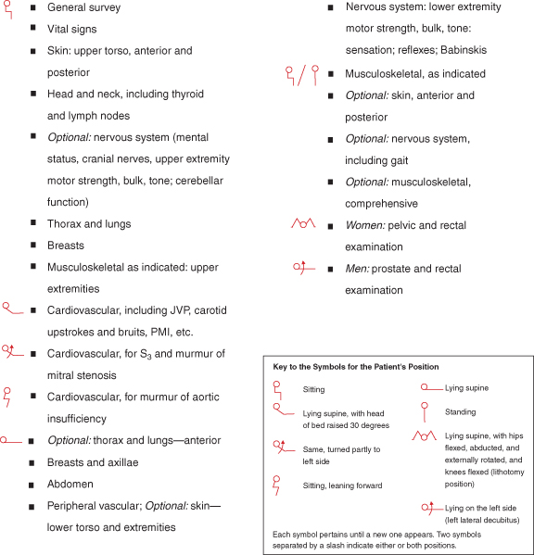
Sequence of the Examination

Slide 6
General Tips for Examination
Maximize the patient’s comfort
Minimize position changes
Drape the patient appropriately – visualize one area of the body at a time
Speak to the patient as you do the examination

Slide 7
General Appearance - Description
Apparent state of health
Acute or chronically ill, frail
Level of consciousness
Awake, alert, responsive or lethargic, obtunded, comatose
Signs of distress
Cardiac or respiratory; pain; anxiety/depression
Height and build
Weight
Skin color and obvious lesions
Dress, grooming, and personal hygiene
Appropriate to weather and temperature
Clean, properly buttoned/zipped
Facial Expression
Eye contact, appropriate changes in facial expression
Odors of body and breath
Posture, gait and motor activity

Slide 8
Body Mass Index
A calculation based on height and weight
Used to classify patients as:
Methods to Calculate Body Mass Index (BMI)
Unit of Measure | Method of Calculation
Weight in pounds, height in inches | Body Mass Index Chart (see table on p. 91)
 | (2) Weight (lbs) x 700* Height (inches) Height (inches)
Weight in kilograms, height in meters squared | (3) Weight (kg) Height (m²)
Either | (4) “BMI Calculator” at website www.nhlbisupport.com/bmibmicalc.htm
Classification of Overweight and Obesity by BMI
 | Obesity Class | BMI (kg/m²)
Underweight |  | <18.5
Normal |  | 18.5-24.9
Overweight |  | 25.0-29.9
Obesity | I | 30.0-34.9
 | II | 35.0-39.9
Extreme Obesity | III | > 40

Slide 9
Blood Pressure – Optimal Conditions
Avoid smoking or drinking caffeinated beverages 30 minutes prior to measurement
Ensure that the room is quiet and comfortably warm
Patient seated quietly in a chair with feet on the floor; at least 5 minutes;
Arm should be FREE of clothing
Palpate the brachial artery
Position the arm so that the brachial artery is at heart level
Rest the arm on a table a little above the patient’s waist, or support the patient’s arm with your own at their mid-chest level

Slide 10
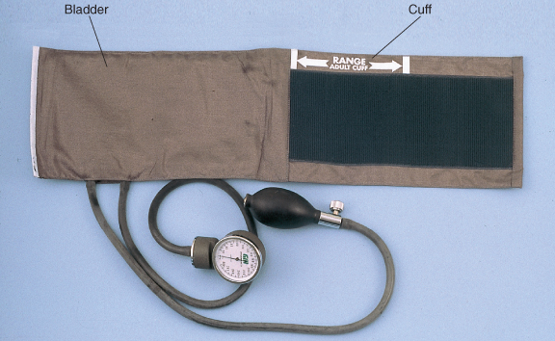
Blood Pressure – Cuff Size and Position
Width: 40% of upper arm circumference
Length: 80% of upper arm circumference

Slide 11
Measurement of Blood Pressure
Center the inflatable cuff over the brachial artery with the lower border 2.5 cm above the antecubital crease
Secure the cuff – snug, not tight. Inflate the cuff.
With the fingers of your opposite hand, palpate the radial pulse and inflate the cuff until it disappears; inflate the cuff a further 30 degrees
Wait 15-30 seconds
Place your stethoscope lightly over the brachial artery
Deflate the cuff at a rate of 2-3 mmHg/second
First sound = systolic blood pressure
Disappearance of sound = diastolic blood pressure

Slide 12
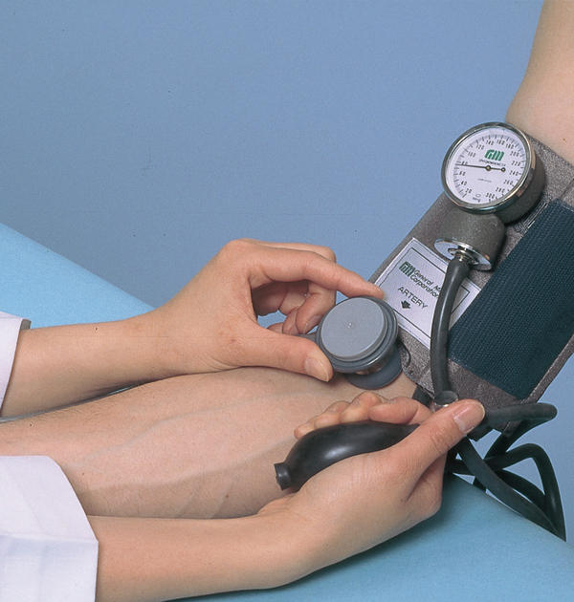
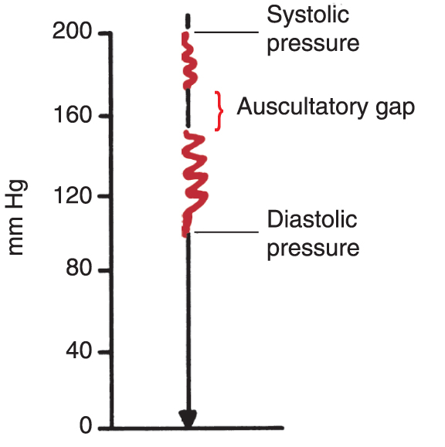
Measurement of Blood Pressure

Slide 13
Blood Pressure
Auscultatory gap
A silent interval that may be present between the systolic and diastolic blood pressures, i.e. the sound disappears for a while, then reappears
Orthostatic Blood Pressure
Measure blood pressure and heart rate with the patient supine, wait 3 minutes, then have the patient stand up and repeat the measurements
Normal: systolic pressure drops slightly or remains unchanged; diastolic pressure rises slightly
Orthostasis: systolic BP drops > 20 mmHg or diastolic BP drops > 10 mmHg

Slide 14
Pulse
An assessment of heart rate
Radial or apical
Count the number of beats/minute
Palpate for pattern
Regular or irregular
Palpate for intensity
Weak, brisk, or bounding
Normal Range: 60-100 beats/minute

Slide 15
Respiratory Rate
Normal rate: 14 to 20 breaths/minute
Observe rhythm: regular, labored
Observe depth: shallow, gasping

Slide 16
Temperature
Average oral temperature: 37°C or 98.6°F
Diurnal variation: 35.8°C (96.4°F) to 37.3°C (99.1°F)
Rectal | 0.5°C (1°F) > oral temperature
Axillary | 0.5°C (1°F) < than oral temperature
Tympanic | 0.8°C (1.4°F) > than oral temperature

