Slide 1
health promotion
Dr. Reem Ali
Spring Semester 2014-2015

Slide 2
Health Promotion in infancy

Slide 3
Health Promotion: Infancy
Areas of focus in well-baby health visits (6 times during infancy) are:
Growth milestones: Ht., Wt., H.C.
Developmental milestones.
Dental health.
Nutritional adequacy.
Parent-child relationship.
Vision & hearing assessments.
Immunization

Slide 4
Health Promotion: Infancy
Growth & Development..
physical parameters are monitored by plotting measurements on a standardized growth charts :
Weight
Height
Head circumference
Assess developmental milestone
Immunization

Slide 5
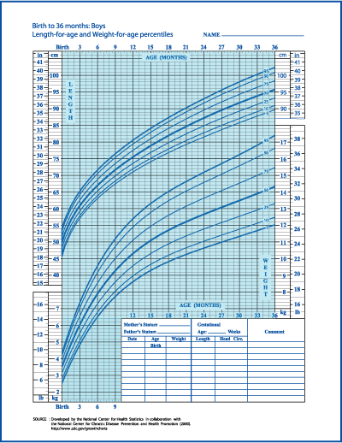

Slide 6
National Jordanian Vaccination Program
Age | 1 mon | 61 days | 91 days | 121 days | 10 m | 12 m | 18-24 m | 6 yrs
Vaccine
BCG | ☻
DTP |  | ☻ | ☻ | ☻ |  |  | ☻ | dT
PCV |  | ☻ | ☻ | ☻ |  | ☻ | ☻
Polio. V |  | IPV | IPV/OPV | OPV | OPV |  | OPV | OPV
HIB |  | ☻ | ☻ | ☻
HBV |  | ☻ | ☻ | ☻
Measles |  |  |  |  | ☻
MMR |  |  |  |  |  | ☻ | ☻

Slide 7
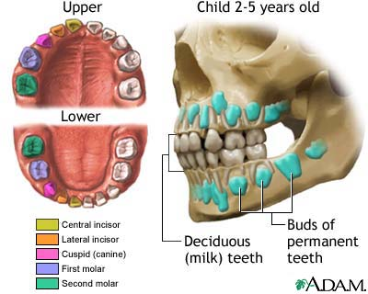
Health Promotion during Infancy: Dental health
First tooth usually erupts at age 6 months, followed by a new one monthly.
Water with fluoride is essential.
Begin brushing even before teeth erupt (using a soft washcloth).

Slide 8
Health Promotion during Infancy: Nutrition
First 6 months of life:
Human milk is the most desirable complete diet for infant.
Commercial iron-fortified formula is the second choice. Whole milk (cow’s) should not be introduced to infants until after 1 year of age..
The introduction of solid foods before 4-6 months is not recommended (immature systems & food allergies).
Second 6 months of life:
Chewing movements do not begin until 7-9 months, thus foods require chewing should not be introduced before that.
Extrusion reflex fades at 4 months until this time it is difficult to introduce solid foods.
Quantity of food: newborn stomach can hold up to 30 ml, at 1 year of age increased to 1 cup (240ml).

Slide 9
Health Promotion during Infancy: Introduction of solid foods
Start with cereals (rice due to fewer allergies) twice daily change by another kind of cereals after a week.
Vegetables: vegetables are the second choice after cereals at 7 month of age, they are rich in iron
Fruits: fruits are offered one month after vegetables (8 mon.).
Meat: usually introduced at 9 months.
Egg yolk at 10 months (↑ iron) should be given before egg white (↑ protein) because protein can cause allergy.
Weaning is gradual, could be started at 9 months (diminished sucking reflex)

Slide 10
Health Promotion during Infancy: Concerns R/T Normal Growth & Development
Teething:
Gums are sore and tender causing pain with less eating or feeding, which make infant hungry and irritable.
High fever, convulsions, vomiting & diarrhea, earache are never normal signs of teething.
Acetaminophine Q 4 hours is enough to decrease pain.
Thumb sucking:
Peaks at 18 mon. it is a normal habit and does not deform the jaw line or cause baby talk as well as it stops by school age.

Slide 11
Health Promotion during Infancy: Concerns R/T Normal Growth & Development
Pacifier
Problem of cleanliness.
Problem of aspiration if it wasn’t one piece.
Strangulation if wear it on a string around the neck.
Weaning should be at 9 months maximum (time of decreased sucking reflex) after that it became difficult.

Slide 12
Health Promotion during Infancy: Concerns R/T Normal Growth & Development
Colic: paroxysmal abdominal pain
Usually occur in infants younger than 3 mon. of age.
Unclear cause but may occur from overfeeding, swallowing too much air while feeding, or from a formula that is too high in carbohydrate.
Thorough assessment should be done R/O any intestinal obstructions or diseases.

Slide 13
Health Promotion during Infancy: Concerns R/T Normal Growth & Development
Failure to Thrive (FTT)
FTT describes infant who fails to gain weight, height or both.
There is a wide variation in normal growth and development in general, the rate of change may be a better indicator of a problem rather than the actual measurement.
There are multiple causes that will disturb the body’s metabolism enough to result in delayed growth.
Two types of FTT are organic and non-organic

Slide 14
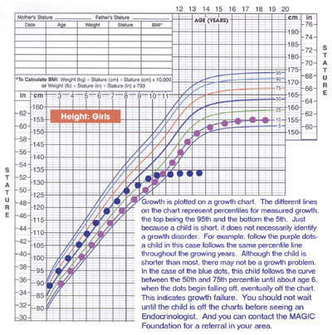
Health Promotion: Infancy
Failure to Thrive (FTT)
FTT describes infant who fails to gain weight, height or both.
There is a wide variation in normal growth and development in general, the rate of change may be a better indicator of a problem rather than the actual measurement.
There are multiple causes that will disturb the body’s metabolism enough to result in delayed growth.
Two types of FTT are organic and non-organic

Slide 15
Health Promotion during Infancy: Concerns R/T Normal Growth & Development
Types of FTT
1- Organic (Intrinsic): medical problems such as:
Chromosomal abnormalities (e.g. Down syndrome).
Defects in major organs & systems (cardiac, respiratory, GI problems).
Abnormalities of the endocrine system (thyroid hormone deficiency, growth hormone deficiency).
Damage to the brain or CNS that may lead to feeding difficulties.
Anemia or other blood disorders.

Slide 16
Health Promotion during Infancy: Concerns R/T Normal Growth & Development
Types of FTT
2- Non-organic (Extrinsic):
Environmental, psychosocial problems.
Emotional deprivation, parental withdrawal or rejection.
Economic factors: low living conditions.
Exposure to infections/ toxins

Slide 17
Health Promotion during Infancy: Concerns R/T Normal Growth & Development
Clinical manifestation of FTT:
Ht., Wt. & H.C. deficiencies.
Delayed physical skills (rolling over, sitting, standing, …etc.).
Mental & social skills are delayed.
Delay of development of secondary sexual characteristics.
Poor hygiene
Less smiling with poor eye contact.

Slide 18
Health Promotion during Infancy: Concerns R/T Health
Diaper Rashes
Most common skin problem during infancy.
Characterized by scaling and/or ulceration of the skin in the diaper area.
It could involve the buttock, lower abdomen, genitalia and upper portion of the thighs.
Etiology: combination of factors: prolonged contact of urine and feces, which breaks into ammonia, leading to maceration and irritation, that cause redness and tenderness. It could be infected with candida.
Nursing Care: Education and prevention:
Change diaper frequently.
Clean skin with water and mild soap.
Dry well and expose to air.
Use petroleum products that act as a barrier to moisture.
In mild cases use Zinc Oxide.

Slide 19
Health Promotion during Infancy: Concerns R/T Health
Bottle mouth Syndrome
Is early severe dental caries of deciduous teeth caused by sucrose in milk
This occurs when infant falls a sleep with a bottle of milk for a long period of time, that allows the milk to stain the oral cavity

Slide 20
Health Promotion during Infancy: Sudden Infant Death Syndrome
2/1000 infants die in their sleep for no apparent reason each year.
Risk of SIDS is highest at 4-6 weeks of age.
Parental blame.
SIDS theories:
Sleep apnea and heart problems
Transition from reflexive breathing to voluntary control.
Inability to swallow effectively in the prone sleeping position (Back to sleep & no soft bedding)

Slide 21
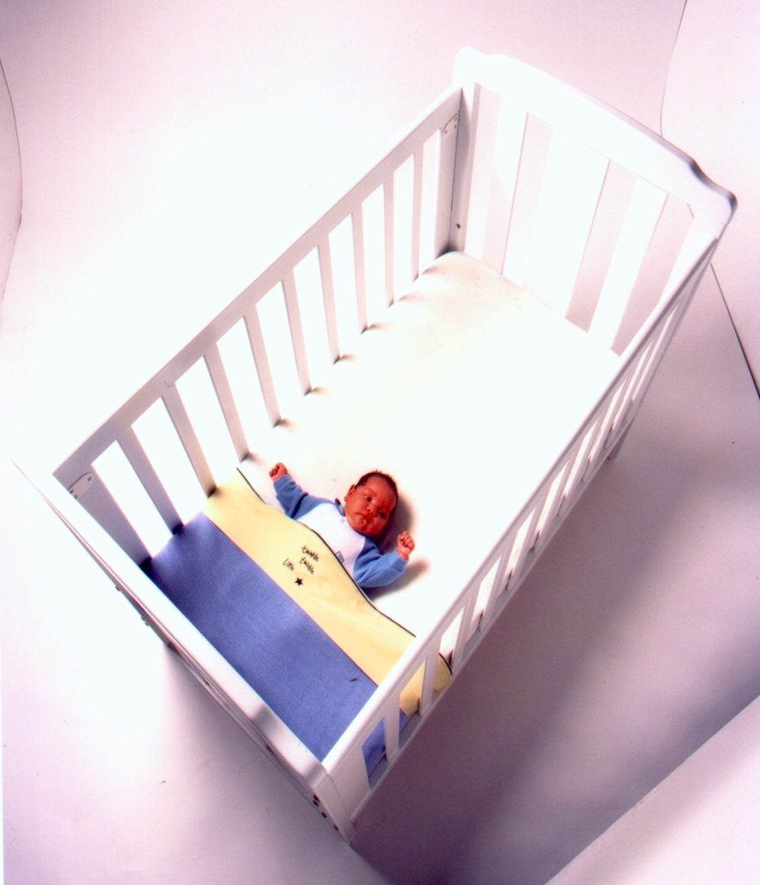
Health Promotion during Infancy: Sudden Infant Death Syndrome
Risk Factors for SIDS:
Low-birth weight infants 5– 10 times more likely to die of SIDS.
Twins and triplets have 2 times SIDS rate.
Young mothers & fathers.
Mothers who smoked.
Mothers who had difficult pregnancy.
Mothers with poor nutrition during pregnancy.

Slide 22
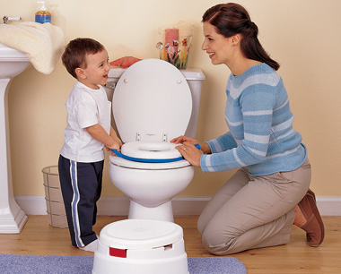
Health Promotion during Toddlerhood

Slide 23
Health Promotion during Toddlerhood: Nutrition
Growth rate dramatically decreases, thus lower calories, proteins, and fluids .
Decrease appetite (physiologic anorexia) they sit and play with food..
One tablespoon of each food served is a good start.
Insist on feeding themselves (may refuse to eat at all), they are picky eaters.
Avoid diet high in sugar / high in fats (no more than 30% of daily calorie from fat). Daily calories requirement = 1300 kcal.
Adequate Calcium and Phosphorous is important for bone mineralization (whole milk).
Assess intake of 5 food groups.

Slide 24
Health Promotion during Toddlerhood: Toilet Training
Readiness for toilet training is unusual before 18 months.
Signs of readiness:..
Dry for 2 hours.
Site and squats.
Begin to be uncomfortable in wet diaper.
Verbalize desire to void or defecate.

Slide 25
Health Promotion during Toddlerhood: Toilet Training
Some helpful strategies for Toilet training
Use potty-chair and limit time to 5-10 min.
Praised for cooperative behavior or successful evacuation.
Dressing children in easily removed clothing (using training pants).
Use same words always for urination or defecation (not to confuse them).
If resist, try again in few weeks.

Slide 26
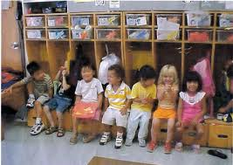
Health Promotion During Pre-School-Age

Slide 27
Health Promotion during Pre-School-Age: common health problems
Infectious diseases:
Communicable diseases: Chicken Pox, Diphtheria, Measles, Pertussis, …etc.
Conjunctivitis.
Stomatitis.
Ingestion of injurious agents:
Cosmetics and personal care products, cleaning products, plants, foreign bodies, gasoline.
Heavy metal poisoning (mercury, iron, lead)

Slide 28
Health Promotion during Pre-School-Age: Tonsilitis
The causative agent may be viral or bacterial.
Often viral in children younger than 3-year-old.
Bacterial is more common in the school age children.
Manifestations of viral infection:
gradual onset
low-grade fever,
slight erythema of the pharynx.
Manifestations of the bacterial infection:
abrupt onset,
temperature equal to or more than 40 º C,
white exudates and severe sore throat.

Slide 29
Health Promotion during Pre-School-Age: Enuresis
Involuntary passage of urine past the age when a child should be expected to have attained bladder control (4 years)
Occur approximately 5- 7 years of age.
Enuresis is primarily an alteration of neuromuscular bladder functioning.
The symptoms may be influenced by emotional factors (birth of a sibling).
No clear etiology. Predictive factors are:
Longer duration of sleep in infancy.
Positive family history.
Slower rate of physical development in children up to 3 years.

Slide 30
Health Promotion during Pre-School-Age: Enuresis
Types:
Primary: if bladder training was never achieved.
Secondary or acquired: if control was established but has now been lost.
Nocturnal: occur at night (most common type)
Diurnal: occur during the day.
Both.

Slide 31
Health Promotion during Pre-School-Age: Enuresis
Management:
Attempts to correct stress factors if any.
Limit fluids after dinner.
Drug therapy (Tofranil): anticholinergic drug that inhibits urination, given an hour before bed.
Bladder stretching exercises.
Motivational therapy/ positive reinforcement (recording the dry nights).
Punishment is contraindicated.

Slide 32
Health Promotion during School-Age

Slide 33
Health Promotion During School-Age: Nutrition
Good appetites.
They need a breakfast to provide them with enough energy to get them through active morning.
Educate them about some elementary facts of nutrition (nutritious snacks).
Fostering industry by helping to plan meals.
Require more iron during pre-puberty and adequate calcium and fluoride for teething.
Balanced diet
Obesity may occur (junk food)

Slide 34
Health Promotion During School-Age: Common health problems
Attention Deficit Disorder (ADD)/Attention Deficit Hyperactivity Disorder (ADHD).
Problem with
inattentiveness
over-activity
Impulsivity الاندفاع
or a combination of the above problems

Slide 35
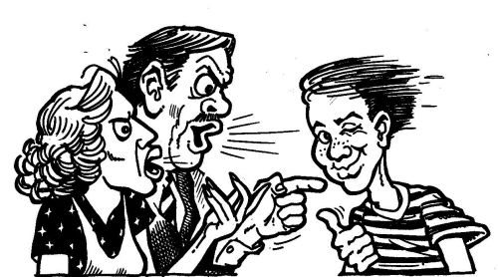
Health Promotion during Adolescence

Slide 36
Health Promotion: Adolescence
Nutrition:
greater nutritional requirement due to extensive growth.
They have an increased appetite, enjoy food (quick snacks).
They are poorly nourished despite the large intake (empty-calorie snacks, sweets, and soft drinks).
Adolescents who are slightly obese because of prepubertal changes may begin low- calorie or starvation diets to lose weight.
a substantial increase in the need for iron, calcium, and zinc for growth- calcium for skeletal growth ,expansion of muscle mass and blood volume
Girls need more iron supplementation

Slide 37
Health Promotion: Adolescence
Sleep
Adolescents need more sleep than school-age children to support the growth spurt (protein synthesis occurs most readily during sleep).
Daily sleep hours = 12 hour.

Slide 38
Health Promotion: Adolescence
Acne
Self-limiting inflammatory disease that involves the sebaceous glands mainly in the face, neck, back, upper arms, chest, and shoulders.
Occurs more frequently in male adolescents
Genetic factors may play apart in the development of acne
Premenstrual flares of acne occur in nearly 70% of females

Slide 39
Health Promotion: Adolescence
Management of Acne
Adequate rests, moderate exercise, well-balanced diet, and decrease emotional stress
Cleansing: Gentle cleansing with mild cleanser once or twice/day
Medication (topical) and sunblock agents are effective measures.

Slide 40
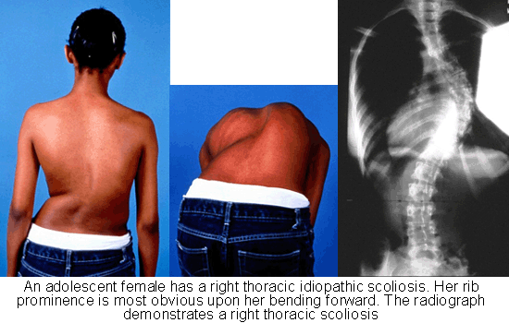
Health Promotion: Adolescence
Scoliosis
Is a lateral curvature of the spine usually associated with a rotary deformity that eventually causes cosmetic and physiologic alterations in the spine, chest, and pelvis.
It can appear at any age but is more frequent in adolescent girls.
May occur spontaneously or in association with other diseases or deformities.

Slide 41
Health Promotion: Adolescence
Scoliosis can be structural or functional.
Structural scoliosis
is characterized by changes in the spine and its supporting structures that causes loss of flexibility and deformity.
Structural scoliosis may be congenital or a secondary defect associated with other disorders, especially neuromuscular disease or paralysis.
Functional or nonstructural scoliosis is caused by some other deformity, such as unequal leg length, which can be corrected by treating the underlying problem.

Slide 42
Health Promotion: Adolescence
Management of scoliosis
Involves straightening and realignment of the vertebrae by
either external (bracing)
internal (surgical) fixation techniques.

