Slide 1
health promotion
Healing Group

Slide 2
Health Promotion
Objectives
Differentiate health promotion from health protection or illness prevention.
Discuss essential components of health promotion.
Identify programs & sites for health promotion
Discuss the nurse's role in health promotion.

Slide 3
Health Promotion
Required Readings
Kozier & Erb's Fundamentals of Nursing: Concepts, Process and Practice(2012) (9th ed.)
Chapter Number 16; Health Promotion (pages 280-287)

Slide 4
Scope of Nursing Practice
Promoting تعزيز health & wellness
Preventing منع illness
Restoring استعادة health
Caring for the dying

Slide 5
Health Promotion: Healthy People 2020
Vision ( رؤية)
A society in which all people live long, healthy lives
Mission
Identify nationwide health improvement priorities
Increase public awareness & understanding of health determinants, diseases, disabilities
Goals
Attain high quality longer lives, free of disease, injury
Provided measurable objectives
Engage multiple sectors
Identify critical research
Health equity (عدالة ) for all groups
Create social and physical environment that promote good health
Promote quality of life, health development & healthy behaviors

Slide 6
Defining Health Promotion
In the literature there are the following terms:
It is difficult to separate these terms, they could be considered as being complementary processes that affect the quality of health. Health promotion can be offered to ALL clients
Health promotion
Health protection
Primary prevention
Illness prevention

Slide 7
Health Promotion
Edelman & Mandle (2010) defined prevention as:
“in a narrow sense means avoiding the development of disease in the future”
“in the broader sense, consists of all interventions to limit progression of a disease”

Slide 8
Health Promotion
Leavell & Clark (1965) defined the levels of prevention:
Primary prevention
Secondary prevention
Tertiary prevention
These three levels may overlap(تداخل )in practice

Slide 9
Primary Prevention
The purpose of primary prevention is to protect from or avoid exposure to potential health risks of the individual or community
Primary prevention focuses on
Health promotion
Protection against specific health problems
Example
Immunization against hepatitis B
Family planning
Risk assessment of specific disease

Slide 10
Secondary Prevention
The goal of secondary prevention is to identify individuals in an early stage of a disease process and to limit future disability
Secondary prevention focuses on:
Early identification of health problems
Prompt intervention to alleviate health problems
Example:
assessing the growth and development of children
Encourage regular medical screening tests such as hypertension and diabetes screening

Slide 11
Tertiary Prevention
Begins after an illness, when the defect is determined to be irreversible
Focuses on restoration and rehabilitation with the goal of returning the individual to an optimal level of functioning
Example
teaching a client who has diabetes to identify and prevent complications
Referring a client to a support group (diabetes group)
Referring a client to rehabilitation center

Slide 12
Health Promotion
According to Pender et al (2011) health promotion is different from disease prevention or health protection
Pender et al (2011) defined health promotion as:
“ behavior motivated by the desire to increase well-being and actualize human health potential”
Pender et al (2011) defined disease prevention & health protection as
“ behavior motivated by a desire to actively avoid illness, detect it early or maintain functioning within the constraints of illness”

Slide 13
Health Promotion & Health Protection
Health Promotion
Not disease oriented
Motivated by personal positive approach to wellness
Health Protection
Illness or injury specific
Motivated by avoidance of illness
Seeks to expand positive
Seeks to stop the insults to health and well-being

Slide 14
Sites for Health Promotion Activities
Community program
Immunization programs
Bicycle safety program, safe driving
Hospitals
Infection control; Stress reduction; Time management; exercise & fitness;
Schools
basic nutrition; dental care; activity & play; drug/alcohol; Domestic violence
Worksite programs
Screening for high blood pressure
Fitness; relaxation techniques
Retirement centers
Classes for health protection
Home based programs
Diet counselor; fitness expert

Slide 15
Programs for Health Promotion
Information dissemination
Health risk appraisal (تقييم) and wellness assessment
Lifestyle and behavior change
Environmental control programs

Slide 16
Programs for Health Promotion: Information dissemination
Many methods can be used to offer information to the public about the risk of particular behaviors, lifestyle choices. These methods includes:
Media (radio, TV)
Newspaper, posters, books
Health fairs
It is a basic but useful method to raise the level of knowledge and awareness of individuals/groups about health habits
Cultural factor and age groups should be carefully considered

Slide 17
Programs for Health Promotion: Health Risk Appraisals & Wellness Assessment
Risk appraisals assessment explain to individuals the risk factors in their lives in order to motivate them to reduce these risks
Wellness assessment focus on positive methods of enhancement
Assessment tools are used to evaluates a person’s health
Many tools are available for assessment including questionnaire ; physical examination, laboratory tests of blood chemistry (e.g. of cholesterol level), blood pressure, and physical fitness levels.
risks such as overweight, smoking can be identified

Slide 18
Programs for Health Promotion: lifestyle & behavior change programs
Required the participation of the individual
These programs directed to enhance individual’s quality of life and extending the life span
Individual usually considers lifestyle changes after he/she learns about the need to change of his health behaviors and become aware of the potential benefits of the process
Example of these program
Stress management
Weight control
exercise

Slide 19
Programs for Health Promotion: environmental control programs
These programs have been developed to reduce the amount of contaminants in water, air and food
The most common concerns of community groups are toxic, nuclear wastes, nuclear power plants, air and water pollution

Slide 20
The Nurse’s Role in Health Promotion
Model healthy lifestyle behaviors and attitudes
Facilitate client involvement in the health promotion programs
Teach clients self-care strategies to enhance fitness and manage stress
Assist individuals, families & communities to increase their levels of health
Educate clients to be effective health care consumers

Slide 21
The Nurse’s Role in Health Promotion
Assist individuals, families & communities to develop & choose health-promoting options
Guide clients’ development in effective problem solving and decision making
Reinforce clients’ personal and family health promoting behaviors
Advocate المؤيد for policies that promote a healthy environment

Slide 22
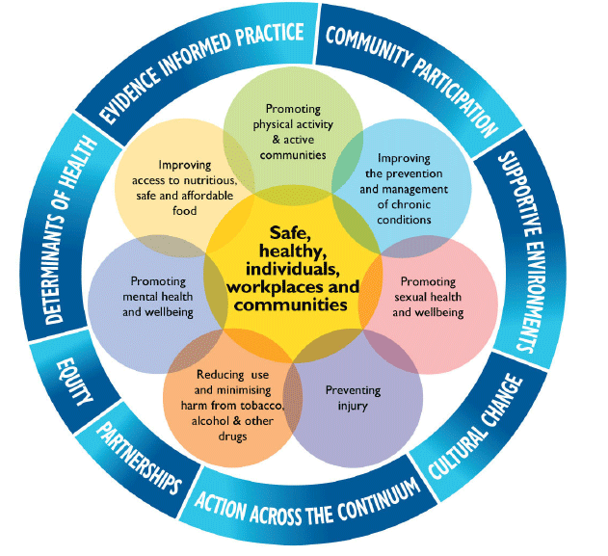
Principles & Priorities of Health Promotion

