Slide 1
Arterial Line & CVP Line
Hemodynamic Monitoring
NSG 409
Spring2016

Slide 2
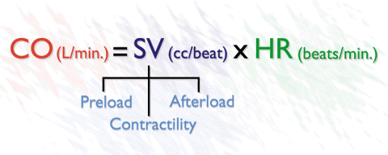

Slide 3
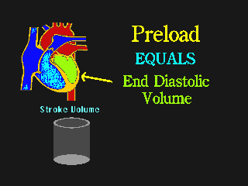

Slide 4
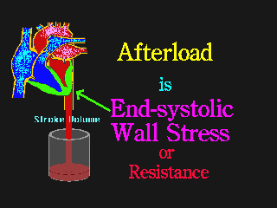

Slide 5
Frank-starling mechanism
states that the stroke volume of the heart increases in response to an increase in the volume of blood filling the heart (the end diastolic volume) when all other factors remain constant.

Slide 6
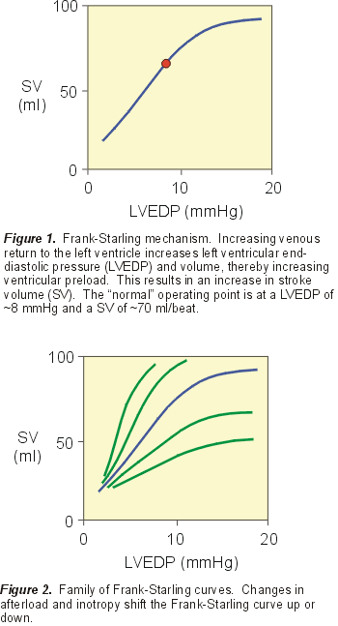
Frank-starling mechanism

Slide 7
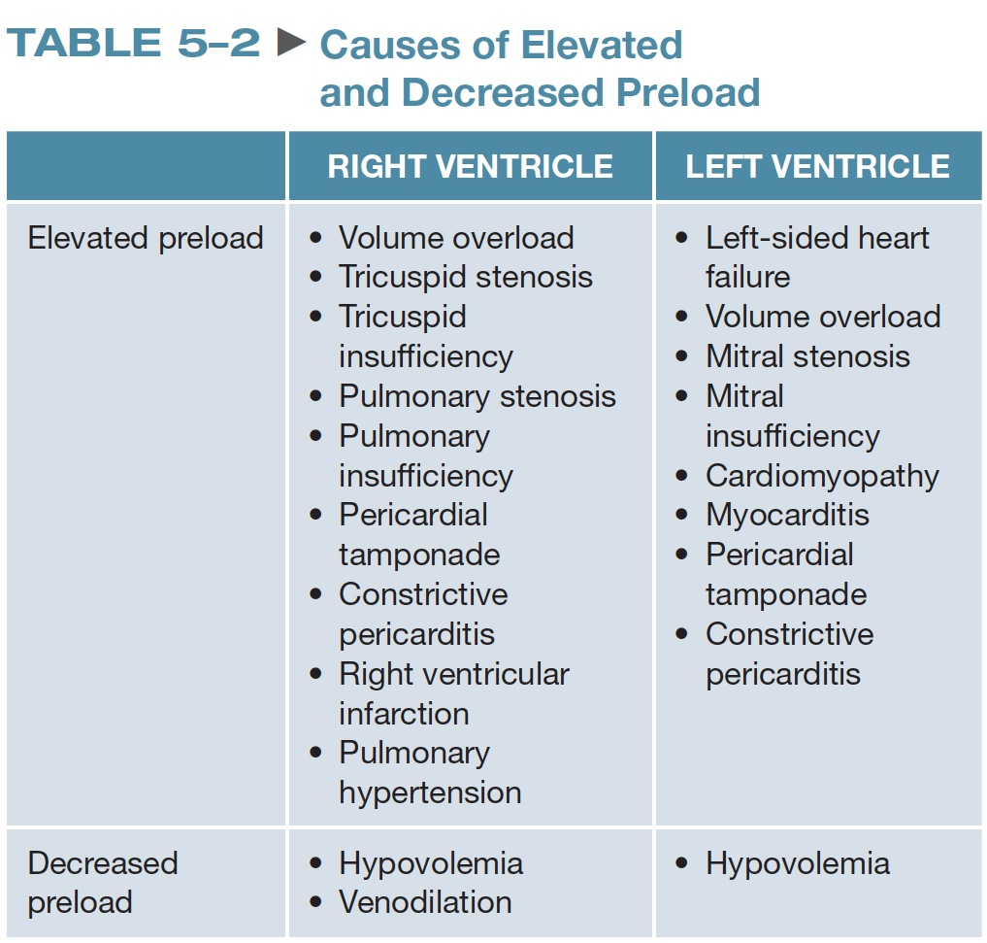
TABLE 5–2 Causes of Elevated and Decreased Preload

Slide 8
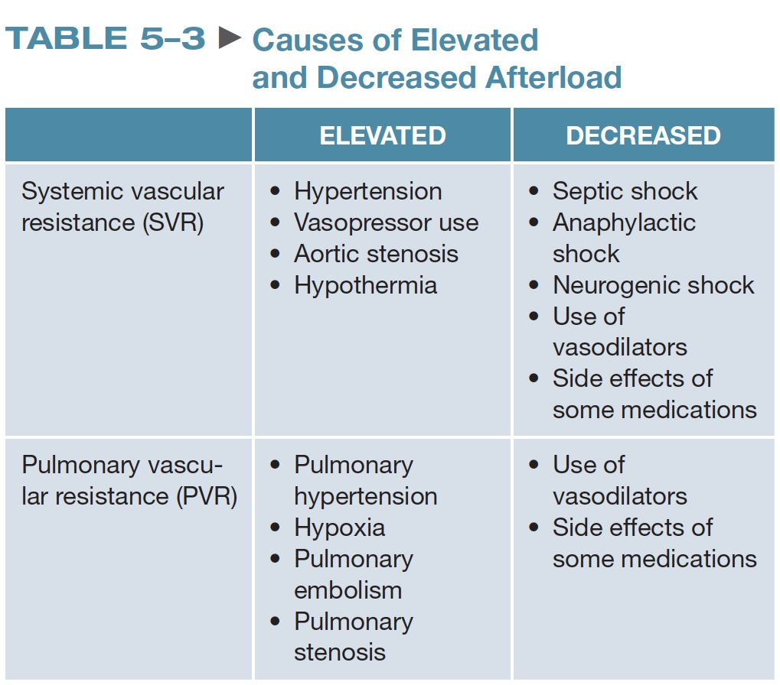
TABLE 5–3 Causes of Elevated and Decreased Afterload

Slide 9
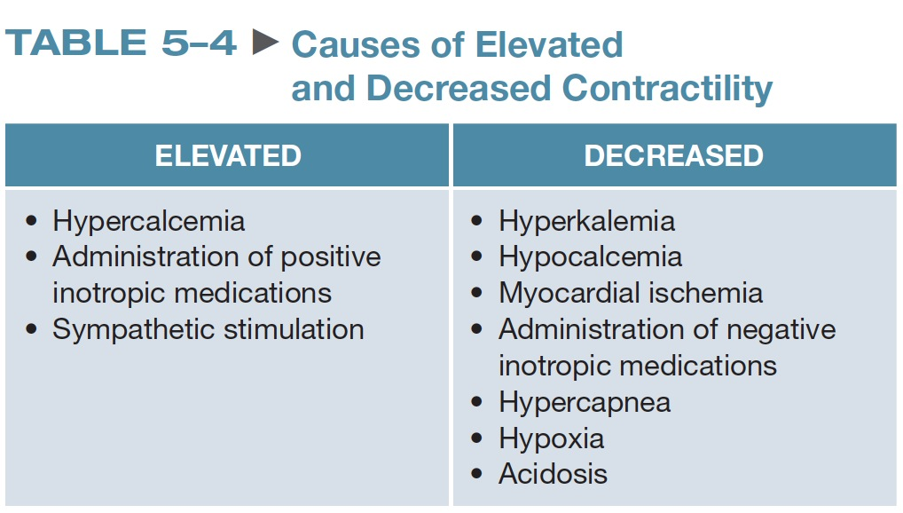
TABLE 5–4 Causes of Elevated and Decreased Contractility

Slide 10
Hemodyanmic Monitoring
Invasive Monitoring
Non -Invasive Monitoring
Central venous pressure catheter (CVP)
Intra-arterial catheter (A-line)
Pulmonary artery catheter (PA or Swan Ganz)
  NIBP
  EKG
  Pulse ox
  Temperature
  Urine

Slide 11
WHY Hemodyanmic Monitoring???

Slide 12
Hemodynamic Monitoring
Is a means of evaluating intracardiac and intravascular volume, intracardiac and intravascular pressure, and cardiac function at bedside.
Purposes :
  To aid in diagnosis of various cardiovascular disease
  Guide therapies to optimize cardiac function
  Minimize cardiovascular dysfunction or treat disorders
  Evaluate pt response to therapy

Slide 13
Indications
It is indicated for conditions in which CO is insufficient to deliver O2 to cells due to alteration in intravascular volume(Preload), alteration in vascular resistance (Afterload)or alteration in myocardial contractility.
Mechanism to assess balance between O2 supply & demand.
Candidate for invasive & minimally invasive hemodynamic monitoring
  Pts in cardiogenic shock, severe heart failure, severe sepsis or septic shock , Multible system Organ Dysfunction, ARDS, post –Cardiac surgery

Slide 14
Pressure monitoring system
Equipments
  A hollow tube catheter
  Fluid filled pressure monitoring system, comprised of flush solution
  IV tubing with drip chamber
  Non compliant tubing
  Stopcocks
  A flush device
  One or more transducers
  A monitor to display pressures and wave lines
Notes:
comprised of : تتألف من

Slide 15
Pressure from the (Intravascular/cardiac chambers) are transmitted through the catheter and Fluid filled non complaint tubing to pressure transducer, which then converts the physiological signal from the patient into an electrical one. The monitor converts and amplifies the electrical signal generated by the transducer to a pressure tracing and digital value
Pressure from the (Intravascular/cardiac chambers)
catheter and Fluid filled non complaint tubing
transducer
monitor

Slide 16
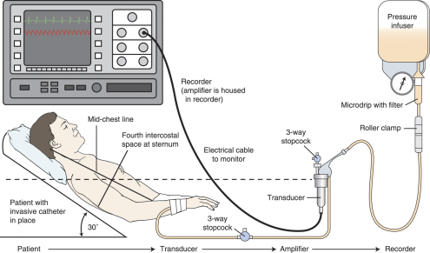

Slide 17
How to set an A-line/Cvp line
https://www.youtube.com/watch?v=vJ_anWmQbUM
https://www.youtube.com/watch?v=GXgE-ANcxDc

Slide 18
Assess Pressure System Component
A continuous Flush system maintain a patent pressure system.
Normal Saline (NS) or Dextrose –Water (D5W) & may be heparinzned.
Bag of solution is placed into a continuous infusion pressure bag that exerts approximately 300 mmHg.
Flow of 3-5 ml per Hour, to prevent backflow of blood through the catheter tubing.

Slide 19
Stopcocks, used for ZEROING the transducer and blood sampling, as well as any other connectors.
A pressure transducer senses changes in the fluid column generated by the pressures in the cardiac chambers or vessels being monitored.
When pressure is applied to the diaphragm of the transducer, sensors are compressed, changing electrical flow to the amplifier or monitor.

Slide 20
Optimizing pressure monitoring system
An optimal pressure monitoring system is one that accurately reproduce the physiological signals transmitted through it (accurate pressure recording and waveform display).
Improper set-up and equipment malfunction are the primary causes for hemodynamic monitoring problems
Notes:
Impedance: مقاومة

Slide 21
Optimizing pressure monitoring system
Pressure Readings might be altered by
  Any impedance between patient and transducers i.e. air bubbles, blood, additional stopcocks .
  Pressure in the continuous pressure device
  < 300 mmHg , soft complaint IV tubing, additional length of tubing.
  (See table 17-16 p. 297 for troubleshooting)
Notes:
Impedance: مقاومة

Slide 22
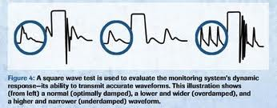
Square Wave Test
Fast Flush: Dynamic response testing
“fast-flush” or “square wave” test
Performed by opening the continuous flush valve rapidly for several seconds creating a square wave
The nurse performs this test to detect if the abnormal wave form is a result of the pt’s physiology OR less Optimized system !!!???
If dynamic response characteristics are inadequate, troubleshoot the system until acceptable dynamic response is achieved
Notes:
Troubleshoot: استكشاف

Slide 23
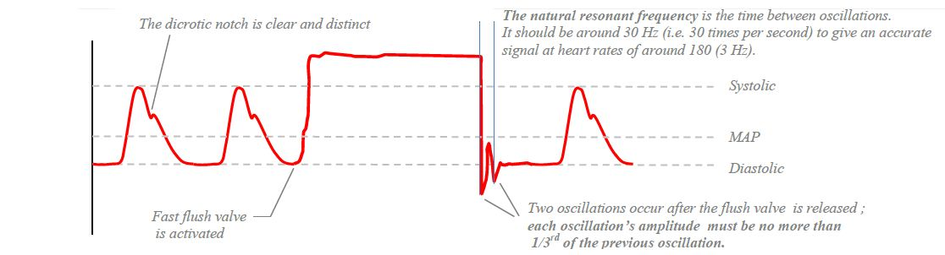
Fast flush system Optimally Damped System
A good art line trace has a distinct dicrotic notch, and after the fast flush, the rhythm will return to the baseline waveform within “1.5 to 2 oscillations close together”
Notes:
osellation

Slide 24
Fast flush system Optimally Damped System
Straight vertical upstroke from baseline → horizontal →straight vertical downstroke→ ending with 1-1.5 oscillations →baseline
A good art line trace has a distinct dicrotic notch, and after the fast flush test there are two oscillations only.
Distance is very close

Slide 25
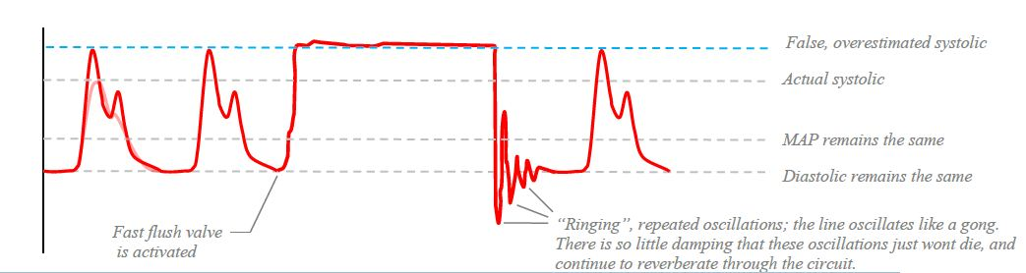
Fast flush system Underdamped System
The under-damped trace will overestimate the systolic, and there will be more than 2 to 3 oscillations above and below the baseline.

Slide 26
Fast flush system Underdamped System
Causes include small air bubbles, very rigid pressure tubing, and additional length of tubing
produce artificially high systolic pressures and low diastolic pressure

Slide 27
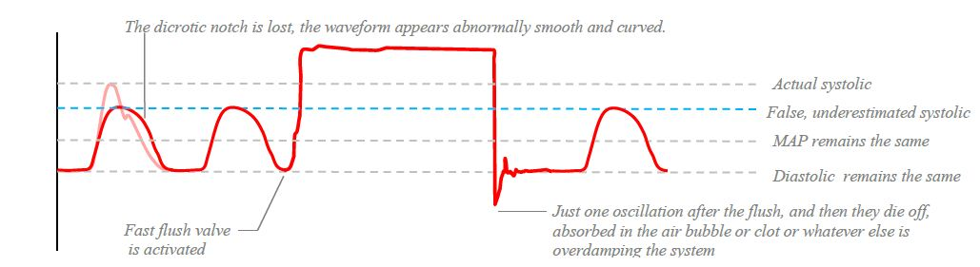
Fast flush system Overdamped System
The over-damped trace will lose its dicrotic notch, and there will be less than 1.5 oscillation above and below the baseline.

Slide 28
Fast flush system Overdamped System
Causes include system leaks, blood clot, or large air bubble in the tubing or transducer.
produce artificially low systolic pressures and low diastolic pressure

Slide 29
Question
To ensure accurate arterial pressures, the nurse must level the transducer to what landmark?
  A. Nipple line
  B. Phlebostatic axis
  C. Sternal notch
  D. Apical impulse

Slide 30
Answer
B. Phlebostatic axis
Rationale: The phlebostatic axis is between the fourth intercostal space and midaxillary line; this is the approximate location of the right atrium.

Slide 31
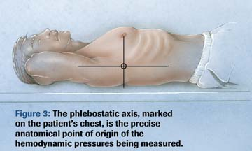
Leveling
To ensure accurate pressure monitoring: System is leveled to external landmark (Phlebostatic Axis : bisection of the 4th ICS & Midpoint of A-P chest diameter.
Typically , The stopcock nearest to the transducer is used to leveling and zeroing !
Zero Reference Point

Slide 32
Leveling continue….
Transducer placed above the reference point produces falsely low readings
conversely a transducer below the reference point produces falsely high readings.
Every inch the transducer is above or below the reference point produces a 2–mm Hg change in pressure reading.

Slide 33
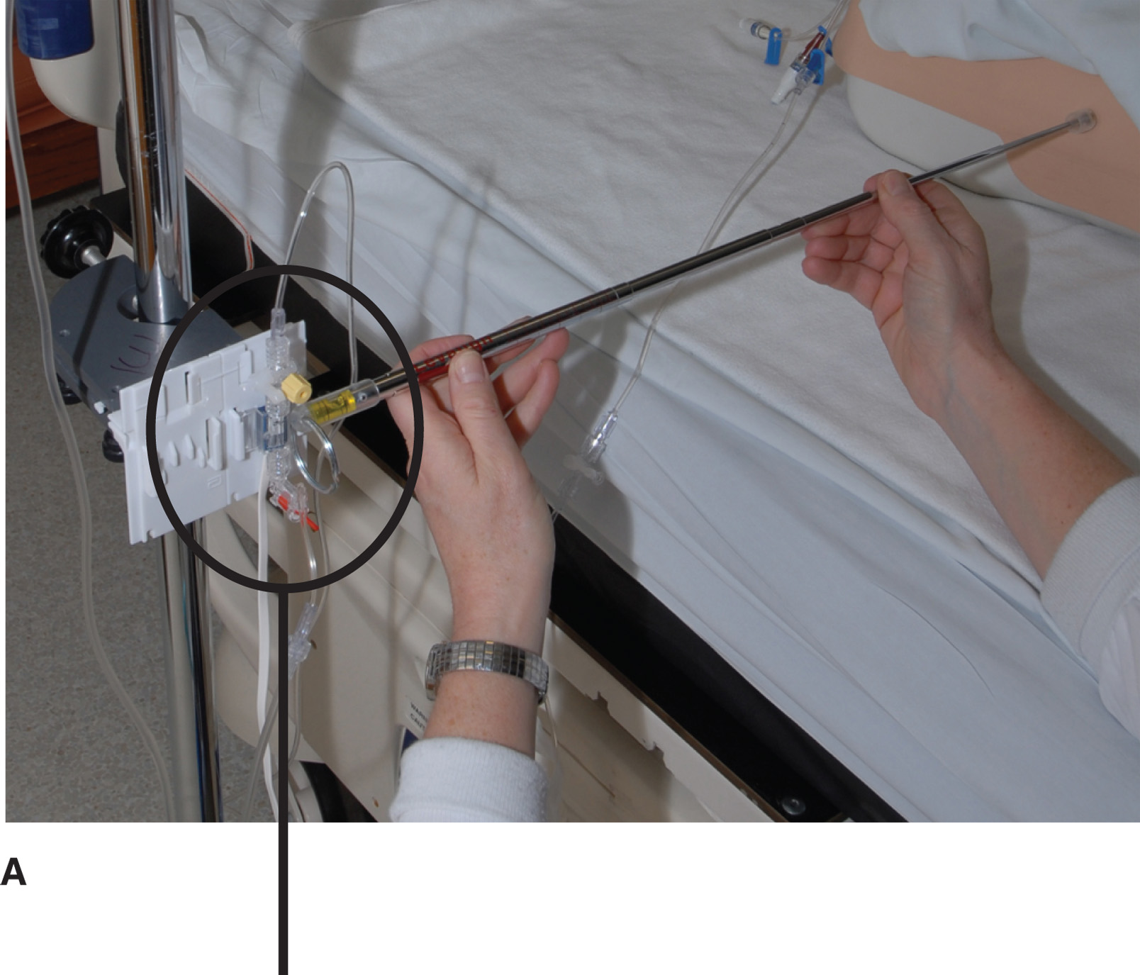
Leveling

Slide 34
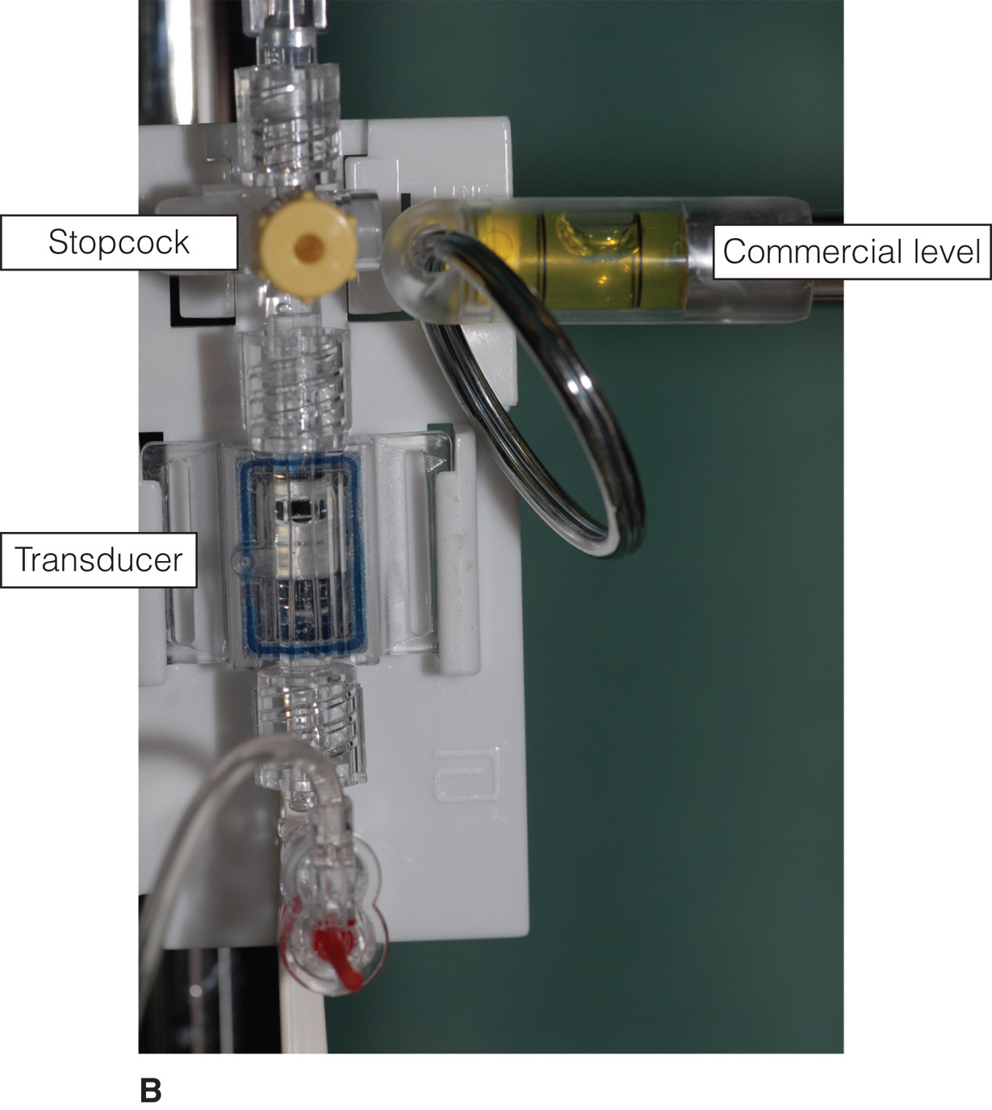

Slide 35
Zeroing
Is the action of opening the pressure system to the atmosphere and observing the reading of ZERO on the monitor
The patient is placed on his or her back, and the head of the bed may be elevated as much as 60 degrees. With a carpenter-type level or laser-light level device, the transducer is placed even with the preestablished zero reference point.
Zeroing involves opening the system to the air to establish atmospheric pressure as zero.
https://www.youtube.com/watch?v=_guFANsGB_I

Slide 36
0 = None
Open to Air
Off

Slide 37
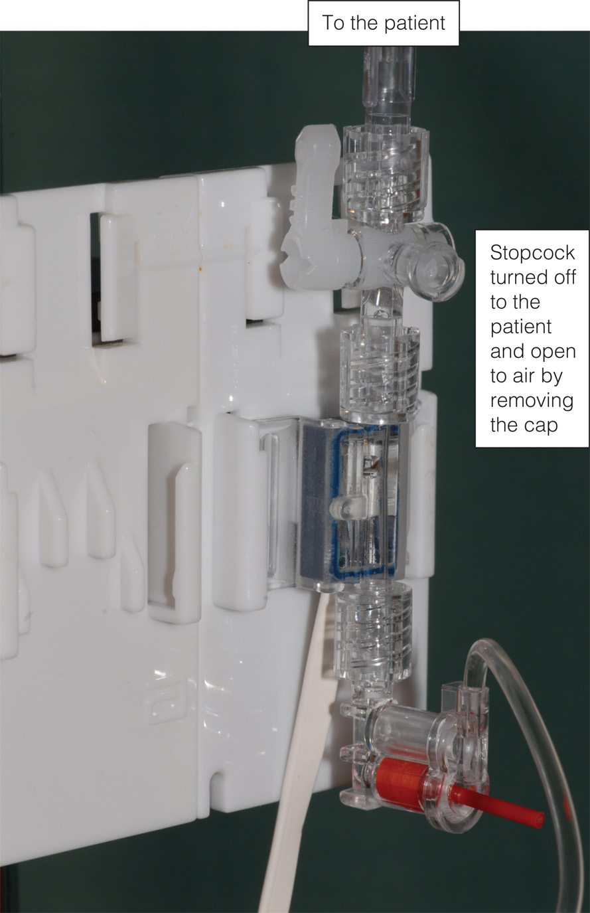

Slide 38
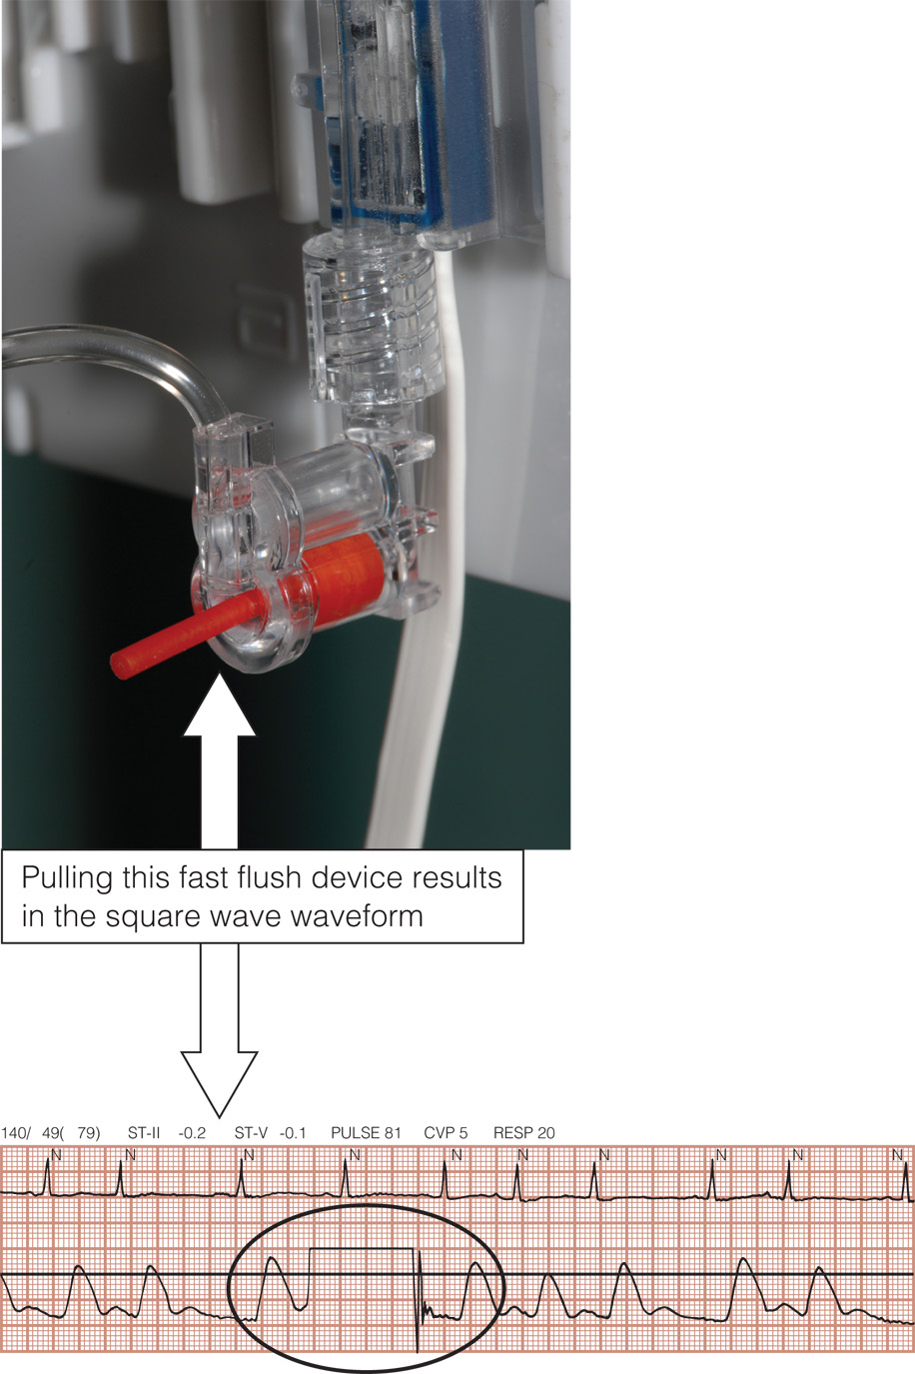

Slide 39
Arterial line

Slide 40
Arterial Line
Allows continuous monitoring of systemic arterial BP .
Provides Vascular access for obtaining blood samples by withdrawing blood from stopcock
Indications for intra-arterial BP monitoring include: monitoring Pts with vasoactive IV infusion; requires frequent arterial blood sampling and laboratory; Pts with cardiovascular instability; & fluctuating, unstable blood pressure.

Slide 41
Sites of Insertion
Most Common
  Radial artery
  Brachial artery
  Femoral artery
Less Common
  Axilliary & Dorsalis Pedis in adults
  Or in neonates (temporal &umbilical)

Slide 42
Factors To Consider In AL
Size of artery→ should be large enough to accommodate catheter without impeding blood flow
Accessibility: easily accessible and free from contamination
Blood flow to limb distal to insertion site → adequate co-lateral circulation in the event that the canulated artery becomes occluded
Pressure monitoring system is assessed, and transducer is leveled and zeroed before catheter is inserted.

Slide 43
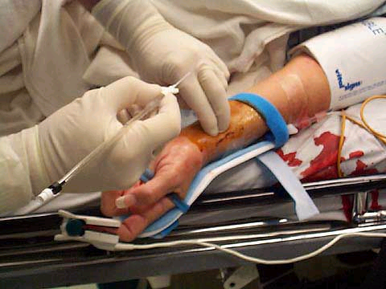
Radial Artery
Most commonly used
Easily to palpate and poses the least limitation to pt’s mobility.
Allen’s Test ! (Video)
  < 7 Seconds : adequate circulation)
  7-15 Seconds possible impairment
  > 15 Seconds inadequate circulation NO CANNULATION !!!

Slide 44
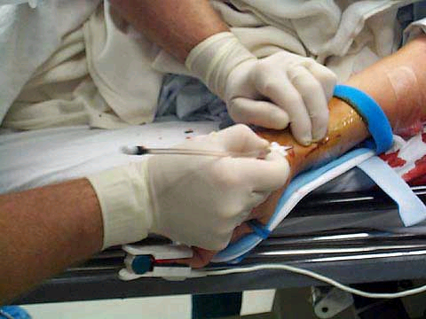

Slide 45

Arterial Pressure
Waveform Analysis
The arterial waveform reflects the pressure generated in the arteries following ventricular contraction and can be described as having:- a rapid upstroke, a clear dicrotic notch, and a definite end diastolic.
  Anacrotic notch
  Peak systolic pressure
  Dicrotic notch
  Diastolic pressure

Slide 46
Arterial Pressure Waveform Analysis
The initial sharp upstroke of the waveform results partly from the rapid ejection of blood from the lt ventricle into Aorta, the QRS complex precedes the rapid rise in arterial pressure.
The dicrotic notch reflects a slight backflow of blood in the aorta, reflecting closure of the aortic valve.
Dicrotic notch corresponds with the end of ventricular repolarization and the T wave on the ECG.

Slide 47

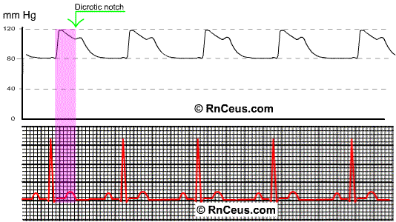

Slide 48
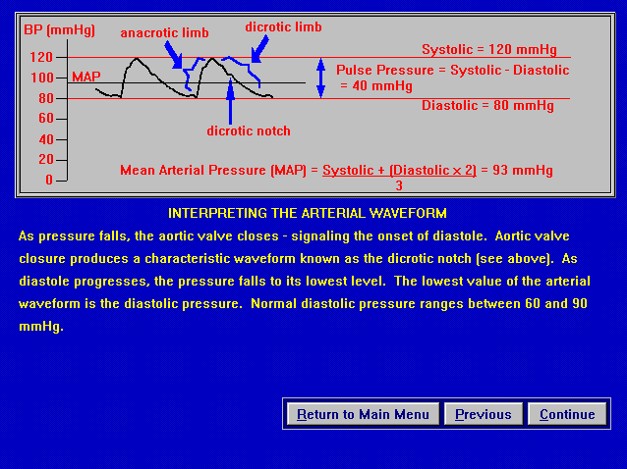
SBP = 90-140 mmHg
DBP = 60-90 mmHg
Mean arterial pressure= (N 70-105 mmHg )
Pulse pressure (30- 100)= SBP – DBP (Indirect refection to the stroke volume)
Wide Pulse pressure → elevated SBP(i.e aortic regurgitation
Narrowed Pulse pressure → hypovolumic status

Slide 49
Mean Arterial Pressure (MAP):
Normal range 70-105 mmHg.
MAP is valuable because it indicates the perfusion pressure; if less than 70 or more than 105 it severely affect vital organs perfusion negatively.
MAP = (CO x SVR); but CO = Hr X SV, therefore,
MAP = Hr x SV x SVR

Slide 50
Example
    MAP = [SP + (DP * 2)] / 3
    For example, if BP= 120/80;
    MAP = [120 + (2 x 80)]/3;
    (120 + 160)/3= 280/3= 93
    MAP = DP + [(SP - DP) / 3]
    For example, if BP= 120/80;
    MAP = 80 + (120-80)/3
    = 80 + (40/3) = 80 + 13 = 93 mmHg

Slide 51
Complications Of Arterial Line
  Accidental blood loss
  Accidental inter-arterial injection of drugs
  Local damage to artery
  Infection
  Impaired circulation to extremity

Slide 52
Nursing Care
Compare B/P with Cuff pressure
  Intra-Arterial BP is higher 5-10 mmHg than pressures obtained by cuff !!!
  Check alarms (SBP, DBP, MAP). Alarms are set either around a patient’s specific parameter or according to institution policy. Typically, high and low alarms are set for systolic, diastolic , and mean pressures and within 10-20 mmHg of pt’s BP
Make sure that the catheter is PATENT.
NO additional IV solutions or medication should be given through the line.

Slide 53
Nursing Care
Assess for adequate circulation, sensation, & movement of extremity.
Tightly secure connections to prevent exsanguination.
Assess the insertion site for s/s of infection, bleeding, hematoma, & tube kinking.

Slide 54
Nursing Care
Evaluate the pressure system: Ensure that the pressure in the pressure bag is maintained at 300mmHg; stopcocks; air bubbles; bedside monitor functioning properly; & alarms set correctly.
Do not allow the flush bag to empty
  –To maintain patency of arterial cannula.
  –To prevent air embolism
  –To maintain accuracy of blood pressure reading
  –To maintain accuracy of fluid balance chart
  –To prevent backflow of blood

Slide 55
Nursing Care
Maintain the transducer level with the patient’s phlebostatic axis (fourth intercostal space midaxillary line)
Monitor colour & temperature of limb distal to arterial line & compare to other limb
In patients with ICP monitoring it is appropriate to level the transducer to the tagus of the ear –In order to correctly calculate cerebral perfusion pressure (CPP).

Slide 56
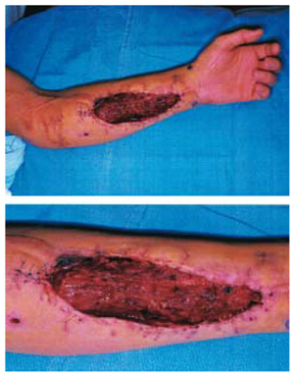
Nursing Care
Blood and fluid are aspirate from the blood-drawing port or stopcock in an attempt to remove a blood clot, and then the system is flushed using the fast flush device.
Never inject anything into an arterial cannula or arterial line

Slide 57
A-L Removal
This is an aseptic procedure
Remember universal precautions
The procedure should be explained to the patient
Take dressing off line
Remove arterial line ensuring that the entry site is covered with gauze
Apply digital pressure for at least 5 minutes to ensure haemostasis
Dress site with gauze and micropore
Assess the peripheral circulation as thrombosis can occur after removal

Slide 58
Central Venous Line

Slide 59
Question
Is the following statement True or False?
A central venous catheter measures right atrial pressure, left ventricular end-diastolic pressure, and intravascular blood volume.

Slide 60
Answer
True
Rationale: Central venous catheter terminates in the superior vena cava near the right atrium; it measures right atrial pressures, left ventricular end-diastolic pressure, and intravascular blood volume.

Slide 61
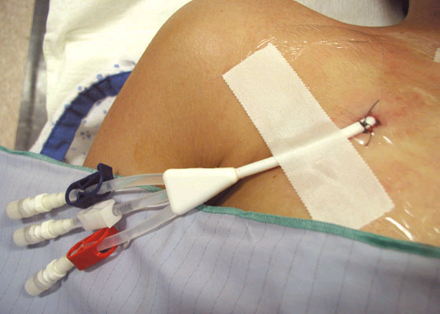
WHAT IS A CENTRAL Venous LINE
Indwelling catheter inserted via subclavian, jugular, antecubital, or femoral & positioned in the vena cava close to right atrium
Connected to hemodynamic monitoring system
Reflects Right atrial pressure and provides information about intravascular blood volume, RVEDP, and Rt ventricular function
CVP indirectly reflects LVEDP and function because the Lt and Rt sides of the heart are linked by the pulmonary vascular bed

Slide 62
Central Venous Line
TYPES OF CENTRAL LINE:
  Single Lumen
  Triple Lumen
  Quadruple Lumen
  Quintuple Lumen
Inserted under sterile technique(gloves, gown, cap, mask) – Video
Chlorhexidine prep
Notes:
Quentiple

Slide 63
Central Venous Pressure[CVP] Monitoring
CVP is pressure of blood in the right atrium or vena cava.
It provides information about :
  Intravascular blood volume
  Right ventricular end-diastolic pressure[RVEDP]
  Right ventricular [RVFx]function.
Alteration in CVP measurements – High –LOW
  Normal range 5-8cm H2O if measured by water manometer; 0-6 mmHg if measured by pressure transducer.

Slide 64
Indications for CVP lines
  Most common indication:
    clients w/ potential or altered fluid status
  Fluid resuscitation
  Parenteral feeding
  Measurement of central venous pressure
  Poor venous access
  Administration of irritant drugs

Slide 65
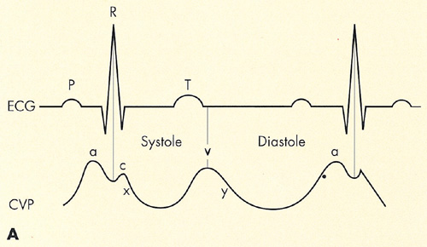
THE CVP WAVEFORM
The CVP waveform reflects changes in right atrial pressure during the cardiac cycle
  a wave: due to the increased arterial pressure during Rt atrial contraction. It correlate with P wave on the ECG.
  C wave: caused by a slight elevation of the tricuspid valve into the Rt atrium during early ventricular contraction. It correlates with the end of QRS complex on an ECG.
  .
Notes:
A wave: due to the increased arterial pressure during Rt atrial contraction. It correlate with P wave on the ECG.
C wave: caused by a slight elevation of the tricuspid valve into the Rt atrium during early ventricular contraction. It correlates with the end of QRS complex on an ECG.
X wave: caused by the downward movement of the ventricle during systolic contraction. It occurs before the T wave on an ECG.
V wave: arises from the pressure generated when the blood filling the Rt atrium comes up against a closed tricuspid valve. It occurs as the T wave is ending on an ECG.
Y wave: produced by the tricuspid valve opening in diastole with blood flowing into the Rt ventricle. It occurs before the P wave on an ECG

Slide 66
THE CVP WAVEFORM
  X wave: caused by the downward movement of the ventricle during systolic contraction. It occurs before the T wave on an ECG.
  V wave: arises from the pressure generated when the blood filling the Rt atrium comes up against a closed tricuspid valve. It occurs as the T wave is ending on an ECG.
  Y wave: produced by the tricuspid valve opening in diastole with blood flowing into the Rt ventricle. It occurs before the P wave on an ECG

Slide 67
Central Venous Line
BLOOD VOLUME
(increased venous return raises cvp
CARDIAC COMPETENCE (reduced ventricular function raises cvp)
Central
Venous
Pressure
CVP
SYSTEMIC VASCULAR RESISTENCE (increased tone raises cvp)
INTRATHORACIC AND INTRAPERITONEAL PRESSURE (raises cvp)

Slide 68
Nursing Care
Monitoring the system and documentation
Obtain CVP readings hourly (Normal CVP < 8 mmHg )
LOW CVP :
    Hypovolemia or pt on diuretic therapy→ require fluid administration
    Sepsis (systemic vasodilatation)
    Vasodilating drugs
High CVP
      Caused by a number of interrelated factors
      Most commonly Right ventricular Failure & Mechanical Ventilator (intrathoracic pressure →compress pulmonary vessels → resistance to blood flow from the rt side to left side → Rt Vent. dysfunction

Slide 69
CVP Reading
CVP reading is ALWAYS interpreted in conjunction with clinical observation (Lung &heart sounds, HR, RR, ECG, UOP)
Left Ventricular Failure →↑CVP , Basilar crackles+ ↓UOP
Mechanical Vent→ Distended neck veins +clear breath sounds + ↑CVP +intrathoracic pressure
Sepsis : ↓CVP +fever+ tachycardia +tachypenia +↑WBC
Receiving Vasodialting drugs ↓CVP +tachycardia

Slide 70
Procedure For CVP Measurement Using A Transducer:
Explain the procedure to the patient
Ensure the line is patent
Position the patient supine (if possible) and align the transducer with the mid axilla (level with the right atrium)
Zero the monitor
Observe the CVP trace
document the reading and report any changes or abnormalities

Slide 71
CVP-Complications
Malposition of the catheter
haematoma
arterial puncture
pneumothorax
haemorrhage
sepsis
air emboli
Catheter embolism(10-20 cc of air
Thrombosis
Haemothorax
Cardiac tamponade
Cardiac arrhythmias

Slide 72
Infection
S & S:
Pain.
inflammation, or redness at entrance or exit sites, or port site.
Drainage.
Elevated WBCs & temperature
Nursing Consideration:
Notify MD.
Routine dressing and IV fluid tubing changes
Sterile technique during dressing, catheter insertion and removal
After catheter removal: Culture (site and catheter tip).
Obtain blood cultures as directed by MD or policy. This may include culture from a peripheral vein, central line catheter, or both.
Treat fever with prescribed medication.
Observe patient for systemic infection.
Antibiotic (catheter left in place for long time)

Slide 73
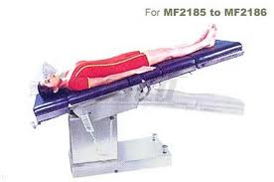
Air embolus :
S & S:
Chest pain, confusion, anxiety
Cyanosis, unresponsiveness
Increased blood pressure and/or pulse rate. Decreased CO. Cardiac arrest
Nursing Consideration:
Clamp line & monitor connections
Place patient on left side with head down (Trendelenburg position). This allow the air to rise to the wall of the Rt ventricle and improve blood flow
Notify MD.
Monitor vital signs,
administer oxygen,
obtain order to initiate peripheral IV

Slide 74
Dislodgement Of Catheter:
-Leakage from catheter or exit site.
-Increase or decrease in external catheter length.
Nursing Consideration:
  Secure catheter and extension tubing with tape.
  Observe for absence of suture (if applicable).
  Observe for protrusion of Dacron cuff from exit site.
  Notify physician of findings.
Notes:
Dislodgement: خلع

Slide 75
Damaged catheter:
Leakage from external catheter.
Pockets of swelling along catheter path.
Nursing consideration:
Apply dry sterile dressing below tear and clamp.
Repair catheter, if applicable,
assessing the infection risk associated with repair vs. removal.
Notify physician

Slide 76
Migration of catheter tip:
Change in intrathoracic pressure because of coughing, sneezing, or vomiting.
Inability to inject fluid
Arrhythmias.
Patient complaint of "gurgling" sound in ear.
Nursing Consideration:
History: gradual or rapid onset?
difficult or forceful flush of catheter?;
Notify physician.
X-ray to verify position.
Discontinue infusion.

Slide 77
Thrombosis
S&S:
Tenderness and edema of neck, shoulder, and/or arm closest to the catheter side.
Impaired movement of neck and jaw, and Jugular Venous Distention
Engorged peripheral veins in arm or chest wall.
Nursing Consideration:
Nurse may attempt to aspirate clot if hospital policy permits
Notify physician.

Slide 78
Pinch-off Syndrome
Resistance to flush. Inability to withdraw blood. Flow restored when patient’s position is changed
Nursing consideration:
A. Notify physician.
B. Obtain chest X-ray to look for catheter compression between the clavicle and the first rib.
C. Catheter removal is usually indicated because this compression can lead to catheter fracture and emboli.

Slide 79
Catheter occlusion:
Unable to administer IV fluids. No flow, Unable to aspirate.
Nursing consideration:
  Flush catheter very gently with normal saline; do not force as this may cause catheter weakening or rupture, or dislodgement of clot.
  Notify physician; may require order to administer fibrinolytic agent to dissolve the clot.

Slide 80
Central venous Line Removal
this is an aseptic procedure
the patient should be supine with head tilted down
ensure no drugs are attached and running via the central line
remove dressing
cut the stitches
slowly remove the catheter
if there is resistance then call for assistance
apply digital pressure with gauze until bleeding stops
dress with gauze and clear dressing e.g. tegaderm

Slide 81
Pulmonary Artery Pressure Monitoring
Clinical indications
Measurements obtained
  Pulmonary arterial Pressure(PAP)
  Pulmonary Capillary Wedge Pressure(PCWP)
  Central Venous Pressure(CVP)
  Cardiac Output measurement
  Mixed Venous Blood gas measurement
  Saturation of venous oxygen concentrations(SVO2)

Slide 82
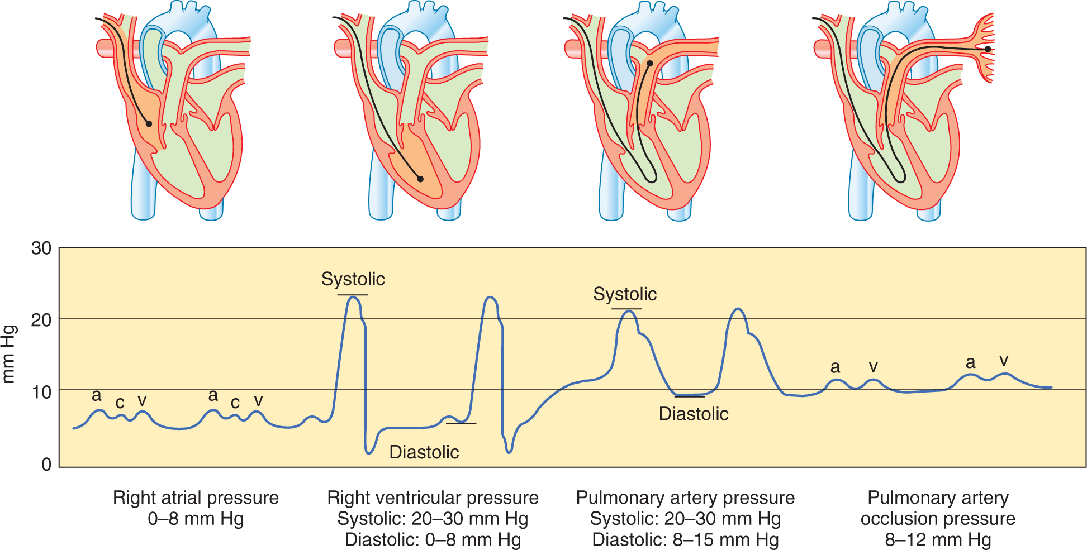
PA Catheter Waveforms

Slide 83
Determination of Cardiac Output
Factors that determine cardiac output
  Heart rate and stroke volume
  Alterations are caused by changes in heart rate, preload, afterload, and contractility.
Obtaining cardiac output values
  Fick’s method for cardiac output determination
  Indicator-dilution methods for cardiac output determination (thermodilution method)

Slide 84
Question
When obtaining a cardiac output, how much time should there be between injections?
  A. 1 minute
  B. 2 minutes
  C. 5 minutes
  D. 10 minutes

Slide 85
Answer
A. 1 minute
Rationale: When injected, the solution passes a temperature probe in the closed system and flows through the right atrium and right ventricle, past the thermistor at the tip of the PAC. A curve is produced and used for determining the CO. The average of several CO determinations is required to obtain a final measurement. Serial measurements and averaging are necessary because of the number of physiological variables and the performance of the technical procedure. Waiting approximately 1 minute between injections allows the catheter thermistor to return to baseline.

Slide 86
Procedure for Intermittent Thermodilution Cardiac Output Determination
Ensuring the accurate amount of injectate volume in the syringe
Injecting the volume in a smooth and rapid manner, in less than 4 seconds
Waiting approximately 1 minute between injections to allow the catheter thermistor to return to baseline

Slide 87
Cardiac Index
when CO calculated to reflect body size, it is termed cardiac index.
Normal range 2.5-4 L/min/m2
Is the preferred value to use clinically because it takes into account body size
CI = CO/Body Surface Area (BSA).

Slide 88
Question
What determines oxygen delivery?
  A. Preload and afterload
  B. Oxygen demand and oxygen delivery
  C. Oxygen extraction and oxygen deprivation
  D. Oxygen content and cardiac output

Slide 89
Answer
D. Oxygen content and cardiac output
Rationale: Arterial oxygen delivery (DaO₂) is the amount of oxygen transported to the tissues. DaO₂ depends on arterial oxygen content and CO.

Slide 90
Determinants of Oxygen Delivery
Oxygen content
  Hemoglobin and oxygen saturation
Cardiac output
  Delivers oxygen to the cells
  DaO₂ is CO and arterial oxygen content.
  Normal is 1,000 mL O₂/minute.
  Increase in demand results in compensatory increase in CO.

Slide 91
Determinants of Oxygen Consumption
Oxygen demand
  Stress increases demand.
  Need adequate delivery of oxygen and cellular extraction of oxygen
Oxygen delivery
  Delivery increases > consumption increases > oxygen demand is met.
Oxygen extraction
  Amount of oxygen removed from blood for use by cells
  O₂ debit: inadequate oxygen consumption causes an anaerobic state and cellular hypoxia

Slide 92
SvO₂
SvO₂—mixed venous saturation
  Level of oxyhemoglobin in desaturated blood returning to the right ventricle
  Can be monitored at the bedside with specialized central venous catheters
  Evaluates the balance of oxygen supply, utilization, and demand
  Normal ranges from 60% to 80%.

Slide 93
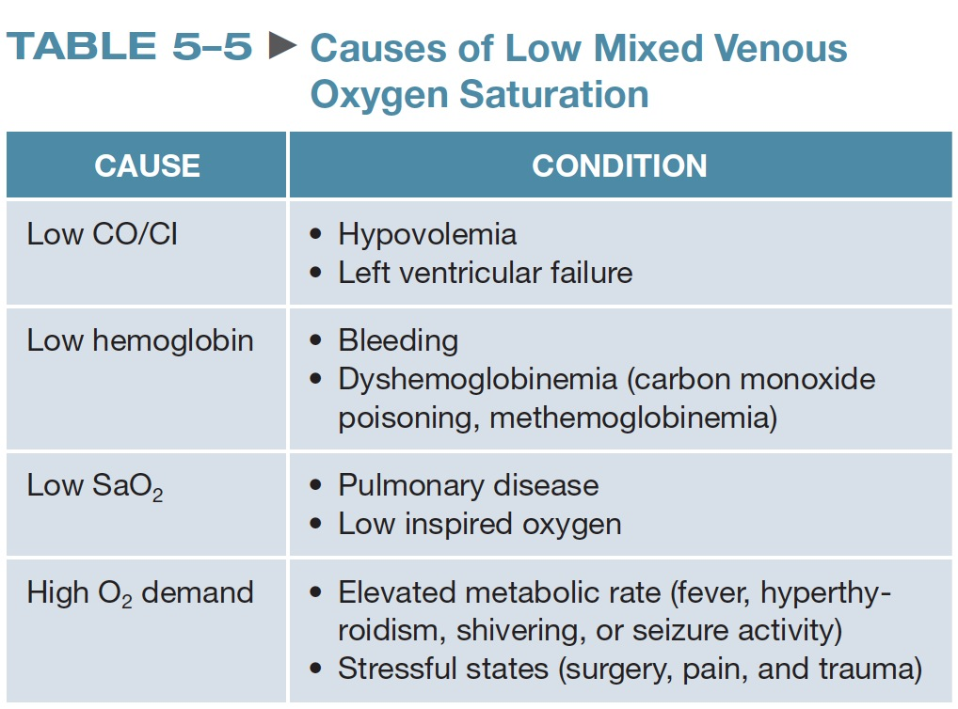

Slide 94
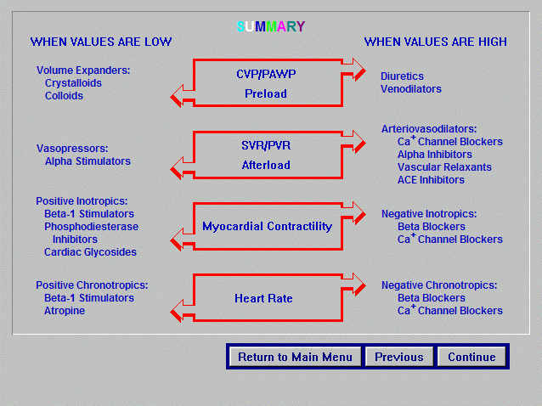

Slide 95
Questions and answers

