Slide 1
Chapter 39 Assessment and Management of Patients With Hepatic Disorders

Slide 2
Review of Anatomy and Physiology of the Liver
Largest gland of the body
Located upper right abdomen
A very vascular organ that receives blood from GI tract via the portal vein and from the hepatic artery

Slide 3
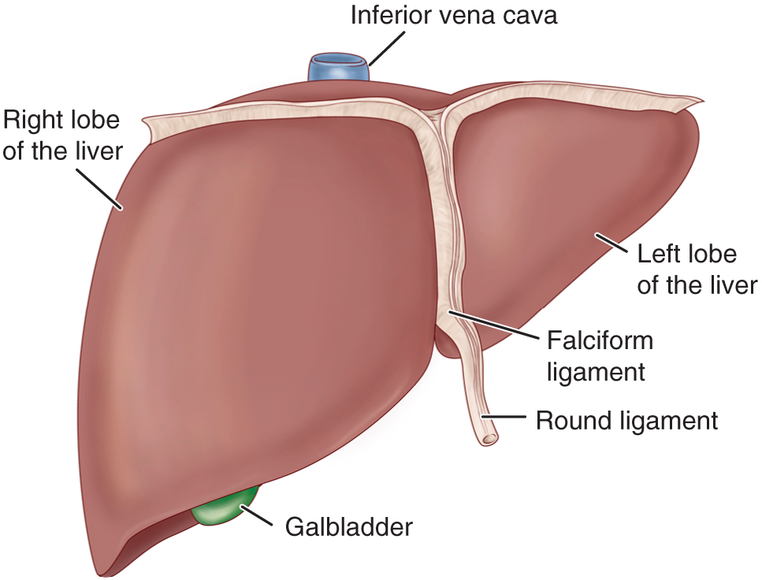
Liver and Biliary System

Slide 4
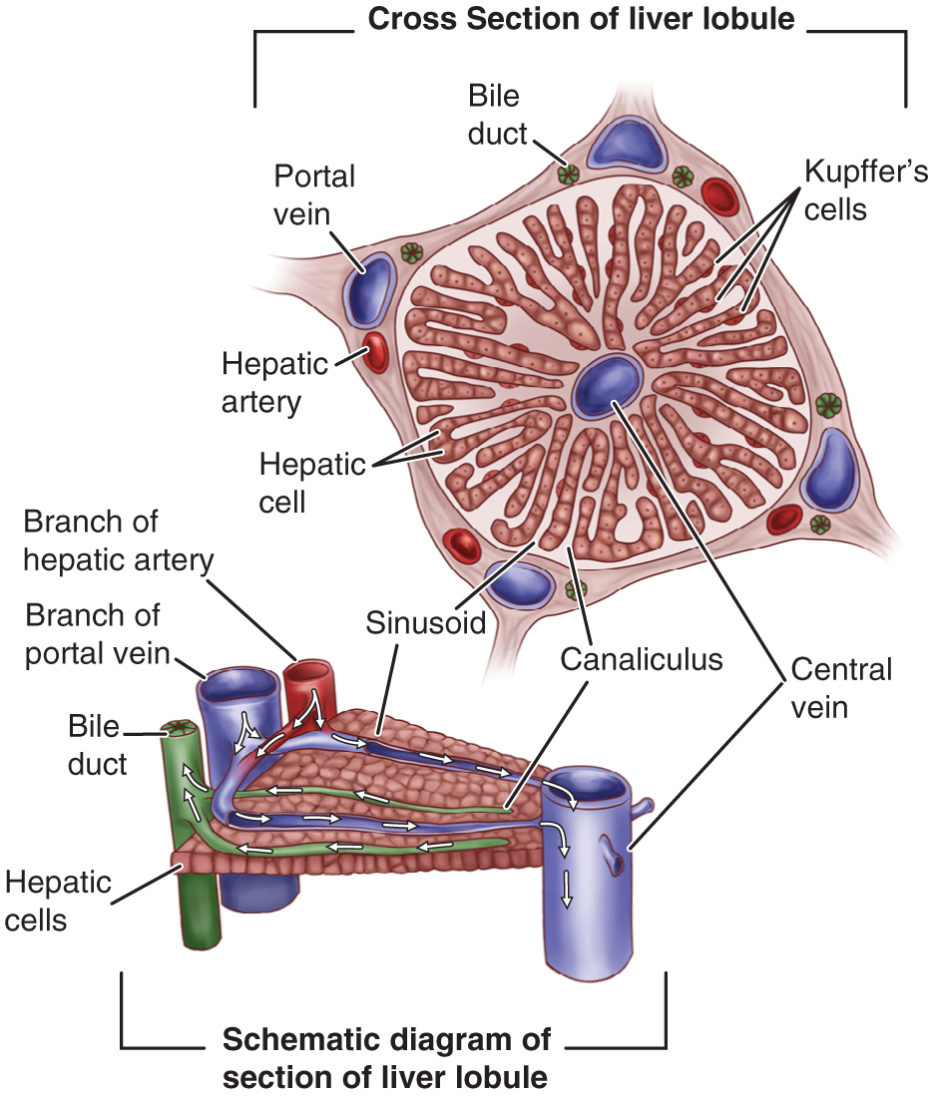
Section of a Liver Lobule

Slide 5
Metabolic Functions
Glucose metabolism
Ammonia conversion
Protein metabolism
Fat metabolism
Vitamin and iron storage
Bile formation
Bilirubin excretion
Drug metabolism

Slide 6
Functions of the Liver:
Glucose Metabolism and regulation of blood glucose concentration.
Ammonia conversion to urea that can be excreted in the urea.
Protein Metabolism: Synthesis almost all plasma proteins.
Fat Metabolism: Breakdown of fatty acids for the production of energy and Ketone bodies
Vitamin and Iron Storage: A, B12 and D And several of the B-Complex.
Drug Metabolism
Bile formation: Composed mainly from water and electrolytes and contain some fatty acids, chol., bilirubin and bile salts.
Bilirubin Excretion
Activation of Vit. D in cooperation of the Kidneys

Slide 7
Assessment:
Health history
Physical Exam
Skin
Abdomen
Diagnostic Evaluation

Slide 8
Health History:
Present or previous exposure or ingestion of hepatotoxic
agents, drugs
Family history or history of cirrhosis, hepatitis, cancer
History of blood transfusions, injection, dental treatment, hemodialysis
Hepatic vein thrombosis
Dietary intake
Duration and onset of present symptoms

Slide 9
Physical Examination
Skin Inspection
Pallor, Jaundice: Skin, Mucosa, and Sclera
Muscle atrophy, Edema, Skin excoriation from scratching (pruritis)
Petechia, Echomosis, Spider angiomas, and palmar erythema.
Abdominal Assessment:
Dilated abdominal wall veins, Ascites, Abdominal dullness.
Palpation for liver tenderness, Size (Firm, sharp ridge with a smooth surface).
Cirrhosis of the liver: smooth, hard, shrunken, fibrotic
Acute Hepatitis: Soft edges and easily moves
Percussion of upper and lower borders.

Slide 10
Liver Function Studies—See Table 39-1
Serum aminotransferases: AST, ALT, GGT, GGTP, LDH
Serum protein studies
Pigment studies: direct and indirect serum bilirubin, urine bilirubin, and urine bilirubin and urobilinogen
Prothrombin labtestsonline.org/understanding/analytes/pt/tab/test/Serum alkaline phosphatase
Serum ammonia
Cholesterol

Slide 11
Cont….
Alanin Transaminase (ALT) Test, (SGPT): Released from damaged Liver cells. It is good indicator for the progress or worsening of the Liver
Aspartate Transaminase (AST):(SGOT): Released from damaged liver, heart, muscle, or brain cell
5’ Nucleotidase Test: Released by the liver when the liver is injured due to bile duct obstruction or impaired bile flow.
Lactic Dehydrogenase Test: Released when organs such as the liver, heart ,lung, or brain injured.

Slide 12
Cont……….
Gamma Glutamyl Transferase or Transpeptidase (GGT) (GGTP): Are the most frequent used tests of liver damage.
Serum Ammonia

Slide 13
Additional Diagnostic Studies
Liver biopsy (see Chart 39-2)
Ultrasonography
CT
MRI
Other

Slide 14
Liver Biopsy
Needle Aspiration of liver tissue to examine liver cells ( An Invasive Procedure)
- Location 6th intercostal space, Mid Axillary Line
Preparation:
- Check PT, PTT, And platelet count, and check for compatible donor blood.
- Check for consent form.
- Vital signs
- Patient education is essential for preperation

Slide 15
During Procedure Nursing Care:
- Expose the Rt side of the patient’s upper ` abdomen (Rt hypochondriac region)
- Instruct the patient to inhale and exhale several time then exhale and hold.

Slide 16
Post-Procedure Nursing Care:
Turn the patient onto the Rt side, place the pillow under the costal margin for several hours ( Recumbent and immobile)
- Assess vital signs q 10-15 min for 1 hr
- observe puncture site for hemorrhage after test
- if the patient discharge ask him to avoid heavy lifting and strenuous activity for 1 week
- Major complications are liver injury, bleeding, and peritonitis, and Pneumothorax.

Slide 17
Hepatic Dysfunction
Acute or chronic (more common)
Cirrhosis of the liver
Causes:
Most common cause is malnutrition related to alcoholism
Infection
Anoxia
Metabolic disorders
Nutritional deficiencies
Hypersensitivity states

Slide 18
Manifestations
Jaundice
Portal hypertension, ascites, and varices
Hepatic encephalopathy or coma
Nutritional deficiencies

Slide 19
Jaundice
Yellow- or green-tinged body tissues; sclera and skin due to increased serum bilirubin levels (more than 2.5 mg/dl).
Types
Hemolytic
Hepatocellular
Obstructive
Hereditary hyperbilirubinemia
Hepatocellular and obstructive jaundice are most associated with liver disease

Slide 20
Types and causes:
Pre-hepatic (Hemolytic) Jaundice: Result of excess breakdown of RBC’s and liver is presented with more bilirubin than it’s capable of excretion
- Hemolytic transfusion reaction
- Hemolytic Disorders ( hereditary or acquired)
- Hemolytic disease of the newborn
- Autoimmune hemolytic anemia
2. Intra-hepatic (Hepatocellular): Decreased bilirubin uptake by damaged liver cells
- Hepatitis
- Cirrhosis
- Cancer of the liver

Slide 21
Cont……..
Post-hepatic ( Obstructive) Jaundice: due to occlusion of the bile ducts
- Gallstone ( cholelithiasis).
- Inflammatory process
- Tumor
- pressure from enlarged organ
4. Hereditary Hyperbilirubinemia: due to several inherited disorders.
- Gilbert’s syndrome
- Dubin-Johnson syndrome
Causes
Impaired Hepatic intake
Conjugation of bilirubin
Excretion of bilirubin into biliary system

Slide 22
Signs and Symptoms Associated with Hepatocellular and Obstructive Jaundice
Hepatocellular
May appear mildly or severely ill
Lack of appetite, nausea, weight loss
Malaise, fatigue, weakness
Headache chills and fever if infectious in origin
Obstructive
Dark orange-brown urine and light clay-colored stools
Dyspepsia and intolerance of fats, impaired digestion
Pruritis

Slide 23
Clinical Manifestations
Yellow Sclera
Yellowish-orange Skin
Clay-colored feces
Tea-colored urin
Pruritis
Fatique
Anorexia
Laboratory diagnostic tests: Increased serum bilirubin, alkaline phosphatase, cholesterol, serum bile salts, prolonged PT.

Slide 24
Portal Hypertension
Obstructed blood flow through the liver results in increased pressure throughout the portal venous system
Results in:
Ascites
Esophageal varices

Slide 25
Ascites: Fluid in Peritoneal Cavity Due To:
Portal hypertension resulting in increased capillary pressure and obstruction of venous blood flow
Vasodilatation of splanchnic circulation (blood flow to the major abdominal organs)
Changes in the ability to metabolize aldosterone, increasing fluid retention
Decreased synthesis of albumin, decreasing serum osmotic pressure
Movement of albumin into the peritoneal cavity

Slide 26
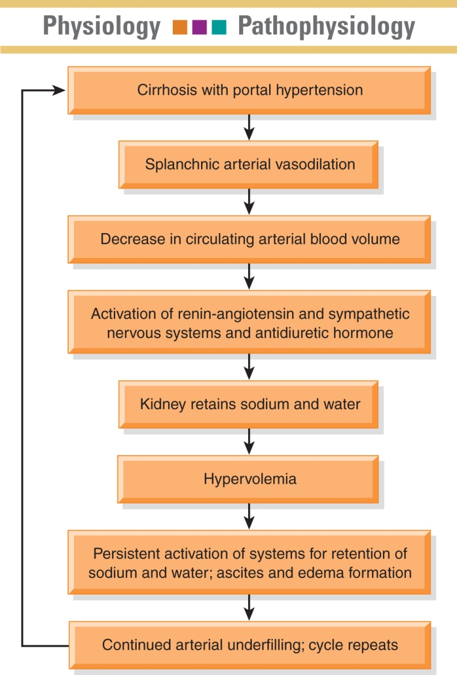
Pathogenesis of Ascites

Slide 27
Manifestation
Increased abdominal girth
Bulging flanks
Striae
Distended veins
Rapid weight gain
SOB
Fluid and electrolyte imbalance

Slide 28
Assessment of Ascites
Record abdominal girth and weight daily
Patient may have straie, distended veins, and umbilical hernia
Assess for fluid in abdominal cavity by percussion for shifting dullness or by fluid wave
Monitor for potential fluid and electrolyte imbalances

Slide 29
Assessing for Abdominal Fluid Wave

Slide 30
Treatment of Ascites
Low-sodium diet
Diuretics Such as aldactone (aldosterone blocking agent) first line therapy. Lasix may be added
Bed rest
Paracentesis
Administration of salt-poor albumin
Transjugular intrahepatic portosystemic shunt (TIPS)

Slide 31
Paracentesis

Slide 33
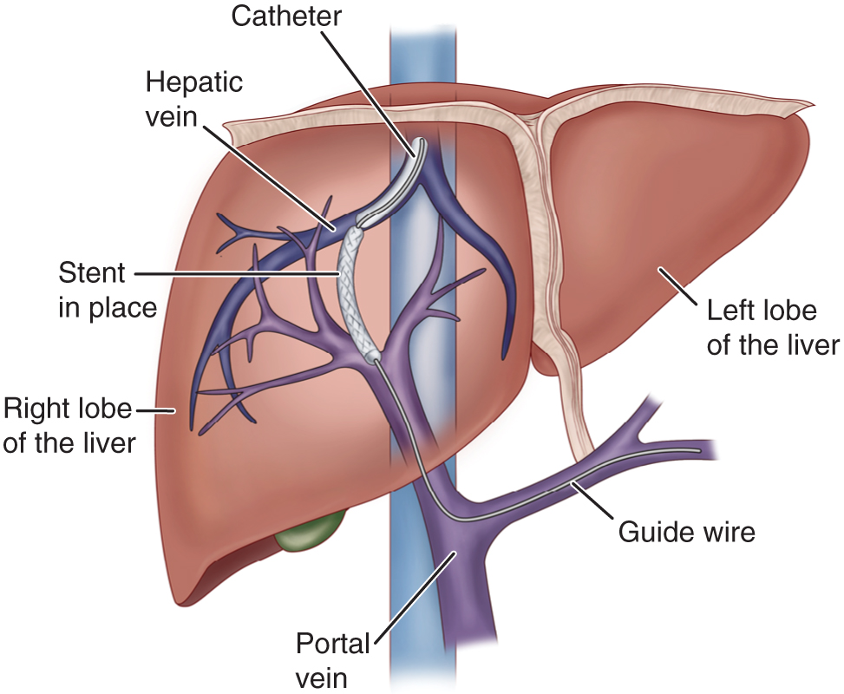
TIPS

Slide 34
Nursing Interventions:
Monitor I/O, Nutritional status
Monitor and prevent edema: Daily Wt and measurements of abd girth
Promotion of breathing
Monitor serum ammonia level
Monitor electrolyte leve
Monitor cognitive status
Monitor and promote skin integrity
Promote comfort
Nursing care of paracentesis (chart 39-2 (p.1084)

Slide 35
Hepatic Encephalopathy and Coma
A life-threatening complication of liver disease. May result form the accumulation of ammonia and other toxic metabolites in the blood
Stages—see Table 39-3
Assessment
EEG
Changes in LOC, asses neurological status frequently
Potential seizures
Fetor hepaticus
Monitor fluid, electrolyte, and ammonia levels

Slide 36
Clinical manifestation
Mental changes
Motor disturbances
Alteration in mood
Changes in personality
Altered sleep pattern ( day and night reversal)
Asterixis( Flapping tremor of hands)
- impaired writing and in ability to draw line or figures ( This way used to assess the improvement of the patient)
- Constructional apraxia ( in ability to draw simple figures)
EEG slowing of brain Waves
Potential seizures
Fetor Hepaticas: Sweet slightly fecal odor to the breath of intestinal origin

Slide 37
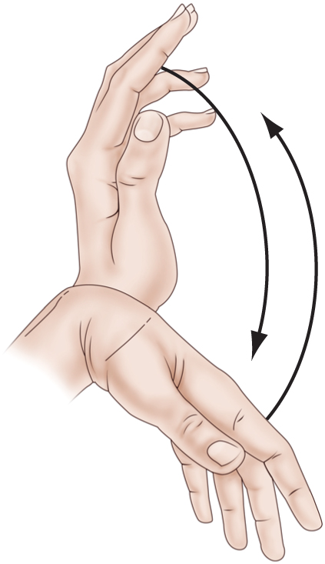
Asterixis

Slide 38
Effects of Constructional Apraxia

Slide 39
Medical Management
Eliminate precipitating cause
Lactulose to reduce serum ammonia levels
IV glucose to minimize protein catabolism
Protein restriction
Reduction of ammonia from GI tract by gastric suction, enemas, oral antibiotics
Discontinue sedatives analgesics and tranquilizers
Monitor for and promptly treat complications and infections

Slide 40
Esophageal Varices:
Are dilated tortuous veins found on the submucosa of lower esophagus
Caused by portal hypertension which is due to portal venous circulation obstruction
Bleeding Esophageal varices can lead to hemorrhagic shock, decreased cerebral, hepatic, and renal perfusion
Encephalopathy risk is increased due to increased nitrogen load in GI tract from bleeding and increased serum ammonia levels
Hemorrhage may result from: Lifting heavy objects, straining at stool, coughing, Vomiting, poorly chewed food, irritating fluids, reflux of stomach contents, and medication

Slide 41
Bleeding of Esophageal Varices
Occurs in about 1/3 of patients with cirrhosis and varices
First bleeding episode has a mortality of 30-50%
Manifestations include hematemesis, melana, general deterioration, and shock
Patients with cirrhosis should undergo screening endoscopy every 2 years.

Slide 42
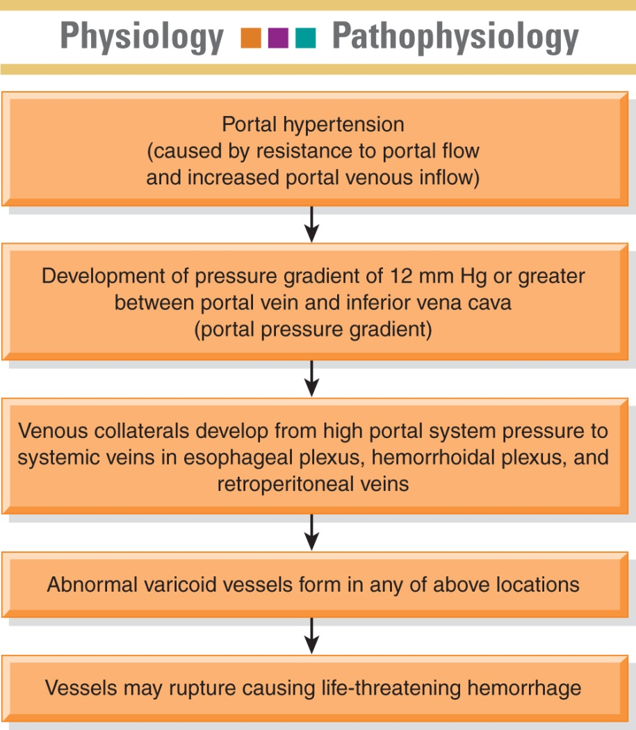
Pathogenesis of Bleeding Esophageal Varices

Slide 43
Assessment and diagnostic Findings:
Endoscopy: to identify the bleeding site
Barium swallow
Ultrasonography
CT
Angiography
Portal hypertension measures: indirect insertion of fluid-filled ballone catheter into the antecubital or femoral vein to the hepatic vein
Laboratory tests such as liver function test, blood flow and clearance studies to assess cardiac output and hepatic bld flow
Managing Esophageal Varices:
- monitor V/S, monitor signs of hypovolemia, O2 administration, Pharmacological therapy to decrease portal pressure ( Vasopressin and Beta Blockers), Balloon Tamponade: Sengstaken-Blakemore tube

Slide 44
Treatment of Bleeding Varices— See Table 39-2
Treatment of shock
Oxygen
IV fluids electrolytes and volume expanders
Blood and blood products
Vasopressin, somatostatin, octretide to decease bleeding
Nitroglycerin may be used in combination with vasopressin to reduce coronary vasoconstriction
Propranolol and nadolol to decrease portal pressure; used in combination with other treatment

Slide 45
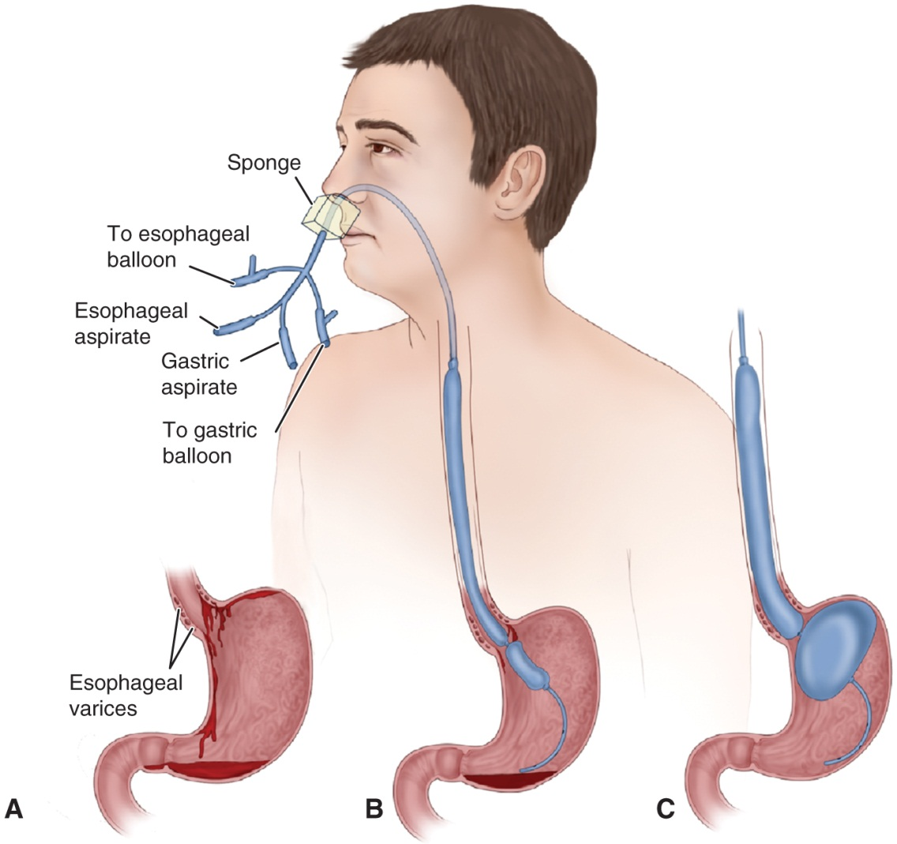
Balloon Tamponade—Sengstaken–lakemore Tube

Slide 46
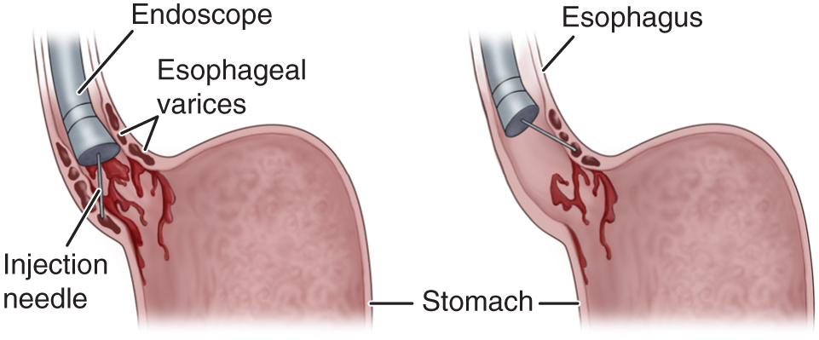
Endoscopic Sclerotherapy

Slide 47
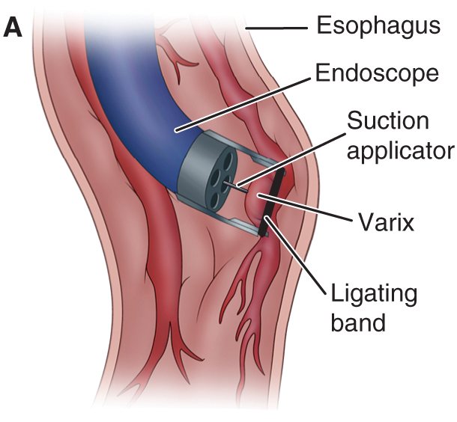
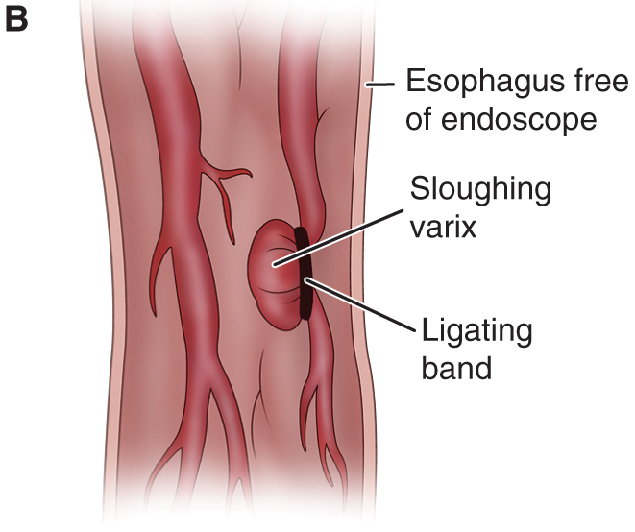
Esophageal Banding

Slide 48
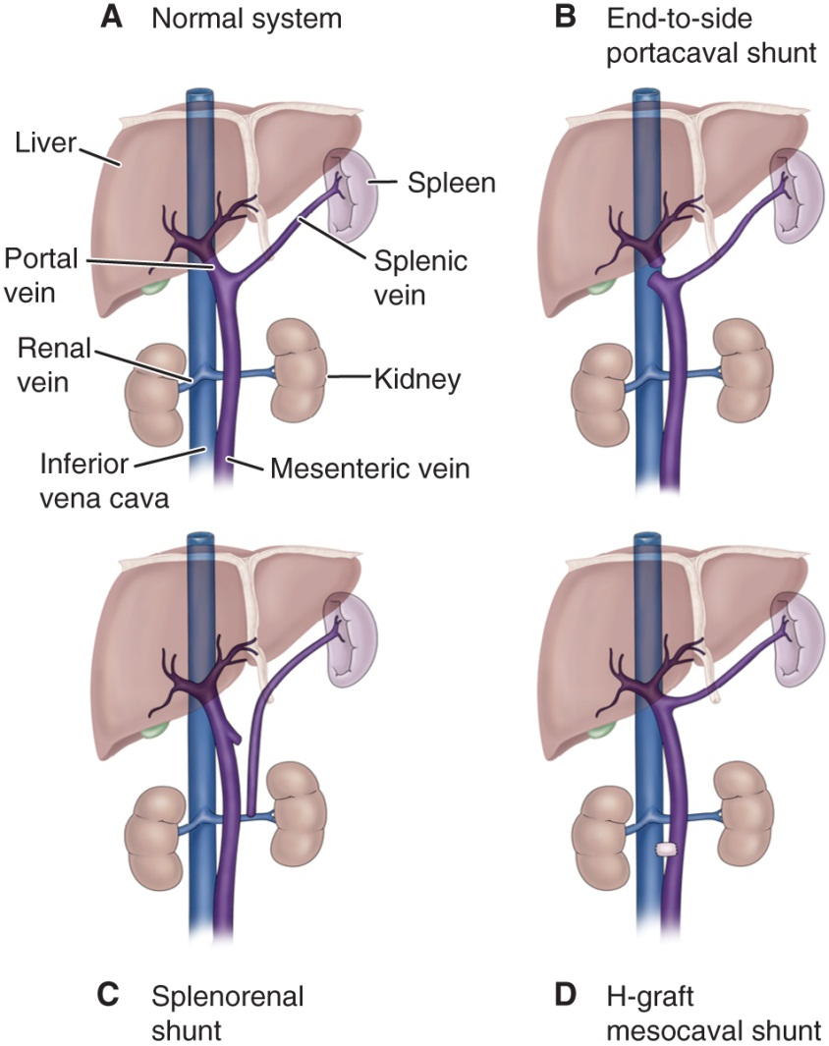
Portal Systemic Shunts

Slide 49
Nursing Management of the Patient with Bleeding Esophageal Varices
Monitor patient condition frequently, including emotional responses and cognitive status.
Monitor for associated complications such as hepatic encephalopathy resulting form blood breakdown in the GI tract and delirium related to alcohol withdrawal.
Monitor treatments including tube care and GI suction.
Oral care
Quiet clam environment and reassuring manner
Implement measures to reduce anxiety and agitation
Teaching and support of patient and family

Slide 50
Hepatitis—See Chart 39-6
Viral hepatitis: a systemic viral infection that causes necrosis and inflammation of liver cells with characteristic symptoms and cellular and biochemical changes.
A
B
C
D
E
Hepatitis G and GB virus-C
Nonviral hepatitis—toxic and drug induced

Slide 51
Hepatitis A (HAV)
Fecal–oral transmission
Spread primarily by poor hygiene; hand-to-mouth contact, close contact, or through food and fluids
Incubation: 15–50 days
Illness may last 4–8 weeks
Mortality is 0.5% for younger than age 40 and 1–2% for those over age 40
Manifestations: mild flu-like symptoms, low-grade fever, anorexia, later jaundice and dark urine, indigestion and epigastric distress, enlargement of liver and spleen
Anti-HAV antibody in serum after symptoms appear

Slide 52
Management
Prevention
Good hand washing, safe water, and proper sewage disposal
Vaccine
See Chart 39-7
Immunoglobulin for contacts to provide passive immunity
Bed rest during acute stage
Nutritional support (see Chart 39-8)

Slide 53
Hepatitis B (HBV)
Transmitted through blood found in blood, saliva, semen, and vaginal secretions, sexually transmitted, transmitted to infant at the time of birth
A major worldwide cause of cirrhosis and liver cancer
Risk factors (see Chart 39-9)
Long incubation period; 1–6 months
Manifestations: insidious and variable, similar to hepatitis A
The virus has antigenic particles that elicit specific antibody markers during different stages of the disease

Slide 54
Management
Prevention
Vaccine: for persons at high risk, routine vaccination of infants
Passive immunization for those exposed
Standard precautions/infection control measures
Screening of blood and blood products
Bed rest
Nutritional support
Medications for chronic hepatitis type B include alpha interferon and antiviral agents: lamividine (Epivir), adefovir (Hepsera)

Slide 55
Hepatitis C
Transmitted by blood and sexual contract, including needle sticks and sharing of needles
The most common blood-borne infection
A cause of 1/3 of cases of liver cancer and the most common reason for liver transplant
Risk factors (see Chart 39-10)
Incubation period is variable
Symptoms are usually mild
Chronic carrier state frequently occurs

Slide 56
Management
Prevention
Screening of blood
Prevention of needle sticks for health care workers
Measures to reduce spread of infection as with hepatitis B
Alcohol encourages the progression of the disease, so alcohol and medications that effect the liver should be avoided
Antiviral agents: interferon and ribavirin (Rebetol)

Slide 57
Hepatitis D and E
Hepatitis D
Only persons with hepatitis B are at risk for hepatitis D.
Transmission is through blood and sexual contact.
Symptoms and treatment are similar to hepatitis B but more likely to develop fulminant liver failure and chronic active hepatitis and cirrhosis.
Hepatitis E
Transmitted by fecal–oral route,
Incubation period 15–65 days,
Resembles hepatitis A and is self-limited with an abrupt onset. No chronic form.

Slide 58
Other Liver Disorders
Nonviral hepatitis
Toxic hepatitis
Drug-induced hepatitis
Fulminant hepatic failure

Slide 59
Hepatic Cirrhosis
Types:
Alcoholic
Postnecrotic
Biliary
Pathophysiology
Manifestations (see Chart 39-11)
Liver enlargement, portal obstruction and ascites, gastrointestinal varices, edema, vitamin deficiency and anemia, mental deterioration

Slide 60
Cont….
Clinical manifestation:
Compensated Decompensated
Intermittent mild fever Ascites
Vascular spider Jaundice
Palmer erythema weakness
Unexplained epistaxis Muscle wasting
ankle edema weight loss
Vague morning indigestion Continuous mild fever
Flatulent dyspepsia purpora
Abdominal pain spontaneous bruising
Firm, enlarged liver Epistaxis
splenomegaly Hypotension
spares body hair
white nails
Gonadal atrophy
Diagnostic Tests: LFT, CT, MRI, Ultrasound scanning and then confirmed by liver biopsy

Slide 61
Medical Management:
Based on presenting symptoms
Monitor for complications
Maximize liver function
- Antiacids to decrease gastric distress and minimize the possibility of gastric bleeding
- Adequate rest, Vitamins and nutritional support to promote healing of damaged liver cells
-Potassium sparing diuretics
- Avoidance of alcohol
- adequate calories and protein ( unless if there is encephalopathy)
- Fluid and elect. Restriction
- Colchicine

Slide 62
Nursing Process: The Care of the Patient with Cirrhosis of the Liver—Assessment
Focus upon onset of symptoms and history of precipitating factors
Alcohol use/abuse
Dietary intake and nutritional status
Exposure to toxic agents and drugs
Assess mental status
Abilities to carry on ADL/IADLs, maintain a job, and maintain social relationships
Monitor for signs and symptoms related to the disease including indicators for bleeding, fluid volume changes, and lab data

Slide 63
Nursing Process: The Care of the Patient with Cirrhosis of the Liver—Diagnoses
Activity intolerance
Imbalanced nutrition
Impaired skin integrity
Risk for injury and bleeding

Slide 64
Collaborative Problems/Potential Complications
Bleeding and hemorrhage
Hepatic encephalopathy
Fluid volume excess

Slide 65
Nursing Process: The Care of the Patient with Cirrhosis of the Liver—Planning
Goals may include increased participation in activities, improvement of nutritional status, improvement of skin integrity, decreased potential for injury, improvement of mental status, and absence of complications.

Slide 66
Activity Intolerance
Rest and supportive measures
Positioning for respiratory efficiency
Oxygen
Planned mild exercise and rest periods
Address nutritional status to improve strength
Measures to prevent hazards of immobility

Slide 67
Imbalanced Nutrition
I&O
Encourage patient to eat
Small frequent meals may be better tolerated
Consider patient preferences
Supplemental vitamins and minerals, especially B complex, provide water-soluble forms of fat-soluble vitamins if patient has steatorrhea
High-calorie diet, sodium restriction for ascites
Protein is modified to patient needs
Protein is restricted if patient is at risk for encephalopathy

Slide 68
Other Interventions
Impaired skin integrity
Frequent position changes
Gentle skin care
Measures to reduce scratching by the patient
Risk for injury
Measures to prevent falls
Measures to prevent trauma related to risk for bleeding
Careful evaluation of any injury related to potential for bleeding

Slide 69
Cancer of the Liver
Primary liver tumors
Few cancers originate in the liver
Usually associated with hepatitis B and C
Hepatocellular carcinoma (HCC)
Liver metastasis
Liver is a frequent site of metastatic cancer
Manifestations:
Pain, a dull continuous ache in RUQ, epigastrium, or back
Weight loss, loss of strength, anorexia, anemia may occur
Jaundice if bile ducts occluded, ascites if obstructed portal veins

Slide 70
Nonsurgical Management of Liver Cancer
Underlying cirrhosis, which is prevalent in patients with liver cancer, increases risks of surgery
Major effect of nonsurgical therapy may be palliative
Radiation therapy
Chemotherapy
Percutaneous biliary drainage
Other nonsurgical treatments

Slide 71
Surgical Management of Liver Cancer
Treatment of choice for HCC if confined to one lobe and liver function is adequate
Liver has regenerative capacity
Types of surgery
Lobectomy
Cyrosurgery
Liver transplant

Slide 72
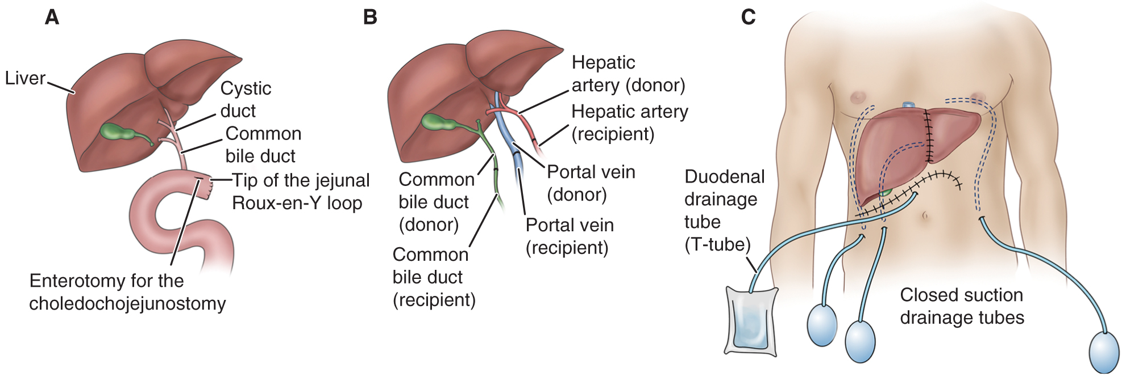
Liver Transplant

Slide 73
Cont…..
Surgical Management:
Lobectomy: Surgical resection of part of the liver up to 90%(Most common surgical procedure
Cryosurgery (Cryoablation): Tumor destroyed by using liquid Nitrogen at 196 C.
Liver transplantation: Replacement the liver with healthy donor organ. Recurrence of primary tumor is 70-80% after transplantation.

Slide 74
Nursing Care of the Patient Undergoing a Liver Transplantation
Preoperative nursing interventions
Postoperative nursing interventions
Patient teaching

