Slide 1
II. Portal Hypertension:
Obstructed blood flow through damaged liver results in increased BP through the portal Venous system
Consequences:
The formation of esophageal, gastric, and hemorrhoidal varices: Rupture cause massive bleeding
Ascites: Accumulation of fluid in the abdominal cavity\
May cause splenomegaly
The 2 main manifestations are: Ascites and varices

Slide 2
1. Ascites:
Ascites: Fluid in Peritoneal Cavity Due To:
Portal hypertension resulting in increased capillary pressure and obstruction of venous blood flow
Vasodilatation of splanchnic circulation (blood flow to the major abdominal organs)
Changes in the ability to metabolize aldosterone, increasing fluid retention
Decreased synthesis of albumin, decreasing serum osmotic pressure
Movement of albumin and fluid into the peritoneal cavity

Slide 3
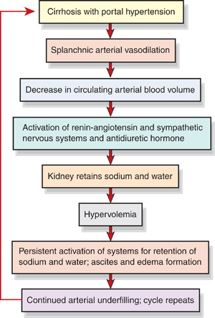
Pathogenesis of Ascites p 1129

Slide 4
Manifestation
Increased abdominal girth
Bulging flanks
Striae
Distended veins
Rapid weight gain
SOB
Fluid and electrolyte imbalance

Slide 5
Assessment of Ascites
Record abdominal girth and weight daily.
Paient may have striae, distended veins, and umbilical hernia.
Assess for fluid in abdominal cavity by percussion for shifting dullness or by fluid wave.
Monitor for potential fluid and electrolyte imbalances.

Slide 6
Assessing for Abdominal Fluid Wave

Slide 7
Management Of Ascites
Dietary modification:
1- negative Na balance to reduce fluid retention
2- no more than 2 g /day of sodium: if fluid accumulation is not relieved use 500 mg regimen and diuretics administered.
3- read food labels
4- taste of un-salted food can be adjusted using lemon juice, herbs, …etc
5- avoid salt substitutes: they contain K+
6- teach patient: home care
Dietary modification is only 10 % effective

Slide 8
Diuretics
Successful in 90%
Meds:
1- aldosteron blocking agent: Spironolactone, prevent K+ loss
2- Lasix: long use may cause Na depletion
3- Ammonium Chloride and Diamox: contraindicated, can cause coma.
Daily weight loss should not > 2kg
No fluid restriction unless Na level is very low
Complication of diuretics:
Electrolyte disturbance, dehydration/hypovolemia,
Encephalopathy: K+ Ammonia

Slide 9
Bed rest:
Upright position stimulates Renin-Angiotensin- Aldosteron system which decreases the response to diuretics
http://www.youtube.com/watch?v=PDE2qdS2ZvY

Slide 10
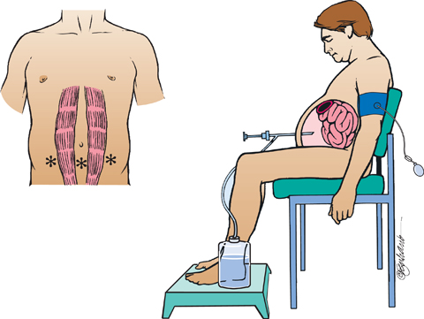
Paracentesis table p 1126
Primarily diagnostic
But can be used in refractive ascites. 5-6 L can be removed
Colloid fluid (salt-poor Albumin) to reduce risk of circulatory dysfunction after paracentesis

Slide 11
TIPS transjagular intrahepatic portosytemic shunt
Treatment of choice for refractive ascites
- reduce portal hypertension
- decrease Na retention
- improve response to diuretics
- prevent recurrence of fluid accumulation

Slide 12
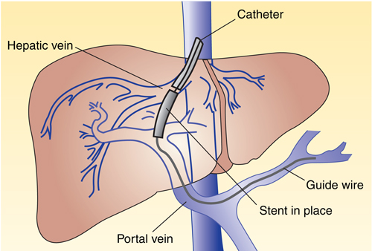
TIPS

Slide 13
Nursing Interventions:
Monitor I/O, Nutritional status
Monitor and prevent edema: Daily Wt and measurements of abd girth
Promotion of breathing
Monitor serum ammonia level
Monitor electrolyte level
Monitor cognitive status
Monitor and promote skin integrity
Promote comfort
Teaching: Rx plan, avoid alcohol
Continued care: home visit, adherence to Rx

Slide 14
2. Esophageal Varices:
Are dilated tortuous veins found on the submucosa of lower esophagus
Caused by portal hypertension which is due to portal venous circulation obstruction
Bleeding Esophageal varices can lead to hemorrhagic shock, decreased cerebral, hepatic, and renal perfusion
Encephalopathy risk is increased due to increased nitrogen load in GI tract from bleeding and increased serum ammonia levels
Hemorrhage may result from: Lifting heavy objects, straining at stool, coughing, Vomiting, poorly chewed food, irritating fluids, reflux of stomach contents, and medication
30-50% mortality rate in 1st bleeding episode.
Patho: blood seeks new routes (collatral circulation) due to the obstruction in vessels in submucusal layer.

Slide 15
Cont……
Clinical Manifestation
Hematemesis
Melena
General deterioration in mental or physical status
Cold clammy skin
Hypotension
Tachycardia

Slide 16
Cont…..
Assessment and diagnostic Findings:
to identify the bleeding site:
Endoscopy: NPO till gag reflex return
Barium swallow
Ultrasonography
CT
Angiography
- Portal hypertension measures: indirect insertion of fluid-filled balloon catheter into the antecubital or femoral vein to the hepatic vein. Reading over 20 ml saline is abnormal.
- Laboratory tests such as liver function test, blood flow and clearance studies to assess cardiac output and hepatic bld flow
Managing Esophageal Varices:
- monitor V/S, monitor signs of hypovolemia, O2 administration, Pharmacological therapy to decrease portal pressure ( Vasopressin and Beta Blockers), Balloon Tamponade: Sengstaken-Blakemore tube

Slide 17
Medical Management of Bleeding Esophageal Varices
monitor circulating volume: central line
V/S
O2
IVF: caution for overhydration
Balloon tamponade: Control Bleeding By applying pressure on the cardiac portion of the stomach and against the bleeding varices by a double-balloon tamponade (Sengstaken-Blakemore tube)
- Has four opening: Gastric Aspiration, Esophageal aspiration, inflating of the gastric balloon, and inflating of the esophageal balloon
- The pressure in the balloon should be 25-40 mmHg and to be checked q 2-4 hrs
- Overinfalting and leaving balloon for long time may cause injury from ulceration and necrosis of the mouth nose or stomach mucosa
- Displacement of tube may result in obstruction of airway and asphyxia from aspiration
- Overinfalting may result in sudden rupture and aspiration of gastric content into the lung.
- Frequent assessment for bleeding and inflation of balloons are needed in order to minimize the complications.

Slide 18
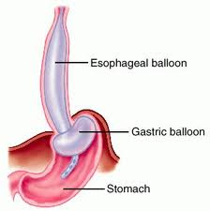
Balloon tamponade

Slide 19
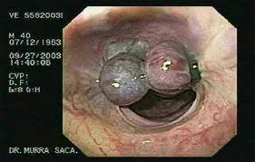
Meds: Vasopressin (decrease BP). Somatostatin (selective splanchenic vasoconstriction). Beta blockers (prevent but not used in acute bleeding)
Endoscopic therapy (injection sclerotherapy)
Useful in GI bleeding, less effective in preventing 1st and subsequent variceal bleeding
Complications: esophageal stricture, perforation, aspiration pneumonia.
Give antiacids post procedure to control sclerosing and reduce acid reflux.
Esophageal Banding Therapy (Band Ligation)
Treatment of choice
Can be combined with pharmacologic treatment.
Less risky than sclerosing
Complications: lacerations, dysphagia, stricture (rare)
TIPS

Slide 20
Surgical management of varices
1- surgical bypass: to reduce portal pressure
2- devascularization and transection
Very risky: cause encephalopathy
2nd line management if everything else failed
Summary available p1134

Slide 21
3. Hepatic Encephalopathy and Coma
Results from accumulation of Ammonia and other toxic metabolites in the blood (eg. False neurotransmitters).
Amonia: excited certain receptors on astrocyte cells, increases neurosteroid production, increases GABA neurotransmitor, depression of CNS
Ammonia is a result of enzyme and bacterial digestion of dietary and blood protein in the GI tract.

Slide 22
Hepatic Coma represents most advanced stages of hepatic encephalopathy. (See stages in table 39-3, p1134)
Normal
Drowsy
Stuporous
coma
GI bleeding in Esophageal Varices increases ammonia.
Survival rate: 40% in 1 yr, after 1st episode. So, pt should be referred for liver transplant

Slide 23
Clinical manifestation
Early symptoms:
Mental changes
Motor disturbances
Alteration in mood
Changes in personality
Altered sleep pattern ( day and night reversal)
Then:
Asterixis( Flapping tremor of hands)
- impaired writing and in ability to draw line or figures ( This way used to assess the improvement of the patient)
- Constructional apraxia ( in ability to draw simple figures)
EEG slowing of brain Waves
Potential seizures
Fetor Hepaticas: Sweet slightly fecal odor to the breath of intestinal origin

Slide 24
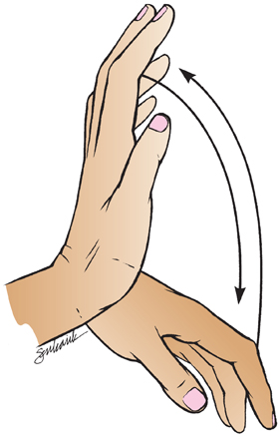
Asterixis

Slide 25
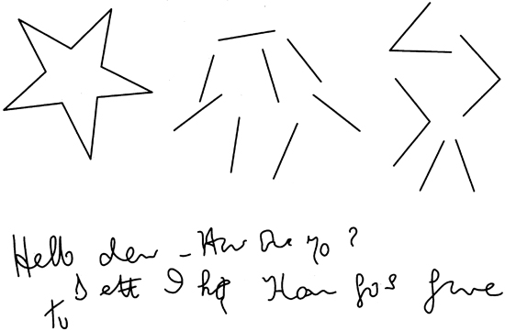
Effects of Constructional Apraxia

Slide 26
Medical Management:
Eliminate the cause
Lactulose: promotes excretion of ammonia through stool to reduce serum ammonia levels
- Causes intestinal bloating and cramps
- Monitor for hypokalemia and dehydration
- For comatose pt give through NG tube or enema
IV administration of glucose to minimize protein breakdown
Administration of vitamins to correct deficiency
Correct electrolyte imbalance

Slide 27
Cont..
Moderate restriction of protein intake( at least .5g/kg usually 1gkg-1.5g/kg) chart 39-5,p 1136
Small frequent meals and complex CHO
Substitute vegetable protein for animal protein
Reduction of ammonia from GI tract by gastric suction, enemas, oral antibiotics
Discontinue sedatives, analgesics, and tranquilizers.
Monitor for and promptly treat complications and infections.

Slide 28
Nursing management:
Prevent injury, assess pt (neuro), assess respiration, intubation if needed, communicate with the family, teach self care.

Slide 29
Hepatitis—See Chart 39-6
Viral hepatitis: a systemic viral infection that causes necrosis and inflammation of liver cells with characteristic symptoms and cellular and biochemical changes.
A
B
C
D
E
Hepatitis G and GB virus-C
Nonviral hepatitis—toxic and drug induced

Slide 30
Hepatitis A (HAV)
Fecal–oral transmission
Spread primarily by poor hygiene; hand-to-mouth contact, close contact, or through food and fluids
Incubation: 15–50 days
Illness may last 4–8 weeks
Mortality is 0.5% for younger than age 40 and 1–2% for those over age 40
Manifestations: mild flu-like symptoms, low-grade fever, anorexia, later jaundice and dark urine, indigestion and epigastric distress, enlargement of liver and spleen
Anti-HAV antibody in serum after symptoms appear

Slide 31
Management
Prevention
Good hand washing, safe water, and proper sewage disposal
Vaccine: about 100% effective (2-3 doses)
See Chart 39-7
Immunoglobulin for contacts to provide passive immunity
Bed rest during acute stage
Nutritional support (see Chart 39-8)

Slide 32
Hepatitis B (HBV)
Transmitted through blood found in blood, saliva, semen, and vaginal secretions, sexually transmitted, transmitted to infant at the time of birth
A major worldwide cause of cirrhosis and liver cancer
Risk factors (see Chart 39-9)
incubation period; 1–6 months. >90% recovers after that
Manifestations: insidious and variable, similar to hepatitis A
The virus has antigenic particles that elicit specific antibody markers during different stages of the disease

Slide 33
Management
Prevention
Vaccine: for persons at high risk, routine vaccination of infants
Passive immunization for those exposed
Standard precautions/infection control measures
Screening of blood and blood products
Bed rest
Nutritional support
Medications for chronic hepatitis type B include alpha interferon and antiviral agents: lamividine (Epivir), adefovir (Hepsera)

Slide 34
Hepatitis C
Transmitted by blood and sexual contract, including needle sticks and sharing of needles
The most common blood-borne infection
A cause of 1/3 of cases of liver cancer and the most common reason for liver transplant
Risk factors (see Chart 39-10)
Incubation period is variable
Symptoms are usually mild
Chronic carrier state frequently occurs

Slide 35
Management
Prevention
Screening of blood
Prevention of needle sticks for health care workers
Measures to reduce spread of infection as with hepatitis B
Alcohol encourages the progression of the disease, so alcohol and medications that effect the liver should be avoided
Antiviral agents: combine 2 antivairal agents, interferon and ribavirin (Rebetol)

Slide 36
Hepatitis D and E
Hepatitis D
Only persons with hepatitis B are at risk for hepatitis D. (needs HBsAG to replicate)
Transmission is through blood and sexual contact. Common in drug users.
Symptoms and treatment are similar to hepatitis B but more likely to develop fulminant liver failure and chronic active hepatitis and cirrhosis.
Rx: under investigation, interferon therapy.
Hepatitis E
Transmitted by fecal–oral route,
Incubation period 15–65 days,
Resembles hepatitis A and is self-limited with an abrupt onset. No chronic form.

Slide 37
Other Liver Disorders
Nonviral hepatitis
Toxic hepatitis
Drug-induced hepatitis
Fulminant hepatic failure: sudden and severe in previously healthy person.
Rx: symptomatic, maintain fluid & E balance

Slide 38
Hepatic Cirrhosis
Is a chronic disease characterized by replacement of normal liver tissue with diffuse fibrosis that disrupt the structure and function of the liver.
Irreversible process
http://www.youtube.com/watch?v=ex5wUWrZubo&feature=related

Slide 39
Type of Hepatic cirrhosis:
Alcoholic cirrhosis: The scar tissue surrounds the portal areas and is the most common type.
Postnecrotic cirrhosis: There are broad bands of scar tissue as a late result of acute viral hepatitis
Biliary cirrhosis: Scarring occurs in the liver around the bile ducts. Usually is the result of chronic biliary obstruction and infection (Cholangitis). Less common type.
The portion of the liver involved in cirrhosis consist of portal and periportal spaces where the bile canaliculi communicated to form the liver bile ducts
These portions become inflamed and the bile duct become occluded with thickened bile an pus.

Slide 40
Pathophysiology ( Causes of Hepatic cirrhosis): .
Nutritional deficiency with reduced protein intake
Excessive alcohol intake ( Most common cause)
Exposure to certain chemecals ( carbon tetrachloride, chlorinated naphthalene, arsenic, or phosphorus) or exposure to infection
Twice as many men as women are affected
Most patients are between 40 and 60 years of age.

Slide 41
Clinical Manifestation:
Liver enlargement: Early symptoms, liver loaded with fatty tissue (firm and has sharp edge, producing abd pain, later the liver decreases in the size due to contraction of scar tissue and the edges become nodular.
Portal obstruction and ascites
Infection and peritonitis
Gastrointestinal varices
Edema
Vitamin deficiency and anemia
Mental deterioration

Slide 42
Cont….
Clinical manifestation:
Compensated Decompensated
Intermittent mild fever Ascites
Vascular spider Jaundice
Palmer erythema weakness
Unexplained epistaxis Muscle wasting
ankle edema weight loss
Vague morning indigestion Continuous mild fever
Flatulent dyspepsia purpora
Abdominal pain spontaneous bruising
Firm, enlarged liver Epistaxis
splenomegaly Hypotension
spares body hair
white nails
Gonadal atrophy
Diagnostic Tests: LFT, CT, MRI, Ultrasound scanning and then confirmed by liver biopsy

Slide 43
Medical Management:
Based on presenting symptoms
Monitor for complications
Maximize liver function
- Antiacids to decrease gastric distress and minimize the possibility of gastric bleeding
- Adequate rest, Vitamins and nutritional support to promote healing of damaged liver cells
-Potassium sparing diuretics: for ascites
- Avoidance of alcohol
- adequate calories and protein ( unless if there is encephalopathy)
- Fluid and elect. Restriction
- Colchicine: anti inflammatory

Slide 44
Nursing Process: The Care of the Patient with Cirrhosis of the Liver: Assessment p1152
Focus on onset of symptoms and history of precipitating factors.
Alcohol use/abuse
Dietary intake and nutritional status
Exposure to toxic agents and drugs
Assess mental status.
Abilities to carry out ADL/IADLs, maintain a job, and maintain social relationships
Monitor for signs and symptoms related to the disease, including indicators for bleeding, encephalopathy, fluid volume changes, and lab data.

Slide 45
Diagnosis
Activity intolerance
Imbalanced nutrition
Impaired skin integrity
Risk for injury and bleeding

Slide 46
Collaborative Problems/Potential Complications
Bleeding and hemorrhage
Hepatic encephalopathy
Fluid volume excess

Slide 47
Planning
Goals may include increased participation in activities, improvement of nutritional status, improvement of skin integrity, decreased potential for injury, improvement of mental status, and absence of complications.

Slide 48
Activity Intolerance
Rest and supportive measures
Positioning for respiratory efficiency
Oxygen
Planned mild exercise and rest periods
Address nutritional status to improve strength.
Measures to prevent hazards of immobility

Slide 49
Imbalanced Nutrition
I&O
Encourage patient to eat.
Small, frequent meals may be better tolerated.
Consider patient preferences.
Supplemental vitamins and minerals, especially B complex; provide water-soluble forms of fat-soluble vitamins if patient has steatorrhea
High-calorie diet, sodium restriction for ascites
Protein is modified to patient needs.
Protein is restricted if patient is at risk for encephalopathy.

Slide 50
Other Interventions
Impaired skin integrity
Frequent position changes
Gentle skin care
Measures to reduce scratching by the patient
Risk for injury
Measures to prevent falls
Measures to prevent trauma related to risk for bleeding
Careful evaluation of any injury related to potential for bleeding

Slide 51
Nursing Management of Cirrhosis:
Adequate Nutrition
2000-3000 cal/day
High protein to help liver regenerate unless encephalopathy is there
High CHO -
Restrict F/E intake if Ascites or edema presents
Rest frequently
Control temperature
Antiemetic, antiacids, antidiarrheal as ordered
Vitamins supplements (Fat soluble)
Removal all hepatotoxic drugs
Avoid alcohol, and give antibiotic if ordered

Slide 52
Cancer of the liver:
May be malignant or Benign (uncommon)
Primary liver cancer are associated with
- Chronic liver disease
- Hepatitis B, and C infection
- Cirrhosis
Type of primary Liver cancer:(few)
Hepatocellular carcinoma (HCC): Most common type. nonresectable
Cholangiocellular carcinoma: Resectable if early detected
Hepatocellular and cholangiocellular carcinoma:
Most of liver cancers are metastasized from other organs( Secondary)

Slide 53
Clinical Manifestation:
Pain, continuous dull ache in the right upper Quadrant, epigastrium or back
Wt loss
Loss of strength
Anorexia
Anemia may occur
Enlarged liver and irregular in palpation
Jaundice and Ascites
Assessment and Diagnostic tests
X-ray. LFT, increase alpha fetoprotien (AFP)/tumor marker, histology/biopsy.

Slide 54
Medical Management:
Nonsurgical Management:
Radiation therapy
Chemotherapy
Percutaneous Biliary drainage: are used to reestablish biliary drainage, relieve pressure and pain and decrease pruritus and jaundice. (Catheter inserted through the abd wall pass the obstruction then to DU after days the catheter is opened to external drainage to assess the bile amount, color and content).
Laser hyperthermia: Using heat and direct it to tumor
Immunotherapy: under investigation

Slide 55
Cont…..
Surgical Management:
Lobectomy: Surgical resection of part of the liver up to 90%(Most common surgical procedure
Local ablation: if not candidate for transplant. E.g. radiofrequency ablation. Complication: pain, bleeding
Liver transplantation: Replacement the liver with healthy donor organ. Recurrence of primary tumor is 70-80% after transplantation.

Slide 56
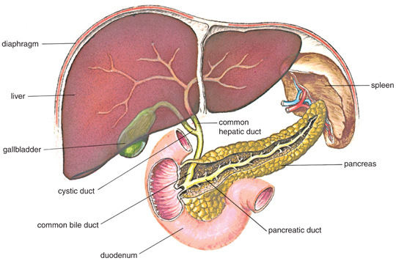
Liver, Biliary System, and Pancreas

Slide 57
Biliary Conditions:
Definition of terms: Biliary (chart 40-1)
Cholecystitis: Inflamation of the gallbladder
Cholelithiasis: the presence of calculi in the gallbladder
Cholecystectomy: removal of the gallbaldder
Cholecystostomy: opening and drainage of the gallbladder
Choledochotomy:opening into the common duct
Choledocholethiasis: stone in the common duct

Slide 58
Cont…..
Choledochlithotomy: incision of common bile duct for removal of stones
Choledochoduodenostomy: anastomosis of common duct to DU
Choledochojejunostomy: anastomosis of CD to jejunom
Lithotripsy: disintegration of gallstones by shock waves
Laparoscopic chlecystectomy: removal of gallbladder by endoscopic procedure
Laser Cholecystectomy: Removal of gallbladder using laser.

Slide 59
Cholecystitis:
Acute infection of the gallbladder causes pain, tenderness, and rigidity of the upper Rt abd and associated with nausea and vomiting and positive Murphy’s sign.
Pain may radiate to midsternal or to RT shoulder

Slide 60
Types:
Calculous: gallbladder stone obstruct bile outflow causing back up of the bile in the gallbladder leading to autolysis and edema. Vascular supply is compromised and leads to gangrene and perforation
Acalculous: Acute gallbladder inflammation in the absence of obstruction by gallstones (major surgical procedure, trauma, or burns, cystic duct obstruction, primary bacterial infection, multiple blood transfusion

Slide 61
Cholithiasis
Calculi, or gallstone usually formed in the gallbladder from the solid constituent of the bile and vary in size, shape and composition
Pigment stone: precipitating of unconjugated pigment in the bile to form stones represent one third of cases. Causes cirrhosis, hemolysis and infection of the biliary tree
Cholesterol stones: more common, Cholesterol is insoluble in water, solubility depend on bile acid and lecithin (phospholipid) in bile. Decreased bile acid and increase cholesterol synthesis in liver cause bile supersaturation with cholesterol which precipitate and form stone

Slide 62
Cont…
Four time more women than men develop cholelesterol stones and gallbladder disease (due to estrogen and contraceptive use which increase cholesterol saturation)
Risk factors :
Obesity, multi parous, Frequent changes in Wt, Rapid Wt loss, oral contraceptive, estrogens, cystic fibrosis, DM, and increases with age due to more cholesterol synthesis and decreased bile acid synthesis

Slide 63
Clinical Manifestations:
Silent, producing no pain and only mild GI symptoms( detected accidentally).
Pain and biliary colic, jaundice, change in urine (dark) and stool color (light), vit deficiency (fat-soluble)
Two type of Symptoms ( which may be acute or chronic)
From disease of the gallbladder itself:
epigastric distress following fatty meal( fullness, abdominal distention)
vague pain in the RUQ
2. From Obstruction of the bile passage by gallstone
fever
palpable mass
Colicky pain ( Rt abdominal pain radiated to the back or Rt shoulder)
Nausea and vomiting
Murphy’s sign (inspiratory pain): Positive
Jaundice (commonly occurs with obstruction of common bile duct)
Changes in Urine color (dark color) and stool color ( clay-colored)
Vitamin deficiency ( fat-soluble vitamins)

Slide 64
Diagnostic Tests:
Abdominal X-ray
U/S
Radionuclide imaging: IV radioactive agent
Cholecystography: oral iodine contrast agent used 10-12 hrs before X-ray, NPO
Endoscopic retrograde cholengiopancretography (ERCP): Direct observation through fiberoptic scope inserted through esophagus into DU ( Discuss nursing implication).
Percutaneous transhepatic Cholengiography: inject the dye directly into the biliary tree.

Slide 65
Cont………
Medical management:
Treatment of acute symptoms
Nutritional and supportive treatment: Low- fat, liquid diet, rest, IV fluids, nasogastric suction, analgesia and antibiotics
Pharmacological therapy to dissolve small, radiolucent gallstones composed primarily of cholesterol (ursodeoxycholic acid and chenodeoxycholic acid)

Slide 66
Nonsurgical removal of gallstones
Dissolving gall stone: infusion of solvent into the gallbladder
Extracorporeal shockwave lithotripsy (through water bath): Pt should have < 4 stones,< 3 cm in diameter, and no liver or pancreas disease. Contraindicated inflammatory disease of the biliary system
Intracorporeal lithotripsy: by ultrasound, pulsed laser
By Instrumentation: such as ERCP

Slide 67
Surgical Management:
Laparoscopic Cholecystectomy
Cholecystectomy
Mini-Cholecystectomy
Choledochostomy
Surgical Cholecystostomy: opening the gallbladder to remove the stone or the pus by drainage when severely inflamed before removal.
Percutaneous Cholycystostomy.

Slide 68
Nursing Process: Undergoing Surgery for Gallbladder Disease: Assessment
Patient history
Knowledge and teaching needs
Respiratory status and risk factors for postop respiratory complications
Nutritional status
Monitor for potential bleeding.
GI symptoms: after laparoscopic surgery, assess for loss of appetite, vomiting, pain, distention, fever--potential infection or disruption of GI tract.

Slide 69
Diagnosis:
Acute pain
Impaired gas exchange
Impaired skin integrity
Imbalanced nutrition
Deficient knowledge

Slide 70
Collaborative Problems/Potential Complications
Bleeding
Gastrointestinal symptoms
Complications as related to surgery in general: atelectasis, thrombophlebitis
Planning
Goals may include relief of pain, adequate ventilation, intact skin, improved biliary drainage, optimal nutritional intake, absence of complications, and understanding of self-care routines.

Slide 71
Postoperative Care Interventions
Low Fowler’s position
May have NG tube
NPO until bowel sounds return, then a soft, low-fat, high-carbohydrate diet postoperatively
Care of biliary drainage system
Administer analgesics as ordered and medicate to promote/permit ambulation and activities, including deep breathing.
Turn, and encourage coughing and deep breathing, splinting to reduce pain.
Ambulation

Slide 72
Patient Teaching (See Chart 40-3)
Medications
Diet: at discharge, maintain a nutritious diet and avoid excess fat. Fat restriction is usually lifted in 4-6 weeks.
Instruct in wound care, dressing changes, care of T-tube.
Activity
Instruct patient and family to report signs of gastrointestinal complications, changes in color of stool or urine, fever, unrelieved or increased pain, nausea, vomiting, and redness/edema/signs of infection at incision site.

Slide 73
Pancreatitis
A severe disorder that can lead to death. Acute pancreatitis does not usually lead to chronic pancreatitis.
Acute pancreatitis: pancreatic duct becomes obstructed and enzymes back up into the pancreatic duct, causing autodigestion and inflammation of the pancreas
Chronic pancreatitis: a progressive inflammatory disorder with destruction of the pancreas. Cells are replaced by fibrous tissue, and pressure within the pancreas increases. Mechanical obstruction of the pancreatic and common bile ducts and destruction of the secreting cells of the pancreas occur.

Slide 74
Causes:
Biliary tract disease: Stones
Long term use of alcohol
Bacterial or viral infection
Blunt abd trauma, peptic ulcer, ischemic vascular disease
Hyperlipidemia, hypercalcemia
Use of corticosteriods, thiazide diuretics, and oralcontraceptivr
ERCP or surgeries near to pancreas.

Slide 75
Assessment and diagnostic findings
History of Abd pain
Serum amylase and Lipase
Increase WBC’s
X-Ray studies
Ultrasound
Abd CT-Scan
ERCP rarely used because patient is acutely ill.

Slide 76
Manifestations
Acute:
Severe abdominal pain
Patient appears acutely ill.
Abdominal guarding
Nausea and vomiting
Fever, jaundice, confusion, and agitation may occur.
Ecchymosis in the flank or umbilical area may occur.
Patient may develop respiratory distress, hypoxia, renal failure, hypovolemia, and shock.
Chronic:
Recurrent attacks of severe upper abdominal and back pain accompanied by vomiting
Weight loss
Steatorrhea

Slide 77
Nursing Process: Assessment
Focus on abdominal pain and discomfort.
Fluid and electrolyte status
Medications
Alcohol use
GI assessment and nutritional status
Respiratory status
Emotional and psychological status of patient and family; anxiety and coping

Slide 78
Diagnosis:
Acute pain
Ineffective breathing pattern
Imbalanced nutrition
Impaired skin integrity
Collaborative Problems/Potential Complications:
Fluid and electrolyte disturbances
Necrosis of the pancreas
Shock
Multiple organ dysfunction syndrome
DIC
Planning:
Major goals include relief of pain and discomfort, improved respiratory function, improved nutritional status, maintenance of skin integrity, and absence of complications.

Slide 79
Relieving Pain and Discomfort
Use of analgesics
Nasogastric suction to relieve nausea and distention
Frequent oral care
Bed rest
Measures to promote comfort and relieve anxiety

