Slide 1
Disorders of hepatobiliary and exocrine pancreas
Dr. Mukhallad Al Janabi
MD, MSc., PhD
Department of physiology
Faculty of Medicine
Wing M2 level 0
E mail: mukmoh@just.edu.jo
Lecture materials based on text book :
Essentials of pathophysiology 4 th edition by Porth

Slide 2
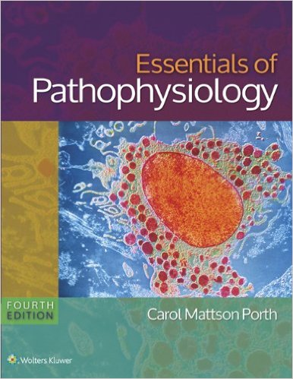

Slide 3
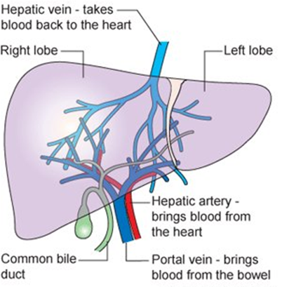
Liver
The liver is the largest visceral organ in the body, weighing approximately 1.3 kg in the adult.
The liver is located below the diaphragm (the right hypochondrium).
The liver is anatomically divided into two large lobes (the right and left lobes) and two smaller lobes (the caudate and quadrate lobes).
Accessory Organ: Gallbladder
Liver Blood Flow:
  Hepatic portal vein
  Hepatic artery
  Hepatic veins: empty into the inferior vena cava

Slide 4
Functions of the Liver
** Carbohydrate metabolism: Stores glycogen and synthesizes glucose from amino acids, lactic acid, and glycerol.
**Fat metabolism: Formation of lipoproteins Impaired synthesis of lipoproteins, Conversion of carbohydrates and proteins to fat Synthesis, recycling, and elimination of cholesterol, Formation of ketones from fatty acid.
**Protein metabolism: Deamination of proteins, Formation of urea from ammonia, Synthesis of plasma proteins.
**Storage of mineral and vitamins
Filtration of blood and removal of bacteria, Production of bile salts
Elimination of bilirubin, Metabolism of steroid hormones
Metabolism of drugs, Synthesis of blood clotting factors .

Slide 5
Tests of Hepatobiliary Function
**Serum aminotransferase levels: assess injury to liver cells. alanine aminotransferase (ALT) and aspartate aminotransferase (AST), which are present in liver cells. ALT is liver specific, whereas AST is derived from organs other than the liver.
** 1. Serum bilirubin
2. γ- glutamyltransferase (GGT), increased its
level indicates hepatobiliary disorders.
3. alkaline phosphatase (ALP)
(increased in bile ducts disorders):.
Serum protein levels
Bilirubin level in blood
Ultrasonography, CT scans, and MRI: evaluate liver structures
Angiography: visualizes the hepatic or portal circulation
Liver biopsy: used to obtain tissue specimens for microscopic examination

Slide 6
Bilirubin Elimination and Jaundice
**Bilirubin is the final product of the breakdown of heme which resulted from damaged aged red blood cells ( this process occurs in macrophages).
** the first stage is formation of biliverdin,
which is rapidly converted to free bilirubin.
**Free bilirubin (insoluble in plasma) is transported in the blood attached (bound) to plasma albumin.
**In hepatocyte, the free bilirubin is converted to
conjugated bilirubin (conjugation with glucuronic acid), making it soluble in bile (the color of bile is due to presence of its bilirubin).
** Conjugated bilirubin is secreted in to bile which passes through the bile ducts into the duodenum.
** In small intestine, it is converted into a highly soluble substance called urobilinogen.
** Part of urobilinogen is reabsorbed into the portal circulation where it either excreted to small intestine again (entrohepatic circulation) or it is excreted by the kidneys.
total serum bilirubin (both conjugated bilirubin and the unconjugated or free bilirubin) is 0.1-1.2 mg/dL.

Slide 7
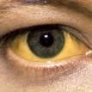
Jaundice (icterus)
** definition: a yellowish discoloration of the skin and deep tissues
results from abnormally high levels of bilirubin (bile pigments) in the blood.
** Jaundice becomes evident when the serum bilirubin levels rise above 2 to 2.5 mg/dL
**The sclera of the eye usually is one of the
first structures in which jaundice can be detected.
CAUSES OF JAUNDICE
Excessive destruction of red blood cells.
impaired uptake of bilirubin by the liver cells.
decreased conjugation of bilirubin.
Obstruction of bile flow in the canaliculi of the hepatic lobules
or in the intrahepatic or extrahepatic bile ducts.

Slide 8
CAUSES OF JAUNDICE
Prehepatic (Excessive Red Blood Cell Destruction). The following conditions cause excessive hemolysis of RBCs).
1.Hemolytic blood transfusion reaction
2. Hereditary disorders of the red blood cell
a. Sickle cell disease b. Thalassemia c. Spherocytosis
2. Acquired hemolytic disorders
3. Hemolytic disease of the newborn
4. Autoimmune hemolytic anemias
Intrahepatic
Decreased bilirubin uptake by the liver, Decreased conjugation of bilirubin
Hepatocellular liver damage,
Hepatitis
3. Cirrhosis
Posthepatic (Obstruction of Bile Flow)
1. Structural disorders of the bile duct
2. Cholelithiasis
4. Congenital atresia (absence or closure) of the extrahepatic bile ducts
4. Bile duct obstruction caused by tumors

Slide 9
Clinical features of different types of jaundice
**In prehepatic jaundice, there is mild jaundice, the unconjugated bilirubin is elevated, the stools are of normal color, and there is no bilirubin in the urine.
**In intrahepatic jaundice, both conjugated and unconjugated bilirubin are elevated, the urine often is dark because of bilirubin in the urine, and the serum alkaline phosphatase is slightly elevated.
**In posthepatic jaundice,
conjugated bilirubin levels usually are elevated
clay colored stools
Dark urine
the levels of serum alkaline phosphatase are markedly elevated.
Blood levels of bile acids often are elevated in obstructive jaundice. As the bile acids accumulate in the blood, pruritus develops. A history of pruritus preceding jaundice is common in obstructive jaundice.

Slide 10
Hepatitis
Acute or chronic inflammation of the liver
Causes of Hepatitis:
1. Autoimmune disorders
2. Reactions to drugs and toxins
3. Infectious disorders like viruses that primarily affect liver cells.

Slide 11
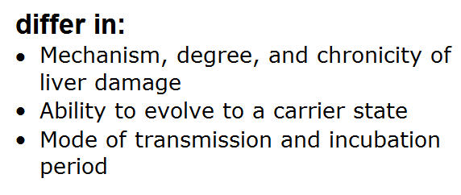
Viral Hepatitis
Hepatic infection due to group of viruses called hepatotropic viruses
Hepatitis A virus (HAV)
Hepatitis B virus (HBV)
Hepatitis C virus (HCV)
Hepatitis D virus (HDV)
Hepatitis E virus (HEV)

Slide 12
Hepatitis A
is caused by the HAV, a small, nonenveloped, single-stranded ribonucleic acid (RNA) virus.
The virus replicates in the liver, is excreted in the bile, and is shed in the stool
contracted primarily by the fecal–oral route
Clinical Manifestations. The onset of symptoms usually is abrupt and includes fever, malaise, nausea, anorexia, abdominal discomfort, dark urine, and jaundice.
Symptoms usually last approximately 2 months but can last longer.
**HAV does not cause chronic hepatitis or induce a carrier state, and rarely causes death.

Slide 13
Hepatitis B
** is caused by the HBV, a double-stranded deoxyribonucleic acid (DNA) virus
**Transmission of virus is through infected blood
** Infection can produce acute hepatitis, chronic hepatitis, progression of chronic hepatitis to cirrhosis, fulminant hepatitis with massive hepatic necrosis, and the carrier state.

Slide 14
Hepatitis C
*Caused by single stranded RNA virus
*Transmission is through blood
The HCV is the most common cause of chronic hepatitis, cirrhosis, and hepatocellular cancer in the world.
Asymptomatic or non specific symptoms like fatigue, malaise, anorexia, and weight loss. Few cases show jaundice.
Consequences of viral hepatitis C are:
*Few patients clear the infection
*Majority develop chronic hepatitis
*Serious consequences of this condition are: cirrhosis and liver cancer.

Slide 15
Hepatitis D and E
Hepatitis D virus is defective RNA virus. In order to replicate D viruses need coinfection with Hepatitis B virus.
The route of infection is blood.
Hepatitis E is caused by HEV is an enveloped, single-stranded RNA virus. It is transmitted by the fecal–oral route and causes manifestations
of acute hepatitis that are similar to hepatitis A.
It does not cause chronic hepatitis or a carrier state.

Slide 16
Liver Cirrhosis
It is the end stage of chronic liver disease where much of the functional liver tissue has been replaced by fibrous tissue.
Causes:
*Alcoholism
*viral hepatitis
*toxic reactions to drugs and chemicals
*biliary obstruction.
*deposition of minerals in the liver

Slide 17
Clinical Manifestations of liver cirrhosis
Often there are no symptoms until the disease is far advanced.
The most common signs and symptoms of cirrhosis are :
weight loss (sometimes masked by ascites), weakness, and anorexia.
Hepatomegaly and jaundice.
There may be abdominal pain because of liver enlargement or stretching of the liver capsule.
The late manifestations of cirrhosis are related to portal hypertension and liver failure. Splenomegaly, ascites, esophageal varices, hemorrhoids. These result from portal hypertension.
Complications include:
1. Bleeding due to decreased clotting factors, thrombocytopenia due to splenomegaly
2. Gynecomastia and a feminizing pattern of pubic hair distribution in men because of testicular atrophy.
3. encephalopathy and neurologic signs.

Slide 18
Clinical manifestations of cirrhosis.

Slide 19
Acute Cholecystitis
**is a diffuse inflammation of the gallbladder. 85% to 90% of cases are associated with the presence of gallstones.
Causes:
It is usually secondary to obstruction of the gallbladder outlet.
Severe trauma
Sepsis
Infection of gallbladder.
Ischemia of gallbladder.
** Sign and symptoms:
1. acute onset of pain
In upper right quadrant
or epigastric area.
2. mild fever, anorexia, nausea, and vomiting.
** There are elevation in WBCs count, bilirubin
and mild elevations in liver enzymes.

Slide 20
Acute Pancreatitis
**Reversible inflammatory process of the pancreatic acini due to premature
activation of pancreatic enzymes.
** It also can involve peripancreatic tissues or those of more distant organs.
pathogenesis : Autodigestion of pancreatic tissue by
activated pancreatic enzymes. The process begins with
the activation of trypsin in pancreatic duct (normally
trypsin is activated in duodenum lumen). Activated trypsin
can then activate a variety of different pancreatic enzymes
that cause pancreatic injury, resulting in an intense
inflammatory response which results in pancreatic tissue damage and sometimes the surrounding tissues.
Causes:
*stones in the common bile duct leading to:
pancreatic duct obstruction or biliary reflux
*alcohol abuse.

Slide 21
Common Causes of Acute Pancreatitis
1. Gallstones (stones in the common duct): 70-80% of all cases of acute pancreatitis are due this factor.
2. Alcohol abuse (alcoholism)
3. Hyperlipidemia
3. Hypercalcemia
4. Infections (particularly viral)
5. Abdominal and surgical trauma
6. Drugs such as thiazide diuretics

Slide 22

Clinical Manifestations
**Abdominal pain: severe pain, usually located in
the epigastric or periumbilical region and may
radiate to the back, chest, or flank areas.
** Serum amylase or lipase is three times greater than normal level.
** there may be elevation in WBCs count, serum bilirubin and blood sugar.
*** Fever, tachycardia, hypotension and severe abdominal tenderness are among physical signs of acute pancreatitis.

