Slide 1
Client Receiving Home Health And Hospice Care
Chapter 32

Slide 2
overview
It is important to differentiate between professional
and non professional home care
-Professional home care services provided by professional licenses, certification, and specific qualifications
-Professionals work at home care services: nurses, social workers, physical therapist, occupational therapist, ....
-non-professional home care agencies: sell equipments for home care

Slide 3
Home health agencies
Voluntary Nonprofit Agencies
Funded by no taxes funds: donation....
Governed by a voluntary initiative
Community based: services within defined geographic location

Slide 4
Home health agencies
2. Hospital Based Agencies
* Could be non profit or generate revenue for the hospital
* Directed by hospitals
*Referral to these agencies: hospital staff

Slide 5
Home health agencies
3. For- Profit Proprietary
Governed by individual owners
Required to pay taxes on profit generated

Slide 6
Clients and Their Families
- Home health care is not client only, but his family aimed any significant others
- Nurse should consider: environmental political, economical, cultural, and religious impact of illness and ability to meet goals outlined in care plan

Slide 7
Care Giving
* 2/3 of women , aged 46 are care givers
* Caregivers are vulnerable to deterioration of their health
* Family care giving indicates: personal care , as bathing , and medical care
* Primary care giver: assume daily care tasks
*Secondary caregiver: assume intermittent responsibilities, shopping, transportation

Slide 8
Care Giving
*Caregiver compete for time , energy and attention
* Care givers describe themselves as physically , emotionally drained .
* Out of pocket expenditure: medication, equipments, transportation, supplies are non-reimbursed , considered struggling for family with fixed income

Slide 9
Home Health Care Personnel
Registered nurses
Licensed practical nurses
Home care aids: physical therapy staff,
occupational therapist, social workers,
administrator personals

Slide 10
The Effective Home Care Nurse
-deliberately build trust
-sense where people are , and suspend judgment
-develop a connection at the first visit
-Face persistence distractions during home visits
Help people solve problems

Slide 11
The Effective Home Care Nurse
-Keep priorities fluid
-Determine how to keep unstable patient safe until next visit
-Maintain boundaries between professional and personal life-
-Work with limited supplies
-Think of personal safety in neighborhood and home

Slide 12
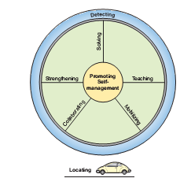
Nursing Practice During the Home Visit

Slide 13
Nursing Practice During the Home Visit
1. Locating the client and getting through the door
- find where the person lives: telephone, or map, GPS - when families are unstable , locating client address is difficult - first visit is challenging - health provider is a guest; respect, listen attentively -therapeutic relation: helping in solving family problem - start where they are and want - start with strength rather than wrong or weakness - family autonomy should be respected - be truthful regarding medical and nursing problems that need resolution -help client in medical problem decisions

Slide 14
Nursing Practice During the Home Visit
2. Hub (center) of the family care giving wheel:
promoting self management, fig 32.1
- home visit involve promoting independence
- teach and develop capacity of self care at home, acute illnesses
- no governmental program assure continuity of care for dependent patients.
- home nurse must work closely with agency social worker to care after the agency leaves

Slide 15
Nursing Practice During the Home Visit
3. Rim (border) of the home health care giving wheel: detecting
Detecting and assessment process are very important for nurses to understand client home context
Evaluate client needs based on their environment (Members, their interaction, cultural influences, environmental safety, .....
Home visit reveals many realities that never been captures or imagined by clinic or hospital settings

Slide 16
Nursing Practice During the Home Visit
4. Spokes of the home car giving wheel:
collaborating, mobilizing, strengthening, teaching , solving problems, fig 32.1
A- collaborating: nursing competencies with collaborating with multiple team members
B- mobilizing: resources in the community that can sustain patient care after discharge
C- strengthening: involve development of self management or family care giving, family members and their ability to provide medical care
D- teaching involve: client or family members for health problems management - helps the person to consider options to change - the solution through mutual process: client is responsible for their own health choices

Slide 17
E- Solving: flexibility and creativity are needed for solving health care problems and other life challenges
- outcomes of care can be achieved by adapting skills and resources available in home - working and caring at home necessitate a strong commitment . - consider personal limitation, the need for referral to another home health nurse rather than abusing and be angry with vulnerable population

Slide 18
Home health nursing Case management
Home health nurse is a Case manager for each client and responsible for coordination of other professionals and paraprofessionals involved in clients care.
“Almalath Agency” provides such services in Jordan for patients with terminal cancer

Slide 19
Duties of home health nurse case manager
Plans the visits frequency and duration based on the client’s conditions
She is the primary contact with the client’s physicians:
Collaborating on initial plan of care.
Reporting changes in client’s conditions
Secure changes in the plan of care

Slide 20
Duties of home health nurse case manager – Cont.
Supervise paraprofessional such as home health aids and observe the care provided at home.
Knowledge of reimbursement for services, the nurse must know who is going to pay for the services.
Conducts case conference among team members taking care of the client, to get the best possible outcomes from the services provided.

Slide 21
Selected Nursing challenges in the home
Infection control
Medication safety
Risk for falls
Technology at home
Nurse safety

Slide 22
Infection control
Work with the family to prevent infection for clients who are:
Debilitated (weakened)
Immunocompromised
Having invasive medical procedures at home that make them vulnerable to infection .
All people living at home will need instructions

Slide 23
Infection control- Cont.
Development of necessary creative solutions to deal with poor conditions at home.
e,.g.: No running water, no heating to boil equipment's or dispose contaminated ones.
Certain precautions are taken to prevent transmission of microorganisms such as wearing gloves, masks, and gowns and cleaning contaminated surfaces at home.

Slide 24
Medication safety
Clients taking multiple medications are at risk of multiple errors in self administration.
These include: Incorrect medication, dose(missed or doubled), time, interval, or route.
Errors might due to multiple prescriptions from several providers that caused contradictory side effects.
Medication boxes might be confusing
Distraction, Visual impairment, forgetfulness, cognitive impairment cause medication errors.

Slide 25
Medication safety- Cont.
Intentional noncompliance to medication could occur due to:
Knowledge deficit
Unacceptable side effects
No immediately obvious consequences when drug is stopped
Resistance to authority
Perception of personal weakness
Prohibitive cost

Slide 26
Medication safety- Nurse interventions
Investigate how the medication is taken
Clear repeated instructions
Updated the medication list
Charting or diagraming the schedule for medication taking
Assuring that the client or caregiver knows how to use the medication.
Mutually figure out solutions with clients.

Slide 27
Risk of falls
Occurs mostly among elderly
Risk factors include:
Hypotension
dizziness
neurologic musculoskeletal effect on gait and balance
impaired vision
medication effect on balance etc.

Slide 28
Risk of falls- nurse interventions
Client should be observed as they move through their home and carry out activities
Investigate factors that obstruct movement or threaten balance.
Inspect certain areas outside and inside home such as stairs, sidewalk, floor rugs and lighting
Check safety of the bathroom(grab bars, raised seats, safe bathtub etc.)
See Display 32.2 teaching to prevent falls

Slide 29
DISPLAY 32.3 TEACHING TO PREVENT FALLS
• Discuss fear of falling as normal and then urge preventive approaches.
• Identify environmental hazards and explain need for change.
• Encourage highest possible level of physical activity considering ability.
• Explain importance of reporting health status changes that increase risk of falls.
• Explain importance of recognizing sensory changes and correcting immediately.
• Teach regular blood pressure monitoring.
• Emphasize slowing down when moving and changing positions.
• Emphasize safe footwear and foot care.
• Explore strategy for responding to a fall, including calling for help and getting up.
• Demonstrate safe body mechanics to lift heavy objects and to move immobilized family members.

Slide 30
Technology at home
Home health nurses teach patients and family to manage a wide array of complex technologies.
Now, the IV needle has evolved into venous access devices and plastic IV fluid bags can be stacked in the refrigerator and hung from the arm of a lamp.
The household becomes home to dialysis, ventilator, and IV nutrition, Nurses teach clients and families to manage it all.

Slide 31
Technology at home- Cont.
Recent information technologies being adopted by home health care agencies significantly improve quality of client care. These include
Medical records available instantly on the nurse’s laptop.
Daily telemedicine monitoring of electrocardiogram, blood pressure, oxygen saturation, and other vital measures.

Slide 32
Nurse Safety
Every home health care agency should have a carefully developed program to assure the safety of personnel traveling to homes.
Display 32.4 lists practices for safe home visiting.

Slide 33
Safe Home Visits (DISPLAY 32.4)
• Carry a cellular phone.
• Be sure the agency knows your itinerary.
• Clarify directions before travel. Carry a map.
• Make joint visits or request security escort if safety is threatened. Refuse to visit when there is strong evidence of personal danger. Consult the police.
• Call to schedule the visit and do not go into the home without invitation.
• Dress simply without expensive jewelry. Do not carry large amounts of cash. Keep wallet or purse locked in the car.
• Wear an agency badge.
• Follow family directions about how to get by in their neighborhood and when to come in or leave their home. Patients and families usually will protect their nurse.

Slide 34
Overview Of The Hospice Movement
The hospice movement has developed to humanize the end-of-life experience and provide palliative care.
Palliative interventions relieve suffering without curing underlying disease.
The hospice movement has emphasized four major changes in end-of-life care:
Care should attend to body, mind, and spirit
Death must not be a taboo (unthinkable) topic
Medical technology should be used with discretion (by choice)
Clients have a right to truthful discussion and involvement in treatment decisions

Slide 35
Hospice Nursing Practice
The nurse role is central to hospice interdisciplinary team
Can function as Case manager; make frequent visits
Work in Collaboration with physicians
Rotation through 24/7 on-call to ensure continuous availability by telephone and visits for emergent problems
Hospice Nurse Competencies are similar to those seen by home health nurses, with addition of expertise in relieving physical and emotional suffering of terminally ill people and families

Slide 36
Roots of Hospice Nursing
Hospice caregiving can be illustrated as a tree strongly rooted in the process of nurses deliberately practicing self-care for themselves. (see Fig. 32.2)
Sustaining oneself
Connecting, speaking truth, and encouraging choice
Collaborating
Strengthening the family
Comforting
Spiritual practice and “letting go”

Slide 37
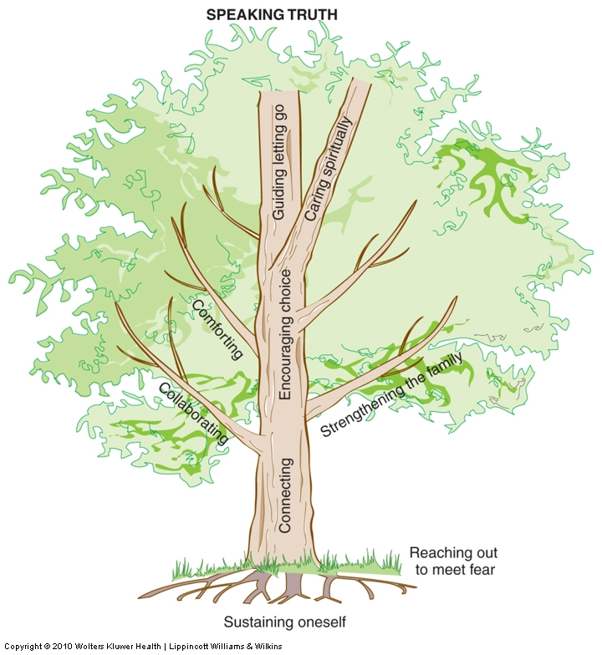

Slide 38
Sustaining oneself
Requires deliberate effort to maintain one’s own physical, emotional, and spiritual well-being
Knowing oneself, identifying sources of stress, learning how to care for self are important
Expert hospice nurses stay healthy by:
Maintaining a balance between giving and receiving
Letting go of predetermined agenda and idealistic hopes to achieve more than humanly possible
Being emotionally open and clear
Deliberately replenishing themselves to restore their energy
Challenges a hospice nurse might face:
Witnessing of suffering and death on a daily basis is stressful
Nurses empowerment/autonomy and resources are limited

Slide 39
The Trunk Reaching Upward: Connecting, speaking truth, and encouraging choice
Connecting :refers to the centrality of relationships in providing hospice care.
The hospice nurse seeks to understand the emotional and spiritual distress common to the end of life, the progressive experience of loss after loss.
Emphasize attentive listening to understand each individual's unique story.
Speaking Truth: encircling the entire top of the care giving tree.
Nurses openly seek to speak truthful about many issues painful to discuss.
Encouraging Choices: through informed decision making

Slide 40
Collaborating
Essential branch on the tree is Interdisciplinary Team Work
Hospice team members are constantly communicating, consulting each other, sharing information and work interdependently
The hospice nurse coordinate the plan of day-to-day care including physical and emotional and psychosocial comfort.
Interdisciplinary team members include:
Physician: responsible for medical care, liaison with client’s primary physician
Social worker
Spiritual counselor
Volunteers
The interdisciplinary team members are challenged to work together to find solutions for complex end-of –life’s emotional, spiritual, and physical components of suffering.

Slide 41
Strengthening the Family
Caregiver family members experience significant personal sufferings
They are vulnerable to physical, emotional illness
They often caught up with family issues, struggle with health-care system
Hospice nurse role is to:
strengthening family members’ abilities as caregivers
Teaching caregivers using creative and flexible teaching methods
Help family members communicate with each other
Gather them together
Act as an intermediary

Slide 42
Comforting
Hospice nurse should be expert in pain and symptoms management
Advanced knowledge is maintained through:
Experience
Continued education
Reading
Fundamentals of palliative care and essential component of pain relief: (see Displays 32.6, 32.7)

Slide 43
Spiritual Practice and “letting go”
Spiritual needs intensify as death draws near.
Hospice nurse recognizes the spiritual distress and practice spiritual caring interventions such as:
Respect for beliefs and spiritual practices
Fostering reconciliation when a problem with estrangement from family, friends, or faith tradition exist.
Guiding Letting Go: is a unique nursing practice that involves helping client to let go of former activities and hopes, including life itself. This requires:
Listening to intense emotions
Helping person and family find resolution
Participating in a vigil at the bedside of the dying person
Encouraging loved ones to say their final words of farewell

Slide 44
Ethical Challenges In Hospice Nursing
The hospice nurse confronts striking ethical challenges at the end of life.
We must strengthen our voice and ask, ‘Is what we are doing good for this person and family?
Hospice nurse needs to develop her own knowledge of nursing and medical ethics in order to question the ethical implications of interventions and advocate the client and family.

Slide 45
Ethical Challenges In Hospice Nursing
Issues of respect or disregard for client autonomy.
Issues of relief or disregard for client suffering
Avoidance of killing at the very end of life

