Slide 1
Inflammation, Tissue Repair, and Wound Healing
Ahmed Al-Dwairi, PhD

Slide 2
Inflammation is a response intended to:
eliminate the initial cause of cell injury,
remove the damaged tissue,
and generate new tissue.
It accomplishes this by:
destroying,
enzymatically digesting,
neutralizing the harmful agents such as toxins, foreign agents, or infectious organisms.
These processes will eventually heal the damaged tissue.
Inflammation is intimately interwoven with the repair processes that replace damaged tissue or fill in the residual defects with fibrous scar tissue.

Slide 3
Inflammation is the reaction of vascularized tissues to injury.
It is characterized by inflammatory mediators, such as
Complement proteins
Inflammatory mediators, eg, tumor necrosis factor alpha,
Vascular endothelial growth factor (VEGF),
Inflammatory cells as neutrophils.
Inflammatory conditions are commonly named by adding the suffix -itis to the affected organ or system.
Examples:
appendicitis refers to inflammation of the appendix, pericarditis to inflammation of the pericardium, and
neuritis to inflammation of a nerve.

Slide 4
Etiology
The causes of inflammation are many and varied:
Exogenous causes:
Physical agents
Mechanical agents: fractures, foreign bodies, sand, etc.
Thermal agents: burns, freezing
Chemical agents: toxic gases, acids, bases
Biological agents: bacteria, viruses, parasites
Endogenous causes:
Circulation disorders: thrombosis, infarction, hemorrhage
Enzymes activation – e.g. acute pancreatitis
Metabolic products deposals – uric acid, urea

Slide 5
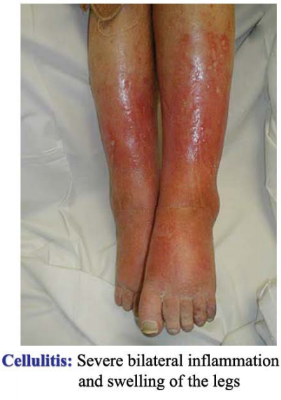
Cardinal signs of inflammation:
rubor (redness),
tumor (swelling),
calor (heat),
dolor (pain),
functio laesa
(loss of function)
Systemic or
constitutional
manifestations (e.g., fever)

Slide 6
Inflammation:
A protective response involving host cells,
blood vessels and proteins
– Goals are:
• eliminate the initial cause of cell injury
• Remove necrotic cells and tissue
• Initiate the process of repair
Also a potentially harmful process
– Components of inflammation that are capable of
destroying microbes can also injury bystander
normal tissue

Slide 7
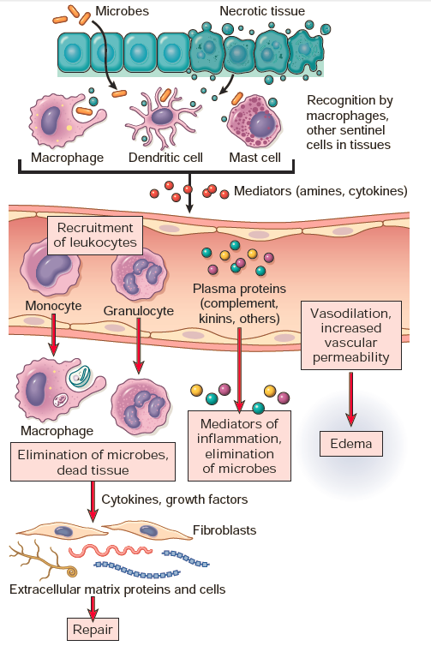
Sequence of events in an inflammatory reaction

Slide 8
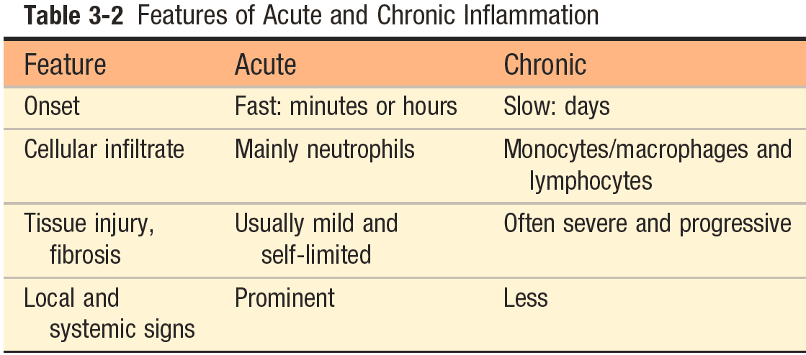

Slide 9
Acute Inflammation
Acute inflammation is the early (almost immediate) reaction of local tissues and their blood vessels to injury.
Acute inflammation can be triggered by a variety of stimuli such as:
infections,
immune reactions,
blunt and penetrating trauma,
physical or chemical agents (e.g., burns, frostbite, irradiation, caustic chemicals).

Slide 10
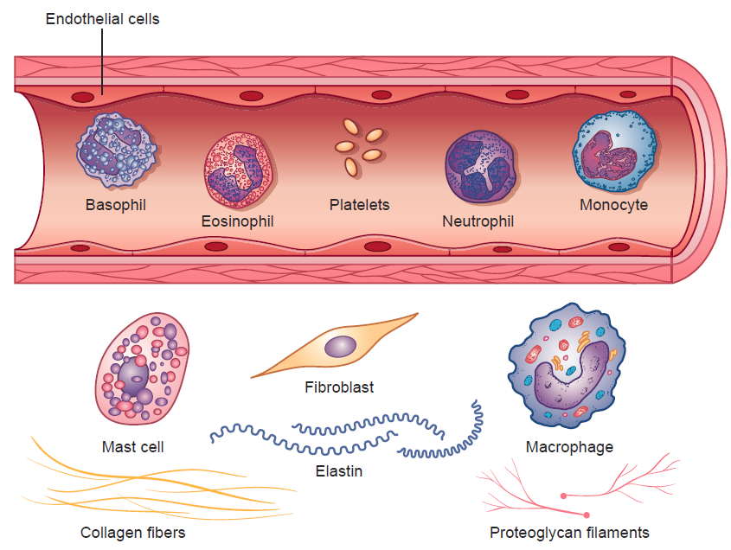
Cells of acute inflammation
PORTH’S PATHOPHYSIOLOGY Concepts of Altered Health States NINTH EDITION, 2014

Slide 11
Endothelial Cells:
Single cell–thick epithelial lining of blood vessels.
Produce antiplatelet and antithrombotic agents that maintain vessel patency and vasodilators and vasoconstrictors that regulate blood flow.
Key players in the inflammatory response
Provide a selective permeability barrier
Regulate leukocyte extravasation by expression of cell adhesion molecules and receptors.
Synthesis and release of inflammatory mediators,
Regulate immune cell proliferation
Participate in the repair process through the production of growth factors that stimulate angiogenesis (formation of new blood vessels)

Slide 12
Platelets or thrombocytes:
Cell fragments circulating in the blood involved in hemostasis.
Activated platelets release potent inflammatory mediators, thereby increase vascular permeability and alter the chemotactic, adhesive, and proteolytic properties of the endothelial cells.
The association between platelets and inflammatory diseases is highlighted by the number of inflammatory disease processes (e.g., atherosclerosis, migraine headache, SLE) shown to be associated with platelet activation.

Slide 13
Neutrophils:
Primary phagocyte that arrives early at the site of inflammation, usually within 90 minutes of injury.
Referred to as polymorphonuclear neutrophils (PMNs)
The cytoplasmic granules of the granulocytes contain enzymes and antibacterial material that are used in destroying engulfed microbes and dead tissue.
Able to generate oxygen (hydrogen peroxide) and nitrogen products (nitric oxide [NO])
The neutrophil count in the blood often increases greatly during an inflammatory process, especially with bacterial infections.

Slide 14
Phases of acute inflammation:
Vascular phase
Cellular phase

Slide 15
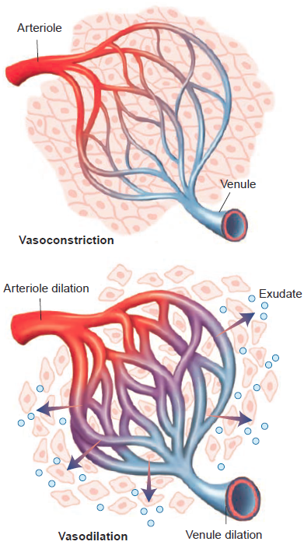
Vascular Phase
Characterized by changes in the small blood vessels at the site of injury.
It begins with momentary vasoconstriction followed rapidly by vasodilation.
Vasodilation involves the arterioles and venules with a resultant increase in capillary blood flow, causing heat and redness.
Increased vascular permeability →exudate into the extravascular spaces.
PORTH’S PATHOPHYSIOLOGY Concepts of Altered Health States NINTH EDITION, 2014

Slide 16
Vasodilation
Change in vessel flow
– Nitric oxide, histamine → vascular smooth muscle →
Vasodilation → increased blood flow (heat & redness)
– Stasis: slow blood flow, hyperviscosity
– Margination of circulating leukocytes & endothelial
activation
Followed by increased permeability of the vasculature
– Formation of an early transudate (protein-poor filtrate
of plasma) gives way to exudate (protein-rich filtrate)
into extracellular tissues

Slide 17
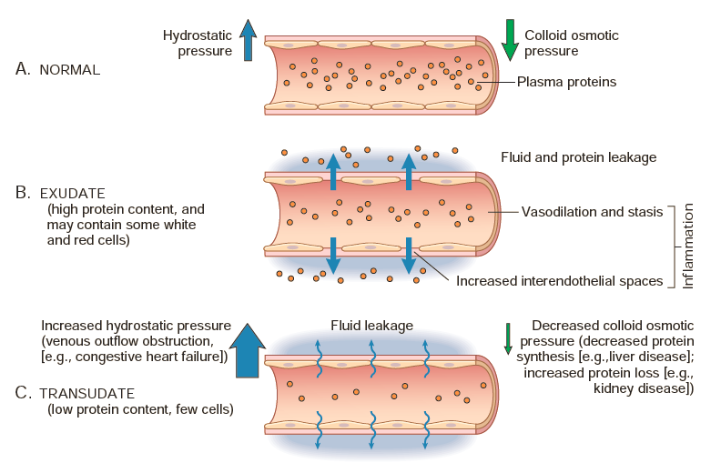

Slide 18
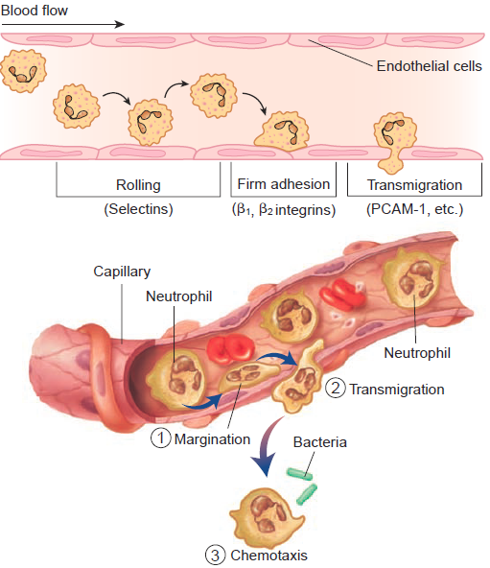
Cellular Phase
Leukocyte Margination, Adhesion, and
Transmigration
Delivery of leukocytes, mainly neutrophils, to the site of injury so they can perform their normal functions of host defense.
The delivery and activation of leukocytes can be divided into the following steps: adhesion and margination, transmigration, and chemotaxis.
Facilitated by complementary adhesion molecules (e.g., selectins, integrins) on the leukocyte and endothelial surfaces.

Slide 19
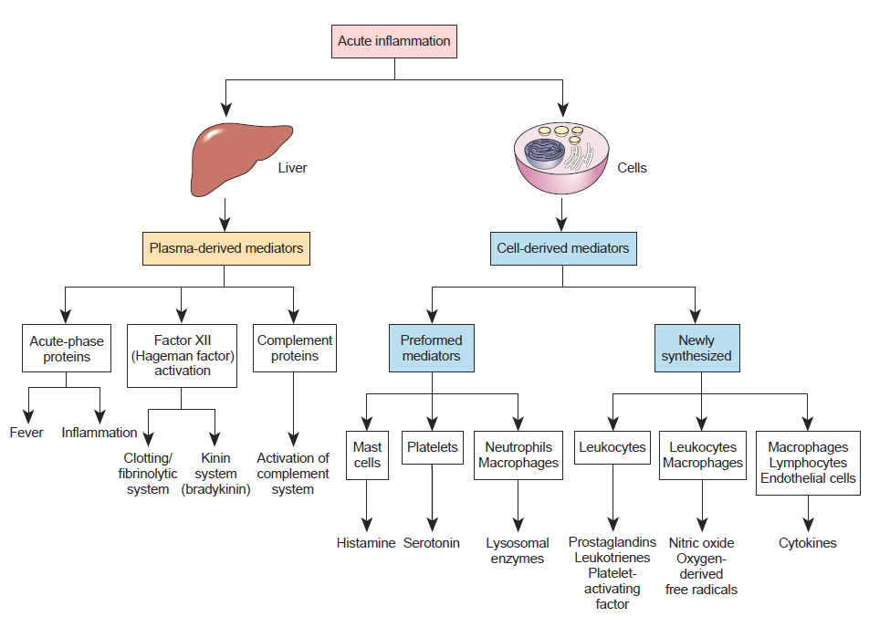
Inflammatory Mediators of Acute Inflammation

Slide 20
Histamine:
Present in preformed stores in cells
Released early during an acute inflammatory reaction.
Found in the connective tissues adjacent to blood vessels.
Found in circulating blood platelets, basophils and mast cell granules.
Released in response to a variety of stimuli, including trauma
Causes dilation of arterioles and increases the permeability of venules.
Antihistamine drugs (H1 receptor antagonists), which bind to the H1 receptors antagonize many of the effects of the immediate inflammatory response.

Slide 21
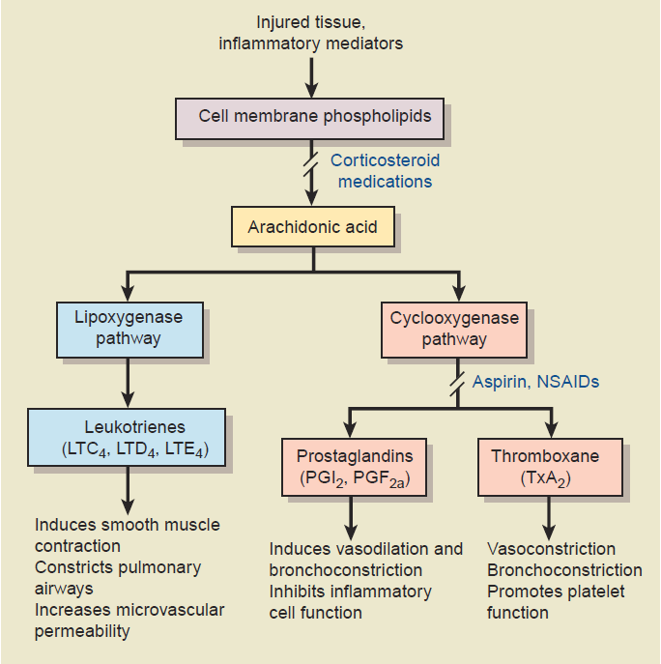
Arachidonic Acid Metabolites:

Slide 22
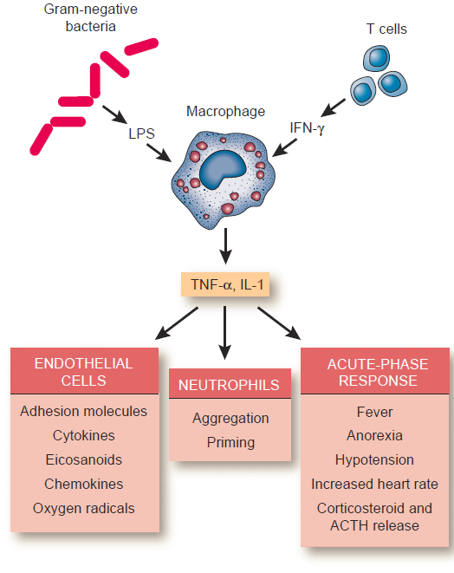
Cytokines and Chemokines:

Slide 23
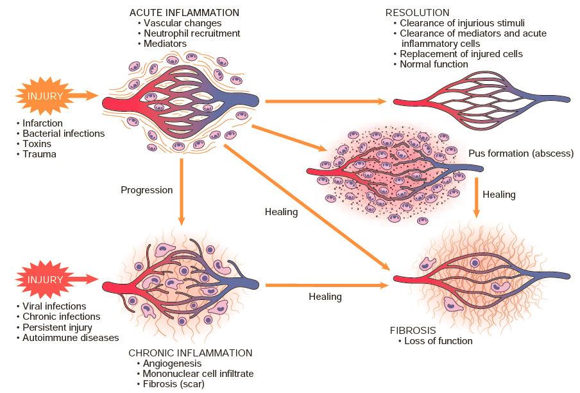
Outcomes of acute inflammation:
resolution, healing by fibrosis, or chronic inflammation

Slide 24
Chronic inflammation
Chronic inflammation = long duration
Develop as the result of a recurrent or progressive acute inflammatory process or from low-grade insults that fail to evoke an acute response.
Components:
Lymphocyte, plasma cell, macrophage (mononuclear cell) infiltration
Tissue destruction by inflammatory cells
Repair with fibrosis and angiogenesis (new vessel formation)

Slide 25
Causes of chronic inflammation
• Persistent injury or infection
– Ulcer, tuberculosis
• Prolonged exposure to a toxic agent
– Pulmonary silicosis (silica in the lung)
• Autoimmune disease—self-perpetuating
immune reaction that results in tissue damage
and inflammation
– Rheumatoid arthritis
– Systemic lupus erythematosus
– Multiple sclerosis

Slide 26
Cells of the chronic inflammatory response
Lymphocytes
Monocytes/ macrophages
Plasma cells
Chronic inflammation also involves the proliferation of fibroblasts instead of exudates.

Slide 27
Nonspecific Chronic Inflammation
Involves a diffuse accumulation of macrophages and lymphocytes at the site of injury.
Chemotaxis → macrophages infiltration → fibroblast proliferation→ → scar formation that in many cases replaces the normal connective tissue or the functional parenchymal tissues of the involved structures.
For example, scar tissue resulting from chronic inflammation of the bowel causes narrowing of the bowel lumen.

Slide 28
Granulomatous Inflammation
Distinctive form of chronic inflammation.
A granuloma typically is a small, 1- to 2-mm lesion in which there is a massing of macrophages surrounded by lymphocytes.
These modified macrophages resemble epithelial cells and sometimes are called epithelioid cells.
Granulomatous inflammation is associated with foreign bodies such as splinters, sutures, silica, and asbestos and with microorganisms that cause tuberculosis, syphilis, sarcoidosis, deep fungal infections, and brucellosis. These types of agents have one thing in common: they are poorly digested and usually are not easily controlled by other inflammatory mechanisms.

Slide 29
TREATMENT OF INFLAMMATION
Acetylsalicylic acid (Aspirin):
Decreases prostaglandin synthesis at the site of inflammation, reducing the inflammatory response.
Reduces pain (analgesic effect) and fever (antipyretic effect).
Not recommended for children with viral infections because the combination of ASA and a viral infection is believed to contribute to the development of Reye’s syndrome, a serious complication involving the brain and liver, which may be fatal.
May cause irritation and ulcers in the stomach. An enteric-coated tablet (the tablet coating does not dissolve until it reaches the small intestine) is available as are drugs to reduce acid secretion in the stomach to reduce this risk.
Anti-inflammatory drugs also interfere with blood clotting by reducing platelet adhesion.

Slide 30
Acetaminophen (Tylenol or Paracetamol)
Decreases fever and pain, but does not diminish the inflammatory response.

Slide 31
Nonsteroidal anti-inflammatory drugs (NSAIDs) such as ibuprofen (Advil or Motrin), piroxicam (Feldene), or diclofenac sodium (Arthrotec).
These drugs have anti-inflammatory, analgesic, and antipyretic activities.
They act by reducing production of prostaglandins.

Slide 32
Glucocorticoids
Examples include prednisone (oral), triamcinolone (topical), methylprednisolone (intra-articular—into joint), dexamethasone (intramuscular [IM] or intravenous [IV] injections),
Referred to as corticosteroids or steroidal anti-inflammatory drugs.
Synthetic chemicals that are related to the naturally occurring glucocorticoids (hydrocortisone), hormones produced by the adrenal cortex gland in the body

Slide 33
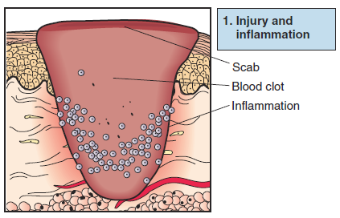
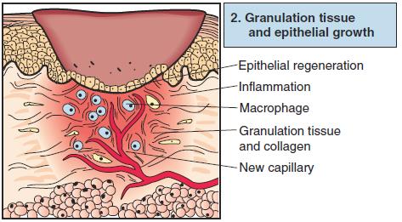
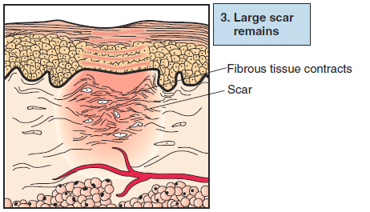
THE HEALING PROCESS

Slide 34
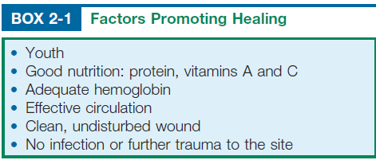
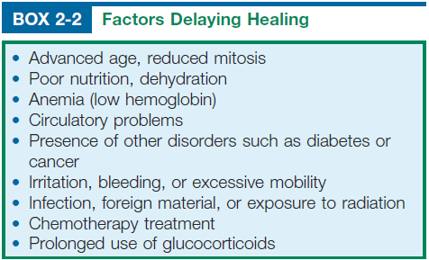

Slide 35
COMPLICATIONS OF HEALING BY SCAR FORMATION
Loss of Function
Contractures and Obstructions
Adhesions
Hypertrophic Scar Tissue
Ulceration

Slide 36
