Slide 1
Intraoperative Nursing management

Slide 2
THE Surgical Team
The Patient
The Nurse ( Circulating and Scrub)
The Surgeon
Anesthesiologist or anesthetist
Surgical technologists

Slide 3
Circulating Nurse Role
Known as circulator
Main Responsibility:
Verifying consent
Coordinating the team
Ensuring cleanliness, proper temperature, humidity, lighting, safe function of equipment, availability of supplies and material
Monitor aseptic practice
Implementing fire safety precaution
Monitor the pt and documents specific activity during operation
Responsible for ensuring that second verification (surgical procedure, site) take place and documented.
Send labeled specimen to the laboratory

Slide 4
The Scrub Nurse Role
Perform a surgical hand scrub.
Setting up the sterile table.
Preparing sutures, ligatures, and specific equipment
Assisting the surgeon & the surgical assistant during operation
Share the circulating nurse in counting all needles, sponges, and instruments
The obtained tissue sample during surgery labeled by the scrub nurse.

Slide 5
The Surgeon:
- Perform the surgical procedure
- Head the surgical team
The Registered Nurse First Assistant (RNFA):
Practice under the direct supervision of the surgeon
Handle tissue, providing exposure at the operative field, suturing, maintaining homeostasis

Slide 6
The Anesthesiologist
Is a doctor, that responsible for administering anesthetics.
Assess pt before surgery, select the anesthesia, administered it, intubated the pt,
Manage any technical problem related to the administration of anesthesthetic.
Supervise the pt condition throughout the surgery ( Bp, P, R, O2 saturation).

Slide 7
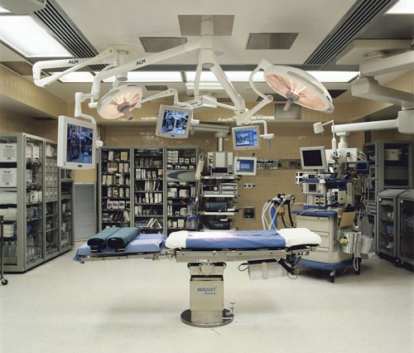

Slide 8
The Surgical environment
It have stark appearance and cool appearance
It lies behind double door, access limited to authorized personnel
Suited in a location that is centered to all supporting services
Has special air filtration devices to screen out contaminating particles, dust, and pollutants.
It have 3 zone:
1- unrestricted zone ( street clothes allowed)
2- semirestricted zone ( attire consist of scrub clothes and cap)
3- restricted zone (scrub clothes, shoe cover, caps and masks worn).

Slide 9
Principles of Surgical Asepsis
All materials in contact with the wound and within the sterile field must be sterile.
Gowns are sterile in the front from chest to the level of the sterile field, and sleeves from 2 inches above the elbow to the cuff.
Sterile drap are used to create a sterile field. Only the top of a draped table is considered sterile. During draping, the drape is held well above the area and is placed from front to back.
Items are dispensed by methods to preserve sterility.
Movements of the surgical team are from sterile to sterile and from unsterile to unsterile areas only.

Slide 10
Movement around the sterile field must not cause contamination of the field. At least a 1-foot distance from the sterile field must be maintained.
Whenever a sterile barrier is breached, the area is considered contaminated.
Every sterile field is constantly maintained and monitored. Items of doubtful sterility are considered unsterile.
Sterile fields are prepared as close as possible to time of use.
Administering of high level of O2 is not recommended to reduce surgical site infections

Slide 11
Environmental controls:
- It is the cleaning and maintenance of the OR room

Slide 12
Types of Anesthesia and Sedation
General
Regional
Moderate sedation
Monitored anesthesia care
local

Slide 13
General Anesthesia
Anesthesia: state of narcosis ( CNS depression done by medication), analgesia, relaxation, reflex loss produced by pharmacologic agents.
Consist of 4 stages each with specific C\M:
Stage I: beginning anesthesia:
C\M:
warmth and dizziness
Feeling of detachment
Ringing, rotating, buzzing in the ear but pt still conscious
May have a sense of inability to move extremities
Noise are exaggerated.

Slide 14
Stage II: Excitement:
Pupil dilated, but reactive
Pulse rate is rapid, respiratory may be irregular
Possible uncontrolled movement
Stage III: Surgical Anesthesia:
Pt unconscious, lies quietly on the table
Pupils are small, but contract to light
Respirations are regular, pulse rate normal
Skin is pink
Stage IV: Medullary Depression:
Respirations are shallow, pulse week and thready
Pupil dilated, no reaction to light
Cyanosis develops, if prompt intervention not conducted death rapidly follows.

Slide 15
Anesthetic agent used in GA are inhales or Administered IV
Inhaled Anesthetic agent include Volatile liquid and gases
Inhaled agent Administered with O2 or NO(Nitrous Oxide), gas anesthesia with O2

Slide 16
Volatile Liquid |  | Advantage |  | Disadvantage | Consideration
Halothane |  | Not explosive, Low incidence of post op N&V |  | Liver damage, hypotension | Monitor P,RR and BP post op
Gases
NO | Recovery rapid, useful with other agents |  | Poor relaxant, weak anesthetic, hypoxia |  | Monitor for chest pain, HTN and stroke
O2 | Increase O2 availability to tissue |  | High concentration hazardous |  | Increased fire risk

Slide 17
IV administration of GA
It could be barbiturate, benzodiazepines, opioid, etc
Advantage:
Onset of anesthesia pleasant, no buzzing, dizziness
Duration of action is brief, pt awaken with little N or V
Disadvantage:
Respiratory depression
Need skilful personnel
Sneezing, coughing, laryngeospasm
Note: review table 19-2 p 451& 452.

Slide 18
Regional Anesthesia
Form of local anesthesia
Injected around nerves
E.g Epidural, spinal, local conduction block.
Epidural Anesthesia:
Injection of local anesthetic agents into epidural space that surrounds the dura matter of the spinal cord
Block (sensory, motor and autonomic function)
Differ from spinal anesthesia by site of injection & amount used
Advantage:
Absence of headache
Disadvantage:
- It need highly technique in administration.

Slide 19
Spinal Anesthesia:
Introduction of anesthetics in to subarchnoid space at the lumber level (L4&L5)
Produce anesthesia to lower extremities, perineum, lower Abd
Disadvantage: N,V, pain, sever headache

Slide 21
Local Conduction Block: e.g
Brachial plexus block : the arm
Paravertebral: for nerve supply the chest, Abd wall, and extremities
Transsacral : perineum, and lower Abd.
Note: Review table 19-3 p 514

Slide 22
Moderate Sedation
Is a form of IV administration of sedation or analgesic to reduce anxiety and control pain during DX procedure
It’s goal to depress pt LOC to a moderate level, to perform diagnostic or surgical procedure

Slide 23
Monitored Anesthesia care
Used for healthy pt undergoing minor surgical procedure, and for critically ill pt who unable to tolerate anesthesia.

Slide 24
Local anesthesia
Insertion of anesthesia into the tissue at planned incision site.
Advantage:
simple, economical
Minimal equipment is needed
Post op recovery is brief
Undesirable effect of GA avoided
Ideal for short and superficial surgical procedure.
Disadvantage:
- High level of anxiety

Slide 25
Potential Adverse Effects of Surgery and Anesthesia
Allergic reactions and drug toxicity or reactions
Cardiac Dysrhythmias
CNS changes and oversedation or undersedation
Trauma: laryngeal, oral, nerve, and skin, including burns
Hypotension
Thrombosis
Refer to Chart 19-1 p 504

Slide 26
Intraoperative Complications
Nausea and vomiting
Anaphylaxis
Hypoxia and respiratory complications
Hypothermia (core body T≤ 36.6ºc)

Slide 27
Malignant hyperthermia (is a rare inherited muscle disorder induced by anesthetic agent), it manifest 10 – 20 min after induction of anesthesia, it can occur at the first 24hr’s.
Pathophysiology: Hypermetabolism for skeletal muscle cell, lead to altered Ca function at cellular level, which cause clinical symptoms of Hypermetabolism, that increase muscle rigidity and cause hyperthermia and further damage to CNS.
C\M: tachycardia, hypotension, oliguria, increase in Temp

Slide 28
Nsg Process for pt during surgery.
DX:
Anxiety R\T expressed concerns due to surgery or OR environment.
Risk for perioperative positioning injury R\T positioning in OR
Risk for injury R\T anesthesia and surgery
Disturbed sensory perception R\T GA or sedation

Slide 29
Nsg Goal
Reducing anxiety
Preventing positioning injuries
Maintaining patient safety
Avoiding complications
Maintaining the patient's dignity

Slide 30
Nsg Intervention
Reducing anxiety:
Introducing self
Address pt by name
Verifying details
Providing explanation
Rational: to help pt feel secure
Tell the pt who well be in the OR, how long the procedure may last
Rational: help pt gain sense of control.

Slide 31
Preventing positioning injuries:
Place pt in comfortable position
Expose the operative field adequately
Not obstruct vascular supply by prevent undue pressure
Respiratory should not be impeded by pressure
Maintain pt safety
Mild restrain may be needed during excitement stage.
Place arm board under the pt cannulated hand to facilitate IV infusion of fluid.

Slide 32
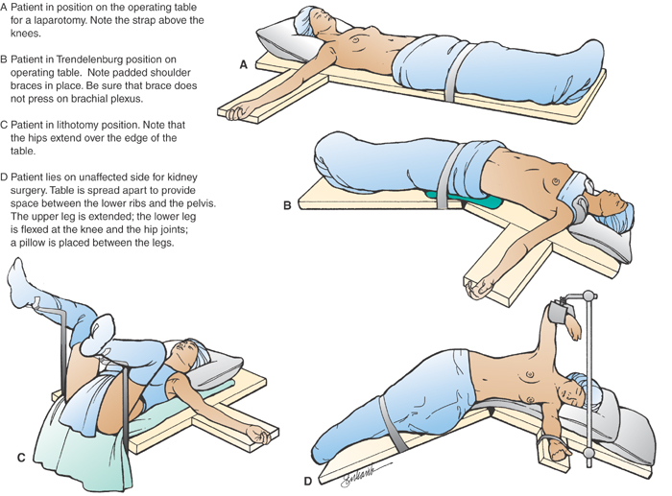

Slide 33
Maintaining patient safety:
Patient identification
Correct informed consent
Verification of records of health history and exam
Results of diagnostic tests
Allergies (include latex allergy)
Monitoring and modifying the physical environment
Safety measures such as grounding of equipment, restraints, and not leaving a sedated patient
Verification and accessibility of blood

Slide 34
Avoiding complications:
For N&V: place pt head at side, lowered the head, provide kidney basin, suction vomitus.
For anaphylaxis: assess pt V\S, administer medication
Hypoxia: monitor pt oxygenation status, apply o2 as needed, monitor pulse oximeter reading
Hypothermia: warm IV fluid, remove wet gown and replace by dry one, warm pt gradually
Malignant hyperthermia: give pt o2, assess pt at risk

