Slide 1
Introduction to Biostatistics
Lecture 1

Slide 2
Biostatistics
Definition:
The application of statistics to biological sciences
Is the science which deals with the development and application of the most appropriate methods for the:
Collection of data.
Presentation of the collected data.
Analysis and interpretation of the results.
Making decisions on the basis of such analysis

Slide 3
Why Study Biostatistics?
Biostatistics is essential for:
Medical (social) research
Understanding medical literature
Differentiating between facts and fancy in daily life

Slide 4
Definitions
Population:
A set of measurements of interest to the researcher
Example:
Sample:
A subset of the population is called sample. A sample usually selected to be representative to the population

Slide 5
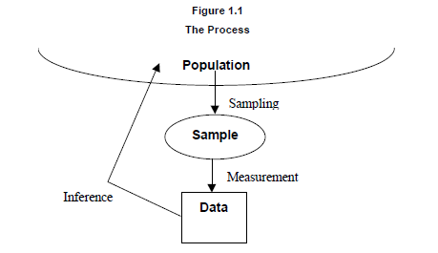

Slide 6
Population vs Sample
The population includes all objects of interest whereas the sample is only a portion of the population.
There are several reasons why we don't work with populations; They are usually large, and it is often impossible to get data for every object we're studying.

Slide 7
Definitions 2
Descriptive statistics deal with the enumeration, organization, and graphical representation of data.
Number and % of sample
How many are men, women, their age groups … etc.
Inferential statistics are concerned with reading conclusions from incomplete information (SAMPLE).
Make inference about the population from a sample
Estimation (% of DM among Jordanians)
Testing Hypothesis ( is drug A more effective in reducing blood pressure than drug B).

Slide 8
Qualitative and Quantitative and Variables
Example of Qualitative variables:
Occupation:
Student
MD
Engineer
Example of Quantitative variables:
Weight
Height
Age

Slide 9
Qualitative and Quantitative and Variables 2
Quantitative variables are variables measured on a numeric scale.
Qualitative variables are variables with
No natural sense of ordering,
Measured on a nominal scale,
Qualitative variables can be coded to appear numeric but their numbers are meaningless, as in male=1, female=2
Example: hair color (Black, Brown, Gray, Red, Yellow) is a qualitative variable,

Slide 10
Variable Types
Categorical Variables (qualitative): Sex, Marital Status, income category
Continuous Variables (quantitative) : Age, Income, Weight, Height, time
Discrete Variables (quantitative) : Number of Students, Number of Children in the House
Binary or Dichotomous Variables: yes or no type questions . Do you have kids? Yes, No

Slide 11
Discrete vs Continuous
Discrete variables are usually obtained by counting. There are a finite or countable number of choices available with discrete data. You can't have 2.63 people in the room.
Continuous variables are usually obtained by measuring: Length, weight, and time.

Slide 12
Variables: review
Qualitative Variables: Variables which assume non-numerical values.
Quantitative Variables: Variables which assume numerical values.
Discrete Variables: Variables which assume a finite or countable number of possible values. Usually obtained by counting.
Continuous Variables: Variables which assume an infinite number of possible values. Usually obtained by measurement.

Slide 13
Scale
Nominal Scale
Ordinal Scale
Interval Scale
Interval Ratio Scale

Slide 14
Scales
Nominal Scale: Data does not represent an amount or quantity (Sex, Marital Status)
Ordinal Scale: Data has an order (Level of Education)
Interval Scale: Data is measured on an interval scale having equal units but an arbitrary zero (Temperature in Fahrenheit)

Slide 15
Scales (2)
There are four levels of measurement: Nominal, Ordinal, Interval, and Ratio. These go from lowest level to highest level. Each additional level adds something the previous level didn't have.
Nominal is the lowest level. Only names are meaningful here.
Ordinal adds an order to the names.
Interval adds meaningful differences
Ratio adds a zero so that ratios are meaningful

Slide 16
Methods of Data Presentation
1- Numerical presentation
2- Graphical presentation
3- Mathematical presentation

Slide 17
Organizing Data
Frequency Data
Frequency Histogram
Relative Frequency Histogram
Frequency Polygon
Bar Chart
Pie Chart

Slide 18
1- Numerical Presentation
Tabular presentation (simple – complex)
Simple frequency distribution Table
Name of variable (Units of variable) | Frequency (number) | %
- - Categories -
Total

Slide 19
Table (1): Distribution of patients by blood type
Blood group | Frequency | %
A B AB O | 12 18 5 15 | 24% 36% 10% 30%
Total | 50 | 100

Slide 20
Table (II): Distribution of patients by age groups
Age Group (years) | Frequency | %
20-30 30-40 40-50 50+ | 12 18 5 15 | 24 36 10 30
Total | 50 | 100

Slide 21
Table (III): Distribution of lung cancer patients by smoking status
Complex frequency distribution Table
Smoking | Lung cancer |  |  |  | Total
 | Yes |  | No
 | No. | % | No. | % | No. | %
Smoker | 15 | 75% | 8 | 20% | 23 | 38.33
Non smoker | 5 | 25% | 32 | 80% | 37 | 61.67
Total | 20 | 100% | 40 | 100% | 60 | 100%

Slide 22
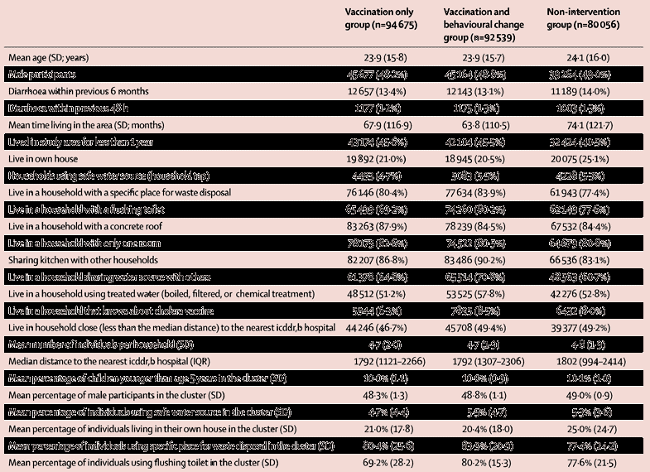
Notes:
.

Slide 23
Let’s look at a study
question: Is eating breakfast good for you?
Does skipping breakfast increase weight gain?

Slide 24
Betts et al, The causal role of breakfast in energy balance and health: a randomized controlled trial in lean adults, Am J Clin Nutr August 2014 vol. 100 no. 2 539-547

Slide 25
Popular beliefs that breakfast is the most important meal of the day are grounded in cross-sectional observations that link breakfast to health, the causal nature of which remains to be explored under real-life conditions.
Objective: The aim was to conduct a randomized controlled trial examining causal links between breakfast habits and all components of energy balance in free-living humans.

Slide 26
TABLE 1
Baseline demographic and anthropometric characteristics and changes at follow-up¹

