Slide 1
Cholinergic Antagonists
Parasympatholytic drugs

Slide 2
Cholinergic Antagonists
we mean drugs that inhibit the function of the cholinergic drugs including acetyl choline.
You should remember that acetylcholine (Ach) acts on two types of receptors mainly:
muscarinic and nicotinic

Slide 3
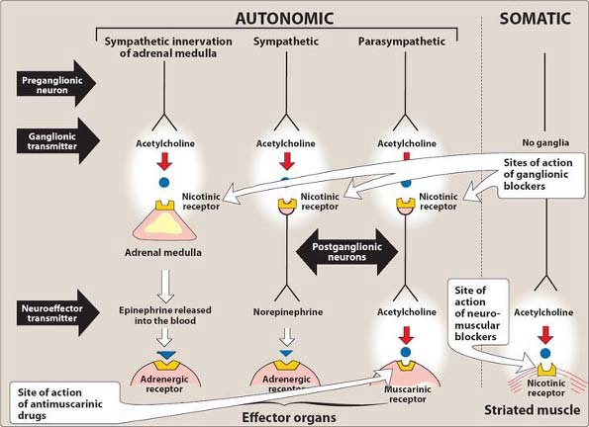

Slide 4
3 types of cholinergic antagonist which is:
1. Anti-muscarinic agents.
Ex: Atropine, Scopolamine, Ipratropium
(All are Competitive antagonist)
2. Ganglion blockers.
We don’t use it these days because of the adverse effect and unspecified actions.
Ex: Hexamethonium
3. Neuromuscular blockers. (NMJ blockers)
These agent are used as adjuvants in anesthesia during surgery.
Ex: Tubocurarine , Suxamethonium.

Slide 5
1- Antimuscarinic Agents
All are competitive antagonists for the binding of ACH to the M receptor.
Example:
Atropine (prototype).
Scopolamine (hyoscine).
Ipratropium.

Slide 6
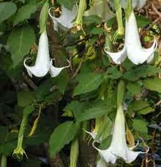
1- Atropine (a cholinergic antagonist)
Atropine acts both centrally and peripherally.
It Blocks M1, M2, M3 .
Antidote for cholinergic agonists ???

Slide 7
 | Actions | Uses | S.E
Eye | 1-Mydriasis 2- Cycloplegia. 3-Dry eye (sandy eye). | Useful for eye exams ,topical atropine | Constipation . Blurred vision. Urinary retention. Dry eye. Dry mouth. Hot, flushed Dry skin?? contra. in elderly with prostatic enlargement???? In patients with glaucoma, intraocular pressure may rise dangerously. THAT’S WHY ITS Contraindicated
Smooth muscle | Relax (bronchial ,biliary, intestinal ,renal and urinary tract smooth muscle) Reduction tone and peristalsis. | Urinary frequency, urgency ?? Antispasmodic ?? SC,IV Relief of intestinal ,biliary or renal colic. Bronchial spasm.
Cardiovascular | Increase HR (tachycardia)?? | Sinus bradycardia
Exocrine glands | Reduced all secretion (gastric acid, sweating ,salivary bronchial ,lacrimal). | Anti-secretory: effects (preoperative)

Slide 8
CNS | At low dose : CNS depression At large dose : Excitement, restlessness ,agitation ,hallucination ,collapse of the circulatory and respiratory systems lead to coma and death.

Slide 9
2- Scopolamine (hyoscine)
3- Ipratropium
Peripheral effects similar to atropine, and a longer duration of action in comparison to those of atropine.
But centrally different ??
More sedatives, amnesiac effect.
Therapeutic uses:
It is an important adjunct drug in anesthetic .
It is effective anti motion sickness drug (effective prophylactically).
Antispasmodic.
Ipratropium it's just an inhaler used in case of bronchial asthma.
Ipratropium is also beneficial in the management of chronic obstructive pulmonary disease.(COPD)

Slide 10
3- Neuromuscular Blockers
This drugs occupied the nicotinic receptors at the NMJ and prevents Ach from activating the receptors ,so the skeletal muscles will become relaxed.
Clinically ,NM block is used only as an adjuvant to anesthesia .

Slide 11
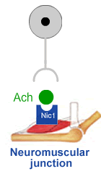

Slide 12
3- Neuromuscular Blockers Either work as antagonists or agonists
1- Non-depolarizing
(competitive antagonist)
2- Depolarizing
(agonist)
‘’Curare’’
Eg: Tubocurarine
This drug acts by blocking ACH receptor (nicotinic receptor) ,so the skeletal muscles will become relaxed.
Does not cross BBB
Used during surgery to relax muscles
Increases safety of anesthetics
Given IV
Eg: succinylcholine (Suxamethonium)
Activates receptor
has a rapid onset & short duration of action & mainly used for rapid endotracheal intubation at the beginning of anesthesia.

Slide 13
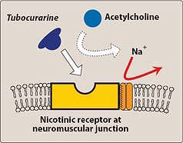
Na⁺

Slide 15
How do we to overcome the effect of non-depolarizing agent or recovery from non-depolarizing agent, what is the drug of choice (DOC)????
Or how we can increase the concentration of ACh???

Slide 16
Sympathetic nervous system

Slide 17
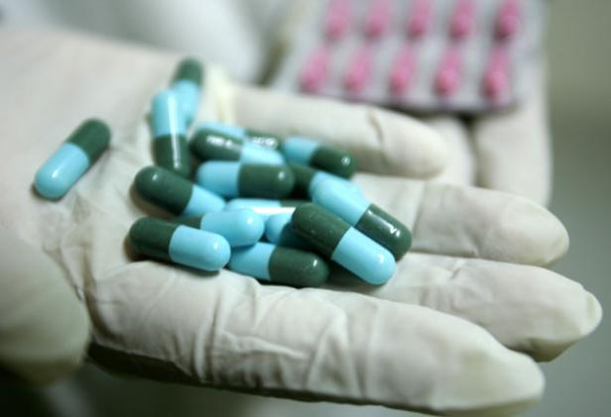
Adrenergic and Anti-adrenergic Drugs

Slide 18
The adrenergic drugs :affect receptors that are stimulated by norepinephrine or epinephrine.
sympathomimetic: adrenergic drugs act directly on the adrenergic receptor (adrenoceptor) by activating it.
Sympatholytics( sympathoplegic) : drugs that block the action of the neurotransmitters at the receptors.

Slide 19
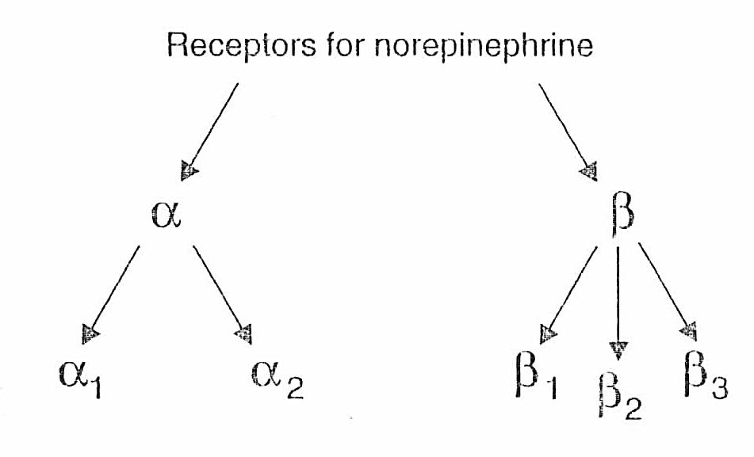
Adrenergic receptors (adrenoceptors)
Adrenergic neurons release NE as the primary NT.
It released in the synaptic space to stimulate the receptors .
The receptors are two types.
Notes:
Alpha 1 receptors are in blood vessels, kidney, liver, pregnant uterus, male sexual organs, intestinal smooth muscle. Causes vasoconstriction, decreased renin secretion , uterine contraction
Alpha 2—Inhibits release of norepinephrine. affects vascular smooth muscle, inhibits insulin secretion, platelet aggregation
B1—affects heart and kidneys
B2—affects lundgs, liver, blood vessel vasodilation, decreased motility and tone
Dopamine—blood vessels of kidneys, heart, viscera; brain

Slide 20
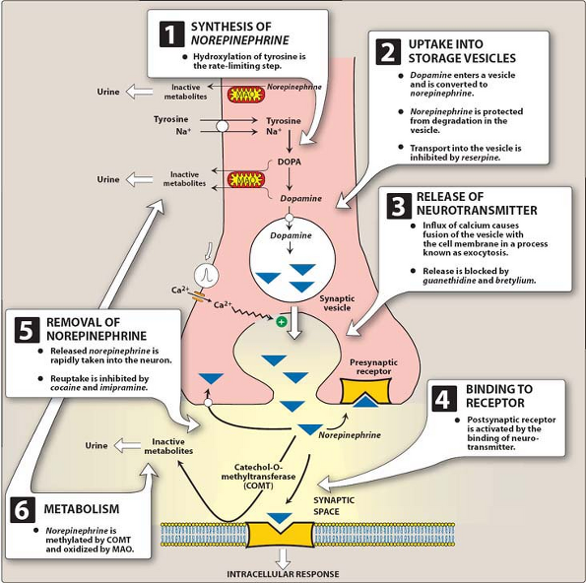

Slide 21
 | α1 Receptors | B1 Receptors | B2 Receptors
Eye | Mydriasis | ----- | ------
Blood vessels | vasoconstriction increases in blood pressure. | ----- | Vasodilation & slightly decrease peripheral resistance .
Bladder | contraction sphincter muscle (urinary retention) | ----- | Relaxation of detrusor muscle
lung | ----- | ----- | bronchodilator
Salivary gland | Increased secretion??? | ----- | -----
Kidneys | Decreased renin secretion | Increased renin secretion | -----

Slide 22
 | α1 Receptors | B1 Receptors | B2 Receptors
Uterus | Contraction |  | Relaxation (inhibition of uterine contractions)
Intestinal smooth muscle | Relax |  | Decreased motility & tone Relax
Liver |  |  | Increase release of glucagon → inc glc
Heart |  | Tachycardia &↑ C.O Increased force of contraction (positive inotropic effect) Increased heart rate (positive chronotropic effect).

Slide 23
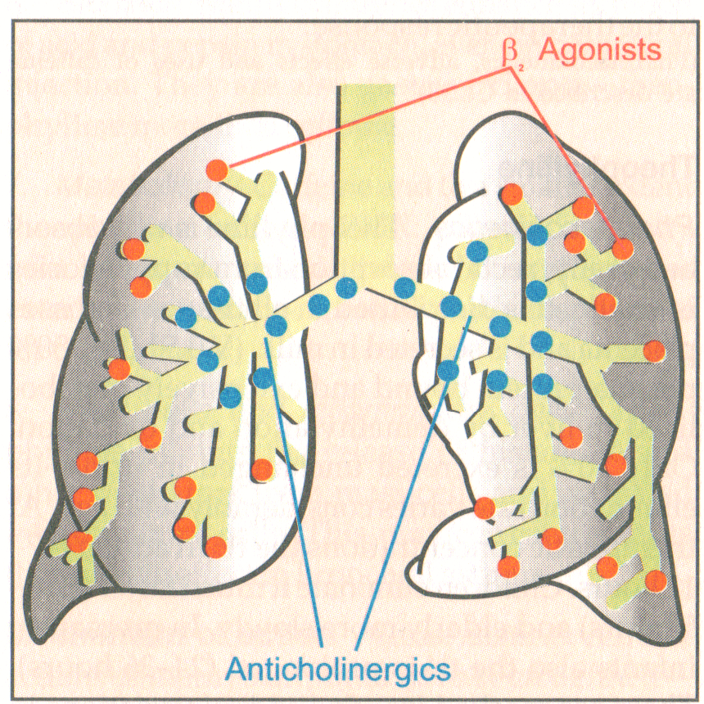
Asthma management
Thank You

Slide 24
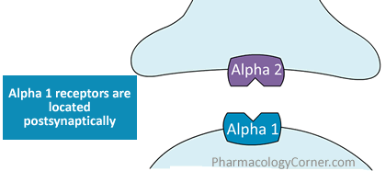
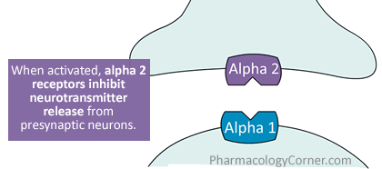
α2 Receptors | presynaptic nerve endings . β cell of the pancreas | feedback inhibition Inhibit insulin release

Slide 25
Adrenergic Agonists
1- Direct Acting Adrenergic Agonists
Ex.
Epinephrine*
Norepinephrine*
Dobutamine
Dopamine*
Phenylephrine
Clonidine.
* Catecholamine
2- Indirect-Acting Adrenergic Agonists
Ex. Amphetamine.
3- Mixed (direct & indirect)
Ex.pseudophedrine

Slide 26
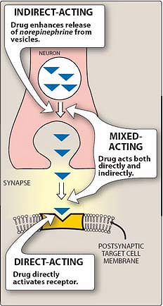

Slide 27
Catecholamines
Epinephrine (adrenaline).
Norepinephrine (noradrenaline).
Dopamine .
occur naturally in the body as neurotransmitters
Tyrosine→dopa→dopamine →NE→EP

Slide 28
Catecholamines
These compounds share the following properties:
Rapid inactivation by MAO & COMT enzymes.
Poor penetration to CNS (polar).
Orally inactive.
Brief duration of action.

Slide 29
Non-catecholamines
Ex. phenylephrine, ephedrine, and amphetamine.
1- longer half-lives, because they are not inactivated by COMT or MAO.
2- lipid solubility (greater access to the CNS)

Slide 30
 | Epinephrine (EP)
 | interacts with 4 receptors α1, α2 ,β 1 ,β2
Actions | ↑ HR & force of contraction → ↑C.O (B1) ↑ systolic BP & little change of diastolic BP (α1) Bronchodilator (B2) ↑ glucose level (Hyperglycemia) (B2 & α2)
uses | Anaphylactic shock (IM) → ( DOC ) Bronchospasm (SC) Stimulates the heart in cardiac arrest (IV) Can be used to prolong local anesthetic action. To produce vasoconstriction at the site of injection & there for we are prolong the duration of action of LA at the site of injection.

Slide 31
Selective Adrenergic Agonists
Selective α1 agonists | E.g. Phenylephrine | used locally as nasal decongestant.
Selective α₂ agonists | E.g. Clonidine | used for treatment of hypertension. Suddenly withdrawn cause hypertensive crisis (rebound HT)
Selective β1 agonists | E.g. Dobutamine | used to ↑ C.O & H.R . Indicated in acute heart failure. & cardiogenic shock . Because it stimulate heart quickly (B1 )
Selective β2 agonists | E.g. Salbutamol | used in asthma. Premature labor

Slide 32
Non-selective adrenergic agonist
Dopamine
Stimulate β1, α1 (H.Dose) & Dopaminergic receptor.
↑ Heart rate & force of contraction
it dilates renal arterioles → ↑ blood flow to the kidneys(to prevent renal blood shut down)
Treatment of cardiogenic shock (continuous infusion). (DOC) & acute heart failure.

Slide 33
Therapeutic uses
Dopamine is the drug of choice for shock and is given by continuous infusion.
It raises the blood pressure by stimulating the β1 receptors on the heart to increase cardiac output, it enhances perfusion to the kidney and splanchnic areas.

Slide 34
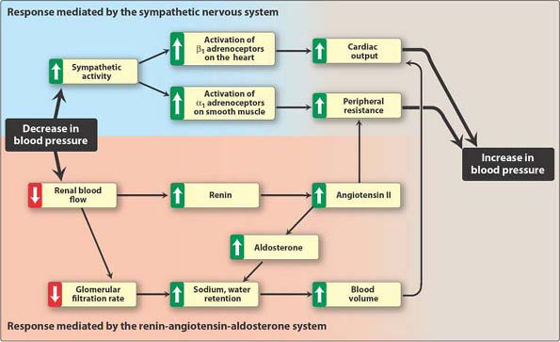

Slide 35
CLINICAL USES OF ADRENOCEPTORS AGONIST
Cardiac arrest:
Anaphylaxis SHOCK :
With local anesthetics:
Cardiogenic shock:
Asthma:
Premature labor:
Nasal decongestant(ND):
To lower BP :

Slide 36
CLINICAL USES OF ADRENOCEPTORS AGONIST
Cardiac arrest: adrenaline or epinephrine
Anaphylaxis: adrenaline or epinephrine
With local anesthetics: adrenaline or epinephrine to prolong duration.
Cardiogenic shock: Dobutamine (β1 agonist) ,Dopamine.
Asthma: salbutamol (β2 agonist).
Premature labor: salbutamol

Slide 37
Nasal decongestant(ND): phenylephrine (α1 agonist) & pseudoephedrine
To lower BP : clonidine (α2 agonist)

Slide 38
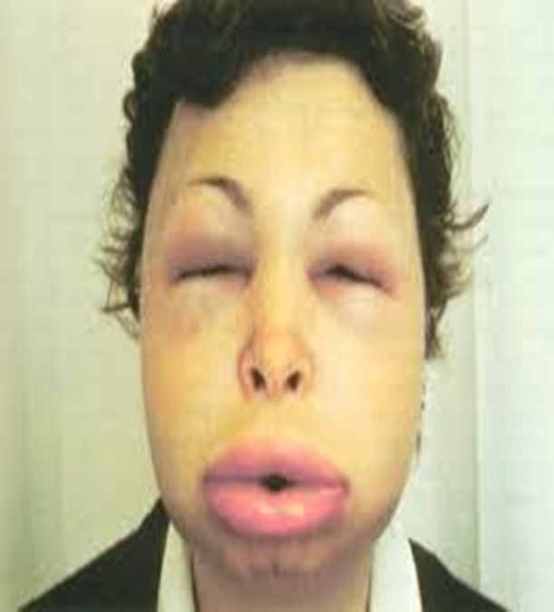
Anaphylactic Shock Treatment
1- Maintain air way.
2- Adrenaline (IM).
3- Antihistamine.
4- Corticosteroids.

Slide 39
Drugs | Indication
Amphetamine | Narcolepsy Hyperactivity in children (sedative effect)
Pseudoephedrine | Nasal decongestant.

Slide 40
Thank you

