Slide 1
Adrenergic Antagonists

Slide 2
Adrenergic Antagonists
These drugs are also known as sympatholytic agents :
Beta-adrenergic blocking drugs.
End with suffix ~olol
Alpha-adrenergic blocking drugs.
End with Suffix ~ sin

Slide 3
β adrenoceptor antagonists
Blocks β1, β2 (non selective)
Ex, Propranolol
Action | Indication
heart: Decreased heart rate Decreased force of contraction Decreased CO Reduced heart excitability. Kidneys: Decreased renin secretion from kidneys → B.P ????? Respiratory : bronchospasm. | 1. Hypertension ( ↓ CO, ↓ renin release) 2. Migraine 3. Angina pectoris & cardiac arrhythmias. 4. palpitation and tremor. 5. Hyperthyroidism. (Thyrotoxicosis)

Slide 4
Beta-adrenergic blockers
Side effect
Contraindications & caution
Bronchoconstriction
Hypotension, Bradycardia.
↓ blood flow to the extremities.(cold extremities)
Nightmares , vivid dreams (propranolol)
Masking symptoms of hypoglycemia.HOW??
Sexual dysfunction in males
Fatigue (DUE TO reduce CO)
1. Heart block
2. Heart failure (not all drugs)
slow disease progression
3. Diabetes (caution)
4. Asthma

Slide 5
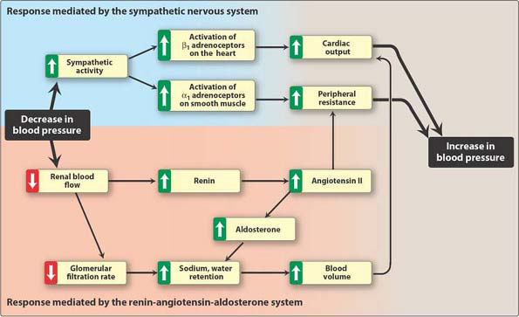

Slide 6
Blocks β1, β2 (non selective)
Ex.
Timolol :Eye drops
Eye : Decreased production of aqueous humor in eye.
Uses: Glaucoma.

Slide 7
Selective β- antagonists
block β- 1 (called cardioselective beta blockers)
Atenolol
Indication : For hypertensive patients with impaired pulmonary function . are useful in diabetic hypertensive patients who are receiving insulin or oral hypoglycemic agents.??

Slide 8
Special conditions—beta blockers
Suddenly withdrawal B-blocker Can result in severe hypertension.
This is due to up regulation of B receptors.
Thus the dose of these drugs must be tapered over 2 to 3 weeks.

Slide 9
Why caution ??
B-blockers
Symptoms of hypoglycemia(tremor ,sweating, palpitation) mediated by sympathetic discharge .
This symptoms will be masked except sweating ????
Also, B-blockers decrease glucose level.

Slide 10
α adrenoceptor antagonists | Non selective (α1 , α2) | Selective α1
Example | Phentolamine. | Prazocin,Tamsulosin
Actions | Vasodilation cause ↓ BP (fall in arterial pressure) | Cause vasodilation(dilate arterioles), ↓ BP. Relax smooth muscle (bladder neck & prostate capsule )
Uses | Pheocromocytoma (to control BP) | Prazocin: hypertension. (Tamsulosin):- -Urinary retention in BPH (benign prostatic hyperplasia) -Reduce hypertrophy in prostate.
Side effect | Postural hypotension??? Reflex Tachycardia ,why??? | postural hypotension; reflex tachycardia (less than non-selective)→ 1st dose syncope

Slide 11
Block α2 receptor → tends to increase NE release → increase HR & C.O .
While ,stimulate α2 receptor → inhibits more NE release→ decrease HR & C.O.

Slide 12
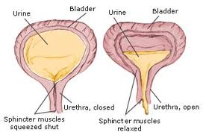

Slide 13
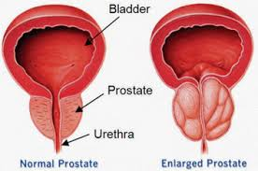
Alpha 1 receptor

Slide 14
The sympathetic NS is more active in maintain BP when a person is standing than when lying down.
This why alpha blockade results in a greater decrease in BP in the standing position .
This effect is called postural hypotension.

Slide 15
Combination selectivity
Labetalol and carvedilol
Antagonist of both α1 & ß adrenoceptors
block alpha 1 receptors to cause vasodilation and beta 1 and beta 2 receptors which affect heart and lungs
Carvedilol → used in hypertension crisis and Heart Failure .
Labetalol → used in HT in pregnancy ALTERNATIVE to Methyldopa.

Slide 16
HERAT FAILURE
B-blockers :
Carvedilol (non-selective β and α), metoprolol (β1 selective), Bisoprolol
Decrease HR .
Inhibit the release of renin.
Decrease remodeling, hypertrophy and cell death.

Slide 17
Q1) Reflex tachycardia is most likely to occur after the administration of ????
1- ????
2- ????
Q2) Rebound hypertension is most likely to occur after the administration of ????
1- ????
2- ????

Slide 18
Q3) The symptoms of excessive stimulation of muscarinic receptors lead to :
a) Constipation .
b) Decreased salivation, Excessive bronchial secretion.
c) Miosis, Bradycardia, Abdominal cramps.
d) Weakness of all skeletal muscles.

Slide 19
Q4) Chronic long-term therapy of myasthenia is usually accomplished with:
a) Edrophonium
b) Neostigmine
c) Echothiophate
d) Carbachol

Slide 20
Q5)The symptoms of mushroom poisoning include all of the following EXCEPT:
a) Salivation, lacrimation.
b) Dryness of mouth, hallucination
c) abdominal colic
d) Bradycardia, hypotension and shock.

Slide 21
Q6)A patient with an acute attack of glaucoma is treated with pilocarpine. The primary reason for its effectiveness in this condition is its:
A. Action to terminate acetylcholinesterase.
B. Selectivity for nicotinic receptors.
C. Ability to inhibit secretions, such as tears, saliva, and sweat.
D. Ability to lower intraocular pressure.
E. Inability to enter the brain.

Slide 22
Q7)Farmer has come under attack with a pesticide agents. The symptoms exhibited are skeletal muscle paralysis, profuse bronchial secretions, miosis, bradycardia, and convulsions. The alarm indicates exposure to an organophosphate. What is the correct treatment?
A. Do nothing until you can confirm the nature of the nerve agent.
B. Administer atropine, and attempt to confirm the nature of the nerve agent.
C. Administer atropine and 2-PAM (pralidoxime).
D. Administer pralidoxime.

Slide 23
Q8)75-year-old man who was a smoker is diagnosed
with chronic obstructive pulmonary disease and suffers from occasional bronchospasm. Which of the following would be effective in treating him?
A. Ipratropium aerosol.
B. Scopolamine patches.
C. Propranolol.
D. Clonidine.
E. Nicotine.

Slide 24
Q9) Which of the following may precipitate an attack of glaucoma if instilled into the eye?
A. Physostigmine.
B. Atropine.
C. Pilocarpine.
D. Echothiophate.
E. Bethanecol.
.

Slide 25
Q10) A 50-year-old male farm worker is brought to the emergency room WITH s&s lost consciousness. His heart rate is 45 (low), and his blood pressure is 80/40(low) mm Hg. He is sweating , salivating, and urination . Which of the following treatments is(the DOC) indicated?
A. Neostigmine.
B. Epinephrine.
C. Clonidine.
D. Atropine.
E. Edrophonium.

Slide 26
Q11) A 68-year-old man presents to the emergency department with cardiogenic shock. The patient requires immediate drug therapy to improve his cardiac function. Which one of the following drugs would be most beneficial?
A. Albuterol.
B. Dopamine.
C. Epinephrine.
D. Norepinephrine.
E. Phenylephrine.

Slide 27
Q12) Remedies for nasal stuffiness often contain which one of the following drugs?
A. Salbutamol.
B. Atropine.
C. Epinephrine.
D. Norepinephrine.
E. Phenylephrine.

Slide 28
Q13) give an Example direct & indirect muscarinic (cholinergic agonist)?
Q14) give an example of cholinergic antagonist?
Q15) give an example of non-depolarizing agent (competitive antagonist)??
Q16)the antidote of organophosphate poisoning?

Slide 29
Q17) A 60-year-old asthmatic man comes in for a checkup and complains that he is having some difficulty in “starting to urinate.” Physical examination indicates that the man has a blood pressure of 160/100 mm Hg and a slightly enlarged prostate. Which of the following medications would be useful in treating both of these conditions?
A. Tamsulosin.
B. Prazocine.
C. Phentolamine.
D. Propranolol.
E. Clonidine.

Slide 30
Q18) the indication of Epinephrine( adrenaline)?
Q19) stimulation Sympathetic pathway lead to :

Slide 31
Q20) which of the following classes can be given (treatment) in urinary retention ?
1- cholinergic agonist.
2- cholinergic antagonist.
3- adrenergic agonist.
4- adrenergic antagonist.
5- 1 & 4.

Slide 32
Good Luck

