Slide 1
The Thorax and Lungs

Slide 2
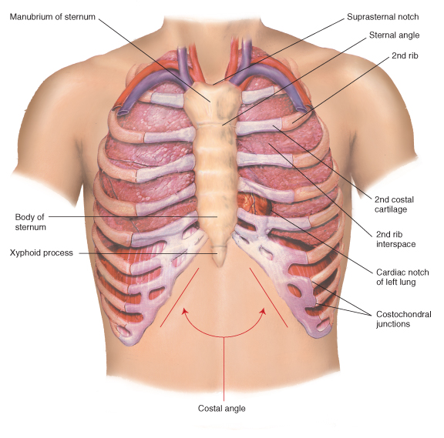
Anatomy and Physiology
The Chest Wall
  Study the anatomy of the
  chest wall, identifying the
  structures illustrated

Slide 3
Anatomy and Physiology
Locating Findings on the Chest
  To make vertical locations, count the ribs
  and interspaces

Slide 4
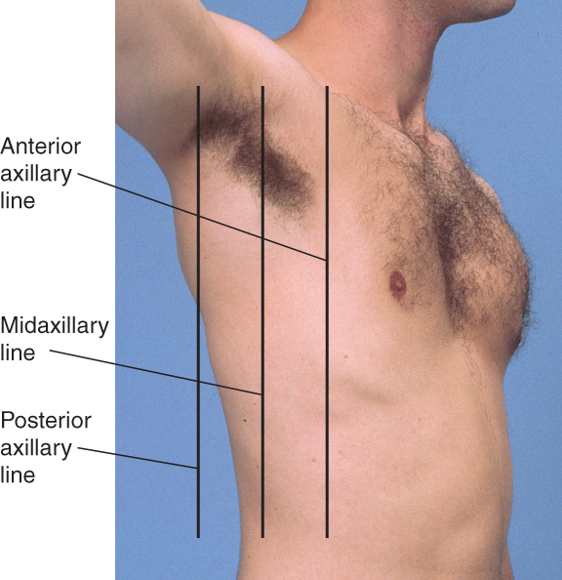
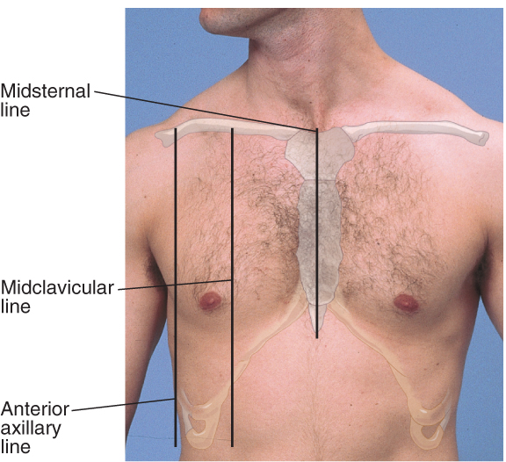
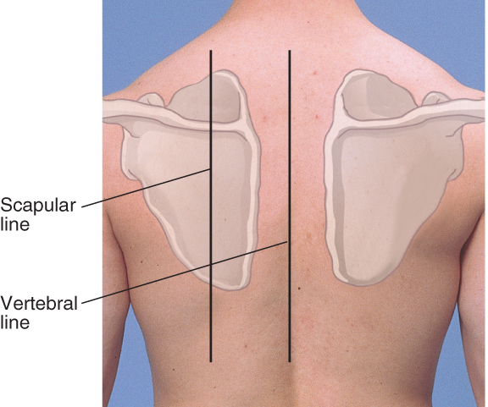
Anatomy and Physiology
Locating Findings on the Chest
  To locate findings around the circumference of the chest, imagine a series of vertical lines

Slide 5
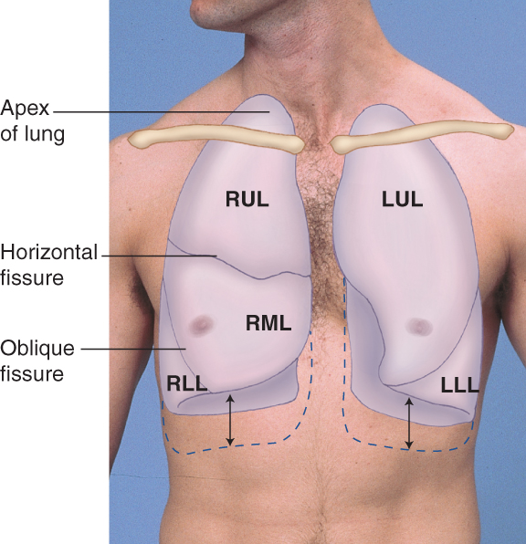
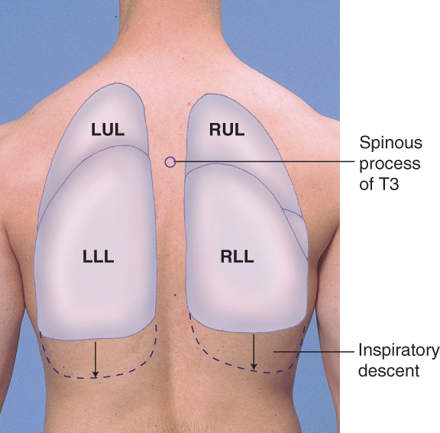
Anatomy and Physiology
Lungs, Fissures, and Lobes
  Each lung is divided roughly in half by an oblique (major) fissure
  The right lung is further divided by the horizontal (minor) fissure
  These fissures divide the lungs into lobes
    The right lung is divided into upper, middle, and lower lobes
    The left lung is divided into upper and lower lobes

Slide 6
Anatomy and Physiology
The Trachea and Major Bronchi
  The trachea bifurcates into its mainstem bronchi at the levels of the sternal angle anteriorly and the T4 spinous process posteriorly
The Pleurae
  The pleurae are serous membranes that cover the outer surface of each lung (visceral pleura), and also the inner rib cage and upper surface of the diaphragm (parietal pleura)

Slide 7
The Health History
Chest Pain
  Initial questions should be as broad as possible, such as “Do you have any discomfort or unpleasant feelings in your chest?”
  Have the patient point to the location of the pain
  Attempt to elicit all seven attributes of the patient’s symptom

Slide 8
The Health History
Chest Pain
  Aside from lung conditions, chest pain may arise from cardiac, vascular, gastrointestinal, musculoskeletal, and skin pathology. It is also commonly associated with anxiety.
  Lung tissue itself has no pain fibers. Pain in lung conditions usually arises from inflammation of the adjacent parietal pleura.
  Other surrounding structures may also irritate the parietal pleura, causing pain.

Slide 9
The Health History
Dyspnea
  Dyspnea is a nonpainful but uncomfortable
  awareness of breathing that is inappropriate to
  the level of exertion
  Once again, begin with a broad question, such
  as “Have you had any difficulty breathing?”
  Make an effort to determine its severity based
  on the patient’s daily activities

Slide 10
The Health History
Wheezing
  Wheezes are musical respiratory sounds that
  may be audible to the patient and to others
Cough
  Cough is typically a reflex response to stimuli
  that irritate receptors in the larynx, trachea,
  or large bronchi. It may sometimes be
  cardiovascular in origin.

Slide 11
The Health History
Cough
  Ask whether the cough is dry or produces sputum,
  or phlegm
  Ask the patient to describe the volume of any
  sputum and its color, odor, and consistency

Slide 12
The Health History
Hemoptysis
  Hemoptysis is the coughing up of blood from the lungs; it may vary from blood-streaked phlegm to frank blood
  Ask the patient to describe the volume of blood produced as well as other sputum attributes
  Try to confirm the source of the bleeding by history and examination before using the term “hemoptysis.” Blood may also originate from the mouth, pharynx,
  or gastrointestinal tract

Slide 13
Health Promotion and Counseling
Tobacco Cessation
  Smoking is the leading cause of preventable death
  in the United States
  Remember the five “As”
    Ask about smoking at each visit
    Advise patients regularly to stop smoking using
    a clear, personalized message
    Assess patient readiness to quit
    Assist patients to set stop dates and provide educational materials for self-help
    Arrange for follow-up visits to monitor and
    support patient progress

Slide 14
Techniques of Examination
In General
  Examine the posterior thorax and lungs while the patient is sitting
  Examine the anterior thorax and lungs with the
  patient supine
  Compare one side of the thorax and lungs with the other, so the patient serves as his or her own control
  Proceed in an orderly fashion: inspect, palpate, percuss, and auscultate

Slide 15
Techniques of Examination
Initial Survey of Respiration and the Thorax
  Observe the rate, rhythm, depth, and effort of breathing
  Inspect for any signs of respiratory difficulty
    Assess the patient’s color
    Listen to the patient’s breathing
    Inspect the patient’s neck
  Observe the shape of the chest

Slide 16
Techniques of Examination
Examination of the Posterior Chest
  Inspection
    From a midline position behind the patient, note the shape of the chest and the way in which it moves
  Palpation
    Identify tender areas
    Assess any observed abnormalities
    Test chest expansion by placing your thumbs at the level of the 10th ribs, with your fingers loosely grasping and parallel to the lateral rib cage. Watch the distance between your thumbs as they move apart during inspiration

Slide 17
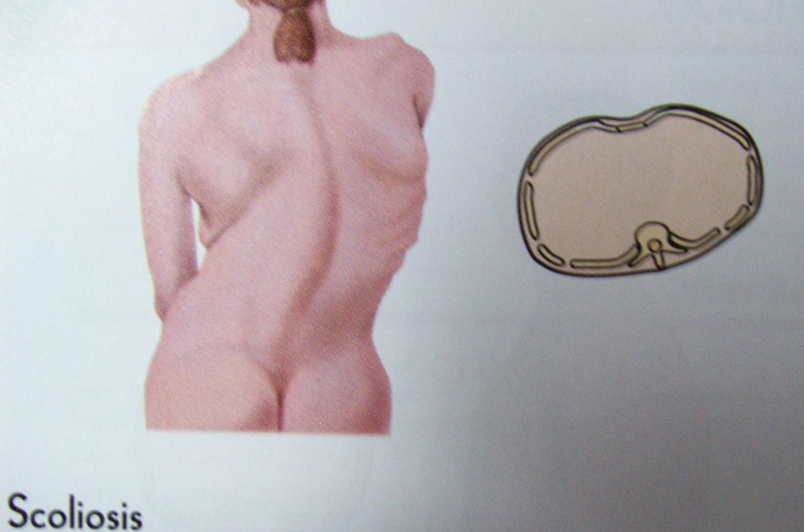

Slide 18
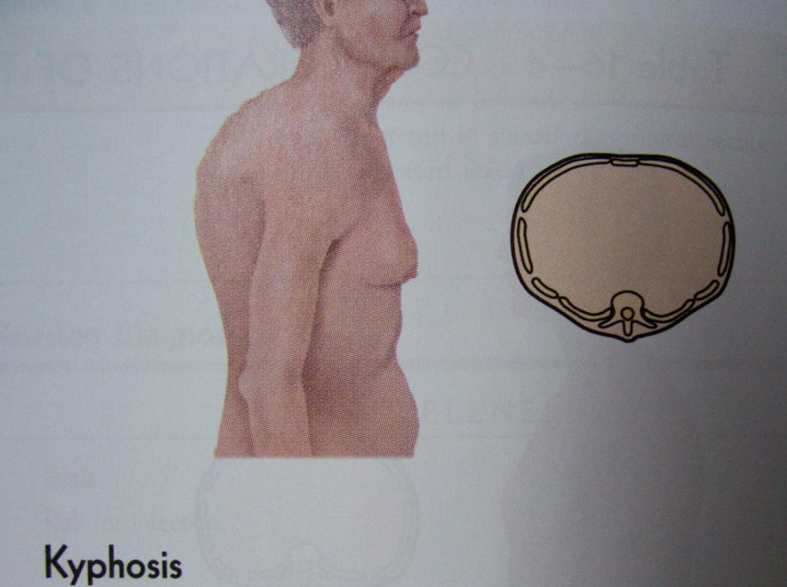
(Humpback)
Exaggerated curvuture of the thoracic spine
Pain and limited mobility

Slide 19
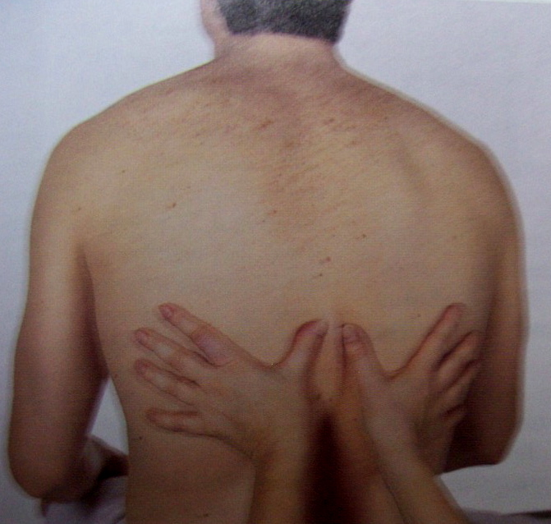
Palpate Posterior Chest
Symmetrical Chest Expansion
Marked
Atelectasis or
Lobar Pneumonia,
Chest trauma,
# ribs
Pneumothorax
Pleural effusion
Chronic fibrosis
Bronchial obstruction
At the level of T9 or T10

Slide 20
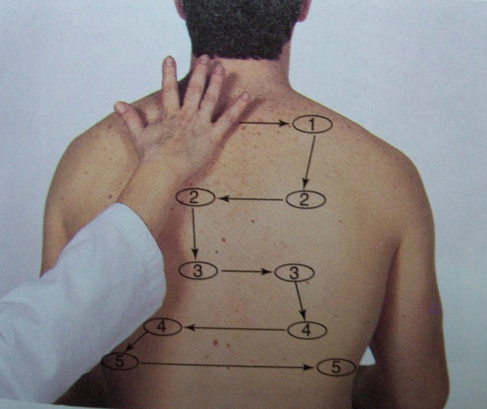
Palpate Posterior Chest
Symmetrical Tactile Fremitus
Palpable vibrations from sounds generated by the larynx
Decreased: as a result of obstruction like: COPD, obstructed bronchus, pneumothorax, emphysema,
pleural effusion or pleural thickening ( fibrosis).or tumor
Increased: with consolidation as in pneumonia.

Slide 21
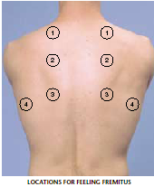
Tactile fremitus

Slide 22
Techniques of Examination
Examination of the Posterior Chest
  Percussion:
    Percussion helps establish whether the
    underlying tissues (5 to 7 cm deep) are
    air-filled, fluid-filled, or solid
    Estimate the extent of diaphragmatic excursion

Slide 23
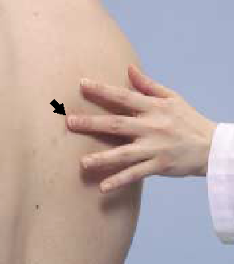
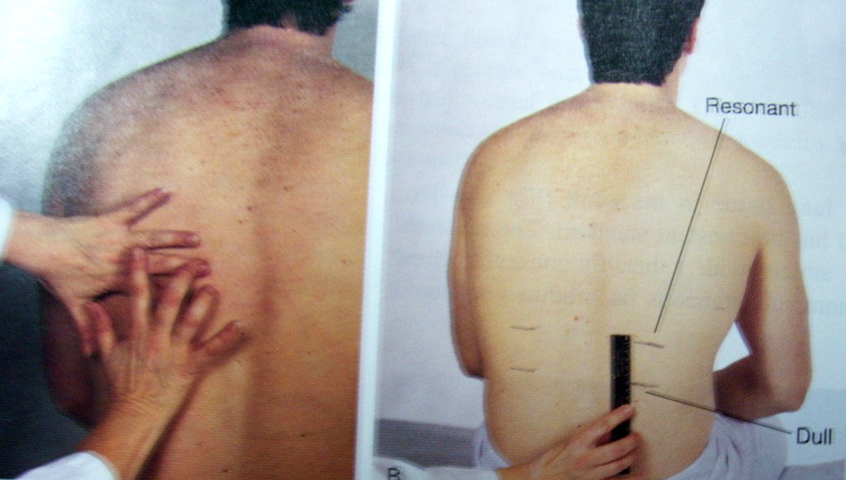
Percussion

Slide 24
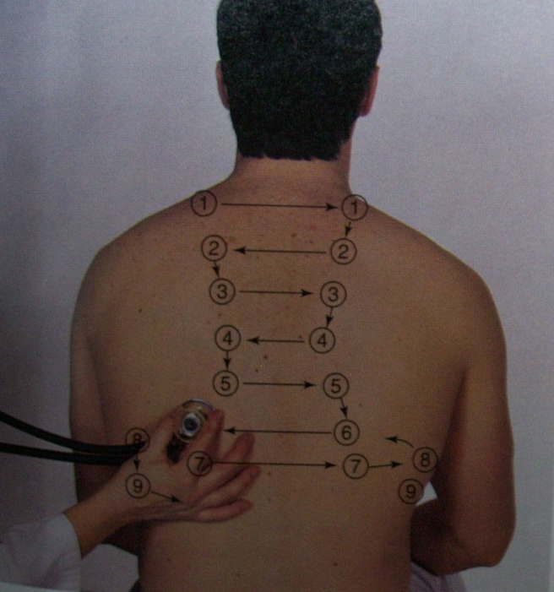
Percussion of Posterior Chest
Lung Fields
Start at the apex
Side-to-side comparison
5-cm intervals
Hyper resonance:
Unilateral hyper resonance; when too much air is present: in large pneumothorax
Generalized hyperresonance; in COPD, Asthma, emphysema,
Dull: when abnormal density in the lungs as with lobar pneumonia, pleural effusion, atelectasis, tumor, empyema, or fibrous tissue.

Slide 25
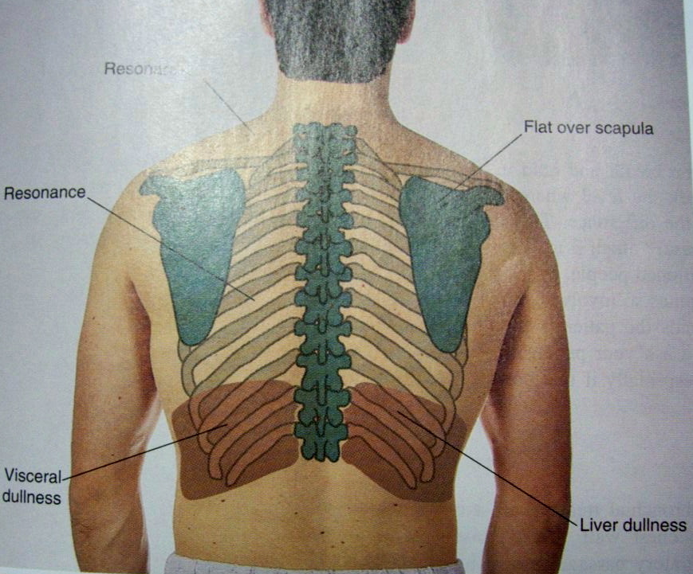
Percussion of Posterior Chest
Expected Normal Findings

Slide 26
Percussion of Posterior Chest
Diaphragmatic Excursion
Abnormal high level of dullness and absence of excursion in pleural effusion or high diaphragm as in atelectasis of lower lobes or diaphragmatic paralysis
5-6 cm in adults

Slide 27
Techniques of Examination
Examination of the Posterior Chest
  Auscultation:
    Auscultation of the lungs is the most important examining technique for assessing air flow through
    the tracheobronchial tree
    Together with percussion, it also helps to assess the condition of the surrounding lungs and pleural space
    Listen to the breath sounds with the diaphragm of a stethoscope after instructing the patient to breathe deeply through an open mouth
    Use the pattern suggested for percussion, moving
    from one side to the other and comparing symmetric areas of the lungs
    Listen to at least one full breath in each location

Slide 28
Techniques of Examination
Examination of the Posterior Chest
  Auscultation:
    Normal Breath Sounds:
      Vesicular – soft and low pitched; usually heard over most of both lungs
      Bronchial – louder and higher in pitch; usually heard over the manubrium
      Bronchovesicular – intermediate intensity and pitch; usually heard over the 1st and 2nd interspaces
    Adventitious (Added) sounds:
      Crackles, Wheezes, and Rhonchi

Slide 29
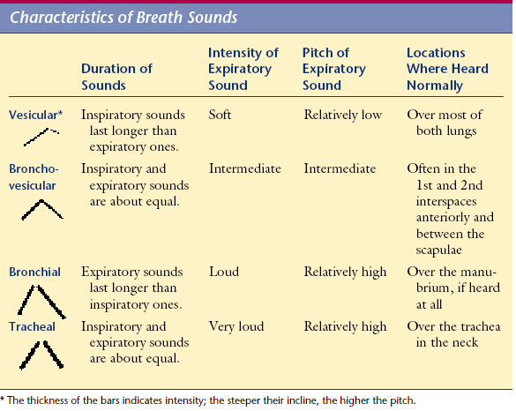
Auscultation of Posterior and Anterior Chest
Characteristics of Normal Breath Sounds

Slide 30
Auscultation of Posterior Chest
Breath Sounds - sequence
Decreased or Absent: if bronchial tree is obstructed or lungs hyperinflated (emphysema, or pleural thickening as in pneumothorax or pleural effusion, COPD
Increased: when consolidation (pneumonia) or compression (fluid in pleural space) cause dense areas that enhance transmission.

Slide 31
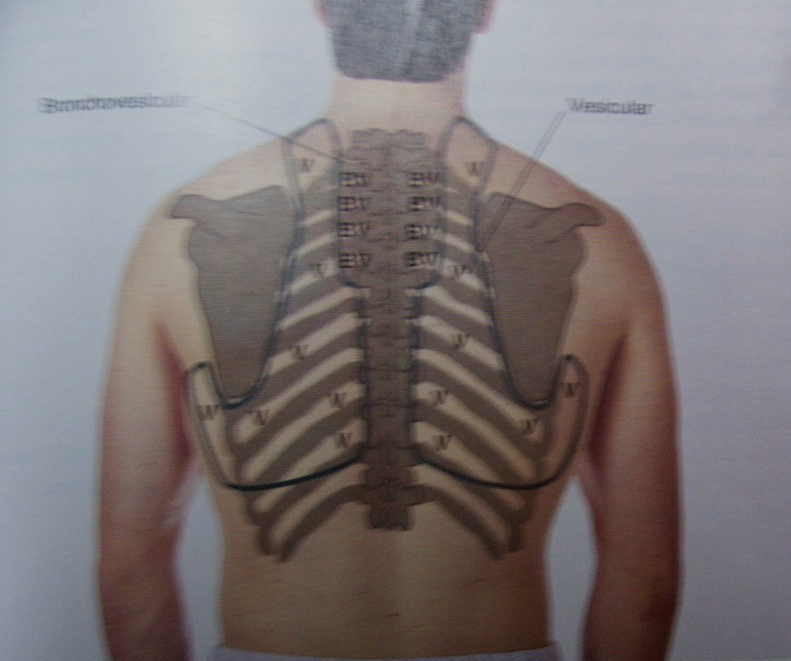
V
V
BV
BV
BV
BV
BV
BV
BV
BV
V
V
V
V
V
V
V
V
V
V
V
V
V
V
V
V
V
V
V
V
V
V
V

Slide 32
Techniques of Examination
Examination of the Anterior Chest
  As for examination of the posterior chest, proceed in an orderly fashion: inspect, palpate, percuss, and auscultate
  With percussion, please note that the heart normally produces an area of dullness to the left of the sternum from the 3rd to 5th rib interspaces

Slide 33
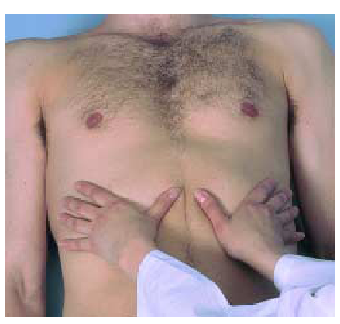

Slide 34
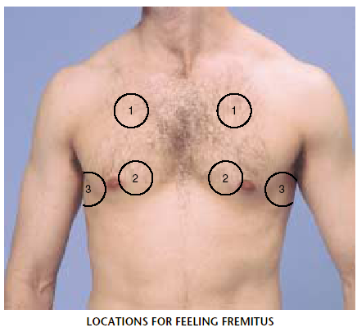
Assess for tactile fremitus: decrease or absent over the pericardium

Slide 35
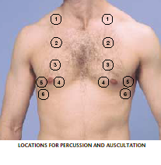
Percussion

Slide 36
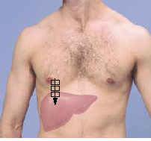

Slide 37
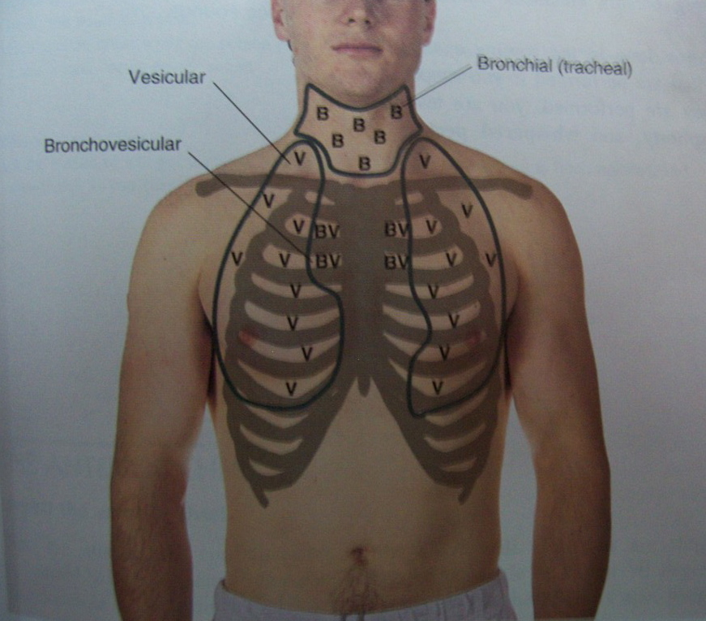

Slide 38
Diagnostic procedures
Chest radiography (X-ray)
Bronchoscopy (thorascopy)
Thoracentesis

Slide 39
Chest radiography
Chest radiography is a valuable diagnostic tool frequently used to:
  assess anatomical and physiological features of the chest
  detect pathological processes.
As x-rays are passed through the chest wall, various structures are visualized. Dense tissues, such as bones, absorb the x-ray beam and appear as opaque or white on the radiograph. Blood vessels and blood-filled organs, such as the heart, are moderately dense structures and appear as gray areas on the radiograph.
During inspiration, normal lungs are filled with air and appear black on the radiograph.
When parts of the lungs are filled with fluid, which is a more dense material, the lungs appear white.

Slide 40
Chest radiography
Bony structures inspected on the chest film include the ribs, clavicles, sternum, spine, and vertebrae.
Approximately eight to nine ribs should overlie lung tissue
on the normal chest film. The ribs are examined for the presence of fractures by following the curve of each rib, beginning anteriorly and moving around posteriorly.
The trachea should appear midline over the thoracic vertebrae.
NO special preparation is needed before or after the Chest radiography; but you should assess your female patients for pregnancy.

Slide 41
Bronchoscopy
Bronchoscopy involves the direct visualization of the larynx, trachea, and bronchi through a flexible fiberoptic bronchoscope.
Bronchoscopy is used diagnostically to
  examine tissues,
  collect secretions,
  obtain a biopsy.
  In addition, bronchoscopy is used therapeutically as a means to remove foreign bodies or secretions from the tracheobronchial tree,
  treat postoperative atelectasis,
  excise lesions.

Slide 42
Bronchoscopy
In preparation for a bronchoscopy,
  a history and physical examination should be performed.
  A chest radiograph,
  clotting studies, and ABGs also are obtained.
  NPO, consent form
  The patient often receives intravenous sedation or analgesia before the procedure.
  If the purpose of the bronchoscopy is therapeutic, medications that suppress a cough or diminish secretions are avoided (e.g., intratracheal topical anesthetics, atropine, and codeine).

Slide 43
Bronchoscopy
Careful monitoring of the patient is indicated after a bronchoscopy; The nurse assesses for any evidence of complications, which may include :
  laryngospasm,
  fever,
  hemodynamic changes
  cardiac dysrhythmias,
  pneumothorax,
  hemorrhage,
  cardiopulmonary arrest.

Slide 44
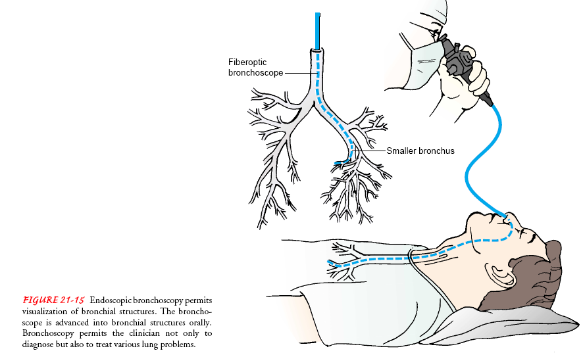
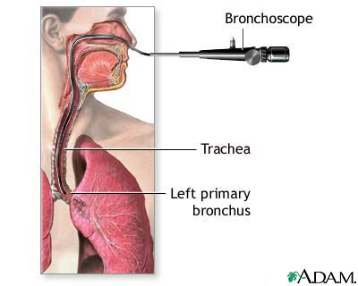
Endoscopic Bronchoscopy

Slide 45
Thoracentesis
In thoracentesis, a needle is inserted into the pleural space to
  remove air, fluid, or both;
  obtain specimens for diagnostic evaluation;
  or instill medications.
before a thoracentesis
  A chest radiograph,
  coagulation studies,
  and patient education are essential.
  Some patients may require medication to reduce anxiety.

Slide 46
Thoracentesis
Unlike bronchoscopy, thoracentesis requires the cooperation of the patient; therefore, a local anesthetic, rather than moderate sedation, is used to minimize the pain and discomfort that accompanies the procedure.
During the procedure, the patient is placed either in a chair or on the edge of the bed in an upright position with arms and shoulders raised so that the ribs lift and separate, allowing easier needle insertion.
If a patient is unable to lift his or her arms, sitting on the bed with the arms placed above the head on a table is an alternative position.

Slide 47
Thoracentesis
During thoracentesis, the nurse’s primary function is to
  provide comfort for the patient,
  perform ongoing assessment of the patient’s respiratory system,
  dress the wound with sterile dressings on completion of the procedure,
  send labeled laboratory specimens as ordered.
Post-thoracentesis nursing care includes
  assessment for complications, including pneumothorax, pain, hypotension, and pulmonary edema.

