Slide 1
An Introduction to the Human Body
Dr: Wafaa Shunnaq

Slide 2
ANATOMY
Through a study of anatomy and its subdivisions, the body may be examined at different levels of structural organization.
Anatomy
the study of structure and the relationships among structures.
Subdivisions
surface anatomy, gross anatomy, systemic anatomy, regional anatomy, radiographic anatomy, developmental anatomy, embryology, cytology, and pathological anatomy.

Slide 3
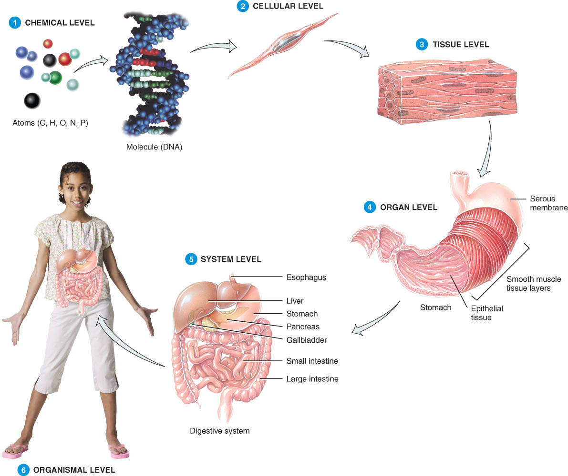
Levels of Organization
Chemical
Cellular
Tissue
Organs
System Level
Organismic Level

Slide 4
LEVELS OF ORGANIZATION
The human body consists of several levels of structural organization
The chemical level
atoms, the smallest units of matter that participate in chemical reactions, and molecules, two or more atoms joined together.
Cells
the basic structural and functional units of an organism.
Tissues
groups of similarly specialized cells and the substances surrounding them and perform certain special functions.

Slide 5
LEVELS OF ORGANIZATION
Organs
structures that are composed of two or more different tissues and have specific functions.
Systems
related organs that have a common function.
The human organism
a collection of structurally and functionally integrated systems; any living individual.

Slide 6
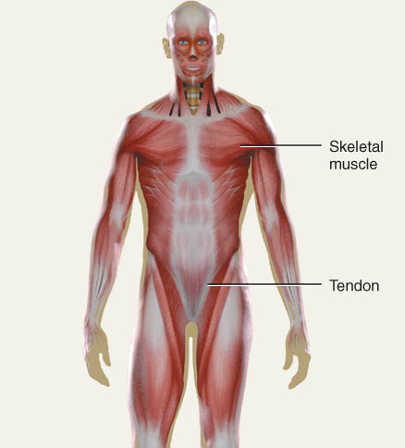
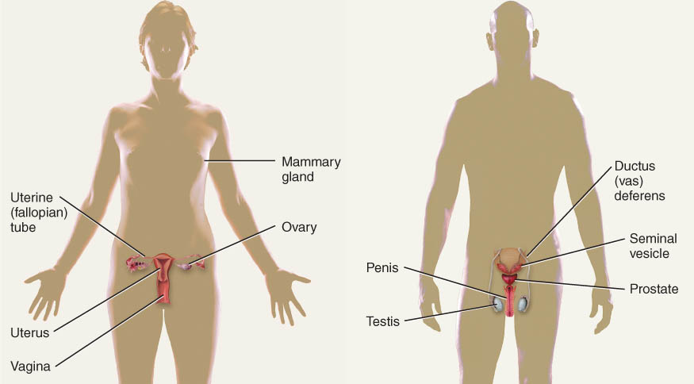
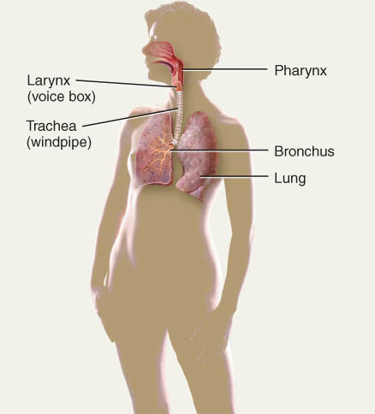
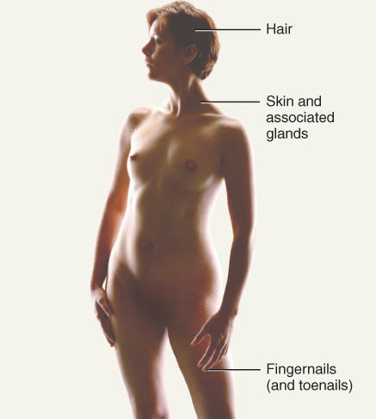
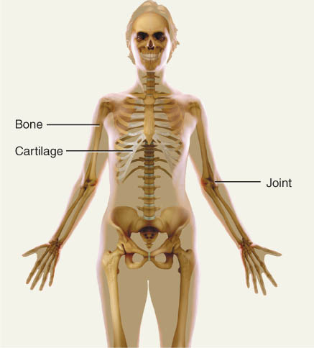
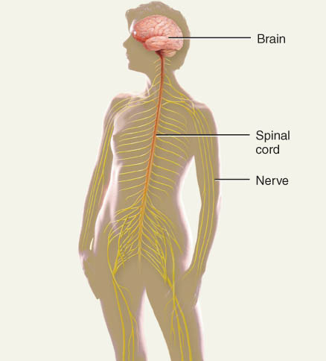
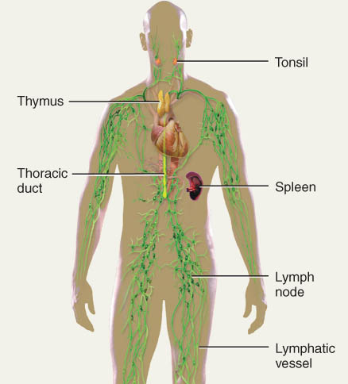
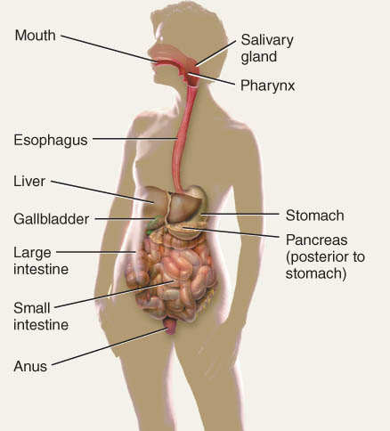
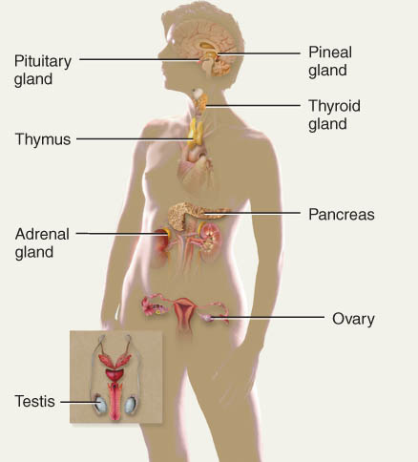
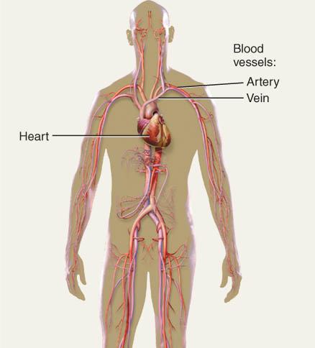
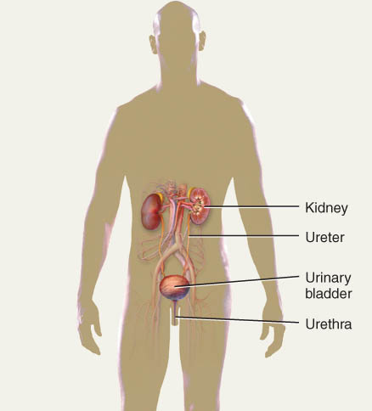
Organ Systems

Slide 7
LEVELS OF ORGANIZATION
The systems of the human body are the integumentary, skeletal, muscular, nervous, endocrine, cardiovascular, lymphatic, respiratory, urinary, digestive, and reproductive.

Slide 8
BASIC ANATOMICAL TERMINOLOGY
Anatomical position
Regions of the body
Anatomical planes and directional terms

Slide 9
Anatomical Position
The anatomical position is a standardized method of observing or imaging the body that allows precise and consistent anatomical references.
When in the anatomical position, the subject stands.
standing upright
facing the observer, head level
eyes facing forward
feet flat on the floor
arms at the sides
palms turned forward (ventral)

Slide 10
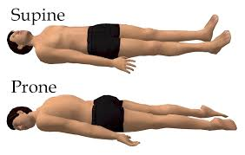
Reclining Position
If the body is lying face up, it is in the supine position.
If the body is lying face down, it is in the prone position.

Slide 11
Regional Names
Regional names are names given to specific regions of the body for reference.
Examples of regional names include:

Slide 12
Common Regional Names cranial (skull), thoracic (chest), brachial (arm), patellar (knee), cephalic (head), and gluteal (buttock)
Clinical terminology is based on a Greek or Latin root word.

Slide 13
Directional Terms
Directional terms are used to precisely locate one part of the body relative to another and to reduce length of explanations.
Commonly used directional terms:
Next slides

Slide 14
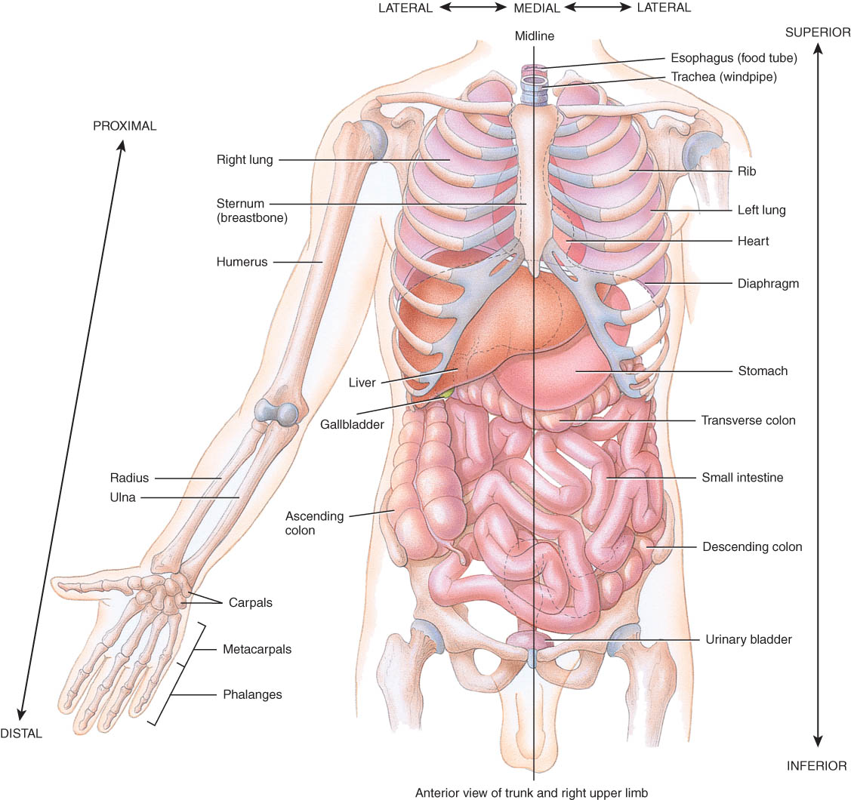
Superior or Inferior
Superior
towards the head
The eyes are superior to the mouth.
Inferior
away from the head
The stomach is inferior to the heart.

Slide 15
Dorsal or Ventral
Dorsal or Posterior
at the back of the body
The brain is posterior to the forehead.
Ventral or Anterior
at the front of the body
The sternum is anterior to the heart.

Slide 16
Medial or Lateral
Medial
nearer to the midline of the body
The heart lies medial to the lungs.
Lateral
farther from the midline of the body
The thumb is on the lateral side of the hand.

Slide 17
Proximal or Distal
Proximal
nearer to the attachment of the limb to the trunk
The knee is proximal to the ankle.
Distal
farther from the attachment of the limb to the trunk
The wrist is distal to the elbow.

Slide 18
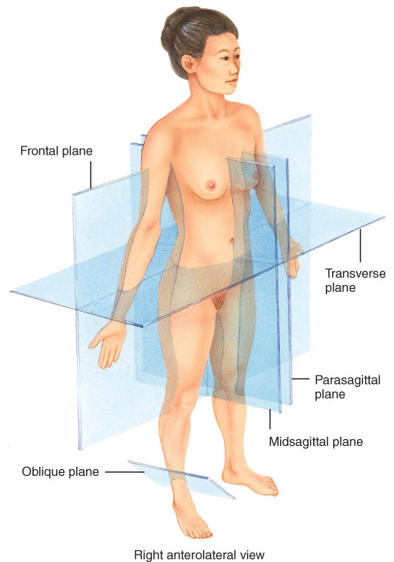
Planes
Planes are imaginary flat surfaces that are used to divide the body or organs into definite areas
Principal planes include:
midsagittal (medial) and parasagittal
frontal (coronal)
transverse (cross-sectional or horizontal)
oblique

Slide 19
Sagittal Plane
Sagittal plane
divides the body or an organ into left and right sides
1. Midsagittal plane
produces equal halves
2. Parasagittal plane
produces unequal halves

Slide 20
Other Planes
Frontal or coronal plane
divides the body or an organ into front (anterior) and back (posterior) portions
Transverse(cross-sectional) or horizontal plane
divides the body or an organ into upper (superior) or lower (inferior) portions
Oblique plane
some combination of 2 other planes

Slide 21
Body Cavities
Body cavities are spaces within the body that help protect, separate, and support internal organs.

Slide 22
Dorsal Body Cavity
Near dorsal surface of body
2 subdivisions
cranial cavity
holds the brain
formed by skull
vertebral or spinal canal
contains the spinal cord
formed by vertebral column
Meninges line dorsal body cavity

Slide 23
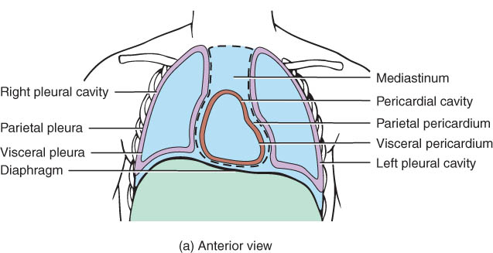
Ventral Body Cavity
Near ventral surface of body
2 subdivisions
thoracic cavity above diaphragm
abdominopelvic cavity below diaphragm
Diaphragm = large, dome-shaped muscle
Organs called viscera
Organs covered with serous membrane

Slide 24
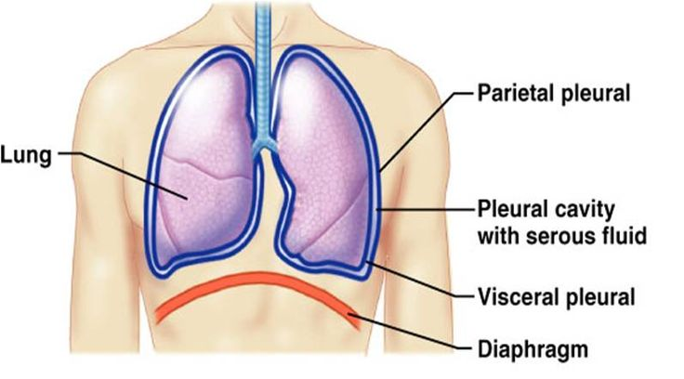
Serous Membranes
Thin membrane lines body cavities
parietal layer lines walls of cavities
visceral layer covers viscera within the cavities
Serous fluid between these two layers to reduces friction

Slide 25
Thoracic and Abdominal Cavity Membranes
A thin, slippery serous membrane covers the viscera within the thoracic and abdominal cavities and also lines the walls of the thorax and abdomen.
Parts of the serous membrane
the parietal layer lines the walls of the cavities
the visceral layer covers and adheres to the viscera within the cavities.
Serous fluid between the two layers reduces friction and allows the viscera to slide somewhat during movements.

Slide 26
serous membranes
The serous membranes include the pleura, pericardium and peritoneum .
The pleural membrane surrounds the lungs
visceral pleura clings to the surface of the lungs
parietal pleura lines the chest wall
The pericardium is the serous membrane of the pericardial cavity
visceral pericardium covers the surface of the heart
parietal pericardium lines the chest wall
The peritoneum is the serous membrane of the abdominal cavity
visceral peritoneum covers the abdominal viscera
parietal peritoneum lines the abdominal wall

Slide 27
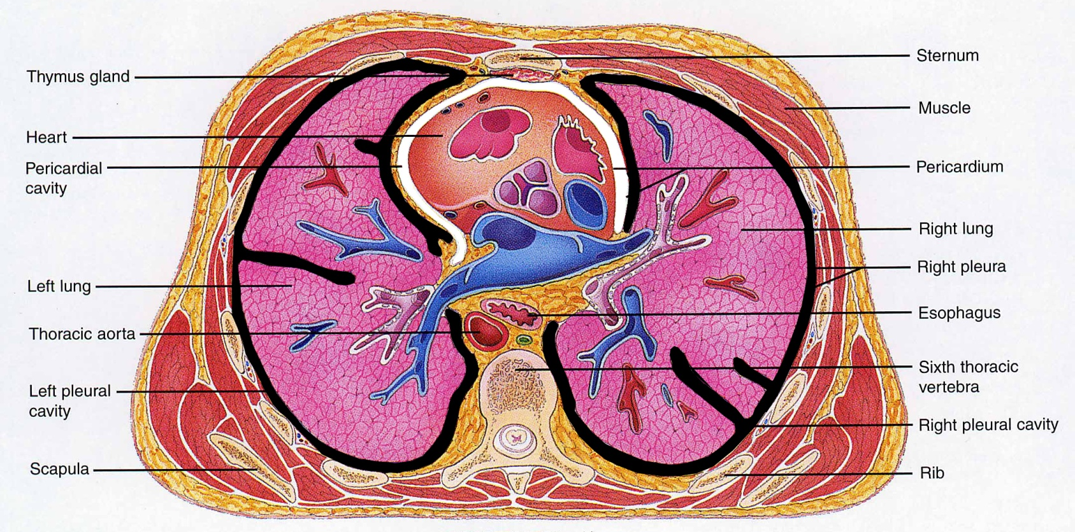
Pleural & Pericardial Cavities
Visceral and Parietal Pleura
Visceral and Parietal Pericardium

Slide 28
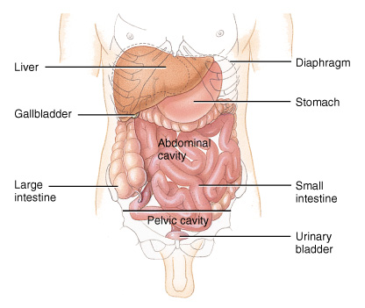
Peritoneum
Visceral peritoneum
serous membrane that covers the abdominal viscera
Parietal peritoneum
serous membrane that lines the abdominal wall

Slide 29
Abdominopelvic Regions and Quadrants
To describe the location of organs or abdominopelvic abnormalities easily, the abdominopelvic cavity may be divided into
nine regions by drawing four imaginary lines.
quadrants by passing imaginary horizontal and vertical lines through the umbilicus.

Slide 30
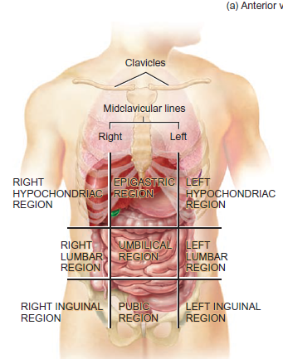
Nine regions
Nine regions by drawing four
imaginary lines.
Rt. & Lf. Hypochondriac
Rt. & Lf. Lumbar
Rt. & Lf. Inguinal (illiac)
Epigastric
Umbilical
Hypogastric (pubic)

Slide 31
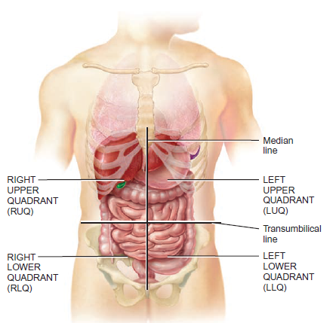
Quadrants
quadrants by passing imaginary horizontal and vertical lines through the umbilicus.
Right and left upper quadrants
Right and left lower quadrants

Slide 32
Clinical Application: Autopsy
An autopsy is a postmortem examination of the body and dissection of the internal organs to confirm or determine the cause of death.

