Slide 1
Chapter 15: Musculoskeletal System

Slide 2
Structure and Function of Joints: Important Terms
Articular Structures: include joint capsule and articular cartilege, synovium and synovial fluid, intra-articular ligaments, and juxta-articular bone
Nonarticular Structures: include periarticular ligaments
Ligaments: ropelike bundles of collagen fibrils that connect bone to bone
Tendons: collagen fibers connecting muscle to bone
Cartilege: collagen matrix overlying bony suyrfaces
Bursae: pouches of synovial fluid that cushion the movement of tendons and muscles over bone or other joint structures.

Slide 3
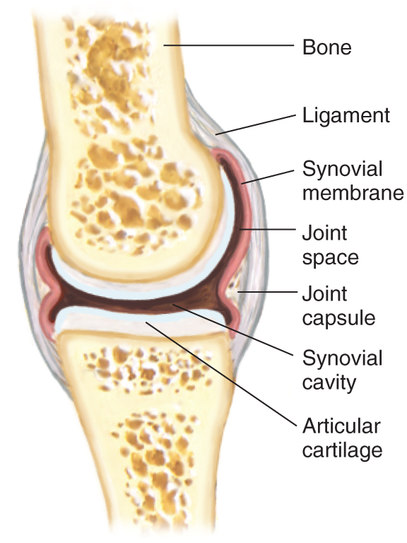
Types of Joints: Synovial, Cartilaginous, and Fibrous
Synovial Joint
Joint is freely movable
Bones covered by articular cartilege
Bones separated by joint capsuleoverlying synovial cavity
Synovial membrane secretes synovialfluid that lubricates joint movement
Examples: shoulder, knee

Slide 4
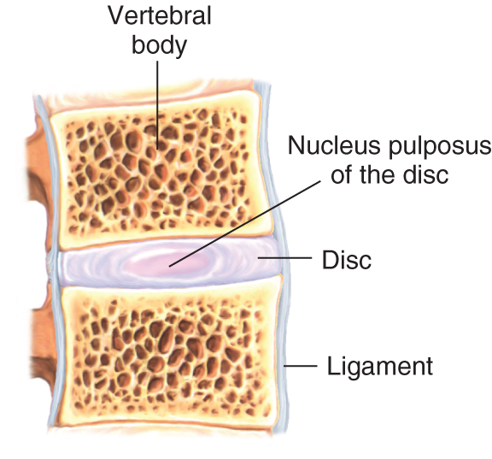
Types of Joints: Synovial, Cartilaginous, and Fibrous
Cartilaginous Joint
Joint is slightly movable
Bones separated by fibrocartilaginous discs
Discs contain nucleus pulposis that cushion bony movement
Example: vertebral bodies of the spine

Slide 5
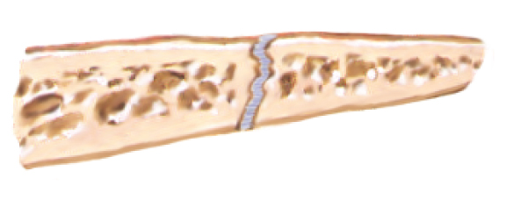
Types of Joints: Synovial, Cartilaginous, and Fibrous
Fibrous Joint
Joints have no appreciable movement
Bones separated by fibrous tissue or cartilege
Example: sutures of the skull

Slide 6
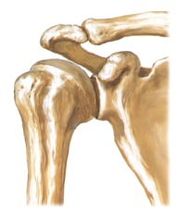
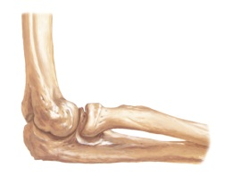
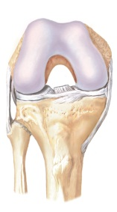
Types of Synovial Joints: note that anatomy determines range of movement
Synovial Joints
Type of Joint | Articular Shape | Movement | Example
Spheroidal (ball & socket) | Convex surface in concave cavity | Wide-ranging flexion, extension, abduction, adduction, rotation, circumduction | Shoulder, hip
Hinge | Flat, planar | Motion in one plane; flexion, extension | Interphalangeal joints of hand and foot; elbow
Condylar | Convex or concave | Movement of two articulating surfaces not dissociable | Knee; temporomandibular joint

Slide 7
Musculoskeletal System: The Health History
Common or Concerning Symptoms
Low back pain
Neck pain
Monoarticular or polyarticular joint pain
Inflammatory or infectious joint pain
Joint pain with systemic features such as fever, chills, rash, anorexia, weight loss, weakness
Joint pain with symptoms from other organ systems

Slide 8
Musculoskeletal System: Tips for Evaluating Joint Pain
Ask the patient to “point to the pain”
This saves considerable time since patient descriptions of the location of the pain may be vague
Clarify and record the mechanism of injury, particularly if the joint pain is caused by trauma
Determine whether the pain is:
localized or diffuse
acute or chronic
inflammatory or noninflammatory

Slide 9
Techniques Of Examination: Overview for Each of the Major Joints*
Inspect for joint symmetry, alignment, or any bony deformities
Inspect and palpate surrounding tissues for: any skin changes, nodules, muscle atrophy, or crepitus
Assess any degenerative or inflammatory changes, especially swelling, warmth, tenderness, or redness
Perform range of motion; use joint-specific maneuvers to test:
joint function and stability
integrity of ligaments, tendons, and bursae
* Includes shoulder, wrist and hands, spine, hips, knees, and ankles. For examination of the temporomandibular, elbow, and foot joints, review Bates’ 9th edition textbook, Chapter 15, The Musculoskeletal System.

Slide 10
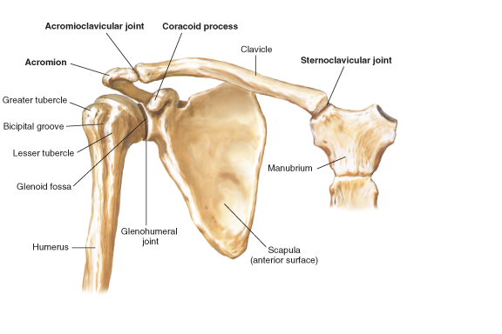
Shoulder: Anatomy Of Bones And Muscles
Review bony anatomy
Review muscle groups, Bates’ 9th edition textbook, p. 513

Slide 11
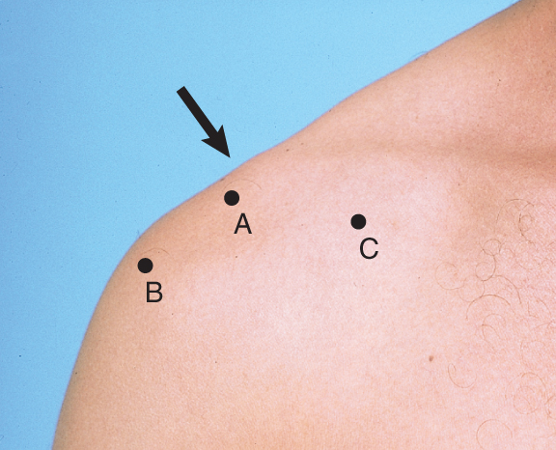
Shoulder: Identify Surface Landmarks
Acromioclavicular joint
Greater tubercle
Coracoid process

Slide 12
Shoulder: Examination
Inspect for swelling, deformity, or abnormal positioning
Palpate over the three bony landmarks for tenderness
Check range of motion: flexion, extension, abduction, adduction, and internal (hands behind small of back) and external (hands behind neck) rotation
Review Bates’ 9th edition textbook, pp. 516 - 519 and perform maneuvers as needed to assess:
Acromioclavicular joint
Subacromial and subdeltoid bursae
Overall shoulder rotation (Apley scratch test)
Rotator cuff

Slide 13
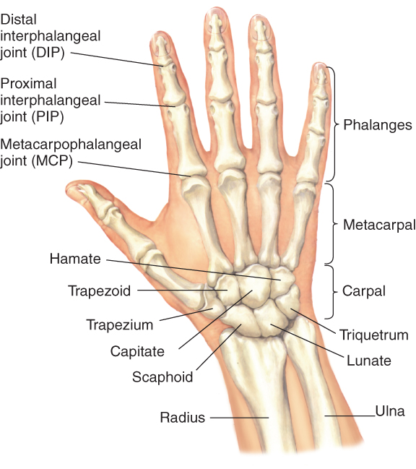
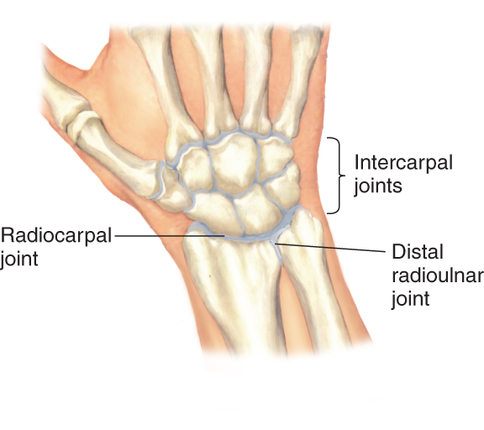
Wrist and Hand: Review the Anatomy

Slide 14
WRIST and HAND: Examination
Inspect for smoothness of motion, surface contour, alignment of wrist and fingers, and any bony deformities
Palpate
the distal radius and ulna at the wrist, the eight carpal bones, and the MCP, PIP, and DIP joints for swelling or tenderness
the “anatomic snuffbox” just distal to the radial styloid with the hand extended for tenderness

Slide 15
Wrist and Hand: Examination
Check range of motion:
Wrist: flexion, extension, ulnar and radial deviation
Fingers: flexion, extension, abduction (fingers spread apart), adduction (fingers back together)
Thumb: flexion, extension, abduction (thumb moves away from palm), adduction (thumb moves toward palm), and opposition (thumb touches each finger)
Test grip strength
Test sensation on the palmar and dorsal surfaces innervated by the median, ulnar, and radial nerves (see Bates’ 9th edition textbook, p. 528)

Slide 16
Wrist and Hand: Carpal tunnel syndrome
Clinical features:
Pain or numbness of the first three fingers of the hand, but not in the palm, especially at night
Loss of sensation in distribution of the medial nerve: palmar surface of thumb, index, middle, and medial 4th fingers
Assess for:
weak abduction of the thumb – most sensitive test
Tinel’s sign – tingling with tapping over the medial nerve as it enters the carpal tunnel
Phalen’s sign – numbness or tingling with pressing backs of hands together in acute flexion

Slide 17
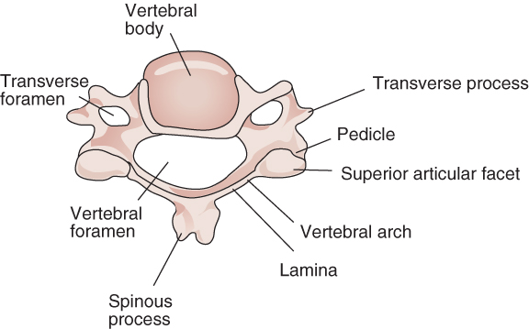
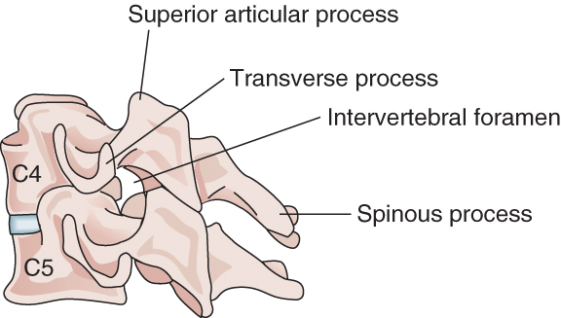
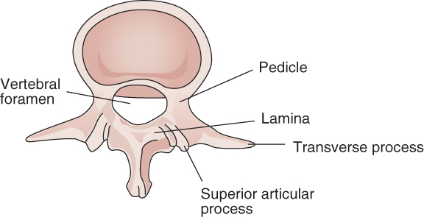
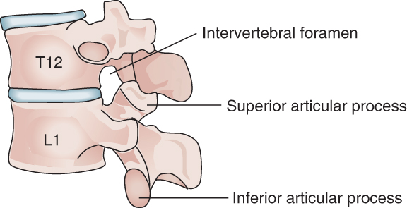
Spine: Anatomy of Representative Cervical and Lumbar Vertebrae
7 cervical, 12 thoracic, 5 lumbar vertebrae stacked on the sacrum and coccyx
Review the anatomy below:

Slide 18
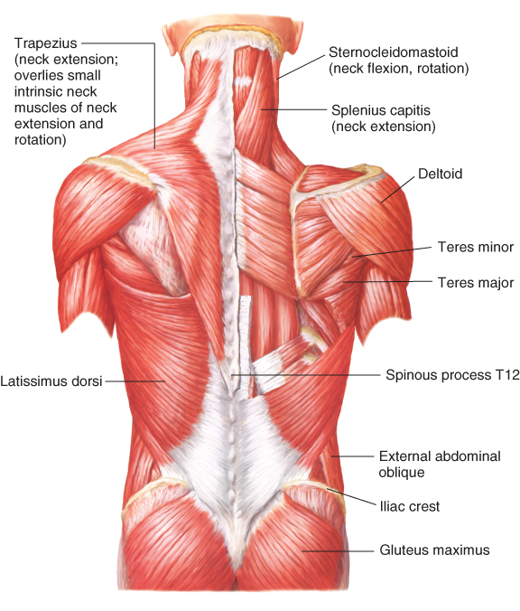
Spine: Muscle Groups

Slide 19
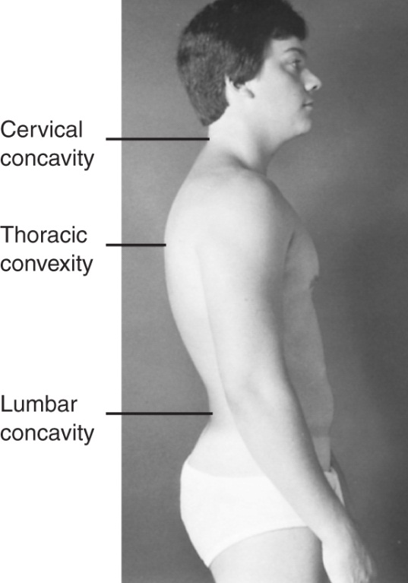
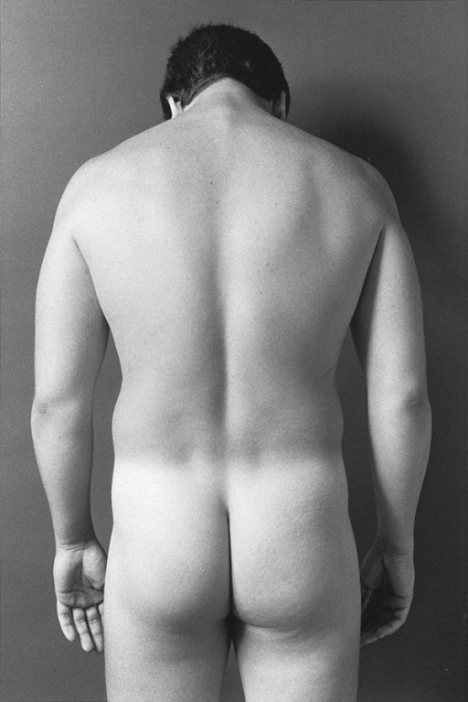
Spine: Examination — Inspection
With patient in gown, directly inspect:
posture
position of neck and trunk, alignment of shoulders and iliac crests, spinal curvature (concave at the neck and low back, convex over the thorax)
ease of gait

Slide 20
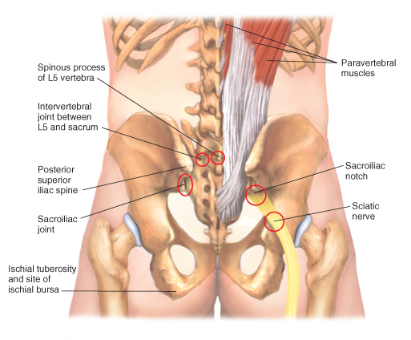
Spine: Examination — Palpation
Palpate
all spinous processes for tenderness or “step-offs”
paravertebral muscles for tenderness or spasm
the sacroiliac joints
the sciatic notch

Slide 21
Spine: Examination — Range of Motion
Neck: assess range of motion
Flexion and extension: chin to neck, look at ceiling
Rotation and lateral bending: turn head side to side, tilt each ear to shoulder
Spine: assess range of motion. You may need to support the patient.
Flexion and extension: bend forward toward toes, bend backward
Rotation and lateral bending: rotate trunk (pull shoulder then opposite hip posteriorly), lean to the right then left

Slide 22
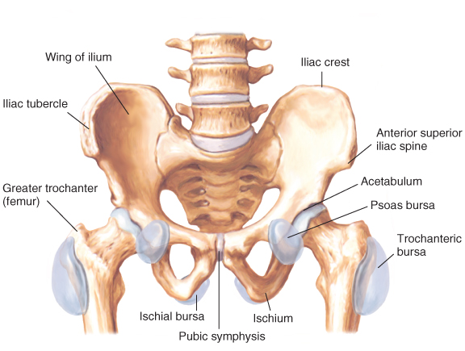
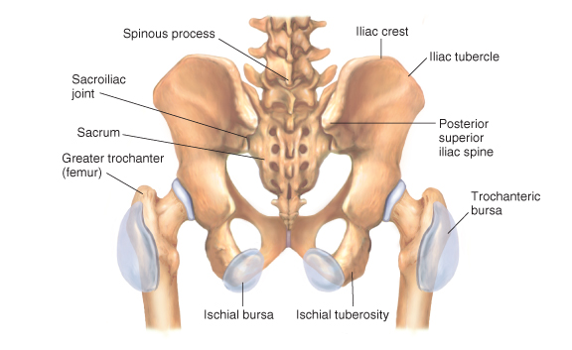
Hip: Review Bony Anatomy and Bursae

Slide 23
Hip: Examination — Inspection and Palpation
Inspect gait, during both swing (non-weight bearing) and stance (foot on ground and bears weight)
assess base – width between footsteps should be 2-4 inches
rhythm should be smooth and continuous
Palpate over inguinal ligament, trochanteric bursa, and ischiogluteal bursa

Slide 24
Hip: Examination – Range of Motion
Assess
Flexion – bend and pull knee to chest. Check for flexion deformity (opposite knee goes into flexion)
Extension – leg extends posteriorly while patient carefully positioned near edge of table
Abduction and adduction – reach across and grasp opposite hip; grasp ankle and move leg laterally, then medially toward opposite hip
External and internal rotation – flex hip and knee to 90°, grasp ankle, rotate flexed lower leg medially then laterally

Slide 25
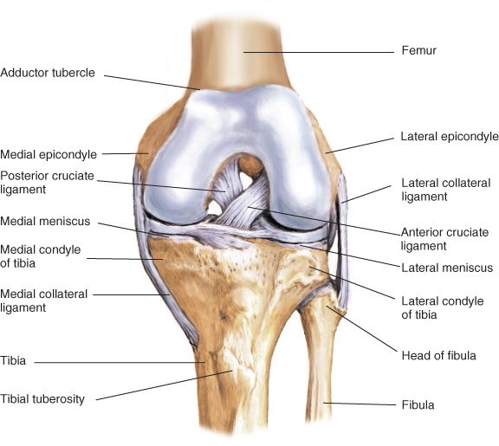
Knee: Review the Anatomy
Identify bony structures, bursae, and especially the 4 ligaments and 2 menisci

Slide 26
Knee: Examination — Inspection and Palpation
Inspect:
contours and alignment of knees for swelling
quadriceps muscle bulk for any atrophy
knee action during swing and stance phases of gait
Palpate, with patient sitting:
Infrapatellar spaces adjacent to patella
Medial and lateral femoral epicondyles and condyles
Medial and lateral margins of tibial plateau
Insertion of patellar tendon at the tibial tubercle

Slide 27
Knee: Examination — Palpation, cont’d
Palpate, with the knee flexed, and note any tenderness:
along the joint line, including menisci and bursae
along the medial and lateral collateral ligaments (MCL & LCL)
over the patellar tendon. If tender, compress the patella against the femur and check knee extension
Palpate:
over the suprapatellar bursa above the knee
the prepatellar bursa over the patella
the pes anserine bursa on posteromedial knee
If swelling, palpate for bulge sign or balloon sign, or balotte the patella (see Bates’ 9th edition textbook, pp. 548 - 550, for techniques)

Slide 28
Knee: Examination — Range of Motion and Maneuvers
Assess range of motion, with patient sitting:
Flexion and extension
Internal and external rotation – patient rotates foot medially and laterally
If pain or swelling, use maneuvers to test stability of ligaments and integrity of menisci
consult Bates’ 9th edition textbook, pp. 550 -551, and apply the following maneuvers as indicated:
MCL – abduction or valgus stress test
LCL – adduction or varus stress
Anterior cruciate ligament (ACL) – anterior drawer sign, Lachman test
Posterior cruciate ligament (PCL) – posterior drawer sign
Medial and lateral menisci – McMurray test

Slide 29
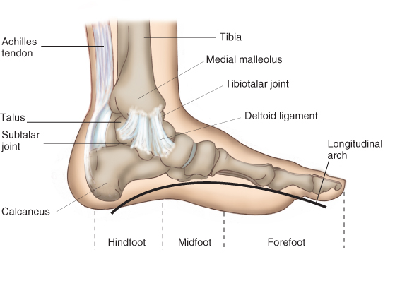
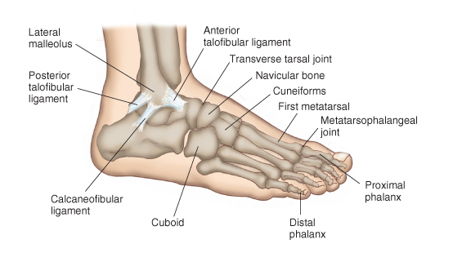
Ankle and Foot: Review the Anatomy
Note: Especially the bony medial and lateral malleoli, the triangular deltoid ligament medially, and the three less stable ligaments laterally

Slide 30
Ankle and Foot: Examination — Inspection and Palpation
Inspect the surfaces of the ankles and feet for any deformities, nodules, swellings, calluses, or corns
Palpate:
the anterior aspect of the ankle using your thumbs
the Achilles tendon for nodules or tenderness
the metatarsophalangeal joints
the heads of the 5 metatarsals – compress between your thumb and index finger

Slide 31
ANKLE and FOOT: Examination — Range of Motion and Maneuvers
Assess range of motion, including:
tibiotalar joint (ankle) flexion and extension
subtalar (talocalcaneal) joint grasp and invert and evert the heel
transverse tarsal joint invert and evert the forefoot
metatarsalphalangeal joints flex and extend the toes

Slide 32
Diagnostic procedures Bone Marrow Aspiration
Is frequently done for evaluation of possible hematological disorders
Bone marrow is usually aspirated from sternum or iliac crest in adults
Preparation for procedure require explanation of the procedure and giving some tranquilizers for anxious patients.
The skin area is cleansed and then a small area is anesthetized with local anesthesia.
Bone marrow needle is introduced with a twisting motion and marrow is aspirated.
After finishing procedure, pressure is applied to site for several minutes.
The site of aspiration is observed closely for 24 hours for signs of bleeding and infection.

Slide 33
Bone Densitometry
Is used to estimate bone density, through the use of x-ray or ultrasound
Dual-photon absrptiometry and dual-energy x-rays determine bone mineral density at the wrist, hip, or spine to estimate the extent of osteoporosis.
One peak is absorbed mainly by soft tissue and the other by bone
Before the imaging study, the nurse should consider:
If patient pregnant, claustrophobia, inability to tolerate position, deformity, metal implants, hair clips, hearing aid.

Slide 34
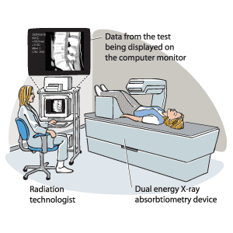

Slide 35
Electromyography
EMG is a test that checks the activity of the muscles and the nerves that control the muscles. (electrical activity of muscles)
The health care provider will insert a very thin needle electrode through the skin into the muscle. The electrode on the needle picks up the electrical activity given off by muscles. This activity appears on a nearby monitor, and may be heard through a speaker.
After placement of the electrodes, patient may be asked to contract the muscle. The electrical activity seen on the monitor provides information about his muscle's ability to respond when the nerves to muscles are stimulated.

Slide 36
EMG is most often used when people have symptoms of weakness, and examination shows impaired muscle strength.( e.g. CTS)
It can help to tell the difference between muscle weakness caused by injury of a nerve attached to a muscle and weakness due to neurological disorders.

