Slide 1
Chapter 67 Musculoskeletal Care Modalities

Slide 2
Cast
A rigid, external immobilizing device
Uses
Immobilize a reduced fracture
Correct a deformity
Apply uniform pressure to soft tissues
Support to stabilize a joint
Materials—nonplaster (fiberglass), plaster

Slide 3
Types of Casts:
Short arm cast 2.Long arm cast
Short leg cast 3.Long leg cast
Walking cast ( long or short) reinforced for strength
Body cast: encircle the trunk
Shoulder spica cast: a body jacket that enclosed the trunk and the shoulder and elbow
Hip spica cast: enclose the trunk and lower extremity ( double hip spica cast ( includes both legs

Slide 4
Casting Materials:
Plaster: Rolls of plaster bandage, need 24 to 72 hrs to dry completely
Nonplaster: Fiberglass cast ( lighter in wt, stronger, water resistant), has pores so diminish skin problems

Slide 5
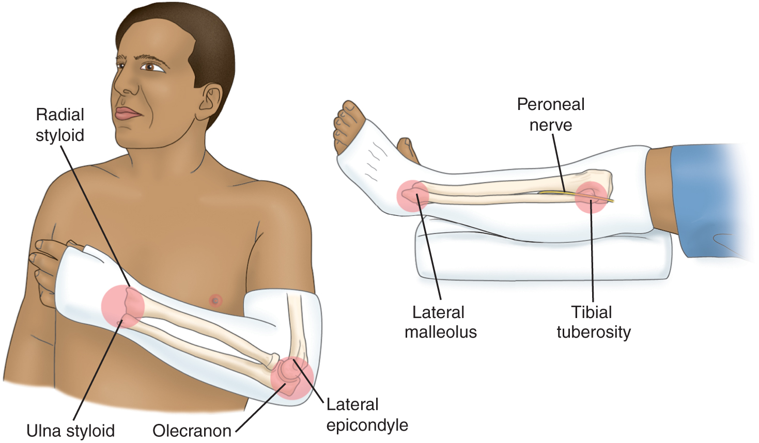
Long-Arm and Short-Leg Cast and Common Pressure Areas

Slide 6
Teaching Needs of the Patient with a Cast
Prior to cast application
Explanation of condition necessitating the cast
Purpose and goals of the cast
Expectations during the casting process- for example heat from hardening plaster
Cast care: keep dry, do not cover with plastic
Positioning: elevation of extremity, use of slings
Hygiene
Activity and mobility

Slide 7
Teaching Needs of the Patient with a Cast
Exercises
Do not scratch or stick anything under cast
Cushion rough edges
Signs and symptoms to report: persistent pain or swelling, changes in sensation, movement, skin color or temperature, signs of infection or pressure areas
Required follow-up care
Cast removal

Slide 8
Splint and Braces
Contoured splints of plaster or pliable thermoplastic materials may be used for conditions that do not require rigid immobilization, for those in which swelling may be anticipated, and for those that require special skin care.
Braces (ie, orthoses) are used to provide support, control movement, and prevent additional injury. They are custom fitted to various parts of the body.

Slide 9
Nursing Process: The Care of the Patient with a Brace, Splint or Cast—Assessment
Prior to application
General health assessment
Emotional status
Presenting signs and symptoms and condition of the area
Knowledge
Monitoring of neurovascular status and for potential complications

Slide 10
Nursing Process: The Care of the Patient with a Brace, Splint, or Cast—Diagnoses
Deficient knowledge
Acute pain
Impaired physical mobility
Self-care deficit
Impaired skin integrity
Risk for peripheral neurovascular dysfunction

Slide 11
Collaborative Problems/Potential Complications
Compartment syndrome
Pressure ulcer
Disuse syndrome
Delayed union or nonunion of fracture(s)

Slide 12
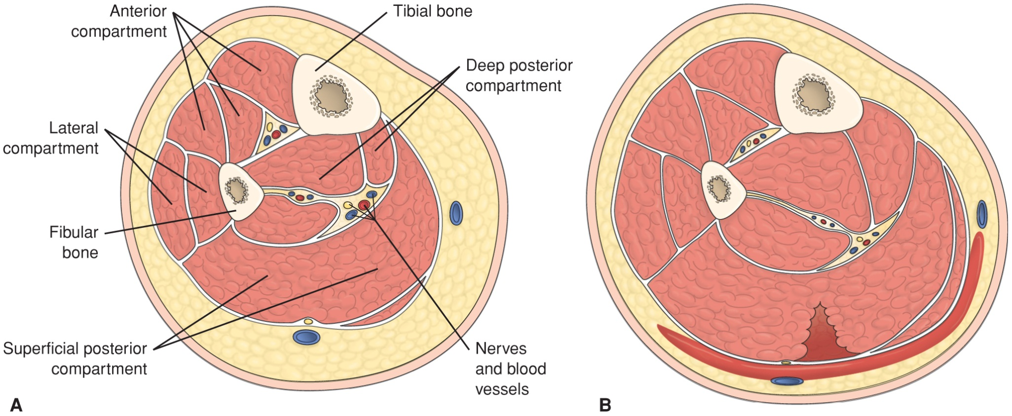
Cross-Section of Normal Muscle Compartments and Cross-Section with Compartment Syndrome

Slide 13
Nursing Process: The Care of the Patient with a Brace, Splint, or Cast—Planning
Major goals include knowledge of the treatment regimen, relief of pain, improved physical mobility, achievement of maximum level of self-care, healing of any trauma-associated lacerations and abrasions, maintenance of adequate neurovascular function, and absence of complications.

Slide 14
Interventions
Relieving pain
Elevation to reduce edema
Intermittent application of ice or cold
Positioning changes
Administration of analgesics
Note: Unrelieved pain may indicate compartment syndrome; discomfort due to pressure may require change of cast
Muscle-setting exercises see Chart 67-3
Patient teaching see Chart 67-4

Slide 15
Interventions
Healing skin wounds and maintaining skin integrity
Treat wounds to skin before the brace, splint, or cast is applied
Observe for signs and symptoms of pressure or infection
Note: Patient may require tetanus booster
Maintaining adequate neurovascular status
Assess circulation, sensation, and movement
Five “P’s”
Notify physician of signs of compromise at once
Elevate extremity no higher than the heart
Encourage movement of fingers or toes every hour

Slide 16
External Fixation Devices
Used to manage open fractures with soft tissue damage
Provide support for complicated or comminuted fractures
Patient requires reassurance due to appearance of device
Discomfort is usually minimal and early mobility may be anticipated with these devices.
Elevate to reduce edema
Monitor for signs and symptoms of complications including infection
Pin care
Patient teaching

Slide 17
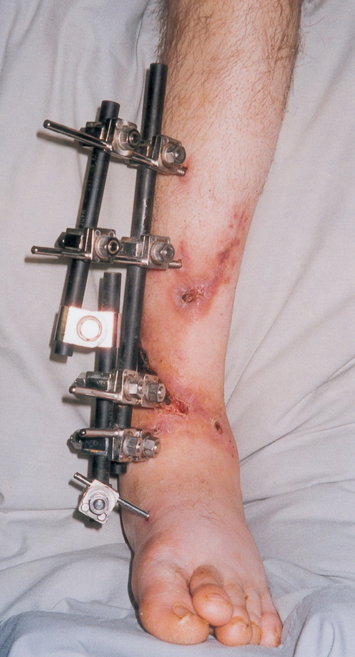
External Fixation Device

Slide 18
Traction
The application of pulling force to a part of the body
Purposes:
Reduce muscle spasms
Reduce, align, and immobilize fractures
Reduce deformity
Increase space between opposing forces
Used as a short-term intervention until other modalities are possible

Slide 19
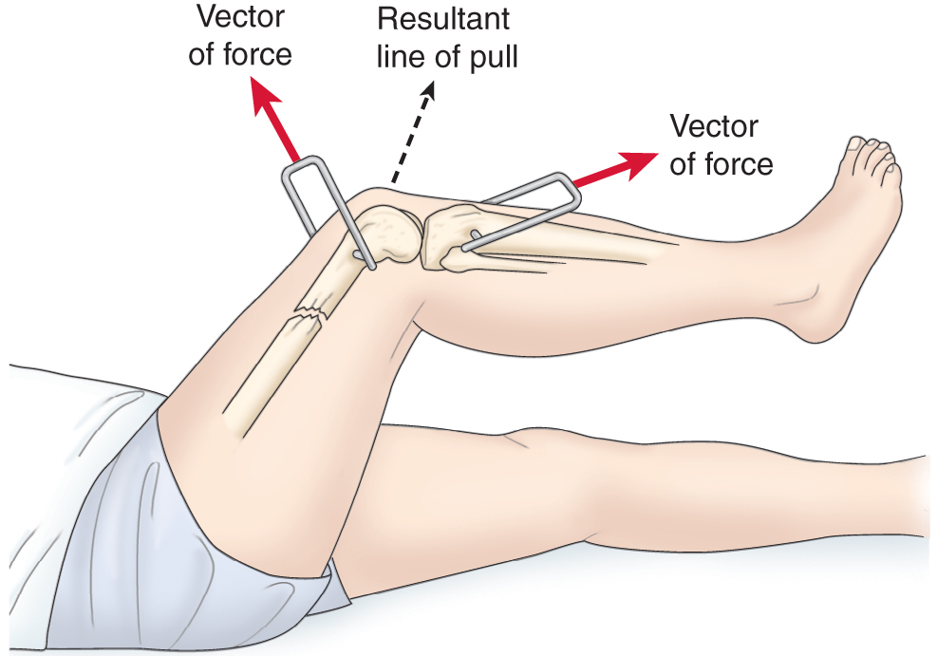
All traction needs to be applied in two directions. The lines of pull are “vectors of force.” The result of the pulling force is between the two lines of the vectors of force.

Slide 20
Principles of Effective Traction
Whenever traction of applied a counterforce must be applied. Frequently the patient’s body weight and positioning in bed supply the counterforce.
Traction must be continuous to reduce and immobilize fractures.
Skeletal traction is never interrupted.
Weights are not removed unless intermittent traction is prescribed.
Any factor that reduces pull must be eliminated.
Ropes must be unobstructed and weights must hang freely.
Knots or the footplate must not touch the foot of the bed.

Slide 21
Types of Traction
Skin traction
Buck’s extension traction
Cervical head halter
Pelvic traction
Skeletal traction

Slide 22
Types of tractions:
I. Skin traction: is used to control muscle spasm and to immobilize an area before surgery. No more than 2-3.5 kg of traction should be used, pelvic traction 4.5 to 9 kg depending on the patient weight
Complications:
Skin breakdown, nerve pressure (drop foot), and circulatory impairment ( DVT)
Nursing interventions:
Ensuring effective traction
Monitor and managing potential complications

Slide 23
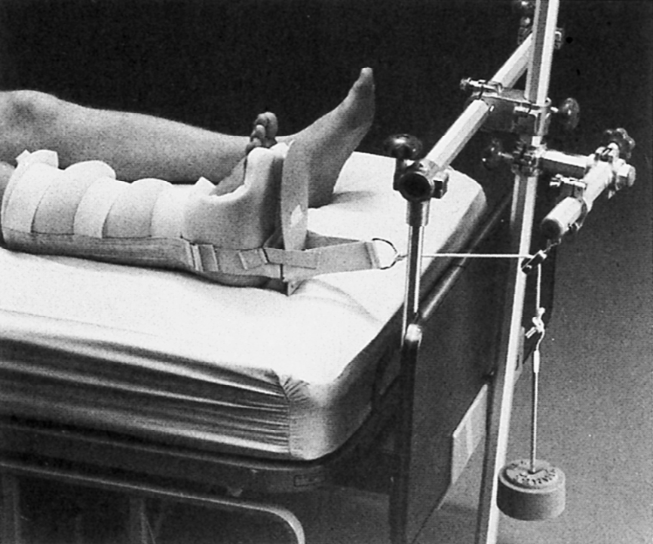
Buck’s Extension Traction

Slide 24
Types of tractions (cont…):
II. Skeletal traction: applied directly to the bone by using metal pin or wires. Most frequently used to treat fracture of long bones and the cervical spine. Is a surgical procedure. Skeletal traction uses 7-12 kg, as the muscle relax the traction weight is reduced to prevent fracture dislocation and to promote healing
After removing the traction cast or splint are then used to support the healing bone.

Slide 25
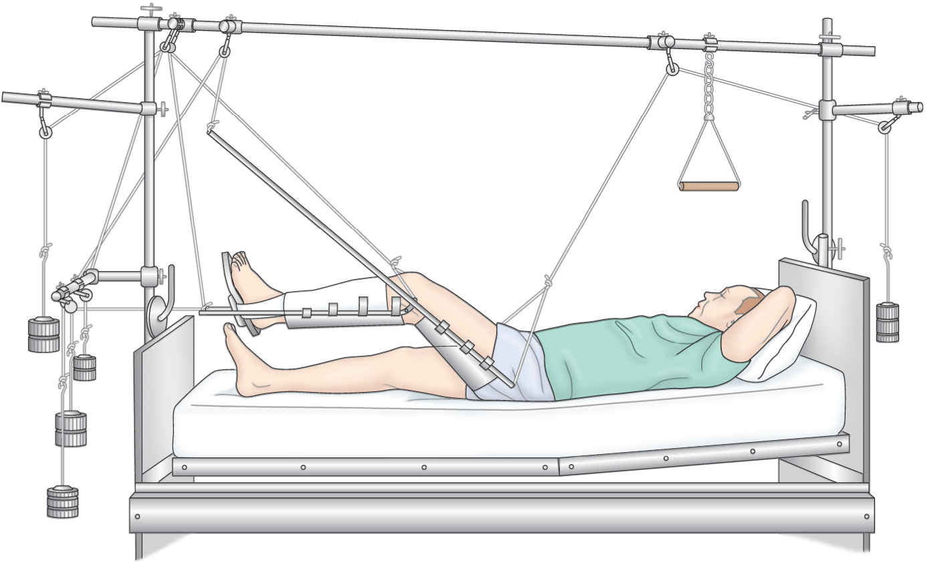
Balanced Skeletal Traction with Thomas Leg Splint

Slide 26
Preventive Nursing Care Needs of the Patient in Traction
Proper application and maintenance of traction
Monitor for complications of skin breakdown, nerve pressure, and circulatory impairment
Inspect skin at least three times a day
Palpate traction tapes to assess for tenderness
Assess sensation and movement
Assess pulses color capillary refill, and temperature of fingers or toes
Assess for indicators of DVT
Assess for indicators of infection

Slide 27
Preventative Interventions
Promptly report any alteration in sensation or circulation
Frequent back care and skin care
Regular shifting of position
Special mattresses or other pressure reduction devices
Perform active foot exercises and leg exercises every hour
Elastic hose, pneumatic compression hose, or anticoagulant therapy may be prescribed
Trapeze to help with movement for patients in skeletal traction
Pin care
Exercises to maintain muscle tone and strength

Slide 28
Nursing Process: The Care of the Patient in Traction—Assessment
Assessment of neurovascular status and for complications
Assessment for mobility-related complications of pneumonia, atelectasis, constipation, nutritional problems, urinary stasis, or UTI
Pain and discomfort
Emotional and behavioral responses
Coping
Thought processes
Knowledge

Slide 29
Nursing Process: The Care of the Patient in Traction—Diagnoses
Deficient knowledge
Anxiety
Acute pain
Self-care deficit
Impaired physical mobility

Slide 30
Collaborative Problems/Potential Complications
Pressure ulcer
Atelectasis
Pneumonia
Constipation
Anorexia
Urinary stasis and infection
DVT

Slide 31
Nursing Process: The Care of the Patient in Traction—Planning
Major goals include understanding of the treatment regimen, reduced anxiety, maximum comfort, maximum level of self-care within the therapeutic limits of the traction, and absence of complications.

Slide 32
Interventions
Interventions to prevent skin breakdown, nerve pressure, and circulatory impairment
Measures to reduce anxiety
Providing and reinforcing information
Encourage patient participation in decision- making and in care
Frequent visits (family and of caregivers/nurse) to reduce isolation
Diversional activities
Use of assistive devices

Slide 33
Interventions
Consultation with/referral for physical therapy
Prevention of atelectasis and pneumonia
Auscultate lungs every 4–8 hours
Coughing and deep breathing exercises
High-fiber diet
Encourage fluids
Identify and include food preferences, encourage proper diet

Slide 34
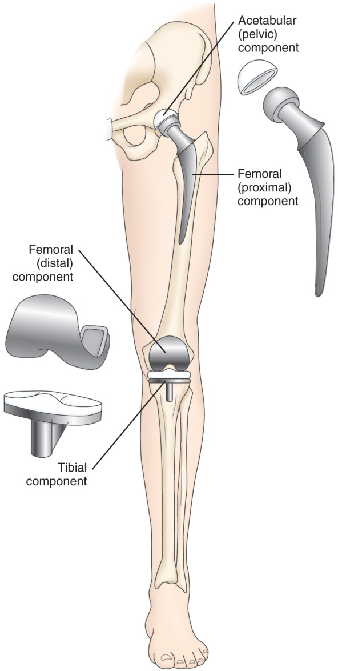
Joint Replacements
Used to treat severe joint pain and disability and for repair and management of joint fractures or joint necrosis.
Frequently replaced joints include the hip, knee, and fingers.
Joints including the shoulder, elbow, wrist, and ankle may also be replaced.

Slide 35
Needs of Patients with Hip or Knee Replacement Surgery
Mobility and ambulation
Patients usually begin ambulation within a day after surgery using walker or crutches.
Weight-bearing as prescribed by the physician
Drain use postoperatively
Assess for bleeding and fluid accumulation
Prevention of infection
Infection may occur in the immediate postoperative period (within 3 months), as a delayed infection (4–24 months), or due to spread from another site (more than 2 years)
Prevention of DVT
Patient teaching and rehabilitation

Slide 36
Hip Prosthesis
Positioning of the leg in abduction to prevent dislocation of the prostheses
Do not flex hip more than 90°
Avoid internal rotation
Protective positioning include maintaining abduction, avoiding internal and external rotation, hyperextension, and a cute flexion

Slide 37
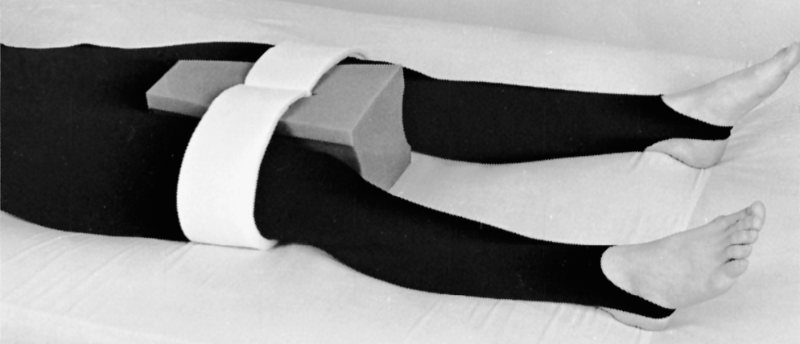
Use of an Abduction Pillow to Prevent Hip Dislocation After Total Hip Replacement

Slide 38
Knee Prostheses
Encourage active flexion exercises
Use of continuous passive motion (CPM) device

Slide 39
CPM Device
Refer to fig. 67-9

Slide 40
CPM Device

Slide 41
Nursing Process: The Care of the Patient Undergoing Orthopedic Surgery—Assessment, Preoperative
Routine preoperative assessment
Hydration status
Medication history
Possible infection
Ask specifically about colds, dental problems, urinary tract infections, infections within 2 weeks
Knowledge
Support and coping

Slide 42
Nursing Process: The Care of the Patient Undergoing Orthopedic Surgery—Assessment, Postoperative
Pain
Vital signs, including respirations and breath sounds
LOC
Neurovascular status and tissue perfusion
Signs and symptoms of bleeding—wound drainage
Mobility and understanding of mobility restrictions
Bowel sounds and bowel elimination
Urinary output
Signs and symptoms of complications—DVT or infection

Slide 43
Nursing Process: The Care of the Patient Undergoing Orthopedic Surgery—Diagnoses
Acute pain
Risk for peripheral neurovascular dysfunction
Risk for ineffective therapeutic regimen management
Impaired physical mobility
Risk for situational low self-esteem and/or disturbed body image

Slide 44
Collaborative Problems/Potential Complications—Postoperative
Hypovolemic shock
Atelectasis
Pneumonia
Urinary retention
Infection
Thromboembolism—DVT or PE
Constipation or fecal impaction

Slide 45
Nursing Process: The Care of the Patient Undergoing Orthopedic Surgery—Planning
Major goals preoperatively and postoperatively may include the relief of pain, adequate neurovascular function, health promotion, improved mobility, and positive self-esteem.
Postoperative goals include the absence of complications.

Slide 46
Relief of Pain
Administration of medications
Patient-controlled analgesia (PCA)
Other medications
Medicate before planned activity and ambulation
Use alternative methods of pain relief
Repositioning, distraction, guided imagery. etc.
Specific individualized strategies to control pain
Use of ice or cold
Elevation
Immobilization

Slide 47
Interventions
Muscle setting, ankle and calf-pumping exercises
Measures to ensure adequate nutrition and hydration
Note: Large amounts of milk should not be given to orthopedic patients on bed rest
Skin care measures including frequent turning and positioning
Follow physical therapy and rehabilitation programs
Encourage the patient to set realistic goals and perform self-care care within limits of the therapeutic regimen

Slide 48
Interventions
Preventing atelectasis and pneumonia
Encourage coughing and deep breathing exercises
Use of incentive spirometry
Constipation
Monitoring of bowel function
Hydration
Early mobilization
Stool softeners
Patient teaching

