Slide 1
Chapter 68 Management of Patients With Musculoskeletal Disorders

Slide 2
Acute low Back pain:
Causes:
A cut lumbosacral strain,
unstable lumbosacral ligaments and weak muscles,
osteoarithritis of the spine,
spinal stenosis, intervertebral disk problems,
and unequal leg length.
Other causes include kidney diorders, pelvic problems, retroperitoneal tumors, abdominal aneurysims, obesity and stress.
L4-L5 and L5-S1 has the greatest degenrative changes

Slide 3
Clinical manifestations:
A cute or chronic back pain lasting more than 3 months without improvement)
Fatique
Pain radiating down the leg ( radiculopathy; Sciatica)
Patient’s gait, spinal mobility, reflexes, leg length, leg motor strength and sensory perception may altered

Slide 4
Cont…
Assessment and diagnostic findings:
Focused history and physical examination ( reflexes, sensory impairment, straight leg raising, muscle strength
X-ray of the spine, CT scan, MRI
Bone scan and blood study
Myelogram and dicogram
Electromyogram and nerve conduction studies
Medical management: Analgesia, rest, stress reduction and relaxation
Review the Nursing process

Slide 5
Nursing Process: The Care of the Patient with Low Back Pain—Assessment
Detailed description of the pain including severity, duration, characteristics, radiation, associated symptoms such as leg weakness, description of how the pain occurred, and how the pain has been managed by the patient
Work and recreational activities
Effect of pain and/or movement limitation on lifestyle and ADLs
Assess posture, position changes, and gait
Physical exam: spinal curvature, back and limb symmetry, movement ability, DTRs, sensation, and muscle strength
If obese, complete a nutritional assessment

Slide 6
Nursing Process: The Care of the Patient with Low Back Pain—Diagnoses
Acute pain
Impaired physical mobility
Risk for situational low self-esteem
Imbalanced nutrition

Slide 7
Nursing Process: The Care of the Patient with Low Back Pain—Planning
Major goals may include relief of pain, improved physical mobility, use of back conservation techniques and proper body mechanics, improved self-esteem, and weight reduction.

Slide 8
Interventions
Pain management
Exercise
Body mechanics
Work modifications
Stress reduction
Health promotion; activities to promote a healthy back
Dietary plan and encouragement of weight reduction

Slide 9
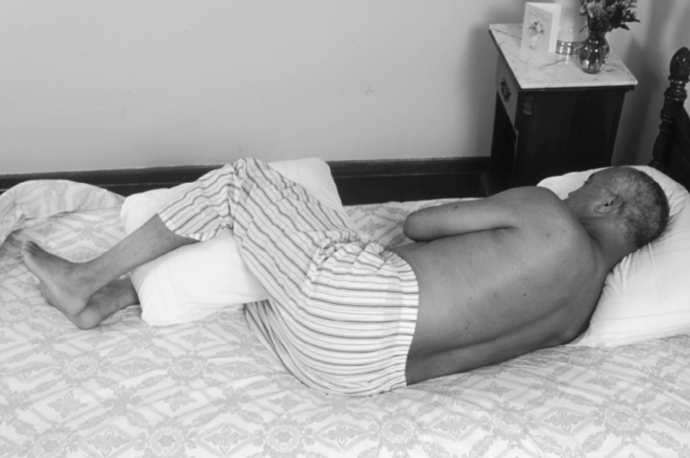
Positioning to Promote Lumbar Flexion

Slide 10
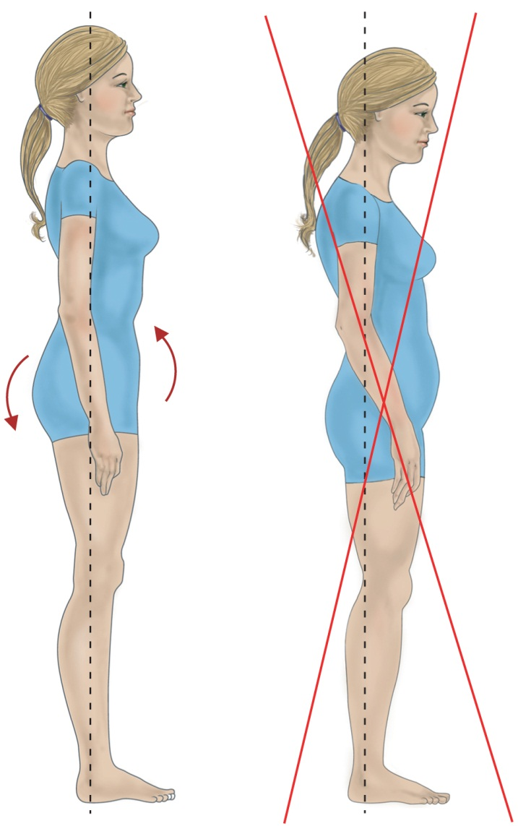
Proper and Improper Standing Postures

Slide 11
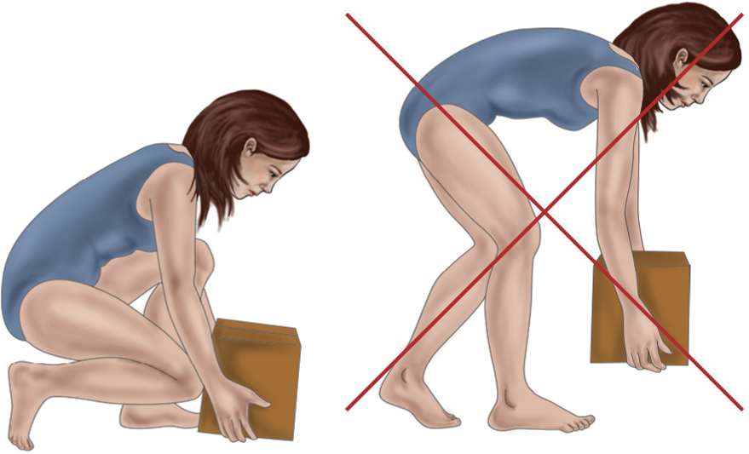
Proper and Improper Lifting Techniques

Slide 12
Osteoporosis
Affects approximately 40 million people over the age of 50 in the United States.
Normal homeostatic bone turnover is altered and the rate of bone resorption is greater than the rate of bone formation, resulting in loss of total bone mass.
Bone becomes porous, brittle, and fragile, and break easily under stress
Frequently result in compression fractures of the spine, fractures of the neck or intertrochanteric region of the femur, and Colles’ fractures of the wrist
Risk factors.

Slide 13
Pathophysiology of Osteoporosis

Slide 14
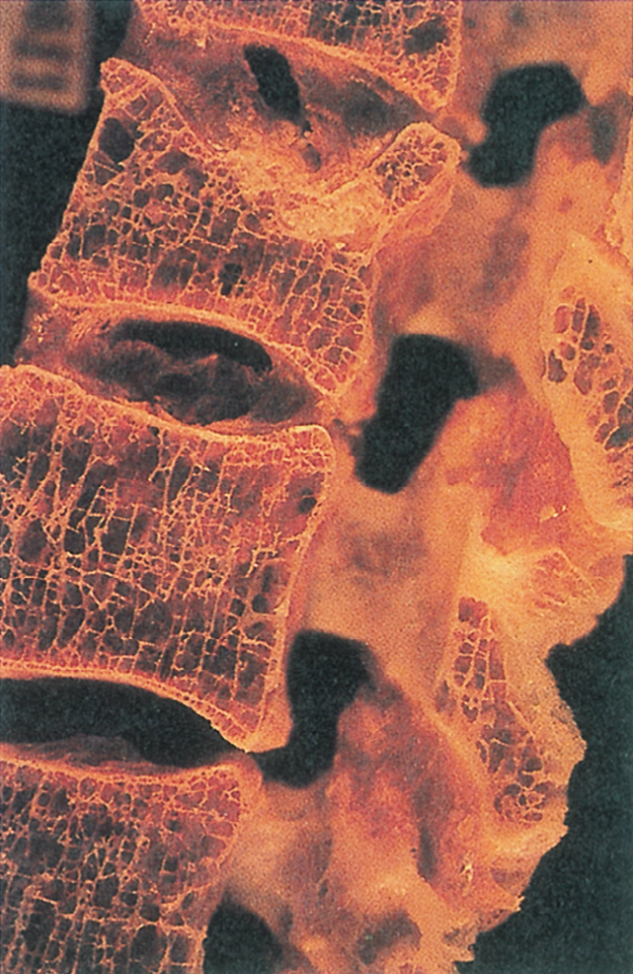
Progressive Osteoporosis Bone Loss and Compression Fractures

Slide 15
Risk factors: see chart 68-7
Assessment and diagnostic findings:
Routine X-ray, and bone sonometer
Lab. Studies: Serum Ca, Serum Ph, urine calcium excretion, ESR
Medical Management:
Adequate balanced diet rich in calcium and Vit D
Regular weight bearing exercise promotes bone formation
Pharmacological therapy: Hormonal replacement therapy ( look for side effect of estrogen and progesterone replacement therapy which result in cancers… thus frequent breast examination is recommended )
Alendronate alternative to Hormonal replacement therapy: inhibiting osteoclast function and dedcreases bon loss
Calcitonin: suppress bone loss

Slide 16
Osteoporosis
Manifestations :
Loss of height
Progressive curvature of spine
Low back pain
Fractures of forearm, spine, hip
Development of “dowager’s hump”
Dorsal kyphosis
Cervical lordosis

Slide 17
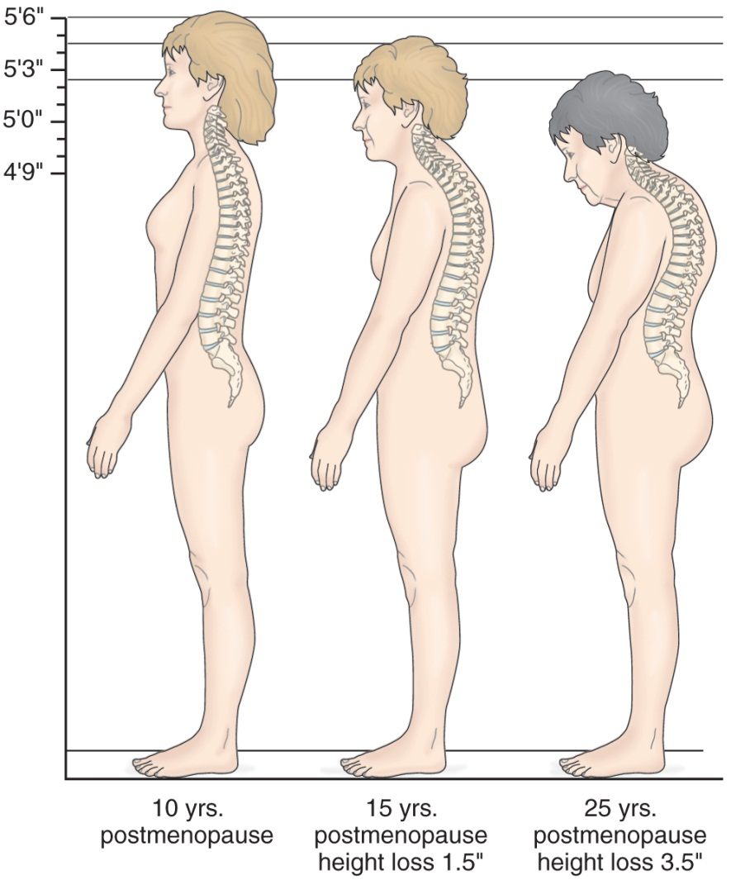
Typical Loss of Height Associated with Osteoporosis and Aging

Slide 18
Prevention
Balanced diet high calcium and vitamin D throughout life
Use of calcium supplements to ensure adequate calcium intake—take in divided doses with vitamin C
Regular weight-bearing exercises—walking
Weight training stimulates bone mineral density (BMD)

Slide 19
Pharmacologic Therapy
Biphosphonates
Alendronate: Fosamax
Risedronate: Actonel
Ibandronate: Boniva
Selective estrogen modulators (SERMs): Evista
Cacitonin
Teriparatide: Forteo
Also need adequate amounts of calcium and vitamin D

Slide 20
Nursing Process: The Care of the Patient with Osteoporosis—Assessment
Occurrence of osteopenia and osteoporosis
Family history
Previous fractures
Dietary consumption of calcium
Exercise patterns
Onset of menopause
Use of corticosteroids as well as alcohol, smoking, and caffeine intake

Slide 21
Nursing Process: The Care of the Patient with Osteoporosis—Diagnoses
Deficient knowledge about the osteoporotic process and treatment regimen
Acute pain related to fracture and muscle spasm
Risk for constipation related to immobility or development of ileus (intestinal obstruction)
Risk for injury: additional fractures related to osteoporosis

Slide 22
Nursing Process: The Care of the Patient with Osteoporosis—Planning
The major goals for the patient may include knowledge about osteoporosis and the treatment regimen, relief of pain, improved bowel elimination, and absence of additional fractures.

Slide 23
Interventions
Promoting understanding of osteoporosis and the treatment regimen
Relieving pain
Improving bowel elimination
Preventing injury

Slide 24
Osteomyelitis
Infection of the bone
Occurs due to:
Extension of soft tissue infection
Direct bone contamination
Blood-borne spread from another site of infection
This typically occur in an area of bone that has been traumatized or has lowered resistance
Causative organisms
Staphylococcus aureus (70–80%)
Other: Proteus and Pseudomonas species, E. coli

Slide 25
Prevention of osteomyelitis is the goal.
Early detection and prompt treatment of osteomyelitis is required to reduce potential for chronic infection and disability.

Slide 26
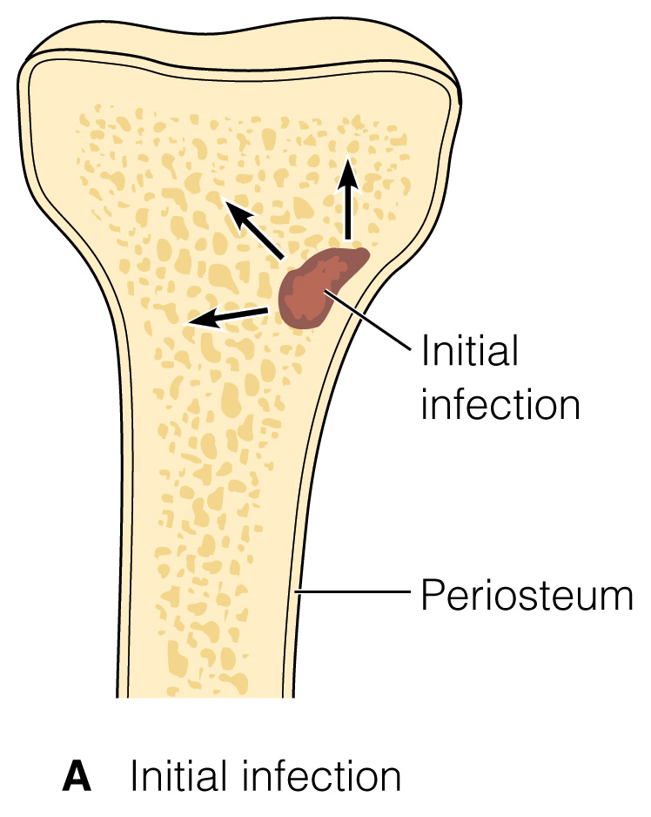
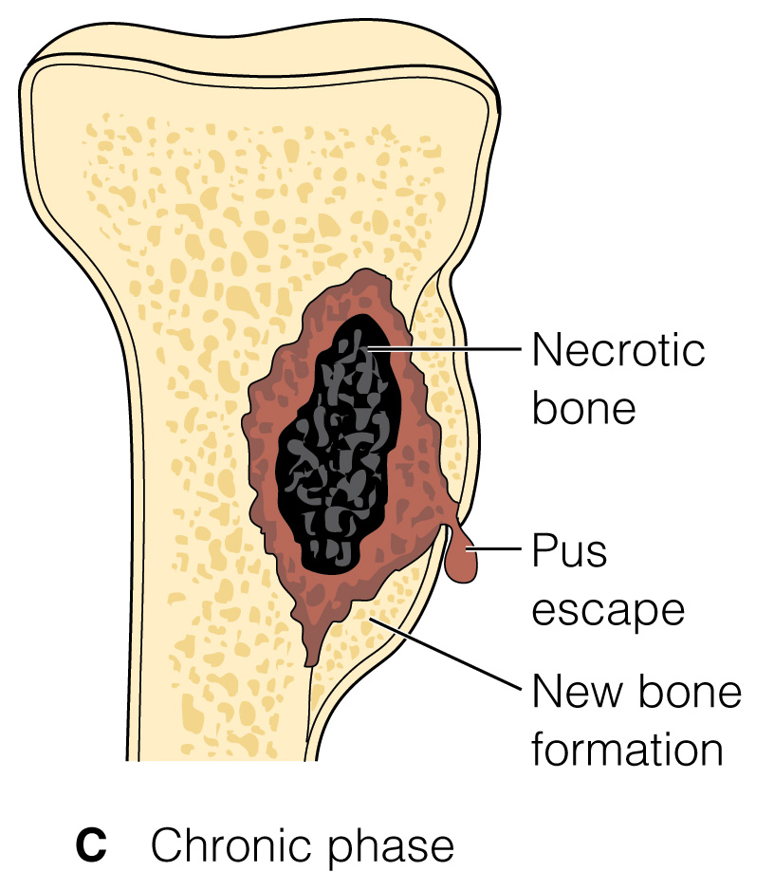

Slide 27
Osteomyelitis
Deep sepsis after arthroplasty may be classified as follows:
Stage 1, acute fulminating: occurring during the first 3 months after orthopedic surgery; frequently associated with hematoma,drainage, or superficial infection
Stage 2, delayed onset: occurring between 4 and 24 months after surgery
Stage 3, late onset: occurring 2 or more years after surgery, usually as a result of hematogenous spread

Slide 28
Nursing Process: The Care of the Patient with Osteomyelitis—Assessment
Risk factors
Signs and symptoms of infection localized pain edema, erythema, fever, drainage
Note: With chronic osteomyelitis fever may be low grade and occur in afternoon or evening
Signs and symptoms of adverse reactions and complications of antibiotic therapy including signs and symptoms of superinfections
Ability to adhere to prescribed therapeutic regimen— antibiotic therapy

Slide 29
Nursing Process: The Care of the Patient with Osteomyelitis—Diagnoses
Acute pain
Impaired physical mobility
Risk for extension of infection: bone abscess formation
Deficient knowledge

Slide 30
Nursing Process: The Care of the Patient with Osteomyelitis—Planning
Major goals may include relief of pain, improved physical mobility, within therapeutic limitations, control and eradication of infection, and knowledge of therapeutic regimen.

