Slide 1
Chapter 69 Management of Patients With Musculoskeletal Trauma

Slide 2
Injuries of the Musculoskeletal System
Contusion: soft tissue injury produced by blunt force
Pain, swelling, and discoloration: ecchymosis
Strain: Pulled muscle-injury to the musculcoteninous unit
Pain, edema, muscle spasm, ecchymosis, and loss of function are on a continuum graded 1st , 2nd, and 3rd degree
Sprain: injury to ligaments and supporting muscle fiber around a joint
Joint is tender and movement is painful, edema, disability and pain increases during the first 2–3 hours
Dislocation: articular surfaces of the joint are not in contact
A traumatic dislocation is an emergency with pain change in contour, axis, and length of the limb and loss of mobility

Slide 3
RICE
Rest
Ice
Compression
Elevation

Slide 4
Common Sports-Related Injuries
Contusions, strains, sprains and dislocations
Tendonitis: inflammation of a tendon by overuse
Meniscal injuries of the knee occur with excessive rotational stress
Traumatic fractures
Stress fractures

Slide 5
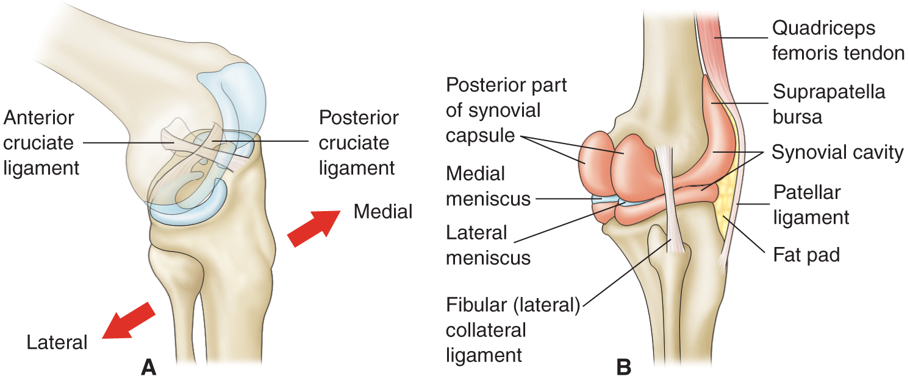
Knee Ligaments, Tendons, and Menisci

Slide 6
Prevention of Sports-Related Injuries
Use of proper equipment; running shoes for runners, wrist guards for skaters, etc.
Effective training and conditioning specific for the person and the sport
Stretching prior to engaging in a sport or exercise has been recommended but may not prevent injury
Changes in activity and stresses should occur gradually
Time to “cool down”
Tune in to the body; be aware of limits and capabilities
Modify activities to minimize injury and promote healing

Slide 7
Occupational-Related Injuries
Common injuries include strains, sprains, contusions, fractures, back injuries, tendonitis, and amputations.
Prevention measures may include personnel training, proper use of equipment, availability of safety and other types of equipment (patient lifting equipment, back belts), correct use of body mechanics, and institutional policies.

Slide 8
Joint Dislocation
articular surfaces of the joint are not in contact
A traumatic dislocation is an emergency with pain change in contour, axis, and length of the limb and loss of mobility
Most common
Shoulder
Acromioclavicular joints
Subluxation
Partial dislocation

Slide 9
Types of Fractures
Complete
Incomplete
Closed or simple
Open or compound/complex
Grade I
Grade II
Grade III

Slide 10
Cont…
Grade I: clean wound less than 1 cm
Grade II: larger wound without extensive soft tissue damage
Grade III: is highly contaminated, has extensive soft tissue damage, and is the most severe

Slide 11
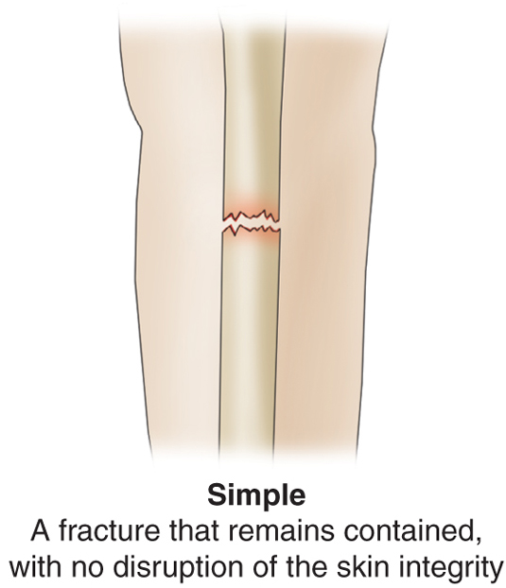
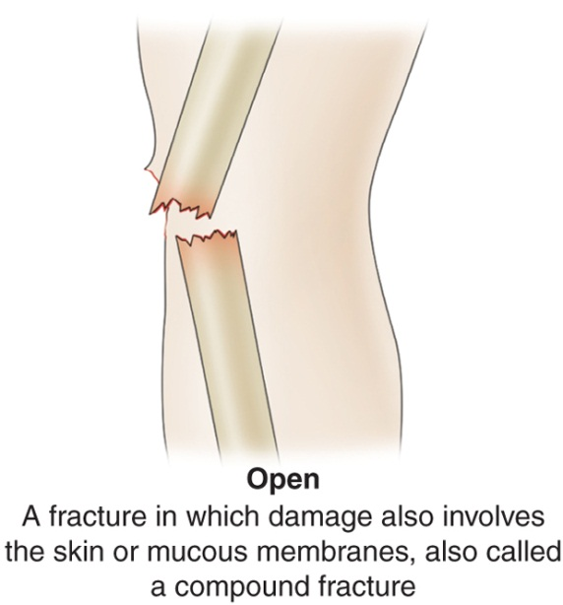
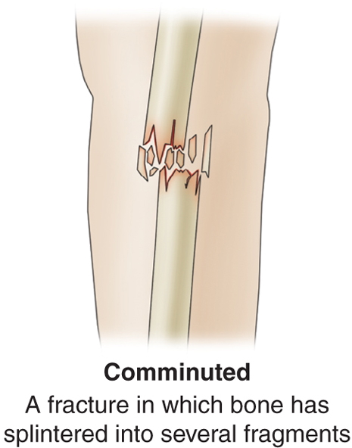
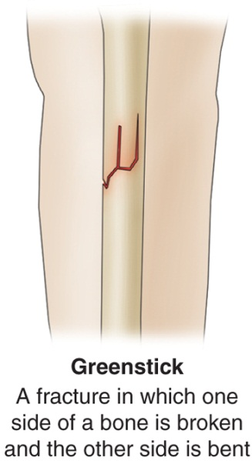
Types of Fractures

Slide 12
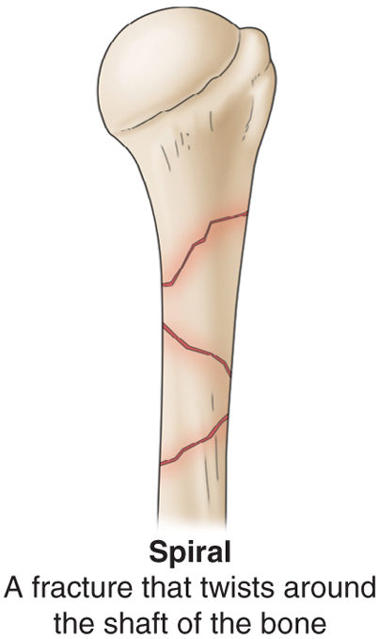
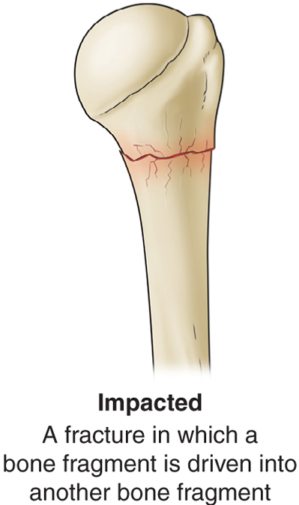
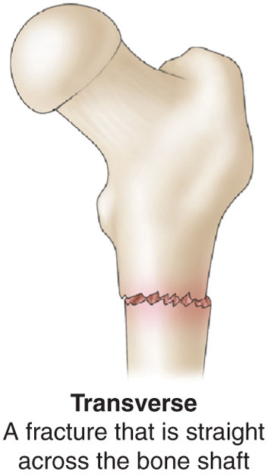
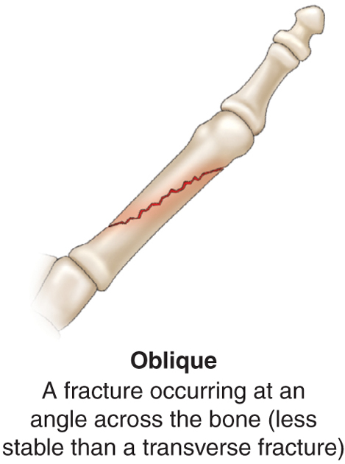
Types of Fractures

Slide 13
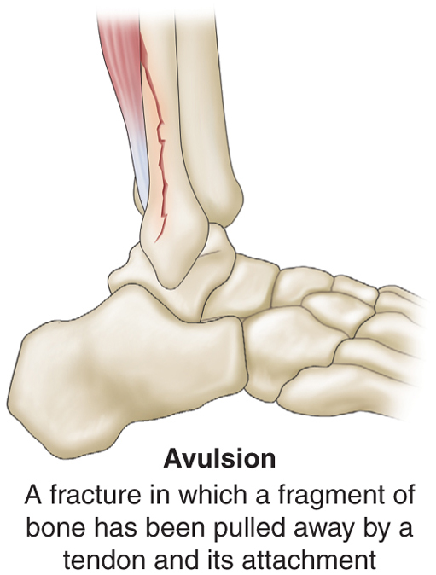
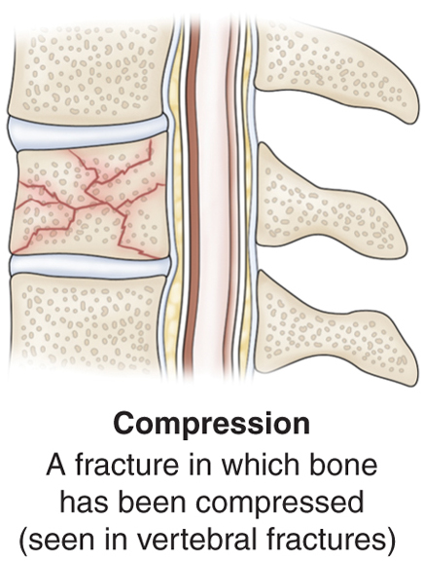
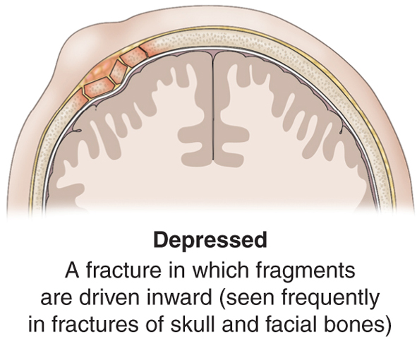
Types of Fractures

Slide 14
Manifestations of Fracture
Pain
Loss of function
Deformity
Shortening of the extremity
Crepitus
Local swelling and discoloration
Diagnosis by symptoms and x-ray
Patient usually reports an injury to the area

Slide 15
Emergency Management
Immobilize the body part
Splinting: joints distal and proximal to the suspected fracture site must be supported and immobilized
Assess neurovascular status before and after splinting
Open fracture: cover with sterile dressing to prevent contamination
Do not attempt to reduce the fracture

Slide 16
Medical Management
Reduction
Closed
Open
Immobilization: internal or external fixation
Open fractures require treatment to prevent infection
Tetanus prophylaxis, antibiotics, and cleaning and debridement of wound
Closure of the primary wound may be delayed to permit edema, wound drainage, further assessment, and debridement if needed

Slide 17
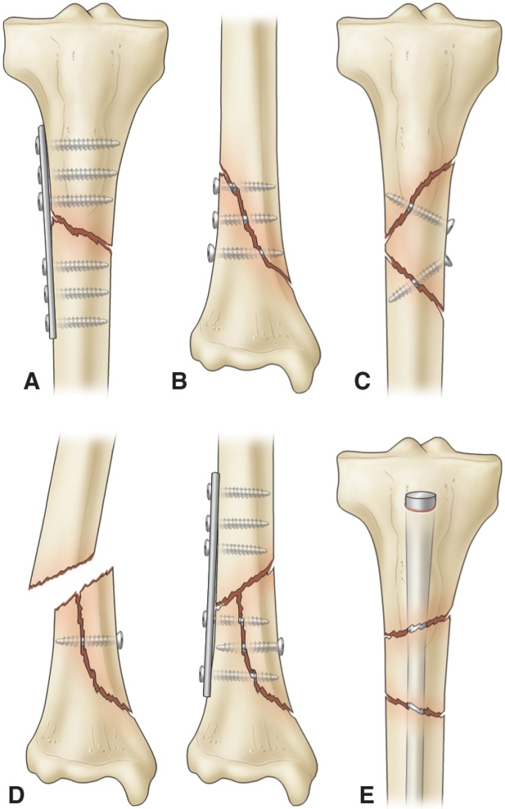
Techniques of Internal Fixation

Slide 18
Three Phases of Fracture Healing
Inflammatory phase
Reparative phase: collagen formation and calcium deposition
Remodeling phase:
1. Excess callus is removed
2. New bone is laid down
3. Fracture site calcifies
4. Bone is reunited

Slide 19
Three Phases of Fracture Healing
Inflammatory phase
Reparative phase: collagen formation and calcium deposition
Remodeling phase:
1. Excess callus is removed
2. New bone is laid down
3. Fracture site calcifies
4. Bone is reunited

Slide 20
Three Phases of Fracture Healing
Inflammatory phase
Reparative phase: collagen formation and calcium deposition
Remodeling phase:
1. Excess callus is removed
2. New bone is laid down
3. Fracture site calcifies
4. Bone is reunited

Slide 21
Complications of Fractures
Factors that affect fracture healing
Shock
Fat embolism
Compartment syndrome
Delayed union and nonunion
Avascular necrosis
Reaction to internal fixation devices
Complex regional pain syndrome (CRPS)
Heterotrophic ossification

Slide 22
Fracture Complications
Early complications:
Shock: Hypovolemic or traumatic shock
result from bleeding or from loss of extracellular fluid
Treatment:
1. Restoring blood volume and circulation
2. Releiving patient pain
3. Provide adequate splinting.

Slide 23
Compartment Syndrome 2.
develop when tissue perfusion in the muscles less than that required for tissue viability.
Physiology
Entrapment of the blood vessels limits tissue perfusion
Results in edema within the compartment
Edema causes further pressure
Early Manifestations
Deep Pain which is not controlled by opioids
Normal or decreased peripheral pulse
Later Manifestations
Cyanosis
Paresthesias, paresis
Severe pain

Slide 24
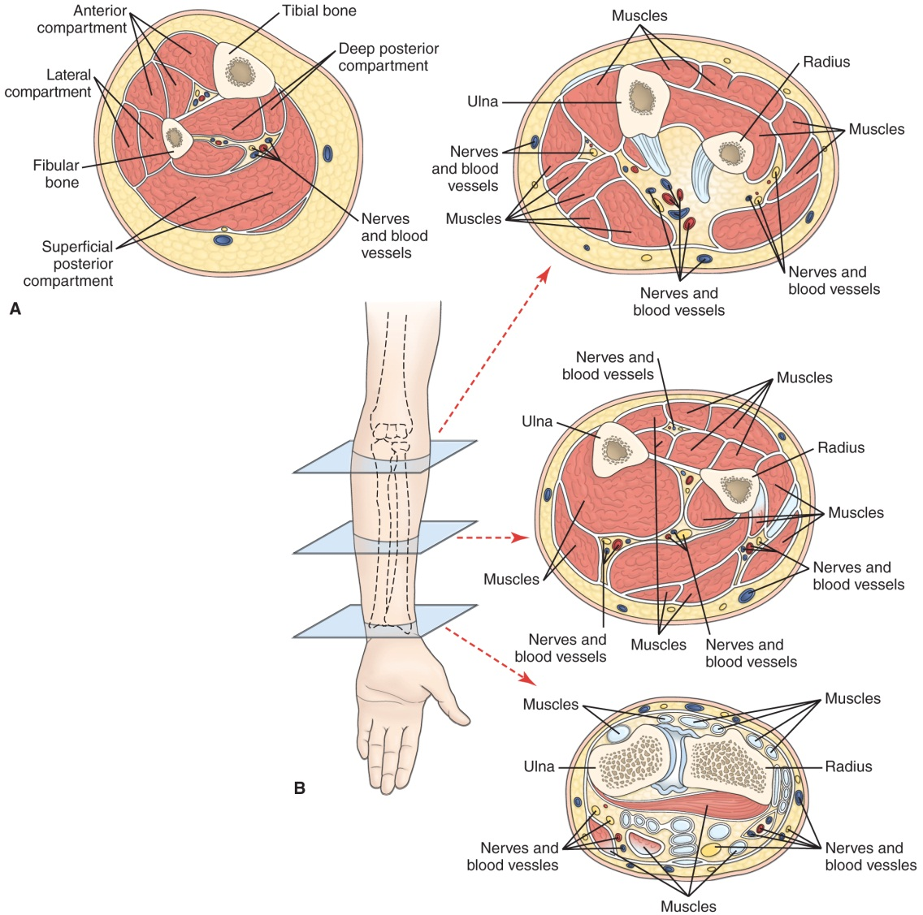
Cross-Sections of Anatomic Compartments

Slide 25
Treatment
Interventions to alleviate pressure
Removal of the cast
Fasciotomy

Slide 26
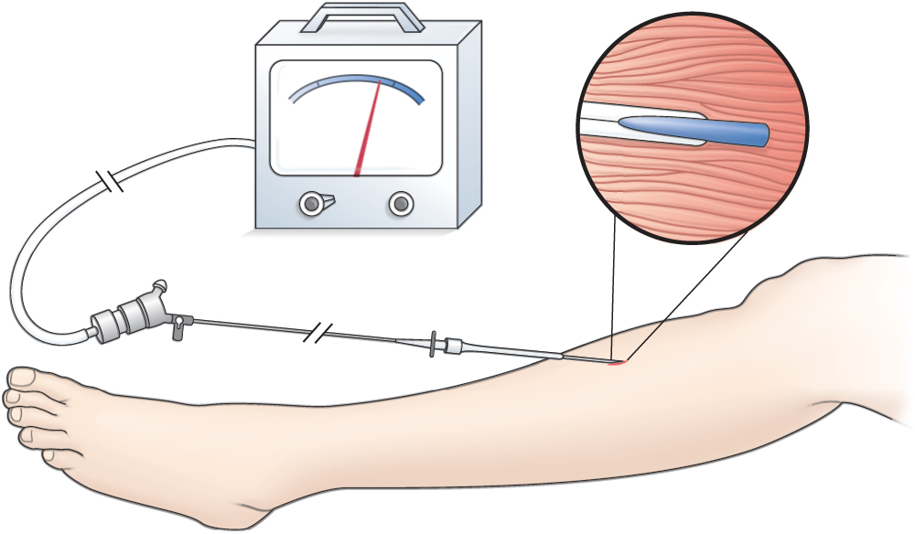
Wick Catheter Used to Monitor Compartment Pressure

Slide 27
Bone Healing Stimulator
Refer to fig. 69-6

Slide 28
3. Fat Embolism Syndrome
Pathophysiology
Bone fracture results in a rise of pressure in the bone marrow
Fat globules enter the bloodstream
Combine with platelets
Travel throughout the body
Occluding small blood vessels
Causes tissue ischemia

Slide 29
Fat Embolism Syndrome
Manifestations
Confusion
Changes in level of consciousness
Pulmonary edema
Impaired surfactant production
Atelectasis
ARDS

Slide 30
Fat Embolism Syndrome
Prevention
Early stabilization of long bone fracture.
Treatment:
Intubation and mechanical ventilation
Fluid balance
Corticosteroids
Vasoactive medication to support the cardiovascular system and prevent hypotension.

Slide 31
4. Deep Vein Thrombosis
Manifestations
Swelling
Leg pain
Tenderness
Cramping
Some are asymptomatic
Diagnosis
Doppler ultrasound

Slide 32
Deep Vein Thrombosis
Treatment
Bed rest
Thrombolytic agents
Heparin
Vena cava filter
Thrombectomy
Prevention is the best treatment
Early immobilization of fractures
Early mobilization of the client

Slide 33
Cont…..
5. DIC
6. Infection
Delayed complications:
Delayed Union: Delay healing, which result from infection and distraction of bone fragment, poor nutrition
Nonunion: failure of the ends of the fractured bone to unite, pt complain of discomfort and abnormal movement at the fracture site. Managed by internal fixation or grafting
Result from infection, interposition of tissue between the bone ends, inadequate immobilization, excessive space, and impaired blood supply

Slide 34
Rehabilitation Related to Specific Fractures
Clavicle
Use of claviclar strap (“figure 8”) or sling
Exercises
Limitation of activities
Do not elevate arm above shoulder for approximately 6 weeks
Humeral neck and shaft fractures
Slings and bracing
Activity limitations and pendulum exercises

Slide 35
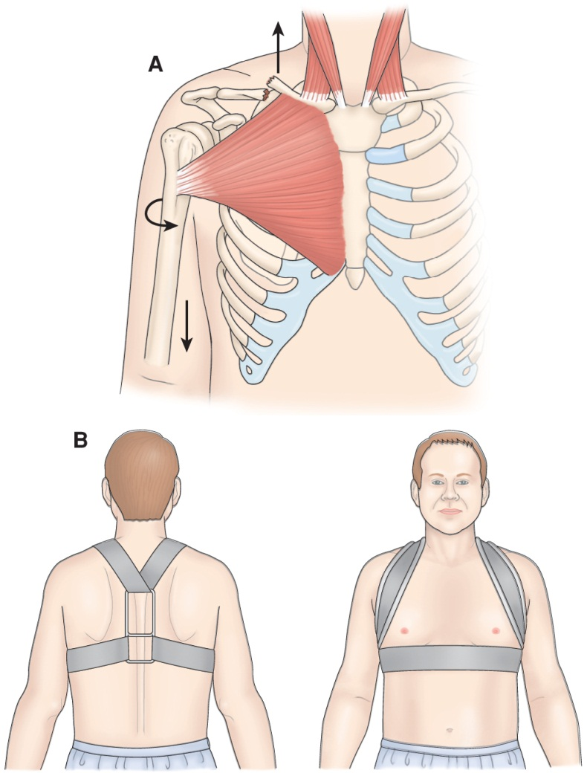
Fracture of Clavicle and Immobilization Device

Slide 36
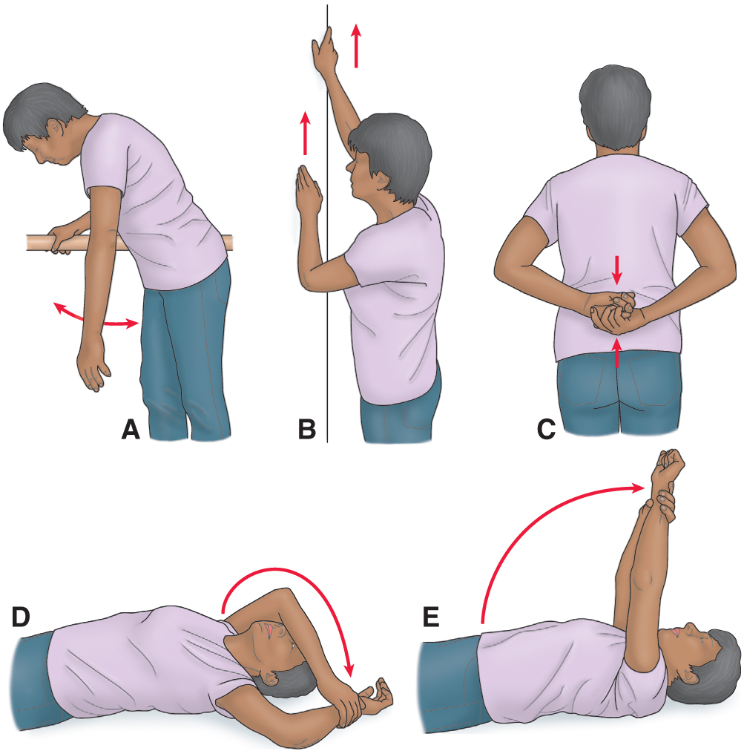
Prescribed Shoulder Exercises (Clavicle Fractures)

Slide 37
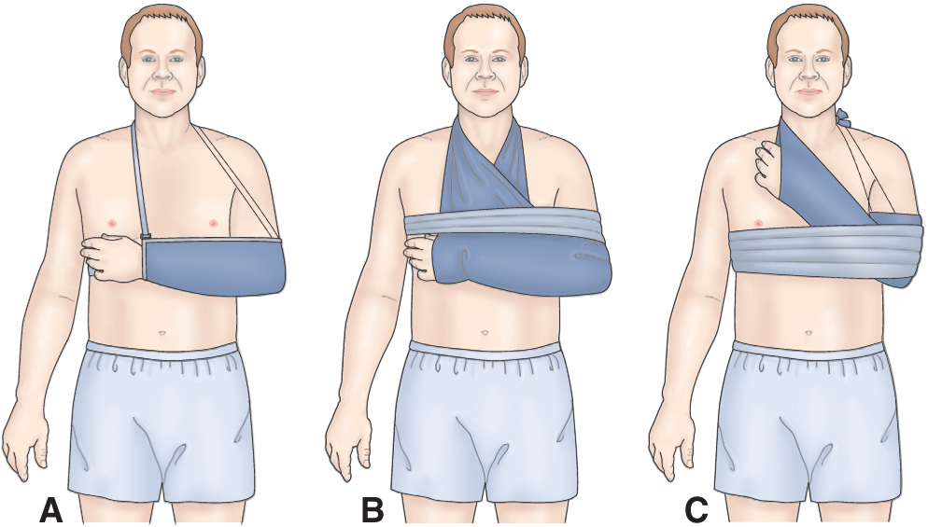
Immobilizers for Proximal Humeral Fractures

Slide 38
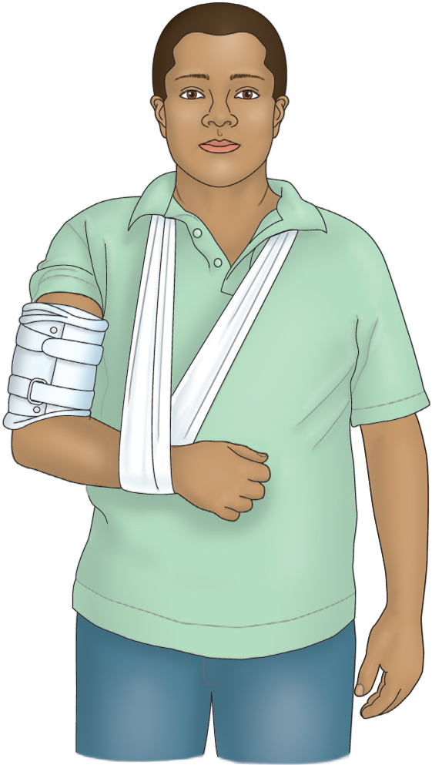
Functional Humeral Brace

Slide 39
Rehabilitation Related to Specific Fractures
Elbow fractures
Monitor regularly for neurovascular compromise and signs of compartment syndrome
Potential for Volkmann's contracture
Active exercises and ROM are encouraged to prevent limitation of joint movement after immobilization and healing (4–6 weeks for nondisplaced, casted) or after internal fixation (about 1 week)
Colles fracture
Early functional rehabilitation exercises
Active motion exercises of fingers and shoulder

Slide 40
Rehabilitation Related to Specific Fractures
Pelvic fractures
Management depends upon type and extent of fracture and associated injuries.
Stable fractures are treated with a few days bed rest and symptom management.
Early mobilization reduces problems related to immobility.
Hip fracture
Surgery is usually done to reduce and fixate the fracture.
Care is similar to that of a patient undergoing other orthopedic surgery or hip replacement surgery.

Slide 41
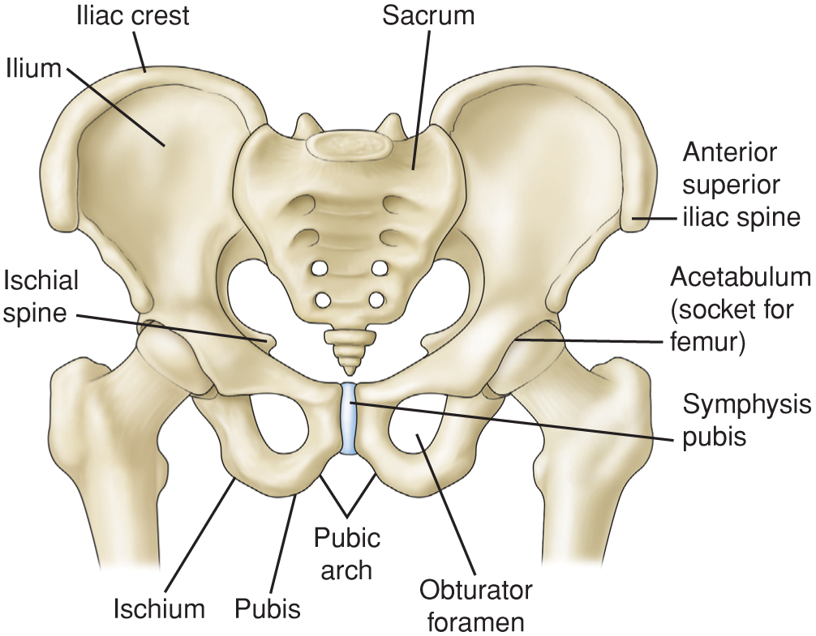
Pelvic Bones

Slide 42
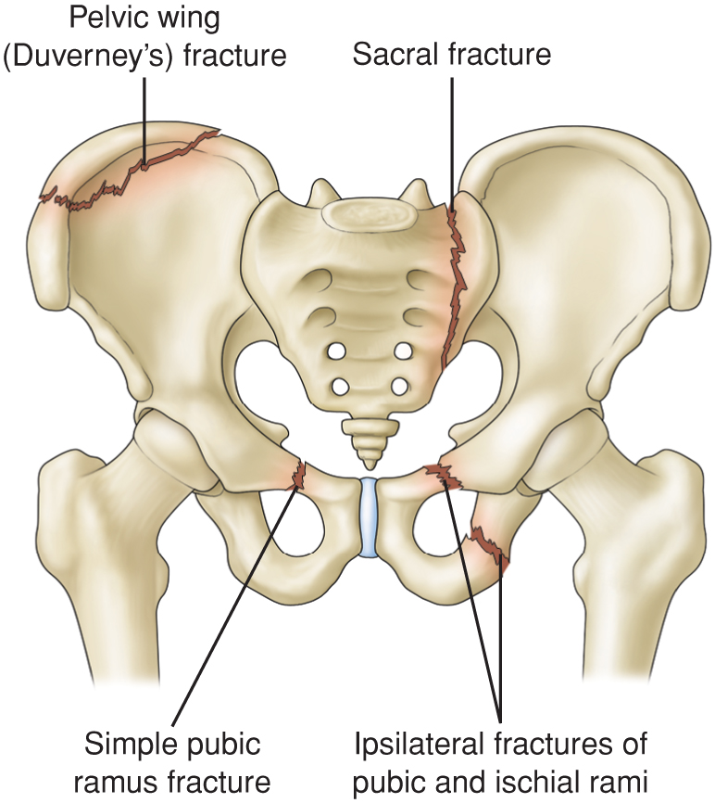
Stable Pelvic Fractures

Slide 43
Unstable Pelvic Fractures

Slide 44
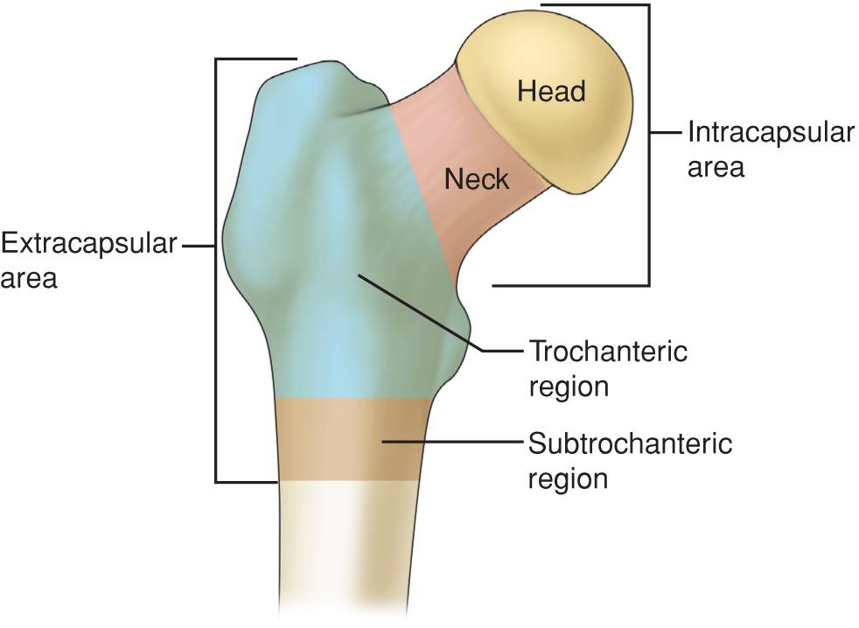
Regions of the Proximal Femur

Slide 45
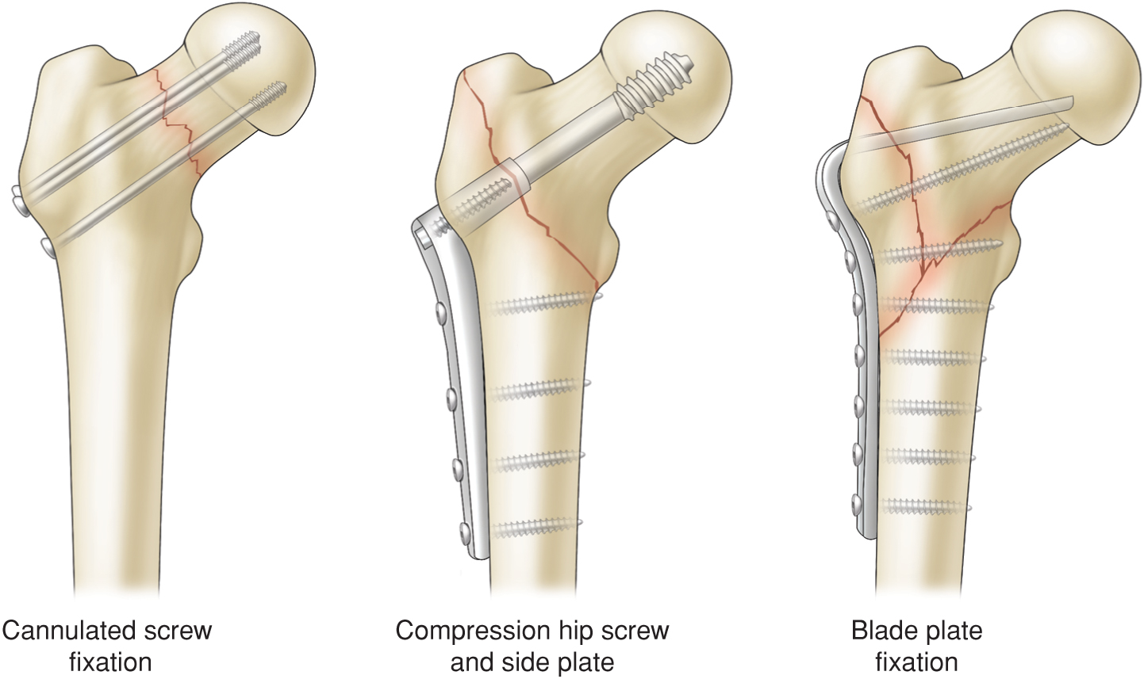
Examples of Internal Fixation for Hip Fractures

Slide 46
Rehabilitation Related to Specific Fractures
Femoral shaft fractures
Lower leg, foot, and hip exercises to preserve muscle function and improve circulation.
Early ambulation stimulates healing.
Physical therapy, ambulation and weight bearing are prescribed.
Active and passive knee exercises are begun as soon as possible to prevent restriction of knee movement.

Slide 47
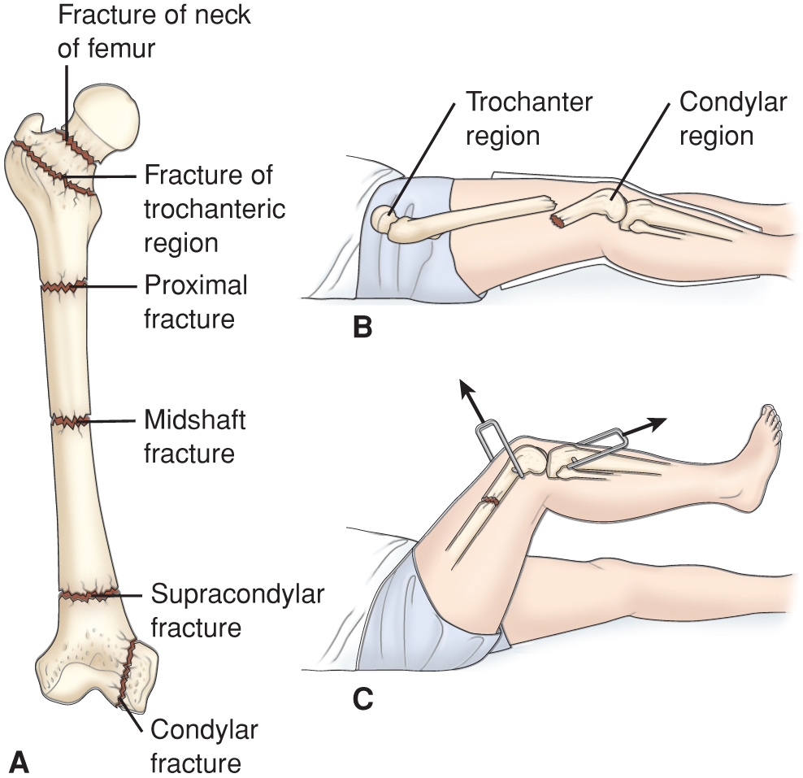
Femoral Fractures

Slide 48
Nursing Process: The Care of the Patient with Fracture of the Hip—Assessment
Health history and presence of concomitant problems
Pain
VS, respiratory status, LOC, and signs and symptoms of shock
Affected extremity including frequent neurovascular assessment
Bowel and bladder elimination; bowel sounds, I&O
Skin condition
Anxiety and coping

Slide 49
Nursing Process: The Care of the Patient with Fracture of the Hip—Diagnoses
Acute pain
Impaired physical mobility
Impaired skin integrity
Risk for impaired urinary elimination
Risk for ineffective coping
Risk for disturbed thought processes

Slide 50
Collaborative Problems/Potential Complications
Hemorrhage
Peripheral neurovascular dysfunction
DVT
Pulmonary complications
Pressure ulcers

Slide 51
Nursing Process: The Care of the Patient with Fracture of the Hip—Planning
Major goals may include relief of pain; achievement of a pain-free, functional, and stable hip; healed wound; maintenance of normal urinary elimination pattern; use of effective coping mechanisms; remains oriented and participates in decision-making; and absence of complications.

Slide 52
Relief of Pain
Administer analgesics as prescribed
Use of Buck’s traction as prescribed
Handle extremity gently
Support extremity with pillows and when moving
Positioning for comfort
Frequent position changes
Alternative pain relief methods

Slide 53
Prompting Physical Mobility
Maintain neutral position of hip
Use trochanter rolls
Maintain abduction of hip
Isometric, quad-setting, and gluteal-setting exercises
Use of trapeze
Use of ambulatory aids
Consultation with physical therapy

Slide 54
Interventions
Use aseptic technique with dressing changes
Avoid/minimize use of indwelling catheters
Supporting coping
Provide and reinforce information
Encourage patient to express concerns
Support coping mechanisms
Encourage patient to participate in decision making and planning
Consult social services or other supportive services

Slide 55
Interventions
Orient patient to and stabilize the environment
Provide for patient safety
Encourage participation in self-care
Encourage coughing and deep breathing exercises
Ensure adequate hydration
Apply TED hose or SCDs as prescribed
Encourage ankle exercises
Patient and family teaching

Slide 56
Rehabilitation of Patients with Amputation
Amputation may be congenital, traumatic, or due to conditions such as progressive peripheral vascular disease, infection, or malignant tumor.
Amputation is used to relieve symptoms, improve function, and save the person's life.
The health care team needs to communicate a positive attitude to facilitate acceptance and participation in rehabilitation.

Slide 57
Rehabilitation Needs
Psychological support
Prostheses fitting and use
Physical therapy
Vocational/occupational training and counseling
Use a multidisciplinary team approach
Patient teaching

Slide 58
Nursing Process: The Care of the Patient with an Amputation—Assessment
Neurovascular status and function of affected extremity or residual limb and of unaffected extremity
Signs and symptoms of infection
Nutritional status
Concurrent health problems
Psychological status and coping

Slide 59
Nursing Process: The Care of the Patient with an Amputation—Diagnoses
Acute pain
Risk for disturbed sensory perception
Disturbed body image
Ineffective coping
Risk for anticipatory or dysfunctional grieving
Self-care deficit
Impaired physical mobility

Slide 60
Collaborative Problems/Potential Complications
Postoperative hemorrhage
Infection
Skin breakdown

Slide 61
Nursing Process: The Care of the Patient with an Amputation—Planning
Major goals may include relief of pain, absence of altered sensory perceptions, wound healing, acceptance of altered body image, resolution of grieving processes, restoration of physical mobility, and absence of complications.

Slide 62
Interventions
Relief of pain
Administer analgesic or other medications as prescribed
Changing position
Putting a light sand bag on residual limb
Alternative methods of pain relief- distraction, TENS unit
Note: Pain may be an expression of grief and altered body image
Promoting wound healing
Handle limb gently
Residual limb shaping

Slide 63
Resolving Grief and Enhancing Body Image
Encourage communication and expression of feelings
Create an accepting, supportive atmosphere
Provide support and listen
Encourage patient to look at, feel, and care for the residual limb
Help patient set realistic goals
Help patient resume self-care and independence
Referral to counselors and support groups

Slide 64
Achieving Physical Mobility
Proper positioning of limb; avoid abduction, external rotation and flexion
Turn frequently; prone positioning if possible
Use of assistive devices
ROM exercises
Muscle strengthening exercises
“Preprosthetic care”; proper bandaging, massage, and “toughening” of the residual limb

