Slide 1
Chapter 17: The Nervous System: Cranial Nerves, Motor System, Sensory System, and Reflexes

Slide 2
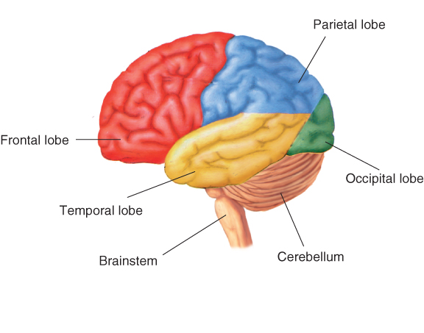
Central and Peripheral Nervous System — Key Definitions
Central Nervous System: the brain and spinal cord
The Brain
4 regions: cerebrum, diencephalon, brainstem, cerebellum
Contains interconnecting neurons (cell bodies and axons)
Gray matter = aggregations of neuronal cell bodies
White matter = neuronal axons coated with myelin

Slide 3
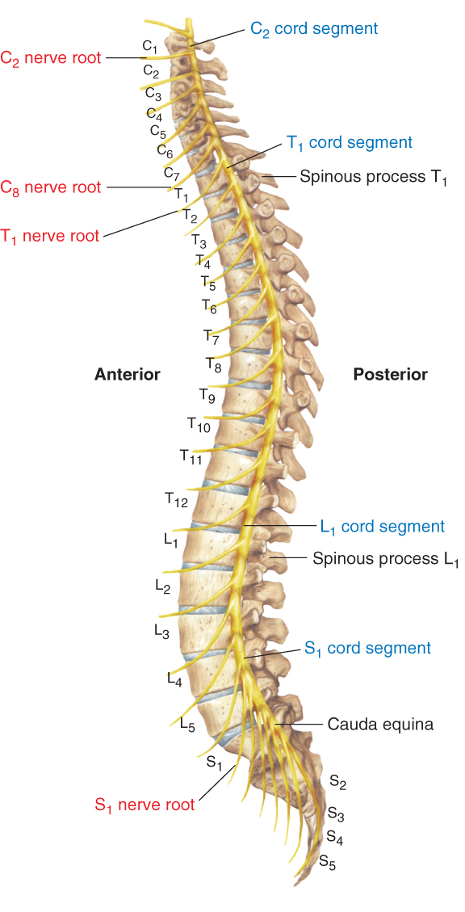
Central Nervous System – Brain and Spinal Cord
The Spinal Cord
Extends from brainstem (medulla) to L1-L2 vertebrae
Contains motor and sensory pathways that exit and enter the cord via anterior and posterior nerve roots and spinal and peripheral nerves
5 segments: cervical (C1-8), thoracic (T1-12), lumbar (L1-5), sacral (S1-5), coccygeal
Note: Cauda equina at L1-2, where nerve roots fan out like a horse’s tail

Slide 4
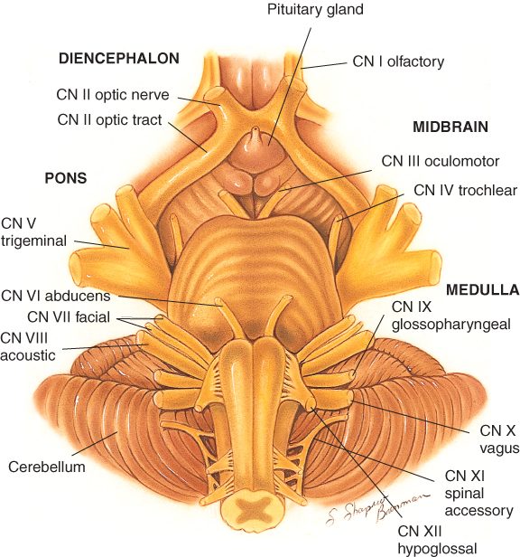
Peripheral Nervous System – Cranial Nerves
Peripheral Nervous System
12 pairs of cranial nerves plus spinal and peripheral nerves. Cranial Nerves govern motor, sensory, and specialized functions like smell, vision, and Hearing.

Slide 5
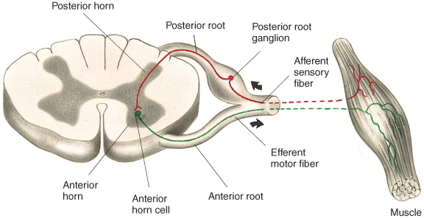
Peripheral Nervous System — Peripheral Nerves
Peripheral Nerves: 31 pairs of nerves that attach to the spinal cord: 8 cervical, 2 thoracic, 5 lumbar, 5 sacral, 1 coccygeal
Each nerve has an anterior (ventral) root containing motor fibers and a posterior (dorsal) root containing sensory fibers. The anterior and posterior roots merge to form a short (<5mm) spinal nerve.
Spinal nerve fibers commingle with similar fibers from other levels to form peripheral nerves.

Slide 6
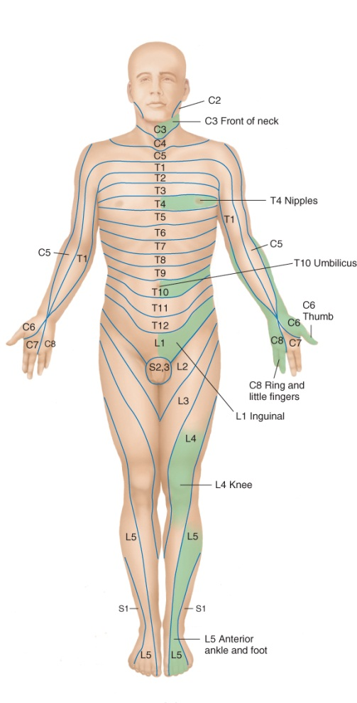
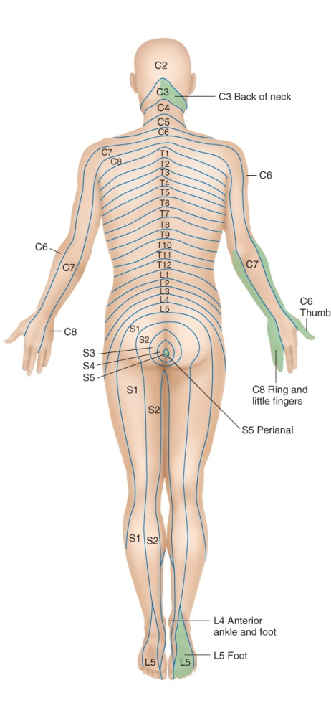
Peripheral Nervous System — Motor and Sensory Pathways, Dermatomes
Motor and Sensory Pathways: Study descending motor and ascending sensory pathways in Bates’ 9th edition textbook, pp. 602 - 606.
Dermatome: Band of skin innervated by the sensory root of a single spinal nerve.

Slide 7
Common or Concerning Symptoms
Headache
Dizziness or vertigo
Generalized, proximal, or distal weakness
Numbness, abnormal or loss of sensations
Loss of consciousness, syncope, or near-syncope
Seizures
Tremors or involuntary movements

Slide 8
The Nervous System: Key Principles
As you examine the patient, remember three important questions:
Is the mental status intact?
Are right- and left-sided findings the same, or symmetric?
If findings are assymetric or otherwise abnormal, does the causative lesions lie in the central nervous system or the peripheral nervous system?
Organize your thinking into 5 categories: mental status, speech, and language; cranial nerves; motor system; sensory system; and reflexes

Slide 9
Examination — Cranial Nerves (CN)
CN I – Olfactory | Occlude each nostril, test different smells
CN II – Optic | Test visual acuity with Snellen eye chart or hand-held card; inspect fundi; screen visual fields by confrontation
CN II-III – Optic, Oculomotor | Inspect size and shape of pupils, test and reactions to light and near response
CN III, IV, VI – Oculomotor Trochlear, Abducens | Test extraocular movements in 6 cardinal directions of gaze; check convergence
CN V – Trigeminal | Palpate temporal and masseter muscles while patient clenching teeth; test forehead, each cheek, and jaw on each side for sharp or dull sensation; test corneal reflex

Slide 10
Examination — Cranial Nerves (CN) (cont’d)
CN VII – Facial | Assess face for asymmetry, tics, abnormal movements. Ask patient to: raise eyebrows, frown, close eyes tightly, show teeth (grimace), smile, puff both cheeks
CN VIII – Acoustic | Test hearing, lateralization, and air and bone conduction
CN IX and X – Glossopharyngeal, Vagus | Assess if voice hoarse; assess swallowing. Inspect movement of palate as patient says “ah”. Warn patient, test gag reflex.
CN XI – Spinal Accessory | Assess strength as pt. shrugs shoulders up against your hands. Note contraction of opposite sternocleidomastoid, and force as pt. turns head against your hands.
CN XII – Hypoglossal | Ask patient to protrude tongue and move side to side. Assess for symmetry, atrophy.

Slide 11
Examination – Motor System
Position, Movement, Muscle Bulk & Tone
Observe body position and involuntary movements such as tremors, tics, fasciculations
Inspect muscle bulk; note any atrophy
Assess muscle tone — flex and extend the arm and the lower leg for residual tension → slight resistance to passive stretch

Slide 12
Examination – Muscle Strength
Muscle strength is graded on a 0 to 5 scale:
0 – No muscular contraction detected
1 – A barely detectable flicker or trace of contraction
2 – Active movement of the body part with gravity eliminated
3 – Active movement against gravity
4 – Active movement against gravity and some resistance
5 – Active movement against full resistance without evident fatigue. This is normal muscle strength.
Ask patient to move actively against your opposing resistance. Assign Grade 5 if the patient overcomes your opposing movement.
If the patient can only move against gravity, assign Grade 3.

Slide 13
Examination – Muscle Strength
Test the following muscle groups and movements:
Biceps and triceps, wrist – flexion and extension
Handgrip, finger abduction and adduction, thumb opposition
Trunk – flexion, extension, lateral bending
Thorax – expansion, diaphragmatic excursion during respiration
Hip – flexion, extension, abduction and adduction
Knee and ankle – flexion, extension

Slide 14
Examination – Coordination
Test coordination, including ...
Rapid alternating movements – patient turns hand rapidly over and back on thigh; taps tip of index finger rapidly on distal thumb; taps ball of foot rapidly on your hand
Point-to-point movements – patient touches nose then your index finger as you move it to different positions; patient places moves heel from opposite knee down the shin to the big toe
Gait – assess gait as patient:
walks across room
walks heel-to-toe
walks on toes then heels
hops in place

Slide 15
Examination – Coordination (cont’d)
Test coordination, including ...
Stance, namely
The Romberg test
patient stands with feet together and eyes open, then with eyes closed for 20 – 30 seconds without support
loss of balance when eyes closed is a positive test
Pronator drift
patient stands for 20 – 30 seconds with both arms straight forward, palms up, and eyes closed; tap arms briskly downward
pronation and downward drift of the arm is a positive test

Slide 16
Examination – Sensory System – General Principles
Compare symmetric areas on both sides of the body
When testing pain, temperature, and touch, compare distal with proximal areas of the extremities
Map out the boundaries of any area of sensory loss or hypersensitivity

Slide 17
Examination – Sensory System
Test pain: use a disposable object such as a broken cotton swab or pin. Discard after each use.
Ask if prick is sharp or dull, or compare 2 sensations with “Does this feel the same on both sides?”
Test light touch, using cotton wisp.
Test vibration: tap a 128 Hz tuning fork on your hand, then place it on the DIP joint of the patient’s finger. Ask “Do you feel a buzz? Tell me when it stops.” Likewise test over the joint of the big toe.
Test position: hold the big toe by its sides between your thumb and index finger, pull it away from the other toes, and move it up then down. Ask the patient to identify the direction of movement.

Slide 18
Examination – Sensory System
Assess discriminative sensation to test the ability of the sensory cortex to analyze and interpret sensations.
Stereognosis: place a key or familiar object in the patient’s hand. Ask the patient to identify it.
Number identification (graphesthesia): outline a large number in the patient’s palm. Ask the patient to identify the number.
Two-point discrimination: using two ends of an opened paper clip, or two pins, touch the finger pad in two places simultaneously. Ask the patient to identify 1 touch or 2.
Point localization: lightly touch a point on the patient’s skin. Ask the patient to point to that spot
Extinction: touch an area on both sides of the body at the same time. Ask if the patient feels 1 spot or 2.

Slide 19
Examination – Deep Tendon Reflexes – General Principles
Select a properly weighted hammer.
Encourage the patient to relax. Position the limbs properly and symmetrically.
Hold the reflex hammer loosely between your thumb and index finger so that is swings freely in an arc.
Strike the tendon with a brisk direct movement. Use the minimum force needed to obtain a response.
Use reinforcement when needed (see Bates’ 9th edition textbook, p. 634).
Grade the response.

Slide 20
Examination – Deep Tendon Reflexes – Scale for Grading
Reflexes are usually graded on a 0 to 4+ scale
4+ Very brisk, hyperactive, with clonus (rhythmic oscillations between flexion and extension)
3+ Brisker than average; possibly but not necessarily indicative of disease
2+ Average; normal
1+ Somewhat diminished; low normal
0 No response

Slide 21
Examination – Deep Tendon Reflexes
Review the techniques for testing reflexes on the videoclip “DeepTendon Reflexes” and elicit the responses below. Learning the cord levels for each response helps localize any abnormalities.
Biceps Reflex (C5-6)
Triceps Reflex (C6-7)
Supinator or Brachioradialis (C5-6)
Abdominal Reflexes (upper—T8-10; lower– T10-12)
Knee Reflex (L2-4)
Ankle Reflex (primarily S1)
Plantar Response (L5-S1)
Clonus, a hyperactive response required for assigning a reflex grade of 4, usually elicited at the ankle

Slide 22
Examination – Special Techniques
Turn to the Bates’ 9th edition textbook, pp. 640 - 646, and learn how the following special techniques:
Asterixis
Meningeal signs: neck mobility, Brudzinski’s sign, Kernig’s sign
Assessment of the stuporous or comatose patient, including the ABC’s (airway, breathing, circulation), level of consciousness (see table on next slide), pupillary response, ocular movements, and posture and muscle tone

Slide 23
Examination – Level of Consciousness (Arousal)
Techniques and Patient Response
Level of Consciousness (Arousal): Techniques and Patient Response
Level | Technique | Abnormal Response
Alertness | Speak to the patient in a normal tone of voice. An alert patient opens the eyes, looks at you, and responds fully and appropriately to stimuli (arousal intact)
Lethargy | Speak to the patient in a loud voice. For example, call the patient’s name or ask “How are you?” | A lethargic patient appears drowsy but opens the eyes and looks at you, responds to questions, and then falls asleep.
Obtundation | Shake the patient gently as if awakening a sleeper. | An obtunded patient opens the eyes and looks at you, but responds slowly and is somewhat confused. Alertness and interest in the environment are decreased.
Stupor | Apply a painful stimulus. For example, pinch a tendon, rub the sternum, or roll a pencil across a nail bed. )No stronger stimuli needed!) | A stuporous patient arouses from sleep only after painful stimuli. Verbal responses are slow or even absent. The patient lapses into an unresponsive state when the stimulus ceases. There is minimal awareness of self or the environment.
Coma | Apply repeated painful stimuli | A comatose patient remains unarousable with eyes closed. There is no evident response to inner need or external stimuli.

Slide 24
Diagnostic Procedures CT Scan
It is a significant tool in neurological diagnoses.
it is makes use of narrow x-ray beam to scan the head in successive layers.
With the aid of a computer pictures are taken at many horizontal levels or slices of the brain or spinal cord.
The resulting pictures distinguish bone and soft tissue (brain, vascular system & ventricular system)
The image is placed on TV and is photographed and stored digitally
It is a safe procedure

Slide 25
Advantages: what does it show?
Variations in tissue density differing from surrounding normal tissue brain
Abnormalities such as tumor mass, brain fracture, displacement of the ventricle and cortical atrophy
Injection of the contrast media into the subarchenoid space through lumber puncture improve the visualization of brain and spinal content

Slide 26
How it is done

Slide 27
Diagnostic procedures MRI
Through the use of large magnetic field and the introduction of a specific radio frequency, protons of the body absorb and emit energy, which is then converted into a picture or an image on a screen or magnetic tape.
The resulting images are clear for all densities of tissue
It better than the CT in clarity for many types of tissue and lesions, does not involve exposure to radiation and is non invasive

Slide 28
MRI: advantages

Slide 29
Nursing intervention
Teaching patient to relax
Instruct him that he might talk to the staff through the microphone while he is inside the scanner
All metal objects removed
Patient put inside the scanner, sedation may be given to patients .

Slide 30
MRI

Slide 31
Diagnostic Procedures Lumber Puncture
Is the insertion of spinal needle into the subarachnoid space between the 3rd & 4th lumber vertebrae
LP is used to obtain pressure readings with a manometer, obtain CSF for analysis, inject anesthesia & medications, and others.
Procedure, patient assume a fetal position, the skin site is cleaned thoroughly, the injected site is determined & a local anesthesia is injected, then the DR insert the needle as mentioned before and CSF fluid or pressure readings are obtained.

Slide 34
After specimens are collected, the needle is withdrawn, slight pressure is applied and adhesive bandage is placed over the insertion site.
The client is restricted to bed resting flat position for 4 to 12 hrs, to prevent CSF leak. Also he encouraged to increase fluid intake for 24 to 48 hrs facilitate CSF production.
Patient may experience headache: bed rest, analgesic and adequate hydration

Slide 35
Complications

Slide 36
Diagnostic Procedures Electroencephalography
EEG is the recording of the electrical activity of the cerebral hemispheres.
Each graphic recording represents the changes in voltage in various areas of the brain.
The test is done to determine the general activity of the cerebral hemisphere, the origin of seizure activity, the cerebral function in pathologic conditions, diagnose sleep disorders and others.
The client is placed on a chair or bed, 16 to 24 electrodes are attached to the scalp with a jelly like substance, and connected to machine.

Slide 37
For baseline records the patient is placed on a table with eyes closed, then the patients is asked to hyperventilate for 3-4 minutes and then look at a bright-flashing lights for photic stimulation
These activation procedures are essential to evoke abnormal electrical discharge associated with seizures.

Slide 38
Preparations;
In some situations, ask the patient to not sleep the night before EEG
Avoid stimulants: coffee, tea, cola, chocolate before the test
Withheld anti-seizures, tranquilizers, and antidepressent 24-48 hrs before the test—medication can alter the test waves
Meal not omitted; change on blood sugar can change electrical activity of brain
Tell pt the procedure may take 45-60 min, lie quietly and should be cooperative
Tell patient it is not a treatment it is a diagnosis procedure

Slide 39
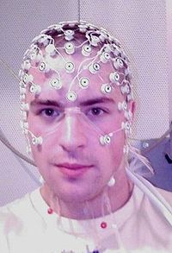
Electroencephalography

