Slide 1
Chapter 60 Assessment of Neurologic Function

Slide 2
Function of the Nervous System
Controls all motor, sensory, autonomic, cognitive, and behavioral activities.

Slide 3
Structures of the Neurologic System
Central Nervous System
Brain and spinal cord
Peripheral nervous system
Includes cranial and spinal nerves
Autonomic and somatic systems
Basic functional unit—neuron

Slide 4
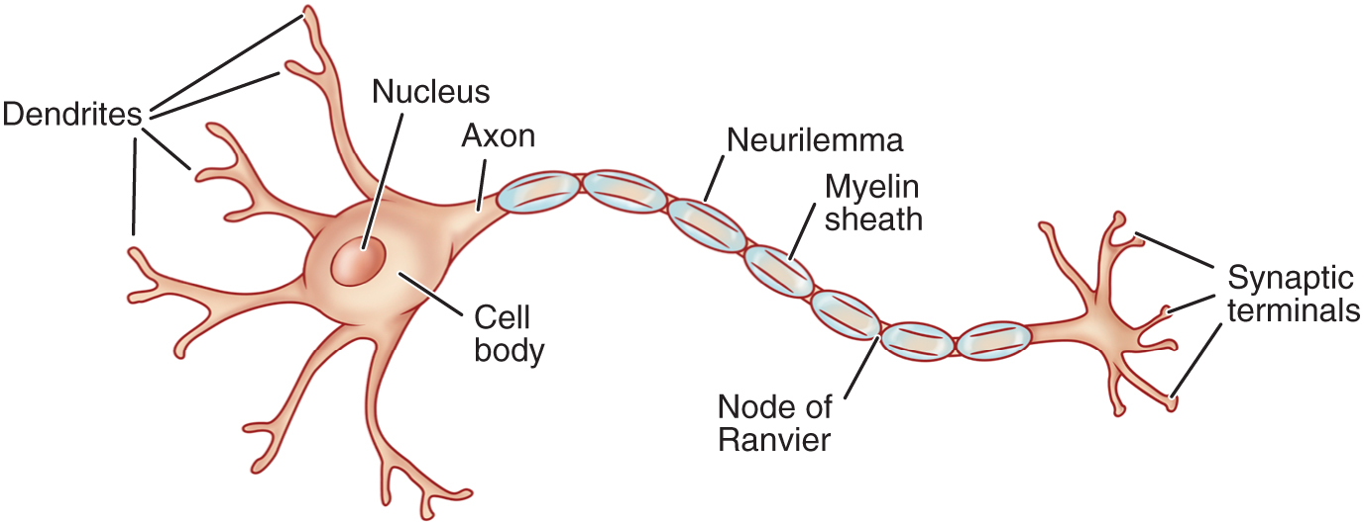
Neuron

Slide 5
Neurotransmitters
Communicate messages from one neuron to another or to a specific target tissue.
Neurotransmitters can potentiate, terminate, or modulate a specific action or can excite or inhibit a target cell.
Many neurologic disorders are due to imbalance in neurotransmitters.

Slide 6
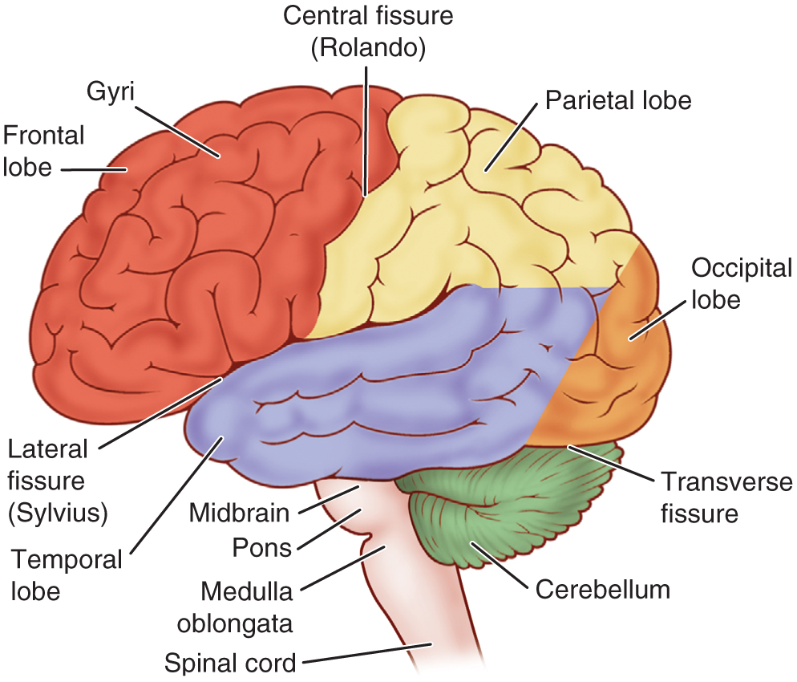
Brain

Slide 7
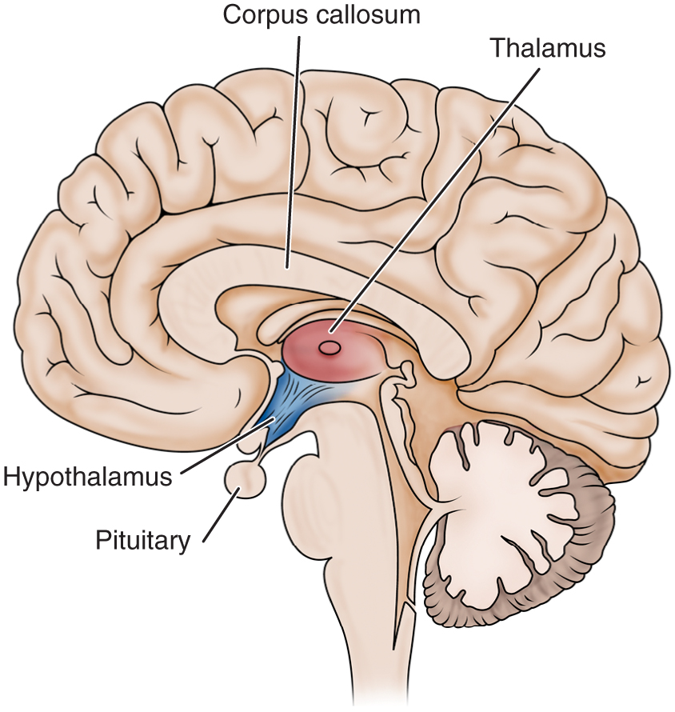
Medial View of the Brain

Slide 8
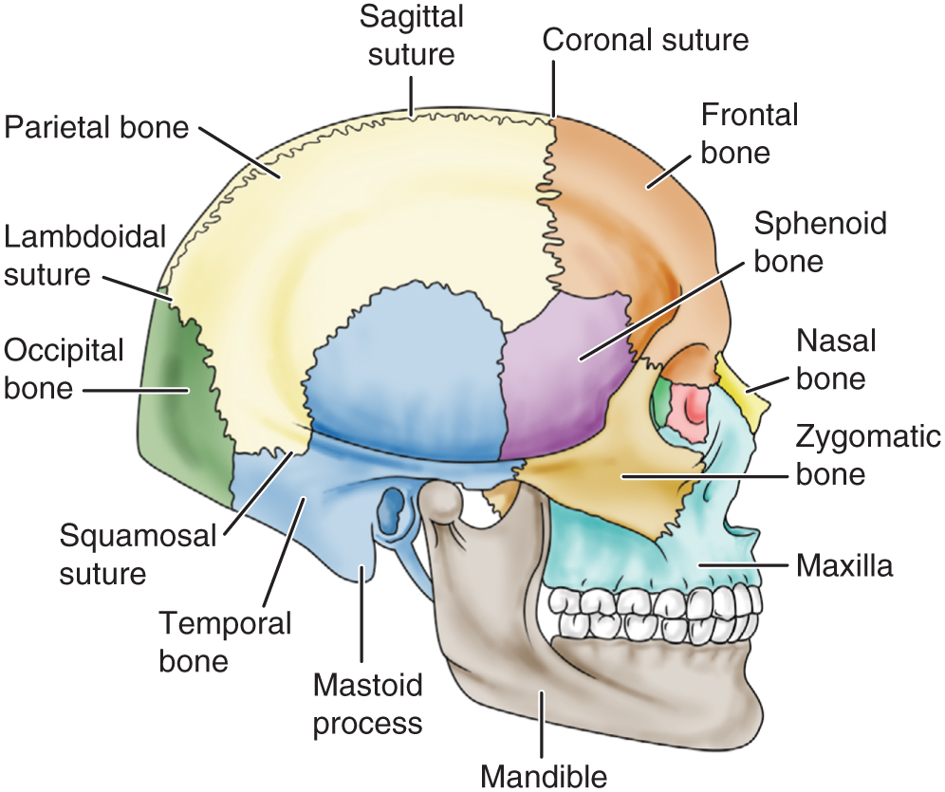
Bones and Sutures of the Skull

Slide 9
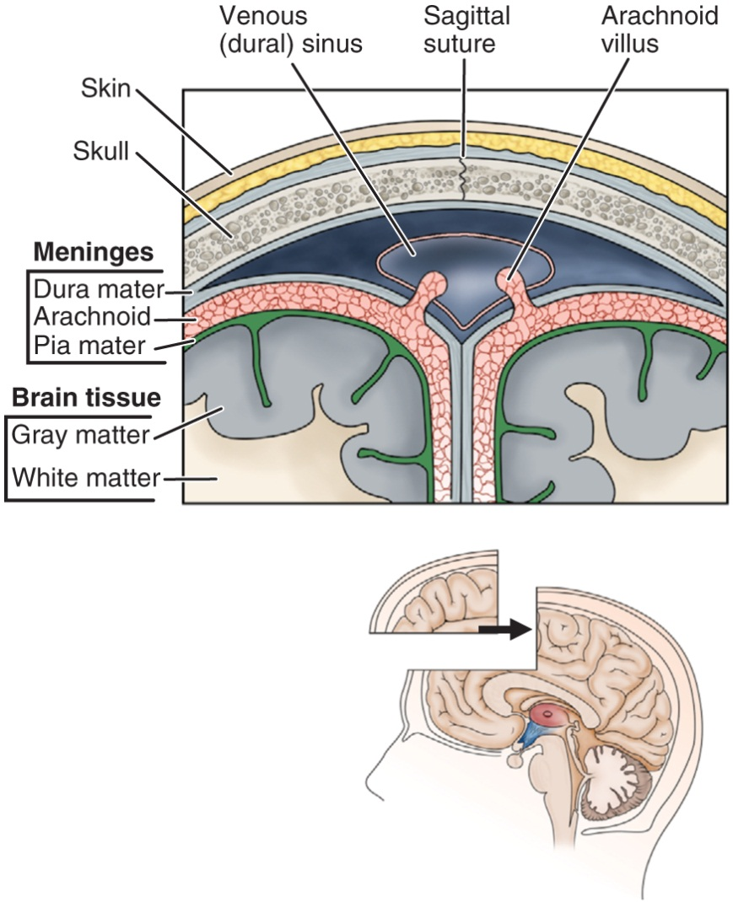
Meninges and Related Structures

Slide 10
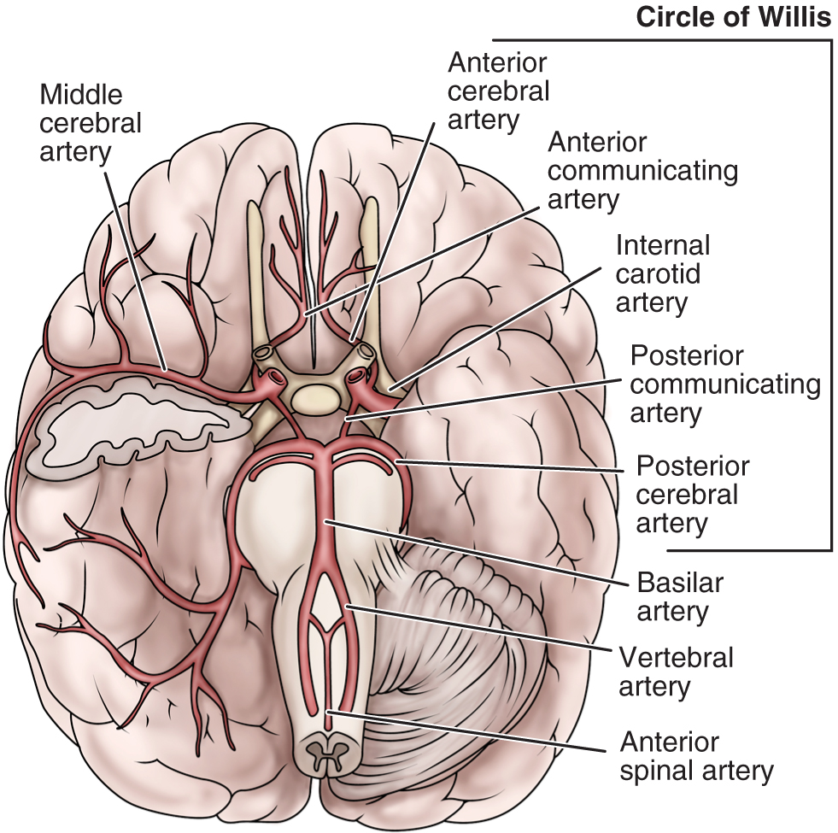
Arterial Blood Supply of the Brain

Slide 11
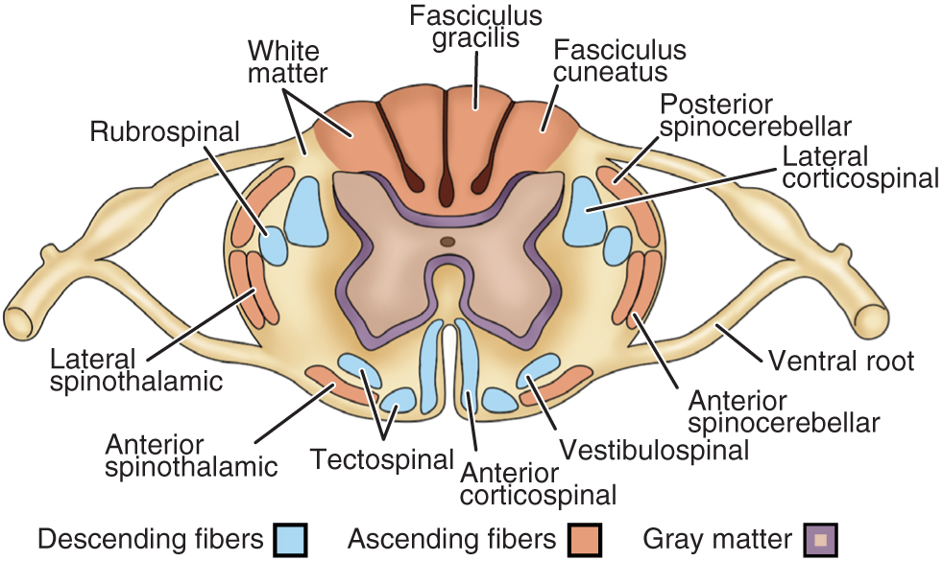
Cross Section of the Spinal Cord Showing the Major Spinal Tracts

Slide 12
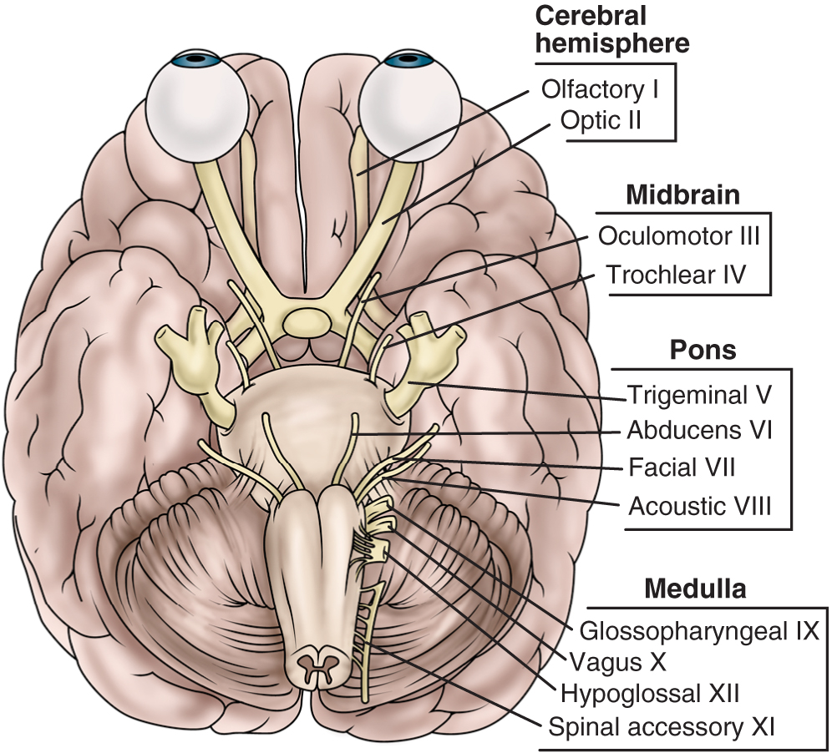
Cranial Nerves

Slide 13
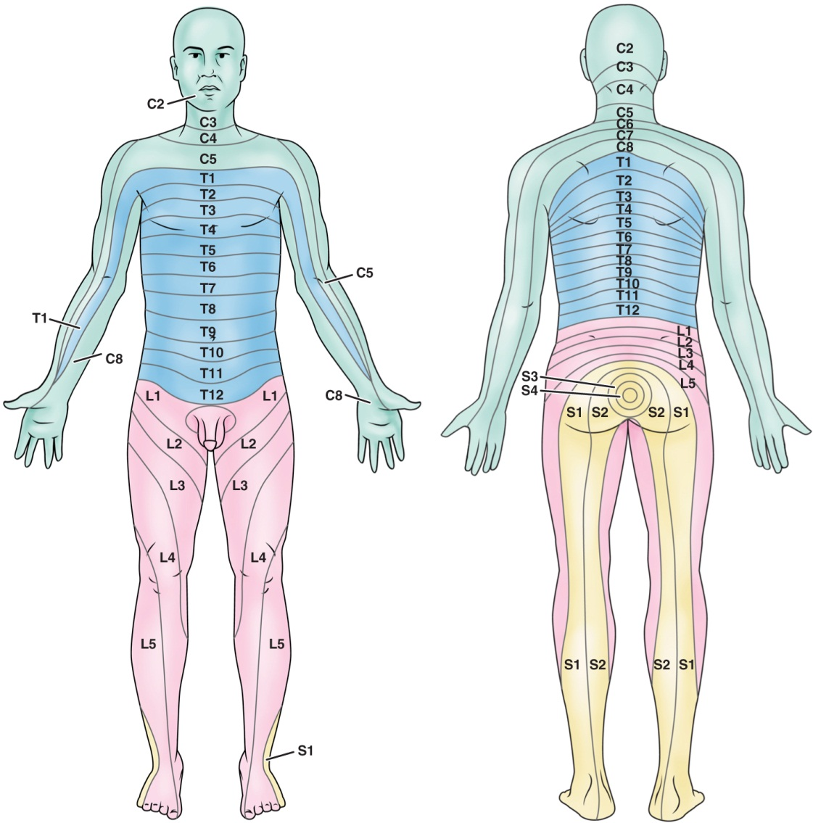
Dermatome Distribution

Slide 14
Autonomic Nervous System
Functions to regulates activities of internal organs and to maintain and restore internal homeostasis
Sympathetic NS
“Fight or flight” responses
Main neurotransmitter is norepinephrine
Parasympathetic NS
Controls mostly visceral functions
Regulated by centers in the spinal cord, brainstem, and hypothalamus

Slide 15
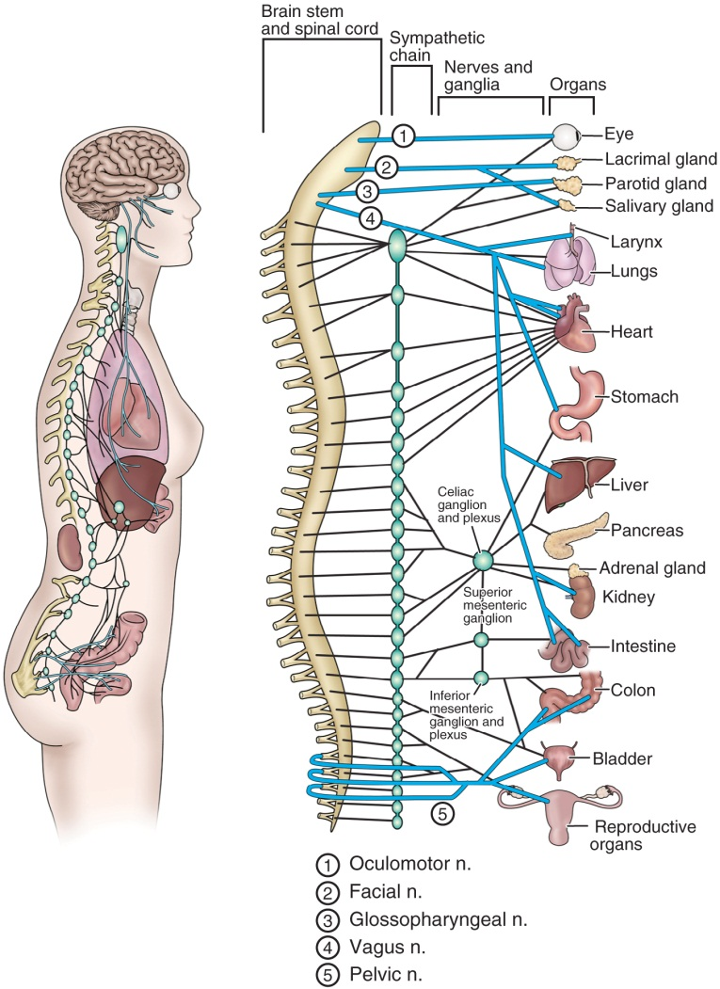
Anatomy of the Autonomic Nervous System

Slide 16
Neurologic Assessment: Health History
Pain
Seizures
Dizziness (abnormal sensation of imbalance or movement) and vertigo (illusion of movement, usually rotation)
Visual disturbances
Weakness
Abnormal sensations

Slide 17
Neurologic Assessment
Cerebral function; mental status, intellectual function thought content, emotional status, perception, motor ability, and language ability
Note the impact of any neurologic impairment on lifestyle and patient abilities and limitations
Cranial nerves
Motor system; posture, gait, muscle tone and strength, coordination and balance, Romberg test
Sensory system; tactile sensation, superficial pain, vibration and position sense
Reflexes; DTRs, abdominal, and plantar (Babinski)

Slide 18
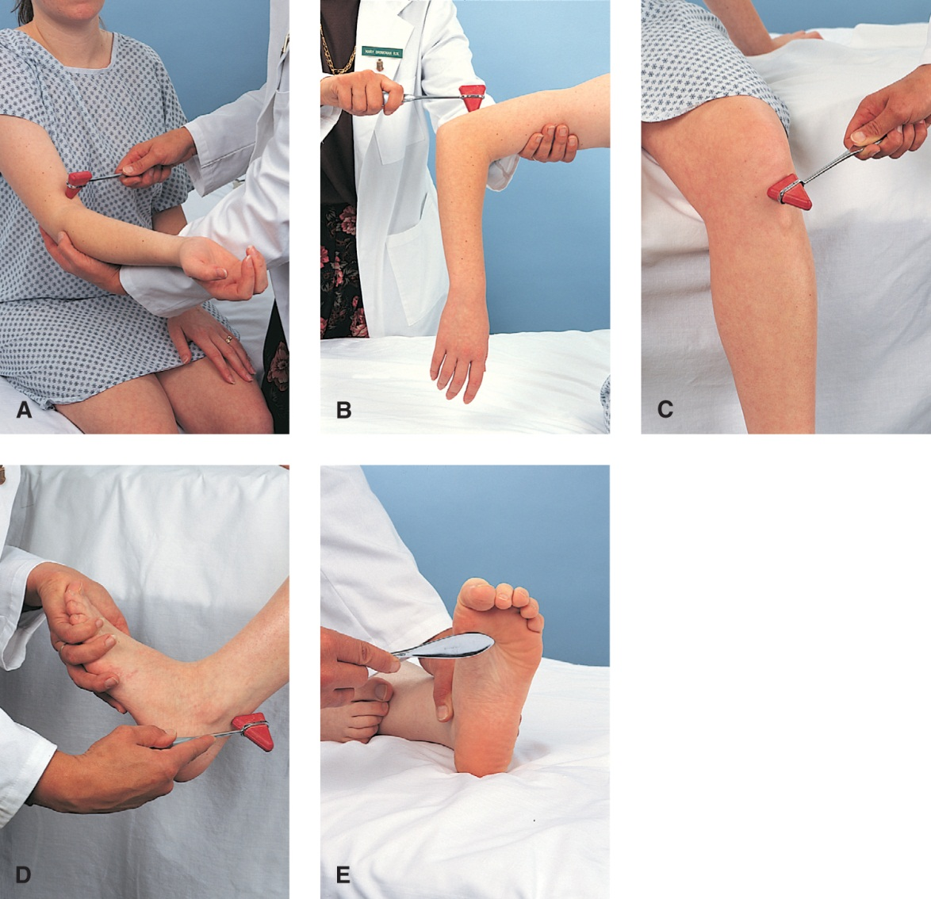
Techniques Eliciting Major Reflexes

Slide 19
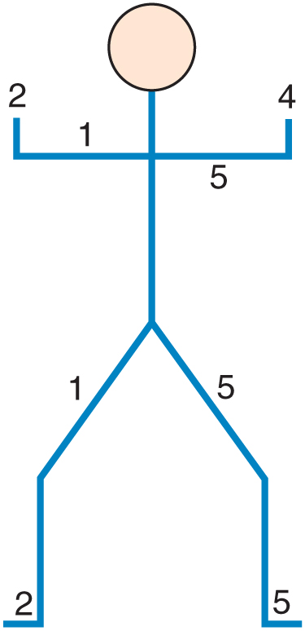
Figure Used to Record Muscle Strength

Slide 20
Gerontological Considerations
Important to distinguish normal aging changes from abnormal changes
Determine previous mental status for comparison. Assess mental status carefully to distinguish delirium from dementia.
Normal changes may include:
Losses in strength and agility; changes in gait, posture and balance; slowed reaction times and decreased reflexes; visual and hearing alterations; deceased sense of taste and smell; dulling of tactile sensations; changes in the perception of pain; and decreased thermoregulatory ability

Slide 21
Diagnostic Tests
Computed tomography(CT)
Positron emission tomography (PET)
Single photon emission computed tomography (SPECT)
Magnetic resonance imaging (MRI)
Cerebral angiography
Myelography
Noninvasive carotid flow studies
Transcranial doppler
Electroencephalography (EEG)
Electromyography (EMG)
Nerve conduction studies, evoked potential studies
Lumbar puncture, Queckenstedt’s test, and analysis of cerebrospinal fluid

Slide 22
Magnetic Resonance Imaging

