Slide 1
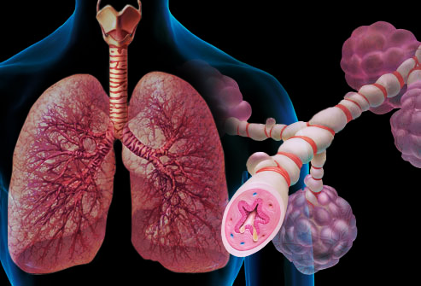
Drugs affecting the respiratory system

Slide 2
Main disorders of the respiratory system are
Bronchial asthma.
Chronic obstructive pulmonary disease (COPD) .
Cough.

Slide 3
3- Goblet cells hyperplasia and Increase in Mucus Glands → leading to Mucus Hypersecretions.
4- Increase in Blood vessels number in Submucosa → Warm Edema.
→ All these changes leads to Luminal Narrowing, So air flow limitations.

Slide 4
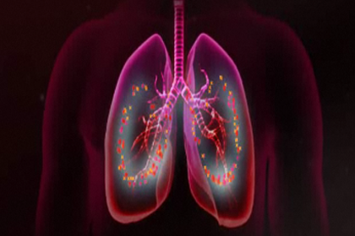
BRONCHIAL ASTHMA

Slide 5
Bronchial Asthma
Recurrent & reversible shortness of breath that occurs when the bronchi and bronchioles become narrow.
Airflow obstruction in asthma is due to bronchoconstriction that results from contraction of bronchial smooth muscle, inflammation of the bronchial wall, and increased mucous secretion

Slide 6
The Main cause for Asthma and COPD is Chronic Airway Inflammation, leading to Airway Structural Remodeling.
Asthmatic attacks may be related to recent exposure to allergens or inhaled irritants, leading to bronchial hyperactivity and inflammation of the airway mucosa.

Slide 7
Asthma is ch.ch by
1- Recurrent & Reversible airways obstruction.
2- chronic Inflammation of the airways.
3- Bronchial hyper-reactivity or hyper-responsiveness → abnormal sensitivity to a wide rang of stimuli.

Slide 8
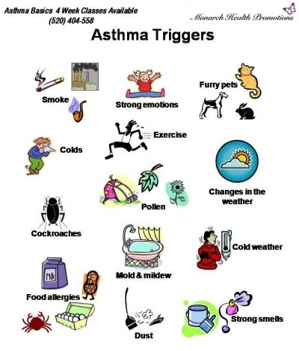

Slide 9
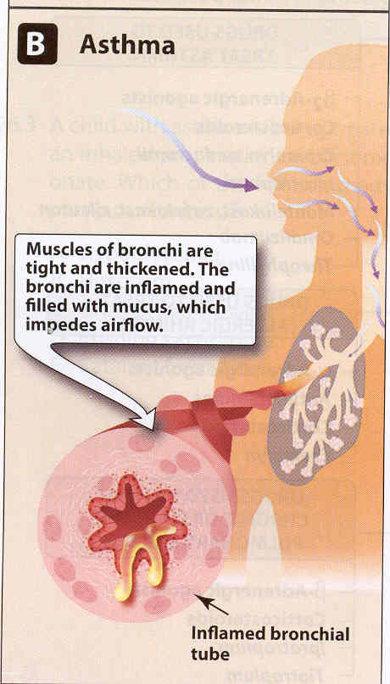
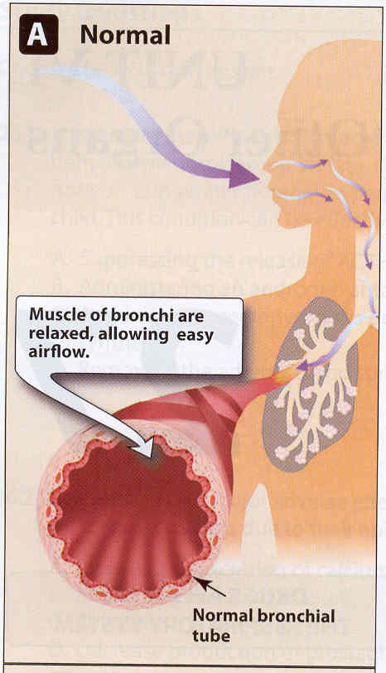
Comparison of bronchi of normal & asthmatic individuals

Slide 10
Pathologic features of asthma
Contraction of airway smooth muscle → resulting from bronchoconstriction.
Mucosal thickening from edema and cellular infiltration → result of inflammation.
Inspissation of abnormally thick, viscid plugs of mucus in the airway lumen.

Slide 11
Asthma
Signs and Symptoms
Signs and Symptoms Vary from Patient to
Patient.
Classic Symptoms:
Coughing.
Wheezing.
Shortness of Breath (SOB) ‘’ dyspnea’’.
Chest Tightness.

Slide 12
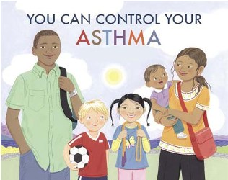
Goals of therapy
1- Preventation of exposure to allergen(s).
2- Dilation of narrowed bronchi.
Used bronchodilator agents.
3- Reduction of the bronchial inflammation and hyperactivity.
Used anti-inflammatory drugs .

Slide 13
Treatment Of Asthma
Symptoms of asthma may be effectively treated by drugs ,but No agent provides a cure for this disease.

Slide 14
Two categories of drugs for treatment of COPD and Asthma
1- Long-term controllers :- Deal with major pathological cause for the disease, so their effect will take long time and will be prolonged more than Bronchodilators
2- Short-term group or Symptomatic Relievers: Which used in ER, but to maintain the patient on something we use Long-term controllers.

Slide 15
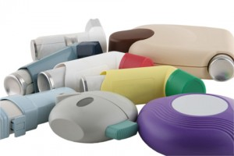
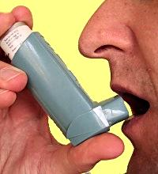
Inhalers ,why?
Drugs goes directly to site of action ,thus rapid action.(large surface area of alveoli)
Avoid systemic adverse reactions that could happens if drug given parentreally or orally.

Slide 16
1- Bronchodilators
(Short-Term Controllers)
2-Anti-inflammatory
drugs
(Long-term controllers)
  1- Corticosteroids
1− β2-agonists
  2- Cromolyn
  & Nedocromil
  2- Anti-muscarinic
  agents
3- Leukotriene antagonist/ pathway inhibitors
3- Methylxanthines

Slide 17
I. Bronchodilators
β2-agonists
Anti-Muscarinic
drugs
Stimulates
β2-adrenergic
receptors of bronchi
Competitively
inhibit the effect of
ACH at M receptor.
Smooth
muscle
relaxation
Methylxanthines
Inhibit phosphodiesterase

Slide 18
1- Dilation of narrowed bronchi
Used for rapid relief of symptoms……

Slide 19
1− β2-selective agents
Used as relievers or bronchodilators.
Are potent bronchodilators →relax airway smooth muscle. Quickly reduce airway constriction and restore normal airflow.
Are the first choice for mild asthma & first line drugs.

Slide 20
B2 agents are divided to
SABA
(Short Acting beta 2 Agonists)
LABA
(Long Acting B2 Agonists)
  Ex. Salbutamol (albuterol)
  Rapid Onset of action (act rapidly ).
  Duration of action 2-3h.
They are the quick relievers and used in Asthmatic Attacks acute asthma attack., or if attacks is expected to happen
& in exercise-induced asthma.
  Ex. Salmoterol.
  Slow Onset of action→ 15- 30 mins.
  Duration of action(> 12 h).
-They are not used "as needed“.
-prescribed for routine administration.
-twice daily as prophylaxis (prevent bronchospasm at night or with exercise).

Slide 21
{ LABA + Inhaled Corticosteroids } is a very good combination for persistent Mild to Moderate Asthma.
Because its Reduce the doses of Corticosteroids and Relief the symptoms for longer duration.

Slide 22

Adverse effect
At large dose →
Skeletal muscle Tremor ,tachycardia and cardiac dysrhythmia.

Slide 23
Route of administration
Inhalation :Drugs goes directly to site of action ,thus rapid action.(large surface area of alveoli)
Short acting agents given by inhalation, orally and parenterally.
Long acting agents only given by inhalation.

Slide 24
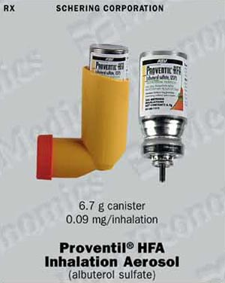
Inhaler

Slide 25
2- Anti-Cholinergic drugs
There will be less Ca entry & less myosin light chain phosphorylation, so the effect will be relaxation of the airway smooth muscle cell so bronchodilation.
ex:- Ipratropium bromide “’Inhaled Atrovent ®’’
Is the only anti-cholinergic used for respiratory disease.
In practice, ipratropium is a good alternative to SABA, if the patient cannot tolerate the side effects of SABA then try to use ipratropium.
It is much more effective on COPD than SABA.
Mostly used in elderly patients (COPD)…WHY?????

Slide 26
Mostly, they use inhaler contain both SABA & anti-cholinergic, it is called combivent.
It is not well absorbed thus the possibility of systemic S/E is minimal.
We DONOT use Atropine …. WHY ????

Slide 27
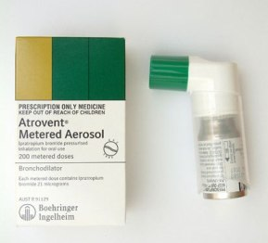
Available only as inhaler.

Slide 28
3- Methylxanthines
Aminophylline (IV) , Theophylline(Oral).
Given slow IV infusion not rapidly (WHY ????)
given in acute severe asthma (status asthmaticus)
Narrow therapeutic index (toxicity and efficacy are close together, if you increase the dose a little bit you might have a toxic effect)
High dose → fatal arrhythmias.

Slide 29
II. Anti-inflammatory agents
  “Long-term controllers”……they control they don't relieve…..
  Used in sever and moderate cases.
  Ex:
      Corticosteroids.
      Cromolyn or nedocromil.
      Leukotriene antagonist/pathway inhibitor..

Slide 30
Corticosteroids
inhibit the chronic inflammation, so the airway structural remodeling will not get worse “will be inhibited” (become less progressive).
Given in any degree of persistent asthma (mild,
moderate, or severe).

Slide 31
ICS therapy directly targets underlying airway inflammation by :
Decreasing the inflammatory cascade (eosinophils, macrophages, and T lymphocytes).
Reversing mucosal edema.
Decreasing the permeability of capillaries.
Inhibiting the release of leukotrienes.
After several months of regular use, ICS reduce the hyper-responsiveness of the airway smooth muscle to a variety of bronchoconstrictor stimuli, such as allergens, irritants, cold air, and exercise.

Slide 32
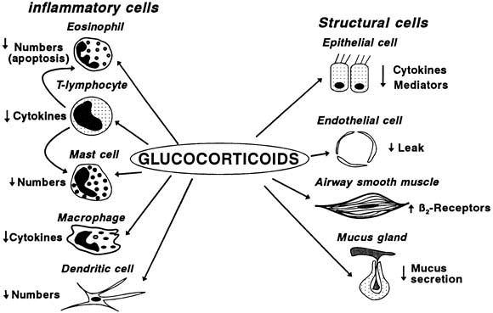

Slide 33
1- Corticosteroids not Bronchodilators (are not useful acute attacks).
Inhaled corticosteroids
Systemic corticosteroids
  Ex. Beclomethasone.
  It is the principle route for chronic use.
It is the most important route (the primary route).
  For asthmatic patients who are inadequate controlled with other regimes.
Ex. methylprednisolone (oral )
Hydrocortisone (IV)
1- Oral route: Used only in severe uncontrolled cases, when the patient is not responding to inhaled corticosteroid & LABA
2. Injection: Used in severe uncontrolled cases in the ER
In status asthmaticus.
High incidence of side effects.

Slide 34
The side effects of corticosteroids:
With Systemic :
1- Moon face.
2- Hirsutism.
3- Central obesity.
4- Osteoporosis.
5- Ulcers.
  with inhaled topical corticosteroids
  oral candidiasis. WHY?
  Hoarseness of the voice→ due to local effect on vocal cord
  Over come these adv.rxn → washing the mouth after inhaled with water.
  with oral corticosteroids therapy → Gradual tapering is needed.

Slide 35
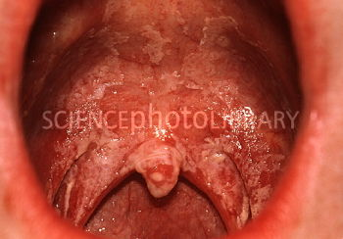

Slide 36
Combined inhaled drugs (corticosteroids with β2-agonists) – seretid, simbicort.

Slide 37
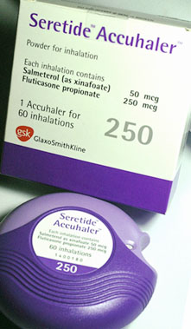
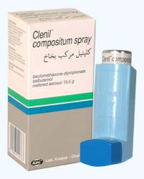

Slide 38
2. Leukotriene antagonists/ pathway inhibitors
Phospholipid
(from cell membrane)
leukotrienes are substances, produced by inflammatory cells .
Leukotrienes are substances released when a trigger, such as cat hair or dust, starts a series of chemical reactions in the body
Leukotrienes cause inflammation, bronchoconstriction, and mucus production result in edema formation
Corticosteroids
-
Phospholipase A₂
Arachidonic acid
Cyclooxygenase
5-Lipoxyenase
Prostacyclin (PGI₂)
are mediators of inflammation, so we need to suppress them.
Leukotrienes
PGE₂
PGF_{2α}
PGH₂

Slide 39
Leukotriene antagonists Two types:
1. LT receptor (LTD4) antagonists:
2. Inhibitors of LT synthesis:
prevent leukotrienes from attaching to receptors on cells in the lungs.
Ex.
Montelukast 1x1 (Singulair®) .
Zafirlukast(2x1).
Orally administered.
Inhibits 5-lipooxygenase (prevent conversion of arachidonic acid to leukotrienes), so no production of leukotrienes.
Ex. Zileuton (Zyflo®).

Slide 40
- It is recommended in prophylaxis of asthma & COPD, especially during allergic seasons like in the spring.
Reduce the dose of corticosteroids (we use it instead of increasing the dose of corticosteroids because of its high toxicity.
used in case of aspirin-induced asthma.
Montelukast is approved for use in children ages 6 and older

Slide 41
They cannot be used alone without corticosteroids.
Leukotriene alone target the propagation only!
Leukotriene + corticosteroids target the inflammation.
So, it must be used in conjugation with steroids to target the inflammation and reduce the dose and dependence of steroids.

Slide 42
Because LKs not the only inflammatory mediators → they are add on therapy (combination )

Slide 43
3- Cromolyn sodium & Nedocromil
‘’Mast cell stabilizer’’
When mast cell degranulates (rupture mast cell) it secrets histamine and other agents which are responsible for allergic manifestations.
stabilizers function by inhibiting the degranulation p
- Mast cell stabilizers function by inhibiting the degranulation process, so there is less histamine involved.
‘’Weak anti-inflammatory.’’

Slide 44
They inhibit some sorts of inflammation but not the whole picture of inflammation.
because they only target one inflammatory cell (mast cell). So, only affect the histamine release and effect on the respiratory tract, that is why the efficacy of these drugs is not that great.

Slide 45
Clinical points:
Both could be used as inhaler or as oral solution.
They are ALTERNATIVE.
Effective in allergic rhinoconjunctivitis.(ND,ED).
Effectively inhibit allergen and exercise-induced asthma.
It is safe to use them in children & pregnant women, so it is the 1st line in long-term controllers to be used here.
Poorly absorbed orally , very few side effects.
Short duration of action (4-6 times a day), so less compliance.

Slide 46
Status asthmatics
Oxygen
Salbutamol (Inh, IV))
IV hydrocortisone followed by oral prednisolone.
Occasionally: ipratropium Inh or aminophylline (aminophylline should not be given to patient who already taking oral theophylline) .

Slide 47


