Slide 1
Nursing Process
Problem solving approach
Provide an organizing framework for knowledge, judgment and actions.
Nursing process requires cognitive skills (thinking), psychomotor (doing) and affective (feeling) skills
Notes:
Definition and requirements

Slide 2
Characteristics of Nursing process
Systematic
The nursing process has an ordered sequence of activities and each activity depends on the accuracy of the activity that precedes it and influences the activity following it.
Dynamic
      The nursing process has great interaction and overlapping among the activities and each activity is fluid and flows into the next activity
Interpersonal
      The nursing process ensures that nurses are client-centered rather than task-centered and encourages them to work to enhance client’s strengths and meet human needs
Goal-directed
      The nursing process is a means for nurses and clients to work together to identify specific goals (wellness promotion, disease and illness prevention, health restoration, coping and altered functioning) that are most important to the client, and to match them with the appropriate nursing actions
Universally applicable
      The nursing process allows nurses to practice nursing with well or ill people, young or old, in any type of practice setting

Slide 3
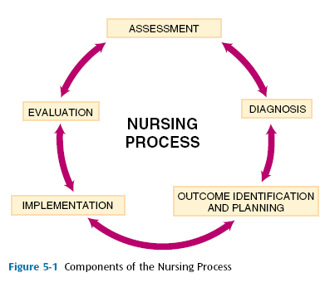
Figure 5.1 Component of Nursing process

Slide 4
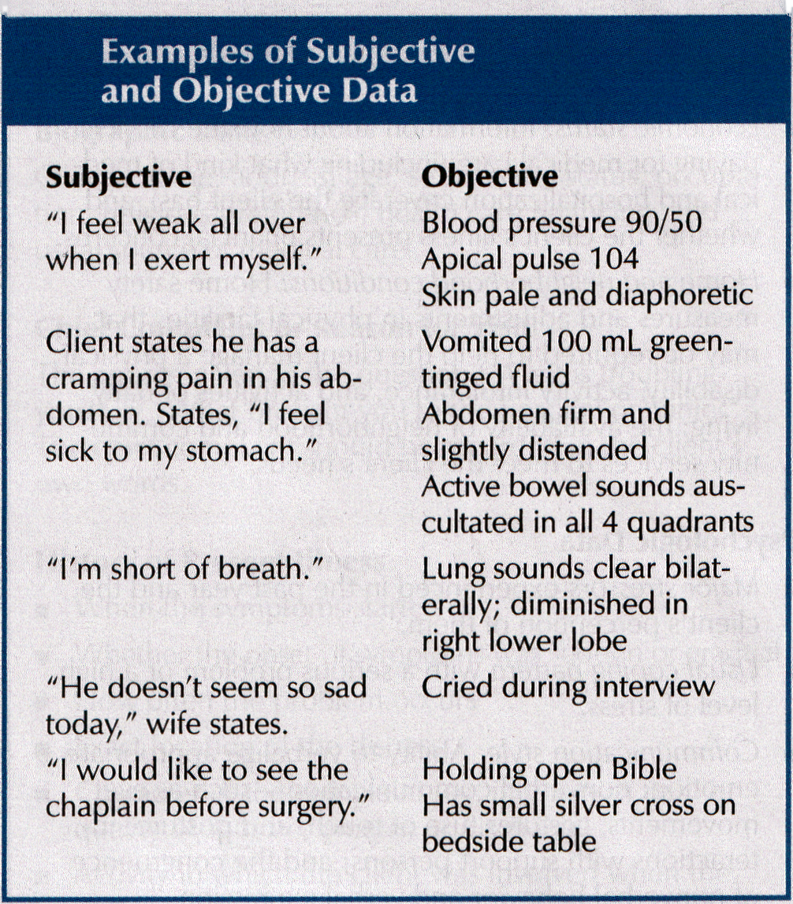
Examples on Subjective and objective data

Slide 5
interview
Time:
  Comfortable
  Free from pain
  No family or friends
Place:
  Well-lighted
  Well-ventilated
  Free from noise
  Privacy
Seating arrangement
  Use suitable angle
Distant
  2-3 feet
Language
  Communicate medical term into simple terms

Slide 6
Communication during interview
Listen attentively
Use language the client understand
Speak slowly, and clearly
Plan for questions
Ask only one question at a time
Do not use your own examples
Convey respect, concern acceptance and interest
Use silence, eye contact

Slide 7
Stages of interview
The opening (introduction)
  To establish rapport and trust
  Orient interviewees
  Verbal consent
The body
  Collect data
3. Closing
  Answer questions
  Thank patient
  Plan for next meeting
  Make Summary

Slide 9
Assessment: Organizing data
Nurses use written or computerized format for organizing data
Called
  Nursing assessment or nursing history, or nursing database form
  Please review JUST /Faculty of nursing formats
  body system model
  Maslow’s hierarchy needs
  Gordon model

Slide 10
Assessment: Validation data
Validation of data is the double checking or verifying data to confirm that it is accurate and factual
Compare subjective and objective data
Clarify vague statements

Slide 11
Nursing Diagnosis
Nurses use critical thinking skills to interpret the collected data, and to identify clients’ problems
Nursing Diagnosis
- focus on unhealthy responses to health and illness.
-describe problems treated by nurses within the scope of independent nursing practice
- may change from day to day as the patient’s responses change
Medical Diagnosis
identify diseases
- describe problems for which the physician directs the primary treatment .
- remains the same for as long as the disease is present
North (NANDA)
American
Nursing
Diagnosis
Association

Slide 12
Guidelines for writing nursing diagnostic statements
  1. State in term of problem not a need
  2. Legally advisable
  3. Use non judgmental statements
  4. Use nursing terminology rather than medical terminology
DIAGNOSIS: Analyzing data
Compare data against standards
Cluster cues
Identify gap or inconsistencies

Slide 13
DIAGNOSIS:IDENTIFY HEALTH PROBLEM
Determine problems and risks
Determine strength
To formulate ng diagnosis
Problem (from NANDA list)
Etiology
Sign and symptoms (manifestations)

Slide 14
EXAMPLE
Diagnostic label, from NANDA list
P
Constipation
Etiology (possible cause/s)
E
Related to
effect of medication
As manifested by: decrease bowel
sounds
Patient’s verbalization,
solid abdomen
Defining characteristics (cluster
of signs and symptoms)
S

Slide 15
Nursing Diagnosis
NANDA Nursing Diagnosis Could Include qualifier Such as
Deficit Eg. Fluid volume deficit
Impaired E.gImpaired verbal communication
Decreased e.g. Decreased cardiac output
In effective e.g. In effective breathing pattern

Slide 16
Types of Nursing Diagnosis
An Actual diagnosis
  Problems present at the time of assessment
A Risk nursing diagnosis
  Problem does NOT exist, but there are risk factors
  Note: risk nursing diagnosis do not include manifestation
A Wellness nursing diagnosis
  Describe human responses to level of wellness that have readiness for enhancement.

Slide 17
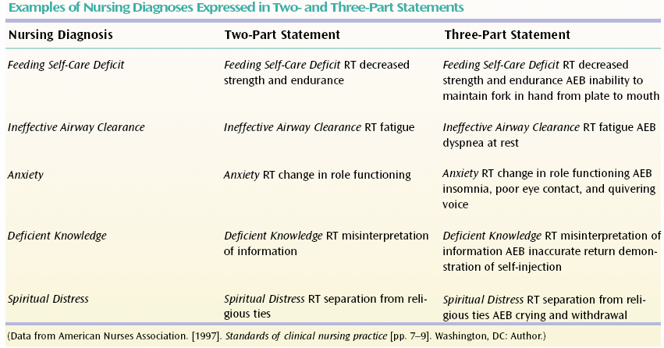

Slide 18
Diagnosis: Examples
Altered nutrition :less than body requirement (RT) decrease appetite ,nausea and increased metabolism As Manifested By (AMB) weight loss, decrease Hb% and paleness.
Self care deficit RT activity intolerance AMB unshaven, long nails.
Risk for Impaired skin integrity RT prolonged immobility

Slide 19
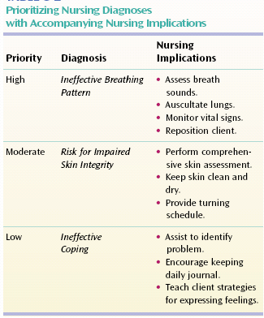

Slide 20
Planning
Planning phase involves decision making and problem solving.
In planning, nurses do not plan for the client, but encourage the client to participate actively as possible.
Types of planning
  1. Initial planning
  2. Ongoing planning
  3. Discharge planning

Slide 21
Planning: nursing care plan
Nursing care plan: is a written or computerized guide that organizes information about the client's care.
The most important purpose of the care plan is to provide continuity of care.

Slide 22
Planning: Setting priority
Priority setting: nurse and client decide which nursing diagnosis requires attention first, second, third, etc. (High, medium, and low priority).
Nurse use Maslow's hierarchy when setting priority.

Slide 23
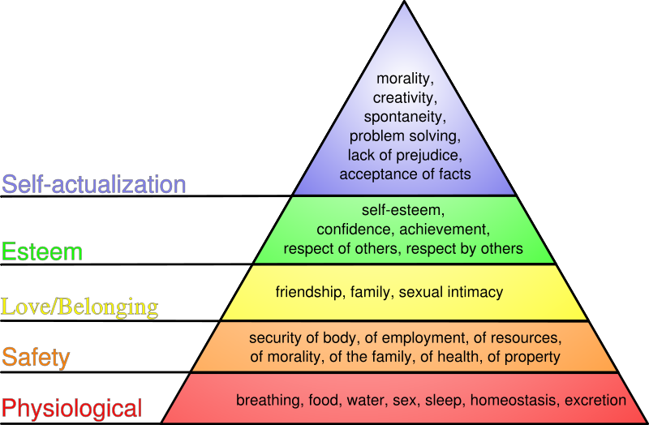
Maslow’s Hierarchy

Slide 24
Planning: Establish Goals/Desired Outcomes
Goal or outcomes describe the observable clients’ responses, what nurses hope to achieve by implementation of nursing intervention
Types of goals
  Short term goals
  Long term goals
components of goals/outcomes
Subject
Verb
Condition
criteria

Slide 25
Guidelines for writing goal/ desired outcomes
Write goals in term of client’s responses, not nurse activities.
Goal will be realistic for client’s capabilities, and time.
Each goal is derived from only one nursing diagnosis.
Use measurable term

Slide 26
Examples on Planning
The client will perform his daily activity of living with minimum assistance of health care team by the end of the physiotherapy session.
The client will verbalize that the pain level decreased from 9 to 5 on pain scale with using of distraction methods.
The client will pass stool within 1 day with out using laxative .
The client’s temperature will be 37.5 within 2 hours

Slide 27
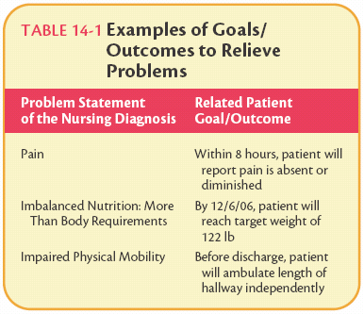

Slide 28
Planning: Action verbs
Apply. Sleep, Walk. Verbalize,
Inject. Eat, State. Breathe
Choose , Drink, Explain, List, Prepare
Types of intervention
  Independent intervention
  Dependent intervention
  Collaborative intervention
Nursing intervention criteria:
  1. safe
  2. appropriate to age and health status
  3. can be achieved with the available resources.
  4. Congruent with client’s culture, value and beliefs.
  5. Based on nursing knowledge and experiences

Slide 29
Phase four
Implementation
Implementation
Reassess
the client
Determine the nurse's
need for assistance
Implement
nursing orders
Document
nursing action

Slide 30
Implementation
Consists of doing and documenting the activities that are specific nursing actions needed to carry out interventions
Implementation skills
  1. Technical skills
  2. Cognitive skills: problem solving, decision making and critical thinking
  2. Interpersonal skills: communication skills

Slide 31
Implementation: guidelines
Base nursing intervention on scientific knowledge
Clearly understand orders to implement nursing procedure.
Adapt activities to individual needs
Implement safe care
Be holistic
Encourage client’s participation

Slide 32
Phase five
Evaluation
evaluation
Collect data
related to out come
Compare
data with outcome
Draw conclusion
about problem
status
Continue, modify
Or terminate the
Client’s plan

Slide 33
Evaluation
After collect data and compare data with goals, reach to conclusions.
Conclusions (based on your assessment)
  1. the goal was met
  2. the goal was partially met
  3. the goal was not met

Slide 34
Example Ng care plan
NURSING PLAN OF CARE
(1) Assessment- Client states fatigue/weakness * Client needs assistance to steady herself while walking short distances
when walking short distances (to bathroom) * Client turns pale on exertion
SUBJECTIVE DATA * OBJECTIVE DATA
----------------------------------------------------------------------------------------------------------------------------------------------------------------------------------------
(2) Analyze | (3) Plan
NURSING DIAGNOSIS-Activity Intolerance-RELATED TO- | LONG TERM GOAL-Client will regain strength and
fatigue or weakness secondary to infection-AS EVIDENCED BY- | energy to resume ADL at home.
clients need to return to bed after ambulating 8 feet (short distance) |
-----------------------------------------------------------------------------------------------------------------------------------------------------------------------------------------------------
(3) Plan | (4) Implement | (4) Implement | (5) Evaluation
CLIENT OUTCOME | NURSING ORDERS | RATIONALE |EVALUATION-OUTCOMES
Client will be able to identify |When getting client up, |When an adult rises to the |Client identified when she was fatigued
symptoms of intolerance to |observe for symptoms of |standing position, 300-800ml |twice during the ambulation to the
activity and when they occur |intolerance such as nausea, |of blood pools in the lower |bathroom and returned to resting period.
will return to resting period for |pallor, dizziness, change in VS |extremities. Weakness, |Goal met.
1 minute, in order to conserve |(Ackley & Ladwig, 2006, p.141) |nausea are signs of hypo- |
energy. 4/15/08 | |perfusion (Ackley & Ladwig, |
| |2006, p.151) |

Slide 37
Nursing process is:_
Problem solving approach
Provide an organizing framework for knowledge, judgment and actions.
Nursing process requires cognitive skills (thinking), psychomotor (doing) and affective (feeling) skills

Slide 38
Purpose of the Nursing Process
Identify patients’ health status (actual)
Identify patients’ health problems (potential)
Establish plans to meet patients’ needs
Deliver specific nursing intervention to meet those needs

Slide 39
Systematic
The nursing process has an ordered sequence of activities and each activity depends on the accuracy of the activity that precedes it and influences the activity following it
Dynamic
      The nursing process has great interaction and overlapping among the activities and each activity is fluid and flows into the next activity
c. Interpersonal
      The nursing process ensures that nurses are client-centered rather than task-centered and encourages them to work to enhance client’s strengths and meet human needs
d. Goal-directed
      The nursing process is a means for nurses and clients to work together to identify specific goals (wellness promotion, disease and illness prevention, health restoration, coping and altered functioning) that are most important to the client, and to match them with the appropriate nursing actions
e. Universally applicable
      The nursing process allows nurses to practice nursing with well or ill people, young or old, in any type of practice setting

Slide 40
Characteristics of the nursing process:
a. Systematic
      The nursing process has an ordered sequence of activities and each activity depends on the accuracy of the activity that precedes it and influences the activity following it.
b. Dynamic
      The nursing process has great interaction and overlapping among the activities and each activity is fluid and flows into the next activity
c. Interpersonal
      The nursing process ensures that nurses are client-centered rather than task-centered and encourages them to work to enhance client’s strengths and meet human needs
d. Goal-directed
      The nursing process is a means for nurses and clients to work together to identify specific goals (wellness promotion, disease and illness prevention, health restoration, coping and altered functioning) that are most important to the client, and to match them with the appropriate nursing actions
e. Universally applicable
      The nursing process allows nurses to practice nursing with well or ill people, young or old, in any type of practice setting

Slide 41
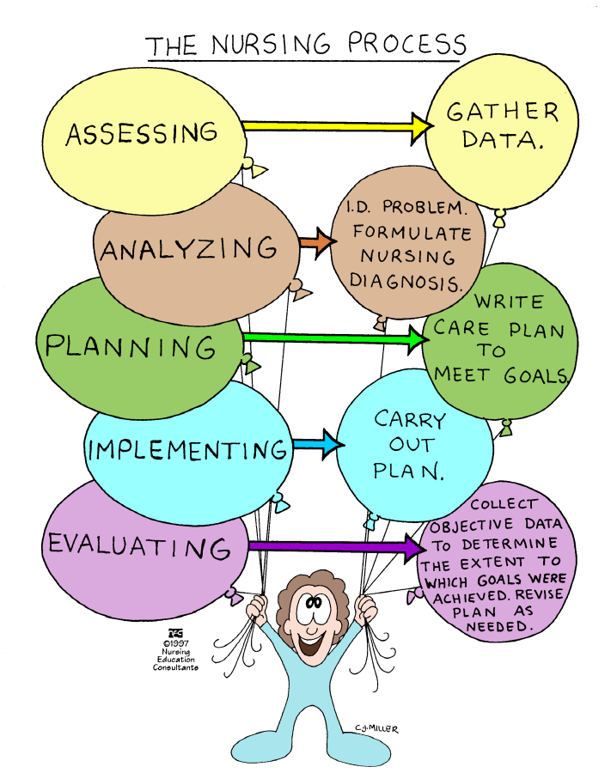

Slide 42
All phases of
nursing process
depend on the
accurate
and complete
data collection

Slide 43
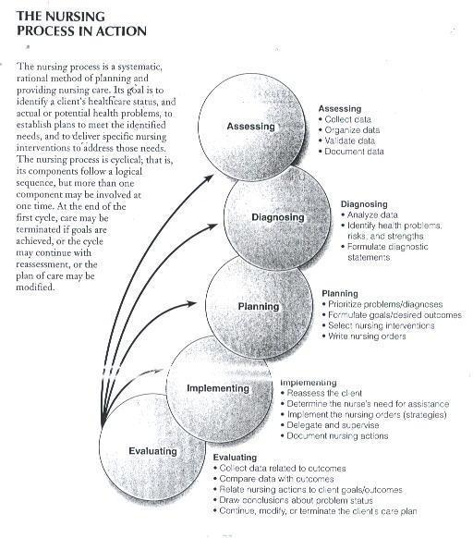
Assessment
Diagnosing
Planning
Implementing
Evaluating

Slide 44
Phase one
Assessment
Is a systematic and continuous collection, organization, validation, and documentation of data.
Nursing assessment focus on client’s responses to health problems.

Slide 45
Types of assessment
Type | Aim | Time frame
1- Initial assessment | Establish complete database for problem identification, reference, and future comparison. | Within the specified time frame after admission health care facility.
2- problem-Focused assessment | Status determination of a specific problem identified during previous assessment. | Ongoing process, integrated with nursing care, a few minutes to a few hours between assessments.
3- Time – lapsed reassessment | Comparison of client’s current status to baseline obtained previously, detection of changes in all functional health patterns after an extended period of time has passed | Several months (3,6,9 months or more) between assessment
4- Emergency assessment | Identification of life – threatening situation | AT anytime in crises

Slide 46
Assessment
Assessment
Data collection
Organize data
Validate data
Document data

Slide 47
Assessment
A. Data Collection
Types of Data
Subjective data (symptoms or covert data).
Data described or verified only by person.
Ex. Pain, worry, value, beliefs, etc.
Objective (signs, or signs).
Detected by an observer or can be measured and tested against standards.
Ex. Skin color, blood pressure, hemoglobin, weight.

Slide 48
Assessment
A. Data Collection
Types of Data

Slide 49
Assessment
A. Data Collection cont.
Source of Data
Primary
The client is the primary source of data
Secondary
Family
Support person
Health care team
Records
Reports
Laboratory tests
Diagnostic procedure.

Slide 50

Assessment
A. Data Collection cont.
Data Collection Method
1. Observation and examination
Observer gather data by his/her senses
Assignment

Slide 51
Assessment
A. Data Collection cont.
Data Collection Method
2. Interviewing
Is a planned communication or conversation with a purpose
  Get or give information
  Identify problems
  Evaluate change
  Teach
  provide support
  Provide counselor
  Provide therapy
Types of interview
  1. Directive
    structured, and collect specific information
    Nurses make control
  2. Non directive
    Rapport building interview
    Clients control the discussion

Slide 52
Assessment
A. Data Collection Cont
Data Collection Method
2. Interviewing cont.
Types of interview
  1. Close ended questions (yes/no)
  2. open ended questions
  Goal to discover and to explore, clarify information.
  Types of questions depends on the needs of the client at the time of interview

Slide 53
Assessment
A. Data Collection cont
Planning for Interview and Setting
Time:
  Comfortable
  Free from pain
  No family or friends
Place:
  Well-lighted
  Well-ventilated
  Free from noise
  Privacy
Seating arrangement
  Use suitable angle
Distant
  2-3 feet
Language
  Communicate medical term into simple terms

Slide 54
Assessment
A. Data Collection cont Communication During Interview
Listen attentively
Use language the client understand
Speak slowly, and clearly
Plan for questions
Ask only one question at a time
Do not use your own examples
Convey respect, concern acceptance and interest
Use silence, eye contact

Slide 55
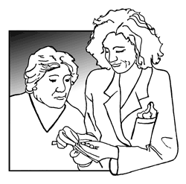
Assessment
A. Data Collection cont
Stages of an Interview
3. Closing
  Answer questions
  Thank patient
  Plan for next meeting
  Make Summary
1. The opening (introduction)
  To establish rapport and trust
  Orient interviewees
  Verbal consent
2. The body
  Collect data

Slide 57
Assessment
B. Organizing Data
Nurses use written or computerized format for organizing data
Called
  Nursing assessment or nursing history, or nursing database form.
  Please review Al-Zaytoonah Un. School of nursing format
  Example : body system model
  Maslow’s hierarchy needs
  Gordon model

Slide 58
Assessment
C. Validate the Data
Validation of data is the double checking or verifying data to confirm that it is accurate and factual
Compare subjective and objective data
Clarify vague statements

Slide 59
Assessment
D. Document Data

Slide 60
Phase Two
Diagnosing
Diagnosis
Analyze data
Identify health
problems
Formulate diagnostic
statement

Slide 61
Diagnosing
Nurses use critical thinking skills to interpret the collected data, and to identify clients’ problems

Slide 62
Differentiating Nursing Diagnosis versus Medical Diagnosis
Nursing Diagnosis | Medical Diagnosis
- focus on unhealthy responses to health and illness. | - identify diseases
- describe problems treated by nurses within the scope of independent nursing practice. | - describe problems for which the physician directs the primary treatment .
- may change from day to day as the patient’s responses change | - remains the same for as long as the disease is present

Slide 63
Diagnosing
NANDA nursing diagnosis
Purpose of NANDA is to define,
refine, and promote
Taxonomy of nursing diagnosis
Assignment
Translate at least 15
nursing
diagnosis
in to Arabic language
North
American
Nursing
Diagnosis
Association

Slide 64
Diagnosing
Guidelines for writing nursing diagnostic statements
  1. State in term of problem not a need
  2. Legally advisable
  3. Use non judgmental statements
  4. Use nursing terminology rather than medical terminology

Slide 65
Diagnosing a. Analyzing Data
Compare data against standards
Cluster cues
Identify gap or inconsistencies

Slide 66
Diagnosing
B. Identify Health Problems
Determine problems and risks
Determine strength

Slide 67
Diagnosing
C. Formulate Diagnostic Statements
Problem (from NANDA list)
Etiology
Sign and symptoms (manifestations)

Slide 68
Diagnosing
Components of nursing Diagnosis
Diagnostic label, from NANDA list
P
Constipation
Etiology (possible cause/s)
E
Related to
effect of medication
As manifested by: decrease bowel
sounds
Patient’s verbalization,
solid abdomen
Defining characteristics (cluster
of signs and symptoms)
S

Slide 69
Diagnosing
Components of nursing Diagnosis
Diagnostic label, from NANDA list
P
Fear
Etiology (possible cause/s)
E
Related to disabling illness
As manifested by: crying,
Aggression, increase breath rate,
Defining characteristics (cluster
of signs and symptoms)
S

Slide 70
Diagnosing
NANDA Nursing Diagnosis Could Include qualifier
Such as
Deficit
Impaired
Decreased
In effective
Examples
Fluid volume deficit
Impaired verbal communication
Decreased cardiac output
In effective breathing pattern

Slide 71
Diagnosing
Types of Nursing Diagnosis
An Actual diagnosis
  Problems present at the time of assessment
A Risk nursing diagnosis
  Problem does NOT exist, but there are risk factors
  Note: risk nursing diagnosis do not include manifestation
A Wellness nursing diagnosis
  Describe human responses to level of wellness that have readiness for enhancement.

Slide 73
Diagnosing
Example
Altered nutrition :less than body requirement (RT) decrease appetite ,nausea and increased metabolism As Manifested By (AMB) weight loss, decrease Hb% and paleness.
Self care deficit RT activity intolerance AMB unshaven , need dress long nails.
Risk for Impaired skin integrity RT prolonged bed fast

Slide 74
Phase three
Planning
planning
Prioritize
problem/diagnosis
Formulate goals
Desired out comes
Select nursing
intervention

Slide 75
Planning
Planning phase involves decision making and problem solving.
In planning, nurses do not plan for the client, but encourage the client to participate actively as possible.
Types of planning
  1. Initial planning
  2. Ongoing planning
  3. Discharge planning

Slide 76
Planning: Nursing care plan
Nursing care plan: is a written or computerized guide that organizes information about the client's care.
The most important purpose of the care plan is to provide continuity of care.
See Faculty of nursing format
of nursing care plan

Slide 77
Planning: Setting priority
Priority setting: nurse and client decide which nursing diagnosis requires attention first, second, third, etc. (High, medium, and low priority).
Nurse use Maslow's hierarchy when setting priority.

Slide 78
Maslow’s Hierarchy

Slide 80
Planning: Establish Goals/Desired Outcomes
Goal or outcomes describe the observable clients’ responses, what nurses hope to achieve by implementation of nursing intervention.
Types of goals
  Short term goals
  Long term goals

Slide 81
Planning: Establish Goals/Desired Outcomes
components of goals/outcomes
Subject
Verb
Condition
criteria

Slide 82
Planning: guidelines for writing goals/desired outcomes
Write goals in term of client’s responses, not nurse activities.
Goal will be realistic for client’s capabilities, and time.
Each goal is derived from only one nursing diagnosis.
Use measurable term

Slide 83
Planning: Examples
The client will perform his daily activity of living with minimum assistance of health care team by the end of the physiotherapy session.
The client will verbalize that the pain level decreased from 9 to 5 on pain scale with using of distraction methods.
The client will pass stool within 1 day with out using laxative .
The client’s temperature will be 37.5 within 2 hours

Slide 85
Planning: Action verb
 | Verbalize | Apply
 | Inject | Breathe
 | Eat | Choose
 | State | Drink
 |  | Explain
 |  | List
 |  | Prepare
 |  | Sleep
 |  | Walk
Class Assignment

Slide 86
Planning: Select Intervention
Types of intervention
  Independent intervention
  Dependent intervention
  Collaborative intervention
Nursing intervention criteria:
  1. safe
  2. appropriate to age and health status
  3. can be achieved with the available resources.
  4. Congruent with client’s culture, value and beliefs.
  5. Based on nursing knowledge and experiences

Slide 87
Phase four
Implementation
Implementation
Reassess
the client
Determine the nurse's
need for assistance
Implement
nursing orders
Document
nursing action

Slide 88
Implementation
Consists of doing and documenting the activities that are specific nursing actions needed to carry out interventions
Implementation skills
  1. Technical skills
  2. Cognitive skills
  problem solving, decision making and critical thinking
  2. Interpersonal skills: communication skills

Slide 89
Implementation: guidelines
Base nursing intervention on scientific knowledge
Clearly understand orders to implement nursing procedure.
Adapt activities to individual needs
Implement safe care
Be holistic
Encourage client’s participation

Slide 90
Phase five
Evaluation
evaluation
Collect data
related to out come
Compare
data with outcome
Draw conclusion
about problem
status
Continue, modify
Or terminate the
Client’s plan

Slide 91
Evaluation:
After collect data and compare data with goals, reach to conclusions.
Conclusions (based on your assessment)
  1. the goal was met
  2. the goal was partially met
  3. the goal was not met

Slide 92
Example: nursing care plan
NURSING PLAN OF CARE
(1) Assessment- Client states fatigue/weakness * Client needs assistance to steady herself while walking short distances
when walking short distances (to bathroom) * Client turns pale on exertion
SUBJECTIVE DATA * OBJECTIVE DATA
----------------------------------------------------------------------------------------------------------------------------------------------------------------------------------------
(2) Analyze | (3) Plan
NURSING DIAGNOSIS-Activity Intolerance-RELATED TO- | LONG TERM GOAL-Client will regain strength and
fatigue or weakness secondary to infection-AS EVIDENCED BY- | energy to resume ADL at home.
clients need to return to bed after ambulating 8 feet (short distance) |
-----------------------------------------------------------------------------------------------------------------------------------------------------------------------------------------------------
(3) Plan | (4) Implement | (4) Implement | (5) Evaluation
CLIENT OUTCOME | NURSING ORDERS | RATIONALE |EVALUATION-OUTCOMES
Client will be able to identify |When getting client up, |When an adult rises to the |Client identified when she was fatigued
symptoms of intolerance to |observe for symptoms of |standing position, 300-800ml |twice during the ambulation to the
activity and when they occur |intolerance such as nausea, |of blood pools in the lower |bathroom and returned to resting period.
will return to resting period for |pallor, dizziness, change in VS |extremities. Weakness, |Goal met.
1 minute, in order to conserve |(Ackley & Ladwig, 2006, p.141) |nausea are signs of hypo- |
energy. 4/15/08 | |perfusion (Ackley & Ladwig, |
| |2006, p.151) |

Slide 93

Documentation

Slide 94
Nursing documentation
A report
Oral or written or computer based communication intended to convey information to others
Record
A written or computer based.
The purpose of making an entry on client record is called recording, charting or documenting.

Slide 95
Nursing documentation Purpose of client record
Communication between health team
Planning client’s care
Research
Education
Legal documentation

Slide 96
Nursing documentation:
Documentation system
Narrative charting
Progress note (Subjective, Objective, Assessment, Plan, Intervention, Evaluation, and Review) (SOAPIER)
Charting by exception
Computerized documentation

Slide 97
Nursing documentation:
Documentation nursing activities
Admission assessment
Nursing care plan
Kardexes
Flow sheets
Progress notes

Slide 98
Nursing documentation:
Guidelines for recording
Date and time
Timing
Legibility
Permanence
Accepted terminology
Correct spelling
Signature
Accuracy
Sequence
Completeness

